Slide 1
Optimizing Fecal Containment
Kim Sisson, MSN, CCRN, CPXP
Clinical Specialist, Critical Care
Notes:
Before the wound care community talked about Microclimate and wound dressing, Hydrofiber was teaching the importance of its lock-in technology; the benefit of controlling moisture away the skin surface is now being discussed in Pressure Injury prevention as Microclimate.
ConvaTec has proudly been discussing the benefit of Hydrofiber lock-in of fluid and anything in the fluid (i.e. bacteria, enzymes … ) keeping this way from the surface for many years; this being the same Hydrofiber in our Aquacel Foam dressings used today for Pressure injury protection.

Slide 2
Objectives
Discuss anatomical features of the colon impacting fecal incontinence
Compare and contrast methods of fecal containment
Discuss interventions associated with seepage, leakage, and expulsion when observed in patients with fecal management systems
Compare Convatec FMS products
Notes:
I have cut and pasted a few sections from the attached Consensus document () as well as a quick read on Hydrofiber (Queen, D. Technology Update: Understanding Hydrofiber Technology. Wounds International 2010) In an attempt to keep my response related to published research on the topic.

Slide 3
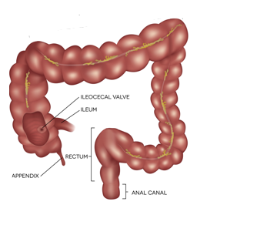
Normal Internal Anatomical Markers
Anal canal (aka the Rectal Vault)
Extends 4 - 5 cm above anal verge
Rectum
12 cm long (includes anal canal)
8 - 10 cm lies below lower edge of peritoneum outside peritoneal cavity
Anorectal junction
Located 10 - 12 cm above the anal opening at the end of the anal canal.
Wang YHW, Wiseman J. Anatomy, Abdomen and Pelvis, Rectum. [Updated 2021 Aug 1]. In: StatPearls [Internet]. Treasure Island (FL): StatPearls Publishing; 2021 Jan-. Available from: https://www.ncbi.nlm.nih.gov/books/NBK537245/. Accessed November 6th, 2021
Notes:
Pictures purchased from my Shutterstock account

Slide 4
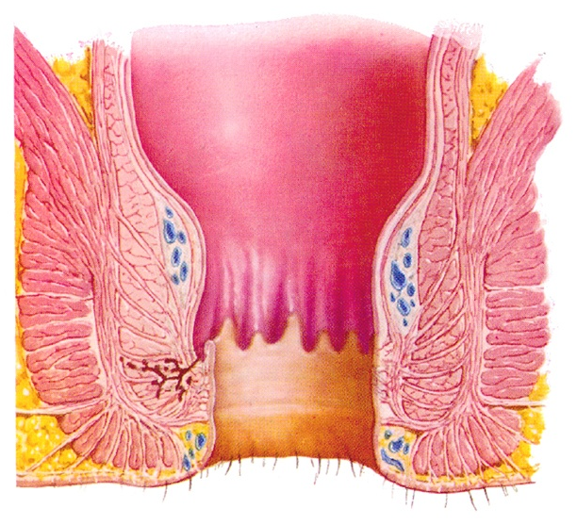
Sphincters
External
  Skeletal muscle
  Lies outside and below internal sphincter
  Normally contracted
  Voluntary control from the brain relaxes the sphincter
  Provides 15 - 30% of resting tone
Notes:
Pictures previously supplied by Convatec

Slide 5
Sphincters
Internal
  Smooth muscle
  Involuntary control
  Governed by sacral nerves which, when stimulated will relax the sphincter
  Provides 70 - 85% of resting tone
Notes:
Pictures previously supplied by Convatec

Slide 6
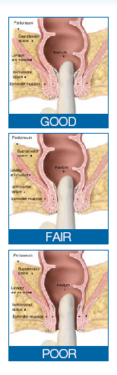
The Rectal Valves
Houston’s Valves
  3 - 5 normal variant; width 1.7 - 7 mm
  Encompass 1/3 circumference of lumen
Inferior
  2.5 - 3.5 cm above anal verge – left of midline and anterior
Middle
  5 cm from anal verge – right anterior
Superior
  9 cm from anal verge – midline posterior
Notes:
Pictures provided previously from Convatec

Slide 7
Rectal Sphincter Tone Assessment
Why?
Establish resting rectal tone
Determine presence of feces in rectal vault
  Type of stool (Hard, soft)
  Impaction
Assess for suitability/contraindications for fecal containment
  Distal rectal strictures/tumors

Slide 8
Impaired Rectal Tone
Impaired sphincter muscles
  Childbirth ( up to 35% of all deliveries)
  Anal/rectal surgical procedures
  Deconditioning
  Pelvic floor dysenergia
Impaired or absent nervous innervation
  Spinal cord injury or tumor
  Childbirth trauma
  Central nervous system diseases (Dementia, MS)
  Medications
Gurland B, Hull T. Transrectal ultrasound, manometry, and pudendal nerve terminal latency studies in the evaluation of sphincter injuries. Clin Colon Rectal Surg. 2008;21(3):157-166. doi:10.1055/s-2008-1080995
Notes:
Picture provided from Convatec

Slide 9
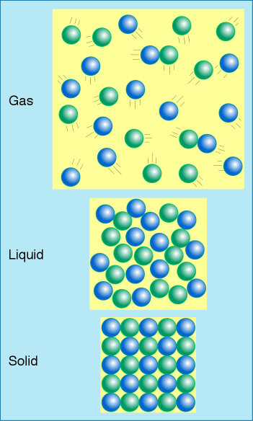
Anal Sampling
Innervation in anal canal can distinguish between flatus, liquid and solid stool allowing passage of some material and not others
“Adapted from: KRPD/Shutterstock.com"
Notes:
Picture purchased from my shutterstock account

Slide 10
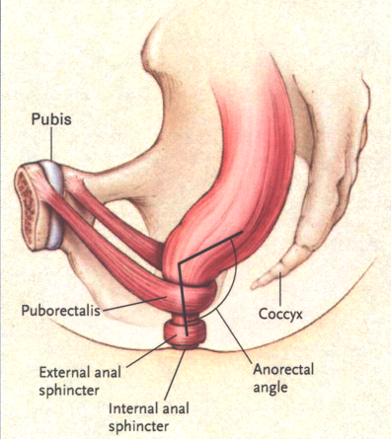
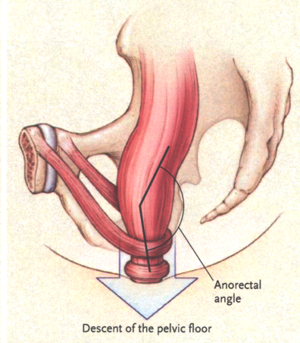
Normal Defecation
Increased abdominal pressure, propulsive colorectal contractions, activation of stimulation via distention
Relaxation of internal anal sphincter (autonomic)
Relaxation of external anal sphincter (voluntary)
Straightening of pelvic musculature (levator ani, puborectalis) and anorectal junction
At rest
With hip flexion, straining
Lembo A, Camilleri M. N Engl J Med. 2003;349:1360-1368.
Muller-Lissner S. Best Pract Res Clin Gastroenterol. 2002;16:115-133.

Slide 11







Stool Consistency
Type
Description
Clinical
Example
1 | Separate hard lumps | Constipation
2 | Sausage-shaped, lumpy | Mild Constipation
3 | Sausage-shaped, cracks | Normal
4 | Sausage-shaped, smooth | Normal
5 | Soft blobs with clear cut edges | Lacking Fiber
6 | Fluffy pieces with ragged edges, mushy | Mild Diarrhea
7 | Watery, no solid pieces, entirely liquid | Diarrhea
¹Bliss, D, Larson S, Burr, J, Savik K. Reliability of a stool classification system. J WOCN 28(6):305-313, 2001
https://www.continence.org.au/bristol-stool-chart#PDF https://www.healthline.com/health/digestive-health/types-of-poop#what-about-constipation
Notes:
Pictures taken by C. Milne from Connecticut Clinical Nursing Associates

Slide 12
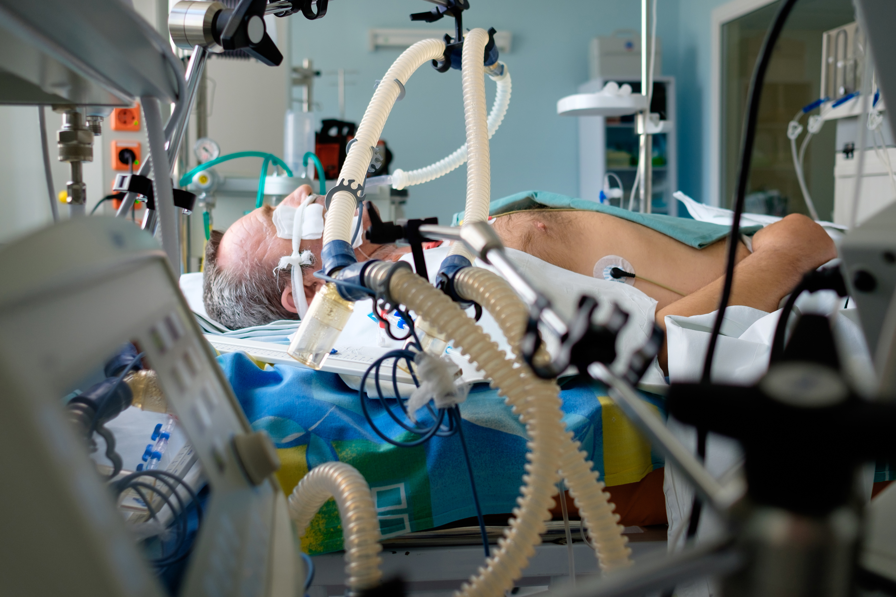
Fecal Incontinence
Infectious or non-infectious diarrhea
Pre-existing fecal incontinence
Trauma
Neurological disorders
Meds
Tube feedings
“Kiryl Lis/Shutterstock.com"
Notes:
Picture purchased from shutterstock account

Slide 13
Ways to Manage Fecal Incontinence
Device Type | Maintain Skin Integrity | Prevent local cutaneous skin infections | Contain potentially infectious stool | Reduce or prevent wound contamination | Allow perineal skin to heal | Minimize pain and discomfort | Promote patient rest between incontinent episodes
Diapers | +/- | +/- | - | - | - | - | -
Pads | +/- | +/- | - | - | - | - | -
External Fecal Pouches | +/- | +/- | +/- | +/- | +/- | +/- | +/-
Fecal Management Systems (FMS) | + | + | + | + | + | + | +

Slide 14
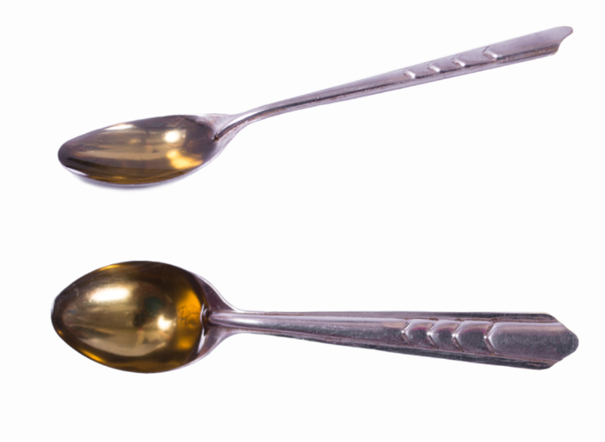
Seepage vs Leakage
Minor Fecal Incontinence:
Staining underclothes or losing less than 2 tsp. of stool
Major Fecal Incontinence:
Complete loss of stool
“249 Anur/Shutterstock.com"
Notes:
Picture purchased from my shutterstock account

Slide 15
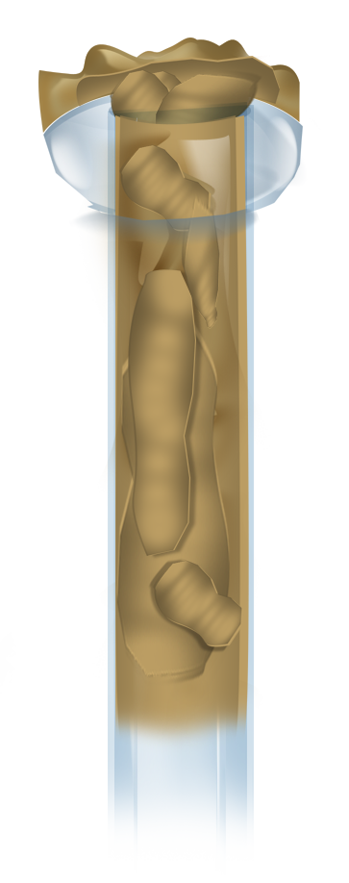
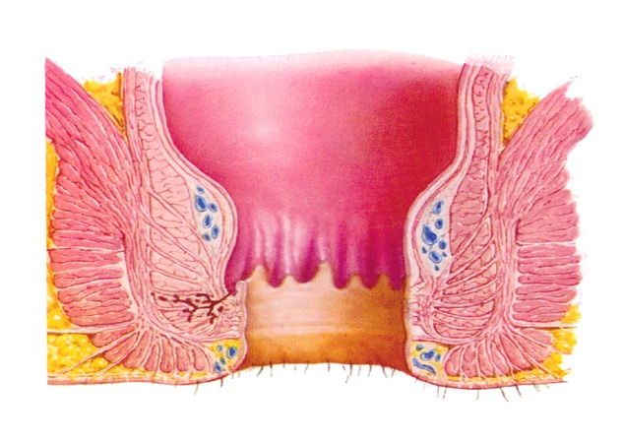
Causes of Seepage and Leakage
Blocked/
Partially Blocked flow of stool
Increased
Peristalsis
massages stool
around balloon
Backlog of stool
Increased
distention
Notes:
Picture provided by Convatec

Slide 16
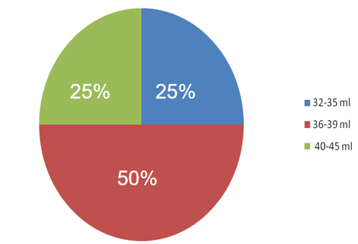
Individualized Balloon Volumes
Percentage of patients with balloon fill
volume in three defined ranges*
Study demonstrates that optimal balloon fill volume varies by patient
40-45 ml
32-35 ml
36-39 ml
The ability to individualize balloon volume may enhance fecal diversion and reduce leakage, expulsion and the potential for overfill.
Over inflation of the retention balloon has the potential to increase the risk of adverse events including rectal pain, bleeding, pressure injuries, and possible perforations.
*Retention balloon fill volume was measured in 17 patients using Flexi-Seal™ Signal™ FMS. Results were published as a poster: Optimizing Fecal Containment Using Individualized Balloon Volumes – C.T. Milne, A. Durnal, and M. Webb presented at 2010 Symposium on Advanced Wound Care.

Slide 17

Quick Tips for FMS Management
Perform rectal exam prior to insertion
Less is more – reduce risk of rectal mucosal injuries by using individualized balloon volume* and not overfilling retention balloon
Apply moisture barrier
Irrigate –before and after medication administration and to flush the catheter
LFTs (Left, Flex, Tug)
Hang the bag on the bedside, lower than the patient
*Fill volumes must still follow IFU guidelines : Under no circumstance should the balloon be inflated with more than 45ml of fluid. If the fill indication dome indicates at less than 30ml of fluid, withdraw the fluid and reposition the balloon in the rectal vault.
“123ARF/Shutterstock.com"
Notes:
Picture purchased from my shutterstock account

Slide 18
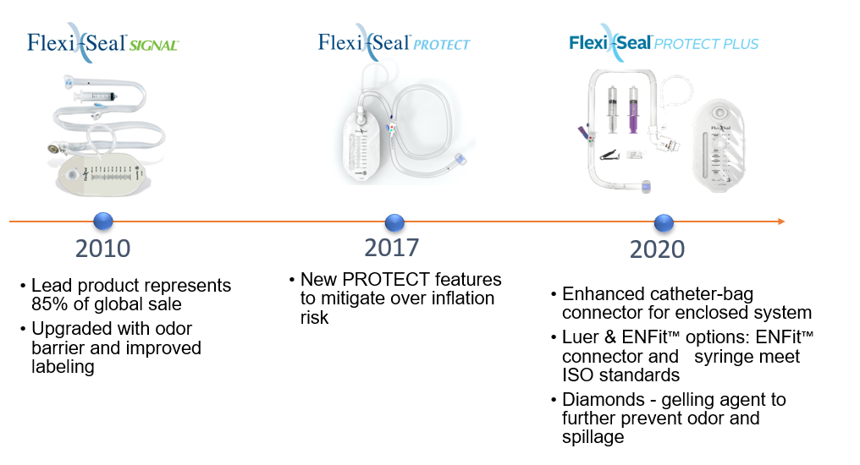
Current Flexi-SealTM Portfolio

Slide 19
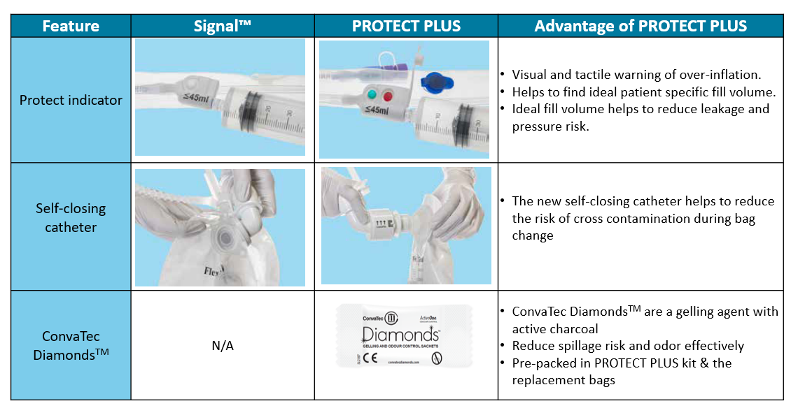
Differences Between Signal and PROTECT PLUSTM

Slide 20
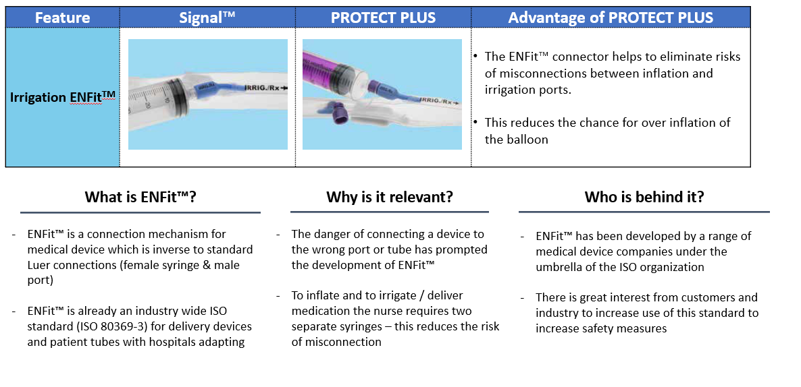
Differences Between Signal and PROTECT PLUSTM

Slide 21


Slide 22



Slide 23


Slide 24
Thank you

Slide 25
Reference
Clark M, Black J Skin IQTM Microclimate Made Easy. Wounds International 2011; 2(2) Available from http://www.woundsinternational.com DSL#11-0152US(4/11
International review. Pressure ulcer prevention: pressure, shear, friction and microclimate in context. A consensus document. London: Wounds International, 2010
National Pressure Ulcer Advisory Panel, European Pressure Ulcer Advisory Panel Press Release – NPUAP Announces a change in terminology from pressure ulcer to pressure injury and updates the stages of pressure injury. April 13, 2016
Brianza DM, Geyer MJ. Using support surfaces to manage tissue integrity. Adv Skin Wound Care 18(3):151-157, April 2005
Call E, et al. Microclimate Impact of Prophylactic Dressings Using In Vitro Body Analog Method. WOUNDS 2013;25(4):94–103
Mayoritz HN, Sims N. Biophysical effects of water and synthetic urine on skin. Adv Skin Wound Care. 2001;14(6): 302-308
Brindle, TC. Outliers to the Braden Scale: Identifying high-risk ICU patients and the results of prophylactic dressing use. World Council of Enterostomal Therapists Journal WCET Journal Volume 30 Number 1 – January/March 2010
Wang YHW, Wiseman J. Anatomy, Abdomen and Pelvis, Rectum. [Updated 2021 Aug 1]. In: StatPearls [Internet]. Treasure Island (FL): StatPearls Publishing; 2021 Jan-. Available from: https://www.ncbi.nlm.nih.gov/books/NBK537245/. Accessed November 6th, 2021
Gurland B, Hull T. Transrectal ultrasound, manometry, and pudendal nerve terminal latency studies in the evaluation of sphincter injuries. Clin Colon Rectal Surg. 2008;21(3):157-166. doi:10.1055/s-2008-108099
Lembo A, Camilleri M. N Engl J Med. 2003;349:1360-1368
Muller-Lissner S. Best Pract Res Clin Gastroenterol. 2002;16:115-133
Retention balloon fill volume was measured in 17 patients using Flexi-Seal™ Signal™ FMS. Results were published as a poster: Optimizing Fecal Containment Using Individualized Balloon Volumes – C.T. Milne, A. Durnal, and M. Webb presented at 2010 Symposium on Advanced Wound Care.
Bliss, D, Larson S, Burr, J, Savik K. Reliability of a stool classification system. J WOCN 28(6):305-313, 20
https://www.continence.org.au/bristol-stool-chart#PDF https://www.healthline.com/health/digestive-health/types-of-poop#what-about-constipation
Photo from Microsoft Office 2013, Bing image search, 2017: Slides 2, 3, 4, 6, 7, 8, 9, 10, 11, 12, 13, 14, 16, 17, 19 22, 23

