Slide 1
LSNA District Town Hall
LPN Membership Proposal

Slide 2
Agenda
Introductions of LSNA Team
Discuss background and overview
Review Texas Nurses Association Pilot
Identify Pros/Cons
Next Steps and Project Structure

Slide 3





LSNA Team for LPN Membership Project
Dr. Lesley Tilley
President
Dr. Cindy Ingram
President-Elect
Mimi Gary
Director of Membership
Miguel Jolivette
Director of Organizational Advancement
Debbie Ford
Interim Executive Director

Slide 4
Background and Overview
ANA Membership Assembly Proposed Bylaws Change
June 2025
LSNA President’s Council discussed options
August 2025
LSNA met with TNA to learn more about pilot
November 2025
LPN Stakeholder Meetings
February/March 2026
LSNA Board Approved to Explore Path for
LPN Membership
July 2025
Socialized to DNA’s
Sept/Oct 2025
Identify Key LPN Stakeholders
January 2026
LPN Membership Discussion Timeline

Slide 5
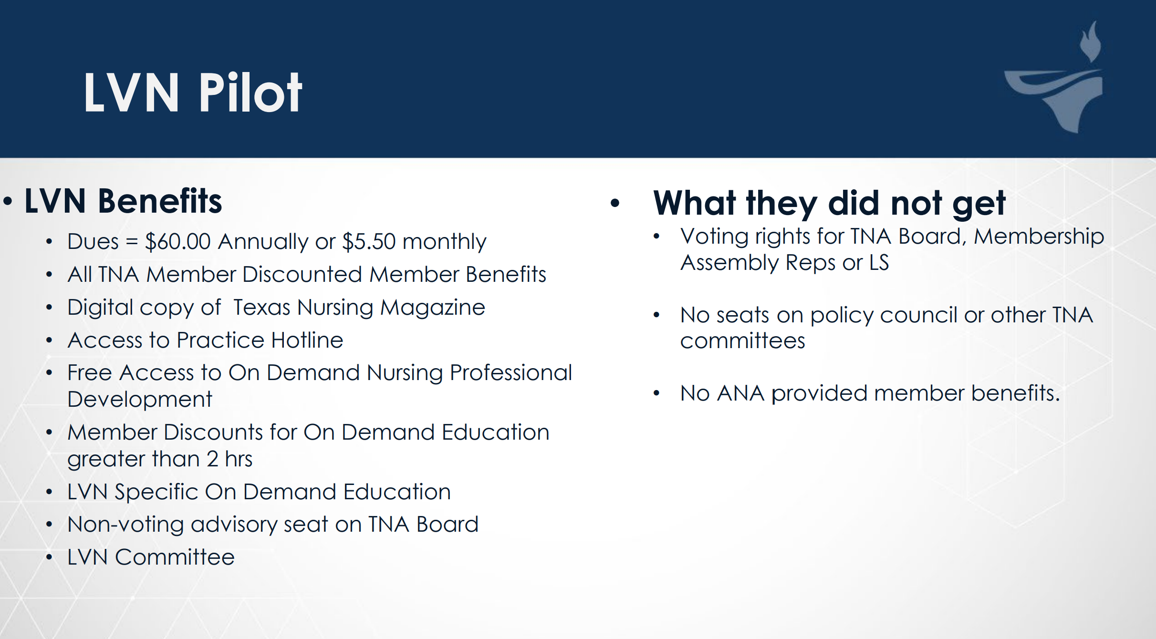
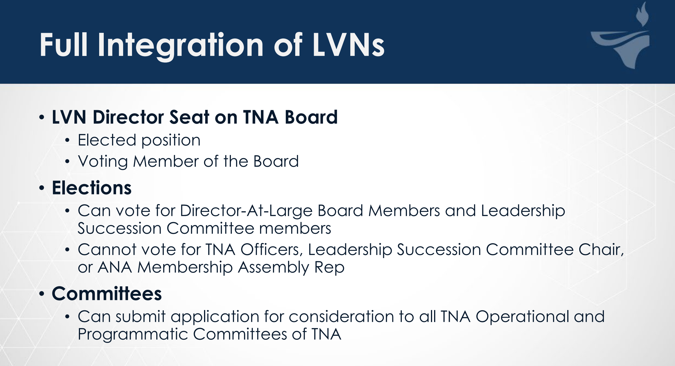
Texas Nurses Association
Grandfathered 41 LPN Association Members and increased over 60 more LPN members in first year.

Slide 6
Pros/Cons
Open Discussion/Feedback/Ideas
PROS
CONS
Strengthened advocacy
Enhanced networking and mentorship
Expand resources
Unified voice
New opportunities for partnerships
Different scopes of practice could lead to friction in roles
Differing needs and expectations could cause misalignment
Resource allocation for LSNA
Membership identity concerns
Risk of under-engagement by LPNs

Slide 7
Clarification of Proposal
This is: Inviting Louisiana LPN’s to membership in the LSNA to partner on advocacy and workforce development.
This is NOT: Defining scope of practice for Louisiana LPN’s and RN’s, that is the specific work of the LSBN and LSBPNE.

Slide 8
Proposed LPN Membership Timeline
February 2026: LPN stakeholder meeting
March 2026: All LSNA Affiliates meeting
April – July 2026: Public comment through DNA Town Halls, membership survey, etc.
June 2026: ANA Membership Assembly: Vote LPN Membership
August – September 2026: Utilize feedback to develop plan
  LSNA Bylaws Change or Substantive Resolution
October – December 2026: LSNA BOD approval
IF Bylaws Amendment:
  January 2027: Send to ANA for approval
  February 2027: Publish for LSNA membership review and meeting with delegates
  March 2027: LSNA delegate vote at Membership Assembly
IF Substantive Resolution
  February 2027: Publish for LSNA membership review and meeting with delegates
  March 2027: LSNA delegate vote at Membership Assembly

Slide 9
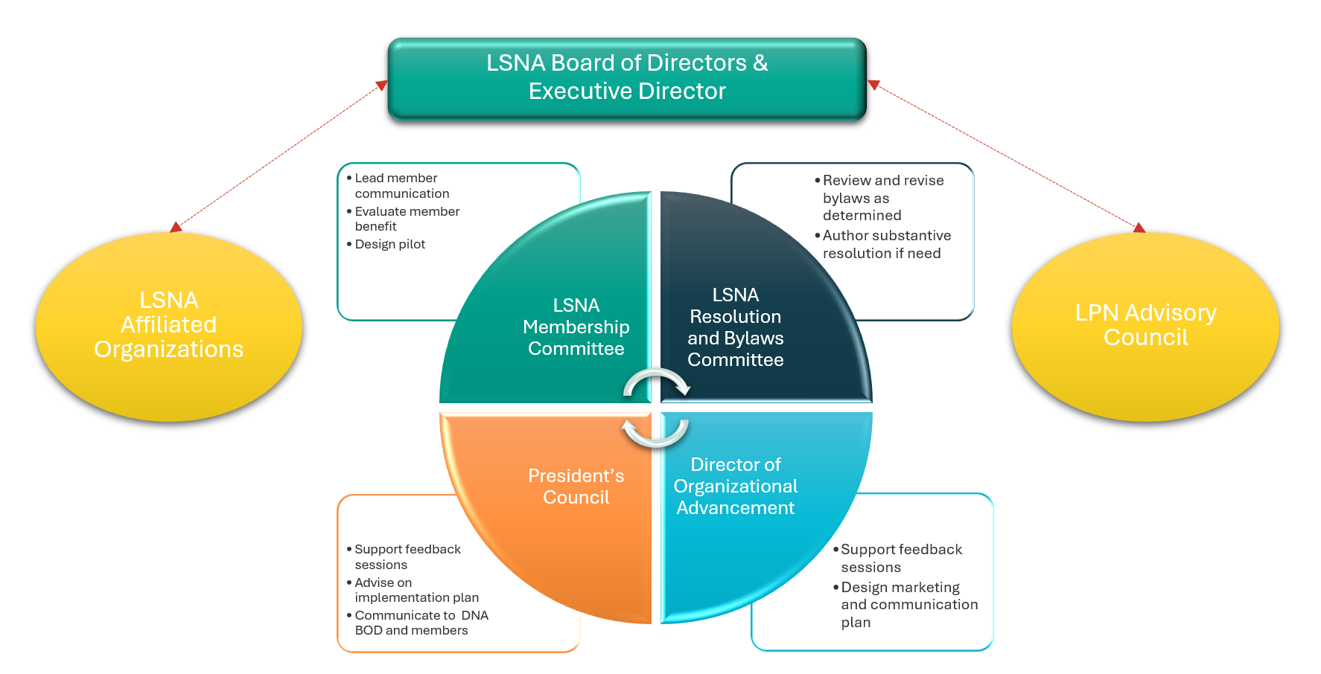
LPN Membership Implementation Structure

Slide 10
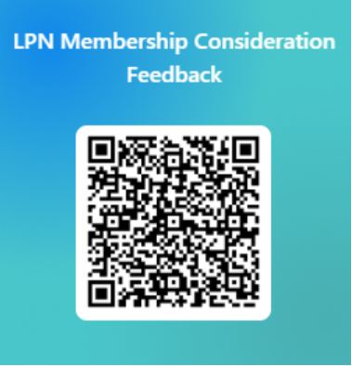
Membership Feedback Session

