Slide 1
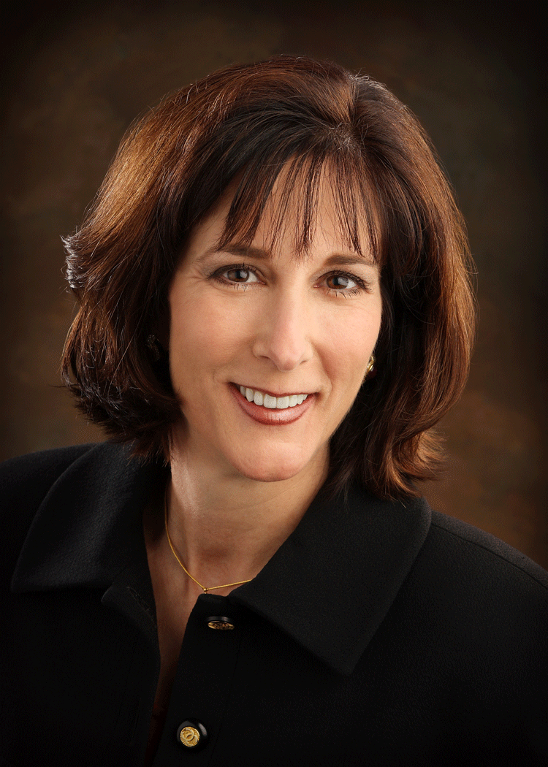

CCRN/PCCN & csc/cmc Review Course
CCRN/PCCN Review Course
Thursday June 18th & Friday June 19th, 2026
Two-day review course for ICU and Progressive Care nurses preparing for AACN’s CCRN or PCCN exams. Covers key adult care concepts—assessment, anatomy, physiology, and pathophysiology—using a systems-based approach.
CSC/CMC Review Course
Saturday June 20th, 2026
One-day review course for cardiac nurses preparing for CMC and CSC certification, covering major cardiac disorders, assessments, interventions, and key related systems.
Provider approved by the California Board of Registered Nursing, Provider # BRN CEP 12084 for 14 Hours of Continuing Education
Barbara Furry, RN-BC, MS, CCRN, FAHA
A nationally recognized healthcare educator with thirty years of critical care nursing experience. She holds a Master’s of Science in Health from Cambridge State University. Barbara is committed to advancing cardiac care and improving patient outcomes through innovative education for nurses, physicians, and allied health practitioners.
Provider approved by the California Board of Registered Nursing, Provider # BRN CEP 12084 for 7 Hours of Continuing Education
Continental breakfast & registration: 0730-0800
Review course: 0800-1630
Location: NorthBay Health, Green Valley Administration Center, 4500 Business Center Drive, Fairfield, CA 94534
CCRN/PCCN 2-Day Course: $350
CMC/CSC 1-Day Course: $150
Both Courses (All 3-Days): $450
  Scan the QR code to register for the upcoming review course (s)
Join the Napa Valley AACN Chapter and save $50 on an individual review course or $100 when you register for all 3 days!
Notes:
---
This slide references information from the following file: https://outlook.office365.com/owa/?ItemID=AAMkADIyZTQ3YWYyLWZmOTktNDVkYS1hMGYxLTYzMDEwYTdlMjgyNQBGAAAAAACeUq6yQtTrTZQab9X0Vwj6BwAkZxM%2fzQT3RbFiusMb7q30AAAAAAEMAAAkZxM%2fzQT3RbFiusMb7q30AAQ3n9jSAAA%3d&exvsurl=1&viewmodel=ReadMessageItem,https://providence4-my.sharepoint.com/personal/balderasm_providence_org/_layouts/15/Doc.aspx?sourcedoc=%7B9B0837C1-AD8E-44D8-AE6A-F3FECC34CC46%7D&file=Staff%20Meeting-%20July2025.docx&action=default&mobileredirect=true&DefaultItemOpen=1,https://providence4-my.sharepoint.com/personal/christian_huertas_providence_org/_layouts/15/Doc.aspx?sourcedoc=%7BAEB7F9A4-8A71-4E32-BFB6-CBD21FAE7FAC%7D&file=5x7_Postcard_Landscape_Template.pptx&action=edit&mobileredirect=true&DefaultItemOpen=1
Side 1 of the 5x7 landscape postcard is designed to communicate the essential “why, what, when, where, and cost” details of the CCRN/PCCN and CMC/CSC review offerings in a compact, print-ready format. The layout begins with a strong title bar spanning the full width of the card to ensure immediate recognition and hierarchy. The header message highlights that the postcard covers both CCRN/PCCN and CMC/CSC review courses and anchors the event to the venue and date range (June 18–20, 2026). This top bar acts as a visual organizer so readers can quickly identify the purpose of the piece when scanning it among other mail. Beneath the header, the content is structured into two columns to improve readability and avoid the impression of a dense text block, which is especially important on a postcard with limited space.
The left column is dedicated to credibility and educational scope. It opens with a “Faculty” section that introduces Barbara Furry, RN-BC, MS, CCRN, FAHA, emphasizing her national recognition, thirty years of critical care nursing experience, her Master of Science in Health from Cambridge State University, and her commitment to advancing cardiac care through innovative education for nurses, physicians, and allied health practitioners. This biographical positioning is intentional: it establishes trust first, then provides the learning value proposition. Below the bio, two course description sections appear. The CCRN/PCCN description states that the two-day course is intended for ICU or progressive care nurses preparing for AACN’s certification exams and that it reviews core adult patient care concepts—anatomy, physiology, assessment, and pathophysiology—using a systems-based approach. It further characterizes the course as an advanced refresher aimed at experienced staff. The CMC/CSC description then clarifies the cardiac focus, listing coronary artery disease, acute coronary syndrome, heart failure, and endocarditis, while also indicating brief summaries of pulmonary, hematology, neurology, gastrointestinal, and renal systems that support cardiac care.
The right column emphasizes logistics so readers can make a decision quickly. In “Schedule & Location,” the CCRN Review Course is clearly listed for Thursday and Friday (June 18–19, 2026) with continental breakfast/registration from 0730–0800 and the course from 0800–1630. The CMC/CSC Review Course is listed for Saturday (June 20, 2026) with the same time blocks. The location is stated as NorthBay Health Green Valley Administration Center, 4500 Business Center Drive, Fairfield, CA 94534. A dedicated “Continuing Education & Fees” section includes the provider approval statement and CE hours (CCRN/PCCN: 14 hours; CMC/CSC: 7 hours), reinforcing compliance and value. Finally, the fee tiers are presented in simple bullets—$225 for Napa Valley Chapter members, $265 for nonmembers, and $275 after 6/12/2026 for all attendees—along with a membership incentive noting that AACN members can join the Napa Valley Chapter for member pricing, with chapter dues of $35/year or $50/two years. A small footer line provides the membership URL for follow-up and registration engagement.

Slide 2


Napa Valley AACN Chapter
  Napa Valley AACN Chapter
  PO Box 523
  Napa, California 94559
Non Profit Organization U.S. Postage Paid
Napa, California Permit #217
  Scan QR code to become a member and save over $50 on course registration!
  The Napa Valley Chapter of the American Association of Critical-Care Nurses (NVAACN) supports the professional growth of acute and critical care nurses in Napa and Solano Counties. Through education, networking, and collaboration, our chapter connects nurses, promotes best practices, and supports excellence in patient care.
Notes:
---
This slide references information from the following file: https://outlook.office365.com/owa/?ItemID=AAMkADIyZTQ3YWYyLWZmOTktNDVkYS1hMGYxLTYzMDEwYTdlMjgyNQBGAAAAAACeUq6yQtTrTZQab9X0Vwj6BwAkZxM%2fzQT3RbFiusMb7q30AAAAAAEMAAAkZxM%2fzQT3RbFiusMb7q30AAQ3n9jSAAA%3d&exvsurl=1&viewmodel=ReadMessageItem,https://providence4-my.sharepoint.com/personal/balderasm_providence_org/_layouts/15/Doc.aspx?sourcedoc=%7B9B0837C1-AD8E-44D8-AE6A-F3FECC34CC46%7D&file=Staff%20Meeting-%20July2025.docx&action=default&mobileredirect=true&DefaultItemOpen=1,https://providence4-my.sharepoint.com/personal/christian_huertas_providence_org/_layouts/15/Doc.aspx?sourcedoc=%7BAEB7F9A4-8A71-4E32-BFB6-CBD21FAE7FAC%7D&file=5x7_Postcard_Landscape_Template.pptx&action=edit&mobileredirect=true&DefaultItemOpen=1
Side 2 of the 5x7 landscape postcard is structured to function as a compliant mailing side while still delivering a clear recruitment message for the Napa Valley AACN Chapter. The design begins with a consistent title bar across the top, mirroring the visual identity of Side 1 for cohesion. The headline reads “Napa Valley AACN Chapter,” followed by the subtitle “Serving Napa & Solano Counties,” which immediately communicates both organizational identity and geographic relevance. This ensures that recipients understand the chapter is local and intended for their professional community. Directly beneath the header on the left side, a prominent “About the Chapter” section states the mission: promoting professional growth of critical care members through education, networking, and sharing of best practices from varying institutions. This mission statement helps establish purpose beyond a single event, positioning the chapter as an ongoing resource.
To reinforce the key behavioral goal—joining the chapter for member pricing and continued professional connection—a highlighted callout is placed mid-left as a savings-driven message: “NVAACN Chapter members receive savings on the review courses — join the local chapter for member pricing!” This callout uses a visually distinct background to capture attention even if the postcard is handled quickly. The savings message is not merely promotional; it ties membership directly to an immediate, tangible benefit (discounted course fees) and also implies long-term value through ongoing chapter support. This aligns with the pricing structure communicated on Side 1 without repeating all fee details, preventing clutter while still connecting the two sides.
Because postcards must reserve space for postage and addressing, the right side is dedicated to mailing functionality. A clearly bordered “PLACE STAMP HERE” box sits at the upper right, ensuring the design is print-ready and meets postal expectations. Beneath it is a larger rectangle labeled “ADDRESS LABEL / RECIPIENT ADDRESS,” intentionally left blank to accommodate either handwritten addressing or an adhesive label, which is practical for bulk mailings. This layout prioritizes usability for chapter volunteers or administrative staff assembling mailers, reducing the risk of placement errors during printing and stuffing.
The chapter’s return address appears in a dedicated “Return Address” section on the lower left: Napa Valley AACN Chapter, PO Box 523, Napa, California 94559. This ensures recipients can respond by mail and reinforces legitimacy. Finally, a QR engagement area is positioned at the lower right, labeled “Scan to become a member,” paired with the URL https://nvaacn.nursingnetwork.com and supported by an embedded QR code. The QR space supports mobile-first action—recipients can join immediately without typing a long link—while the printed URL provides redundancy for those who prefer desktop access. A small footer reminder repeats the membership link as a gentle prompt for questions or joining, preserving clarity while keeping the mailing side functional and compliant.

