Slide 1
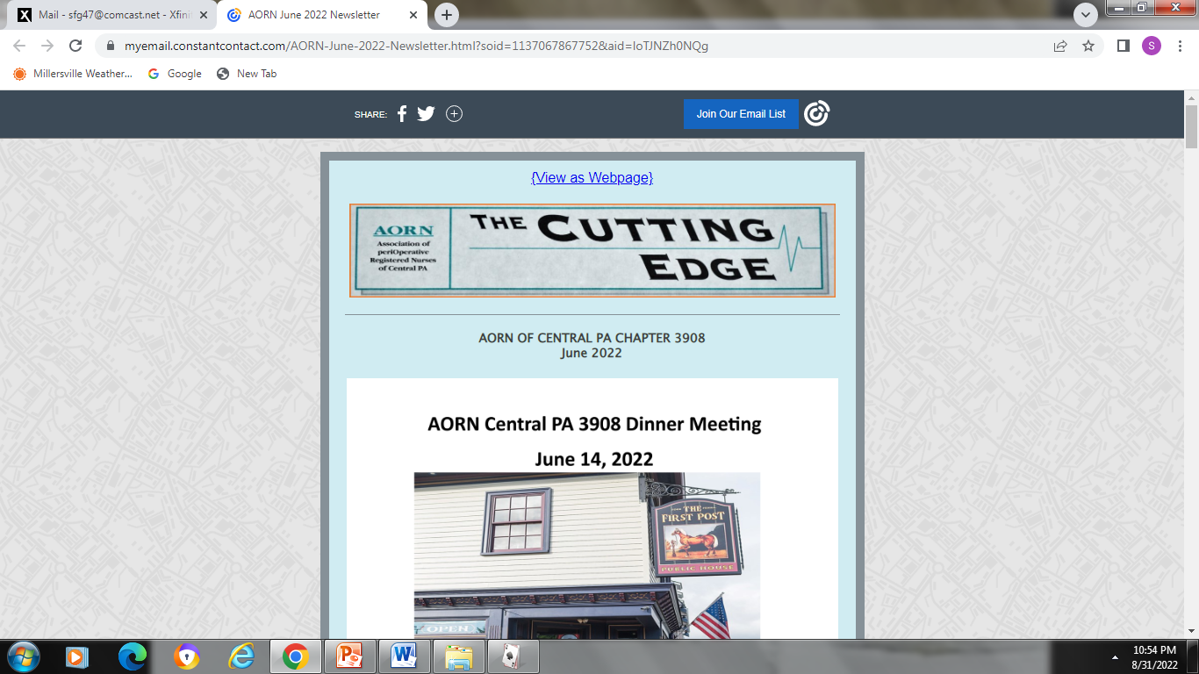

2025-2026 OFFICERS
PRESIDENT
Susan Glass 2026-2027
sfg47@comcast.net
PRESIDENT-ELECT
vacant
SECRETARY
Patricia Hogue 2026-2028
pehufnagel@aol.com
TREASURER
Kim Dodson 2025-2027
jldkad119@aol.com
BOARD OF DIRECTORS
Kathy Law 2026-2028
kclaw241412@gmail.com
Pat Graybill-D’Ercole 2025-2027
pgd619@comcast.net
Denise McMillan 2025-2027
dmcmillan2@wellspan.org
neecer818@comcast.net
Elaine Kohan 2025-2027
lainie2285@aol.com
AORN OF CENTRAL PA CHAPTER 3908
June 2026
Please join us for our annual AORN Chapter 3908 dinner meeting, sponsored by Johnson & Johnson and hosted by Mark Dowhan
Members in good standing (those with current active memberships) are invited to attend
WHEN: Tuesday June 9, 2026
WHERE: First Post York, 3691 E. Market St, York, PA
TIME: 6:00PM-Cocktails, 6:30-Dinner, with a brief business meeting to follow
RSVP by June 1 to neecer818@comcast.net or reply in Nursing Network (eligibility will be confirmed via the May 1 chapter roster obtained from AORN headquarters

Slide 2
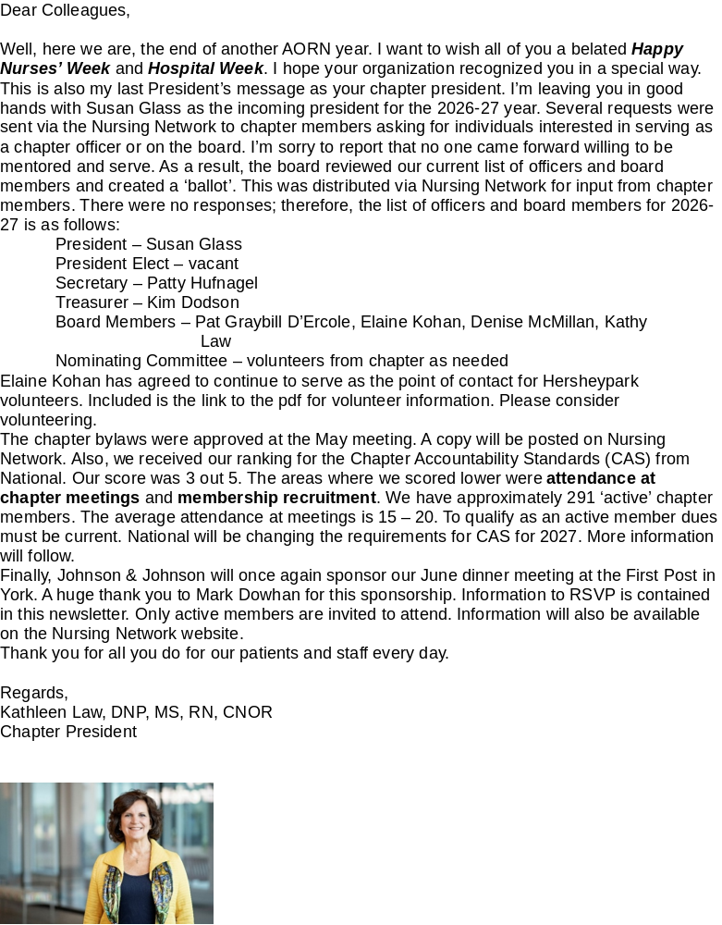
Link to Hersheypark
https://www.hersheypark.com/volunteers

Slide 3

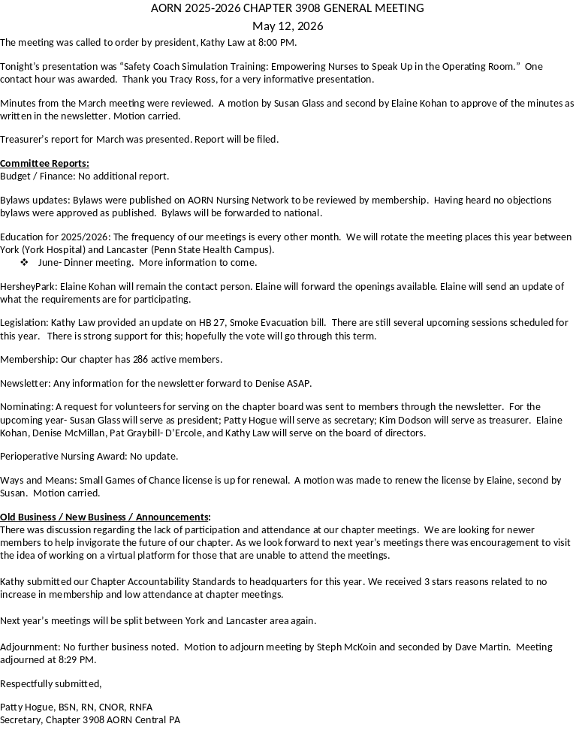

Slide 4



