Slide 1

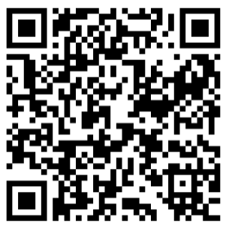

Temperature Check: Guidelines- Driven Normothermia Practice
Joyce M Ianniciello BSN RN CNOR
Area Clinical Leader Infection Prevention Perioperative
AORN MA Chapter 1
Join us for a 2 credit CE Virtual Event
Thursday 5/28/26 7:30pm
Via Zoom link: Here or scan below

