Slide 1


2025-2026 OFFICERS
PRESIDENT
Kathy Law 2025-2026
kcl070657@gmail.com
PRESIDENT-ELECT
vacant
SECRETARY
Patricia Hufnagel 2024-2026
pehufnagel@aol.com
TREASURER
Kim Dodson
jldkad119@aol.com
PAST PRESIDENT
Kathy Law
BOARD OF DIRECTORS
Susan Glass 2024-2026
sfg47@comcast.net
Pat Graybill-D’Ercole 2025-2026
pgd619@comcast.net
Helena Ely-Dyson 2024-2026
elydyson@gmail.com
NOMINATING COMMITTEE
Denise McMillan Chair 2025-2027
dmcmillan2@wellspan.org
neecer818@comcast.net
Elaine Kohan 2025-2027
lainie2285@aol.com
AORN OF CENTRAL PA CHAPTER 3908
April/May 2026
No April Meeting
This newsletter will most likely be for both April and May
Likely no separate May newsletter sent out
May meeting at Penn State Medical Center
Room 2106 (see above)

Slide 2

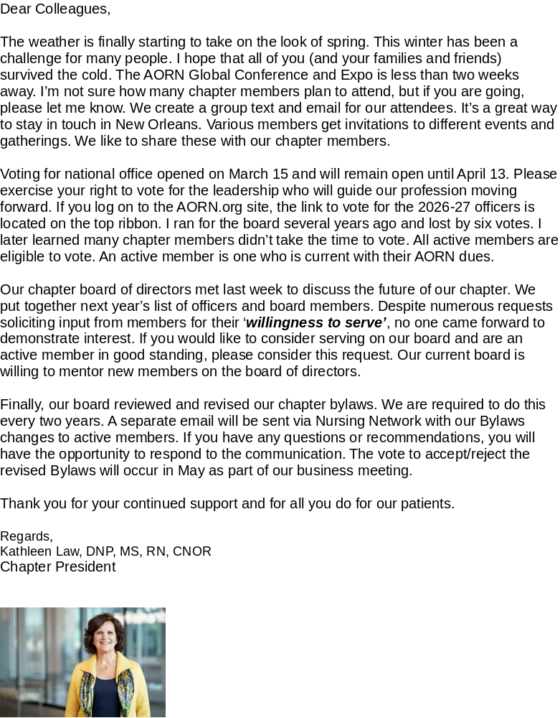

Slide 3
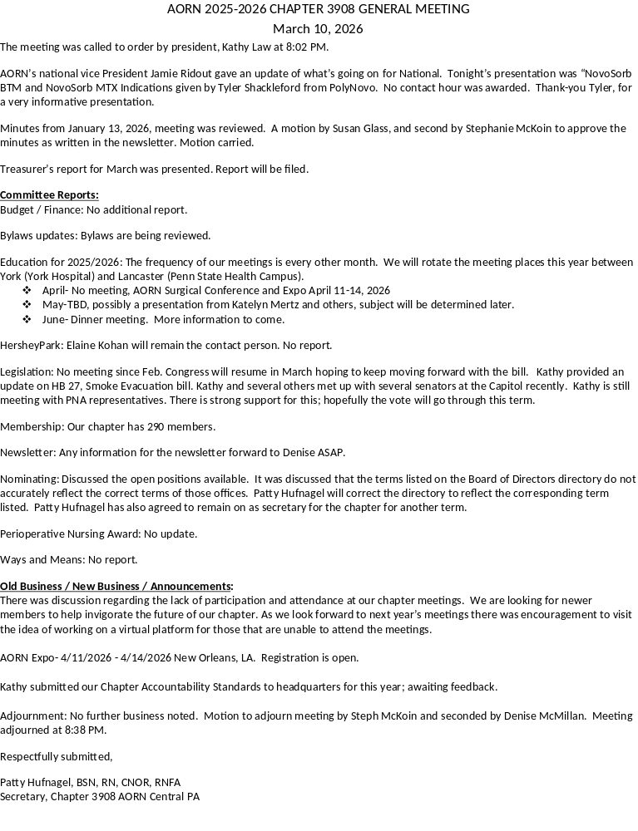

Slide 4
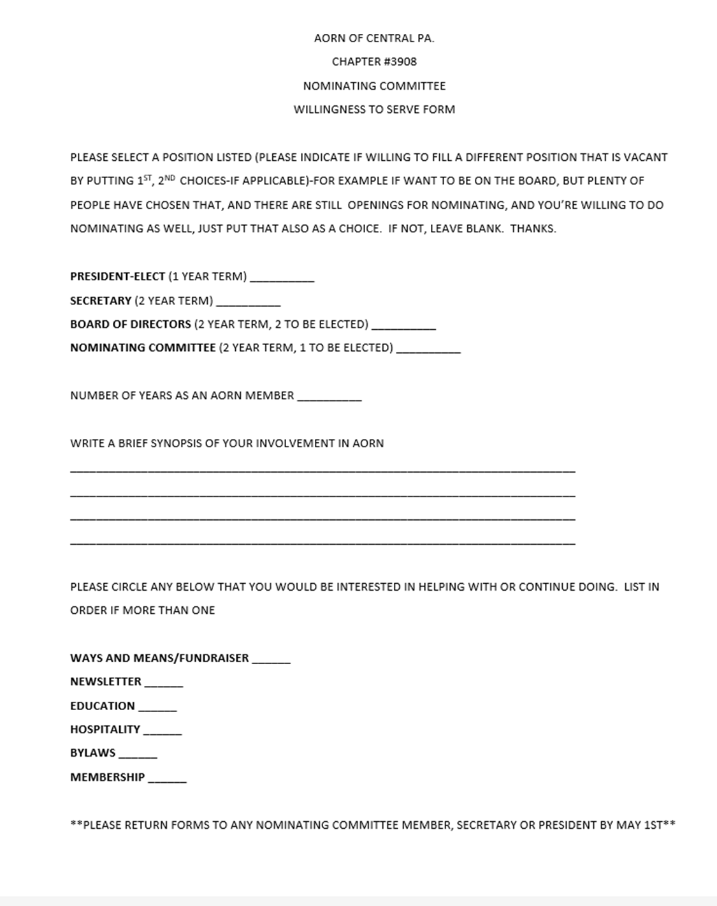

Slide 5
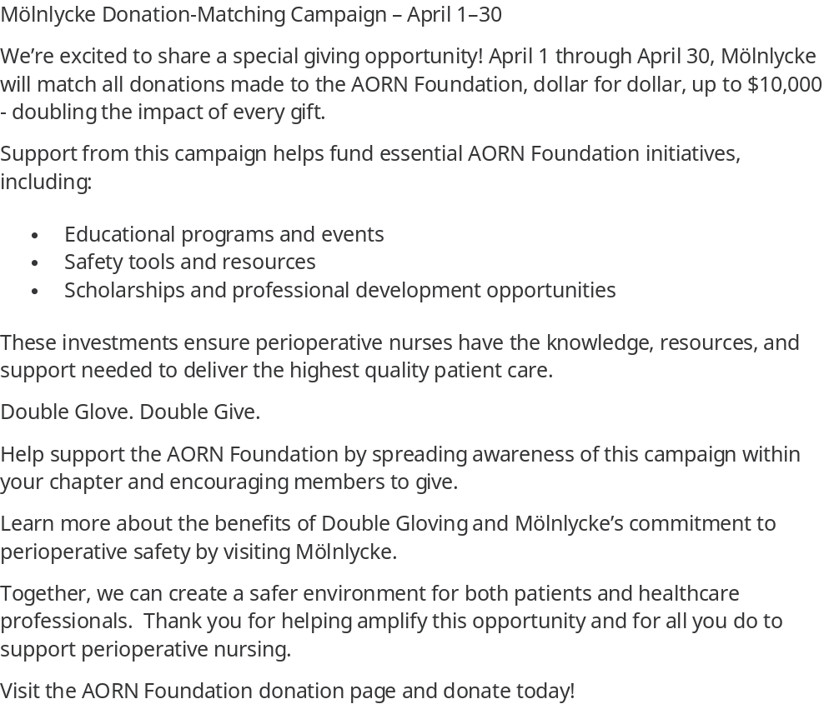
AORN FOUNDATION MATCHING CAMPAIGN

Slide 6



