Slide 1
Pediatric IBD
Dawn R. Ebach, MD

Slide 2
Objectives
​Describe the presentation and diagnosis of inflammatory bowel disease in a pediatric patient.
Understand limitations of therapy in the pediatric IBD patient

Slide 3
Overview of Pediatric IBD

Slide 4
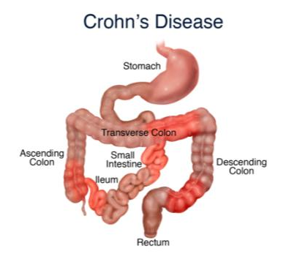
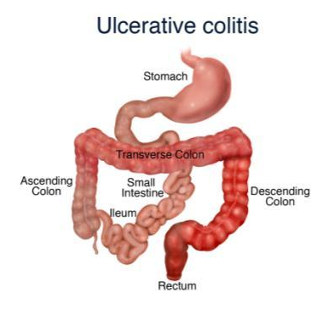
What is
Inflammatory Bowel Disease (IBD)?
Future will be more specific classification based on cause and predicted disease course
Images courtesy of Monroe Carrell Jr. Children’s Hospital at Vanderbilt Pediatric IBD Program.
1. Levine A, et al. Inflamm Bowel Dis. 2011;17(6)1314-21. 2. Vermeire S, et al. Curr Opin Gastroenterol. 2012;28(4):321-6.
Notes:
Slide 10
Inflammation: an immune response to injury that causes redness, swelling, and pain.
Crohn’s disease: can affect any part of the GI tract from the mouth to the anus; inflammation can extend throughout layers of intestine; often patchy distribution; granuloma. Majority is ileocolic (45%) vs. small bowel alone (33%) and colon alone (20%)
Ulcerative colitis: affects only the colon and rectum; inflammation is the innermost lining of the intestine; often starts in rectum and continues in colon in continued fashion.
We have come to understand that there is great variability in the types of IBD that the broad classification of Crohn’s disease (CD) and ulcerative colitis (UC) alone may not adequately characterize the underlying pathophysiology of these diseases.
References
Levine A, Griffiths A, Markowitz J, Wilson DC, Turner D, Russell RK, et al. Pediatric modification of the Montreal classification for inflammatory bowel disease: the Paris classification. Inflamm Bowel Dis. 2011;17(6):1314-21.
Vermeire S, van Assche G, Rutgeerts P. Classification of inflammatory bowel disease: the old and the new. Curr Opin Gastroenterol. 2012;28(4):321-6.

Slide 5
How Many Children Have IBD?
  Estimated 1.6 million people in the United States have IBD
  25% of IBD diagnosed in pediatric age group
  Incidence: 7-10 children out of 100,000 develop IBD
  each year
  Prevalence: Approximately 60,000 children in the US
  have IBD*
  133% increased prevalence between 2007 to 2016*
    From 33/100,000 to 77/100,000; higher in boys
      Adults increased 127%
  Overall cost of IBD greater in children vs. adults
1. Kugathasan S, et al. J Pediatr. 2003;143(4):525-31. 2. Baldassano RN, et al. Gastroenterol Clin North Am. 1999;28(2):445-58. 3. Kappelman MD, et al. Clin Gastroenterol Hep. 2007;5(12):1424-9. 4. Kappelman MD, et al. Gastroenterol. 2008;135(6):1907-13. 5. Ye Y. et al. IBD 2020;26(4); 619-625.
Notes:
Slide 11
References
Kugathasan S, Judd RH, Hoffman RG, et al. Epidemiologic and clinical characteristics of children with newly diagnosed inflammatory bowel disease in Wisconsin: a statewide population-based study. J Pediatr. 2003;143(4):525-31.
Baldassano RN and Piccoli DA. Inflammatory bowel disease in pediatric and adolescent patients. Gastroenterol Clin North Am. 1999;28(2):445-58.
Kappelman MD, Rifas-Shiman SL, Kleinman K, et al. The prevalence and geographic distribution of Crohn's disease and ulcerative colitis in the United States. Clin Gastroenterol Hep. 2007;5(12):1424-9.
Kappelman MD, Rifas-Shiman SL, Porter CQ, et al. Direct health care costs of Crohn's disease and ulcerative colitis in US children and adults. Gastroenterol .2008;135(6):1907-13.

Slide 6
Symptoms of IBD
  IBD varies, but common symptoms include:
    Frequent and/or urgent bowel movements
    Diarrhea (or constipation)
    Bloody stool
    Abdominal cramping
  Presentation more severe in children
    UC: Higher incidence of pancolitis (>80%)
    Crohn’s disease: ~20% risk of surgery or complicated disease within
    3 years of diagnosis
    More likely to have upper gastrointestinal (GI) tract involvement
    In adolescents, ratio of Crohn’s to ulcerative colitis (UC) is 2-3:1 (vs. 1:1 in adults)
  Delay in growth and puberty
  Unique psychological and social concerns
Notes:
Slide 12
Crohn’s disease is 2-3 times more frequent in children than in adults.

Slide 7
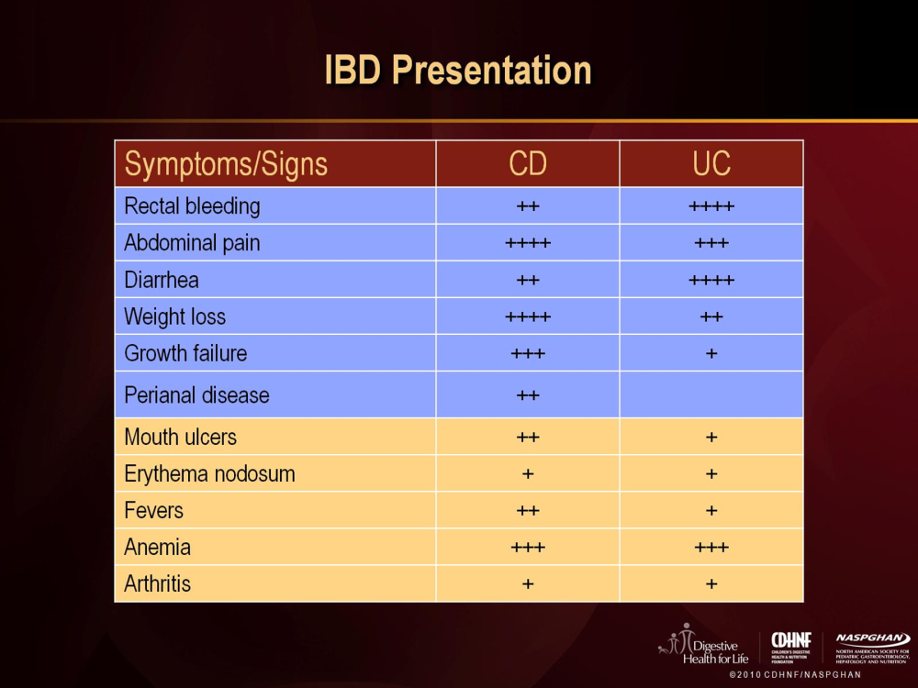

Slide 8
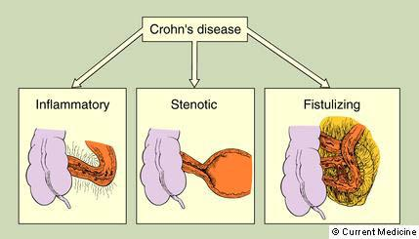
Crohn’s Subtypes

Slide 9
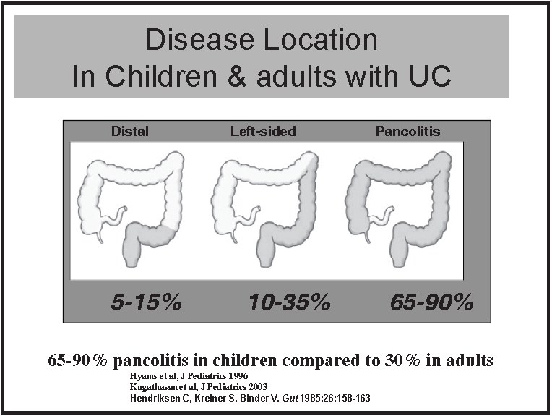

Slide 10
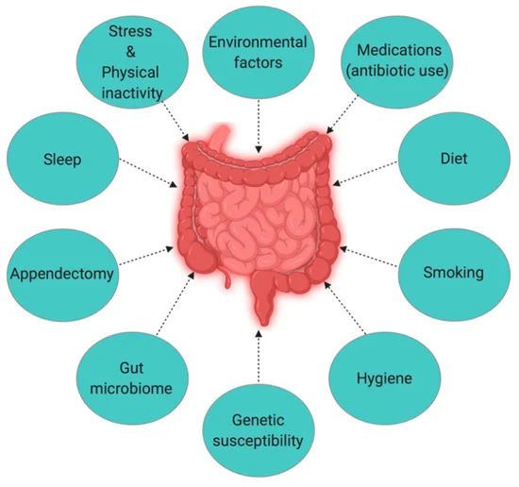
Cause of IBD
Children who have a parent with IBD have increased risk 2-10 times
15-20% of patients have a close relative with IBD
Identical Twins: concordance of 50% in Crohn’s and 15% in ulcerative colitis

Slide 11
Types of Crohn’s

Slide 12

Effect Of IBD On Growth
  Growth often affected in children with IBD,
  may appear before other symptoms
  Decreased rate of growth and
  height percentiles
    Adult height compromised
    Crohn’s disease: 32-88%
    UC: 9%-34%
  Causes
    Inflammation
    Steroids
    Poor nutrition
  Growth is good marker for disease activity
1. Sawczenko A, et al. Pediatrics. 2006;118(1):124-9. 2. Heuschkel R, et al. Inflamm Bowel Dis. 2008;14(6):839-849.
Notes:
Slide 16
Courtesy of Sandra Kim
Poor linear growth is a common sequelae of pediatric IBD and is roughly twice as common in Crohn’s disease as it is in ulcerative colitis. The causes of growth failure in IBD are varied. Malabsorption, increased caloric needs, suboptimal intake due to anorexia, and gastrointestinal losses all contribute to malnutrition, which directly affects growth. However, delayed puberty, corticosteroids, and proinflammatory cytokines such as TNFα and interleukin 6 are also responsible for growth failure. Weight loss may precede decreases in height velocity.
References
Sawczenko A, Ballinger AB, Savage MO, Sanderson IR. Clinical features affecting final adult height in patients with pediatric-onset Crohn’s disease. Pediatrics 2006;118(1):124-9.
Hildebrand H, Walters T, Griffiths A. Guidelines for the management of growth failure in childhood inflammatory bowel disease. Inflamm Bowel Dis. 2008;14(6)839-49.

Slide 13

Growth Failure

Slide 14
Psychological and Social Effects
  Specific issues facing children and teens
  with IBD
    Defining what it means to have a chronic illness
    Coping with procedures, clinic visits, hospitalizations
    Adhering to complicated medical and dietary regimens
    Quality of life and social interactions impacted
    Body image and disordered eating patterns
    Need for support systems at home and at school
Notes:
Slide 19
Courtesy of Janice Arnold

Slide 15
Psychological and Social Effects
  Children and teens with chronic disease are at greater risk of psychological stressors
    Low self-esteem
    Poor social functioning
    Depression
  Quality of life and support resources are key
Notes:
Slide 20
Courtesy of Janice Arnold

Slide 16
Diagnosis

Slide 17
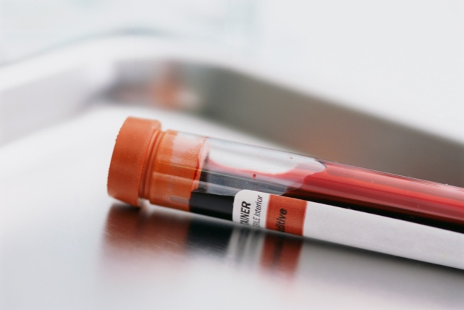
Diagnosis
  Laboratory data
    CBC, ESR, CRP
    Albumin
    Calprotectin
    Stool cultures/C. difficile toxin

Slide 18
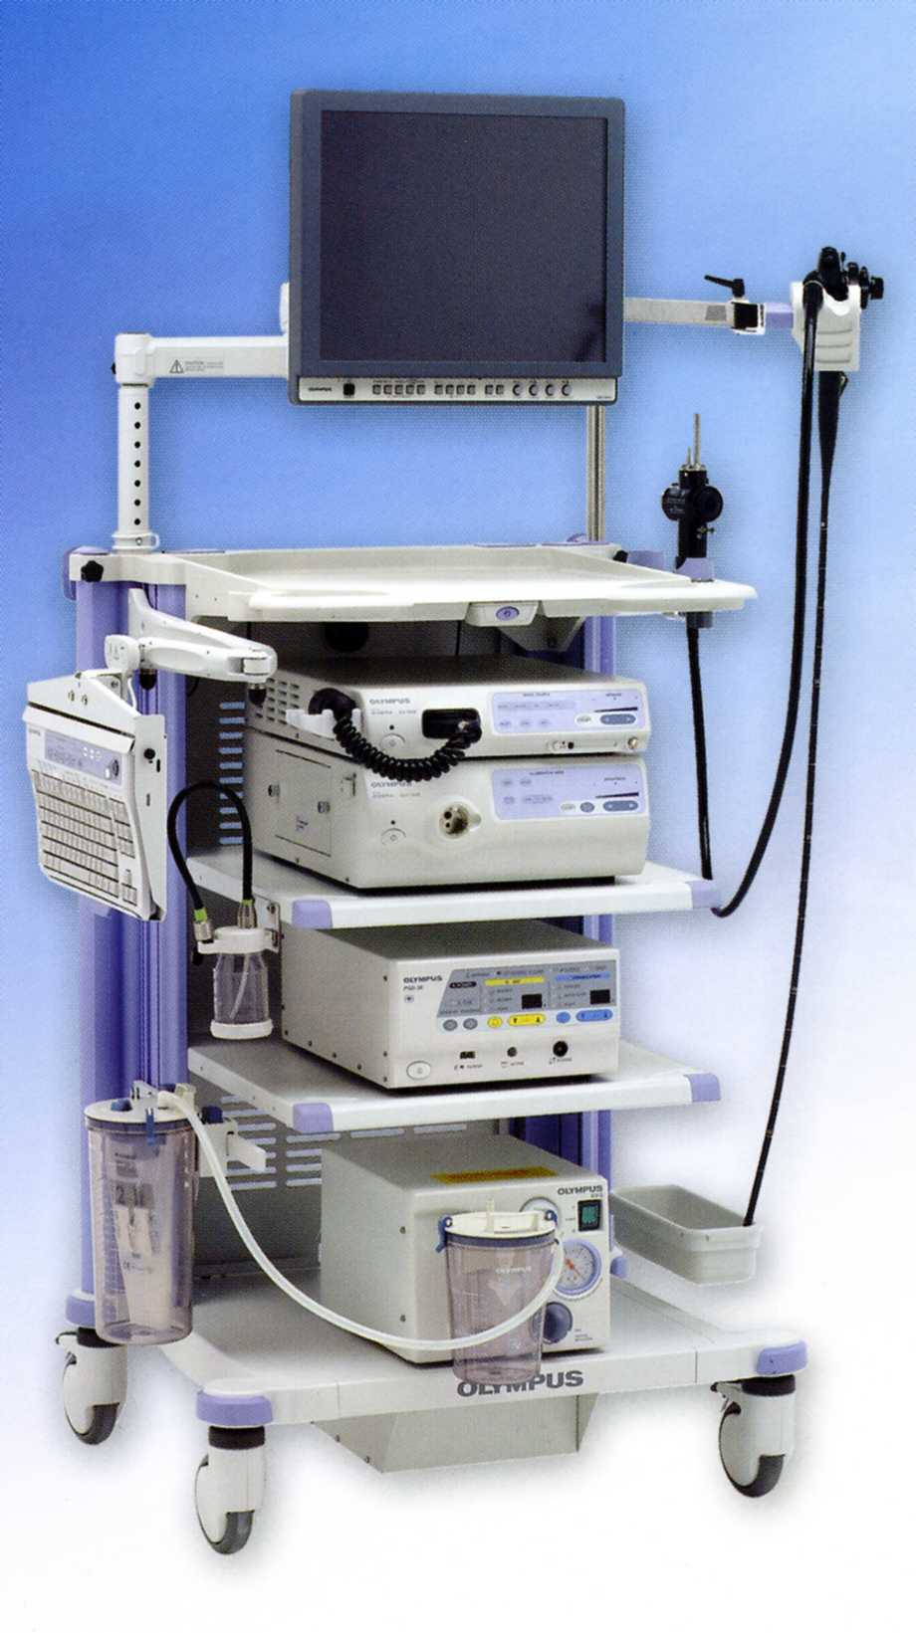
Diagnosis
  Radiology
    CT scan (if abscess suspected)
    MR enterography
    Ultrasound
  Endoscopy
    Upper and Lower
    Wireless video capsule

Slide 19
Therapy

Slide 20
Goals of Therapy
  Treat inflammation
  Induce remission – elimination or significant reduction of symptoms
  Prevent complications and surgeries
  Restore or maintain normal growth and development
  Provide safe, cost-effective treatment
  Improve quality of life
Notes:
Slide 22

Slide 21

Balancing Act
Adherance
Side effects
Risk versus benefit
Cost
“See Saw Margery Daw” ca 1920 Jennie Harbour

Slide 22
Difficulty with Pediatric Treatments
  Limited data in pediatric IBD therapy
    Treatment extrapolated from adult studies
    Not “one size fits all”
  Concerns of drug toxicity
    Infections
    Cancer
    Impact of lifetime therapy duration
  Outcomes for clinical trials needs to consider pediatric-specific outcomes
Notes:
Slide 23
Courtesy of Sandra Kim

Slide 23
Steroids
Prednisone, Budesonide
Benefits
Can help induce remission
Cheap (mostly)
If need to use frequently need to escalate therapy
Risks
Impairs growth
Acne
weight gain
Mood
Decreased bone density
Hypertension
Increased blood sugar
Striae

Slide 24
aminosalicylates
Mesalamine
  Lialda
  Apriso
  Delzicol
Sulfasalazine
Most Benefit In Colitis
No benefit in Crohn
Does not suppress immune system
Doesn’t get all patients in remission or maintain remission
Cost (co-pays)

Slide 25
Immunomodulators
6MP, Azathioprine (Imuran), Methotrexate
Maintenance therapy
Oral or SQ (MTX)
Azathioprine
  Concern for cancer risk (skin, lymphoma)
  Risk of HLH/Lymphoma with primary EBV
  Increased viral infection
  Monitor WBC, liver
  Risk of pancreatitis
Methotrexate
  Pregnancy risk
  Nausea
  Liver/pancreas

Slide 26
Biologics
Anti TNF therapy
  Infliximab
    IV infusions
  Adalimumab
    SQ injections
Effective in induction and maintenance of remission
Treats fistulizing and perianal disease
Well tolerated generally
Risk of infusion reactions (IFX) – due to antibodies
Infection risk (TB, Histo)

Slide 27
Biologics
Vedolizumab (Entyvio) - IV
  Not approved in kids!
  Inhibits trafficking of inflammatory cells to the intestine
  Gut specific
Injectable available
Very well tolerated with few side effects
Rare development of Ab

Slide 28
Biologics
Ustekinumab (Stelara)
  Not approved in kids
  One IV infusion then injection every 8 weeks
  Antibody that blocks IL12 and IL23
Very well tolerated
Low risk of Ab formation
IL 23 antibodies:
Risankizumab (Skyrizi)
3 IV infusions
OBI every 8 weeks
Guselkumab (Tremfya)
induce IV (x3) or injection

Slide 29
“Small Molecules”
Tofacitinib (Xeljanz)
  Approved for UC in adults
Upadacitinib
  Approved for UC and CD in adults
Jak inhibitors
ORAL
Some concern for blood clots
Risks of infection (TB)
Risks of lymphoma
Concern for heart disease
Acne

Slide 30
“Small Molecules”
Ozanimod (Zeposia)
  Approved Adult UC
  Oral
  S1P receptor modulator (keeps WBC from coming out of lymph nodes/spleen)
Risks:
  Arrhythmia
  Macular edema
  Posterior Reversible Encephalopathy Syndrome
  HTN
  Herpes Zoster

Slide 31
Enteral Therapy
Exclusive Enteral therapy
All nutrition is formula
Steroid sparing
Difficult to do
Cost
Special diets
  Specific Carbohydrate diet
  Crohn’s disease exclusion diet
  Mediterranean Diet

Slide 32
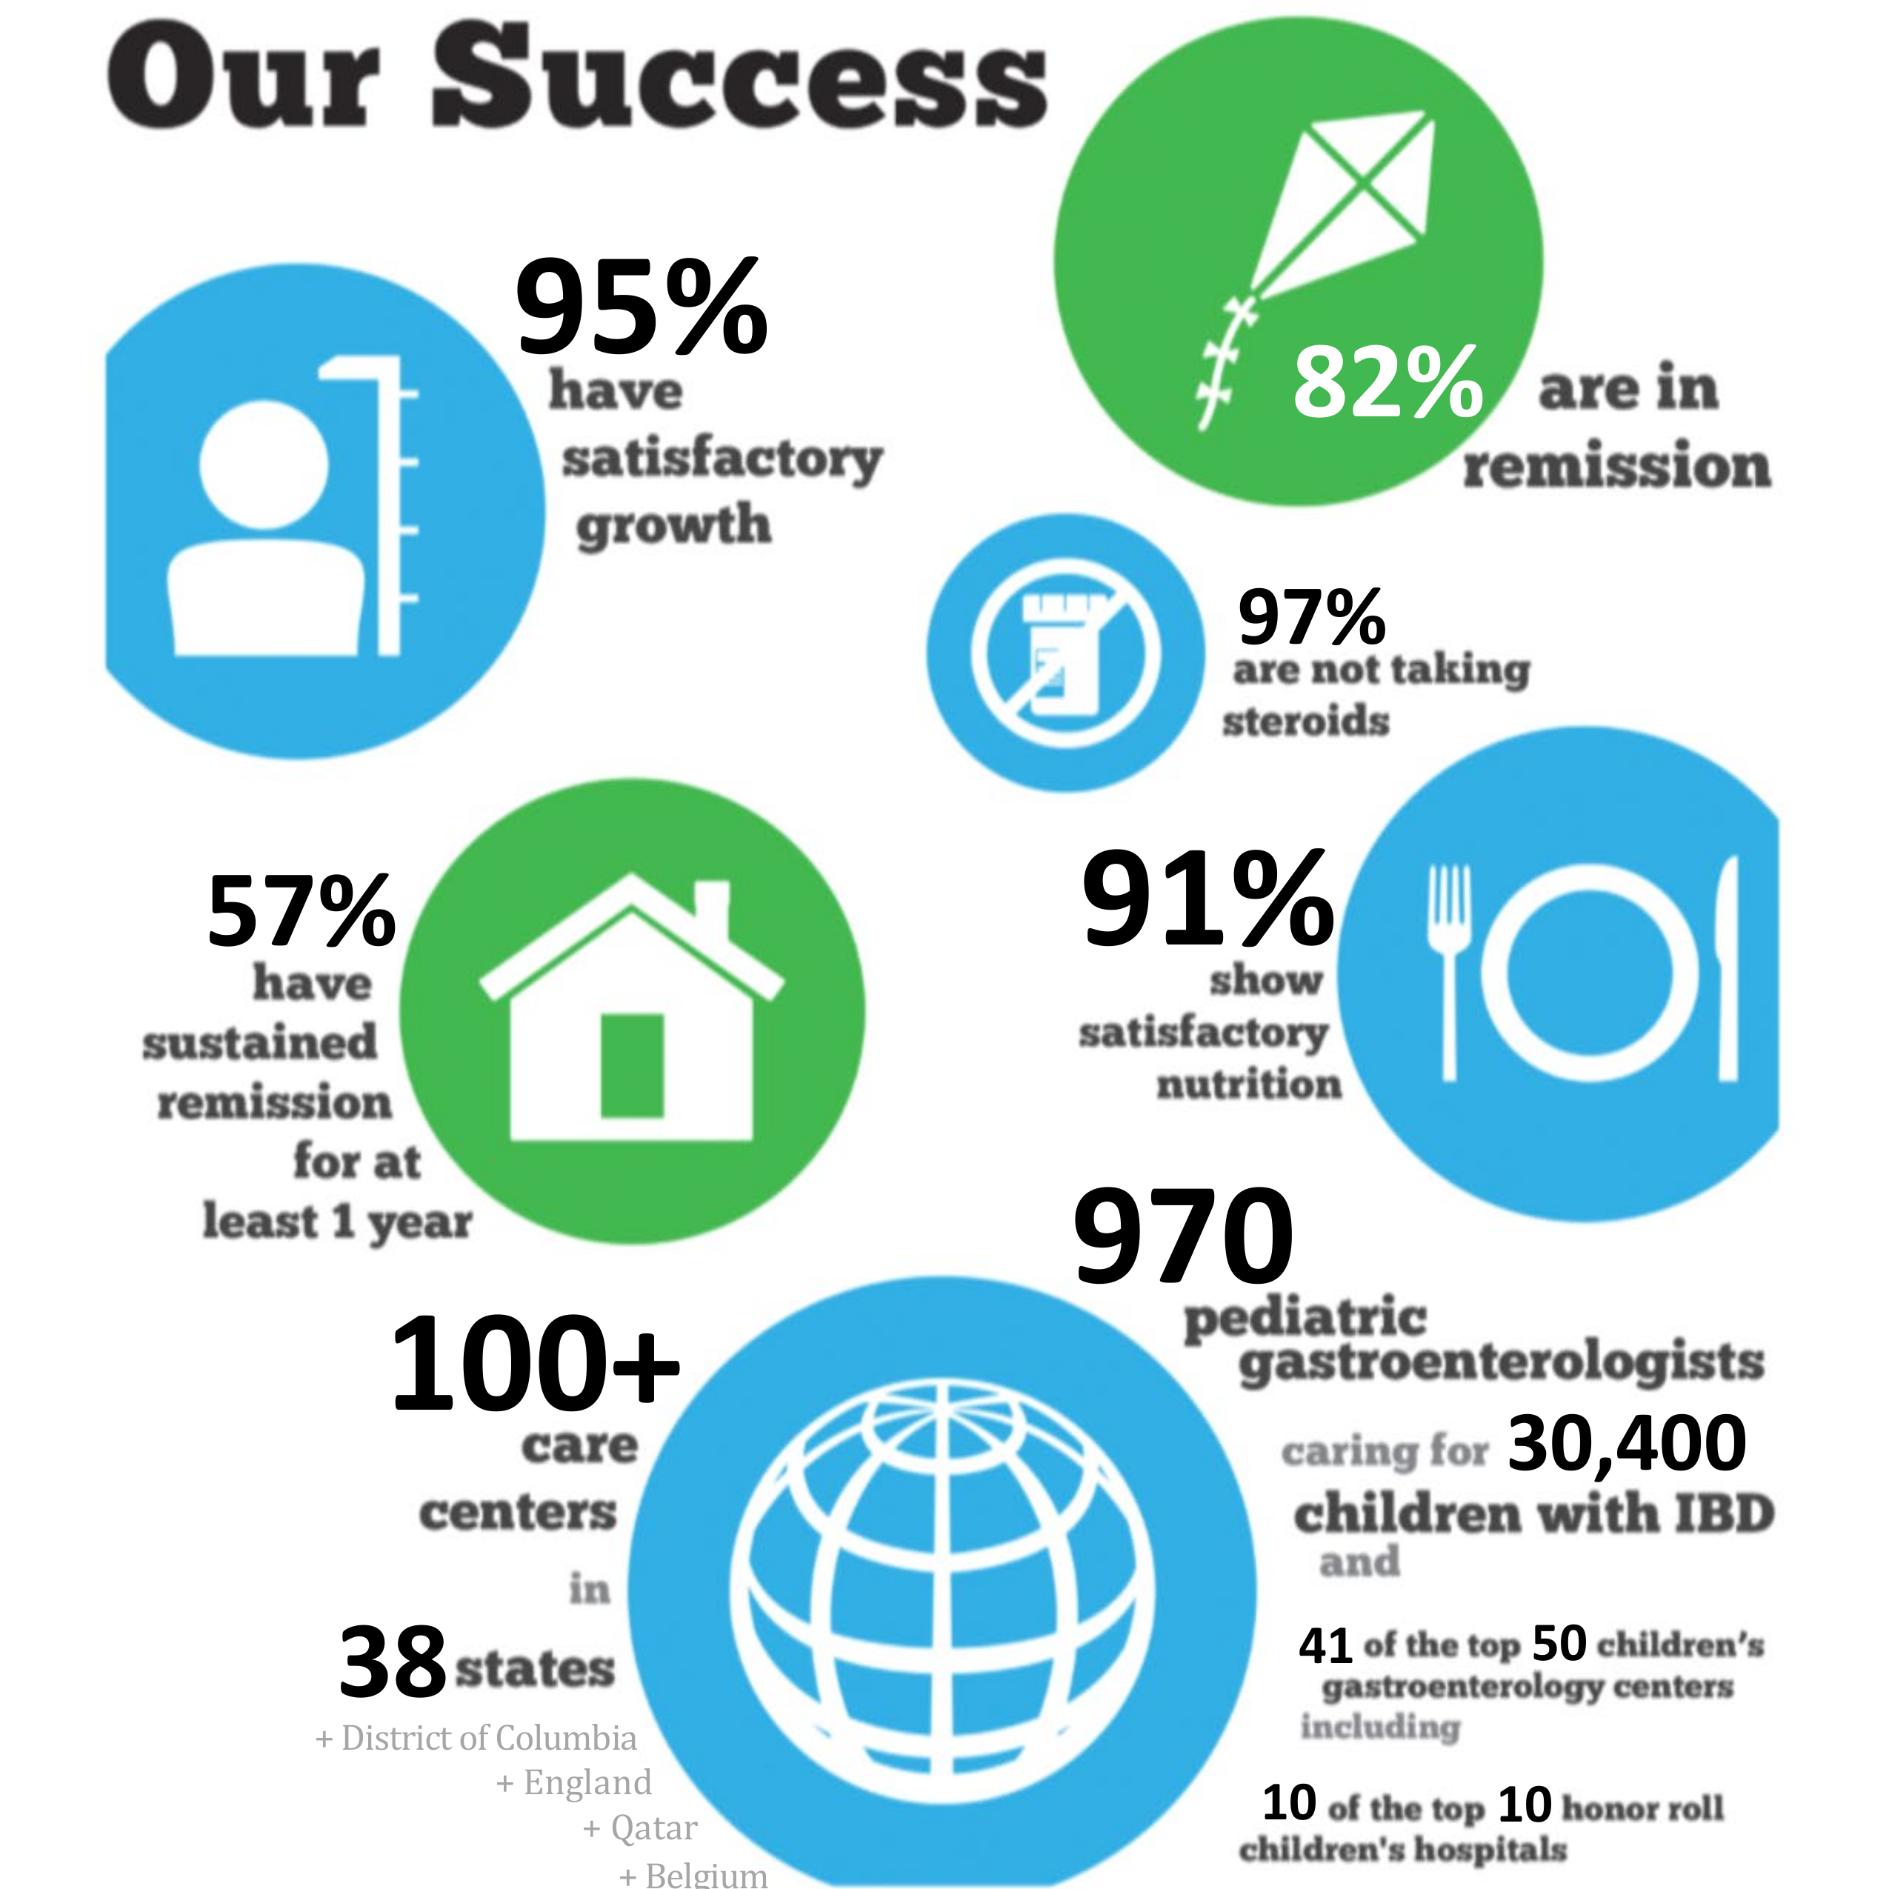
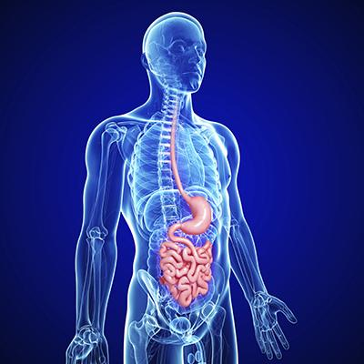


Resources
Improvecarenow
Crohn’s And Colitis
Foundation
GIKIDS.org
Gottransition.org
Improvecarenow.org

Slide 33
WE must accept finite disappointment but never lose infinite hope.
“
”
Martin Luther King

Slide 34
THANK YOU

