Slide 1
Alcohol associated liver disease
SGNA Nursing Conference
April 25, 2026

Slide 2
Disclosures
None to declare

Slide 3
Learning Objectives
Review alcohol use disorder and the epidemiology of alcohol associated liver disease
Practical guide for the management for alcohol associated hepatitis
Liver transplantation in alcohol associated liver disease
Key takeaways

Slide 4
Introduction
Alcohol associated liver disease is the most common cause of liver disease in the US and worldwide
Prevalence increasing since 2014
COVID led to a 14% rise in alcohol use ->increased mortality and listing for liver transplant
Younger adults, women and minorities have seen the largest increase in alcohol consumption over the last decade
Jophlin et al, ACG119 (1):30-54, Jan 2024
Notes:
Responsible for 3 million deaths annually, worldwide attributed to harmful alcohol consumption
5.3% of all deaths
13.5% of deaths in people aged 20-39
Cirrhosis = the 11th cause of death in the united states – 50% due to alcohol
Classically M>F
But increased marketing – gender gap has been narrowing
Prevalence of ArLD has been increasing since 2014
pinkwashing
Young people and women from latin America, western Europe have the highest rates of harmful alcohol consumption

Slide 5



Marketing plays a crucial role
Notes:
“The feminisation of alcohol marketing”

Slide 6
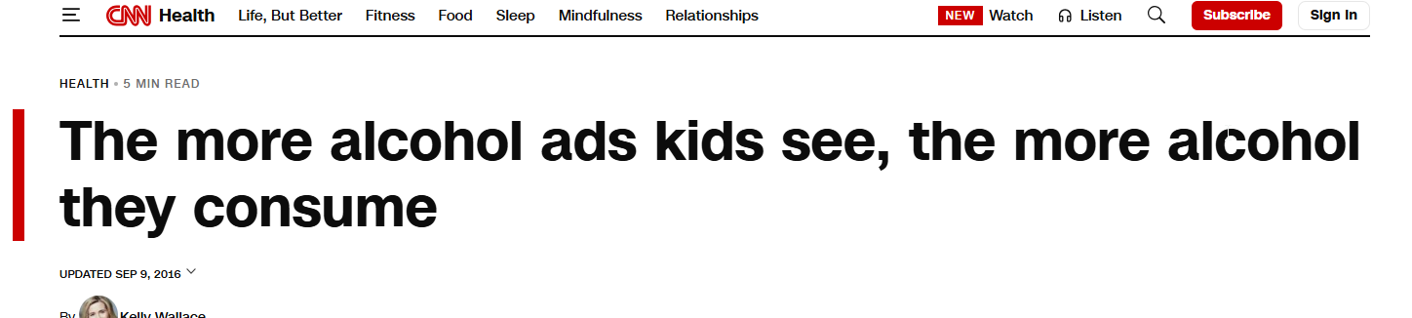


Marking plays a crucial role

Slide 7

Harmful drinking is the biggest risk factor for alcohol related liver disease
Notes:
There are no health benefits to alcohol consumption and
There is a dose dependent and duration relationship between alcohol consumption and risk of advanced liver disease (so amount and duration important)
Daily drinking = higher risk

Slide 8
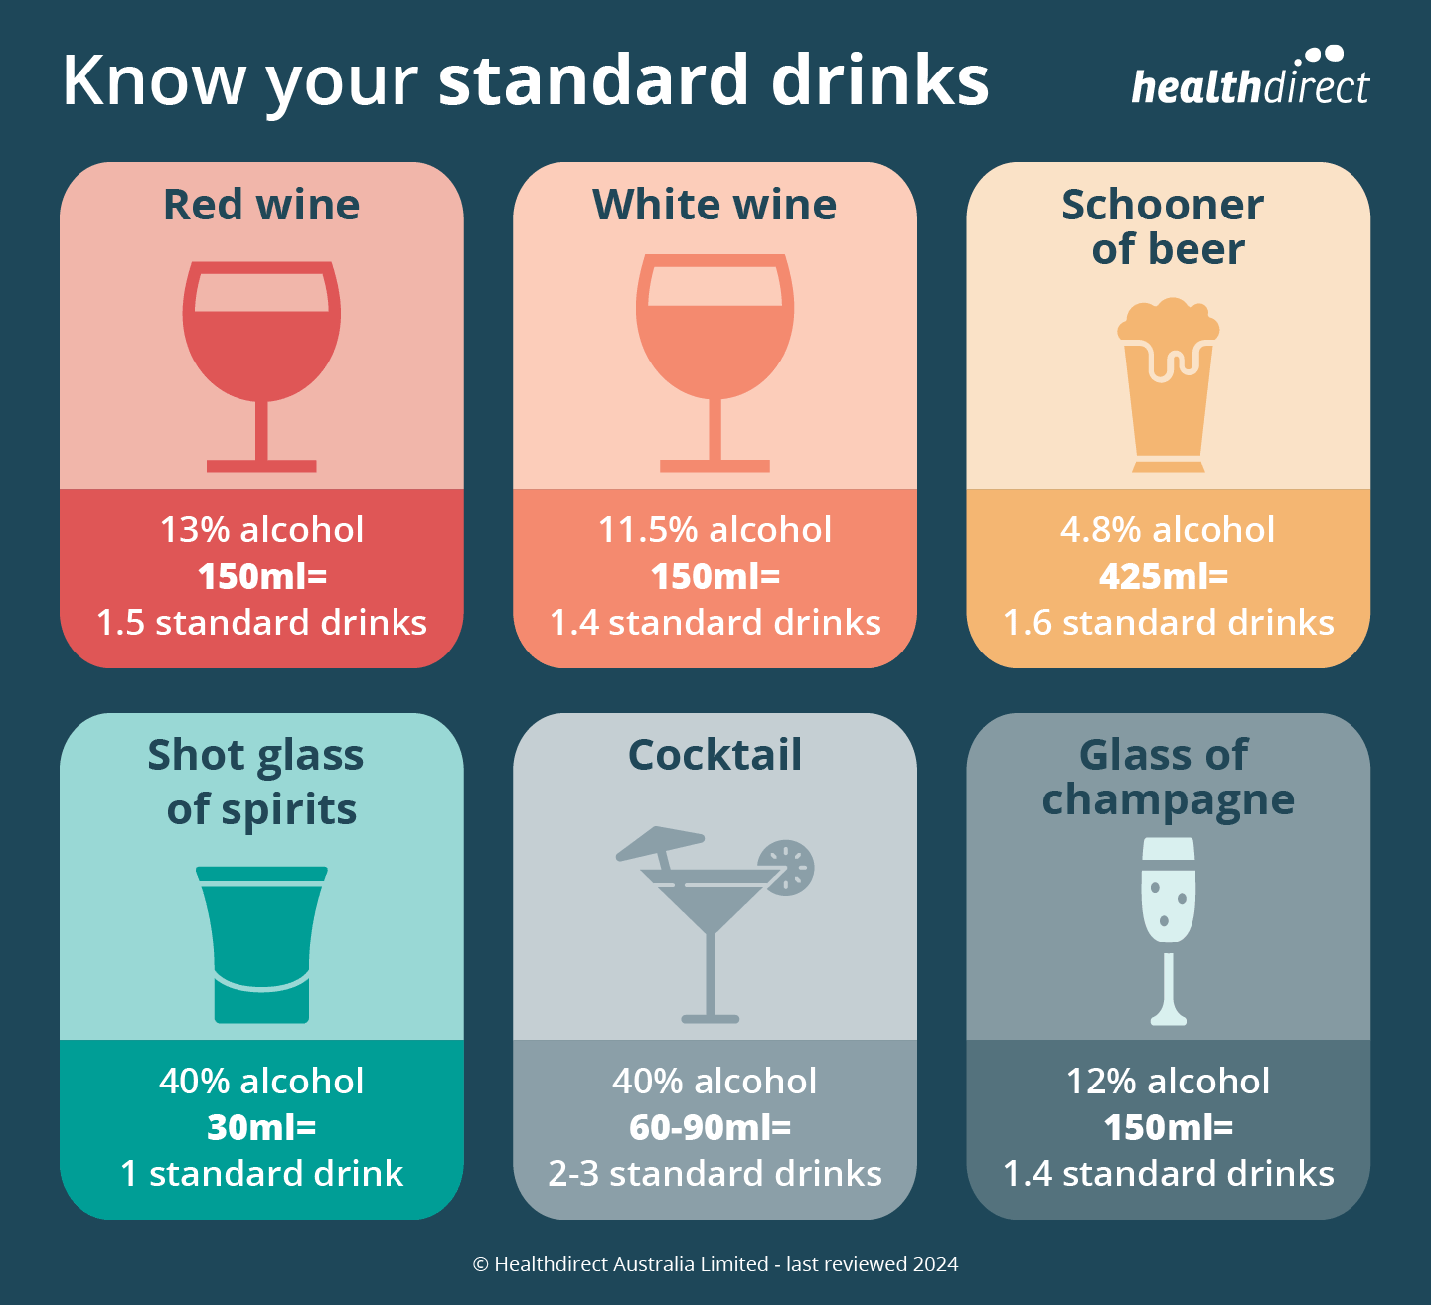
What qualifies as harmful drinking?
Men
  ≥ 3 drinks per day OR ≥ 21 drinks per week
Women
  ≥ 2 drinks per day OR ≥ 14 drinks per week
Jophlin et al, ACG119 (1):30-54, Jan 2024
Notes:
A standard drink is any drink that contains about 0.6 fluid ounces or 14 grams of pure alcohol

Slide 9
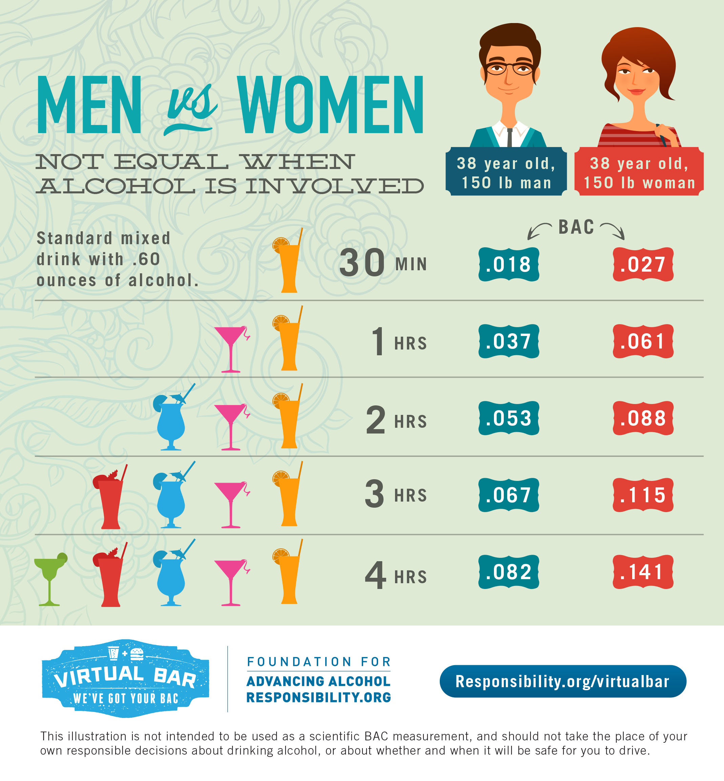
All is not equal…
Bizarro et al, UEGJ, Feb 2023
Notes:
Women are more vulnerable to the harmful effects of alcohol, relative risk of cirrhosis and liver related mortality is higher amongst women with increased alcohol consumption compared with men
Higher body fat content
Lower gastric alcohol dehydrogenase activity
Lower total hepatic volume
Drinking with meals lower 31% lower relative risk of developing cirrhosis when compared to drinking outside of meals

Slide 10
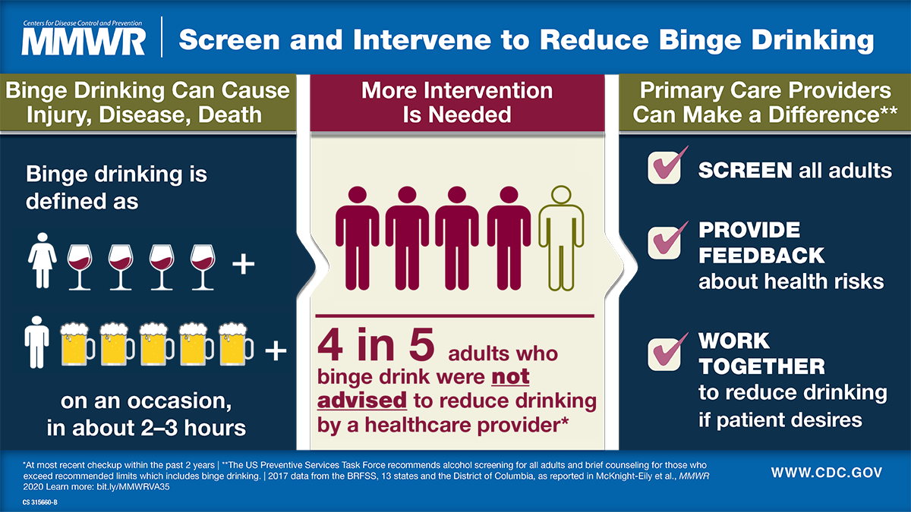
We should be proactively screening…
Notes:
Screening in a population of individuals with GI conditions had a higher odds ratio for harmful alcohol consumption

Slide 11
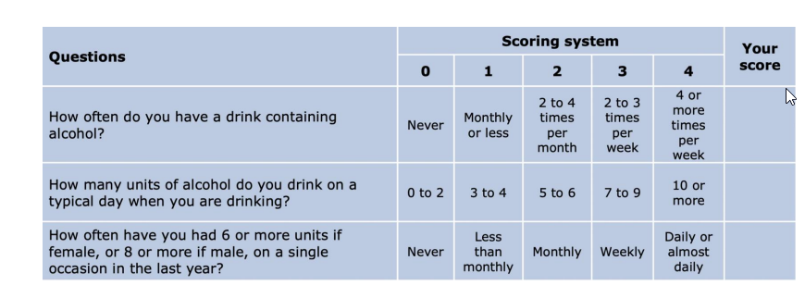
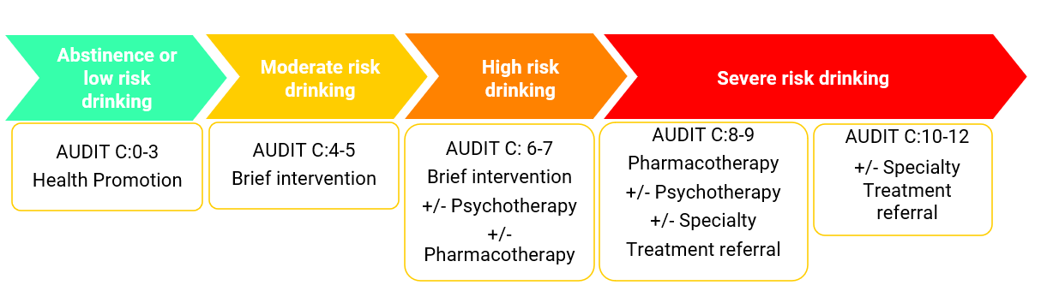
Screening for alcohol use disorder: AUDIT-C
Notes:
Audit C, Alcohol use disorders identification test consumption, sensitivity of 73-97% for women, 82-100% for men

Slide 12
Biomarkers of alcohol use
PETH interpretation:
< 10 ng/mL – not detected
10-19 ng/mL- Light alcohol consumption (<2 drinks per day for several weeks)
20-200 ng/mL- Moderate alcohol consumption (up to 4 drinks per day for several weeks)
> 200 ng/mL – Heavy alcohol consumption (at least 4 drinks per day for several weeks)
 | Specimen | Window | Sensitivity % | Specificity % | PPV % | NPV %
EtG | Urine | 3–7 d | 70–76 | 93–99 | 81–97 | 85–99
CDT | Blood | 2-4 wks | 25-100% | 93-99% | 64-100% | 71-93%
EtS | Urine | 3–7 d | 73–82 | 86–89 | 70–80 | 85–93
PEth | Blood | 30 d | 73–100 | 66–96 | 85 | 100
Jophlin et al, ACG119 (1):30-54, Jan 2024
Notes:
Helpful to get more accurate understanding of intake

Slide 13
Management of alcohol use disorder
Medication | Mode of Action | Typical Dose | Use in Liver Disease
Naltrexone | Mu opioid receptor antagonist | 50 mg per day 380 mg monthly intramuscular injection | Risk of hepatotoxic effects precludes use in advanced liver disease May consider in early liver disease
Acamprosate | NMDA agonist Calcium load | 666 mg three times daily (reduce if body weight is <65 kg) | Precaution in Child–Pugh class C cirrhosis
Not approved in the US
Baclofen | GABA B receptor agonist | 10–25 mg three times daily | Acceptable side-effect profile in patients with liver disease Minimal hepatic metabolism
Topiramate | GABA A receptor agonist AMPA–kainite glutamate receptor blocker Calcium- and sodium-channel blocker | Up to 100 mg twice daily | Risk of encephalopathy precludes use in advanced liver disease May consider in compensated liver disease
Gabapentin | GABA A receptor agonist | Up to 900 mg twice daily | Uncertain
Haber, Paul S, N Engl J Med 2025;392:258-266
Notes:
Therapeutic target = sustained abstinence
Most effective strategy to prevent disease progression and improve long-term outcomes
Motivational interviewing techniques/ brief intervention
Can lead to reduced alcohol consumption in those with mild AUD –AUDIT score of 8-20
2018 meta analysis of 69 studies including more than 33 000 patients,BI led to a reduction in alcohol consumption by 20 grams/ week in the primary care setting
Compensated ArLD- naltrexone, acamprosate, baclofen
Baclofen GABA receptor agonist average of 5.8 months, has been shown to safely reduce alcohol use in patients with AH and increases abstinence rates in those with ALD cirrhosis
Started at a dose of 5 mg TiD with dose escalation at 3-5 day intervals- to a max of 15 mg TiD
Acamprosate- no hepatic metabolism, safe in cirrhosis, caution in renal impairment dose reduction when GFR 30-50 ml/min, avoid in GFR<30
Naltrexone caution in decompensated cirrhosis and renal failure
Genetics play a role with cohort studies of twins sowing heritability ranging from 16-72% with higher rates in men
?GLP1RA

Slide 14
Why is alcohol harmful for the liver?

Slide 15
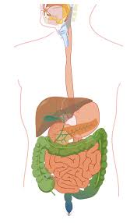
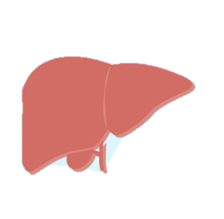
Alcohol Metabolism:
Oxidative pathway
Alcohol dehydrogenase (ADH)
Aldehyde dehydrogenase (ALDH)
Alcohol
Acetaldehyde
Acetate
ROS!
Lipid accumulation -> steatotic liver disease
Inflammation -> Alcohol associated hepatitis
Fibrosis -> Cirrhosis
HCC
Bizarro et al, UEGJ, Feb 2023
Notes:
Alcohol promotes fatty acid uptake and lipogenesis, also reduces beta oxidation and VLDL release from the liver- promoting increased fat accumulation
ROS- activate hepatic immune cells and inflammatory pathways- drives inflammation within the liver –acute/chronic progressive
Fibrosis- activation of Kupffer cells, fibroblasts – progressive fibrosis and risk of developing cirrhosis
ROS/acetaldehyde directly damage DNA, interfere with repair response –and promote carcinogenesis
The risk of HCC is 5x higher in women than in men per the same amount of alcohol consumption (80 grams/ day)
Men have 70-80% higher gastric alcohol dehydrogenase activity than women, women have a higher hepatic ADH activity
Women more prone to toxic metabolites within the liver
Ethanol could promote adipose tissue dysfunction- leading to progression of liver damage – same alcohol consumption leads to higher systemic levels compared with men
Women smaller than men, smaller body water content, smaller hepatic volumes
Chronic alcohol consumption increases adipose tissue lipolysis (chronically adipose tissue loss and free fatty acid release) and liver fat deposition – leading to hepatic steatosis
Chronic alcohol intake impairs insulin regulation and glucose tolerance. Alcohol inhibits insulin secretion
Females have a higher inflammatory response to enteric endotoxins- the amount of which is increased by exposure to alcohol compared to males –leading to more severe hepatic injury and necrosis, estrogen blockade in animal models has been shown to attenuate alcohol related injury in females.
In men chronic alcohol consumption leads to hormonal imbalance- lowering testosterone levels and increasing estrogen levels. –erectile dysfunction, infertility, gynaecomastia
Ethanol is a psychoactive compound that acts as a central nervous system depressant
Absorbed by the GI tract and distributed throughout the body
Factors that influence alcohol absorption, quantity consumed, body composition, gastric emptying and enzymatic activity
The enzymes responsible for ethanol metabolism are located through the GI tract, liver, adipose, breast, brain and blood

Slide 16
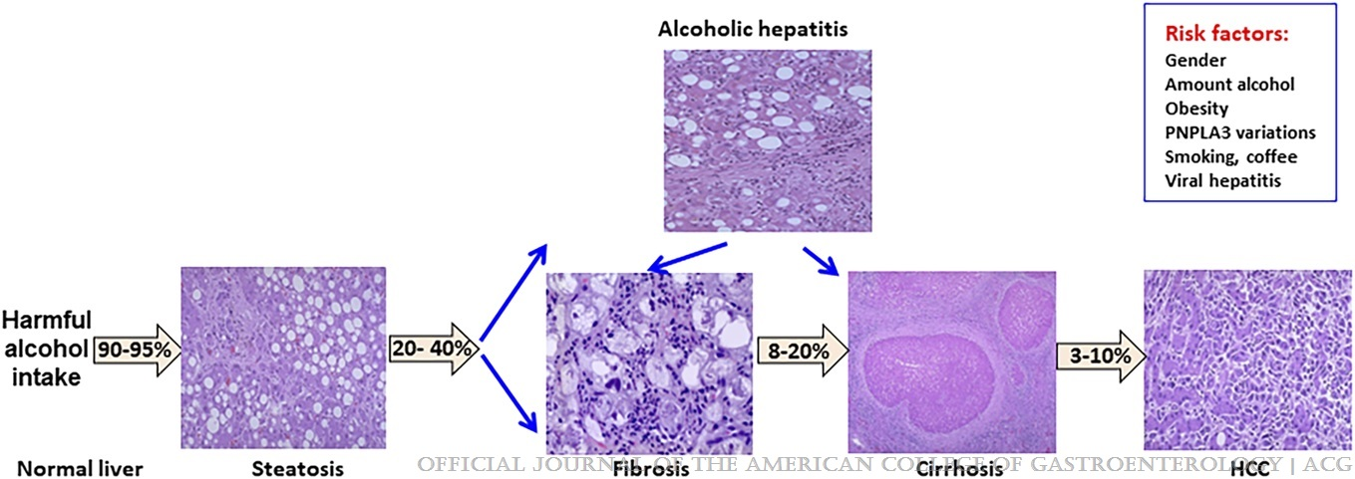
Evolution of alcohol associated liver disease
Jophlin et al, ACG119 (1):30-54, Jan 2024
Notes:
Alcohol contributes to 48% of hospitalizations related to cirrhosis
And more than 40% of listings for liver transplantation
Over 30% of cases of HCC
The COVID pandemic led to a 14% rise in alcohol use ->increased mortality an ArLD transplant listing
AUD mortality rates increased by 24.8% in 2020 and 22% in 2021, compared with prepandemic rates
Hospitalization for ArLD have also increased among younger individuals, minorities, women
Women are less likely to use AUD therapies and prevention strategies than men, ?more stigma, conflicting child or family and personal needs and financial barriers
It is expensive- ArLD highest cost burden for hospitalizations of any etiology of liver disease(2010-2016- cost of 22.7 billion)
Women have higher rates of HCC

Slide 17
Risk factors for advanced liver disease
Metabolic risk factors
  Obesity
  Diabetes
Genetic – Hispanics and American Indians- higher rates of polymorphisms associated with increased risk
Smoking
Status post gastric bypass surgery
Pre-existing liver disease
  Viral hepatitis
Notes:
Binge drinking in those with underlying metabolic syndrome confers higher risk of developing cirrhosis
PNPLA3 higher prevalence in Hispanic/ native American – can be as high as 30%
Not routinely tested
Others A1AT heterozygotes higher risk
Smoking is a risk factor – smoking > 20 cigarettes daily independently associated with a 3 x increased risk of ArLD cirrhosis
BMI risk factor BMI > 30, and >3 drinks per day higher risk of liver disease, cirrhosis, HCC
Overweight or obese, + harmful alcohol consumption at 1.5-2x increased risk of liver disease
Diabetes in the setting of heavy alcohol consumption associated with a 6x increased risk of liver related hospital admission
Gastric bypass is associated with a 2-3x increased risk for the development of alcohol associated hepatitis
Viral hepatitis + alcohol acts as cofactor- accelerated liver disease

Slide 18
Screening for Alcohol related liver disease
Individuals who report increased alcohol consumption should be screened for liver disease as silent condition
FIB-4
Transient elastography (Fibroscan)
US/ cross sectional imaging
Invasive assessment with liver biopsy rarely needed
Notes:
FIB-4 recommended as first line test- sensitivity of 80-90% for excluding advanced fibrosis, <1.3 or < 2 amongst individuals aged > 65, 8% false positive rate, 4% false negative rate
Transient elastography cut offs of 12-15 kPa identify advanced fibrosis or cirrhosis with a sensitivity and specificity exceed 85%

Slide 19
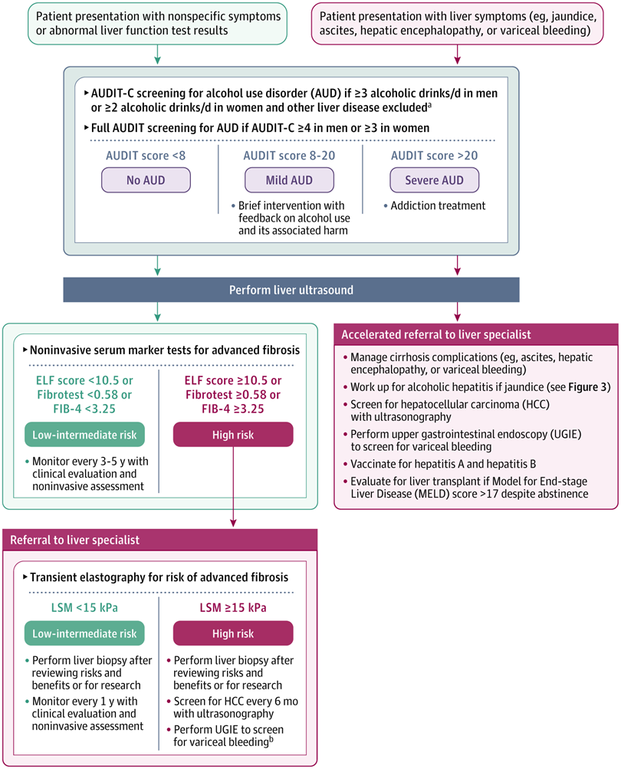
Screening for Alcohol related liver disease
Mathurin, Singal, JAMA 2021;326;(2):165-176

Slide 20
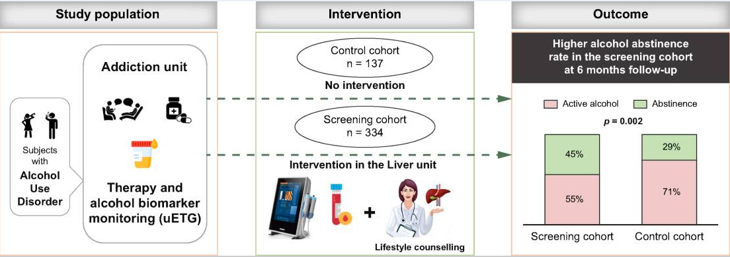
Knowledge is power…
Avitabile et al JHEP rep 2024 July 2;6(10):101165

Slide 21
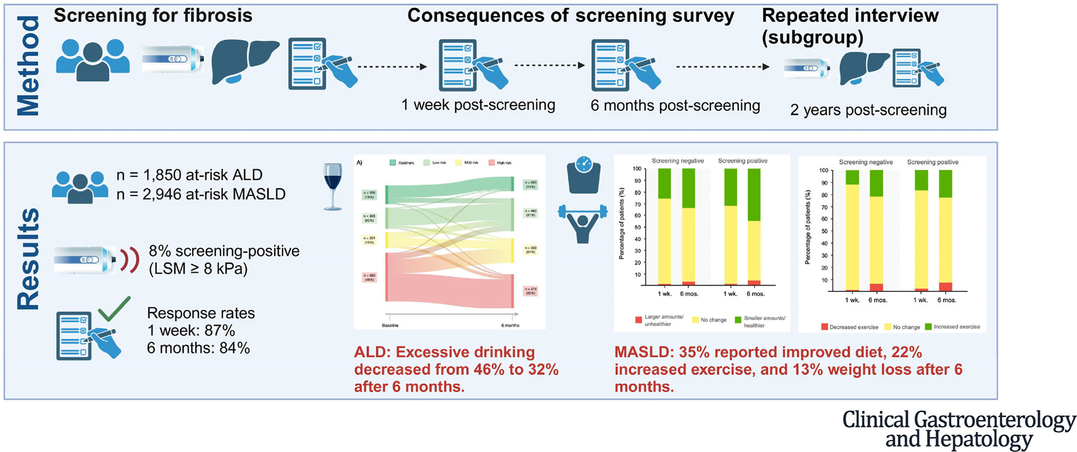
Knowledge is power…
Kjaergaard et al, Clin Gastro & Hep 22;5, 1037-1047

Slide 22
Alcohol associated hepatitis
Rapid onset jaundice with the development of acute on chronic liver failure
1 month mortality ranging between 20-50%
Background of prolonged history of heavy alcohol consumption
Mortality is higher in younger individuals and women
Jophlin et al, ACG119 (1):30-54, Jan 2024
Notes:
Distinct phenomenon-Rapid onset jaundice, acute on chronic liver failure, severe form 1 month mortality of 20-50%
?Pathophysiology poorly understood
Occurs amongst individuals with prolonged history of heavy alcohol consumption
Patients with recurrent AAH more men, trend toward lower survival
Female gender associated with an 8% higher risk of acute on chronic liver failure
Risk higher in younger individuals and women
Can be associated with a 6 month mortality rate as high as75%
Acute decompensation in individual with preexisting liver disease
Acute severe inflammation – triggers increase in portal pressure – do novo portal hypertension
Presence of one or more SIRS symptoms, temp, tachycardia, RR >20, WCC >12 – associated with 3x increased risk of death, increased risk of renal failure @ 90 days
Spontaneous recovery those with a MELD score of <21 at 90 days happened in 35% of individuals
50% continued to have ascites and HE beyond 2 years
7% recompensated MELD < 15 without ascites or hepatic encephalopathy
Lack of relapse important predictor of outcomes
Relapse more likely in younger <48 years and those with a history of prior alcohol rehabilitation

Slide 23
Alcohol associated hepatitis
Maddrey discriminant function ≥ 32 associate with a 20-50% mortality over 30 days
MELD > 20 correlates with a 20% 90 day mortality
Initial evaluation, abdominal imaging, liver screen, infectious work up, management of withdrawal symptoms, nutritional review, high dose thiamine
Max benefit for MELD 25-39
MELD ≤ 20
MELD > 20
Contraindication to steroids
MELD > 50
No contraindication to steroids
32 mg methylprednisolone
40 mg prednisolone daily
Link to outpatient Hepatology follow up
Early liver transplant
Palliative care
Non-responder
D4 or D7 Lille >0.45
Responder
D4 or D7 Lille ≤ 0.45
Continue steroids for 28 days
Jophlin et al, ACG119 (1):30-54, Jan 2024

Slide 24
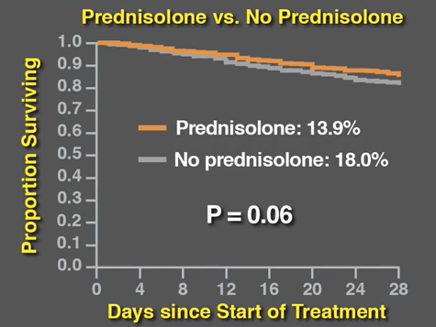
STOPAH trial
Odds ratio: 0.72 (95% CI 0.52-1.01)
No reduction in mortality at 90 days or 1 year compared with placebo
Thursz et al,NEJM 2015;372:1619-1628
Notes:
Benefit at 28 days, no significant difference between placebo at 90 days and 1 year
2015
65 hospitals in the UK, 1103 patients
MELD outperformed discriminant function in determining 28 day and 90 day mortality

Slide 25
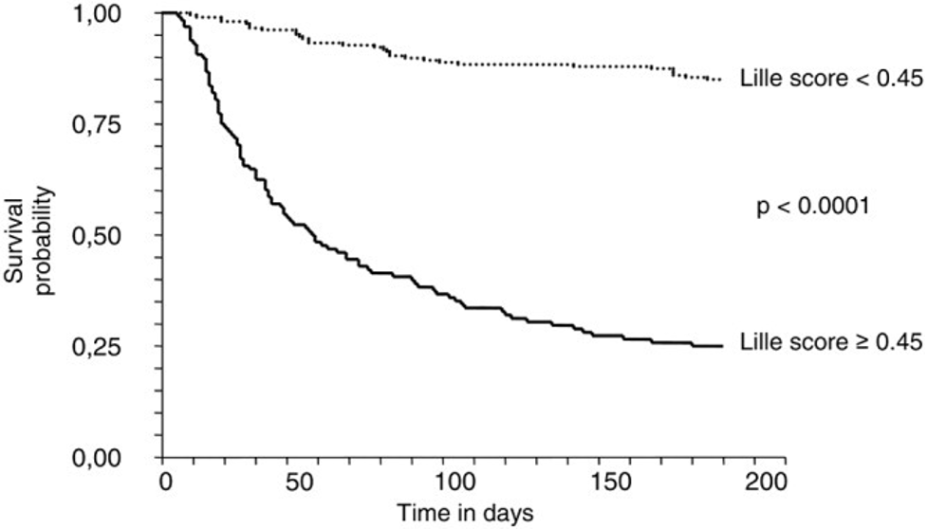
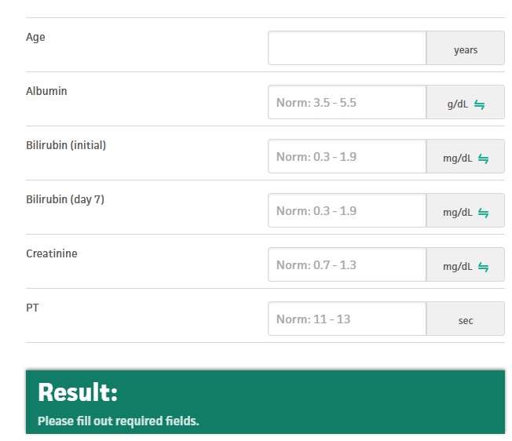
Lille score
Louvet et al Hepatology, 2007, 45;6. 1348-1354

Slide 26
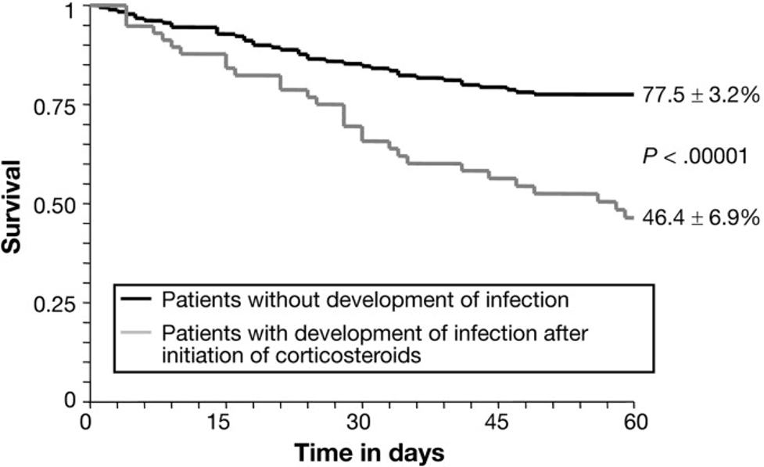
Caution with use of steroids
Louvet et al, Gastro 2009, Aug; 137(2):541-548
Notes:
Infections are common at presentation and during hospitalization
Prospective study of 1092 patients with AH -12.4% had infection at presentation
26.1% developed infection during treatment with steroids or pentoxifylline
9.3% developed infection after treatment
-at least 40% at some stage of admission
Multicenter retrospective cohort study showed 49% had evidence of infection and diagnosis of infection was an independent risk factor for 90 day mortality
No difference in mortality with use of empiric antibiotics

Slide 27
Liver Transplantation:
Early liver transplantation improves outcomes for individuals with severe alcohol associated hepatitis
  6- month survival of 77% versus 23% in historical controls (p <0.001) ¹⁻³
  Careful patient selection and integrated management approach crucial for low recidivism rates
  Relapse rates 20-34% at 1-3 years ¹⁻²
  Only relapse with heavy drinking associated with adverse post transplant outcomes
1.Crabb et al Hepatol 2020
2. Cotter et al, ILTS 2026,
3. Mathurin et al N Engl J Med 2011;365:1790-1800
Notes:
Integrated MDT care- at all points in transplant journey
Combined counseling, pharmacotherapy, lab testing

Slide 28
Key takeaways:
Alcohol remains a significant public health issue in the US and is the leading cause of liver disease
Women are more vulnerable to toxicity at lower concentrations
Proactive screening and harm reduction essential to improving outcomes
Effective management of alcohol related liver disease requires a multi disciplinary approach

Slide 29
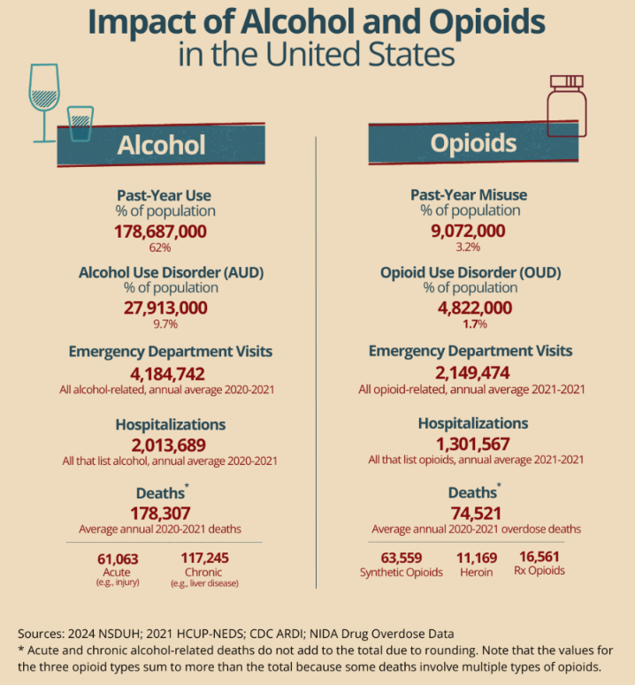
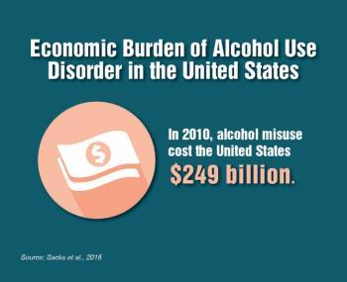

Slide 30
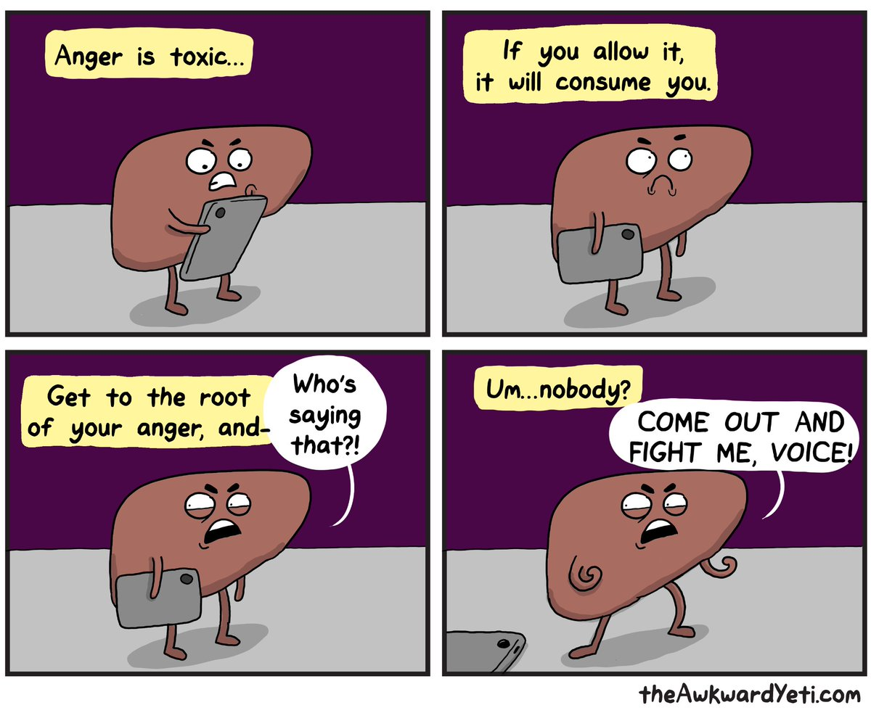
Notes:
Important to keep the liver happy

Slide 31
Thank you
Sara Naimimohasses
2026 SSGN Conference
Alcohol associated liver disease
Dept of Gastroenterology
uihc.org

