Slide 1

The In’s and Out’s of Lower Motility
Katie Sinwelski, BSN, RN, CGRN

Slide 2
Disclosure
I have no disclosures that would create conflict of interest

Slide 3

Objectives
Understand what patient’s and diagnoses we see and treat in lower motility
Review special considerations for lower motility patients
Describe Peristeen Irrigation System and what factors lead to prescribing it
Understand Rebyota suspension and its role in preventing recurrent C.Diff infection
Discuss Anorectal Manometry diagnostic test (ARM)
Describe therapeutic treatment with anal biofeedback therapy

Slide 4

What is Lower Motility?
You may hear some say
“We’re the girls that stick probes and blow balloons up people’s butts’
“The Butt Cave”
“The Butt Hut”
“Poop Queens”
“The Poop Cheerleaders”
“Butt Dungeon”
“Swirl World”
While the nicknames and jokes aren’t all wrong, we are all of that and more…

Slide 5
What is Lower Motility?
  What are we
    A specialty of the GI procedure unit that focuses on diagnosing and treating various pelvic floor conditions and motility of lower tract such as:
      Constipation
      Incontinence
      Dyssynergic Defecation
      Incomplete Evacuation
      Chronic Clostridium Difficile infections
      Neurogenic Bowel

Slide 6

Tests and Treatments
4 different test and services we off to patient’s at this time
  Initiation of the Peristeen Irrigation System
  Rebyota (fecal microbiota) stool transplant
  Anorectal Manometry test
  Anal Biofeedback therapy

Slide 7
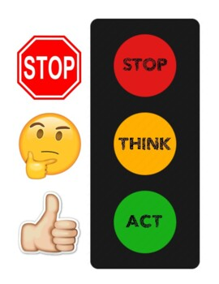
Special Considerations
Patient history
  Co-existing mental health conditions (anxiety, depression, PTSD)
  History of Sexual Assault or abuse
  Gender identity
Patient mobility status
  Most of tests are performed with patient in left lateral position
  Some of tests do require patient to get up and walk to bathroom/commode
Is patient able to follow basic commands?
Patient health literacy level & their understanding of their condition
Remember talking about bowel habits is embarrassing for many

Slide 8
Peristeen Anal Irrigation System

Slide 9
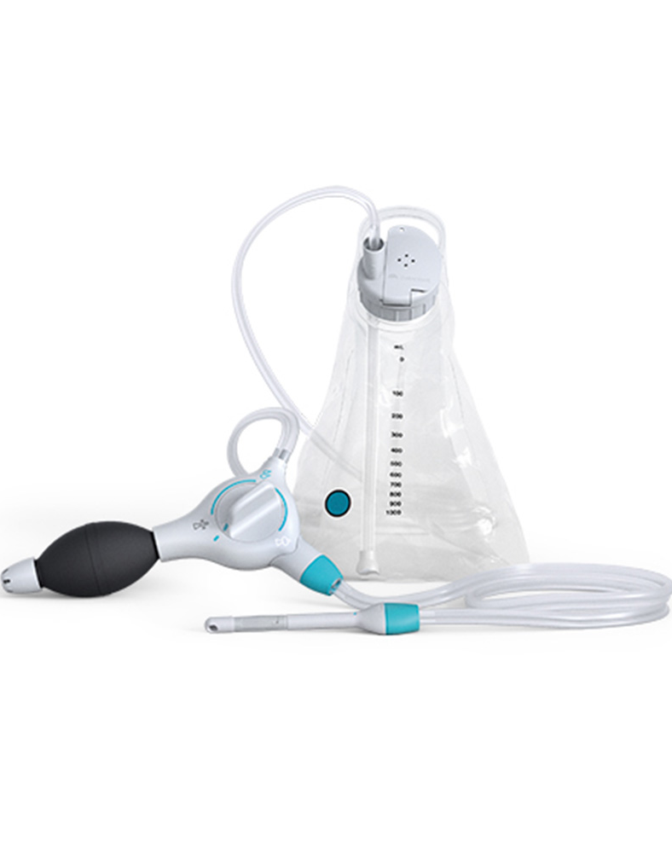
Peristeen Irrigation
An irrigation system that can be used for patients with
  Neurogenic bowel
  Chronic constipation
  Fecal incontinence
  Those with time consuming bowel management procedures
Can be used for adults as well as children ages 2 and up
We see patients for their first time using it. Have patient bring supplies in that was mailed to them and we walk them through using the equipment, help them troubleshoot
Notes:
Source: University of Iowa Health Care Service Record 2018-2019 (new statistics available each Sept/Oct)

Slide 10
Initiating Peristeen Therapy
Pre-training day
  Prior authorization needs to occur and initial shipment of supplies needs sent to patient from supplier
  Patient brings their supplies with them to training day
1 week prior to training
  Ensure patient has received supplies
  Physical exam has taken place
  Bowel preparation program explained to patient
    Ensure provider orders bowel prep and/or stool softeners
    Program helps ensure training day goes smoothly
    Occasionally provider orders KUB as well to check stool burden prior to training

Slide 11
Initiating Peristeen Therapy
3 days prior to training
  Ensure bowel program has been initiated
  Ensure necessary equipment is available for training (i.e. a commode chair, any transfer devices, a lift)
  Make sure patient is hydrating adequately

Slide 12
Peristeen Training Day
Patient comes to our clinic for us to educate them and teach them how to use Peristeen device
Digital rectal exam must be performed prior to starting training to assess for any abnormalities, fecal impaction, or heavy constipation
Check with provider on recommended amount of water they want patient to instill
Go over education videos with patient
Hands on training on toilet

Slide 13
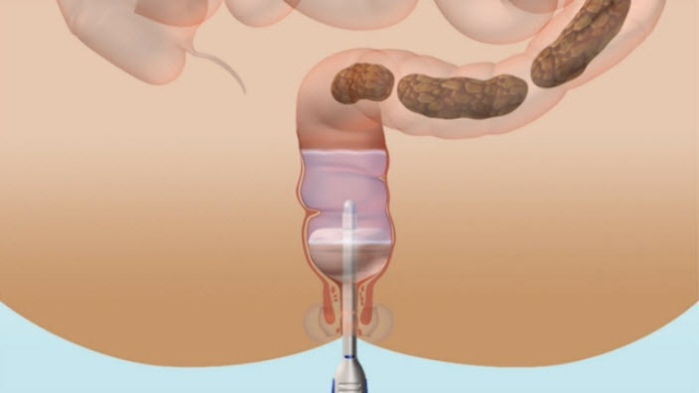
How It Works
The water bag is filled with lukewarm water
Tube is connected to water bag, a balloon catheter is hooked at end of tubing
  Bag has temperature indicator on it that will turn colors to tell patient if water temp is good
Once tubing is primed and catheter is ready, catheter is inserted in rectum
  Only is inserted up until the finger grip on catheter
Balloon on catheter is inflated
Water is then pumped into colon to required amount of water determined by healthcare provider
Once desired amount of water has been instilled, knob on hand pump is turned to deflate balloon

Slide 14
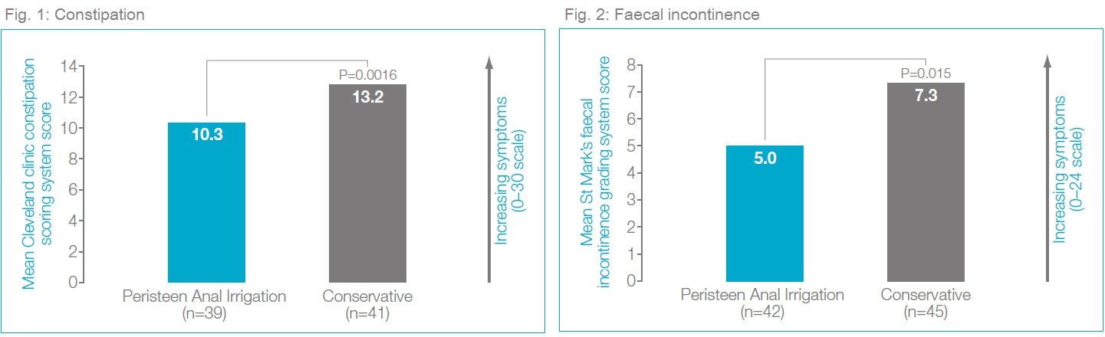
Benefits of Peristeen
Patient’s can decide when and where to empty their bowels-gives predictability
Help prevent constipation and incontinence
Minimize likelihood of involuntary release of stool for up to 2 days
Improve quality of life

Slide 15
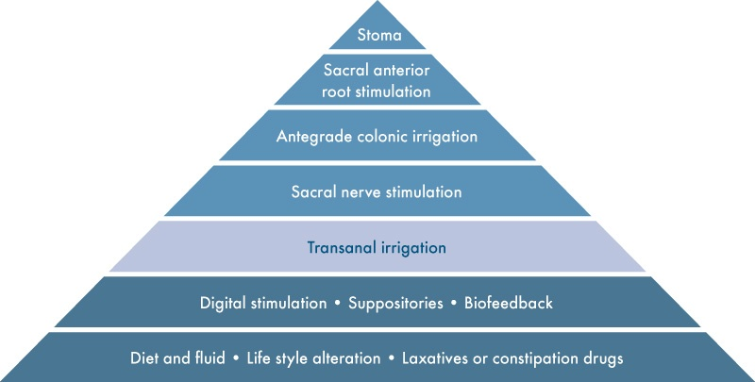
When to Consider Peristeen

Slide 16
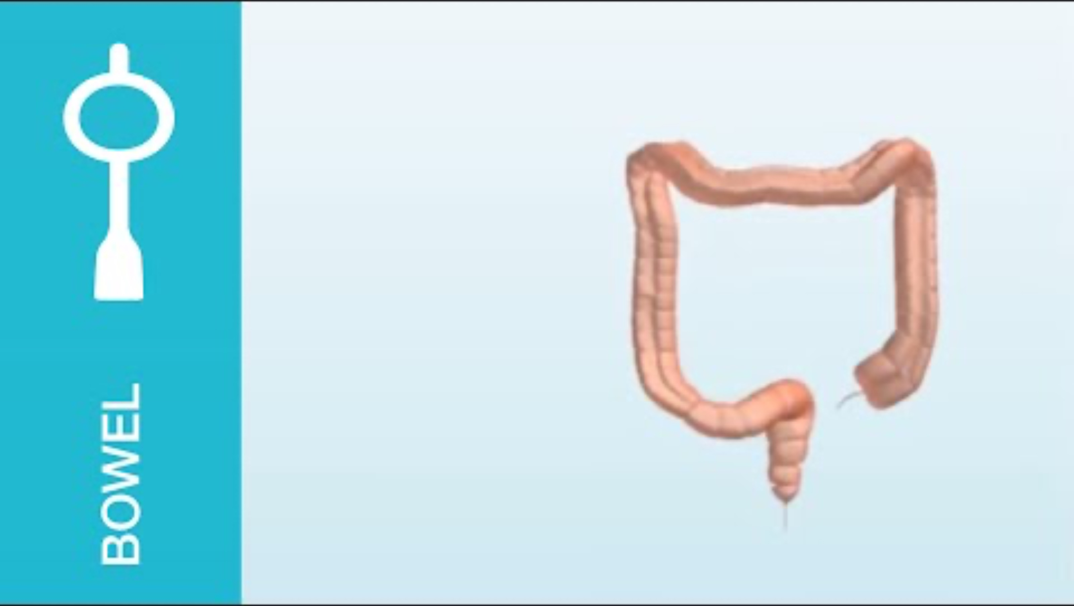
Peristeen Effectiveness

Slide 17
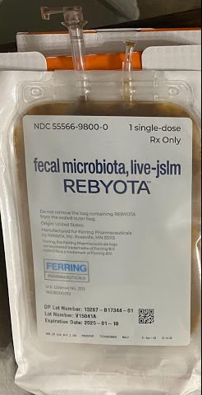
Rebyota
Fecal microbiota rectal suspension

Slide 18
What is Rebyota?
A single dose live biotherapeutic product (LBP) that is used and approved to prevent reoccurrence of Clostridium Difficile infection
  The. FDA designates LBP’s as biological products that contain live organisms that are used to help prevent, treat or cure a disease
The single dose provides trillions of live fecal microbes to restore gut microbiome to a healthy state and prevent Clostridium Difficile
Delivers 15 billion to 7.5 trillion colony forming units of live fecal microbes (CFU) and more than 15 million CFU of essential bacteriodes
Notes:
Source: Carver College of Medicine Office of Research/UI Health Care Annual Report (Updated April 2020)

Slide 19
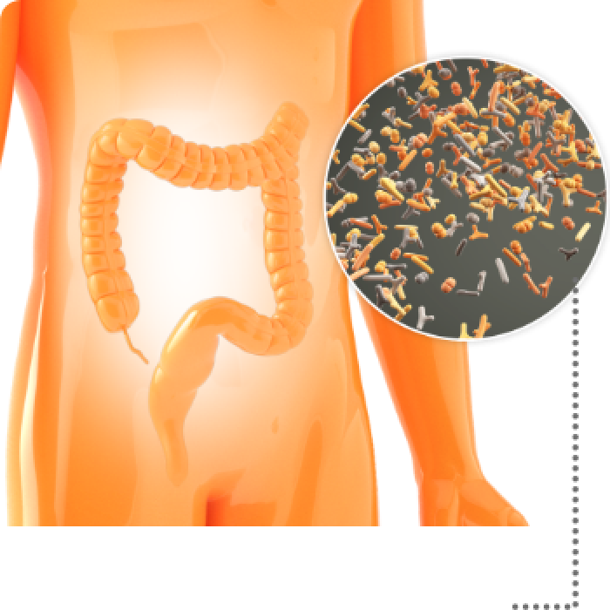
Review of Clostridium Difficile Infection
Occurs when healthy gut microbiome is disrupted resulting in changes in composition of organisms, loss of protective mechanisms, and reduced diversity in microbiome
  C.diff is an opportunistic infection that can occur from this
Approximately half a million cases occur in USA each year with nearly 30,000 cases resulting in death
First line treatment is antibiotics such as vancomycin, flagyl and/or fidaxomicin
Up to 35% of patients that develop C.Diff will experience a reoccurrence in 2-8 weeks
  up to 65% of these patients experience subsequent reoccurrent c. diff episode
Notes:
Source: University of Iowa Health Care Service Record 2018-2019 (new statistics available each Sept/Oct)

Slide 20
You have a patient with recurrent CDI. What’s the next step?

Slide 21


Questions to answer when considering Rebyota
Is patient 18 years of age?
Has patient had Clostridium Difficile Infection(s)?
Is patient pregnant or lactating?
Does patient have severe food allergies?
Is patient actively infected with CDI?
Notes:
Source: University of Iowa Health Care Service Record 2018-2019 (new statistics available each Sept/Oct)

Slide 22

Starting Rebyota
You got referred to our program that is overseen by Dr. Divya Ashat. Once information is approved it is sent to our lower motility team
Lower motility teams responsibilities
  Prepping patient
  Alerting Pharmacy
  Administering Product

Slide 23
Preparation for Rebyota
Outpatient Rebyota currently performed on Wednesdays
No bowel preparation is needed. Patient can eat, drink, and take normal medications
Can’t have active CDI disease
Pre-call is first done on the prior Friday to confirm patient is aware of appointment, is still taking antibiotics, and knows when to stop antibiotics
Antibiotic course
    Must be on antibiotics leading up to appointment
    Patient to stop antibiotics 24-72 hours before administration. This period is the washout period that must occur before administration
    We currently recommend taking last antibiotic dose on Sunday prior to Wednesday appointment
2 days prior (Monday) call is made to:
  Patient confirming appointment/any last-minute questions
  Pharmacy stating to bring product to unit storage fridge

Slide 24
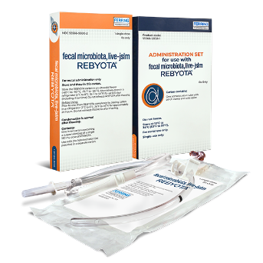
Rebyota Product
Rebyota is stored in pharmacy in deep freeze
Once ready to be used is moved to refrigerator to be thawed
Can sit in Refrigerator up to 5 days
Takes 24 hours to de-thaw in fridge
  Product cannot be warmed or put in warm water to thaw like traditional FMT product
Product can only be out of fridge for 5 minutes

Slide 25
Rebyota Administration
Have patient empty bowel and bladder
Remove product from fridge
Prime product through administration set
Have patient lie in left side position or knee-chest position
Apply lubricant to administration tube tip and insert into rectum 12cm (up to black line on tube)
Hold tube in one hand, other hand holds product bag up
  Determine speed of instillation by how patient is feeling (hold higher to speed up, lower to slow down)
Once bag is empty, dispose of product
Encourage patient to hold stool in up to 15 minutes
  Doing so helps minimize cramping
  If patient cannot hold 15 minutes, it’s okay
    Does not impact efficacy of product

Slide 26
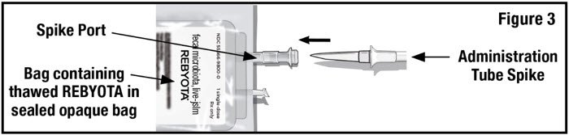
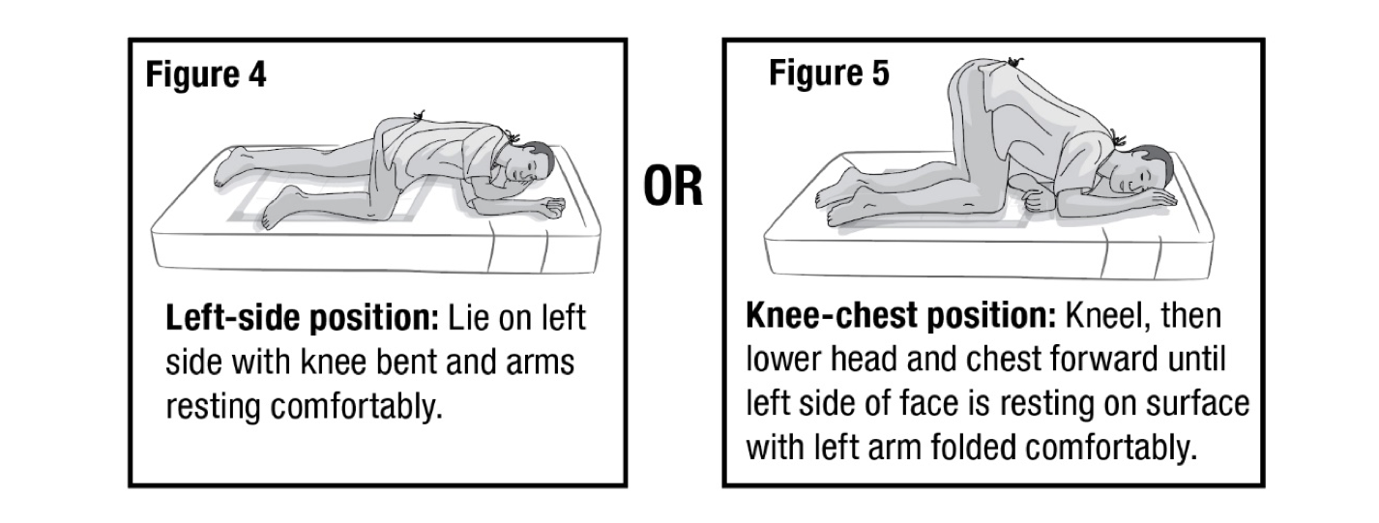

Slide 27
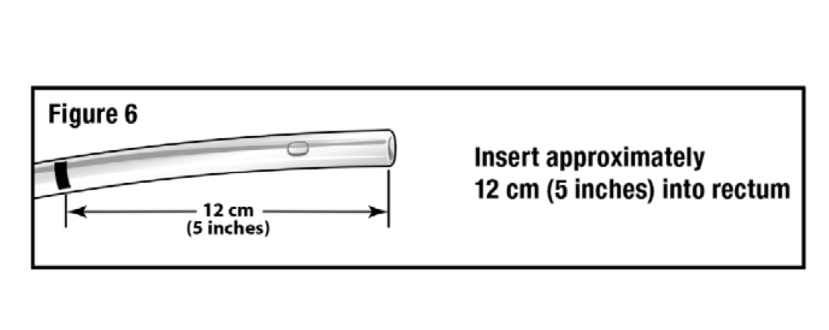
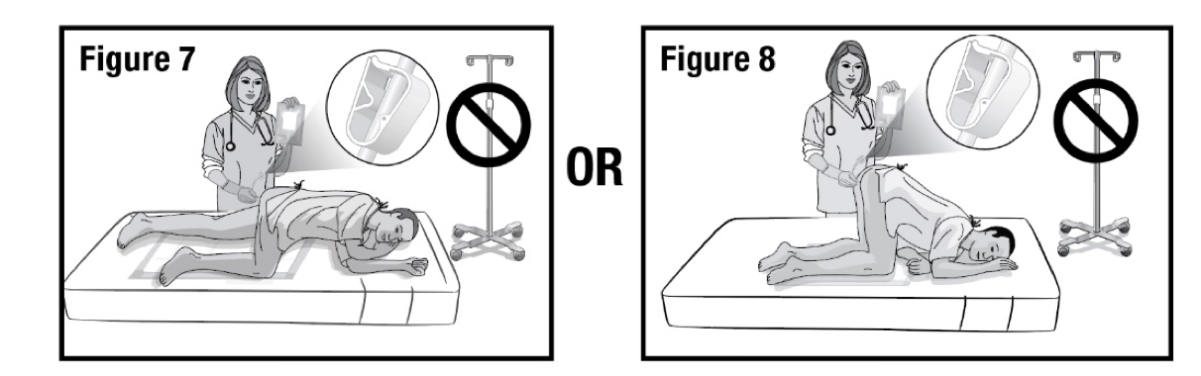

Slide 28
Post Administration Education
Educate patient on following items
  Mild to moderate side effects are seen in less than 10% of patients. These include stomach pain, gas, diarrhea, upset stomach, and bloating. Side effects happen most often during the first 2 weeks after treatment
  Rebyota may have food allergens. Contact us right away if you think you are having an allergic reaction or any infection
  Contact your referring provider if:
    If you have diarrhea 3 or more times in a day for 2 days in a row
    Before taking antibiotics for any reason for 8 weeks after treatment

Slide 29
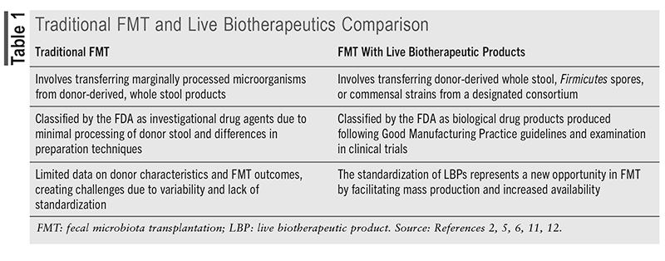
Rebyota vs Standard FMT
Rebyota allows patients to not have to go through any bowel prep and doesn’t require a scope to be done making it much easier on the patients

Slide 30

Rebyota Success

Slide 31
Pelvic Floor Anatomy & Normal Defecation Process

Slide 32
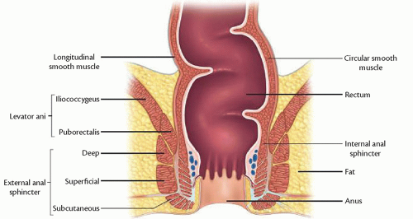

Slide 33
Function of Pelvic Muscles
External Anal Sphincter
  Controlled by the Somatic Nervous system
  Voluntary Control
  Critical in preventing passive loss of stool
Internal Anal Sphincter
  Controlled by the Autonomic Nervous System
  Involuntary Control
  Primarily responsible for resting tone of the anus

Slide 34
Normal Defecation Process
Rectal filling starts to occur
Internal Anal Sphincter relaxes in response to rapid distention (also known as recto anal inhibitory reflex, or RAIR)
  While that is occurring, pressure in external anal sphincter increases (contracts) and sampling reflex occurs (allows anal canal to distinguish stool from gas)
    If this did not occur with EAS, this would allow passive stool loss
Once one is able to go to bathroom
  Rise in intraabdominal pressure occurs resulting in relaxation of pelvic floor (particularly external anal sphincter)
  Stool evacuates
  Stool passing through causes traction in anal verge. Once traction is released, causes closing reflex to occur in external anal sphincter

Slide 35
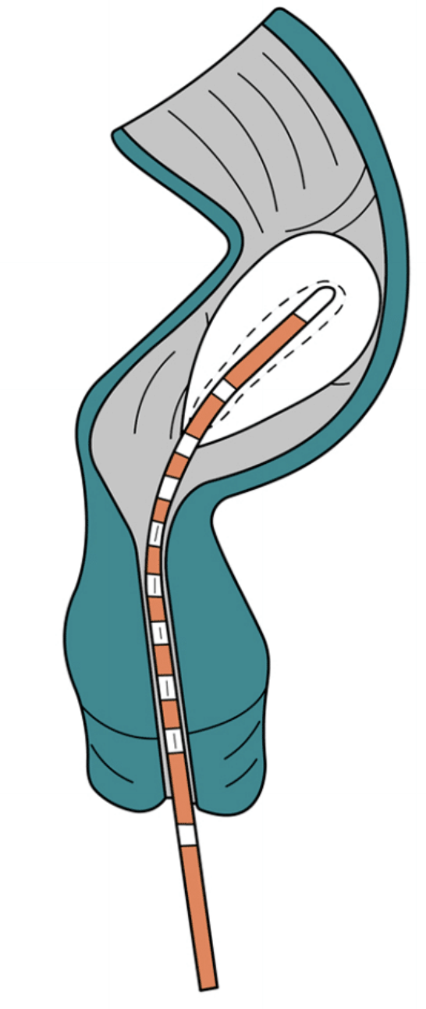
ARM diagnostic test
Anorectal Manometry

Slide 36
What is Anorectal Manometry?
It is a test used to assess the integrity of the anorectal complex, which is made up of the internal anal sphincter (IAS), the external anal sphincter (EAS), and puborectalis muscle (PRM)
It is used to detect disorders such as pelvic floor dyssynergia, rectal hypersensitivity/hyposensitivity,
Reasons we test patients
  Incomplete evacuation
  constipation,
  Incontinence
  Rectal pain
  Hirschsprung disease
  Pre-op testing for reversal of Colostomy
  Ongoing problems with bowel movements

Slide 37
Preparing for ARM
If patient has not had a bowel movement within 6 hours of ARM or does not feel empty, patient advised to do 1 fleets enema (tap water if kidney problems) before ARM appointments
Patient can take medications and eat/drink like normal.
No driver needed- patient will be awake for procedure
If patient has a lot of anxiety, it is okay for them to take their prescribed anxiety medication beforehand-will not affect the test
Procedure takes roughly 35-40 minutes to complete

Slide 38
Pre-ARM setup
Make sure probe has had in-vivo calibration performed within 7 days
  This is to ensure that probe is getting calibrated so it gets accurate measurements during test
Check patient’s diagnosis for test
  Constipation/incomplete evacuation or incontinence
Prepare room and probe
  Supplies needed
    Gauze
    ARM balloon
    Dental floss, unwaxed
    50cc syringe
    Extension tubing
    Expulsion ballon
    Lubrication (if needed for patient comfort/pain, 2% lidocaine jelly can be used)
Once balloon is on probe, test to ensure no air leaks

Slide 39
ARM Procedure Process
Introduction and education to patient
  Majority of our outside referrals have not gotten education on what the procedure is we are doing, what it tests for, what to expect during test, and what to expect after test
  Explanation of what tasks will be done during test explained
Have patient change into gown and lay on left side
Digital rectal exam performed
  Is there hard stool present? Any abnormalities?
    If yes, perform enema
  Have patient demonstrate a squeeze and push during DRE- is patient able to understand what it means to squeeze and push? Also, great way to get an idea of patient’s sphincter strength pre-test

Slide 40
Probe Placement
Insert probe into rectum
Check that probe is lined up with sphincter
  If patient has incontinence or low sphincter strength, to verify placement you may have to have patient squeeze to check that probe is aligned correctly
Once probe is placed in right spot, dry off skin and put tegaderms on to hold probe in place
Next press start to begin test recording
Have patient lay still on left side for 3 minutes- once 3 minutes is up, press start to record the 60 second resting pressure (this is to capture what the sphincter does at baseline)

Slide 41
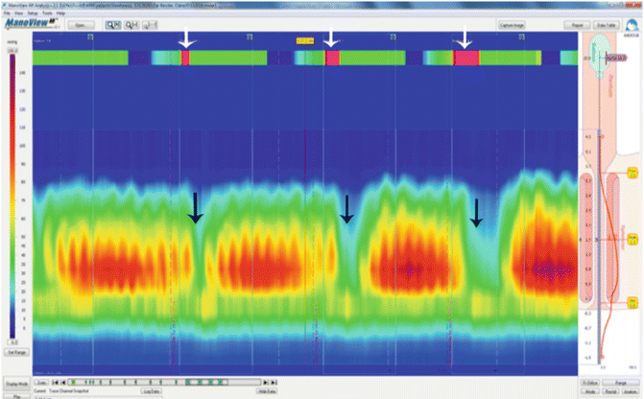
Probe Placement verification
Want to make sure you have a curve like this (or can obtain this curve when asking patient to squeeze)

Slide 42
ARM Procedure
First exercise is Squeeze exercise
  Have patient squeeze x2 for 5 seconds each (with 30 seconds rest between each squeeze to allow muscles to go back to baseline)
  1 squeeze for 30 seconds
  This exercise will give us “anal squeeze pressure”
Second exercise is Coughing
  Have patient do a single cough x 2, with 30 second pause between each cough
  This will test Cough reflex
    When coughing is performed, should lead to contraction of sphincter
    In other words you want pelvic floor to tighten up when you cough so nothing slips out (urine or stool)

Slide 43
ARM Procedure
Third Exercise is Pushing/bearing down
  Have patient push/bear down like having a bowel movement
  3 pushes 15 seconds in length, with 30 second pauses between each push
  This gives us our Recto-anal pressure gradient (RAPG)
  With RAPG we want to see that with increase in intra-abominal pressure from pushing, that the anal sphincter will relax
Next we test for RAIR
  RAIR= Recto-anal inhibitory reflex
  This is reflex that occurs in the body when rapid distention occurs in rectum leading to relaxation of the IAS
  This is tested by nurse rapidly pushing with 30cc of air at first and if no relaxation occurs, an additional 20cc can be pushed to total 50
  Positive RAIR will result in relaxation which can be noted by color lightening up
  For this part of the test we typically tell patients that we are testing to see how their muscles react to us putting a little bit of air in balloon and that they may feel the balloon blowing up and may not

Slide 44
ARM Procedure
Once RAIR testing is done, we move into sensation testing
  We test for 3 sensations: Initial desire to defecate, urgency, and maximum tolerated sensation
  Patients are told a scenario to imagine they are out shopping at store
    First sensation= they could finish shopping and wait until they got home to go to bathroom
    Urgency= they could finish their shopping at store but will need to use bathroom at store before they go home
    Maximum tolerated= they need to put their cart down and get straight to bathroom
    Sometimes patients don’t reach all sensations, can skip over some, that’s okay
    Balloon can go up to 400cc
    This part of test shows us rectal compliance and rectal sensation
      Hypersensitivity
      Hyposensitivity
Once sensation test is done, that is the end of the testing with the manometry probe

Slide 45
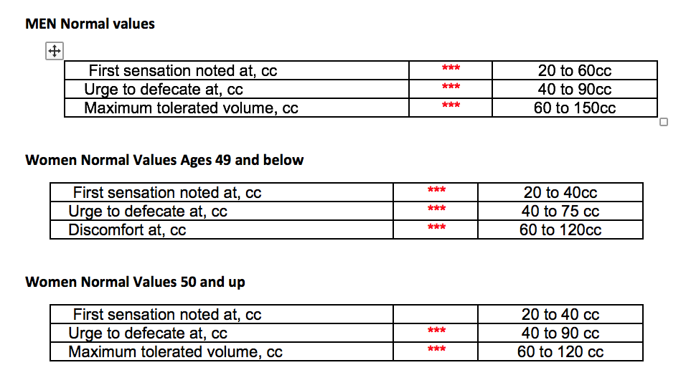
Sensation Values by Age & Gender

Slide 46
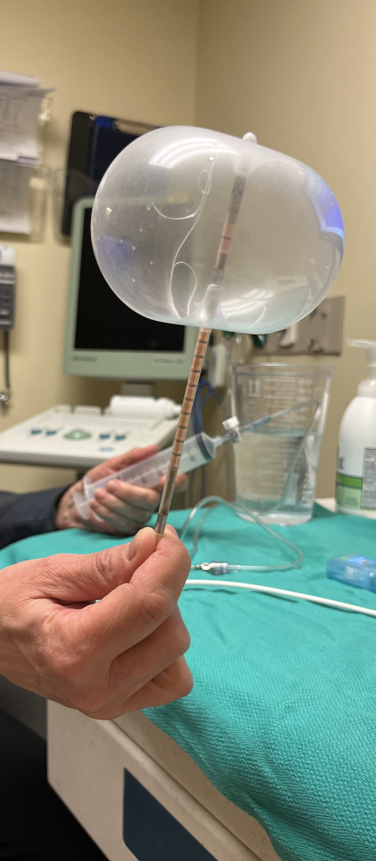

This is what 400cc looks like with the manometry balloon.
It compares to the size of a tomato
Patient’s do get up to this volume and don’t feel the urgency sensation.

Slide 47
ARM Procedure
Once the manometry probe testing is done, we move into our final step with the balloon expulsion test
  this probe is inserted up to a certain distance (there are markings on the tube)
  50ml of room temperature water is instilled in balloon
  Patient is brought in bathroom and given a timer. Patient is instructed to try and push the probe out like it’s a bowel movement. they are allotted 5 minutes to push probe out
  Balloon expulsion test has a 87% sensitivity, and a specificity of 89%
    Sensitivity refers to a tests ability to correctly identify individuals who have a specific condition
    Specificity refers to a tests ability to correctly identify individuals who don’t have a particular disease or condition
    In other words, the test is very reliable
Once balloon expulsion is done, the test is done.
Patients can have some mild bleeding from probes, otherwise no side effects
Typically give up to 14 days for test to be read

Slide 48
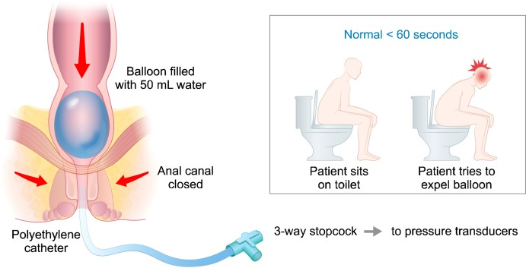
Balloon Expulsion Test

Slide 49
Post ARM- What Happens Next?
Medication recommendations for constipation/ incontinence or recommend further testing
No pelvic floor dyssynergia or hyposensitivity/hypersensitivity
Pelvic floor dyssynergia, hyposensitivity or hypersensitivity noted
Anal Biofeedback training and/or Pelvic Floor Physical Therapy

Slide 50
Pelvic Floor Dyssynergia
It is an inappropriate contraction or failed relaxation of the pelvic floor muscles- particularly external anal sphincter
  Rectal distention occurs, stool starts to move down the anal canal, external anal sphincter fails to relax not allowing stool to pass or only allowing small amounts leading to incomplete evacuation
It is the leading cause for 40-50% of patients with constipation
Typically affects more women than men
Can in turn also affect the bladder in some patients
Can occur from learned behavioral habits, straining, pregnancy, pelvic trauma, or physiological factors

Slide 51
Fecal Incontinence
Can result from dysfunction of the internal and/or external anal sphincters
Certain factors can cause this including vaginal delivery, sphincter surgeries, inflammatory bowel disease, nerve damage, radiation therapy, anatomical issues (prolapse or rectocele), dietary factors
Common to have both fecal and urinary incontinence simultaneously
Often affects women more than men

Slide 52

Anal Biofeedback
Where We Train You How To Actually Poop

Slide 53
What is Anal Biofeedback?
It is a form of bowel retraining used to improve and restore normal bowel function
Performed with use of probe that detects pressures in anorectal complex
  Patients are able to see feedback on screen from probe giving them feedback on whether they are relaxing muscles appropriately or contracting them appropriately
  Patients get verbal feedback from us at the same time
  Probe also has balloon on end that is used to test sensation and recondition rectal sensation that is hyposensitive or hypersensitive
Used to treat a number of bowel conditions such as
  Pelvic floor dyssynergia
  Constipation
  Incontinence/Seepage
  To improve rectal sensation
Often can be ordered in conjunction with pelvic floor physical therapy
  Biofeedback alone is not as effective as it is when combined with Pelvic floor PT

Slide 54
Overview of UIHC Biofeedback Program
3 different tracks of the program
  Constipation
  Fecal Incontinence
  Constipation and Fecal Incontinence
Patients are asked to schedule 6 appointments, minimum of 2 weeks between each session
  Session 1 = information overload with a trial of trying exercises with the monitor
  Sessions 2-6= check in how patient is doing & answer questions or concerns. Main focus on exercises
  Sessions slotted for 90 minutes
Prep call and letter for each session
  Prep is same as ARM; no prep needed. Enema recommended if patient does not feel empty or hasn’t had bowel movement recently

Slide 55
1st time Biofeedback Session
Constipation
Fecal Incontinence
Constipation & Fecal Incontinence

Slide 56
First time Biofeedback: Constipation
Education
Sensation Testing
Bearing Down Exercises

Slide 57
Biofeedback Education for Constipation
Anatomy Review for Dyssynergia Defecation
Folder with Education provided
  Baseline survey
  Constipation Questionnaire
  Stool Diary
  Goals of program
  Abdominal Breathing
  How to Have a Bowel Movement
Verbal recall of patient’s bowel movements for last week
  Medications taking for bowel movements
  Straining score
  # of stools
  Average Bristol Stool Scale
  Feel Empty?
  Use of Fingers?

Slide 58
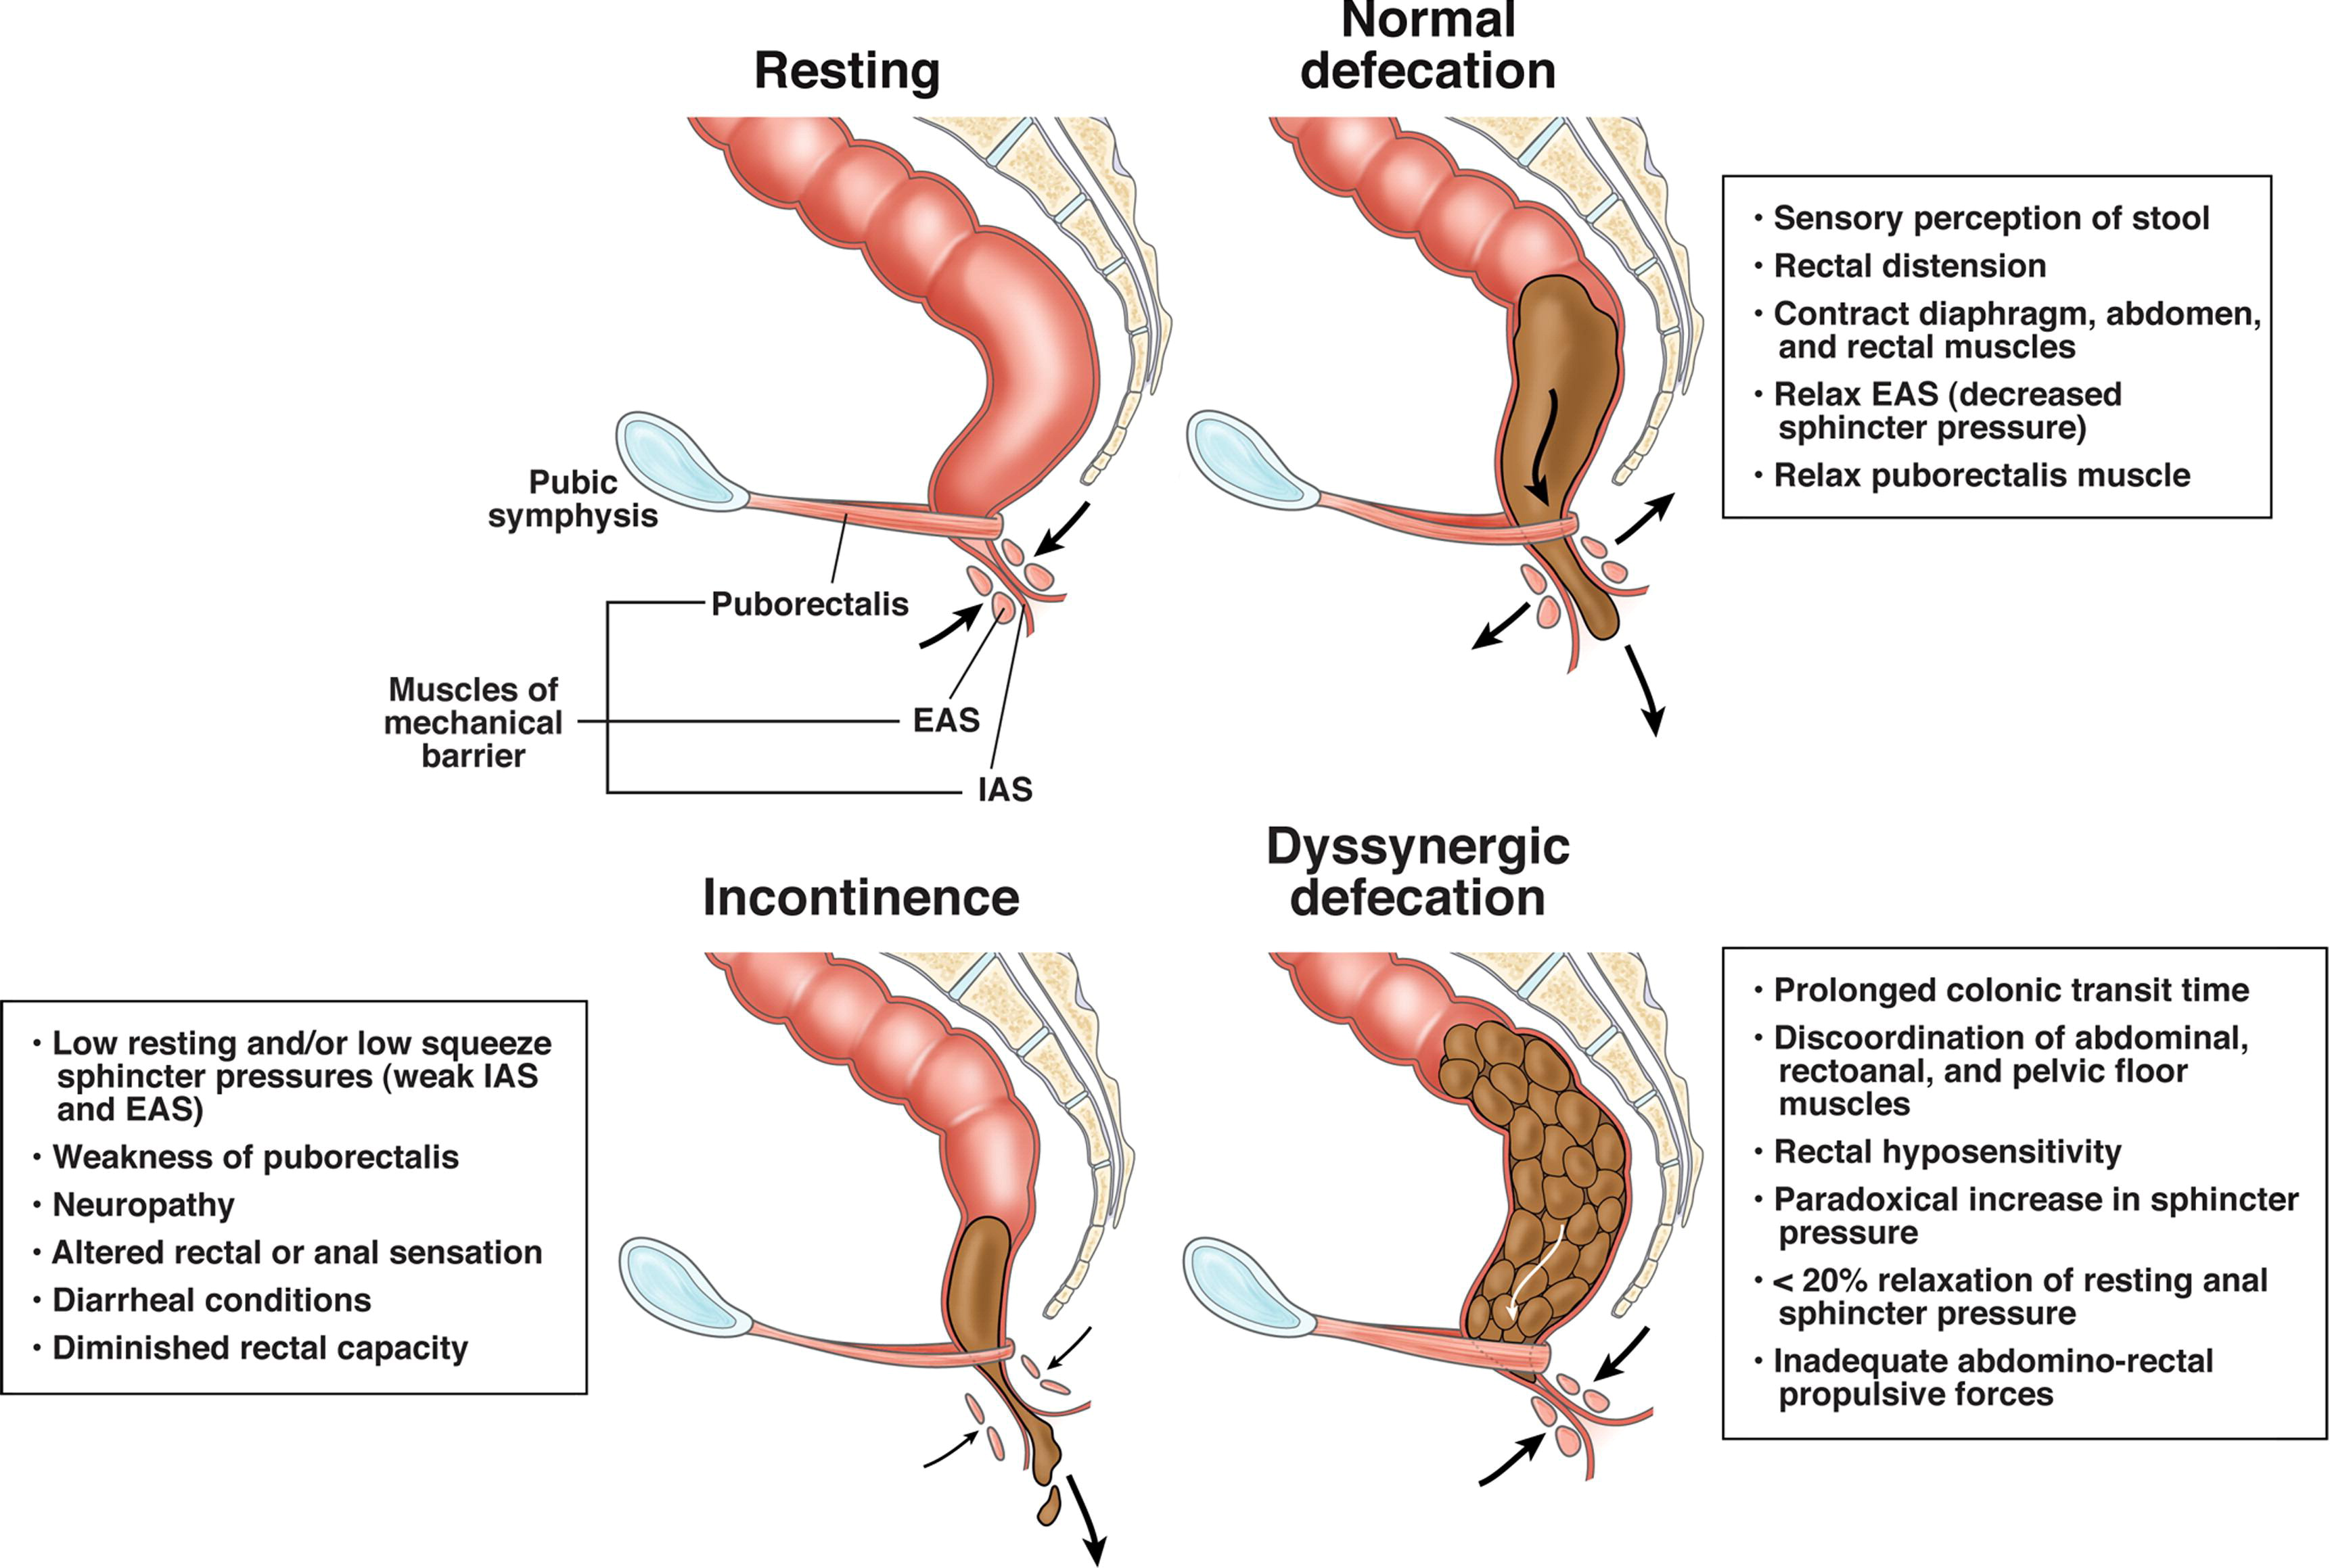
Biofeedback Education for Constipation

Slide 59
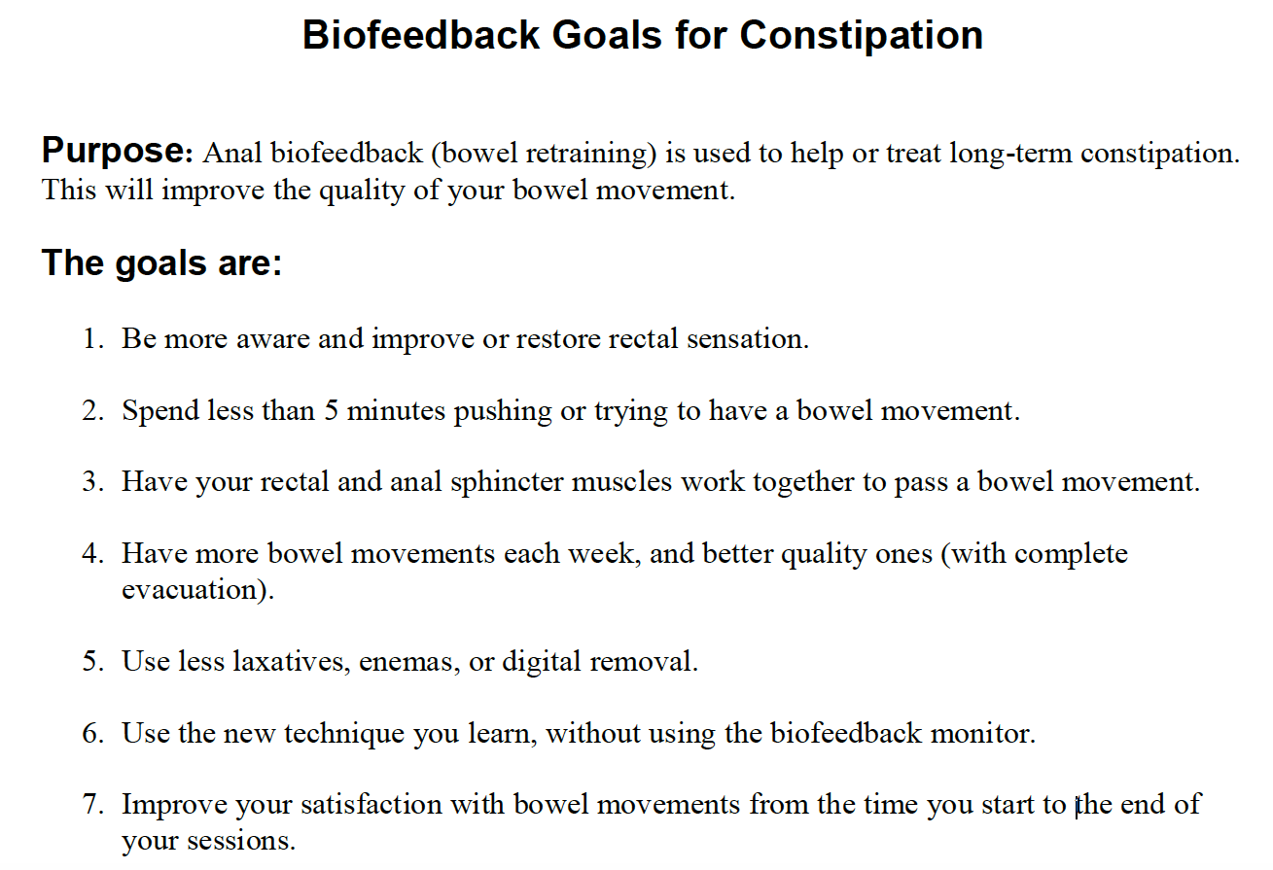
Biofeedback Goals- Constipation

Slide 60
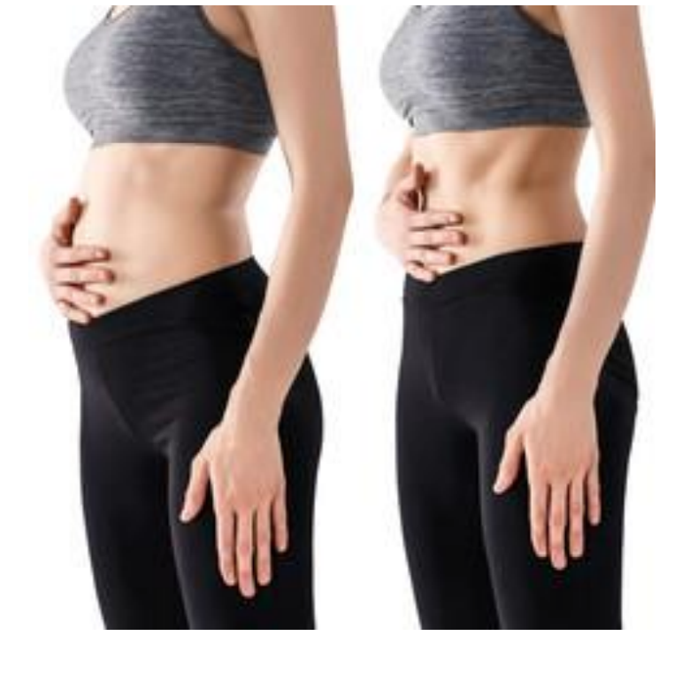
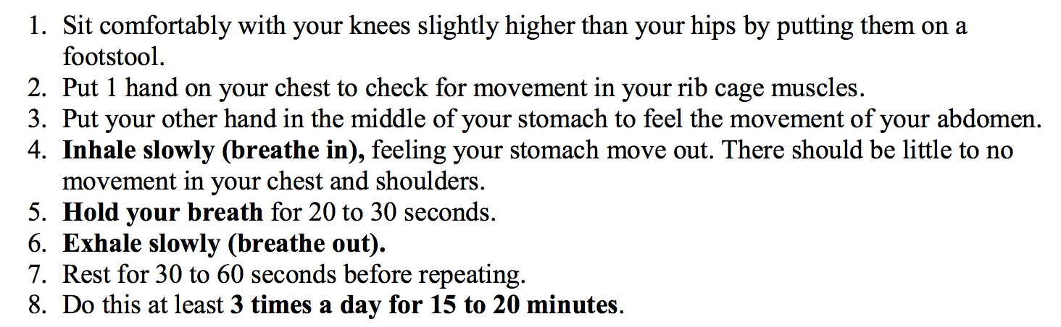
Abdominal Breathing
Abdominal breathing helps improve coordination between the abdominal muscles, anal muscles, and breathing.
Helps patient’s to have easier, more complete bowel movements

Slide 61
How to Have Bowel Movement
Abdominal Breathing to be used when going to bathroom
The Process
  Choose lowest toilet possible
  Feet should be shoulder width apart and flat on stools
    Squatty potty/stools to raise legs up
  Slowly inhale
  Hold Breath
  Keep your Abdomen Firm
  Relax your legs
  Lean Forward
  Push (bear down) at medium effort
  Keep holding your breathing while pushing for 20-30 seconds
Other tips
  Don’t ignore an urge to have a bowel movement
  Use technique every time you go to bathroom
  Don’t spend more than 5 minutes trying to have a bowel movement
  Try to have bowel movement 30 minutes after eating

Slide 62
Sensation Testing- Constipation
Have patient lay on left side, turned way from computer screen
Provide DRE
Probe placed to depth of 2, secured with tegaderm
Explain 3 sensations testing for with the shopping scenario from ARM test
    First sensation= they could finish shopping and wait until they got home to go to bathroom
    Urgency= they could finish their shopping at store but will need to use bathroom at store before they go home
    Maximum tolerated= they need to put their cart down and get straight to bathroom
Steadily inflate balloon, documenting at each point patient feels each sensation
Biofeedback balloon can only go to 180 cc
Assess sensation numbers to chart for respective gender and age

Slide 63
Sensation Testing- Constipation
Sensation Normal?
Proceed to bearing down exercises
Sensation Abnormal?
Hyposensitive?
Recondition. Inflate balloon fast, trying to spark sensation/get patient to feel sensation sooner
Sensation Abnormal?
Hypersensitive?
Recondition. Inflate balloon slow, trying to get patient to tolerate higher pressure

Slide 64
Bearing Down Exercises
Bearing Down- 10cc of Air
Bearing Down- 60cc of Air
Sit patient on commode with stools/squatty potty
10cc of air instilled in balloon
Educate patient about the monitor and what they are seeing
  Rectal pressure vs. anal pressure
Teach back method with Abdominal breathing
Walk through “How to Have a Bowel Movement”
Perform bearing down exercises using abdominal breathing technique
  Have patient do 7-10 bearing down movements
60cc of air instilled in balloon
Perform bearing down exercises using abdominal breathing technique
  Have patient do 3 bearing down movements
Educate patient how some do better with air, some do better without

Slide 65
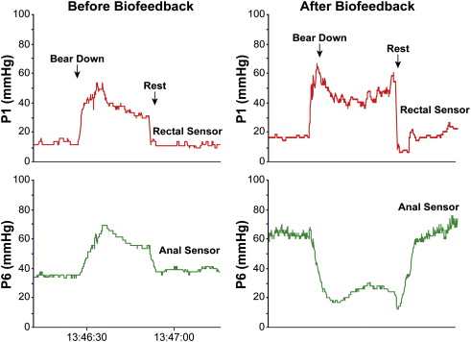
Bearing Down Exercises

Slide 66
First Time Biofeedback: Incontinence
Education
Sensation Testing
Strength Exercises

Slide 67
Biofeedback Education for Incontinence
Anatomy Review for Incontinence
Folder with Education provided
  Baseline survey
  Clinical Grading for Incontinence
  Stool Diary
  Goals of program
  Squeeze Exercise
Verbal recall of patient’s bowel movements for last week
  Medications taking
  Accidents? (mild, moderate, excessive)
  Bristol stool scale
  Leakage?
  Urgency (able to hold bowel movement for more than 15 mins)?
  Use of pads?

Slide 68
Biofeedback Education for Incontinence

Slide 69
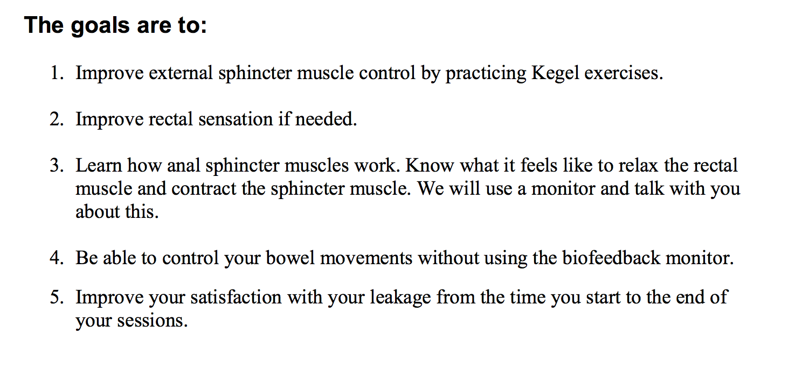
Biofeedback Goals- Incontinence

Slide 70
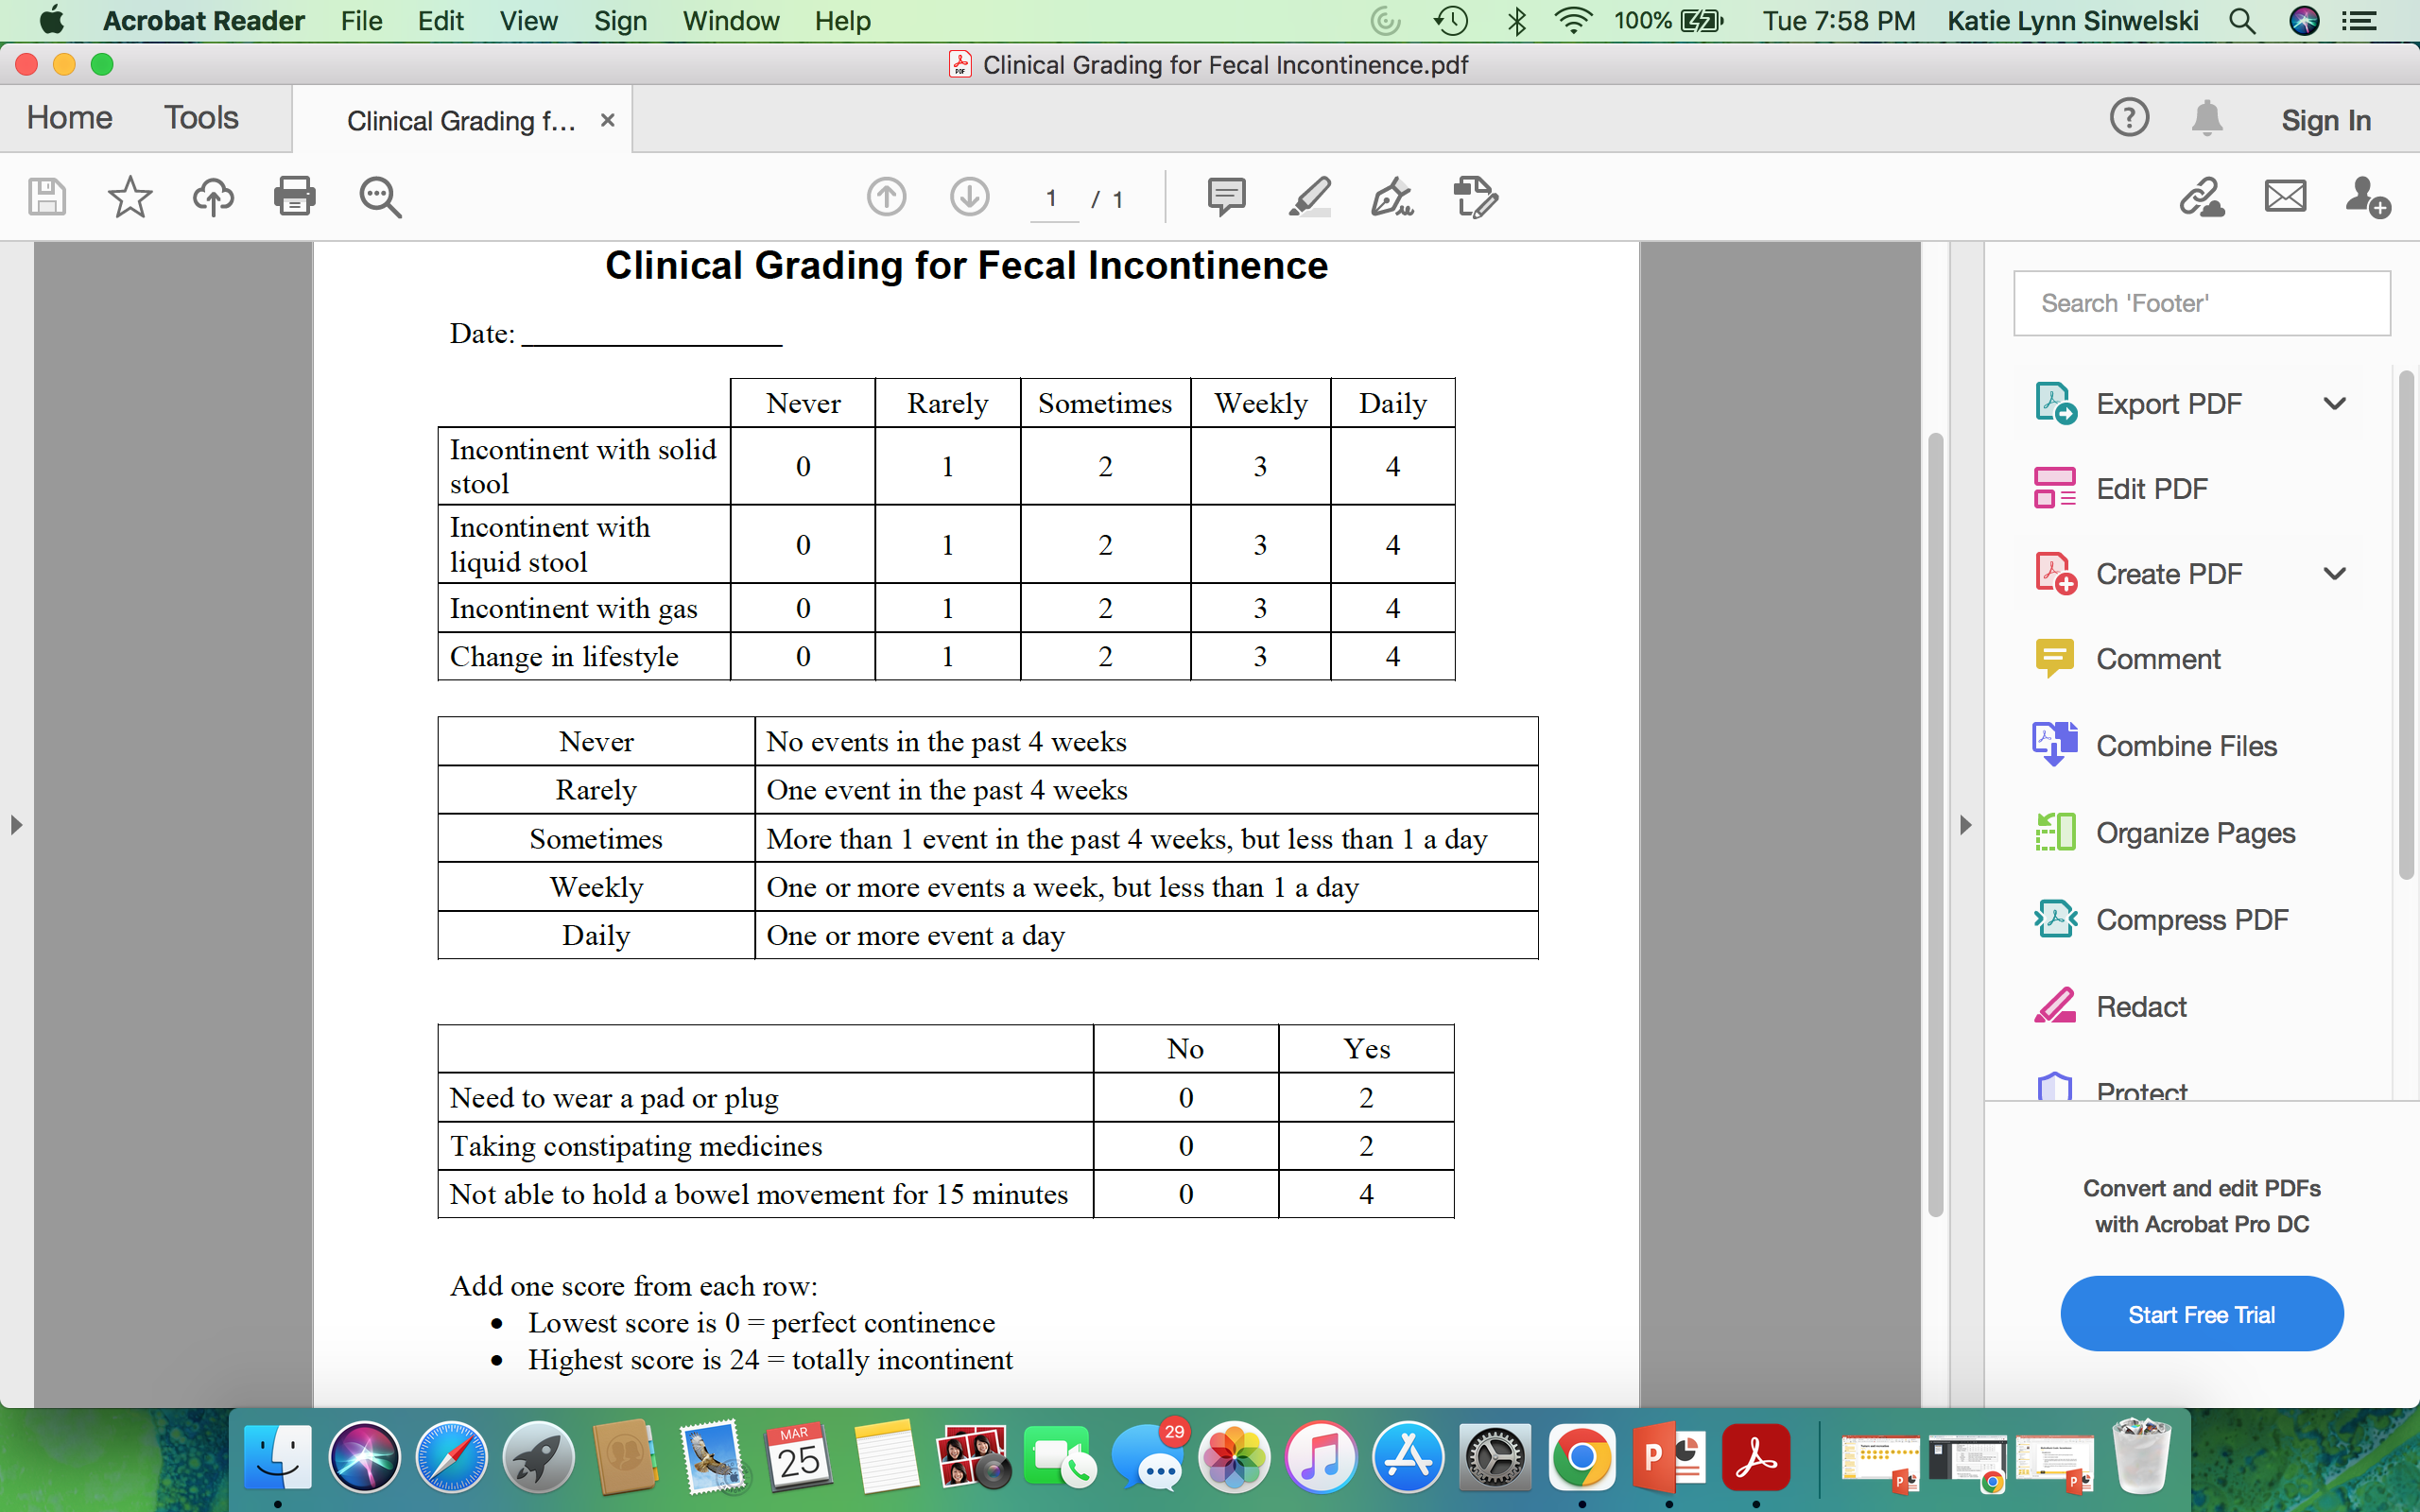
Fecal Incontinence Grading Scale

Slide 71
Fecal Incontinence Grading Scale

Slide 72
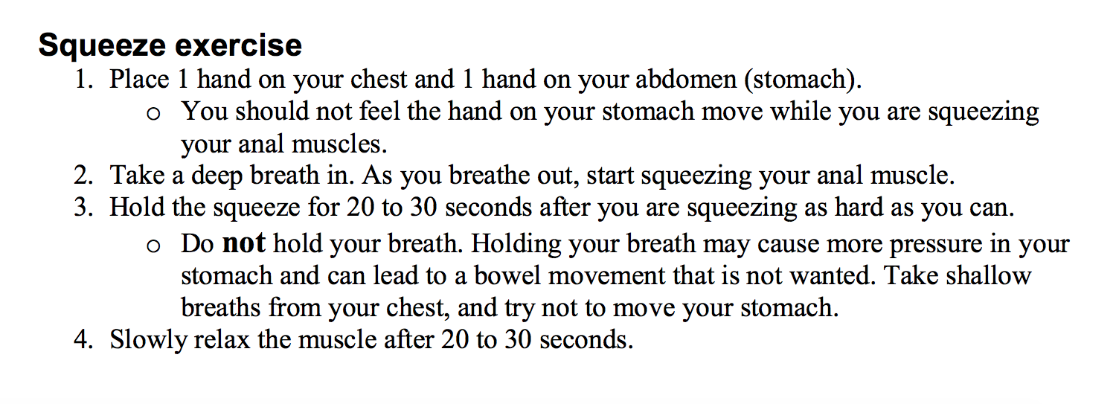
Squeeze Exercises for Fecal Incontinence
Recommend choosing quiet place to be alone for 20 minutes.
Can do exercises sitting, standing or lying down
Do exercises 3 times a day for 15-20 minutes, 20 squeezes each time, resting 30-60 seconds between each squeeze
Do these exercises for rest of life- will keep muscles strong. Muscles could become weak if you stop

Slide 73
Sensation Testing- Incontinence
Have patient lay on left side, turned way from computer screen
Provide DRE
Probe placed to depth of 2, secured with tegaderm
Explain 3 sensations testing for with the shopping scenario from ARM test
    First sensation= they could finish shopping and wait until they got home to go to bathroom
    Urgency= they could finish their shopping at store but will need to use bathroom at store before they go home
    Maximum tolerated= they need to put their cart down and get straight to bathroom
Steadily inflate balloon, documenting at each point patient feels each sensation
Biofeedback balloon can only go to 180 cc
Assess sensation numbers to chart for respective gender and age

Slide 74
Sensation Testing- Incontinence
Sensation Normal?
Proceed to bearing down exercises
Sensation Abnormal?
Hyposensitive?
Recondition. Inflate balloon fast, trying to spark sensation/get patient to feel sensation sooner
Sensation Abnormal?
Hypersensitive?
Recondition. Inflate balloon slow, trying to get patient to tolerate higher pressure

Slide 75
Strength Exercises
Strength Exercises- 10cc of Air
Strength Exercises- 60cc of Air
Keep patient on bed, laying on left side. Move bed to spot where patient can view screen
10cc of air instilled in balloon
Educate patient about the monitor and what they are seeing
  Rectal pressure vs. anal pressure
Teach back method with breathing
Perform squeeze exercise, holding squeeze for 20-30 seconds
  Have patient do 10 squeeze exercises
60cc of air instilled in balloon
Perform squeeze exercise, holding squeeze for 20-30 seconds
  Have patient do 3 squeezes
Educate patient how some do better with air, some do better without

Slide 76
Final Take Aways
Biofeedback program is only as successful as one makes it
Sometimes this is not the only answer to the problem at hand
  This can be one piece to a bigger puzzle
Get to Know your Patient’s
  Treat them like an individual vs. just another patient
Make it a goal to make something “uncomfortable” comfortable
Rebyota is the current FDA approved treatment for recurrent clostridium difficile infection
Easier on the patient
More widely available than standard FMT
Can be administered by any healthcare professional
Anorectal Manometry is the tool used to diagnose conditions such as pelvic floor dyssynergia
Peristeen Irrigation is a system you can use to help those with conditions such as neurogenic bowel to establish a bowel routine that helps them become regular

Slide 77
References
Bajwa, A., Fellow, R., & Emmanuel, A. (2009). The physiology of continence and evacuation. Best Practice & Research Clinical Gastroenterology, 23(4), 477–485. https://doi.org/10.1016/j.bpg.2009.06.002
Fazio, V. W., Church, J. M., & Delaney, C. P. (2005). Current Therapy in Colon and Rectal Surgery. Mosby.
Ferring Pharmaceuticals Inc. . (2025, February 20). Rebyota® (fecal microbiota, live-jslm) for recurrent C. diff infection: HCP. Rebyota. https://www.rebyotahcp.com/
GadEl Hak, N., El-Hemaly, M., Hamdy, E., El-Raouf, A. A., Atef, E., Salah, T., El-Hanafy, E., Sultan, A., Haleem, M., & Hamed, H. (2011). Pelvic floor dyssynergia: Efficacy of biofeedback training. Arab Journal of Gastroenterology, 12(1), 15–19. https://doi.org/10.1016/j.ajg.2011.01.001

Slide 78
References
Gala, T., Johnston, L., Solanki, D., Grossi, U., Schizas, A., Hainsworth, A., & Ferrari, L. (2024). Anorectal manometry — How to perform and interpret manometry. Continence, 10, 101214. https://doi.org/10.1016/j.cont.2024.101214
Garcia, M., Castex, J., Duhaime, E., & Monk, M. (2024). Fecal microbiota, live-jslm (RBL; RebyotaTM) for recurrent clostridioides difficile infection. The Journal for Nurse Practitioners, 20(10), 105195. https://doi.org/10.1016/j.nurpra.2024.105195
Ladi-Seyedian, S.-S., Sharifi-Rad, L., Nabavizadeh, B., & Kajbafzadeh, A.-M. (2019). Traditional Biofeedback vs. Pelvic Floor Physical Therapy—Is One Clearly Superior? Current Urology Reports, 20(7). https://doi.org/10.1007/s11934-019-0901-9
Lee, B. E., & Kim, G. H. (2014). How to Perform and Interpret Balloon Expulsion Test. Journal of Neurogastroenterology and Motility, 20(3), 407–409. https://doi.org/10.5056/jnm14068

Slide 79
References
Moore, K. (2024, November 15). Exploring Live Biotherapeutics for Recurrent Clostridioides difficile. Uspharmacist.com. https://www.uspharmacist.com/article/exploring-live-biotherapeutics-for-recurrent-clostridioides-difficile
Quigley, E. M. M. (2013). Disorders of the pelvic floor and anal sphincters; a gastroenterologist’s perspective. Revista Médica Clínica Las Condes, 24(2), 293–298. https://doi.org/10.1016/s0716-8640(13)70161-5
Rao, S. S. C. (2010). Advances in Diagnostic Assessment of Fecal Incontinence and Dyssynergic Defecation. Clinical Gastroenterology and Hepatology, 8(11), 910-919.e2. https://doi.org/10.1016/j.cgh.2010.06.004
Rao, S. S. C., Valestin, J., Brown, C. K., Zimmerman, B., & Schulze, K. (2010). Long-Term Efficacy of Biofeedback Therapy for Dyssynergic Defecation: Randomized Controlled Trial. The American Journal of Gastroenterology, 105(4), 890–896. https://doi.org/10.1038/ajg.2010.53

Slide 80
References
Rebyota. (2025, January 20). Why REBYOTA? | REBYOTA® (fecal microbiota, live-jslm). Rebyota. https://www.rebyotahcp.com/why-rebyota/
Wellspect HealthCare. (2025). Treatment options for neurogenic bowel dysfunction. Wellspect.com. https://blog.wellspect.com/neurogenic-bowel

Slide 81
Questions?
Katie-Sinwelski@uiowa.edu

Slide 82
Thank you
Katie Sinwelski, BSN, RN, CGRN
Digestive Health Procedures
katie-sinwelski@uiowa.edu

