Slide 1


Slide 2

Quality in Motion: Driving Excellence
across the Stroke Continuum
How systems, people, and relationships
drive stroke outcomes

Slide 3

About the Presenter
Laura Kay Soares, RN, MSN-Ed, SCRN
Stroke & Sepsis Program Coordinator
With more than 30 years of experience across acute care, emergency services, hospice, and home health, Laura brings deep expertise in stroke and sepsis program development, regulatory readiness, and performance improvement.
What Drives Her Work
A belief that strong relationships are the foundation of high-reliability care. While data and protocols provide structure, trust, communication, and shared ownership are what move quality forward.

Slide 4
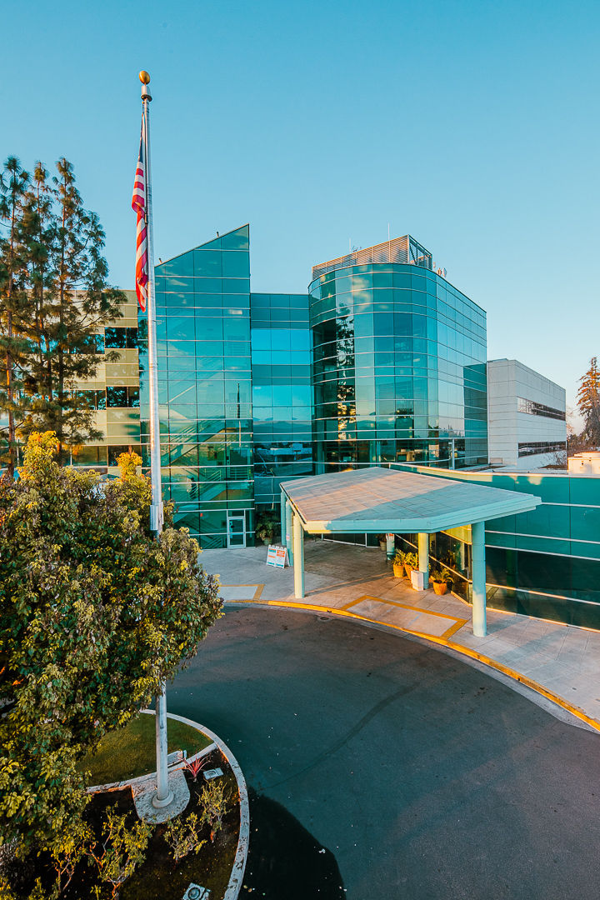
About Our Stroke Program
The stroke program at Sierra View Medical Center promotes health through primary prevention and ensures access to the highest standard of stroke care through advanced medicine and collaborative partnerships, supported by evidence-based practice.
About Sierra View Medical Center
167-bed acute care hospital, (18 Main ED beds and 20 Telemetry/Stroke beds)
Located in the foothills of the Sierra Nevada range
Not for profit, public entity with a five-member Board of Directors
On track to see about 700 stroke alerts for FY2026
36% of stroke alerts code out to an actual stroke (benchmark is 25-40%).
Current median DTN time is 47 min with our 7 out of our last 10 administrations being under 30 min.
Current median door to CT time is 8 min

Slide 5

Stroke Program Timeline
2015: Charter development
Feb 2017: I was hired Stroke & Sepsis Coordinator
2017 - Present: Revision of project charter, stroke committee reconvened, etc
2017: First TPA given in September
Awards – AHA GWTG
  2019: Silver plus, Type 2 diabetes honor roll
  2021-2024: Gold plus, target Type 2 diabetes honor roll
  2025: Gold plus, Target type 2 diabetes honor roll, Target stroke honor roll
2020: TeleNeurology
2021: Certification as Primary Stroke Center
2023, 2025: Successful re-certification for Primary Stroke. Two survey findings in 2025.

Slide 6
Objectives
Articulate how a high-reliability “quality engine” supports consistent, efficient stroke care across the continuum
Identify evidence-based strategies and performance improvements that organizations of any size can apply to strengthen their stroke quality infrastructure
Recognize the essential contributions of interdisciplinary teams in sustaining high-quality stroke care
Explain how process optimization and communication alignment reduce variation and improve patient flow throughout the stroke continuum
Identify forward-looking opportunities to advance stroke quality through guideline alignment, readiness initiatives, and continuous improvement

Slide 7
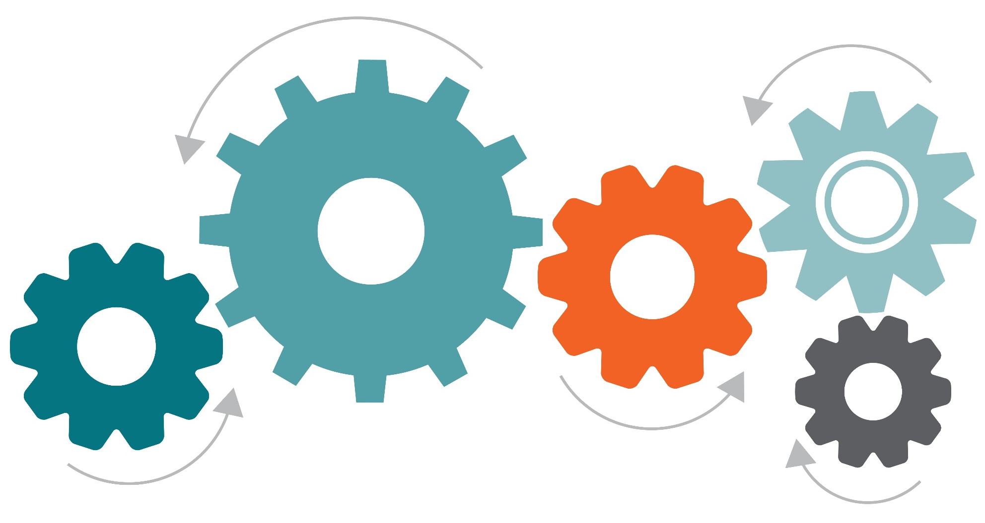
The Quality Engine is like an Internal Combustion Engine:
The Transmission = Processes & Protocols
Converts power into motion!
The Driver = The Stroke Coordinator
Even the best car needs a skilled driver!
The Fuel System = Data
Quality fuel powers performance!
The Engine Block = Interdisciplinary Teamwork
This holds everything together!
The Exhaust System = Communication
A muscle car needs clean airflow to run efficiently!

Slide 8

The Driver
Stroke Coordinator & Staff
Even the best car needs a skilled driver!
Reads the dashboard – Reports!
Listens for misfires – Audits and real-time
Tunes the system – Direct observation
Builds relationships with every “pit crew” member (Lab, CT, MRI, nurses, MDs, etc.)
Strong relationships = smoother handling, faster response, fewer breakdowns

Slide 9
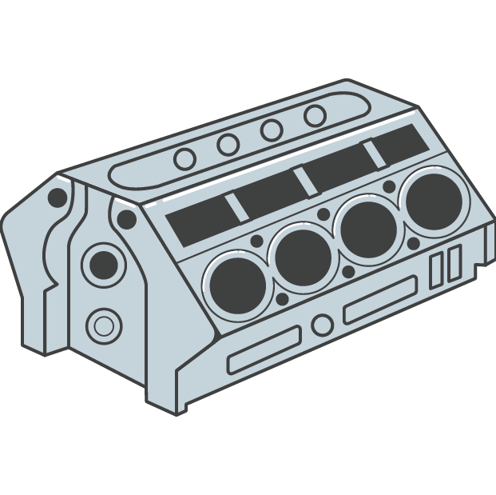

The Engine Block
Interdisciplinary Teamwork
The engine block is to the car what the stroke team is to the hospital: the central structure that makes high-performance function possible.
The engine block (or cylinder block) is the central, structural foundation of an internal combustion engine. It’s functions ensure engine stability, durability, and heat management.
The hospital stroke team is also the central, structural foundation of a process that cares for a human being. The cohesiveness of the team ensures performance, durability, and acute care management. Engine Block
Engine Block
Stroke Team
Tightly integrated system where every component must sync to deliver rapid performance
If one part fails or slows,
the whole system suffers

Slide 10

The Transmission
Processes and Protocols
The transmission converts power into motion. The stroke program accomplishes this through:
Standardized pathways
Clear roles and responsibilities
Smooth handoffs
When the transmission slips, the whole car slows down or stops!

Slide 11
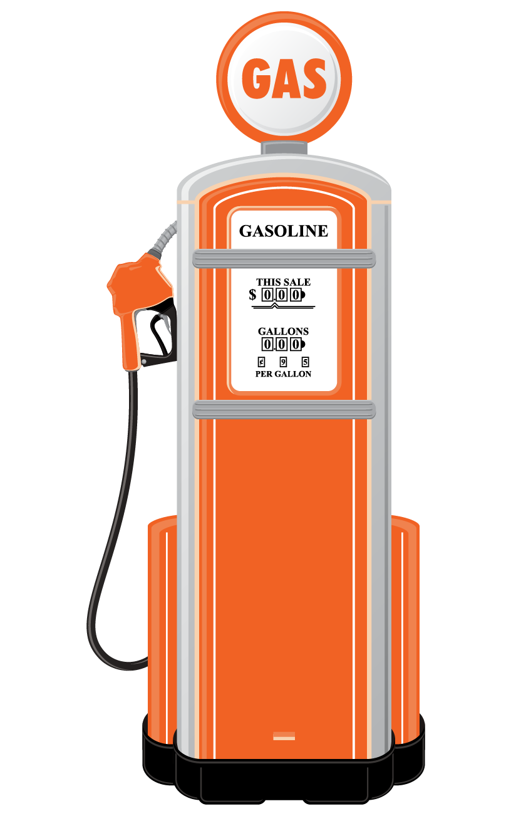
The Fuel System
Data
Quality fuel powers performance – Accurate data provides the insight and reliability needed for consistent, high-quality care.
Accurate, timely data drives improvement
Dashboards, metrics, case reviews = fuel injection
Bad data = contaminated fuel poor performance

Slide 12

The Exhaust System
Communication
A muscle car needs clean airflow to run efficiently:
EMS pre-notification
Rapid updates between teams
Closed loop communications
Poor communication = clogged exhaust slow, inefficient care

Slide 13

Relationships
Technical expertise matters – but relationships determine reliability

Slide 14
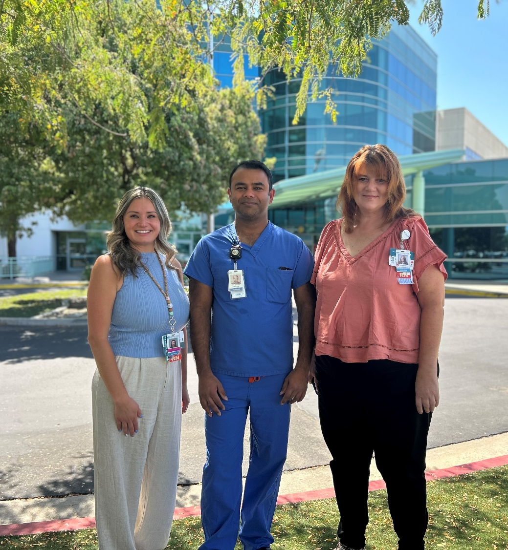
The Human Element
Relationships Drive Quality
Trust speeds communications
Teams respond faster to people they know
Collaboration reduces friction
Psychological safety improves reporting and learning
Everyone feels ownership of outcomes
Manners matter!

Slide 15
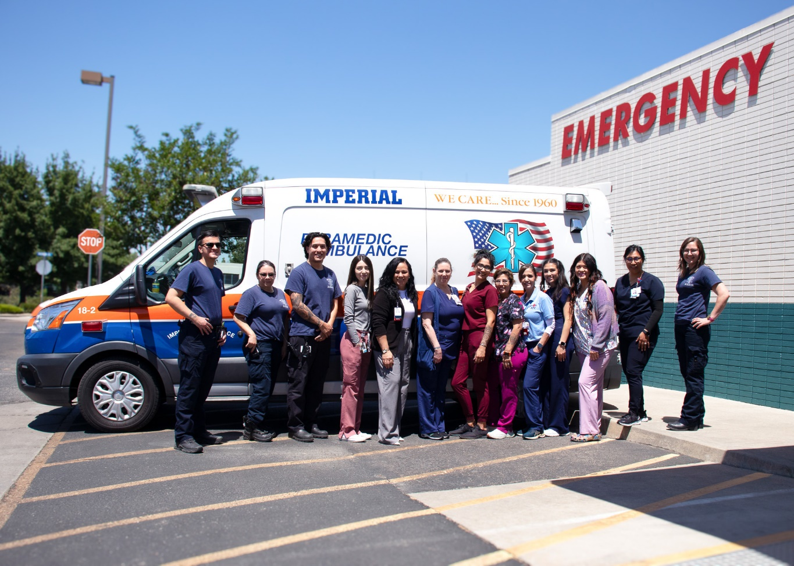
Relationship Building Strategies
Purposeful rounding
Regular check-ins with EMS, ED, Imaging, and Pharmacy
Celebrating wins - next slide
Co-designing solutions
Being visible, approachable, and consistent
Case Example: ED and CT

Slide 16

Staff Recognition

Slide 17
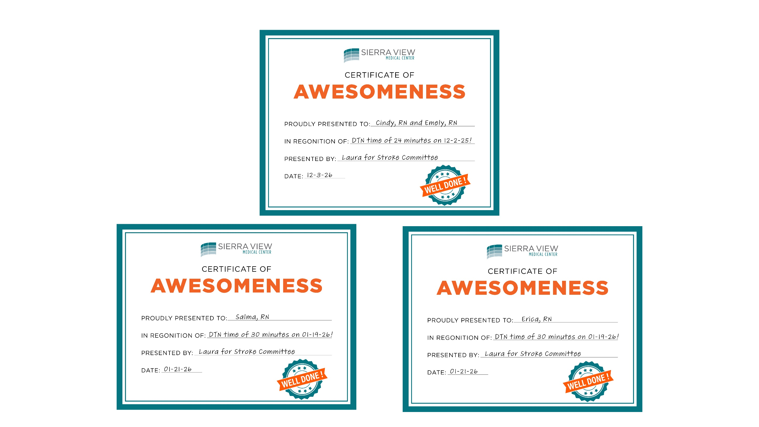

Slide 18


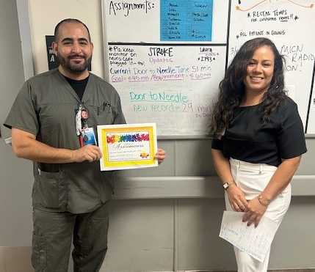
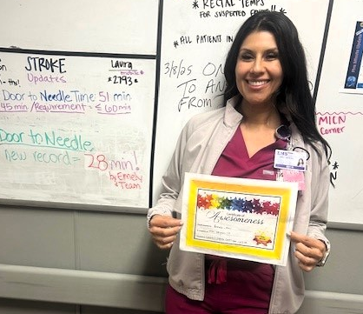
Door-to-Needle Time

Slide 19
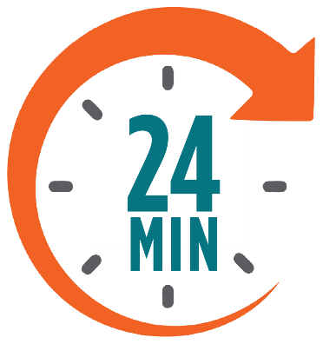
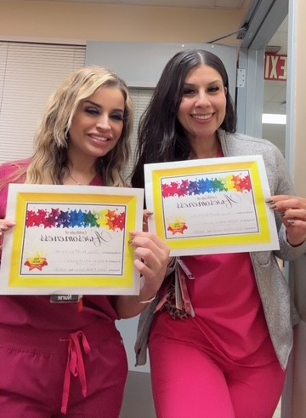
Door-to-Needle Time
A new Emergency Department record
Achieved by Cindy Betancourt, RN, and Emely Estrada, RN
Rapid stroke recognition and activation
Immediate imaging and evaluation
Timely tPA administration
Achieved well below the 60-minute benchmark, reflecting a highly coordinated and efficient stroke response.

Slide 20
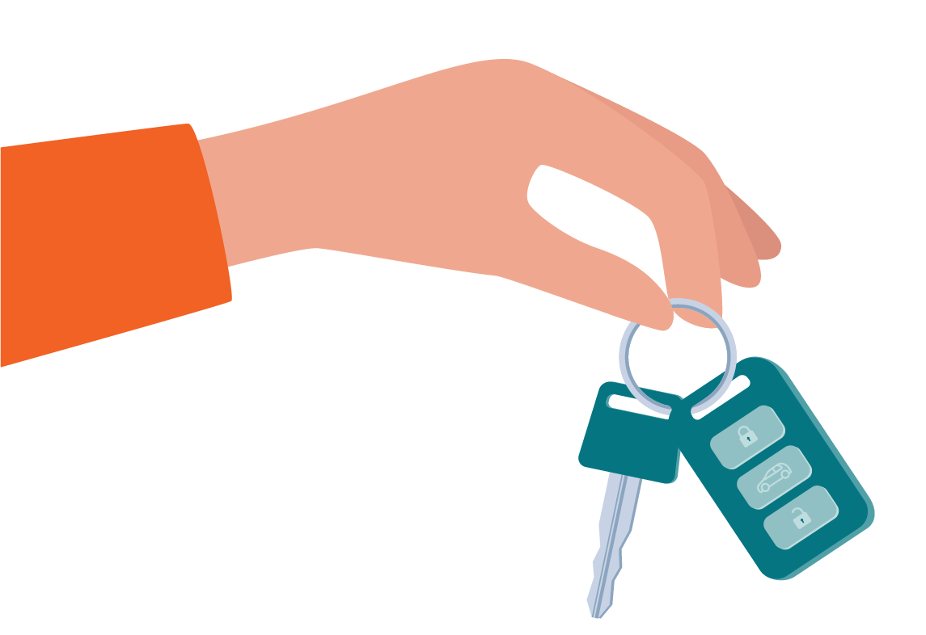
Key Takeaways
High-reliability systems require strong processes and strong relationships
Evidence-based strategies are scalable across all hospital sizes
Interdisciplinary teamwork is essential for optimal outcomes
Stroke Coordinators elevate performance through influence, trust, and connection

Slide 21
?
Discussion & Questions

Slide 22
Thank You

