Slide 1
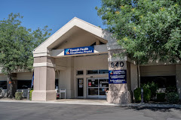
Where Recovery Becomes Momentum: Stroke in Inpatient Rehab
Samuel Matsuo, M.D.
Danny Pavlovich, OTD, OTR/L

Slide 2
Why Does Inpatient Stroke Rehabilitation Matter?
Stroke = high disability risk
Early decisions impact long-term outcomes
Transition between settings is critical
More than medicine. Life.

Slide 3
Inpatient Rehabilitation on the Recovery Continuum
Acute care → stabilize
Inpatient rehab → restore function
Goal: safe return to community
More than medicine. Life.

Slide 4
What does Inpatient Rehab Look Like in Stroke Recovery?
3 hours therapy/day
Interdisciplinary care
Daily functional training
More than medicine. Life.

Slide 5
Who Comes to Inpatient Rehab?
Medically stable
Able to participate
Functional deficits present
Rehab potential
More than medicine. Life.

Slide 6
What Makes a Strong Candidate for Inpatient Rehab
Engaged, alert
Can tolerate intensity
Functional goals
Family support
More than medicine. Life.

Slide 7
When Might Inpatient Rehab not be the Correct Fit
Unable to participate
Medically unstable
Limited carryover
Poor tolerance
More than medicine. Life.

Slide 8
What is Done Early Matters
First 48–72 hours are critical
Early mobility
Positioning
Attention to affected side
More than medicine. Life.

Slide 9
Common Challenges We See
Limited early use of affected side
Poor positioning habits
Delayed mobility
Expectation mismatch
More than medicine. Life.

Slide 10
What We’re Trying to Achieve
Independence in activities of daily living (ADL’s)
Safe mobility
Cognitive safety
Discharge home
More than medicine. Life.

Slide 11
What Rehab Looks Like Daily
Structured therapy schedule
Repetition across disciplines
Functional focus
More than medicine. Life.

Slide 12
How We Think About Treatment
Task-specific
Repetition-driven
Functional
Patient-centered
More than medicine. Life.

Slide 13
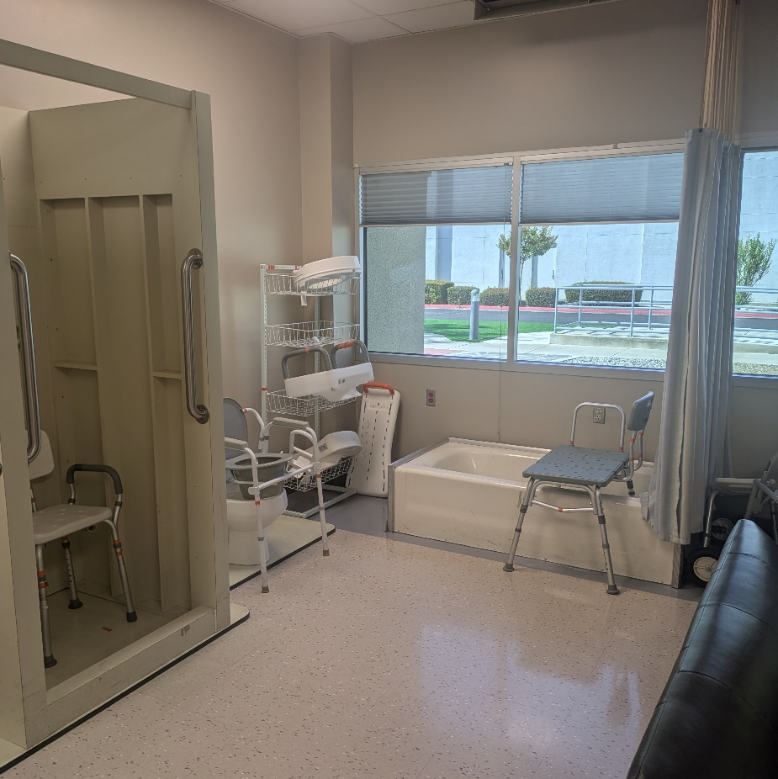
ADL Training
Dressing
Toileting
Bathing
Grooming
More than medicine. Life.

Slide 14
Example: Getting Someone Dressed Again
One-handed techniques
Adaptive equipment
Task breakdown
Repetition
More than medicine. Life.

Slide 15
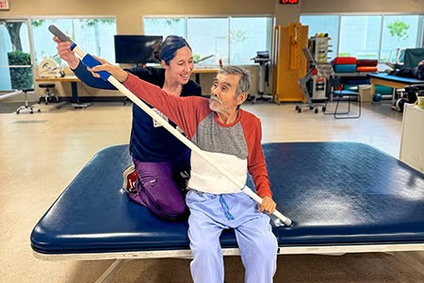
Motor Recovery / Neuro Re-education
Repetition
Weight bearing
Bilateral integration
Motor relearning
More than medicine. Life.

Slide 16
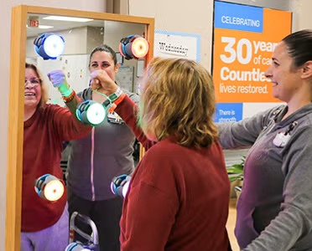
Preventing Learned Non-Use
Early use of affected limb
Use as stabilizer
Cueing attention
More than medicine. Life.

Slide 17
Upper Extremity Return
Positioning matters
Prevent complications
Encourage functional use
More than medicine. Life.

Slide 18
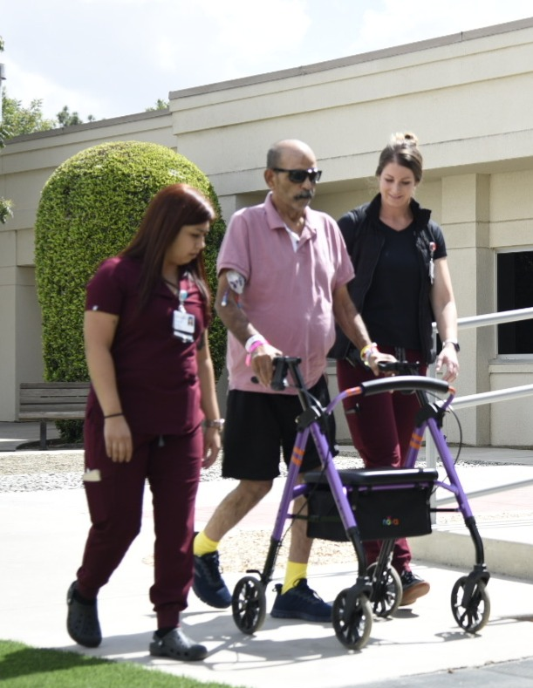
Mobility & Transfers
Standing tolerance
Transfers
Gait training
Balance
More than medicine. Life.

Slide 19
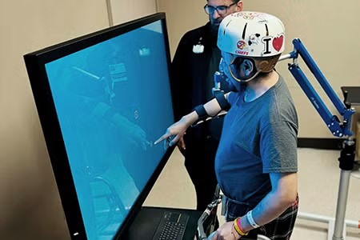
Technology in Rehab
Increases intensity
Improves engagement
Provides feedback
More than medicine. Life.

Slide 20
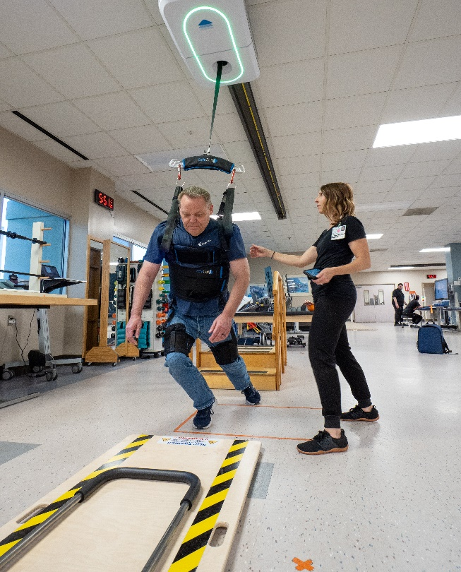
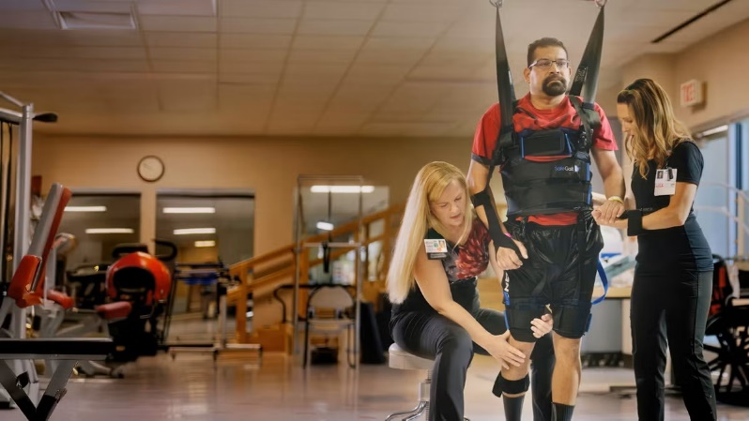
Body Weight Support / Safegait
Safer early mobility
Reduces fall risk
Allows higher intensity
More than medicine. Life.

Slide 21
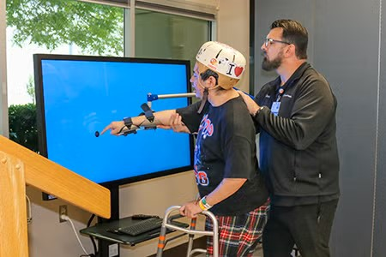
BITS
Visual scanning
Reaction time
Coordination
More than medicine. Life.

Slide 22
Role of Speech Therapy
Swallowing safety and diet recommendations
Cognitive deficits (memory, attention, problem-solving)
Communication (aphasia, dysarthria)
Supports safe eating and participation in care
More than medicine. Life.

Slide 23
Role of Physical Therapy (PT)
Mobility (bed mobility, transfers, walking)
Strength, balance, and endurance
Fall prevention and safety with movement
Prepares patients for safe functional mobility
More than medicine. Life.

Slide 24
Role of Occupational Therapy (OT)
Activities of daily living (dressing, bathing, toileting)
Upper extremity function and coordination
Cognitive and visual-perceptual skills in daily tasks
Fall prevention and safety within daily activities
Prepares patients for independence at home
More than medicine. Life.

Slide 25
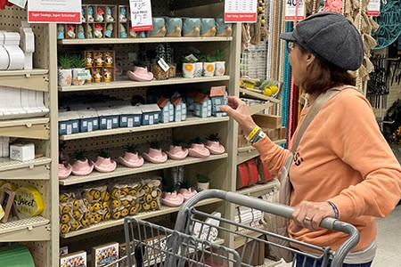
Role of Recreational Therapy (RT)
Leisure and meaningful activity engagement
Community reintegration
Coping, motivation, and quality of life
Social participation and routine development
More than medicine. Life.

Slide 26
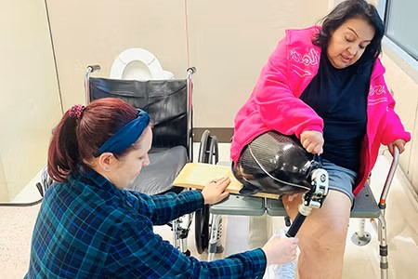
Education Starts Day One
Stroke signs
Safety
Home setup
Risk factors
Family Training
Home Exercise/Home Programs
(start in room, right away)
More than medicine. Life.

Slide 27
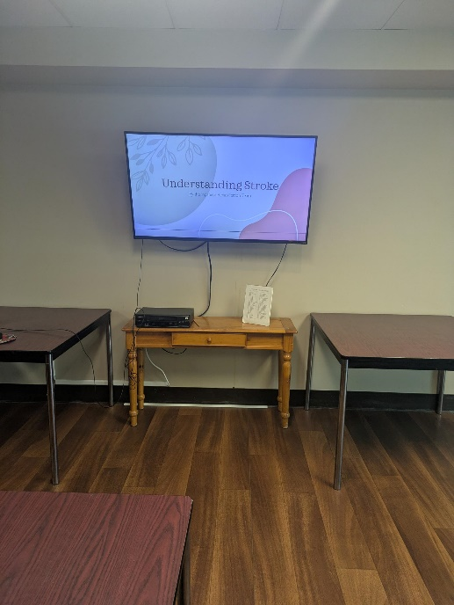
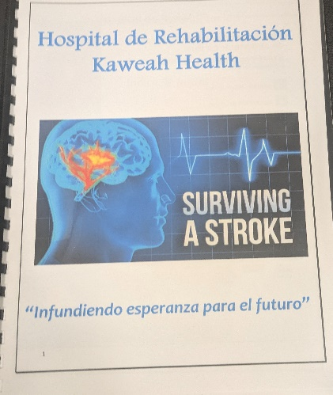
Education Provided Throughout Rehab Stay
Stroke Education Classes Provided Weekly
  Topics include
    Symptoms
    Prevention
    Emotional Regulation
    Diet Management
    Sexuality
    Fall Prevention
More than medicine. Life.

Slide 28
Preparing Patients for Return to Home and Community
Simulated and real home environment training
Home assessments to identify safety barriers
Community outings (store, public spaces)
Assessment of real-world safety and independence
More than medicine. Life.

Slide 29
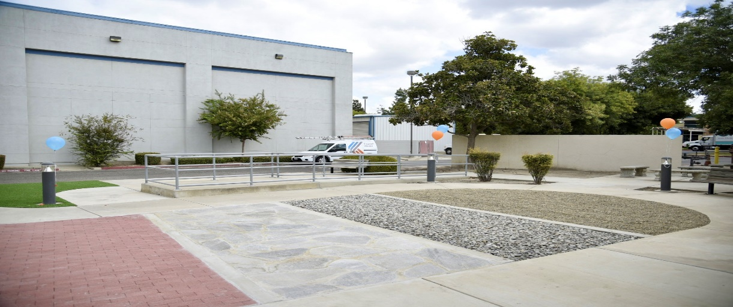
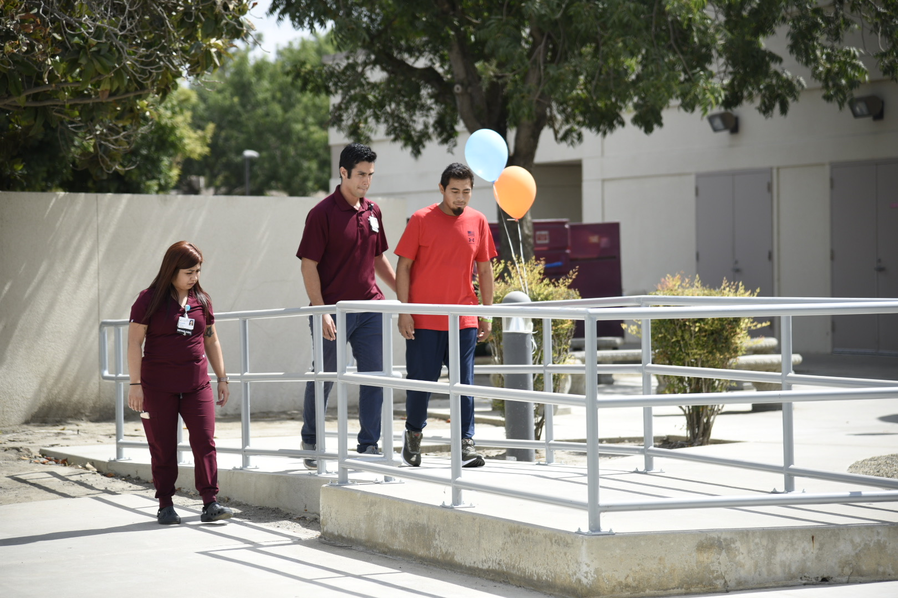
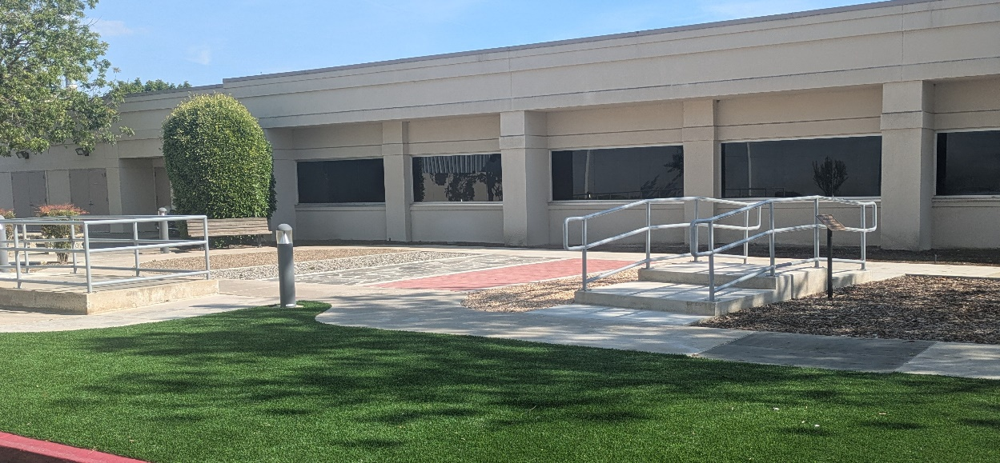
Outdoor Mobility Course
More than medicine. Life.

Slide 30
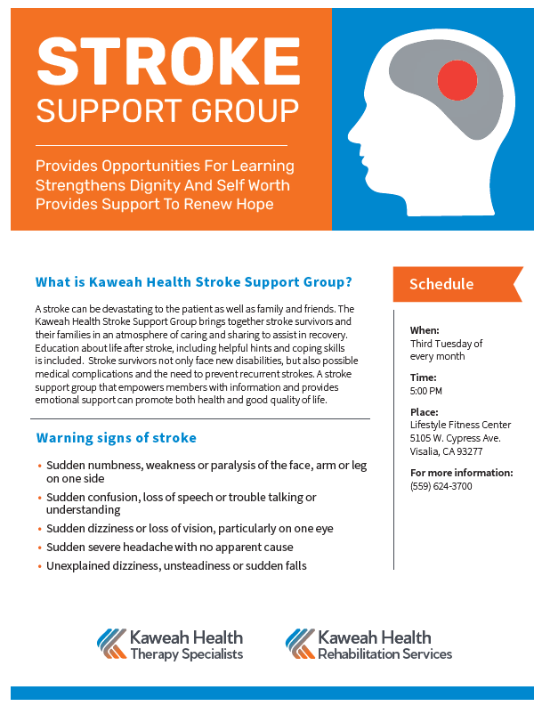
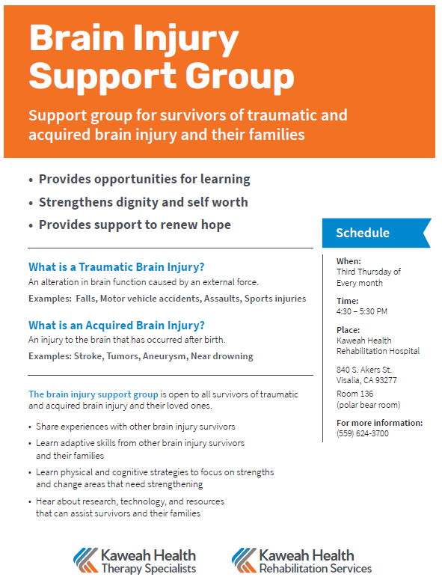

Support Groups Offered Following Rehab Stay
Stroke Support Group
Brain Injury Support Group
Aphasia Support Group
More than medicine. Life.

Slide 31
What Drives Success in Stroke Recovery?
Repetition
Consistency
Patient engagement
Family involvement
More than medicine. Life.

Slide 32
Case Study
57 yr old male
Acute Left Pontine Infarct
Presents to ED with right upper extremity weakness, slurred speech and loss of balance while walking
More than medicine. Life.

Slide 33
Case Study
Presents at acute hospital with:
loss of balance,
decreased coordination
decreased functional strength
Slurred speech
Requiring max assistance for adls and transfers
More than medicine. Life.

Slide 34
Case Study
Throughout stay
  Worked on pre-gait training
  Safe gait training
  Progress from max assist squat pivot transfers to using FWW to ambulation without device short distances
More than medicine. Life.

Slide 35
Case Study
Work on overall motor control and grasp, progressing from limited functional use and shoulder flexion of 120 on R UE to full range of motion and grasp at discharge
Mild cognitive deficits and slurred speech when started progressing to not needing SLP services at discharge
Family training and stroke education completed
More than medicine. Life.

Slide 36
Takeaways
Early care impacts outcomes
Rehab is functional and intensive
Team approach is essential
More than medicine. Life.

Slide 37
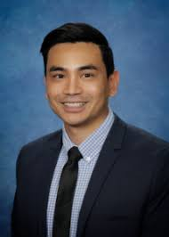
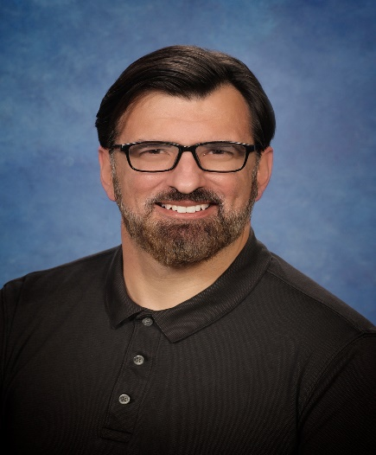
Questions?
Contact Us
Thank you!
Samuel Matsuo smatsu@KaweahHealth.org
Danny Pavlovich dpavlovi@kaweahhealth.org
More than medicine. Life.

Slide 38
References
All photos used from Kaweah Health website
Inpatient acute rehabilitation program. Kaweah Health. (2025). https://www.kaweahhealth.org/our-services/rehabilitation-services/inpatient-acute-rehabilitation-program

Slide 39
References

