Slide 1
Neuro Monitoring
That Saves Brains
Detecting Deterioration Early
Assessment · Causes of Deterioration · When to Call/CT · Seizures · Airway
Jordan Amar, MD, MSc
Assistant Professor of Clinical Neurology
Division of Neurocritical Care/Stroke
Department of Neurology
Visalia Nursing Symposium · 2026

Slide 2
The Nurse Is the Monitor
No technology replaces sustained, skilled clinical observation
Every 40 sec
First 60 min
You are first
A stroke occurs in the United States
Highest-risk window for irreversible deterioration
Before the MD, before imaging — you catch the change
This talk is for you. The decisions you make in the first minutes determine what the team can do.
Your assessment is not a task to complete — it is the most powerful diagnostic tool in the building.
Neuro Monitoring That Saves Brains · Visalia Nursing Symposium 2026
Jordan Amar, MD, MSc · USC Keck

Slide 3
What We'll Cover Today
01
Neurological Assessment Fundamentals
GCS · Pupils · Focal deficits · NIHSS
02
Causes of Neurological Deterioration
Edema · Hemorrhage · Herniation · Seizure · New stroke · Metabolic
03
Recognizing Trends & Trajectories
Why direction matters more than any single number
04
When to Call & When to CT
Red flags · Escalation criteria · The call that changes outcome
05
Seizures at the Bedside
Recognition · Timing · Acute management · Status epilepticus
06
Protecting the Airway
Aspiration risk · Positioning · Intubation triggers
Neuro Monitoring That Saves Brains · Visalia Nursing Symposium 2026
Jordan Amar, MD, MSc · USC Keck

Slide 4
01
Neurological Assessment
GCS · Pupils · Focal deficits · NIHSS
USC Keck · Division of Neurocritical Care & Stroke

Slide 5
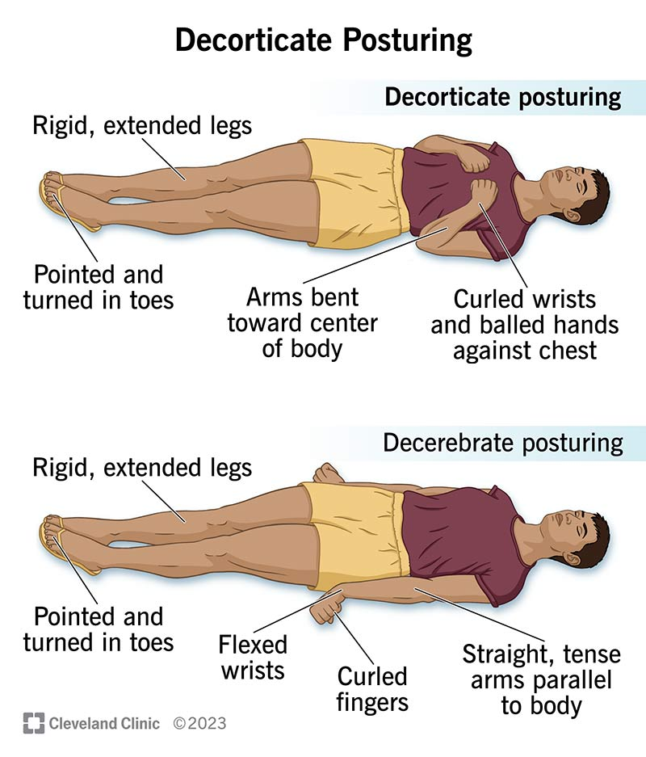

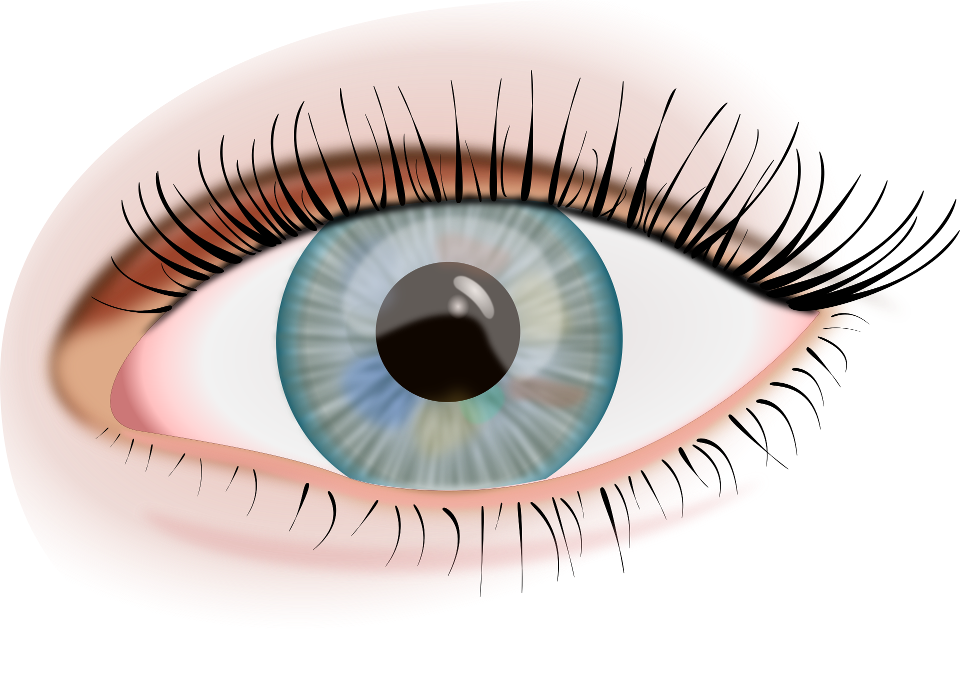

Glasgow Coma Scale (GCS)
Reproducible, communicable — every nurse every shift speaking the same language
EYE
OPENING
E4
VERBAL
V5
MOTOR
M6
4 — Spontaneous
3 — To voice
2 — To pain
1 — None
5 — Oriented
4 — Confused
3 — Words only
2 — Sounds
1 — None
6 — Obeys commands
5 — Localizes
4 — Withdraws
3 — Flexion
2 — Extension
1 — None
GCS ≤ 8 → Protect airway GCS 9–12 → Monitor closely GCS 13–15 → Track trend
Neuro Monitoring That Saves Brains · Visalia Nursing Symposium 2026
Jordan Amar, MD, MSc · USC Keck
6 — Obeys commands
5 — Localizes
4 — Withdraws
3 — Flexion
2 — Extension
1 — None

Slide 6
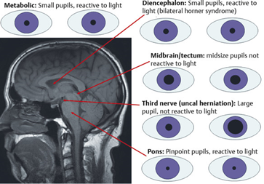
Pupil Assessment
Size · Symmetry · Reactivity · Shape — document baseline meticulously
Equal, round, reactive 3–5 mm
Pupils say A LOT
Normal. Document precisely — this patient's baseline is what matters.
Unequal pupils (new anisocoria > 1 mm)
Herniation until proven otherwise. Call immediately.
Fixed and dilated (≥ 6 mm, non-reactive)
Uncal herniation or catastrophic ICP elevation. Emergency.
Pinpoint bilateral (≤ 2 mm)
Pontine lesion or opioid effect. Assess clinical context.
Oval or irregular shape
Surgical history, prior trauma, or midbrain involvement.
Neuro Monitoring That Saves Brains · Visalia Nursing Symposium 2026
Jordan Amar, MD, MSc · USC Keck

Slide 7
Focal Neurological Deficits
Your structured exam finds what imaging cannot show in real time
Language
Name objects, repeat a phrase, follow commands. Note word-finding errors, paraphasia, absent output.
Face
Ask to smile. Look for nasolabial fold flattening or corner drooping — subtle asymmetry counts.
Arm/Leg
Arms: palms up, eyes closed, 10 sec. Legs: 30° elevation, 5 sec. Note side, degree, drift.
Gaze
Eyes deviate toward hemisphere lesion (away in posterior fossa). New conjugate deviation = urgent.
Sensation
'Do you feel this equally?' Hemineglect presents as inattention — screen actively.
Neuro Monitoring That Saves Brains · Visalia Nursing Symposium 2026
Jordan Amar, MD, MSc · USC Keck

Slide 8
NIHSS — Speaking the Team's Language
You don't need to score it formally — knowing the domains makes you a better communicator
1a. Level of consciousness (0–3)
1b. LOC questions: month & age (0–2)
1c. LOC commands (0–2)
2. Best gaze (0–2)
3. Visual fields (0–3)
4. Facial palsy (0–3)
5a/5b. Motor arm L / R (0–4 each)
6a/6b. Motor leg L / R (0–4 each)
7. Limb ataxia (0–2)
8. Sensory (0–2)
9. Best language (0–3)
10. Dysarthria (0–2)
11. Extinction / inattention (0–2)
Max total score: 42
0–5: Minor · 6–15: Moderate · 16–20: Moderate-severe · > 20: Severe
Neuro Monitoring That Saves Brains · Visalia Nursing Symposium 2026
Jordan Amar, MD, MSc · USC Keck

Slide 9
02
Causes of Deterioration
Edema · Hemorrhagic conversion · Herniation · Seizure · New stroke · Metabolic · Systemic
USC Keck · Division of Neurocritical Care & Stroke

Slide 10
The Deteriorating Patient: Think in Categories
Your pattern recognition triggers the right response — and calls for the right test
Cerebral Edema
New Stroke / Expansion
Hours–days post-stroke or post-op
Extension of territory or new embolus
Hemorrhagic Conversion
Hydrocephalus
IVT/anticoag patients — hours–days
Obstructive or communicating — insidious
Herniation
Metabolic / Systemic
Midline shift — rapid, life-threatening
Glucose, Na⁺, hypoxia, sepsis, drugs
Seizure / Post-ictal
Infection
Can mimic stroke — time the event
Meningitis, abscess, UTI/pneumonia
When a patient deteriorates: describe WHAT you see and WHEN it started — the team builds the differential.
Neuro Monitoring That Saves Brains · Visalia Nursing Symposium 2026
Jordan Amar, MD, MSc · USC Keck

Slide 11
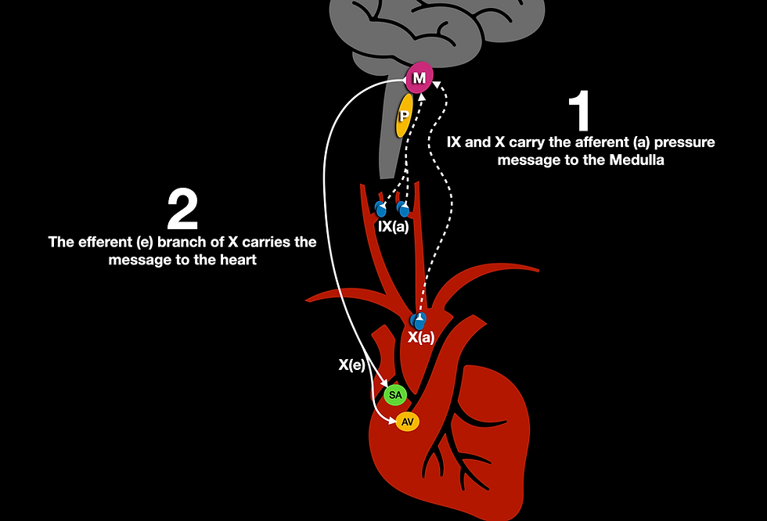
Cerebral Edema
Peak onset 24–96 hrs post-stroke — can begin within hours for large infarcts
What You Will See
Cushing’s Reflex
Worsening GCS from prior check
New or worsening focal deficit
Increasing headache or vomiting
Rising BP (Cushing's reflex)
Irregular or slowing respirations
Your Actions
Call MD with SBAR — don't wait
HOB 30° — do not lay flat
Avoid hypotonic fluids
Avoid fever — T > 38°C worsens injury
Prepare for urgent CT or ICU transfer
Malignant MCA syndrome: massive hemispheric edema — can be fatal within 24–48 hrs. Young patients highest risk.
Neuro Monitoring That Saves Brains · Visalia Nursing Symposium 2026
Jordan Amar, MD, MSc · USC Keck

Slide 12
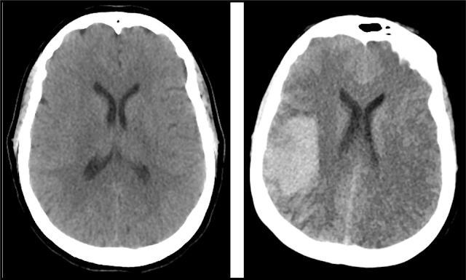
Hemorrhagic Conversion (HT)
Bleeding into ischemic infarct — a feared complication after thrombolytics
Risk Factors
The same patient…6 hours apart
Recent tPA or TNK administration
Anticoagulation (heparin, DOAC, warfarin)
Large infarct (MCA territory)
Significant post-treatment hypertension
Reperfusion after successful EVT
Bedside Red Flags
Sudden GCS decline in a treated patient
Severe new headache post-tPA/TNK
Rapid BP escalation after treatment
New focal deficit in treated patient
Any sudden decline post-tPA/TNK = sICH until proven otherwise. Stop anticoagulation. CT head STAT.
Neuro Monitoring That Saves Brains · Visalia Nursing Symposium 2026
Jordan Amar, MD, MSc · USC Keck

Slide 13
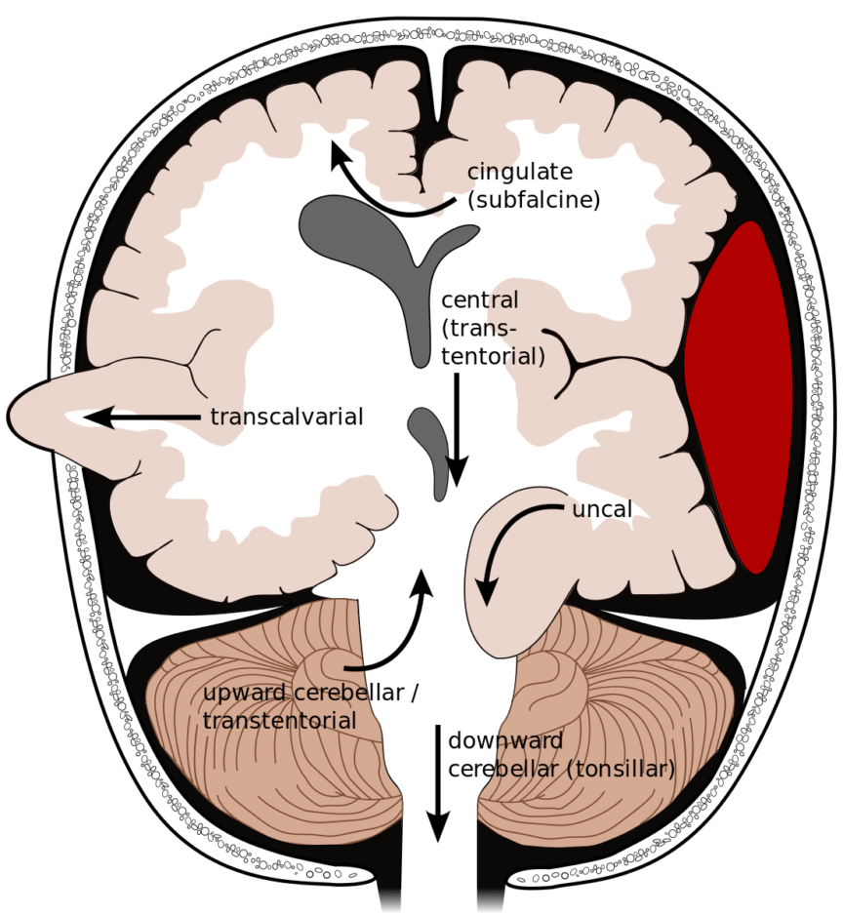
Transtentorial Herniation
Brain shifting under the tentorium — minutes matter
Ipsilateral pupil dilation (CN III)
Decreasing alertness, new agitation
Brain Herniation Syndromes
Early Warning
Fixed unilateral pupil
Contralateral hemiparesis — Cushing's triad
Rapid GCS decline
Developing
Bilateral fixed dilated pupils
Decorticate/decerebrate posturing
GCS ≤ 6 — irregular respirations
Established
Fixed pupil = call MD NOW. HOB 30°. Hyperventilate with BVM if GCS drops precipitously awaiting intubation.
Neuro Monitoring That Saves Brains · Visalia Nursing Symposium 2026
Jordan Amar, MD, MSc · USC Keck

Slide 14
New Stroke, Infarct Expansion & Hydrocephalus
Three causes that demand rapid imaging
Stroke Expansion / New Embolus
Early Ischemic Edema & Re-occlusion
Hydrocephalus
Sudden new focal deficit distinct from admission
Cardioembolic patients (afib, valve) highest risk
Action: NIHSS delta, call MD, urgent CT/MRI
Gradual worsening over first 24 hrs in large stroke
Abrupt return of deficits = re-occlusion
Action: strict BP per MD order, call for any GCS change
Cerebellar stroke blocks 4th ventricle (obstructive)
SAH/IVH impairs CSF absorption (communicating)
Action: HOB 30°, call MD, prepare for urgent CT
Neuro Monitoring That Saves Brains · Visalia Nursing Symposium 2026
Jordan Amar, MD, MSc · USC Keck

Slide 15
Metabolic & Systemic Causes
Treatable — and often missed when everyone is focused on the brain
Hypoglycemia
Dysnatremia Na⁺↕
Check BG first, always. BG < 60 mimics stroke exactly. Treat before imaging.
Rapid shifts cause edema or osmotic demyelination. Seizure, coma, AMS.
Hypoxia SpO₂<94%
Drug Effect / Withdrawal
Even mild hypoxia worsens brain injury silently. O₂, reposition, escalate.
AED levels, opioids, benzos, alcohol withdrawal — med reconciliation.
Fever T > 38°C
Infection / Sepsis
Expands ischemic penumbra. Treat aggressively in all neuro patients.
Septic encephalopathy, meningitis, UTI in neuro. Cultures, UA, call MD.
Rule: Check glucose and SpO₂ FIRST in every deteriorating patient — fast, cheap, completely reversible.
Neuro Monitoring That Saves Brains · Visalia Nursing Symposium 2026
Jordan Amar, MD, MSc · USC Keck

Slide 16
Vital Sign Patterns That Mean Something
Recognize the patterns that require immediate action
Cushing's Triad
Late sign of critical ICP — herniation imminent. Call NOW.
HTN + Bradycardia + Irregular resp.
Rising BP alone
Autoregulatory response — do NOT treat without MD order.
SBP > 180 or rapid rise ≥ 40 mmHg/30 min
Hypoxia SpO₂ < 94%
O₂, reposition, reassess airway. Escalate if not correcting.
Even mild — brain injury is hypoxia-sensitive
Fever T > 38.0°C
Antipyretics + cooling. Treat aggressively in neuro patients.
Increases cerebral metabolic demand
Tachycardia + Fever + AMS
Consider sepsis, meningitis, NMS, withdrawal. Call MD.
New combination in neuro patient
Neuro Monitoring That Saves Brains · Visalia Nursing Symposium 2026
Jordan Amar, MD, MSc · USC Keck

Slide 17
03
Recognizing Trends & Trajectories
A single value tells you where the patient is — a trend tells you where they're going
USC Keck · Division of Neurocritical Care & Stroke

Slide 18
It's Not the Number — It's the Direction
Two patients, same current GCS — completely different trajectories
STABLE TREND
DETERIORATING TREND
GCS 14 — on admission
GCS 14 — on admission
GCS 14 — at 2 hours
GCS 13 — at 2 hours
GCS 14 — at 4 hours
GCS 12 — at 4 hours
Reassuring. Continue per protocol. Document trend explicitly.
Each point counts. Notify MD now. Prepare for imaging.
Rule-of-thumb: 2-point GCS drop = immediate MD notification.
1-point drop = reassess in 30 min and document.
Neuro Monitoring That Saves Brains · Visalia Nursing Symposium 2026
Jordan Amar, MD, MSc · USC Keck

Slide 19
Documentation as a Monitoring Tool
Your notes are the trend data — if it isn't written, the deterioration is invisible
✓ Document This
✗ Avoid These
Timestamp every neuro check precisely
Record GCS components — not just total
Document what was NORMAL, not only abnormal
Capture patient-reported symptoms verbatim
Note who was notified, at what time, their response
'Neuro intact' — specifics required
'No change' — always state the baseline
Documenting after the fact without noting assessment time
'Looks okay' — describe exactly what you observed
Your documentation is the legal and clinical record. It protects the patient — and it protects you.
Neuro Monitoring That Saves Brains · Visalia Nursing Symposium 2026
Jordan Amar, MD, MSc · USC Keck

Slide 20
04
When to Call & When to CT
Escalation criteria · The SBAR call · CT decision framework
USC Keck · Division of Neurocritical Care & Stroke

Slide 21
Call Now: Red Flag Findings
Immediate MD/RRT notification — no wait-and-see, no finishing the task first
Sudden new focal deficit — arm drift, facial droop, speech change
GCS drop of ≥ 2 points from documented baseline
New fixed or unequal pupils (new anisocoria)
New gaze deviation or inability to follow commands
Sudden onset 'worst headache of life'
Systolic BP > 220 or rapid rise > 40 mmHg in 30 min
Any sudden decline in a patient within 24 hrs of tPA/TNK
Suspected seizure or failure to return to baseline post-ictal
SpO₂ < 92% unresponsive to repositioning or supplemental O₂
When in doubt: call. Document the call. Over-calling is defensible. Under-calling is not.
Neuro Monitoring That Saves Brains · Visalia Nursing Symposium 2026
Jordan Amar, MD, MSc · USC Keck

Slide 22
The Escalation Call: SBAR
S
SITUATION
"Mr. Torres in 412 has new right arm drift and slurred speech — started 20 minutes ago."
B
BACKGROUND
"64M admitted yesterday for hypertensive urgency. No prior stroke. Last normal neuro check at 1900."
A
ASSESSMENT
"GCS dropped 15 to 13. Right facial droop is new. Cannot follow commands on the right."
R
RECOMMEND
"I need you to come evaluate him now. I believe he needs urgent neuroimaging."
Neuro Monitoring That Saves Brains · Visalia Nursing Symposium 2026
Jordan Amar, MD, MSc · USC Keck

Slide 23
Imaging Decisions: When CT Changes Management
CT without contrast rules out hemorrhage — it does NOT rule out ischemic stroke
URGENT — Activate stroke protocol now
SOON — Notify MD for imaging order
MONITOR — May follow clinically
New focal deficit (stroke activation)
GCS ≤ 13 with unclear etiology
New blown pupil / suspected herniation
Acute decline post-tPA/TNK
Progressive deficits over 1–4 hours
New severe or thunderclap headache
Post-ictal without return to baseline
Unexplained new AMS
Mild confusion improving on reassessment
Headache with normal neurological exam
Brief LOC with full recovery
Stable exam with new symptom history
MRI DWI is the gold standard for ischemic stroke. A normal CT head does not rule out stroke.
Neuro Monitoring That Saves Brains · Visalia Nursing Symposium 2026
Jordan Amar, MD, MSc · USC Keck

Slide 24
05
Seizures at the Bedside
Recognition · Timing · Acute management · Status epilepticus
USC Keck · Division of Neurocritical Care & Stroke

Slide 25
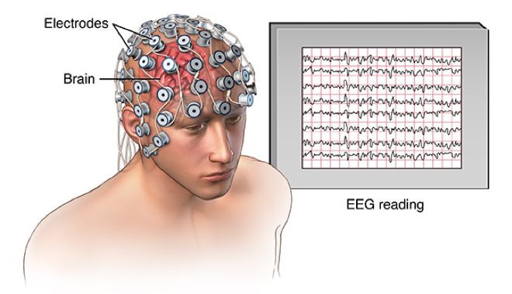
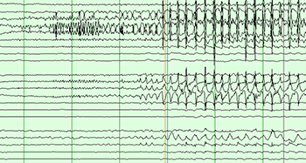
Recognizing Seizure Activity
Not always convulsive — you are the one who witnesses it
Full-body rigidity then rhythmic jerking. LOC, possible incontinence.
EEG – Synchronized electrical discharge
Generalized tonic-clonic
Focal motor
Rhythmic jerking of one limb or face. Patient may remain awake.
Focal impaired awareness
Staring, automatisms (lip smacking, fumbling). Unresponsive with eyes open.
Subclinical / NCSE
Eye deviation, twitching eyelid, AMS without motor signs. Requires EEG.
Post-ictal
Confusion after seizure. Todd's paralysis can perfectly mimic acute stroke.
Neuro Monitoring That Saves Brains · Visalia Nursing Symposium 2026
Jordan Amar, MD, MSc · USC Keck

Slide 26
Acute Seizure Management: Sequence Matters
What you do in the first 60 seconds establishes the safety window
Time It
Airway
1
Start a clock immediately. Duration determines treatment urgency — 5 min = benzodiazepine threshold.
4
Jaw thrust if needed. Suction secretions. Apply O₂. Have BVM immediately available.
Protect
Meds
2
Side-lying. Clear area. Do NOT restrain. Do NOT put anything in the mouth. Ever.
5
Lorazepam IV is standard first-line. Know your seizure order set before you need it.
Call
Reassess
3
Notify MD now. Activate your facility's seizure protocol. Don't wait for it to stop.
6
Post-ictal confusion is expected. Any new focal deficit after seizure = stroke until proven otherwise.
Neuro Monitoring That Saves Brains · Visalia Nursing Symposium 2026
Jordan Amar, MD, MSc · USC Keck

Slide 27
Status Epilepticus
Seizure ≥ 5 minutes OR two seizures without return to baseline = emergency
0–5 min
Protect airway · O₂ · IV access · glucose check · CALL MD
5–20 min
Benzodiazepine: Lorazepam 0.1 mg/kg IV — or Midazolam IM if no IV access
20–40 min
2nd agent: Levetiracetam, Valproate, or Fosphenytoin IV — per MD order
40–60 min
Refractory → ICU, anesthesia consultation, intubation. Full neurology emergency.
Neuro Monitoring That Saves Brains · Visalia Nursing Symposium 2026
Jordan Amar, MD, MSc · USC Keck

Slide 28
06
Protecting the Airway
Aspiration risk · Positioning · Intubation triggers · Your role
USC Keck · Division of Neurocritical Care & Stroke

Slide 29
Aspiration Risk in Neurological Patients
Silent aspiration occurs without coughing — you have to look for it
High-Risk Features
Warning Signs at Bedside
Dysphagia from stroke or brainstem involvement
GCS ≤ 13 — reduced airway protection
Facial droop — impairs lip/tongue coordination
Dysarthria — suggests bulbar weakness
History of aspiration or recurrent pneumonia
Sedation, opioids, anticonvulsants on board
Wet or gurgling voice after swallowing
Coughing or choking with liquids/solids
Drooling or inability to manage secretions
Recurrent low-grade fever / new CXR infiltrate
Patient reports 'food sticking' or difficulty swallowing
NPO until formal swallow evaluation for any patient with dysphagia risk. Notify MD before offering anything orally.
Neuro Monitoring That Saves Brains · Visalia Nursing Symposium 2026
Jordan Amar, MD, MSc · USC Keck

Slide 30
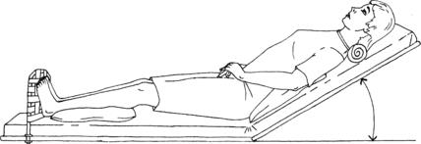
Positioning & Intubation Triggers
Defaults, deviations, and the findings that mean: secure the airway now
HOB 30°
Flat / Trendelenburg
HOB Positioning (assume unless otherwise discussed)
Default for all neurological and intubated patients. Reduces aspiration and ICP.
Avoid unless hemodynamic emergency. Worsens ICP. Needs MD order.
Recovery Position
C-spine Precautions
Active vomiting or GCS ≤ 8. Side-lying until airway secured.
Traumatic or uncertain mechanism — until radiographically cleared.
Intubate When:
▸ GCS ≤ 8 · Loss of gag reflex
▸ SpO₂ < 90% on 15L · Rapid GCS decline > 2 pts/hr
▸ Blown pupil / Cushing's · Refractory status epilepticus
The best intubation is the one you prepared for — not the crash airway.
Neuro Monitoring That Saves Brains · Visalia Nursing Symposium 2026
Jordan Amar, MD, MSc · USC Keck

Slide 31
Putting It All Together
Clinical scenario — the deteriorating post-operative patient
Scenario: 71F, post-op day 1 craniotomy, baseline GCS 15. You arrive for the 0200 neuro check.
Assess
GCS 13 (was 15). New left arm drift. Pupils equal 3 mm reactive. Slurred speech.
Trend
Two-point GCS drop. Three new deficits within one hour of your last check.
Vitals
BP 188/104 (up from 140s). HR 56 and falling. Respirations irregular — Cushing's triad.
Decision
Edema vs. hemorrhagic conversion vs. herniation. Call MD STAT. Stage for CT + airway.
Document
Time of change · each deficit · vitals · who notified · time of notification.
Neuro Monitoring That Saves Brains · Visalia Nursing Symposium 2026
Jordan Amar, MD, MSc · USC Keck

Slide 32
6 Things to Remember
Visalia Nursing Symposium 2026 · USC Keck School of Medicine
1
Assessment
GCS q2–4h · Pupils · Focal deficits · NIHSS language
2
Deterioration
Edema · HT · Herniation · Seizure · New stroke · Metabolic — know the differential
3
Trends
2-point GCS drop = call now · Cushing's triad = emergency
4
Call/CT
New focal deficit · Fixed pupil · GCS ≤ 8 · Post-tPA decline
5
Seizures
Time it · Protect · Lorazepam at 5 min · Status epilepticus → ICU
6
Airway
HOB 30° · NPO for dysphagia risk · Intubation threshold: GCS ≤ 8
You are not just monitoring — you are protecting the brain.
Neuro Monitoring That Saves Brains · Visalia Nursing Symposium 2026
Jordan Amar, MD, MSc · USC Keck

Slide 33
Thank You
Questions & Discussion
Jordan Amar, MD, MSc
Assistant Professor of Neurology
Division of Neurocritical Care & Stroke · Department of Neurology
USC Keck School of Medicine
“Any person who is rude because you called for help has no business in the profession of helping people.”
- My mentor
Visalia Nursing Symposium · 2026

