Slide 1
Thrombolytics Today: Tenecteplase vs Alteplase & Post-Thrombolytic Management
Robyn Stoianovici, PharmD, BCCCP
Senior Clinical Pharmacist, Neurocritical Care
Notes:
TNK and tPA and weave in weave pharmacist involvement in a stroke activation throughout the presentation
BP management post-intervention, such as agent choice and general strategy, but I won't discuss in-depth on BP goals (practice varies for post-thrombectomy specifically and I see there are other sessions in the agenda regarding BP)
• Blood pressure agent selection and medication strategy post-reperfusion
• How pharmacy integrates into rapid stroke activation workflows, especially in community settings
2026 Guideline for the Early Management of Patients With Acute Ischemic Stroke
2018 Guidelines for the Early Management of Patients With Acute Ischemic Stroke

Slide 2
Objectives
Understand the changes to the new 2026 AHA/ASA Acute Ischemic Stroke guideline for IV thrombolytics and blood pressure goals
Analyze the literature for both alteplase and tenecteplase in acute ischemic stroke
Discuss the benefits for tenecteplase as an IV thrombolytic choice in acute ischemic stroke
Review blood pressure management medication choices and strategies, IV thrombolytic reversal, and managment of orolingual angioedema

Slide 3
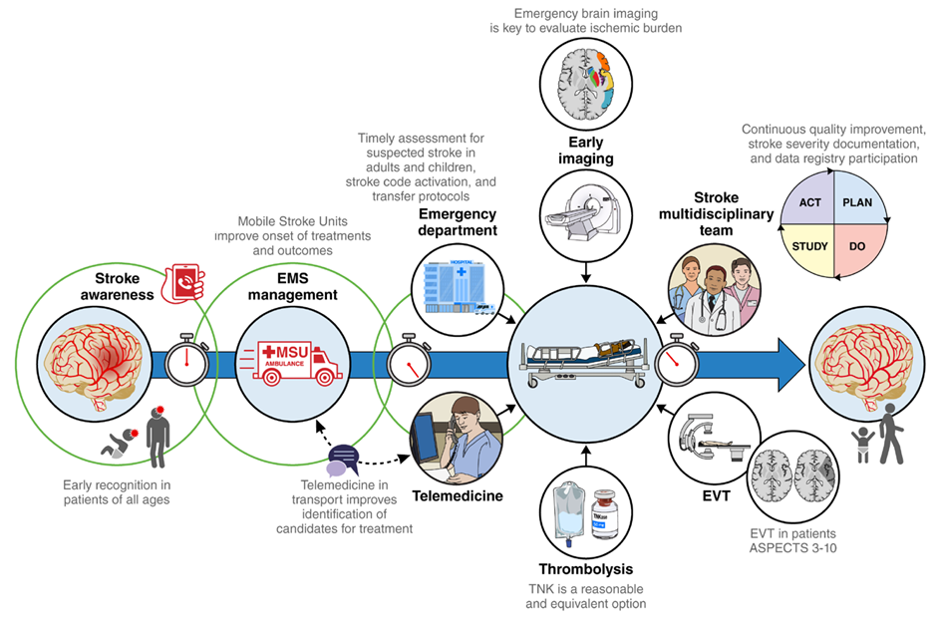
2026 AHA/ASA Guideline for the Early Management of Patients with Acute Ischemic Stroke

Slide 4
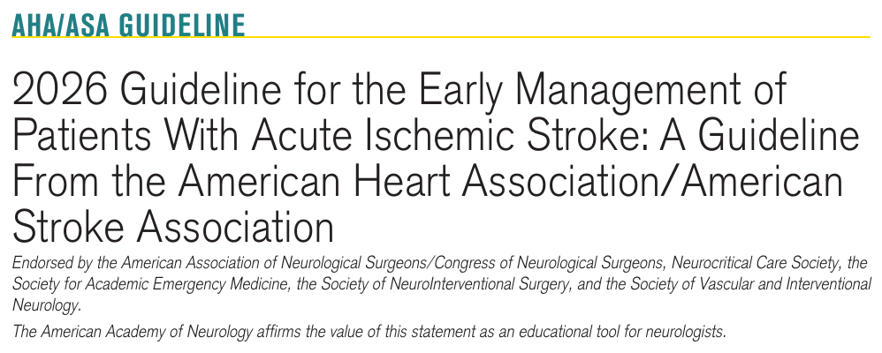

Slide 5
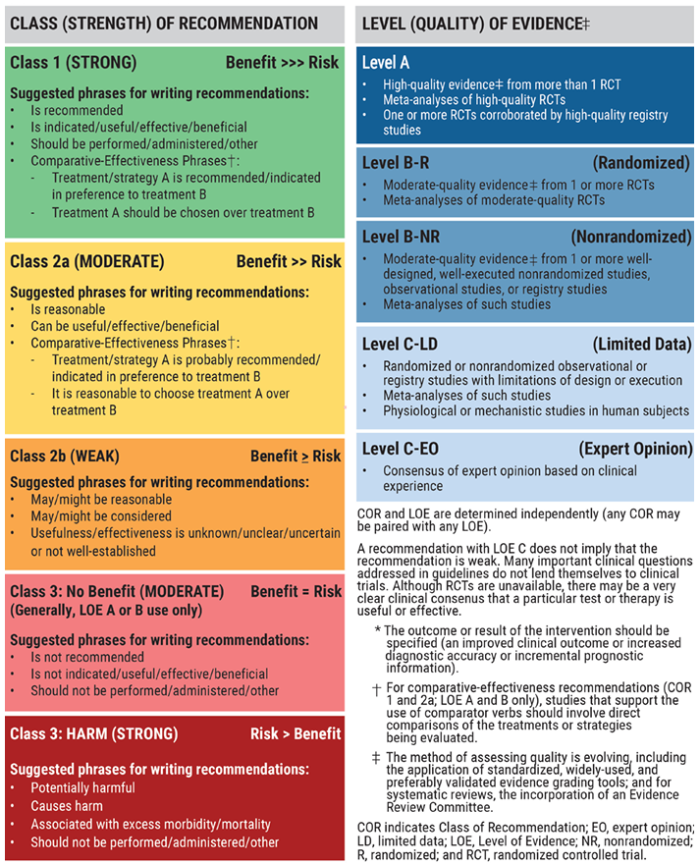

Slide 6
IV Thrombolytics
Tenecteplase & Alteplase

Slide 7
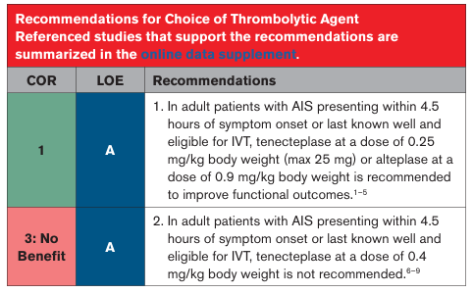
IV Thrombolytics in Acute Ischemic Stroke
Comparing 2019 guideline update:
  Tenecteplase (TNK) class 2b (B-R) recommendation
  TNK 0.4 mg/kg not superior or noninferior to alteplase (tPA) but possible alternative in minor neuro impairment and no major occlusion (2b, B-R)
2026 AHA/ASA Guideline for the Early Management of Patients with Acute Ischemic Stroke

Slide 8
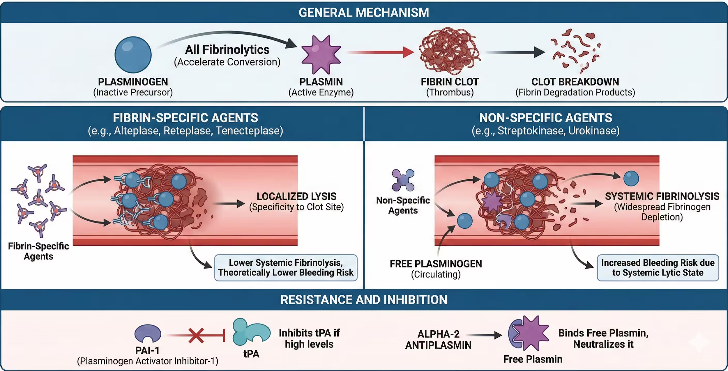
https://pharmacologymentor.com/pharmacology-of-fibrinolytics/
Notes:
promotes initiation of fibrinolysis by binding to fibrin and converting plasminogen to plasmin​

Slide 9
 | Alteplase | Tenecteplase
FDA approved indication | Acute ischemic stroke, STEMI in centers without PCI, acute massive pulmonary embolism | Acute ischemic stroke (2/2025), Thrombolysis in patients with STEMI if PCI unavailable/delayed
Dosing in AIS | 0.9 mg/kg, max total 90 mg (0.09 mg/kg bolus, 0.81 mg/kg continuous infusion over 60min) | 0.25 mg/kg (max 25mg)
Binding affinity | Fibrin + PAI ++ | Fibrin +++ PAI +
Initial/circulating half life Terminal half life | 5 minutes 1 hour | 20-24 minutes Up to 2 hours
Metabolism | Hepatic | Hepatic
Average wholesale price | 100 mg vial: $10,560 | 25 mg vial, 50 mg vial: $10,255
TNK is genetically engineered mutant tissue plasminogen activator with 3 sites of amino acid replacements == advantages in PK / PD
Lexi-Comp, Inc. (Lexi-Drugs®) 2026.​
Notes:
TNK FDA approval February 2025
Alteplase: fibrinolytic activity persists for up to 1 hour after infusion terminated

Slide 10
IVT Relative Contraindications
Pre-existing disability
Recent DOAC exposure (<48 hours)
Ischemic stroke within 3 months
Prior ICH
Recent major non-CNS trauma (14 days to 3 months)
Recent major non-CNS surgery within 10 days
Intracranial arterial dissection
Intracranial vascular malformations
Recent STEMI within 3 months
Acute pericarditis
Left atrial or ventricular thrombus
Systemic active malignancy
Pregnancy and post-partum period
Dural puncture within 7 days
Arterial puncture within 7 days (noncompressible)
Moderate to severe TBI ≥ 14 days to 3 months
Neurosurgery ≥ 14 days to 3 months
2026 AHA/ASA Guideline for the Early Management of Patients with Acute Ischemic Stroke
Notes:
DOAC: risk vs benefit considering timing of last DOAC admin, renal function, stroke severity, availability of MER + availability of DOAC-specific antiXa assays (delays)
Moved from absolute to relative: DOAC, history of ICH/SAH, AIS within 3mo
Severe TBI and neurosurgery within 3 months used to be an absolute contraindication

Slide 11
IVT Absolute Contraindications
CT with hemorrhage
CT with extensive hypodensity
Moderate to severe TBI within 14 days
  >30min LOC + GCS <13 OR hemorrhage, contusion, or skull fracture
Neurosurgery within 14 days
Acute spinal cord injury with in 3 months
Intra-axial neoplasm
Infective endocarditis
Severe coagulopathy or thrombocytopenia
  PLT <100k, INR >1.7, aPTT >40, PT >15
Aortic arch dissection, known or suspected
Amyloid-related imaging abnormalities or on amyloid immunotherapy
2026 AHA/ASA Guideline for the Early Management of Patients with Acute Ischemic Stroke
Notes:
Severe TBI from 3mo down to 14d
Moved to benefit > risk: GI bleed

Slide 12
IVT Benefit over Risk
Extracranial cervical dissections
Extra-axial intracranial neoplasms
Angiographic procedural stroke (post-angiography)
Unruptured intracranial aneurysm
History of GI/GU bleeding
History of MI
Recreational drug use
Uncertainty of stroke diagnosis / stroke mimic
Moya-Moya disease
2026 AHA/ASA Guideline for the Early Management of Patients with Acute Ischemic Stroke
Notes:
2019: tPA in GI/GU bleeding may be reasonable, tPA administration within 21 d of a GI bleeding event is not recommended (contraindicated)
2026: previous remote history of GI/GU bleeding that is stable may be candidates; benefit and risk on individual basis in conjunction with GI/GU consult

Slide 13
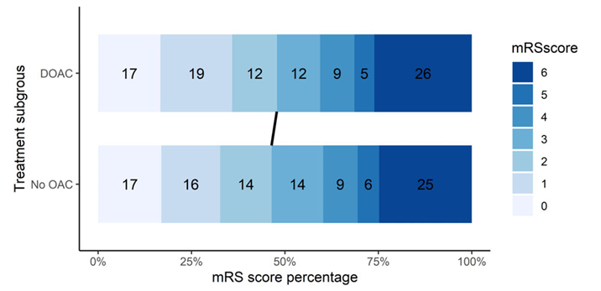
Thrombolytics and DOACs
Safe Implementations of Treatments in Stroke International Stroke Thrombolysis Registry –retrospective observational study, propensity score matched (2013-2024)
  894 on DOAC and 1,788 no DOAC = 39% rivaroxaban, 36% dabigatran, 20% apixaban
  mRS 0-2 at 3 months: 48% vs 46% (p=0.06)
  sICH at 36h: (SITS criteria) 1.1 vs 1.5%, p=0.50; (ECASS-II criteria) 4.0 vs 4.3%, p=0.59
    ≤ 4h from DOAC had highest sICH
  Death at 3 months: 25.1% vs 24% (p=0.65)
Criticisms:
  Retrospective bias, selection bias
  Limited EVT population (20%)
  tPA vs TNK
  34% missing mRS at 3 months
Matusevicius M et al. Ann Neurol. 2025;97(6):1205-1214.
Notes:
DOAC intake was associated with a lower odds ratio for SICH by ECASS II definition (OR 0.21, 95% CI 0.03–0.67) and death by 3-month follow-up (OR 0.64, 95% CI 0.42–0.93)

Slide 14
Hemorrhagic Transformation Criteria
SITS-MOST criteria:
  Local or remote parenchymal hemorrhage type 2 on the 22-36h post-treatment imaging scan
  Neurological deterioration of 4 points or more on the NIHSS from baseline or from the lowest NIHSS value between baseline and 24
  Leading to death
ECASS-II criteria:
  Decrease in the NIHSS score of 4 or more points
  Blood at any site in the brain on the CT

Slide 15
Thrombolytics and DOACs
Considerations:
Timing of last DOAC (possibly subjective, risk of inaccuracy)
Renal function and clearance of medication
  Anti-Xa assays calibrated to DOAC, if available (time-limited, lack of validated thresholds)
No liver disease, active cancer, renal dysfunction
Informed discussion, patient or family preference
Concerns:
Lack of evidence of benefit over risk
No RCTs; mainly observational, registry data
Notes:
anticoagulants prevent the formation of new blood clots by acting at a different site of the coagulation cascade, but ultimately inhibiting fibrin formation, whereas recombinant tissue plasminogen activator dissolves existing clots by activating mainly fibrin bound plasminogen and consequently depolymerizing fibrin
Further research is needed to determine in which patient population on DOACs IVT should be considered

Slide 16
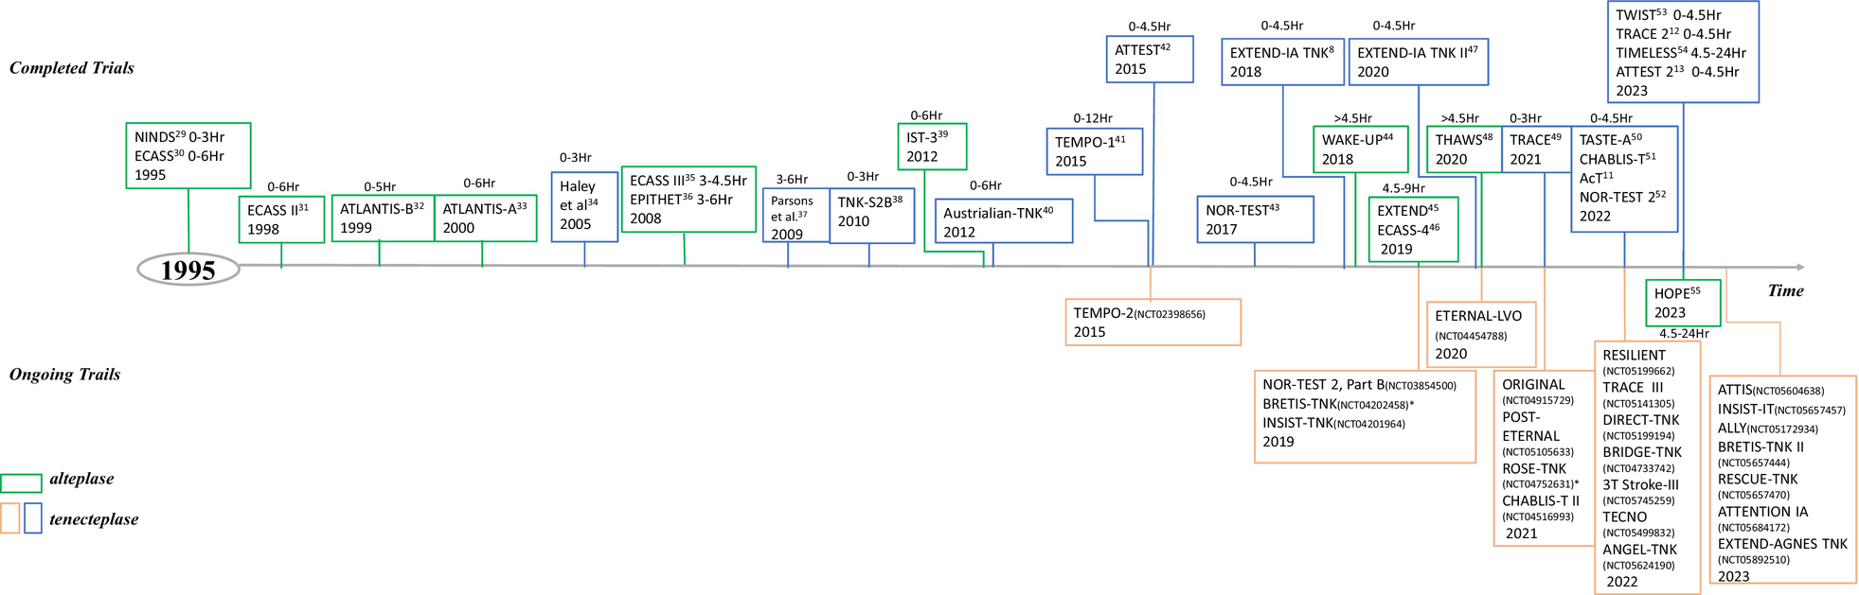
Wang L et al. J Am Heart Assoc. 2024;13(9):e031692.

Slide 17
Alteplase
Trial | Journal | Time | Primary Benefit | Harm
MAST-Italy (n=622) | Lancet 1995 | <6 hours | None | Increased early death
ECASS-I (n=620) | JAMA 1995 | <6 hours | None | Benefit not outweigh risk
NINDS-I (n=291) | NEJM 1995 | <3 hours | None | No difference
NINDS-II (n=333) | NEJM 1995 | <3 hours | ~13% absolute benefit mRS at 90 days | Increase ICH
MAST-Eu (n=310) | NEJM 1996 | <6 hours | None | Stopped early due to harm
ASK (n=340) | JAMA 1996 | <4 hours | None | Stopped early due to harm
ECASS-II (n=800) | Lancet 1998 | <6 hours | None | No difference
ATLANTIS-B (n=613) | JAMA 1999 | 3-4 hours | None | Stopped early due to “unlikely to prove beneficial”
ATLANTIS-A (n=142) | Stroke 2000 | <6 hours | None | Stopped early due to harm
ECASS-III (n=821) | NEJM 2008 | 3-4.5 hours | 7% absolute benefit | Increase ICH
DIAS-2 (n=193) | Lancet 2009 | 3-9 hours | None | No difference
IST-3 (n=3035) | Lancet 2012 | <6 hours | None | No difference
https://first10em.com/thrombolytics-for-stoke/
Notes:
Alteplase FDA approval for stroke in 1996

Slide 18
Tenecteplase
Initial investigations
Pilot study (US; 2005): TNK 0.1 to 0.4 mg/kg == unclear optimal dosing
TNK-2SB (phase 2B/3, US; 2010): TNK 0.1, 0.25, 0.4 mg/kg
  0.4 mg/kg showed high symptomatic ICH rate, discarded as inferior
  0.1 and 0.25 mg/kg unclear efficacy
Australian TNK (phase 2B; 2012):
  TNK 0.25 mg/kg superior to 0.1 mg/kg and tPA 0.9 mg/kg within 6 hours for recanalization and 24h clinical improvement
ATTEST (phase 2, Scotland; 2015):
  No difference between TNK 0.25 mg/kg and tPA 0.9 mg/kg <4.5 hours from stroke
Pooled analysis (TNK-2SB, AUS TNK, ATTEST; 2016):
  TNK 0.25 mg/kg better early neuro improvement and functional outcome at 3 months compared to tPA
Haley EC et al. Stroke. 2005; 35:607-612.
TNK-2SB. Haley EC et al. Stroke. 2010;41:707–711.
Australian TNK. Parsons M et al. N Engl J Med. 2012;366:1099–1107.
ATTEST. Huang X et al. Lancet Neurol. 2015;14:368–376.
Huang X et al. Int J Stroke. 2016;11:534–543.
Wang L et al. J Am Heart Assoc. 2024;13(9):e031692.

Slide 19
Tenecteplase
Optimal dosing and Phase 3 investigations
NOR-TEST (phase 3 superiority, Norway; 2017):
  TNK 0.4 mg/kg within 4.5 hours was not superior to tPA, favored minor strokes
  Similar frequency of sICH (2-3%)
NOR-TEST 2, Part A (phase 3 noninferiority, Norway; 2022): terminated early
  TNK 0.4 mg/kg vs tPA within 4.5 hours or wake-up stroke with DWI mismatch had worse safety and functional outcomes in moderate to severe AIS
NOR-TEST 2, Part B: TNK dose change to 0.25 mg/kg == no results
NOR-TEST. Logallo N et al. Lancet Neurol. 2017;16:781–788.
NOR-TEST 2. Kvistad CE et al. Lancet Neurol. 2022;21:511–519.
Wang L et al. J Am Heart Assoc. 2024;13(9):e031692.

Slide 20
Tenecteplase
Efficacy and safety of TNK 0.25 mg/kg in phase 3 trials
Study (Country, Year) | Sample size (intervention/ control) | Intervention/ control (mg/kg) | mRS score 0-1 at 90 days (%) | Met noninferiority | Safety outcome
 |  |  |  |  | Incidence of sICH (%) | Mortality rate (%)
AcT (Canada, 2022) | 1577 (806/771) | TNK 0.25 vs tPA 0.9 | 36.9 vs. 34.8 | Yes | 3.4 vs. 3.2 | 15.3 vs. 15.4
TRACE-2 (China, 2023) | 1407 (705/696) | TNK 0.25 vs tPA 0.9 | 62 vs. 58 | Yes | 2 vs. 2 | 7 vs. 5
ORIGINAL (China, 2024) | 1465 (732/733) | TNK 0.25 vs tPA 0.9 | 72.7 vs.70.3 | Yes | 1.2 vs. 1.2 | 4.6 vs. 5.8
ATTEST-2 (UK, 2024) | 1777 (885/892) | TNK 0.25 vs tPA 0.9 | 44 vs. 42 | Yes | 2 vs. 2 | 8 vs. 8
TASTE (intl, 2024) | 680 (339/341) | TNK 0.25 vs tPA 0.9 | 57 vs. 55 | Yes | 3 vs. 2 | 7 vs. 4
AcT. Menon BK et al. Lancet. 2022;400:161–169.
TRACE-2. Wang Y et al. Lancet. 2023;401:645–654.
ORIGINAL. Meng X et al. JAMA. 2024;332(17):1437-1445.
ATTEST-2. Muir KW et al. Lancet Neurol. 2024;23(11):1087-1096.
TASTE. Parsons MW et al. Lancet Neurol. 2024;23(8):775-786.
Notes:
rhTNK-tPA from China – same terminal amino acid sequence but different production process compared to Boehringer and Genentech
TRACE-1 (phase 2 rh-TNK-tPA in China, 2022): 0.1, 0.25, 0.32 mg/kg within 3 hours -- 0.25 mg/kg better mRS score 0-1 rate and lower sICH

Slide 21
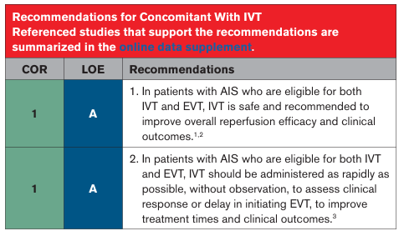
IVT and Endovascular Thrombectomy
2026 AHA/ASA Guideline for the Early Management of Patients with Acute Ischemic Stroke
Notes:
Improved verbiage on recommendation #2 (used to say observation after IV tPA to assess for clinical response should not be performed)

Slide 22
TNK and Endovascular Thrombectomy
EXTEND-IA TNK (AUS; 2018): (n=202) EVT with TNK 0.25 mg/kg vs tPA within 4.5h
  Reperfusion >50%: 22% vs 10%, P=0.002; 90d median mRS 2 vs 3 (OR 1.7; 95% CI, 1.0 to 2.8; P=0.04)
  sICH 1% in both groups
BRIDGE-TNK (China; 2025): (n=278) TNK + EVT vs EVT alone within 4.5h
  mRS 0 to 2: 52.9% vs 44.1% (adjusted RR, 1.18; 95% CI, 1.01 to 1.39; P=0.04)
  sICH within 48h: 8.5% vs 6.7%; mortality at 90d: 22.3% vs 19.9%
DIRECT-TNK (phase 3, Brazil; currently recruiting): TNK + EVT vs EVT alone within 4.5h
EXTEND-IA TNK. Campbell BCV et al. N Engl J Med. 2018;378(17):1573-1582.
BRIDGE-TNK. Qiu Z. N Engl J Med. 2025;393(2):139-150.
Wang L et al. J Am Heart Assoc. 2024;13(9):e031692.
Notes:
https://www.nejm.org/doi/full/10.1056/NEJMoa2503867
EXTEND-IA TNK Part 2 (AUS, NZ; 2020): (n=300) TNK 0.25 vs 0.4 mg/kg before EVT within 4.5h
Reperfusion >50%: 19.3% in both groups (adj OR 1.03 [95% CI, 0.66-1.61]; P = .89)
No difference in functional outcomes or sICH

Slide 23
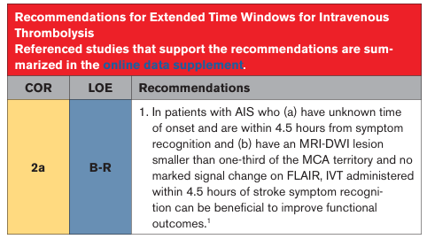
Extended Time Window IVT
WAKE-UP (intl; 2018): stopped early (n=503) tPA vs placebo (EVT excluded)
  Unknown onset, MRI DWI-FLAIR mismatch within 4.5h
  mRS 0 or 1 at 90d: 53% vs 42% (adjusted OR, 1.61; 95% CI,1.09 to 2.36; P=0.02)
  sICH 2% vs 0.4%
2026 AHA/ASA Guideline for the Early Management of Patients with Acute Ischemic Stroke
WAKE-UP. Thomalla G et al. N Engl J Med. 2018;379(7):611-622.
Notes:
WAKE-UP stopped early due to loss of funding, enrolled fewer patients than planned

Slide 24
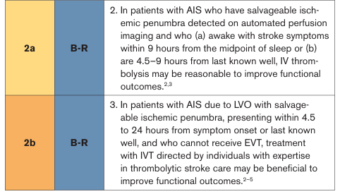
Extended Time Window IVT
2026 AHA/ASA Guideline for the Early Management of Patients with Acute Ischemic Stroke

Slide 25
IVT Beyond 4.5 hours
Meta-analysis of phase 3 trials:
  IVT was associated with greater odds of mRS 0–1 at 90d outcome (OR, 1.43 [95% CI, 1.17–1.75])
  Increase in sICH (OR 4.25 [95% CI, 1.67–10.84])
TIMELESS (US & CAN; 2024): (n=458) TNK vs placebo 4.5 to 24h
  Median last known well ~13 hours; 77% underwent EVT in both groups
  No significant difference in a lower mRS score at 90d (adj OR 1.13; 95% CI, 0.82 to 1.57; P=0.45)
  Complete recanalization at 24h: 76.7% vs 63.9%, OR 1.89 [95% CI, 1.21–2.95]
  Mortality (20% vs 18%) and sICH (3% vs 2%) were similar
Campbell BCV, et al. Lancet. 2019;394:139–147.
TIMELESS. Albers GW et al. N Engl J Med. 2024;390:701–711.
Notes:
https://pmc.ncbi.nlm.nih.gov/articles/PMC12961998/

Slide 26
TNK and ICH Complications
ATTEST (Scotland; 2015): TNK trend towards fewer ICH complications
  TNK 2% vs tPA 4%, p=0.55; total ICH events: 15% vs 29%, p=0.091
CERTAIN (2023): (n=9238) retrospective observational study, >100 hospitals (NZ, AUS, US)
  Definition: NIHSS decrease by 4 points attributed to IPH, SAH, or IVH
  TNK 1.8% vs tPA 3.6%, aOR, 0.42 [95% CI, 0.30–0.58]; P<0.01
  Similar results in both EVT and non-EVT patients (EVT: TNK 38% vs tPA 20%)
ATTEST. Huang X et al. Lancet Neurol. 2015;14:368–376.
CERTAIN. Warach SJ et al. JAMA Neurol. 2023;80(7):732-738.
Wang L et al. J Am Heart Assoc. 2024;13(9):e031692.

Slide 27
TNK Benefits
Longer half-life and greater fibrin specificity == more targeted and faster clot dissolution
  Reduced hepatic elimination and increased resistance to plasminogen activator inhibitor-1
Effective and safe
Superior efficacy in LVO stroke
Simpler single-bolus administration – improves door-to-needle and door-in-door-out times
Less complex dosing, possible reduction in dosing errors
Might be cheaper than alteplase depending on supplier
Alternative in alteplase shortages (November 2024, October 2025)
EXTEND-IA TNK. Campbell BCV et al. N Engl J Med. 2018;378(17):1573-1582.
Warach SJ et al. Stroke. 2022;53(12):3583-3593.
Katsanos et al. Stroke. 2021;52(1):308-312.
Notes:
At UC Davis Health, we transitioned to TNK July 2021 given the data that had been published up until that point (similar efficacy in functional outcomes and reperfusion and similar rates of ICH, bleeding, etc) along with reduced cost between the two products and perceived benefit in preparation and timing.

Slide 28
Looking to the Future
TNK’s FDA approval in AIS and endorsement from the 2026 AHA/ASA Acute Ischemic Stroke Guidelines:
  Bolster TNK addition to institutional formularies for indication of AIS
  Improve clinical outcomes due to saved time
  Genentech accepts returns for credit (for product mixed but not used)
What’s next for further research:
  If there is a benefit for patients 4.5h from awakening selected by CT scan
  If there is a benefit for patients who have a basilar artery occlusion or non-large vessel occlusion beyond 4.5-hour time window (currently underway)

Slide 29
Post-Thrombolytic Management

Slide 30
Post-IVT Monitoring
Hold all antithrombotics including DVT prophylaxis for 24 hours post-thrombolytic administration
BP, HR, RR, O2 saturation, temperature, serial neuro exam (NIHSS)
  Every 15min for 2 hours, 30min for 6 hours, 60min for 16 hours
Signs or symptoms of bleeding
  Avoidance of placing invasive lines and catheters, especially in non-compressible sites
Signs of orolingual angioedema (swelling of the oropharynx, lips, or tongue)
Notify the team STAT for decreased level of consciousness, sudden headache, vomiting, neurological deterioration (decrease in NIHSS by ≥ 2 points), inability to protect airway

Slide 31
Blood Pressure Goals
2026 recommendations:
Pre-IVT: BP <185/110 to reduce hemorrhagic complications (1, B-NR)
Post-IVT: BP <180/105 for first 24h after thrombolytics (1, B-R)
  Intensive SBP reduction <140 vs <180 showed no benefit in functional outcomes (3, B-R)
    ENCHANTED trial: failed to improve functional outcome (OR, 1.01; 95% CI, 0.87–1.17), but lowered bleeding risk (OR, 0.75; 95% CI, 0.600.94)
    < 2% of patients underwent thrombectomy
2026 AHA/ASA Guideline for the Early Management of Patients with Acute Ischemic Stroke
ENCHANTED. Lancet. 2019;393(10174):877-888.
Notes:
Post-thrombolytics BP goal not proven by an RCT but was based on protocol of thrombolytic RCTs

Slide 32
Blood Pressure Goals
2026 recommendations:
Endovascular thrombectomy
  Pre-procedure: BP <185/110
  During and post-procedure for 24h: BP ≤180/105 (2a, B-NR)
  LVO of anterior circulation (mTICI 2b, 2c, or 3) and without other indication for BP management target, intensive SBP reduction target of <140 mm Hg for the first 72 hours is harmful and not recommended (3, A)
2026 AHA/ASA Guideline for the Early Management of Patients with Acute Ischemic Stroke

Slide 33
Blood Pressure Management
Bolus medications (IVP):
Medication | Mechanism | Dose | Frequency | Onset | Duration | Considerations
labetalol | non-selective beta-blocker | 10-20 mg, up to 80 mg | q10min to q4 or 6 hours | within 5 min | ~6 hours | bradycardia
hydralazine | direct arterial vasodilator, inhibits Ca release | 10-20 mg | q4 to 6 hours | 10-80 min | 3 to 7 hours | tachycardia, variable response, ICP
enalaprilat | ACE inhibitor | 1.25 mg | q6 hours | within 15 min | ~6 hours | renal dysfunction
Notes:
No metoprolol
Hydralazine MoA: inhibits inositol trisphosphate (IP3)-induced calcium release from the smooth muscle cell sarcoplasmic reticulum and inhibits myosin phosphorylation in arterial smooth muscle
Slove acetylators may have profound hypotension
ACEI MoA: Competitive inhibitor of angiotensin-converting enzyme (ACE); prevents conversion of angiotensin I to angiotensin II, a potent vasoconstrictor; results in lower levels of angiotensin II which causes an increase in plasma renin activity and a reduction in aldosterone secretion

Slide 34
Blood Pressure Management
Titratable continuous infusions, slow (>15 minutes):
Medication | Mechanism | Dose | Titration | Onset | Considerations
labetalol | non-selective beta-blocker | 10-20 mg load IVP, 0.5 to 2 mg/min (10mg/min) | every 5-20 min | within 5 min | bradycardia
nicardipine | Ca-channel blocker | 2.5-15 mg/hour | 2.5mg/h every 15 min | within 1-5 min | volume overload, different concentrations (20mg or 40mg / 200mL)
Titratable continuous infusions, rapid (<5 minutes):
Medication | Mechanism | Dose | Titration | Onset | Considerations
clevidipine | Ca-channel blocker | 1-21 mg/hour | double every 90s | 2-4 min | better volume, hypertriglyceridemia, pulmonary shunting
Notes:
No nitroglycerine or nitroprusside or esmolol
Esmolol downsides: beta-selective until higher doses when it becomes more non-selective (limited by HR), high volume
Nitroglycerin downsides: cerebral vasodilation – increase ICP, not a durable option
Nitroprusside downsides: can increase ICP / decrease CPP, cyanide toxicity risk, methemoglobinemia, not a durable option; avoid in AKI
Nicardipine: max concentration at max rate = 75 ml/hr

Slide 35
Blood Pressure Management
IVP BP medications are preferred if sustainable and do not cause major BP fluctuations
  Can be preferred when transitioning off continuous infusions with initiation of oral BP medications
Need for tight immediate control: clevidipine
  Ideal pharmacokinetics and pharmacodynamics for urgent/emergent situations (e.g. ICH)
Utilize oral antihypertensives when appropriate to mitigate high usage of IV BP medications
Assess for other underlying causes of elevated BP (e.g. pain, anxiety)

Slide 36
Blood Glucose Management
Hyperglycemia is an independent marker of larger ischemia, reduced function and cognitive outcomes, and increased risk of mortality
  Persistent hyperglycemia both at 6 and 24 hours:
    increased risk of mortality within 30 days [odds ratio (OR) 24.0; 95% confidence interval (CI): 2.8–199.3]
    hemorrhagic transformation (OR = 13.3; 95% CI: 2.7–66.1)
Effect of diabetes or hyperglycemia on outcomes after IVT:
  Admission glucose was inversely associated with favorable functional outcome (adj OR 0.92; 95% CI, 0.90 to 0.94)
  Directly associated with symptomatic ICH (adj OR 1.09; 95% CI, 0.104 to 1.14)
  Similar in endovascular patients and additionally associated with mortality
SITS-ISTR Registry. Tsivgoulis G et al. Diabetes. 2019;68:1861–1869.
Mi D et al. Ther Adv Neurol Disord. 2017;11:1756285617731686.
Desilles JP et al. Stroke. 2013;44(7):1915-1923.
Chamorro A et al. Stroke. 2019;50(3):690-696.
Notes:
https://pmc.ncbi.nlm.nih.gov/articles/PMC8463990/
https://practicalneurology.com/diseases-diagnoses/stroke/hyperglycemia-management/31861/

Slide 37
Blood Glucose Management
2026 recommendations:
Blood glucose (BG) <60 mg/dL should be treated to avoid complications (1, C-LD)
Target BG 140 to 180 mg/dL with close monitoring to prevent worse functional outcomes (2a, C-LD)
BG 80 to 130 mg/dL is not recommended to improve 3-month functional outcomes (3, A)
Sliding scale correction with rapid- or short-acting insulins (aspart or regular)
  For diabetic patients, basal coverage with long-acting insulin (glargine) and nutritional coverage with rapid-acting insulins (aspart)
BG ≥180 mg/dL x 2 == start insulin infusion to target BG 140 to 180 mg/dL
Pharmacist-managed insulin therapy in the ICU
  Lower day weighted mean BG ≥180 mg/dL (21% vs 14% pre- and post-intervention)
  No difference in hypoglycemic events (3.6% vs 3.4%)
2026 AHA/ASA Guideline for the Early Management of Patients with Acute Ischemic Stroke
Kuo A et al. Crit Care Med. 2025;53(1).
Notes:
https://practicalneurology.com/diseases-diagnoses/stroke/hyperglycemia-management/31861/
https://pmc.ncbi.nlm.nih.gov/articles/PMC8463990/

Slide 38
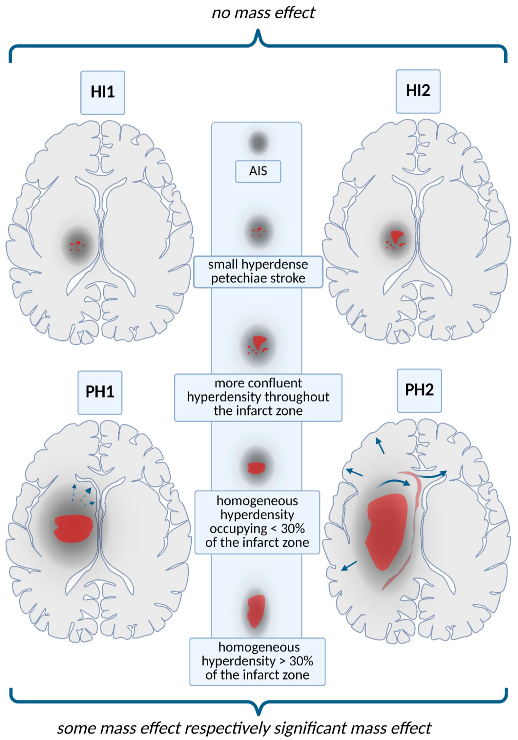
Symptomatic ICH within 24h of IVT
Occurs in approximately 3-5% of patients with a median onset time of 8 hours and within 24 hours of IVT
If CT scan shows significant hemorrhage causing symptomatic decline:
  Stop all further antithrombotics, including alteplase if still infusing
  Send CBC, type and screen, fibrinogen, PT/INR, aPTT, TEG
  Reversal of IVT == hemostatic therapy
  Supportive therapy including BP and ICP management, temperature control, glucose control
2026 AHA/ASA Guideline for the Early Management of Patients with Acute Ischemic Stroke
Notes:
TXA or aminocaproic acid can be beneficial when blood products are contraindicated by patient/family or if cryo dis not available in a timely manner

Slide 39
Symptomatic ICH within 24h of IVT
Hemostatic therapy
Cryoprecipitate – preferred
  10 units infused over 10-30 minutes (may increase fibrinogen by 50-70 mg/dL)
  Contains fibrinogen, factors VIII and XIII, and von Willebrand factor​
Tranexamic acid – use if blood products are contraindicated​ or declined by patient/family
  IV 1 g over 10 minutes
  Forms a reversible complex that displaces plasminogen from fibrin resulting in inhibition of fibrinolysis; inhibits the proteolytic activity of plasmin​
Aminocaproic acid
  IV 4-5 g over 1 hour followed by 1 g/hour for 8 hours until bleeding is controlled
  Binds competitively to plasminogen; blocking the binding of plasminogen to fibrin and the subsequent conversion to plasmin resulting in inhibition of fibrin degradation
Lexi-Comp, Inc. (Lexi-Drugs®) 2026.​
Notes:
Limitations for cryo: some institutions require type and screen, time taken for product to thaw, transfusion reactions
Benefits for TXA: fast administration, simple reconstitution of a vial
Limitations for amiocaproic acid: needs to be compounded in IV room, two separate bags (one loading dose, one continuous infusion)

Slide 40
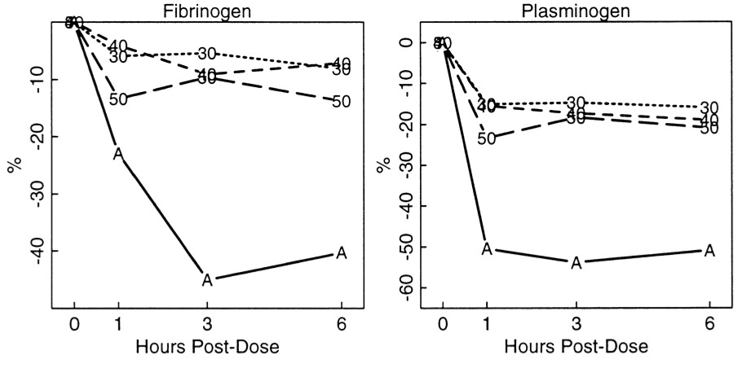
Symptomatic ICH within 24h of IVT
Repeat coagulation studies (CBC, INR, PTT, fibrinogen, consider TEG) and imaging as necessary
  Repeat fibrinogen level 60 minutes after infusion is complete and repeat cryo as necessary (goal fibrinogen >150-200 mg/dL)
Tenecteplase is unlikely to affect serum fibrinogen concentrations (clot-bound fibrin specificity)
  Check fibrinogen concentrations post-therapy, but not a reliable target
A, alteplase (tPA); 30, 40, and 50, respective doses of TNK-tPA in mg
TIMI 10B Trial. Cannon CP et al. Circulation. 1998;98(25):2805-2814.
Huang X et al. Stroke. 2015;46(12):3543-3546.

Slide 41
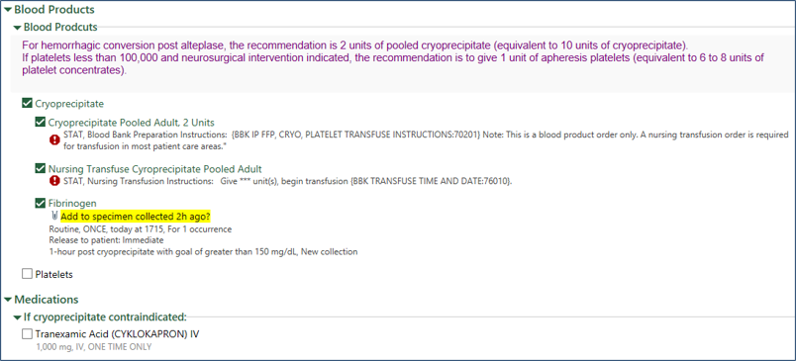
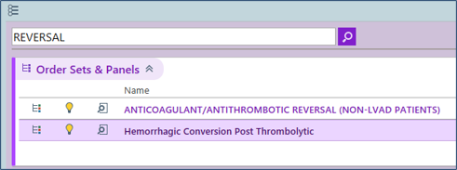
Reversal Order Set

Slide 42
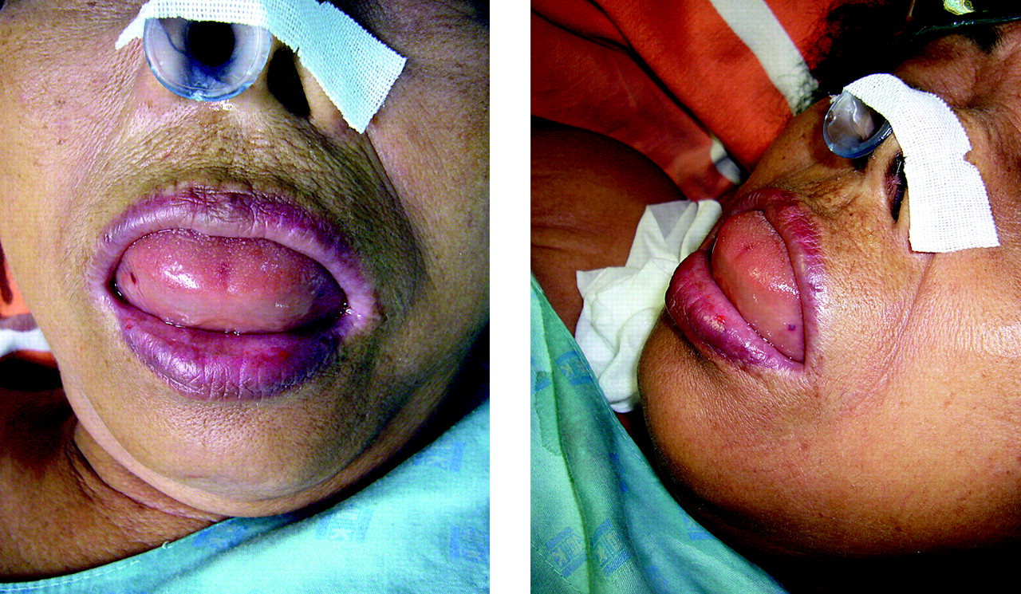
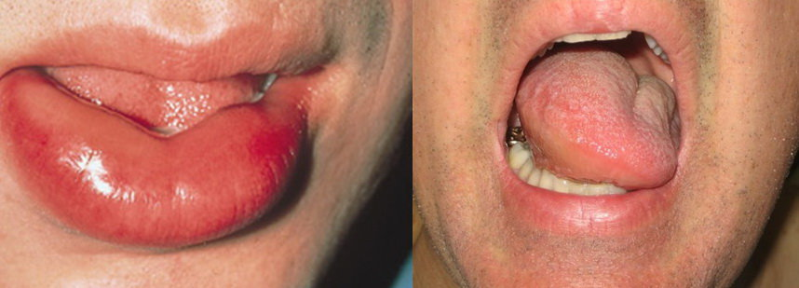
Orolingual Angioedema from IVT
Incidence of angioedema after thrombolytic therapy is 2-8% in general population
  Alteplase: up to 5.1%; Tenecteplase: 0.1-2.8%
  6x higher for patients taking ACE inhibitors
Mechanism: increased bradykinin, activation of the complement cascade (C3a and C5a), increased release of histamine
Dellabella A et al. Stroke. 2024;55(8):e242-e244.
Hutton EM et al. Stroke. 2024;55(8):2193-2197.
Notes:
swelling of the oropharynx, lips, or tongue
ACE inhibitors block the ability for ACE to inactivate bradykinin, resulting in a slower rate of bradykinin degradation, enhanced biologic activity, and increased ability to induce angioedema. Additionally, ACE inhibitors block the ability of ACE to degrade substance P, another mediator linked to angioedema.
also activate factor XII, leading to the cleavage of prekallikrein to kallikrein. Kallikrein cleaves circulating high molecular weight kininogen to bradykinin

Slide 43
Orolingual Angioedema from IVT
Maintain airway – consider endotracheal intubation as necessary
  Edema involving larynx, palate, floor of mouth, or oropharynx with rapid progression within 30 minutes poses higher risk
Discontinue IVT infusion if alteplase, hold ACE inhibitors
Administer methylprednisolone IV 125 mg, diphenhydramine IV 50 mg, famotidine IV 20 mg
Further increase in angioedema, administer epinephrine IM 0.3 mg (1 mg/mL)
Consider icatibant (Firazyr) 30 mg SQ, may repeat every 6 hours up to 90 mg per 24 hours
Monitoring
  Airway status, oxygenation, vital signs
2026 AHA/ASA Guideline for the Early Management of Patients with Acute Ischemic Stroke
Notes:
in cases of bradykinin angioedema, patients may not respond to these initial treatments though they do interfere with the histamine pathway

Slide 44
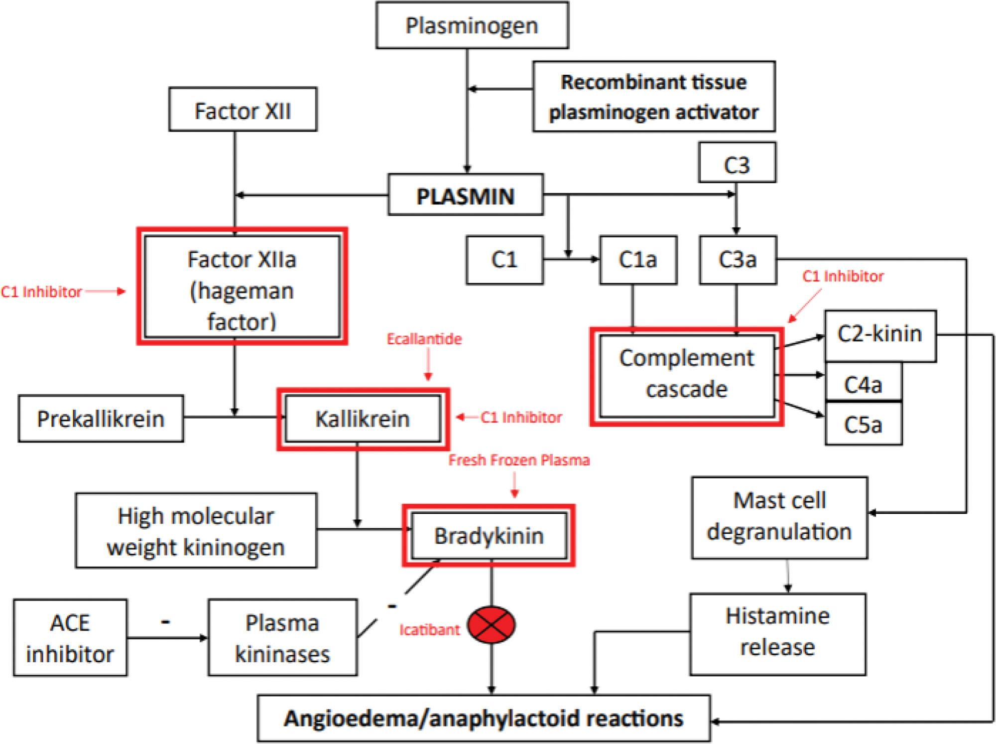
Orolingual Angioedema from IVT
Bradykinin B2 receptor antagonist
  Icatibant (Firazyr – synthetic)
  Does not interfere with thrombolysis
C1-esterase concentrate (plasma-derived)
  Cinryze, Berinert
  Irreversibly bind to and inactivate kallikrein and factor XIIa to prevent bradykinin formation; works on compliment cascade to regulate generation of inflammatory mediators; inhibits plasmin
FFP
  Contains kininase II and leads to degradation of accumulated bradykinin
Dellabella A et al. Stroke. 2024;55(8):e242-e244.
Hutton EM et al. Stroke. 2024;55(8):2193-2197.
Notes:
ACE inhibitors block the ability for ACE to inactivate bradykinin, resulting in a slower rate of bradykinin degradation, enhanced biologic activity, and increased ability to induce angioedema. Additionally, ACE inhibitors block the ability of ACE to degrade substance P, another mediator linked to angioedema.

Slide 45
Key Takeaways
Tenecteplase is well supported as the thrombolytic choice for IVT and is as safe and effective as tPA
Tenecteplase has simpler dosing and has been shown to improve door-to-needle and door-in-door-out times
Appropriate blood glucose management decreases risk of mortality and hemorrhagic transformation
If emergent IVT reversal is needed, cryoprecipitate is preferred, but a fibrinogen target in patients who receive TNK might be inaccurate

Slide 46
Thrombolytics Today: Tenecteplase vs Alteplase & Post-Thrombolytic Management
Robyn Stoianovici, PharmD, BCCCP
Senior Clinical Pharmacist, Neurocritical Care
Notes:
TNK and tPA and weave in weave pharmacist involvement in a stroke activation throughout the presentation
BP management post-intervention, such as agent choice and general strategy, but I won't discuss in-depth on BP goals (practice varies for post-thrombectomy specifically and I see there are other sessions in the agenda regarding BP)
• Blood pressure agent selection and medication strategy post-reperfusion
• How pharmacy integrates into rapid stroke activation workflows, especially in community settings
2026 Guideline for the Early Management of Patients With Acute Ischemic Stroke
2018 Guidelines for the Early Management of Patients With Acute Ischemic Stroke

Slide 47
Modified Rankin Scale
Modified Rankin Scale Score | Description
0 | No symptoms
1 | No significant disability. Able to carry out all usual activities, despite some symptoms.
2 | Slight disability. Able to look after own affairs without assistance, but unable to carry out all previous activities.
3 | Moderate disability. Requires some help, but able to walk unassisted.
4 | Moderately severe disability. Unable to attend to own bodily needs without assistance, and unable to walk unassisted.
5 | Severe disability. Requires constant nursing care and attention, bedridden, incontinent.
6 | Dead.

