Slide 1

Rapid Recognition and Prehospital Stroke Systems
Miranda Lewis, MD
Medical Director, Central California EMS Agency
UCSF-Fresno Emergency Medicine

Slide 2
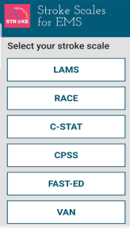

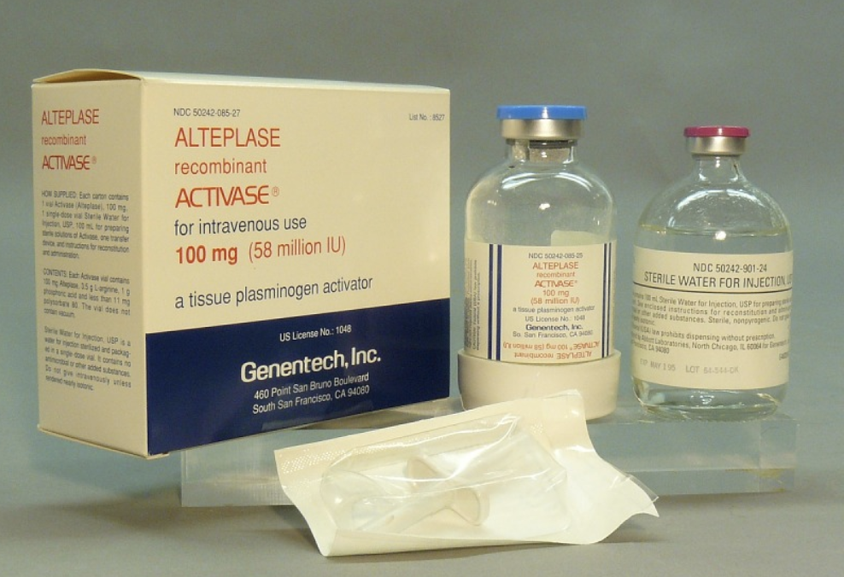
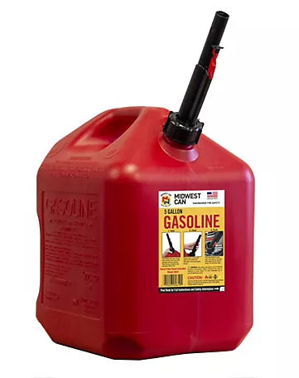
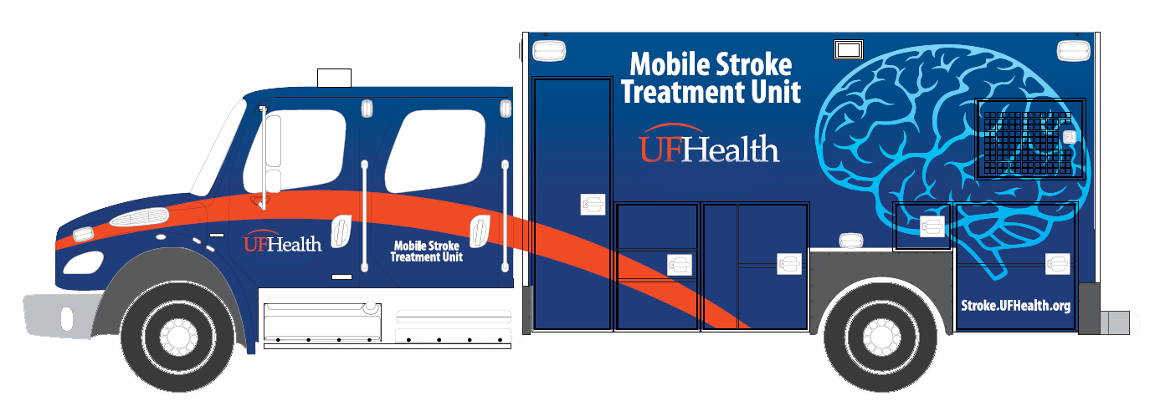
The Evolution of Prehospital Stroke Care
Prehospital Destination Determination
Prehospital Screening and Alert
Notes:
30 years ago, we didn’t even have stroke scales in EMS. Diesel was the only treatment available and it didn’t really matter where the patient went because there was no treatment available. As science advanced and tPA was approved by the FDA in 1996, there was a paradigm shift as stroke became a treatable condition. The first prehospital stroke scales, like Cincinnati Prehospital Stroke Scale and FAST emerged as we recognized that EMS plays an important role in early recognition and notification. We have evolved significantly from diesel therapy to a stroke system of care designed for early recognition, notification, and more nuanced destination decisions. And in some regions, this has evolved to mobile stroke units that take the diagnostics and treatment to the patient.

Slide 3

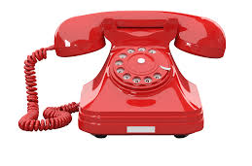
What proportion of stroke patients utilize EMS?
59%
Mochari-Greenberger H, Xian Y, Hellkamp AS, et al. JAHA. 2015; 4(8)
Notes:
We analyzed data from 398 798 stroke patients admitted to 1613 Get With The Guidelines–Stroke participating hospitals between October 2011 and March 2014. Overall, 59% of stroke patients were transported to the hospital by EMS. Additionally there were significant racial disparities in EMS use with Hispanic and Asian men and women had 20% to 29% lower adjusted odds of using EMS versus their white counterparts; black women were less likely than white women to use EMS (odds ratio 0.75, 95% CI 0.72 to 0.77).

Slide 4

Dispatch is the entry point into the stroke system of care!
Notes:
It all starts with dispatch. When you call 911, the call gets routed first to a primary PSAP. This is often law enforcement dispatch. They will determine that the call is medical in nature and route the call to a secondary PSAP.
That secondary PSAP then has to figure out what is going on, what type of help to send, and how urgently to send it.
Accurate dispatcher recognition has been associated with faster triage, greater likelihood of admission to endovascular-capable centers, and higher
treatment rates for stroke. Importantly, dispatcher labeling of calls as suspected stroke can influence EMS personnel’s initial assessment and prioritization at the scene.

Slide 5
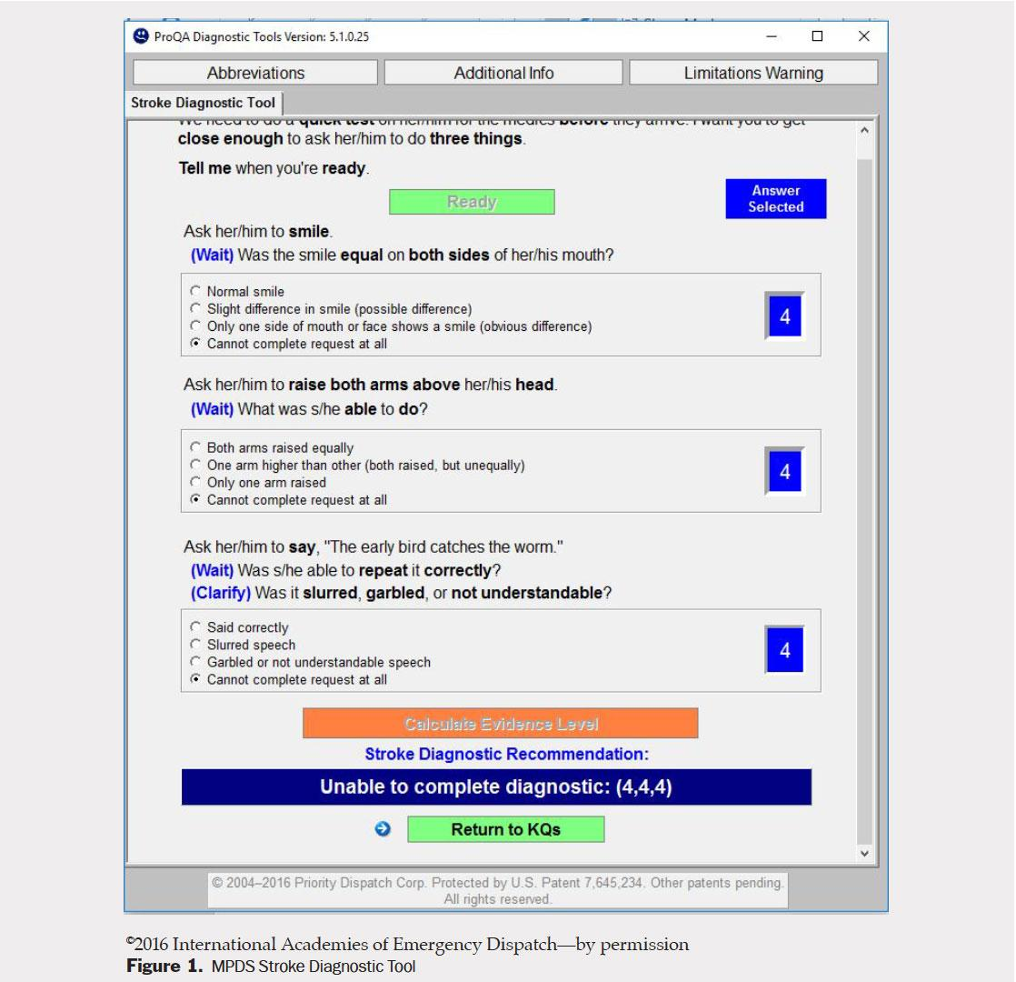
Notes:
Telecommunicators have to screen the calls and ask questions to determine what type of response is needed. Not every 911 call gets a lights and sirens response, so it is important that the telecommunicators are able to identify that a stroke emergency is occurring. They also have screening tools built into their dispatch protocols to help them identify stroke. But despite these tools, sensitivity for stroke detection in dispatch centers varies from ~18-83% internationally.

Slide 6
What difference does dispatch make?
Dispatcher sensitivity for stroke detection 48-80%
Influences downstream provider impressions
Determines the type of EMS response
EMS scene times shorter when stroke identified by dispatch*
  ≤ 15 min scene time 57.4% when dispatch as stroke vs 48% ”other”
*Abbas AY, Odom EC, Nwaise I. Journal of Stroke and Cerebrovascular Diseases. 2022; 31(3)
Notes:
A retrospective study analyz-
ing National EMS Information System (NEMSIS)
data on 966 745 US patients transported by EMS
between 2012 and 2016 assessed the impact of
dispatch complaints on prehospital time intervals
for patients with suspected stroke. Approximately
37% of dispatch complaints were identified by EMS
as suspected strokes. Compared with nonstroke
dispatches, stroke-identified calls had shorter on-
scene times, with 57.4% meeting the benchmark
of ≤15 minutes versus 48.0% for nonstroke calls.1
These findings highlight the importance of EMS
dispatchers in recognizing stroke symptoms and
the need for continuing improvement.

Slide 7
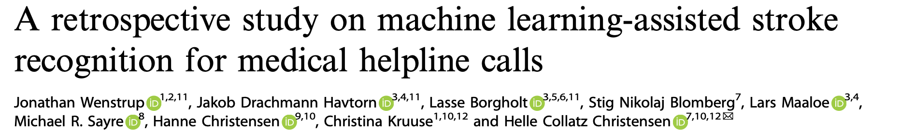


52.7%
63%
p < 0.0001
npj Digital Medicine (2023) 6:235 ; https://doi.org/10.1038/s41746-023-00980-y
Notes:
A group in Copenhagen studied whether a machine learning model could identify stroke in emergency line callers. They found that the dispatcher identified stroke with 52.7% sensitivity while the machine learning model had significantly higher sensitivity at 63%. Telecommunicators will not be replaced by AI, but it is likely that AI will be increasingly used in 911 centers to support telecommunicators in identifying time sensitive conditions such as stroke.

Slide 8

Median Response Time
7.6 minutes*
* 2024 CARES Annual Report

Slide 9
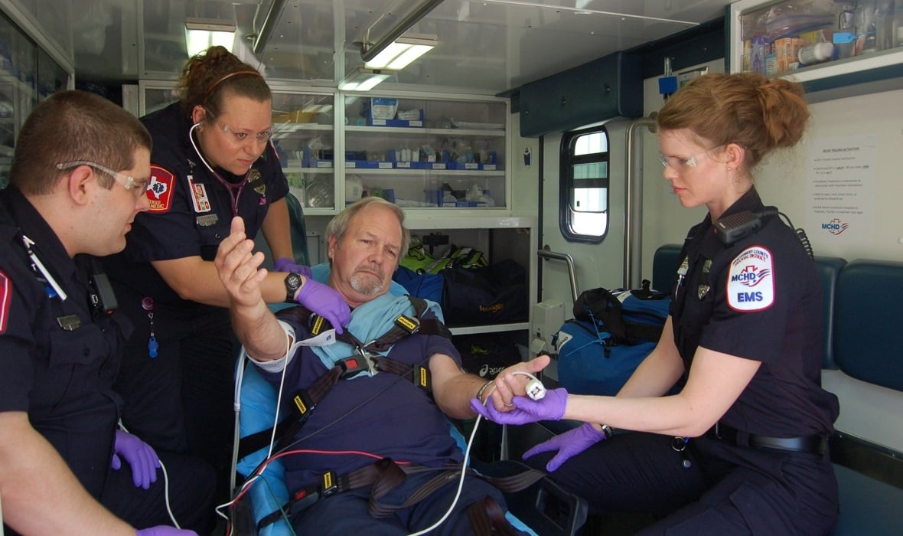
Goal < 10 minutes
Scene Time
Notes:
When accounting for unavoidable delays such as patient access and reluctance to transport, last year, we achieved < 10 minute scene time 82% of the time

Slide 10
Transport Time &
Hospital Activation

Slide 11
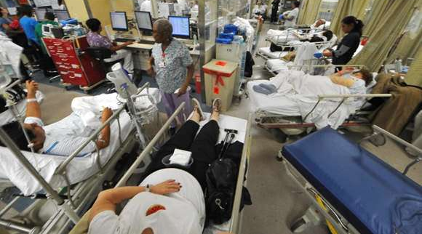
The prehospital assessment determines not just whether a stroke is recognized – but where the patient enters the system
Notes:
EMS is critical for determining where a patient enters the ED system. In this era of ED overcrowding, long ambulance offload times that may be up to 40 minutes, and where a large number of patients are cared for in hallway beds, the EMS report and assessment may make a huge difference as to whether a patient is treated in the window.
EMS is not just “transport”—it is the first triage node in a regional stroke system
Prehospital decisions affect:
Door-to-CT / door-to-needle times
Direct-to-angio vs ED-first workflows
Interfacility transfer burden

Slide 12
CPSS
ACT-FAST
RACE
GFAST
CSTAT
ELVO
FANG
FAST VAN
VAN
EMSA
FACE2AD
FAST-ED
AAW
FPSS
HEMIPARESIS
HEMIPLEGIA
LAMS
LARIO
MDIRECT
mNIHSS
NIHSS
sNIHSS EMS
STSS
VES
PASS
POMONA
SAFE
SAVE
ROSIER
SNOW

Slide 13

What makes a good stroke scale?
Scale performance is context dependent!
Notes:
A good prehospital stroke scale should optimize sensitivity- we don’t want to miss strokes. Specificity is also important when it comes to allocation of resources. We do not want to have so many false positives that we are overwhelming our CSC with patients. Also, we may be bypassing a primary stroke center in some circumstances, so we only want to do that for the true LVOs.
For example, an urban region with sufficient resources may prioritize a scale with a high sensitivity because delays to IVT that might result from bypassing a closer PSC will be relatively short whereas delays to EVT related to interfacility transport are relatively long.
In regions with larger distances or limited resources a higher specificity might be preferred because of the longer delays to IVT associated with bypassing a PSC.

Slide 14
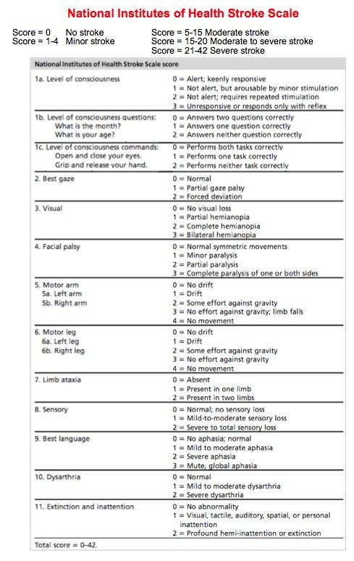

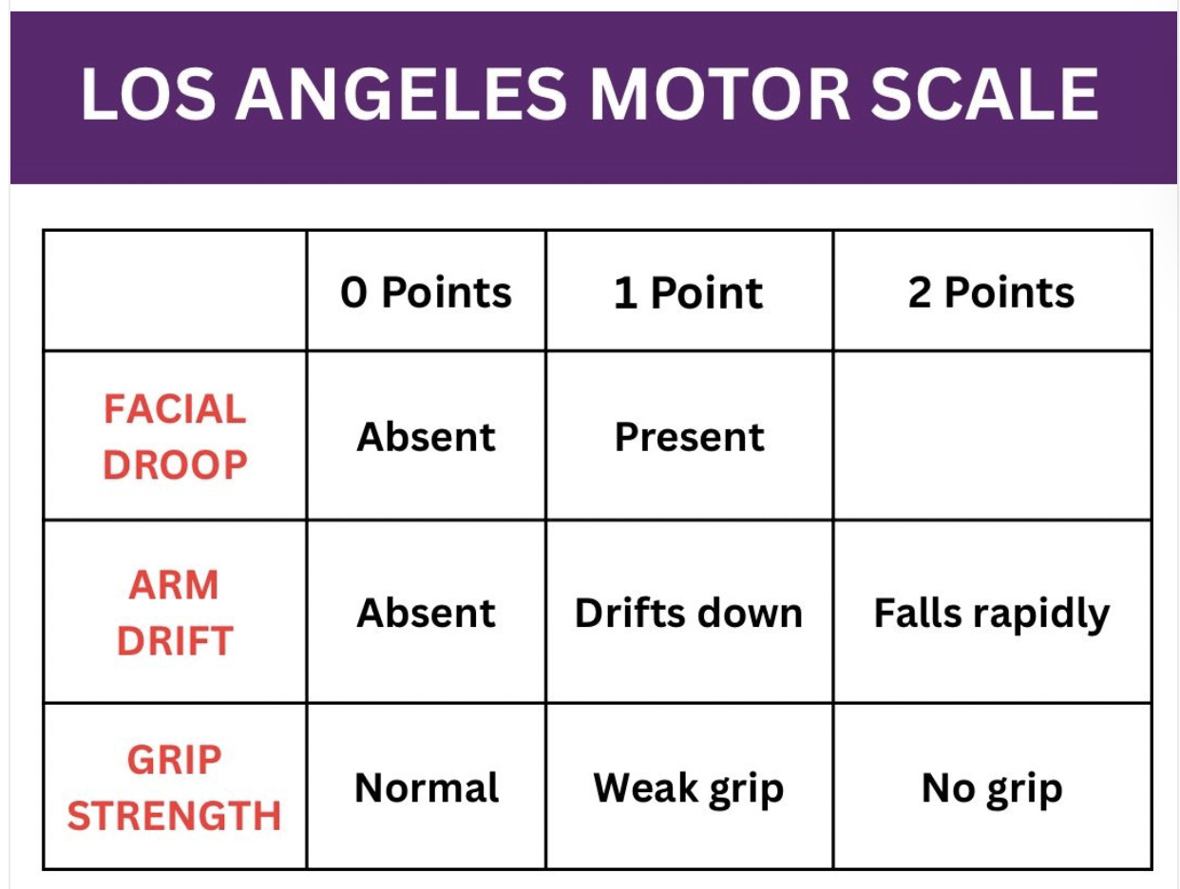

Slide 15
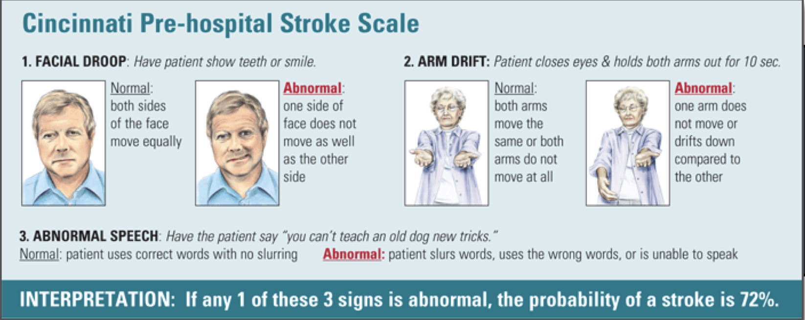
Cincinnati Prehospital Stroke Scale
Notes:
CPSS has been around since 1997

Slide 16
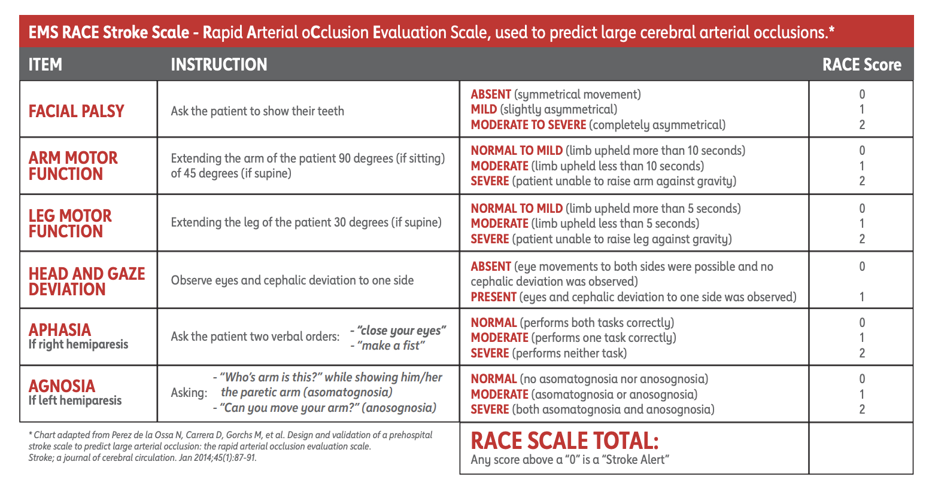
Sensitivity 64%
Specificity 86%
Overall performance (AUROC) 0.81
Ease of use?
Dekker L et al. Neurology. 2025;105:e213570
Notes:
Scores range from 0-9. A score of 5 or greater is suggestive of LVO.

Slide 17
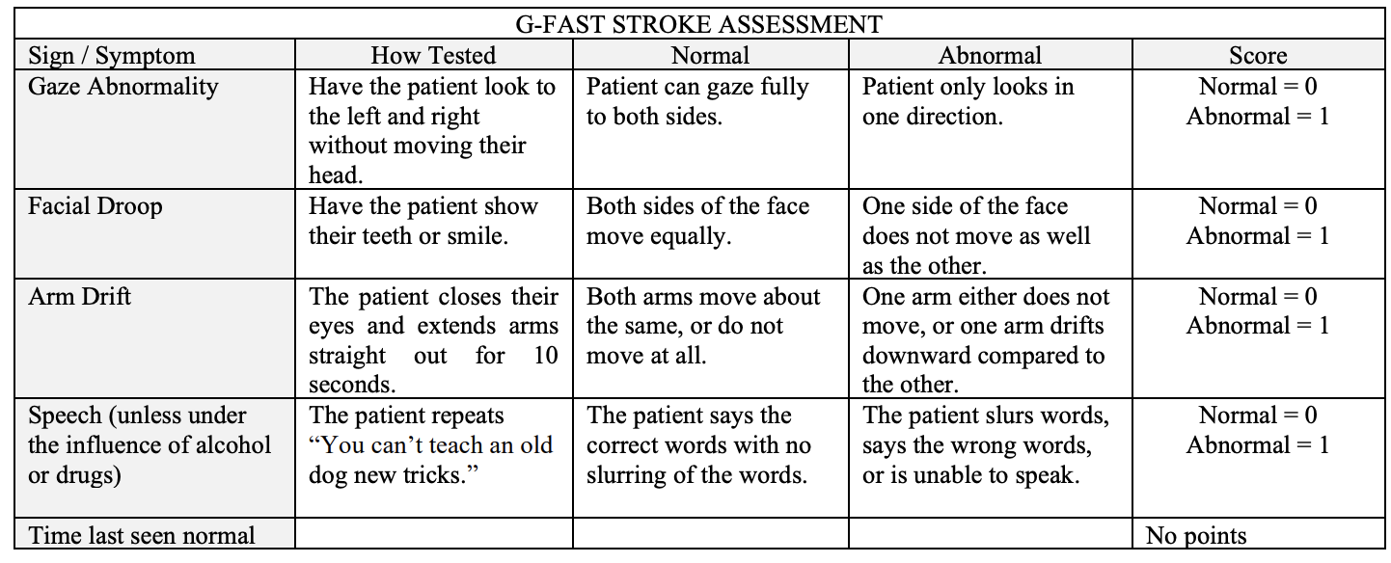
G-FAST
Sensitivity 65%
Specificity 81%
Overall performance (AUROC) 0.80
Ease of use?
Dekker L et al. Neurology. 2025;105:e213570
Notes:
Strengths:
High sensitivity for anterior circulation stroke
Operational simplicity → reproducibility across providers
Poor sensitivity for:
Posterior circulation
Isolated aphasia (variable)

Slide 18
Sensitivity 69%
Specificity 80%
Overall performance (AUROC) 0.80
Ease of use?
Dekker L et al. Neurology. 2025;105:e213570

Slide 19
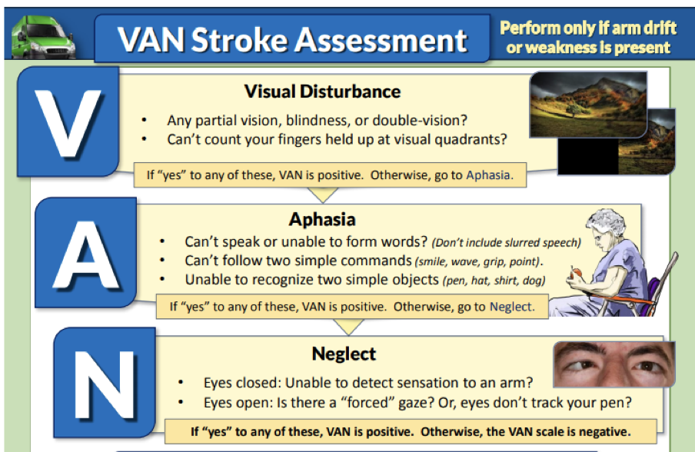
Sensitivity 78%
Specificity 68%
Overall performance (AOC) 0.79
Ease of use?
Ahmad Nawabi et al. Neurology. 2026;106:e214484
Notes:
VAN is combined with Cincinnati Prehospital Stroke Scale (or other scale assessing for weakness). If the patient has weakness, then you go on to perform the VAN assessment to evaluate for LVO.

Slide 20
Challenges with Prehospital Stroke Scales
Gaze deviation is high yield but challenging to assess
Not designed for posterior circulation strokes
Not validated in pediatric patients
None have both high sensitivity and specificity
Efficacy is system dependent
Communication barriers
Altered Mental Status
Notes:
Gaze deviation can be challenging for providers to assess and sometimes can be seen in seizure and other stroke mimics.

Slide 21
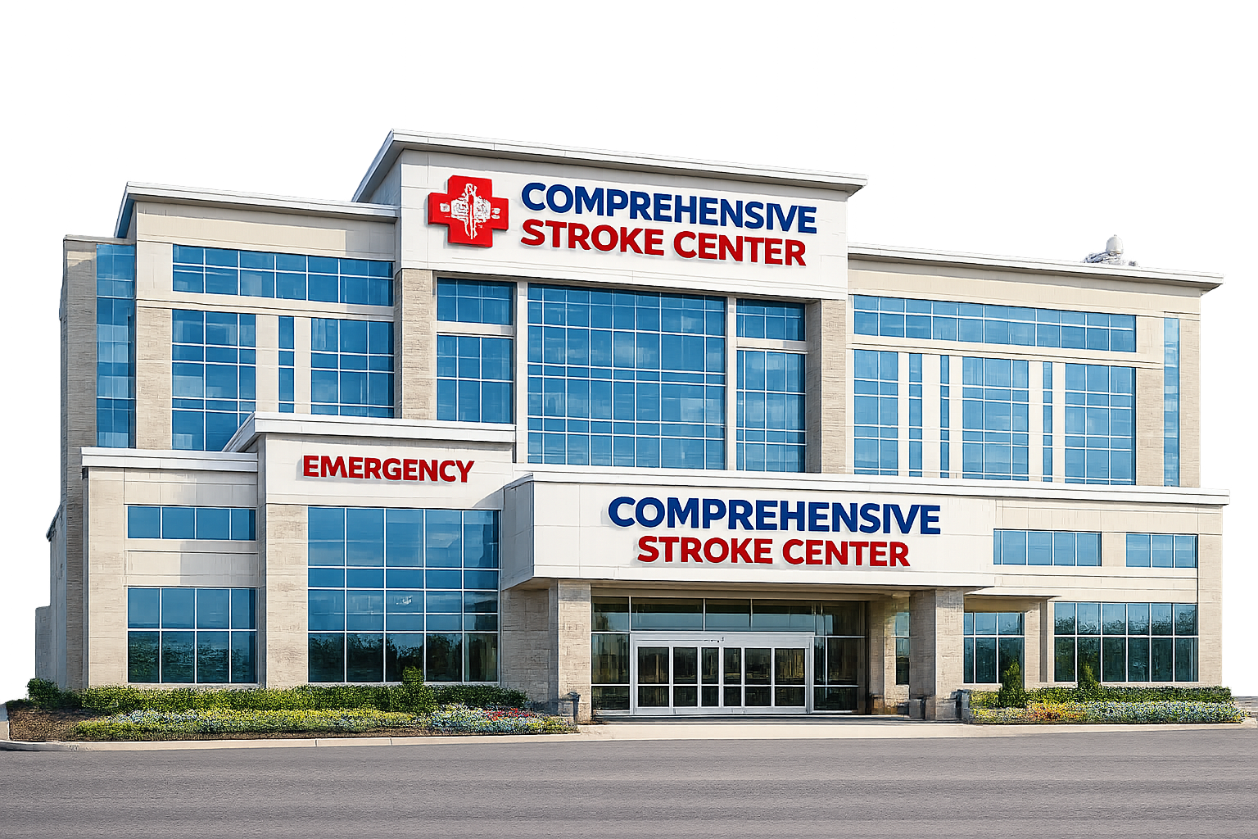

Strategies for Routing Patients
Delay to EVT
Transfer Delays
Overcrowding at CSC/Overtriage
Delay to thrombolytics
Long transport time

Slide 22
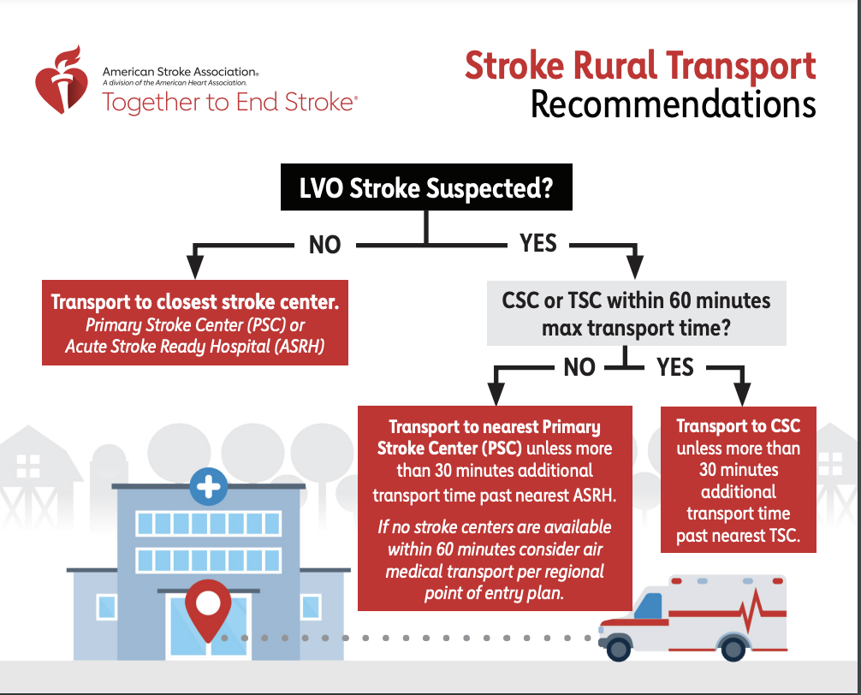
https://www.stroke.org/en/professionals/stroke-resource-library/pre-hospitalems

Slide 23
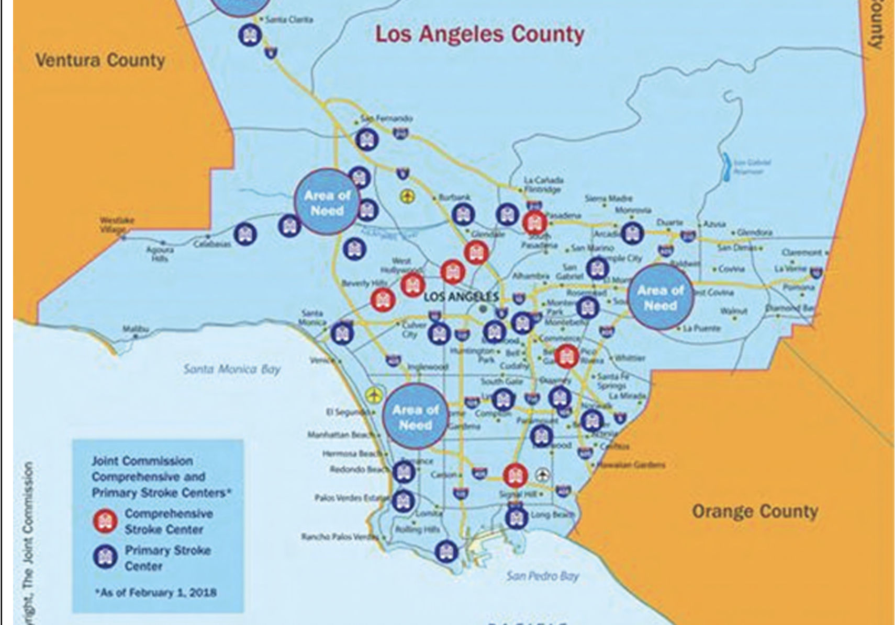
Urban vs Rural Tradeoffs
Urban
Rura

Slide 24
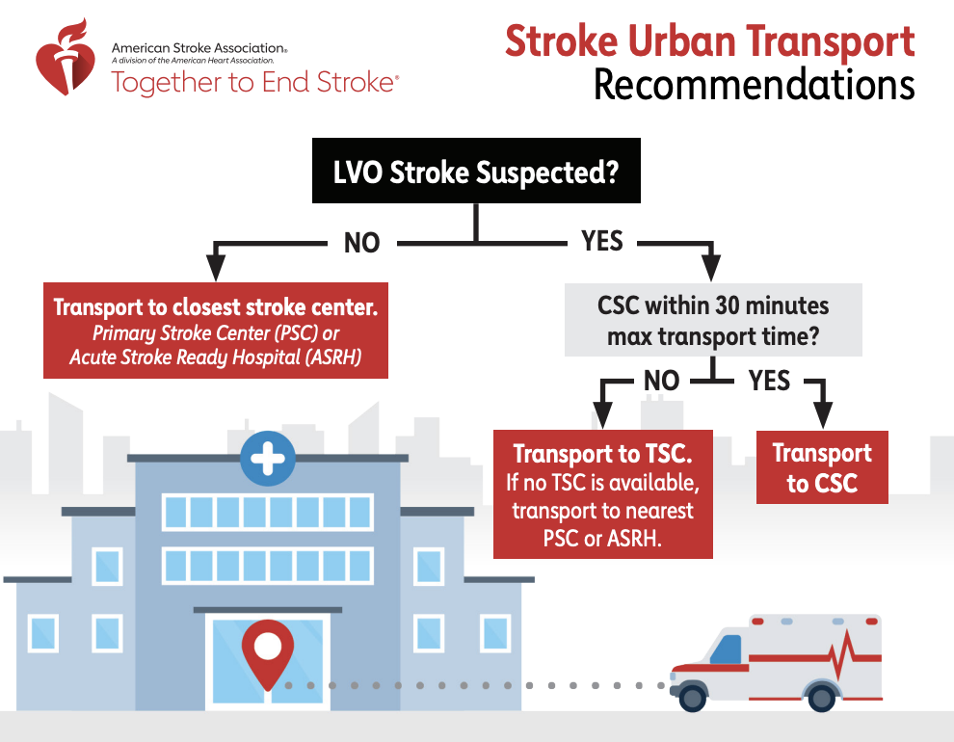
https://www.stroke.org/en/professionals/stroke-resource-library/pre-hospitalems

Slide 25
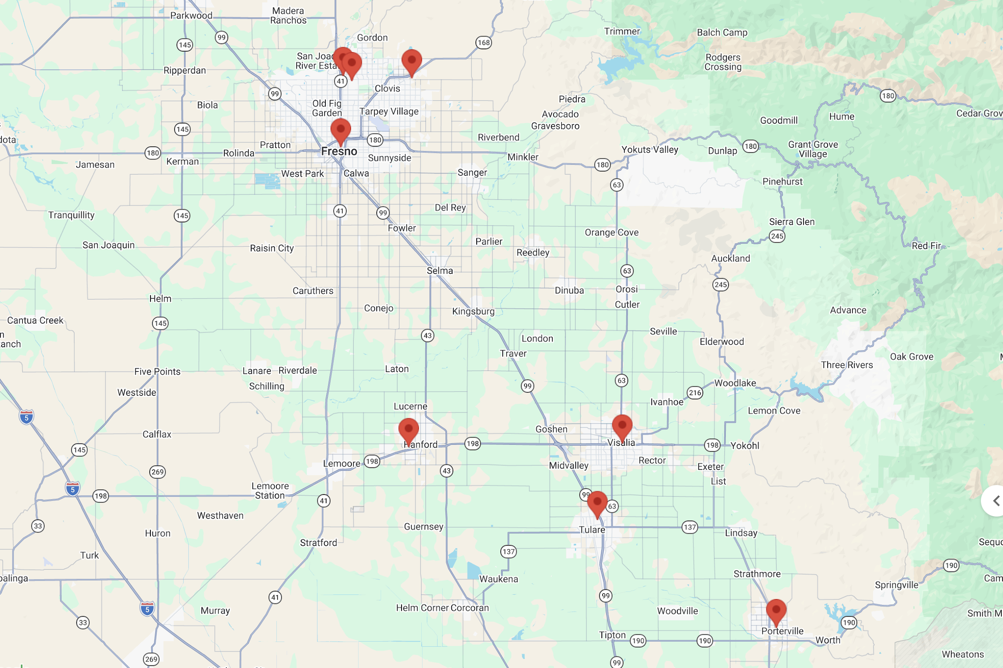
Notes:
If you have a stroke in Exeter, the transport time to the nearest primary stroke center is about 15 minutes while transport to the nearest comprehensive stroke center is close to an hour.

Slide 26


Slide 27
What difference does EMS prenotification make?
Allows for mobilization of resources
Door to imaging time shorter (26 vs 31 min)*
Door to needle time shorter (78.2 vs 83 min)*
More eligible patients treated with tPA (71.8% vs 62.2%)*
Decreased in hospital mortality (OR 0.87) **
* Lin CB, Peterson ED, Smith EE, et al. Circulation: Cardiovascular Quality and Outcomes. 2012; 5(4).
** Nielsen VM, Song G, DeJoie-Stanton C, Zachrison KS. Prehosp Emerg Care. 2023;27:639–645.

Slide 28
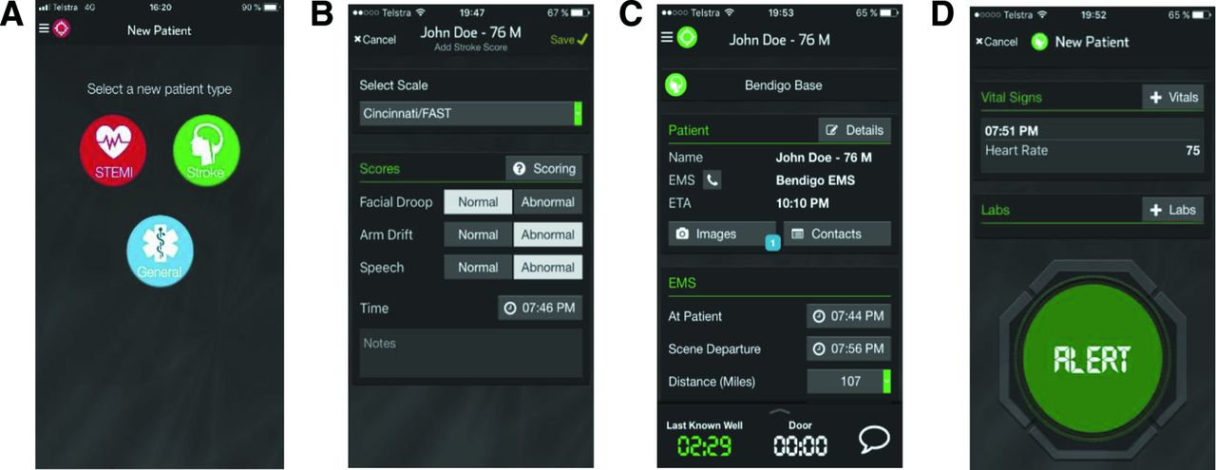
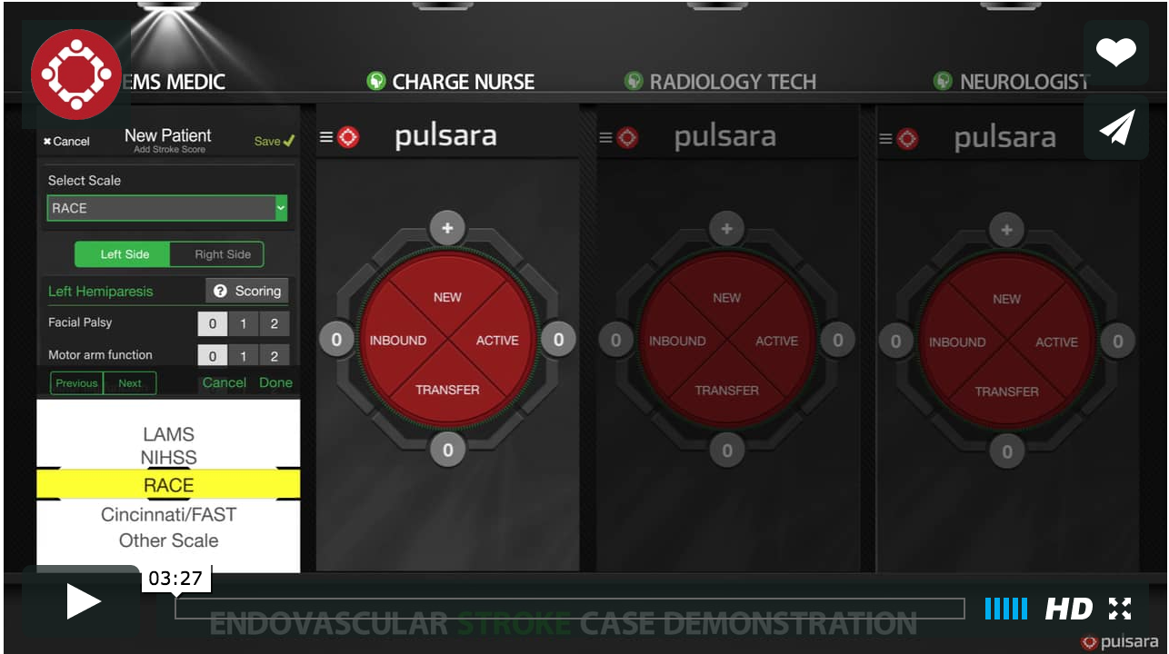
Bladin CF, Bagot KL, Vu M, et al. BMJ Open 2022;12:e052332. doi: 10.1136/bmjopen-2021-052332
Notes:
In this Australian-first study, uptake of the digital communication app was strong, patient-centred care timelines improved, although door-to-treatment times remained similar.
Prenotification can be as simple as a call in to the hospital or more complex apps like pulsara that message multiple care team members including CT, neurology, neurointervention, ED docs and nursing so everyone has the same information and are communicating together.

Slide 29
Where should the EMS to ED handover occur?
Ambulance gurney to CT table?
Ambulance gurney to hybrid CT/angiography device?

Slide 30
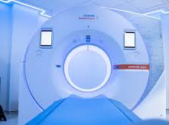
Does a Direct to CT Protocol Make a Difference?
Cone et al, 2018
  7 hospitals, 1040 patients
  No difference in door to needle (48 min vs 48 min)
Sloane et al, 2020
  41 stroke centers, 789 patients
  No difference in door to needle (57 min vs 54 min)
  Door to imaging improved (13 min vs 16 min)

Slide 31
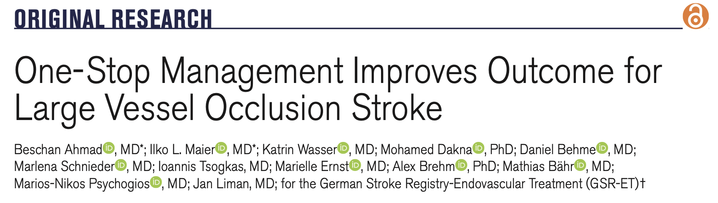
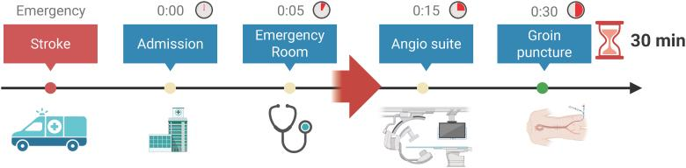
Observational study
One stop management (n=205) vs conventional approach (n=2470)
Door to reperfusion 78.06 vs 147.47 minutes
Significant improvement in NIHSS and MRS at 90 days (OR 2.26)
Notes:
On hospital arrival (T=0:00), immediate emergency department management is initiated, including neurological assessment, vascular access, and monitoring. Patients meeting criteria (National Institutes of Health Stroke Scale [NIHSS] score ≥7, symptom onset <4.5 hours) undergo direct transfer to the angiography suite (T=0:05), bypassing conventional imaging delays. Flat-detector CT and biphasic flat-detector CT angiography (FDCTA) are acquired to exclude hemorrhage and confirm LVO (T=0:15), followed by intravenous thrombolysis (rtPA [recombinant tissue-type plasminogen activator]) when indicated.
Conventional approach included multidetector CT before mechanical thrombectomy whereas the one stop approach routed patients with NIH > 7 and symptoms <4.5 hours directly to the angio suite where they underwent imaging, thrombolysis, and groin puncture

Slide 32
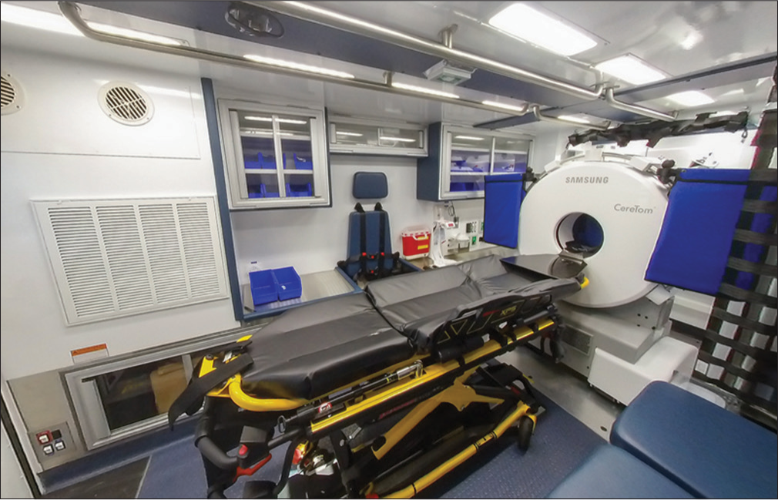
What if we bring the stroke care to the patient?
Notes:
Staffed with CT tech, nurse, paramedic, and either teleneurology or in some cases a neurologist will be on board if available.

Slide 33
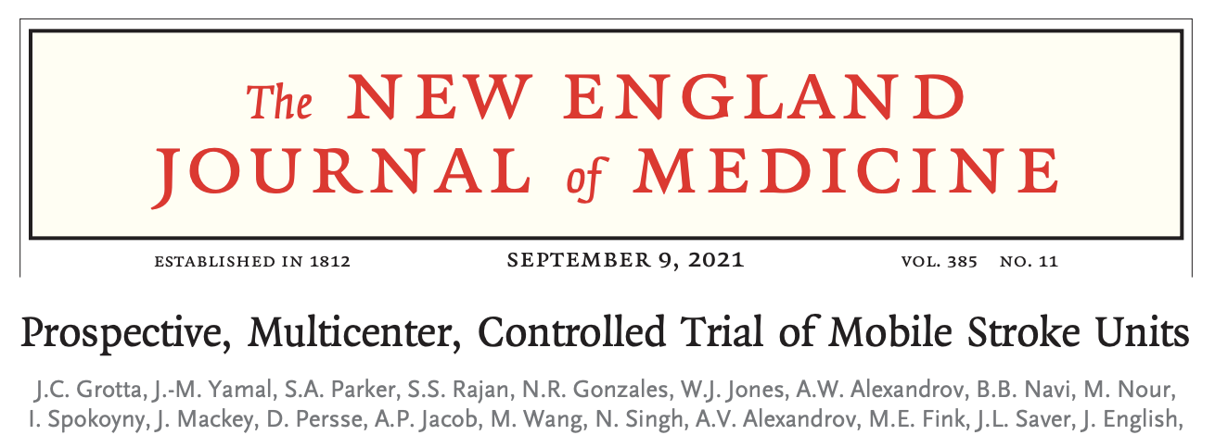
Pts eligible for tPA
N=1047
Mobile Stroke Unit
N=617
Time to tPA 72 min
90 day MRS 0-1 53.5%
EMS
N=430
Time to tPA 108 min
90 day MRS 0-1 45.5%
Notes:
1047 patients eligible to receive tpa

Slide 34
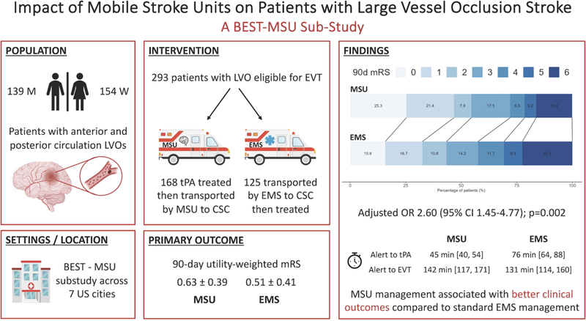

Slide 35
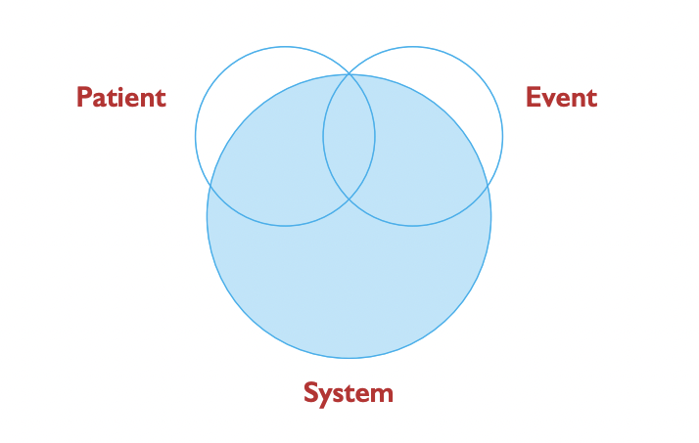
Factors Which Determine Outcomes After Stroke

Slide 36


Leadership
Training
System excellence requires performance improvement at every step in the stroke continuum
QI
Culture of Excellence
Notes:
The science informs what we do but operationalizing that science is truly an art form. The art is how you implement these principles in your community and how you inspire the practitioners in your agency to stick to the principles that we know work because we have the science to back it up. The art is challenging and requires leadership, QI, training and a culture of excellence. And we need to continue to practice the art of medicine. That fine touch that brings the science into practice.

Slide 37
References
Wenstrup J, Drachmann Havtorn J, Borgholt L, et al. npj Digital Medicine. 2023; 6:235.
Bhatt NR, Martin-Gill C, Al-Qudah A, et al. J Neurointervent Surg. 2025; 17: 1201-1206.
Jauch EC, Schwamm LH, Panagos PD et al. Stroke. 2021; 52: e133-e152.
Cone DC, Cooley C, Ferguson J, et al. Prehospital Emergency Care. 2018; 22(1).
Ahmad B, Maier IL, Wasser K, et al. Stroke Vasc Interv Neurol. 2026; 6:e001941
Nielsen VM, Song G, DeJoie-Stanton C, Zachrison KS. Prehosp Emerg Care. 2023;27:639–645.
Lin CB, Peterson ED, Smith EE, et al. Circ Cardiovasc Qual Outcomes. 2012;5:514–522.
Bladin CF, Bagot KL, Vu M, et al. BMJ Open 2022;12:e052332. doi: 10.1136/bmjopen-2021-052332
Abbas AY, Odom EC, Nwaise I. Journal of Stroke and Cerebrovascular Diseases. 2022; 31(3)
Mochari-Greenberger H, Xian Y, Hellkamp AS, et al. J Am Heart Assoc. 2015 Aug 12;4(8):e002099.
Ahmad Nawabi AL, Rivera Rivera E, de Wilde D, et al. Neurology. 2026; 106:e214484
Sloane B, Bosson N, Sanossian N, Saver JL, Perez L, Gausche-Hill MJ Stroke Cerebrovasc Dis. 2020 Jan;29(1):104477.

