Slide 1
Soft Tissue Infections Timothy Bax Columbia Surgical Specialists

Slide 2
Objectives
Physiology of microorganisms
Types of infections
Treatment strategies

Slide 3

MICROBIOLOGY PRIMER

Slide 4
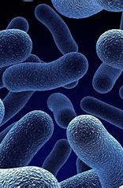
What is the difference between colonization and infection?

Slide 5
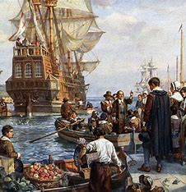
Colonization
The action or process of settling among and establishing control over the Indigenous people of an area.

Slide 6
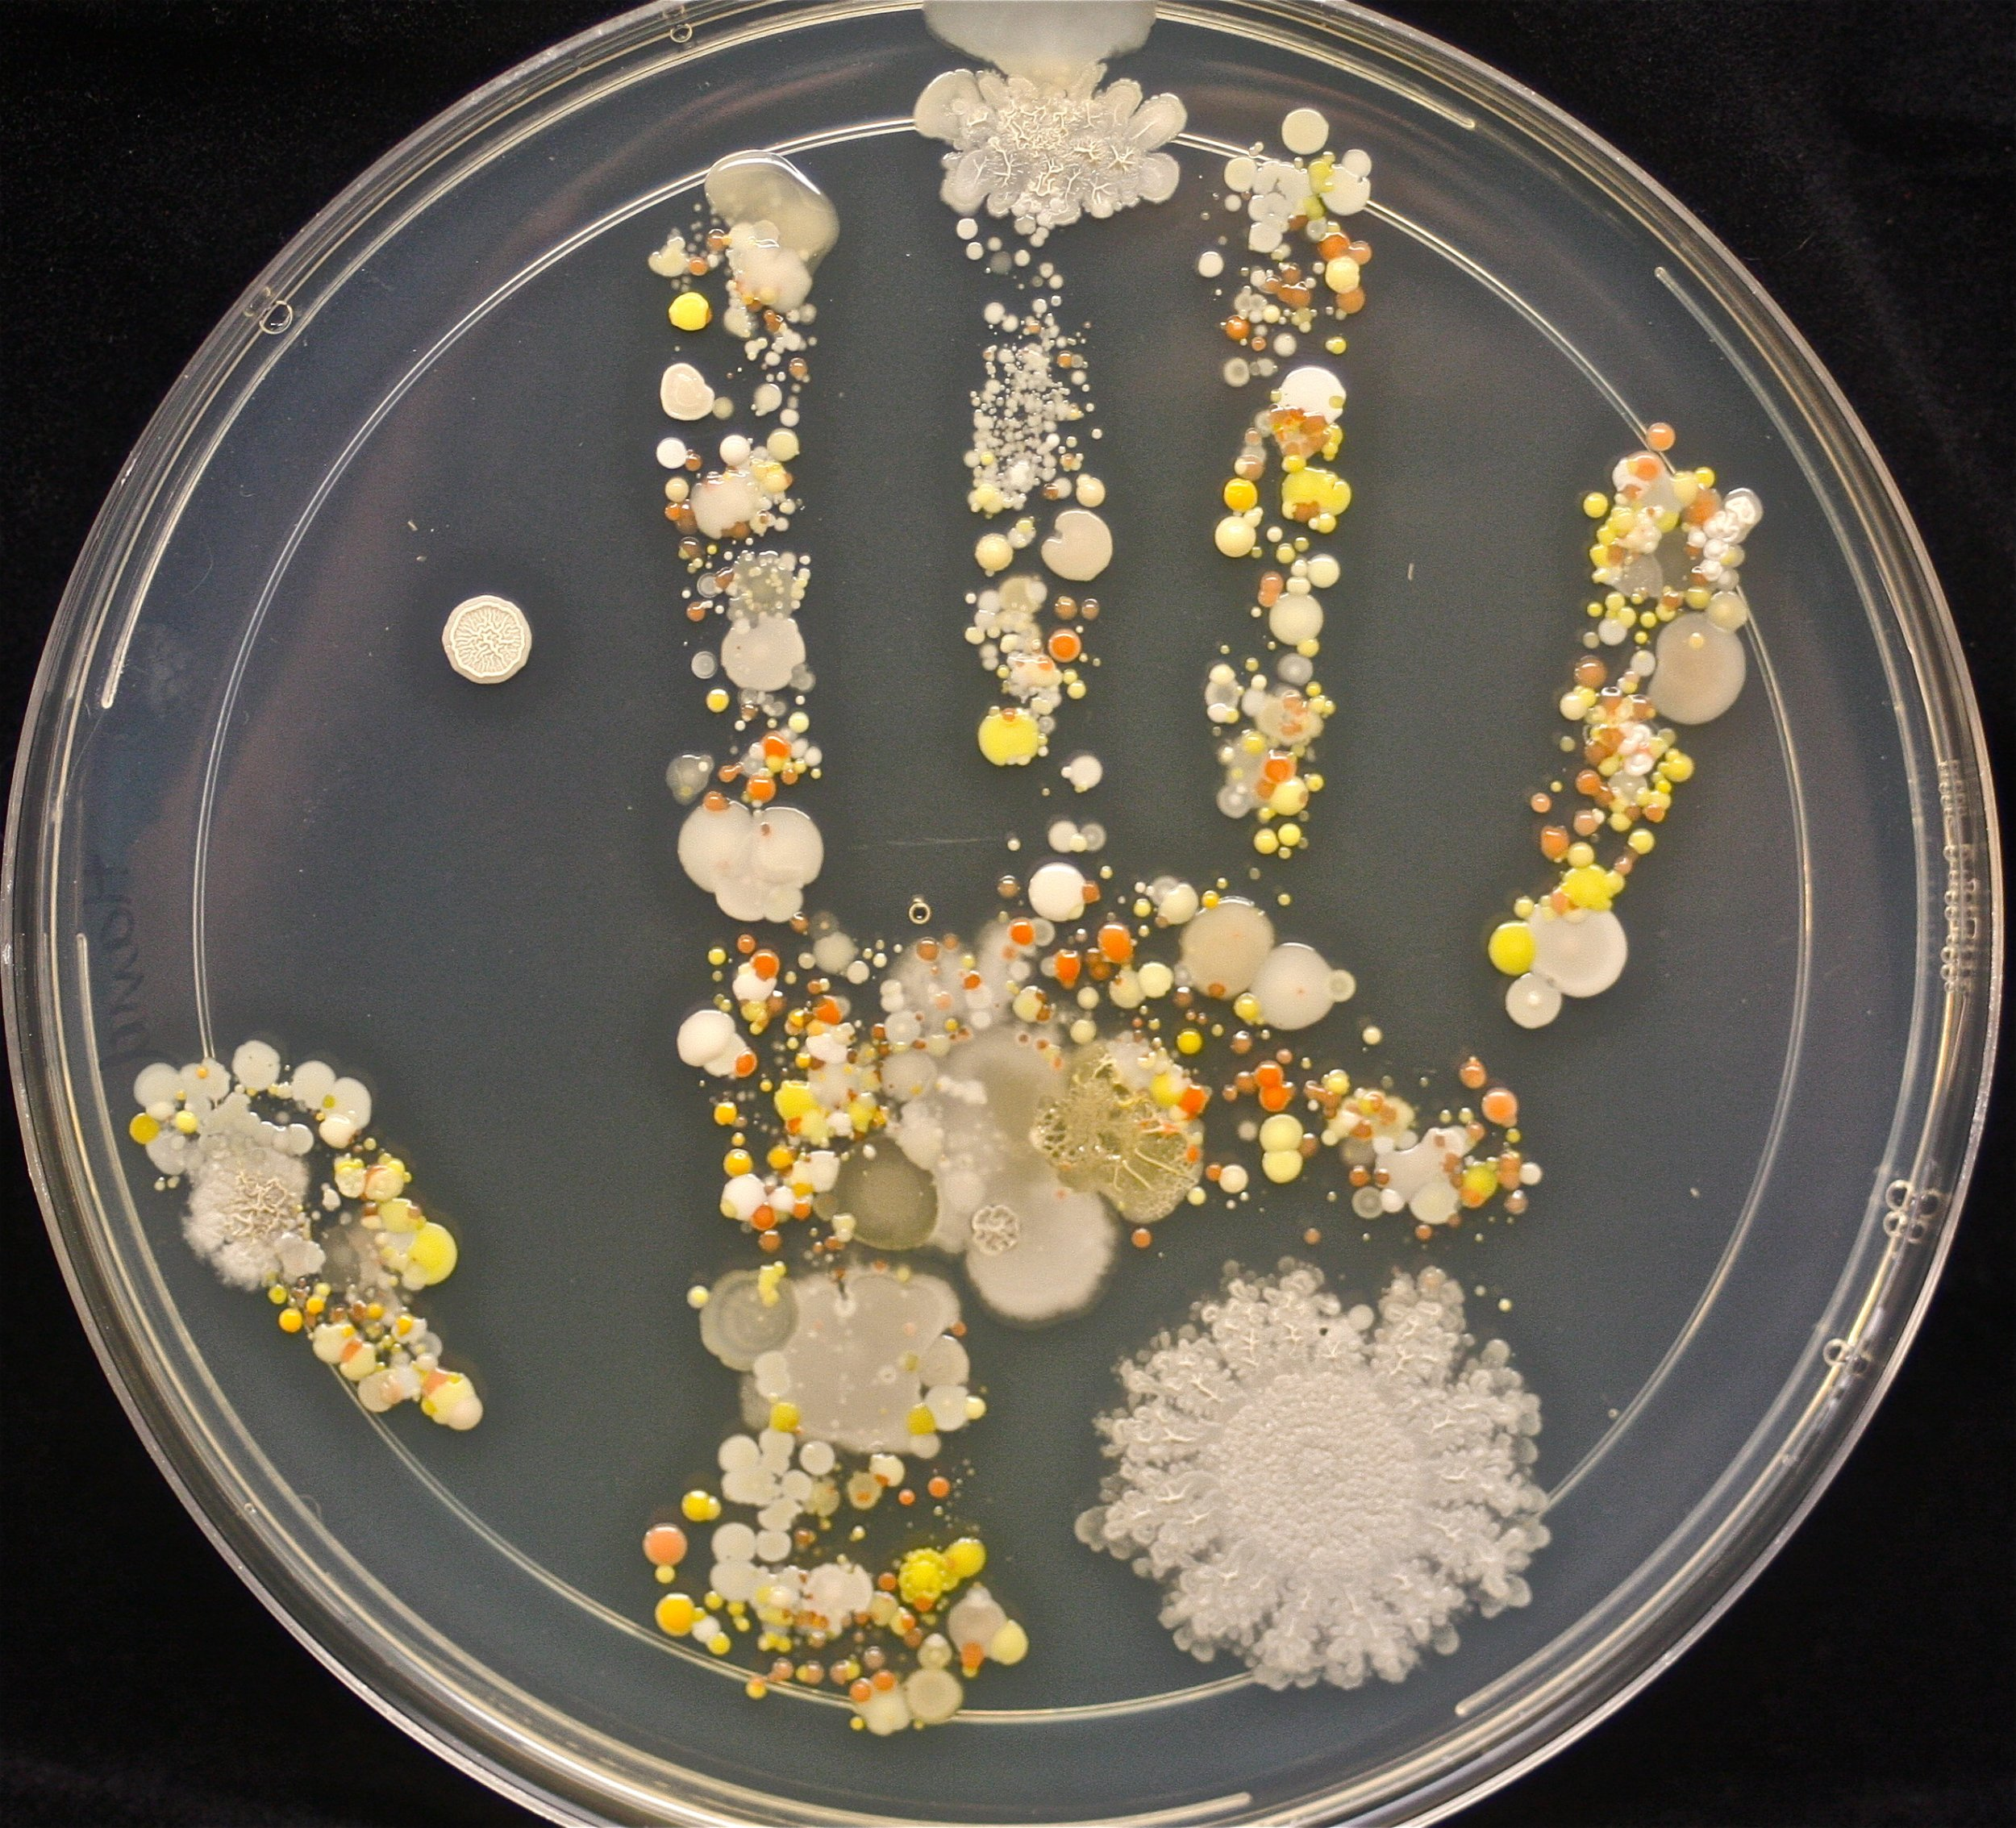
Colonization
The action by a plant or animal of establishing itself in an area

Slide 7
Colonization
The action by a plant or animal of establishing itself in an area
(8 yo hand)

Slide 8
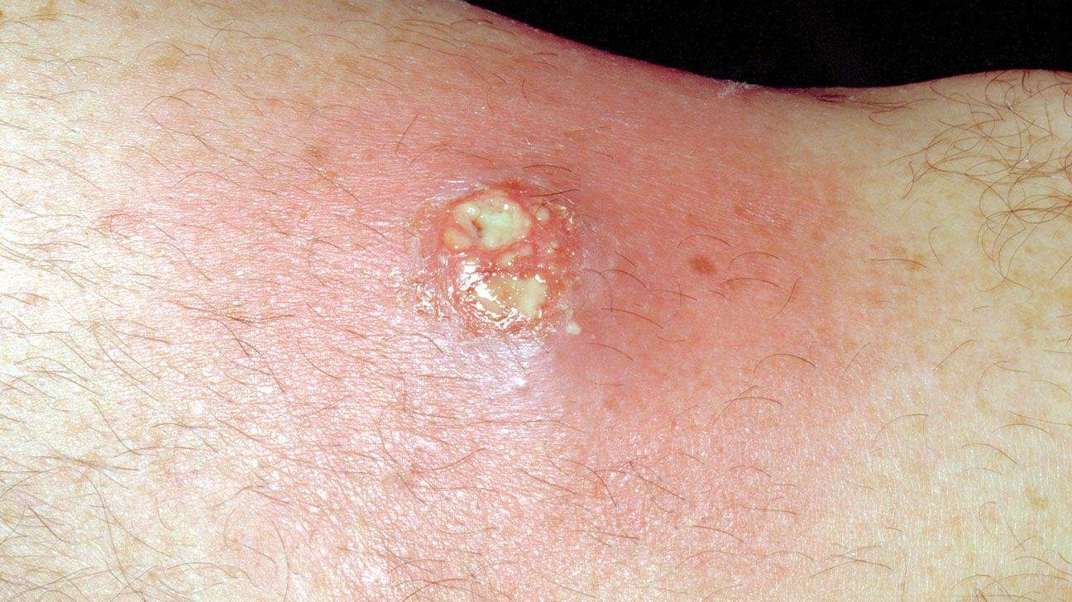
Infection
The process of infecting or the state of being infected

Slide 9
Infection
The process of infecting or the state of being infected.
The colonizer is now causing damage to the host.

Slide 10
How do microorganisms hurt us?

Slide 11
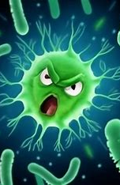
WHAT DO ORGANISMS WANT?
(Evolutionarily speaking)

Slide 12
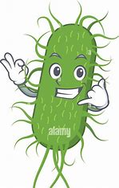
WHAT DO ORGANISMS WANT?
(Evolutionarily speaking)
Proliferation
Transmission

Slide 13
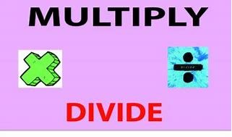
PROLIFERATION
Multiply by Dividing

Slide 14
PROLIFERATION
Multiply by Dividing
This requires some type of nutrient source

Slide 15

PROLIFERATION
Multiply by Manufacturing

Slide 16
PROLIFERATION
Multiply by Manufacturing
This uses cellular machinery to make clones (usually at the expense of the cell)

Slide 17
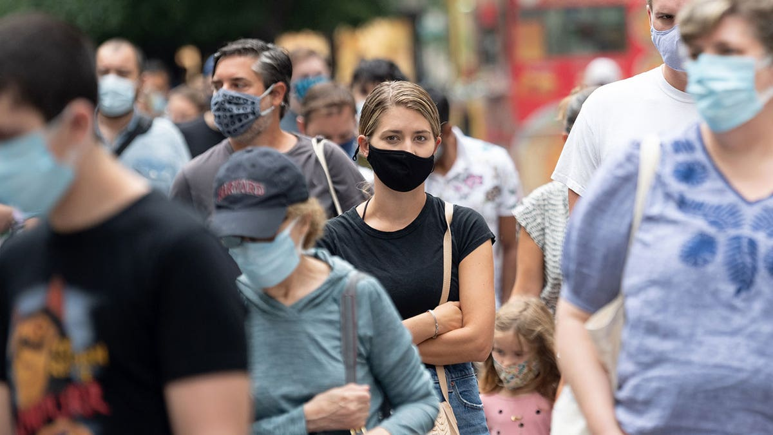
TRANSMISSION
Air

Slide 18
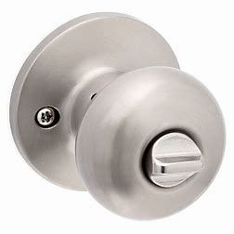
TRANSMISSION
Air
Touch

Slide 19

TRANSMISSION
Air
Touch
Fecal-oral

Slide 20
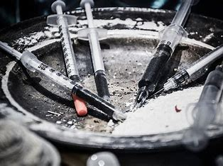
TRANSMISSION
Air
Touch
Fecal-oral
Blood

Slide 21
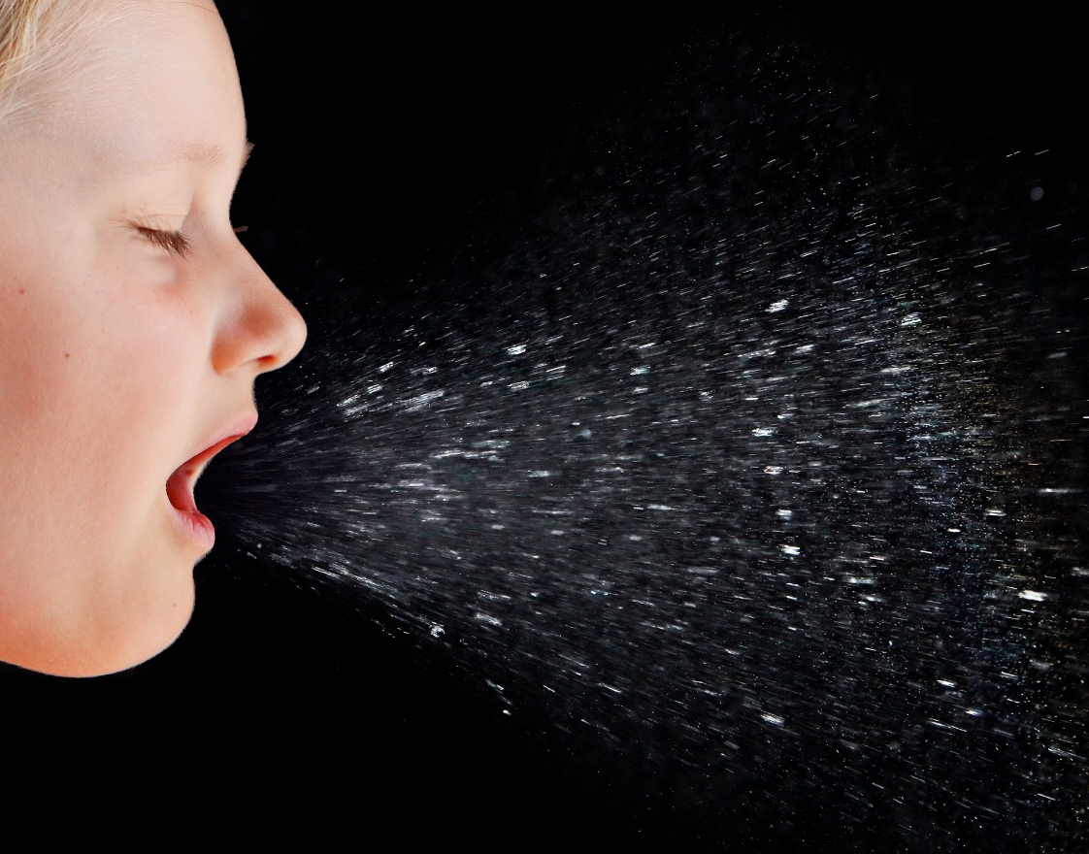
IDEAL PATHOGEN

Slide 22
IDEAL PATHOGEN
-Good at hiding in host

Slide 23
IDEAL PATHOGEN
-Good at hiding in host
Mycobacterium leprae causes no host response with 10,000 organisms/1cc blood

Slide 24
IDEAL PATHOGEN
-Good at hiding in host
-Rapidly multiplies

Slide 25
IDEAL PATHOGEN
-Good at hiding in host
-Rapidly multiplies
Staph and Strep have a doubling time in a petri dish of 20-30 min

Slide 26
IDEAL PATHOGEN
-Good at hiding in host
-Rapidly multiplies
-Easily transmitted

Slide 27
IDEAL PATHOGEN
-Good at hiding in host
-Rapidly multiplies
-Easily transmitted
Ro is a measure of how many people can expect to be infected by 1 individual with the disease.

Slide 28
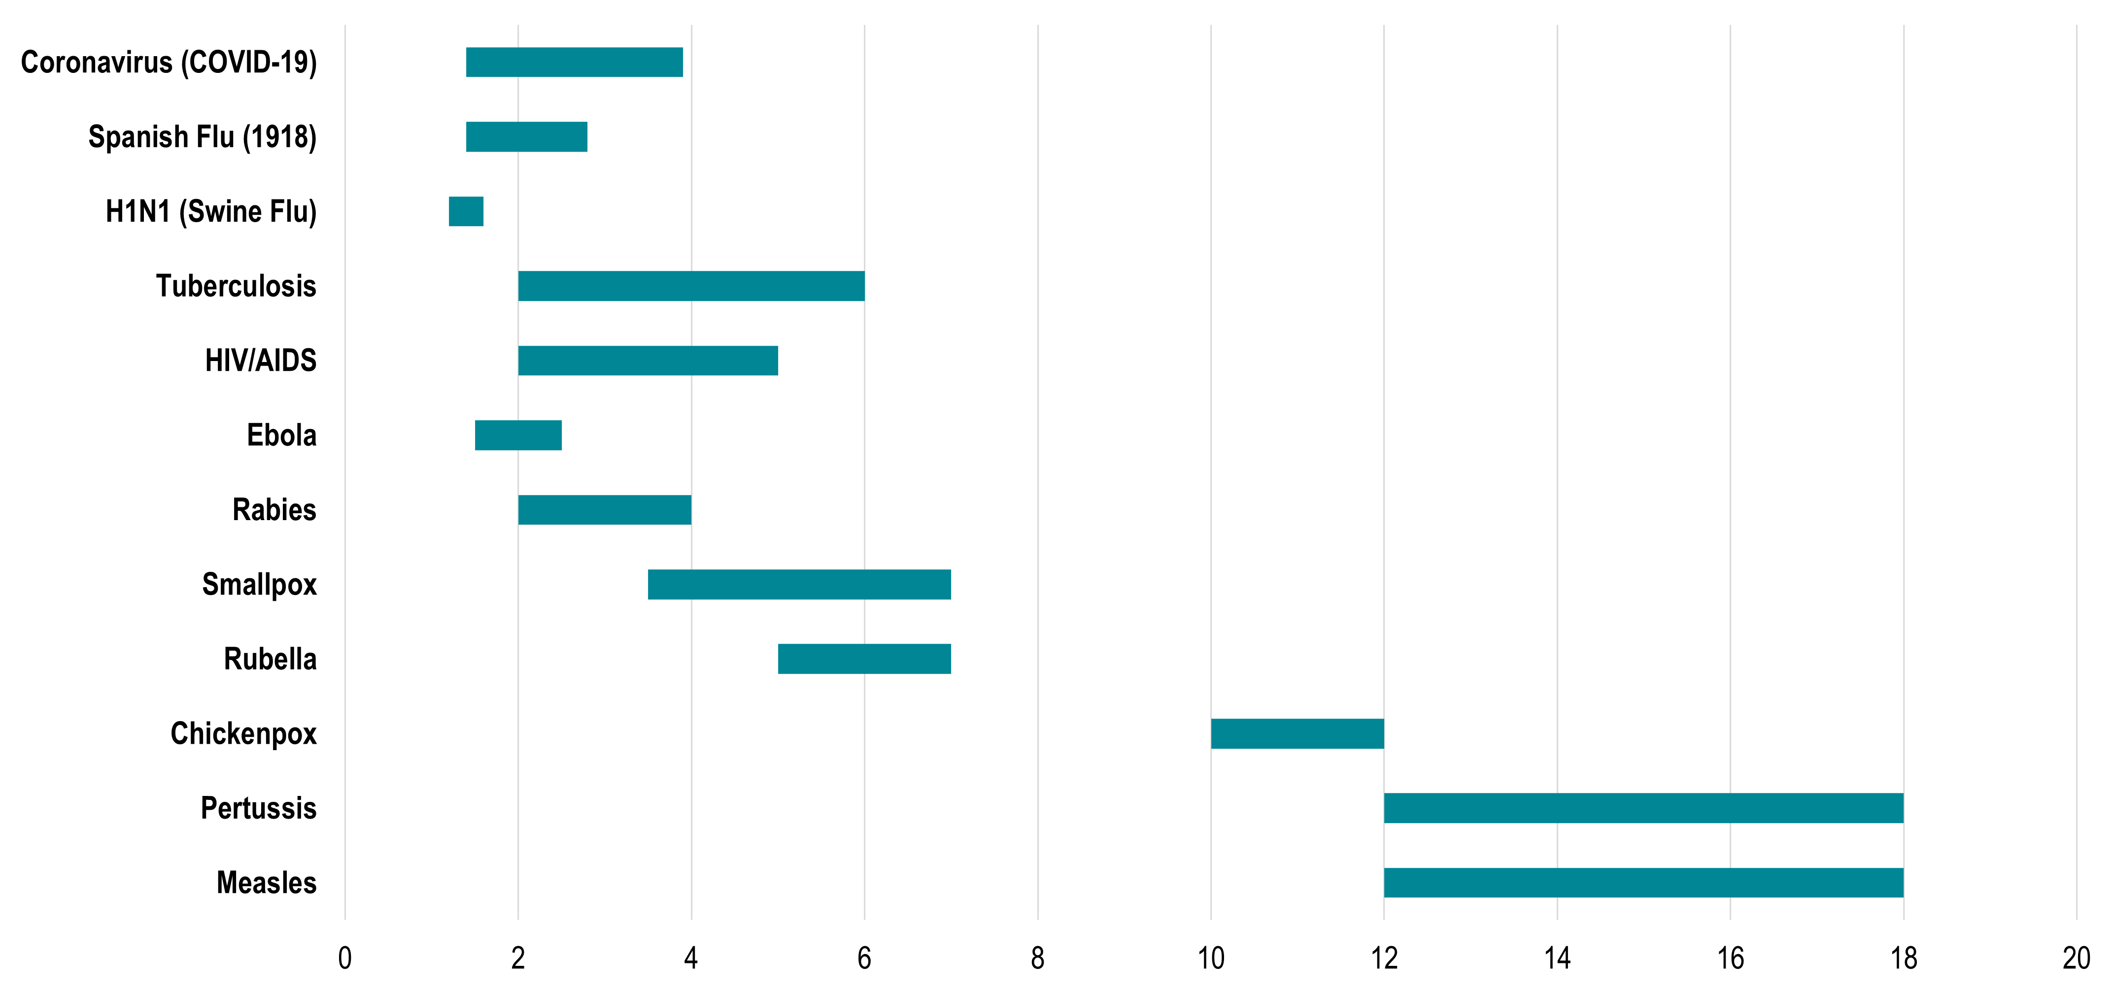

Slide 29
Why do microorganisms kill us?

Slide 30

MOSTLY BY ACCIDENT
This Photo by Unknown Author is licensed under CC BY-SA

Slide 31
MOSTLY BY ACCIDENT (Unless you are an anaerobe and prefer dead flesh)
This Photo by Unknown Author is licensed under CC BY-SA

Slide 32
How do microorganisms hurt us?

Slide 33
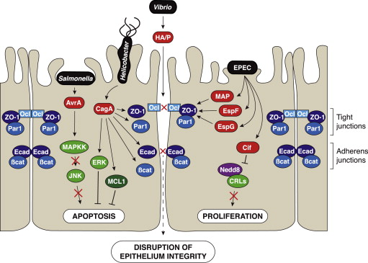
Direct cellular damage

Slide 34
Example 1: Strep mutans

Slide 35
Strep mutans
Most common infection in Western civilization

Slide 36

Strep mutans
Most common infection in Western civilization

Slide 37
Strep mutans
Most common infection in Western civilization
Creates plaque which holds bacteria against teeth
Bacteria metabolize sugar creating acid
Acid decalcifies tooth causing cavities

Slide 38
Strep mutans
Most common infection in Western civilization
Creates plaque which holds bacteria against teeth
Bacteria metabolize sugar creating acid
Acid decalcifies tooth causing cavities
Fluoride makes enamel resistant to acid (brushing your teeth works too)

Slide 39
Example 2: Rift Valley Fever
Virus that replicates in hepatic cells

Slide 40
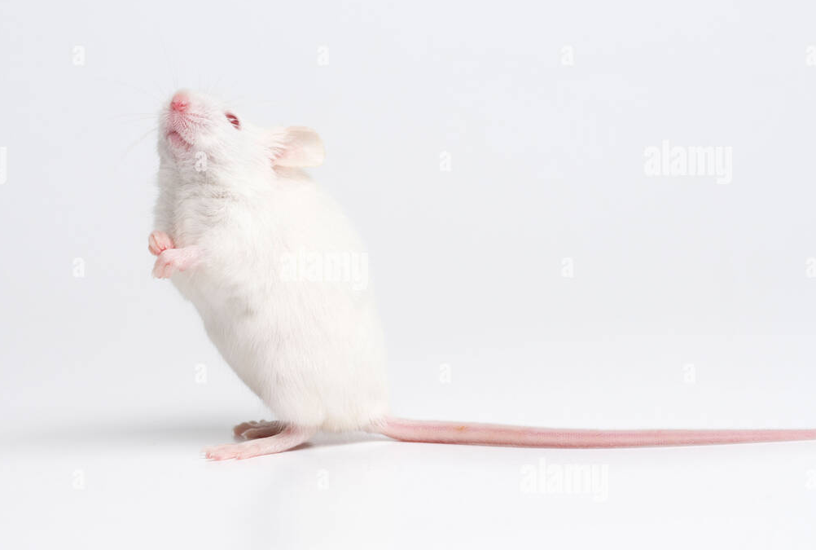
Rift Valley Fever
Virus that replicates in hepatic cells
If injected in mice causes fulminant liver failure and death in less than 6 hours

Slide 41
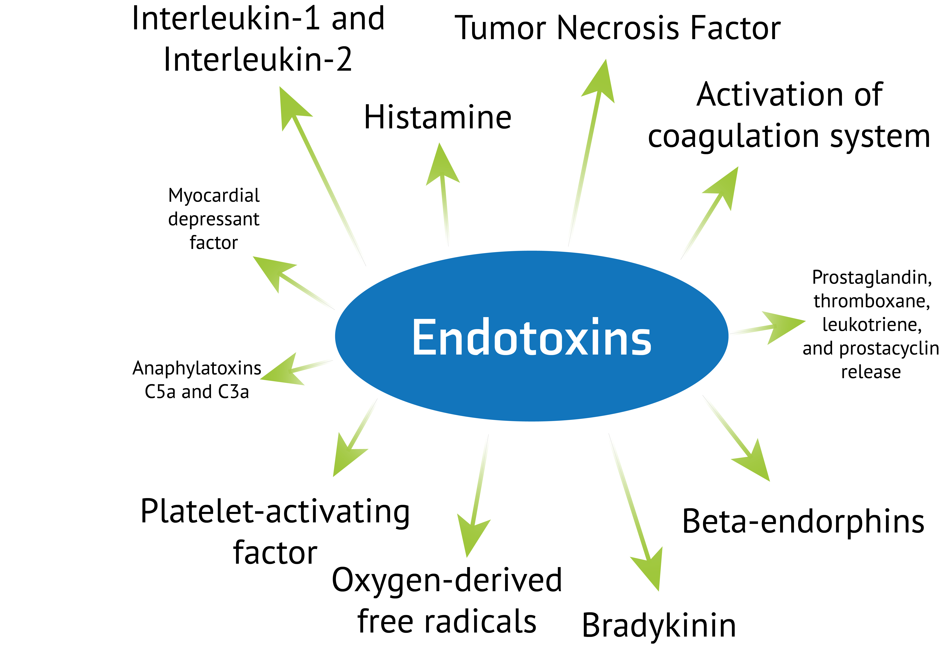
Endotoxins
Lipopolysaccharides on cell surface of gram– bacteria with several possible effects

Slide 42
Exotoxins
Proteins secreted or released upon bacterial death from Gram+ bacteria
Activate immune system – Type 1
Cell damage/death – Type 2
Local effects(H. pylori neutralizes acid)
Breakdown intracellular bonds (scalded skin)

Slide 43
Exotoxins –Super antigens
Staph aureus, Group A Strep
1 nanogram of antigen typically activates 0.001-0.0001% of T cells
Superantigens activate up to 20% of T cells

Slide 44
What’s wrong with wbc activation? Or How does our immune system hurt us?

Slide 45

Helpful immune effects
Identify and kill pathogens
Phagocytosis
Antibody production
Cytokine release
Fever, vasodilation
Chemotaxis

Slide 46
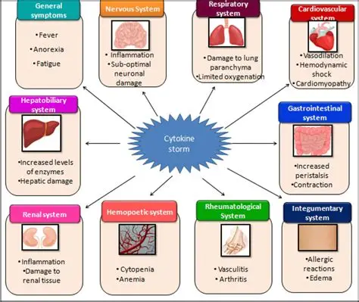
Not so helpful immune effects

Slide 47
Symptoms of infection

Slide 48
Early: Malaise, headache, muscle ache, fatigue
Fever, chills, tachycardia
Localizing signs – pain, redness, cough, etc.
Late: Sepsis, Multisystem organ failure

Slide 49
Soft tissue infections

Slide 50

The simple, Bax way of thinking about soft tissue infections

Slide 51
The simple, Bax way of thinking about soft tissue infections
Types of soft tissue infection
Cellulitis
Phlegmon
Abscess
Necrotizing(NSTI)

Slide 52
The simple, Bax way of thinking about soft tissue infections
Diagnosing soft tissue infection
Physical exam
Physical exam
Look at the patient
(Labs)
(Imaging)

Slide 53
Cellulitis

Slide 54
Cellulitis
Infection plus immune response limited to the skin +/- subcutaneous tissues
-Most commonly Staph or Strep
-Redness, warmth, swelling, (pain)

Slide 55
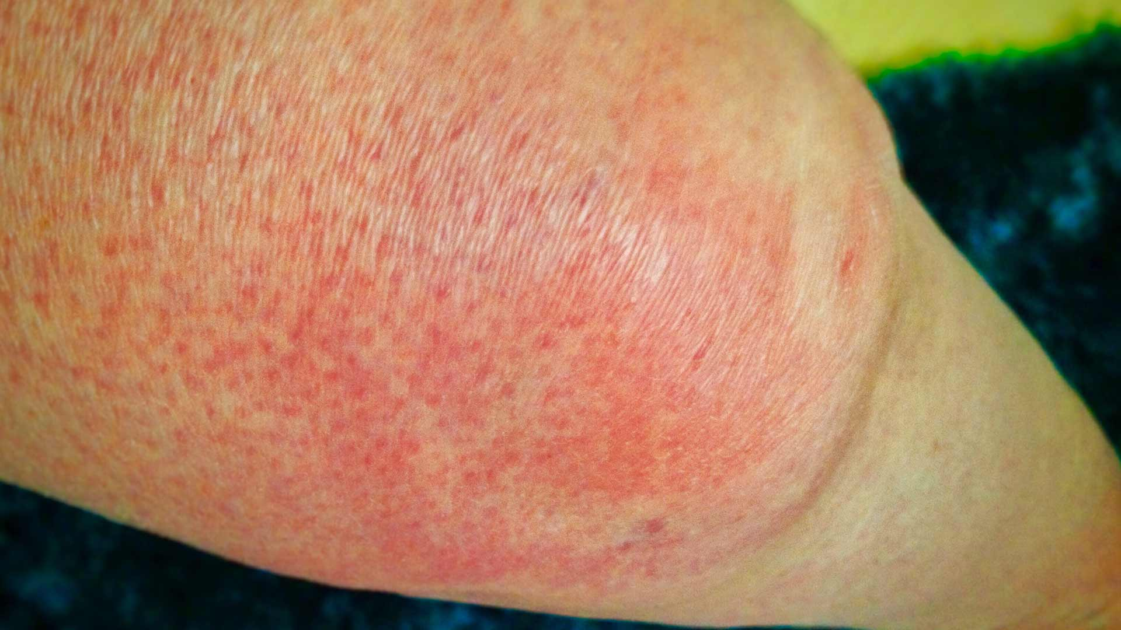
Cellulitis

Slide 56
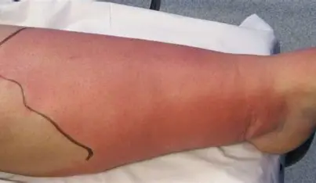
Cellulitis

Slide 57
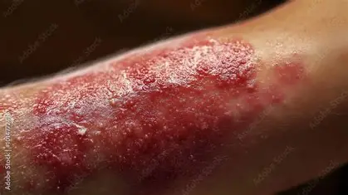
Cellulitis

Slide 58
Phlegmon

Slide 59
Phlegmon
Infection plus immune response coalesces into an inflammatory mass
-Involves more of the subcutaneous fatty tissue
-Redness, warmth, swelling, pain **firm, woody mass**

Slide 60
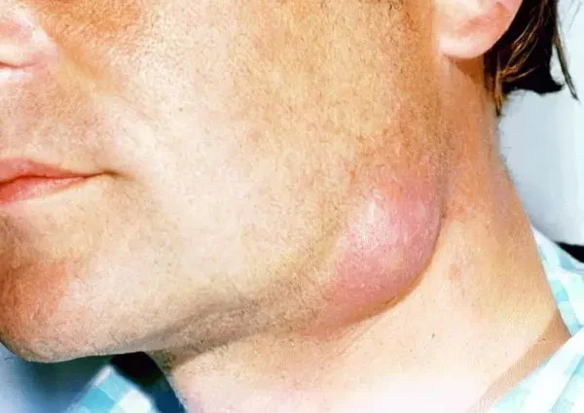
Phlegmon

Slide 61
Abscess

Slide 62
Abscess
Infection plus immune response coalesces into a fluid collection
-Redness, warmth, swelling, pain **ballotable mass**

Slide 63
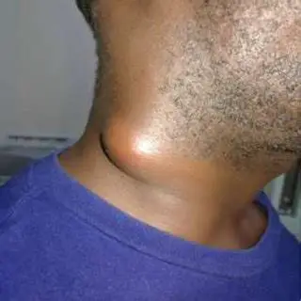
Abscess

Slide 64
The simple, Bax way of thinking about soft tissue infections - Part II

Slide 65
The simple, Bax way of thinking about soft tissue infections - Part II
Sponge vs water balloon

Slide 66
The simple, Bax way of thinking about soft tissue infections - Part II
Sponge
-Infection/inflammation tracks through tissues like water in sponge
-Like a sponge, cutting into it doesn’t release much fluid
-Cellulitis, phlegmon

Slide 67
The simple, Bax way of thinking about soft tissue infections - Part II
Water balloon
-Infection/inflammation coalesces and liquifies
-Like a water balloon, cutting into it effectively drains all the fluid
-Abscess

Slide 68
A little bit about imaging

Slide 69
A little bit about imaging
Plain Xray
Ultrasound
CT
MRI

Slide 70
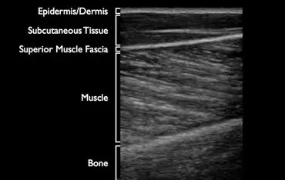
A little bit about imaging

Slide 71
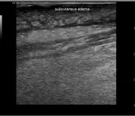
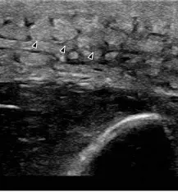
A little bit about imaging

Slide 72
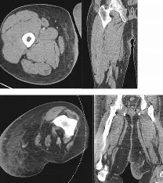
A little bit about imaging

Slide 73
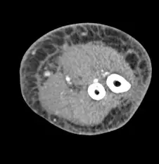
A little bit about imaging

Slide 74
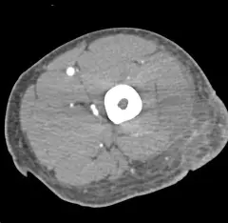
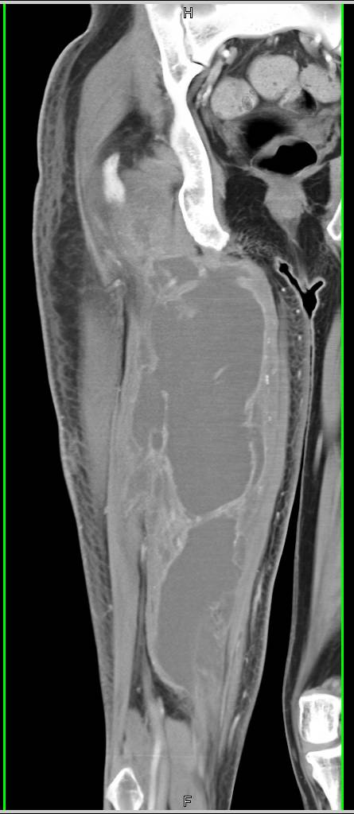
A little bit about imaging

Slide 75
A little bit about imaging
Helpful at differentiating sponges from water balloons

Slide 76
NSTI-Necrotizing Soft Tissue Infection

Slide 77
NSTI-Necrotizing Soft Tissue Infection
Infection tracks deep to skin and fat along the fascia
-(Redness), warmth, swelling,**pain
-Bruising/discoloration

Slide 78
NSTI-Necrotizing Soft Tissue Infection
Infection tracks deep to skin and fat along the fascia
-(Redness), warmth, swelling,**pain
-Bruising/discoloration
-Commonly caused by Group A strep
-Frequently co-infected with an anaerobe like Clostridium gangrenosum

Slide 79
NSTI-Necrotizing Soft Tissue Infection
-Group A strep travels along the fascial plane and causes microvascular thrombosis
-The opportunistic Clostridium follows behind in the now avascular tissues further promoting tissue death

Slide 80
NSTI-Necrotizing Soft Tissue Infection
Case 1

Slide 81
NSTI-Necrotizing Soft Tissue Infection
Case 1
41 yo woman presents to ER with 2 days flu like symptoms of N/V/D, fever. Also mentions worsening groin pain since pulling muscle in soccer practice yesterday.
0440 96.8 114/56 105 99%
WBC 7.4 Creat 1.3 Gluc 150

Slide 82
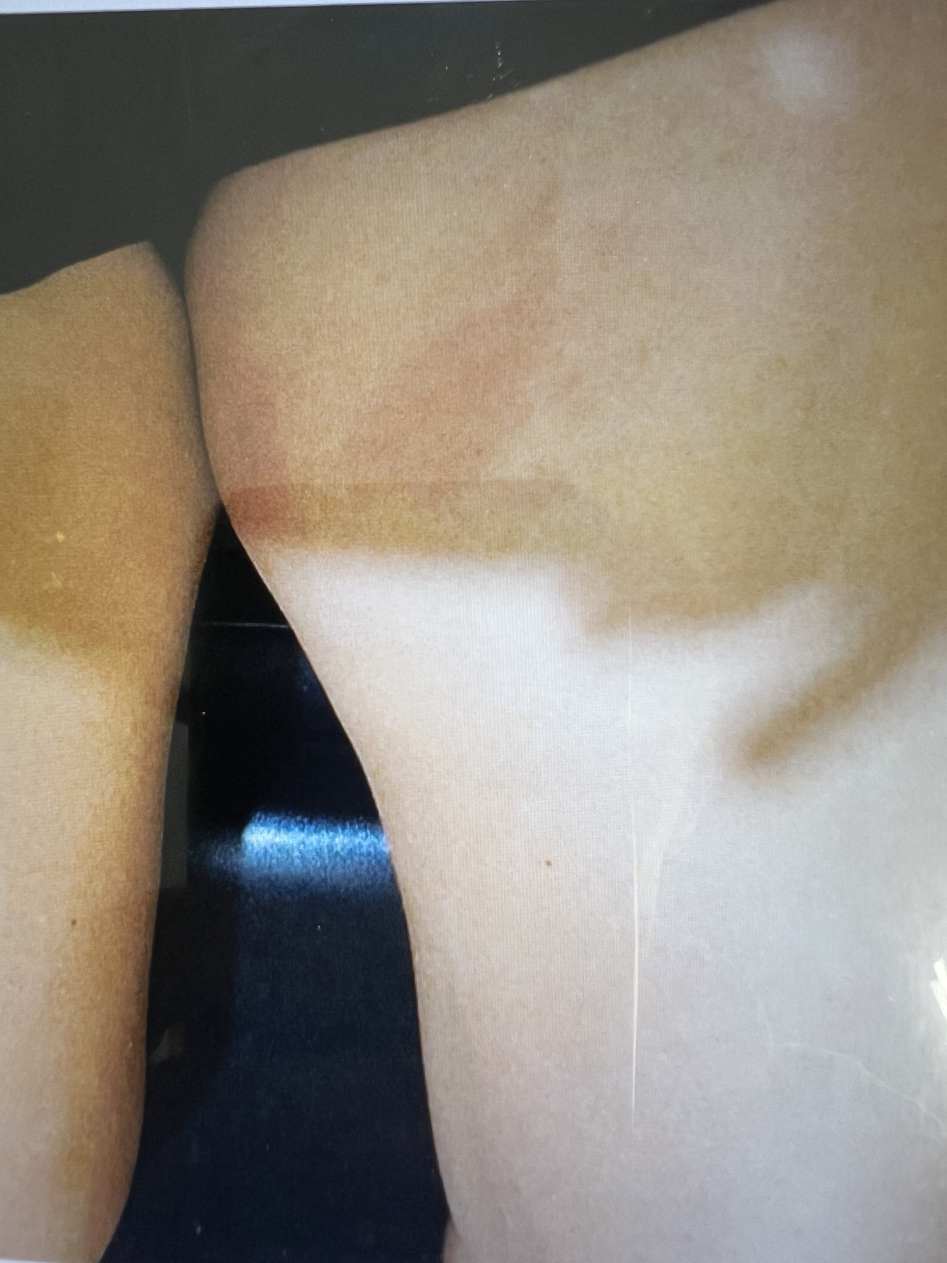
NSTI-Necrotizing Soft Tissue Infection
Case 1

Slide 83
NSTI-Necrotizing Soft Tissue Infection
Case 1
41 yo woman presents to ER with 2 days flu like symptoms of N/V/D, fever. Also mentions worsening groin pain since pulling muscle in soccer practice yesterday.
0440 96.8 114/56 105 99%
WBC 7.4 Creat 1.3 Gluc 150
0515 2L NS, Oxy 5, CXR, UA, Covid, Inf A,B, RSV all neg
0656 MS 4mg
0703 82/62 100 100%
0858 91/63 109 feels a bit better. Home with Zofran, Tramadol

Slide 84
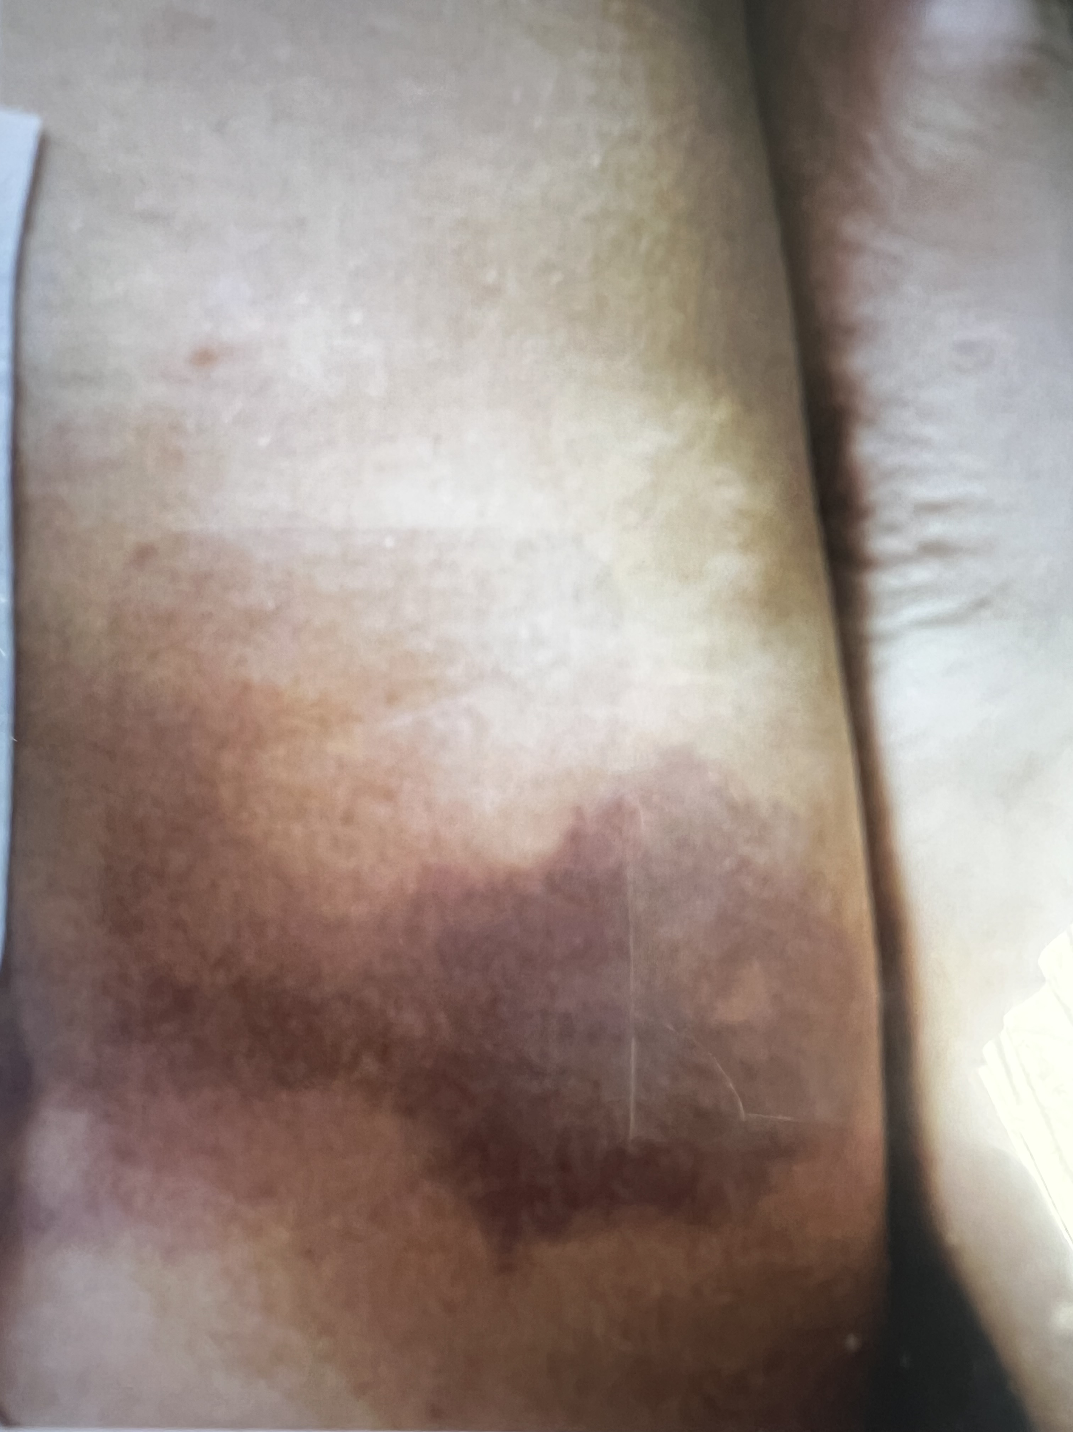
NSTI-Necrotizing Soft Tissue Infection
Case 1

Slide 85
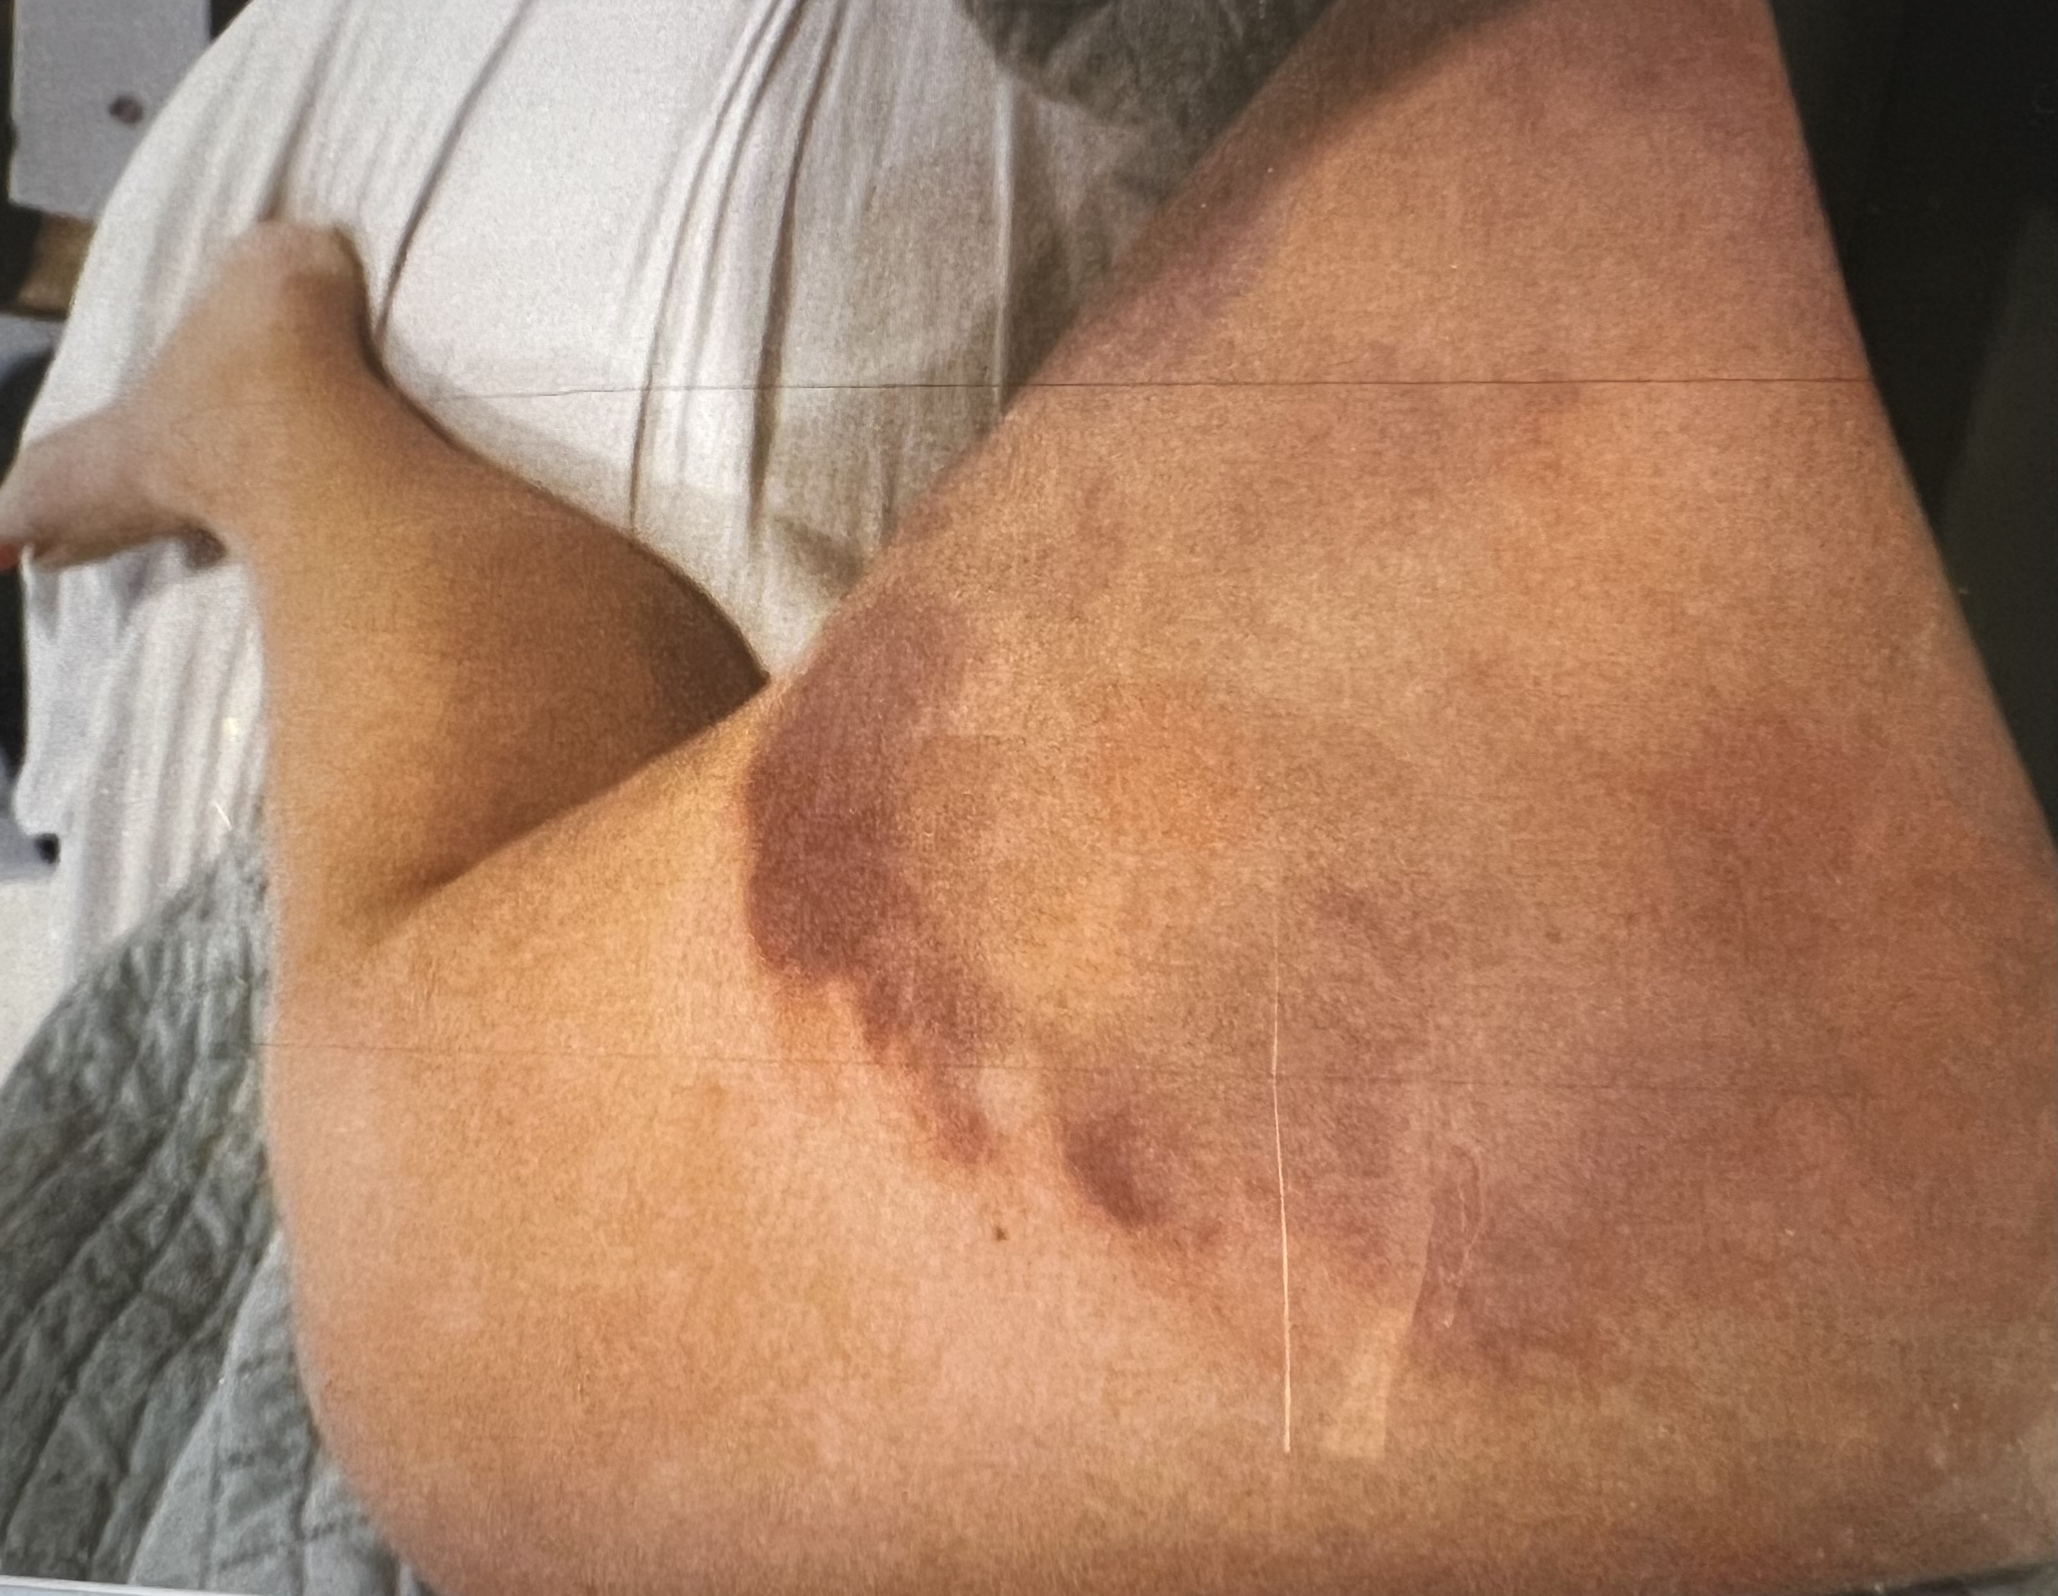
NSTI-Necrotizing Soft Tissue Infection
Case 1

Slide 86
NSTI-Necrotizing Soft Tissue Infection
Case 1
1533 Returns to ER with paraesthesias, tongue swelling, increasing leg pain
96.7 thready pulse No BP

Slide 87
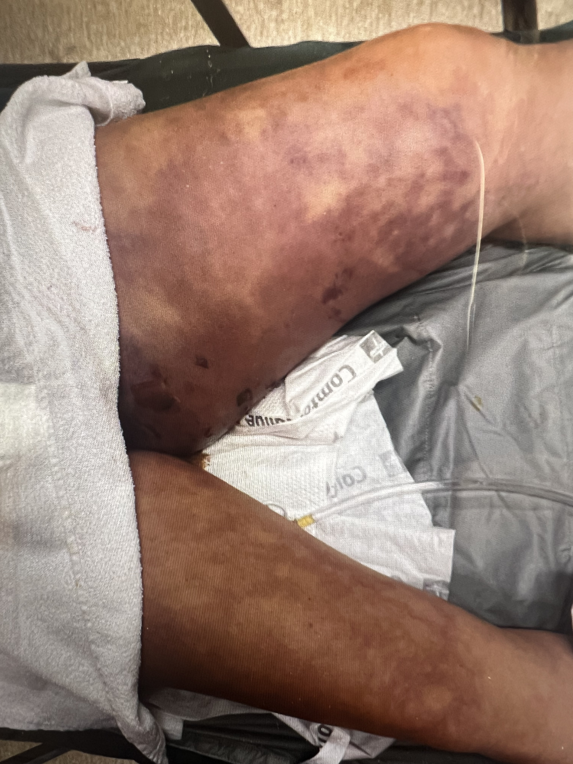
NSTI-Necrotizing Soft Tissue Infection
Case 1

Slide 88
NSTI-Necrotizing Soft Tissue Infection
Case 1
1533 Returns to ER with paraesthesias, tongue swelling, increasing leg pain
96.7 thready pulse No BP
1559 WBC 1.3 Creat 1.9
1649 CTA
1730 Crit care, ortho, GS consults → Tx to Harborview
1924 Pre-transport intubation followed by PEA arrest
2052 Leave facility

Slide 89
A little bit about lab studies

Slide 90
A little bit about lab studies
Routine test
CBC, CMP
CRP
Lactate

Slide 91
A little bit about lab studies
Routine test
CBC, CMP
CRP
Lactate
Cultures
Cellulitis
Cx helpful <16%
Blood cx + <8%
Clin Inf Dis 2024
JAMA 2016

Slide 92
A little bit about lab studies
LRINEC
Laboratory Risk Indicator for Necrotizing Fasciitis
WBC, CRP, Hgb, Sodium, Creat, Gluc

Slide 93
A little bit about lab studies
LRINEC
Laboratory Risk Indicator for Necrotizing Fasciitis
WBC, CRP, Hgb, Sodium, Creat, Gluc
145 pt with Nec Fasc, 309 pt with cellulitis
314 patients analyzed to find predictors
140 patients for validation group, cutoff score of 6
PPV 92%
NPV 96% auROC .98
Wong, Crit Care Med 2004

Slide 94
A little bit about lab studies
LRINEC
Does it really work?

Slide 95
A little bit about lab studies
LRINEC
Does it really work?
930 pts Sens Spec
cutoff of 6 25% 92%
cutoff of 8 33% 91% auROC .68
Wong, PLoS One 2022

Slide 96
A little bit about lab studies
LRINEC
Does it really work?
930 pts Sens Spec
cutoff of 6 25% 92%
cutoff of 8 33% 91% auROC .68
5982 pts
cutoff of 6 68% 85%
cutoff of 8 41% 95%
Wong, PLoS One 2022
Fernando, Ann Surg 2019

Slide 97
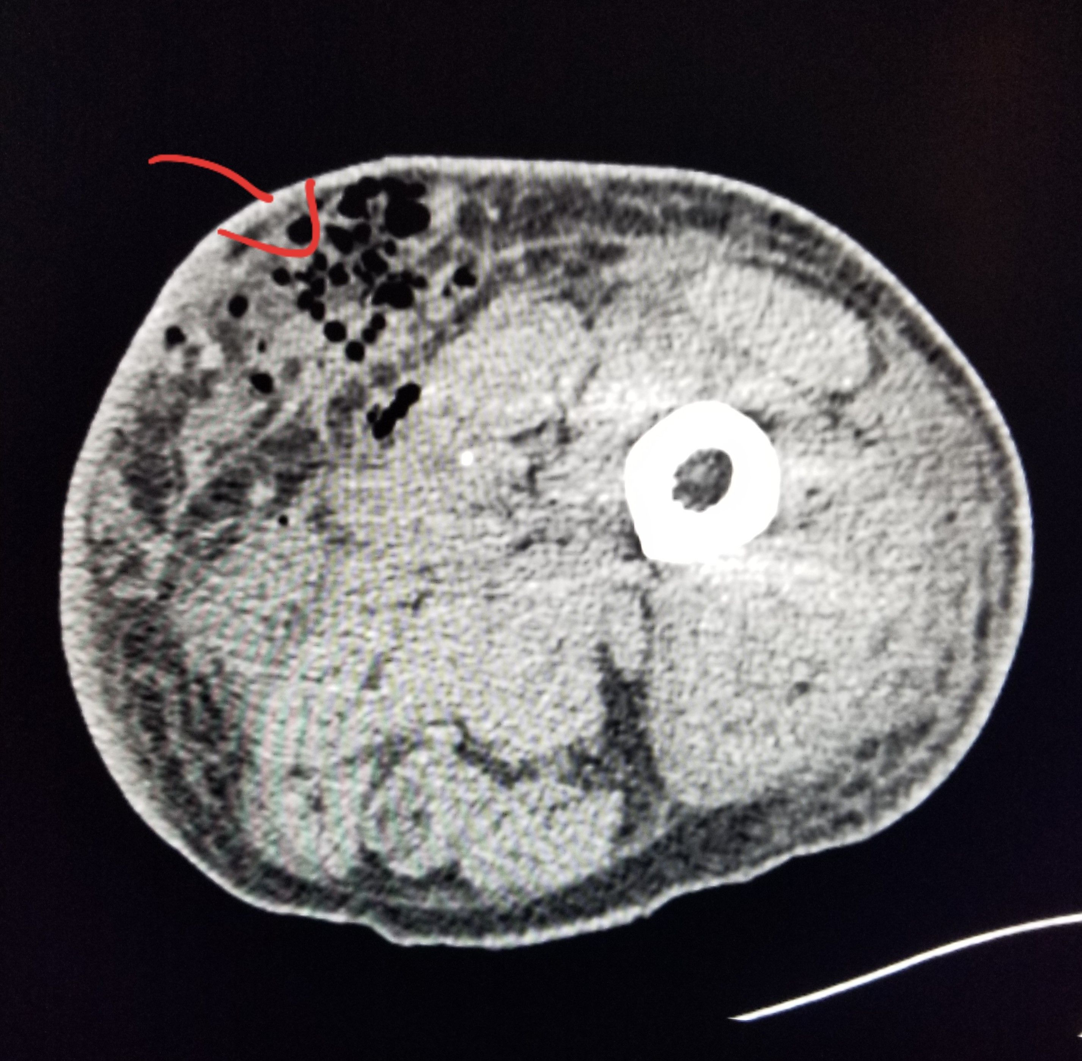
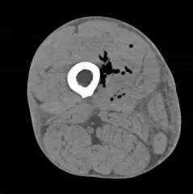
A little bit more imaging

Slide 98
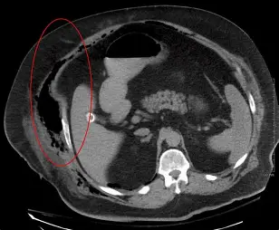
A little bit more imaging

Slide 99
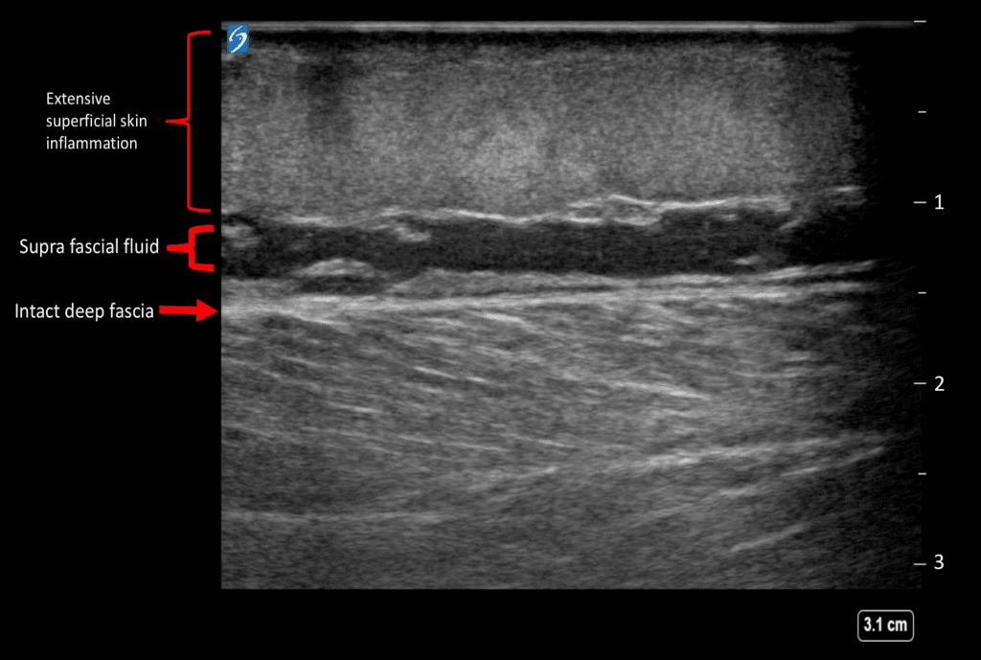
A little bit more imaging

Slide 100
NSTI-Necrotizing Soft Tissue Infection
Case 2
64yo man on Tremfya for psoriasis presents to ER with 2 days of body aches, N/V/D, mild SOB.
2300 35.5 103/79 101 18 98%
0100 Home- ‘Flu’, Covid neg, Flu swab pend.

Slide 101
NSTI-Necrotizing Soft Tissue Infection
Case 2
64yo man on Tremfya for psoriasis presents to ER with 2 days of body aches, N/V/D, mild SOB.
2300 35.5 103/79 101 18 98%
0100 Home- ‘Flu’, Covid neg, Flu swab pend.
Returns to ER that afternoon with focal R flank/RLQ pain and suprapubic bruising.
1400 36.6 91/52 128 27 90%
WBC 12.6 Creat 7.8 Lact 5.8 Na 123

Slide 102
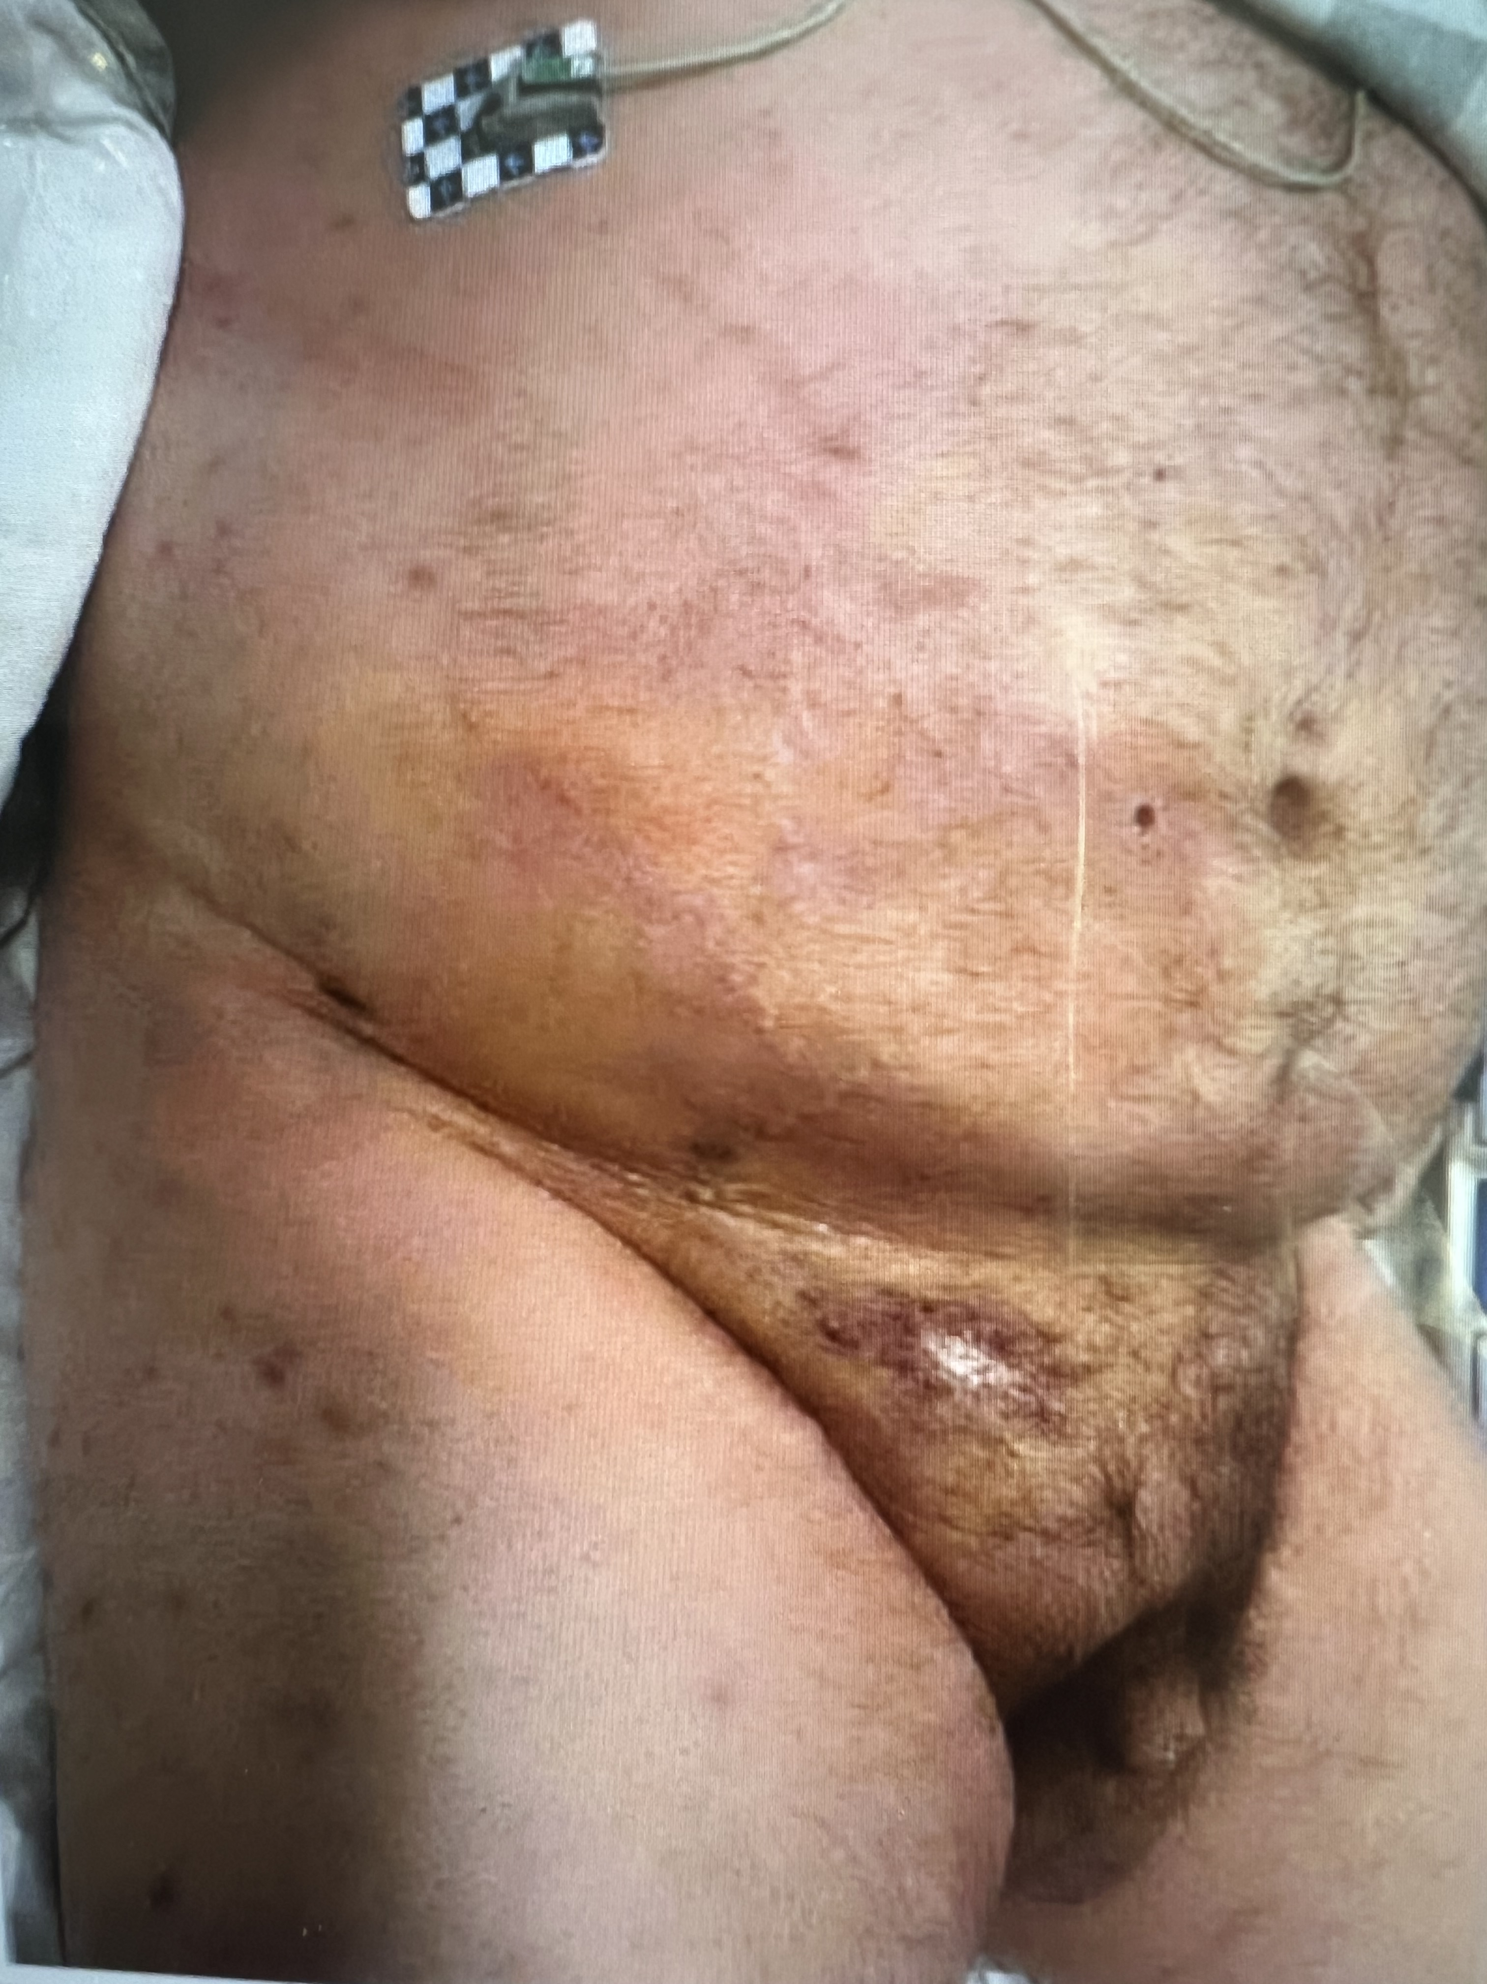
NSTI-Necrotizing Soft Tissue Infection
Case 2

Slide 103
NSTI-Necrotizing Soft Tissue Infection
Case 2
1400 Returns to ER with more focal R flank/RLQ pain and suprapubic bruising.
36.6 91/52 128 27 90%
WBC 12.6 Creat 7.8 Lact 5.8 Na 123
Central line, fluids, pressors, abx
1800 Transfer to higher level care

Slide 104
NSTI-Necrotizing Soft Tissue Infection
Case 2
2100 Arrives at receiving hospital
Intubated, fluids, dialysis, pressors, abx
0100 Gen surg consult -> groin cutdown in ICU
1000 Repeat cutdown -> nec fasc
1100 Debride 25x60cm skin, fat, fascia
Expires next day

Slide 105
Treatment strategies

Slide 106
antibiotics

Slide 107
Types of antibiotics
Bacteriostatic
Sulfa, Clindamycin, Tetracycline, Linezolid
Bacteriocidal
Penicillins, Vancomycin, Gentamycin, Meropenem, Imipenem

Slide 108
Where do antibiotics go?
Everywhere there is blood flow

Slide 109
Surgery

Slide 110
What can surgery accomplish?
Drain abscess
Cut out dead tissue
Cut out infectious agents

Slide 111
Treatment strategies

Slide 112
Cellulitis
Sponge =Antibiotics

Slide 113
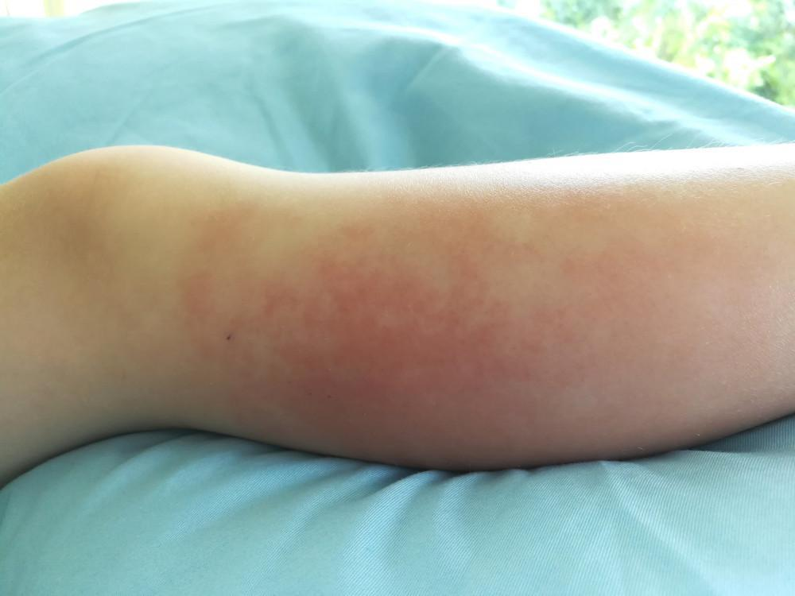
Cellulitis
Mild cellulitis without associated wound or systemic symptoms
Beta hemolytic strep
Oral Abx
-PCN or amoxicillin or cephalexin

Slide 114
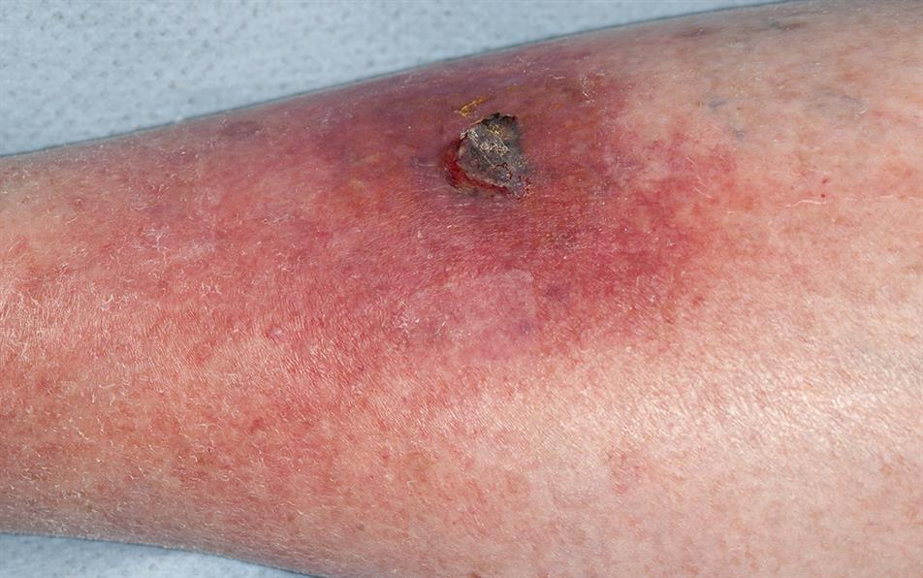
Cellulitis
Cellulitis with associated wound or abscess, no systemic symptoms
MSSA,MRSA, Beta hemolytic strep
Oral Abx
-TMP/SMZ or doxycycline plus
PCN or amoxicillin or cephalexin
-Linezolid

Slide 115
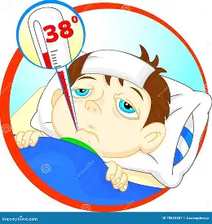
Cellulitis
Severe cellulitis with systemic symptoms
MSSA, MRSA, Beta hemolytic strep
IV Abx
-Vancomycin or daptomycin or linezolid

Slide 116
Phlegmon
Sponge=Antibiotics

Slide 117
Phlegmon
Cellulitis with associated wound or abscess, no systemic symptoms
MSSA,MRSA, Beta hemolytic strep
Oral Abx
-TMP/SMZ or doxycycline plus
PCN or amoxicillin, or cephalexin
-Linezolid
Severe cellulitis with systemic symptoms
MSSA, MRSA, Beta hemolytic strep
IV Abx
-Vancomycin or daptomycin or linezolid

Slide 118
Phlegmon
Sponge=Antibiotics
Close observation for water balloon development

Slide 119
Abscess
Water balloon=Drainage
Sponge along edges=Antibiotics(short course)

Slide 120
Abscess
Cellulitis with associated wound or abscess, no systemic symptoms
MSSA,MRSA, Beta hemolytic strep
Oral Abx
-TMP/SMZ or doxycycline plus
PCN or amoxicillin, or cephalexin
-Linezolid
Severe cellulitis with systemic symptoms
MSSA, MRSA, Beta hemolytic strep
IV Abx
-Vancomycin or daptomycin or linezolid

Slide 121
NSTI
Excisional debridements
N+1
Antibiotics

Slide 122
NSTI
Monomicrobial
-Usually involves extremities, head or neck
-Mostly beta hemolytic strep
Group A>>B, C, G
-Can be MSSA, MRSA
+Surgical debridement
+IV Abx
Strep-PCN plus Linezolid***
IVIG for Toxic Shock Syndrome
MSSA-Cefazolin or Oxacillin or Nafcillin
MRSA-Vancomycin or Linezolid or Daptomycin

Slide 123
NSTI
Polymicrobial
-Usually involves perineum or trunk…can be anywhere!
-Mixture of gram+/gram- and aerobe/anaerobe
+Surgical debridement
+IV Abx
Pip/tazo or Meropenem plus Vancomycin plus Linezolid

Slide 124
Case #3
-51 yo man with polysubstance use disorder who presented to community ER with R arm pain after injecting antecubital multiple times with reused needle
-VS not impressive, WBC 25K
-R hand cool, forearm compartments tight
-CT concerning for nec fasc

Slide 125
Case #3
-Call to SHMC ortho team who recommended debridement there prior to transfer and then admission to medical team at SH with ortho consulting
-Underwent fasciotomies including carpal tunnel for the compartment syndrome at OSH
-2330: Arrived at SHMC
-Plan: IV abx, follow cap refill, surgery consult if worsens

Slide 126
Case #3
-0800: Increased pain, decreased cap refill so gen surgery called around
-Dressing taken down and wound evaluated

Slide 127
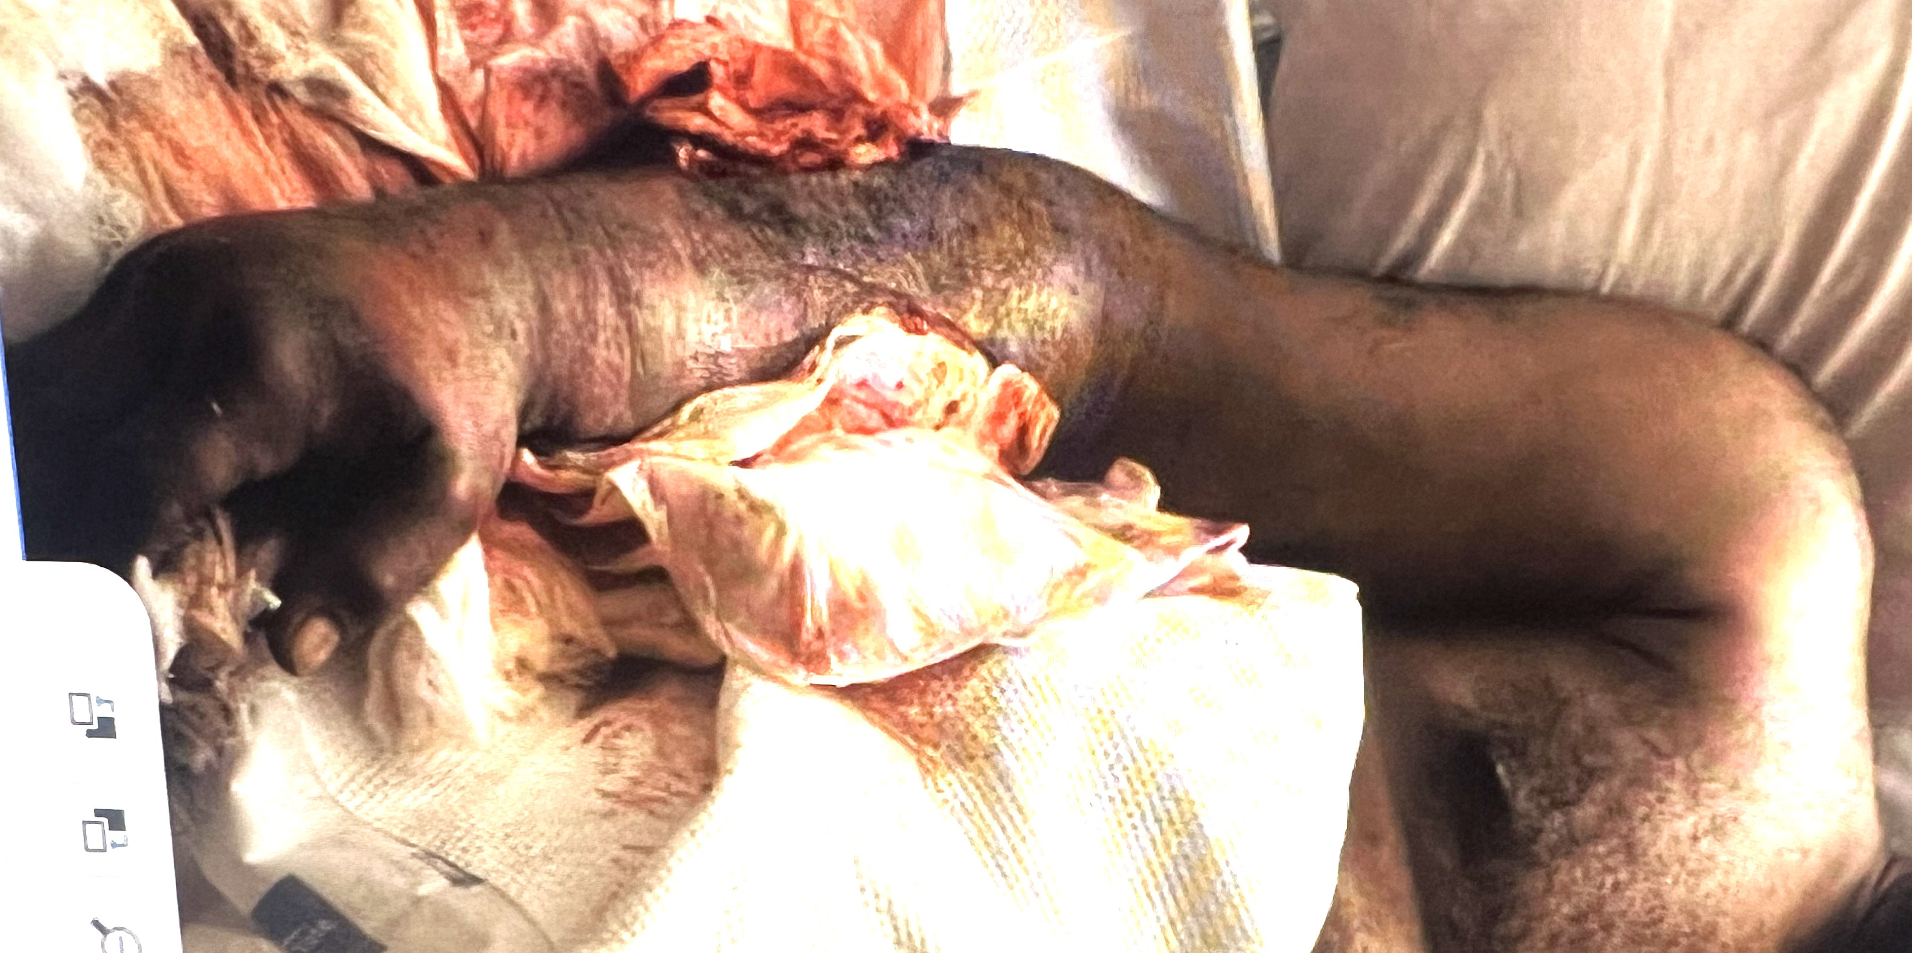
Case #3: NSTI

Slide 128
Case #3
-HD 2 0830:Taken emergently to the OR with general surgery, ortho and hand for extensive debridement(Orthopedic surgeon was wondering if he had arrived as he hadn’t heard anything from transfer center, floor or medical team)

Slide 129
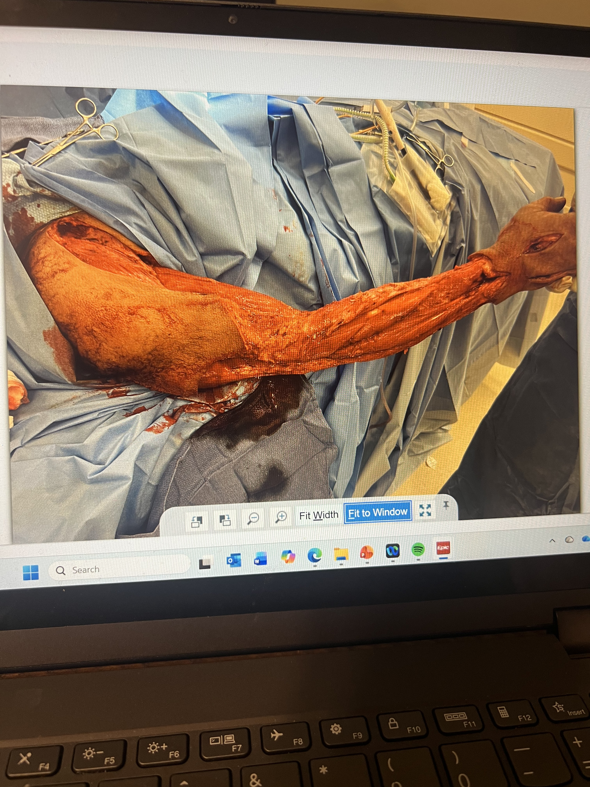
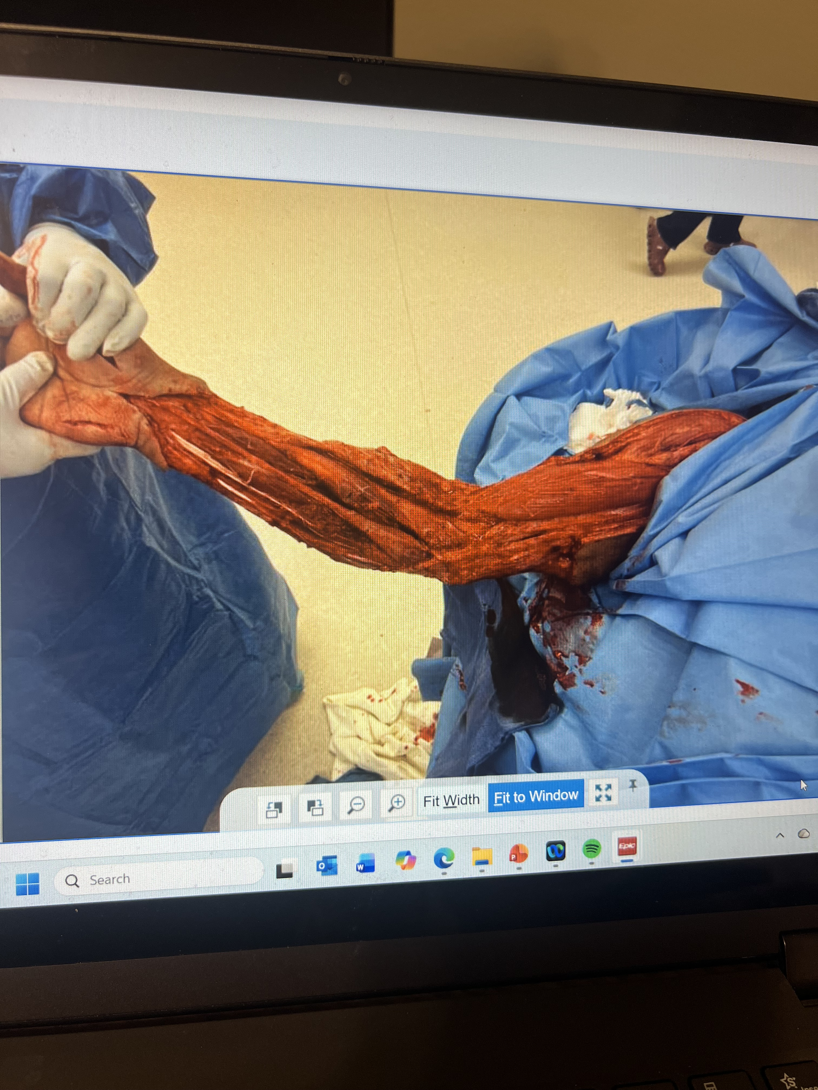
Case #3: NSTI

Slide 130
Case #3
-HD 3 Progressive multisystem organ failure despite maximal support. Pt expired.

Slide 131
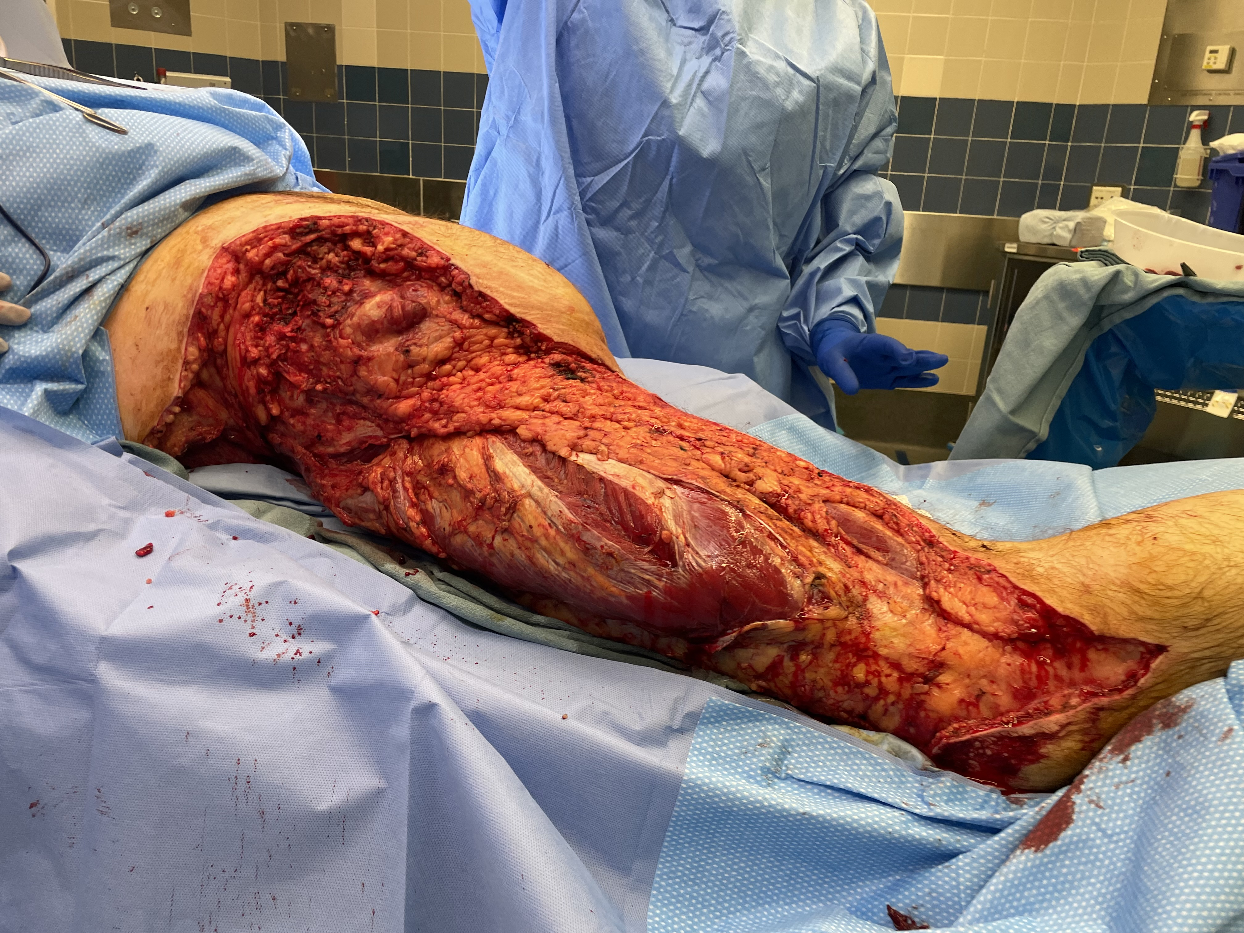
NSTI example

Slide 132
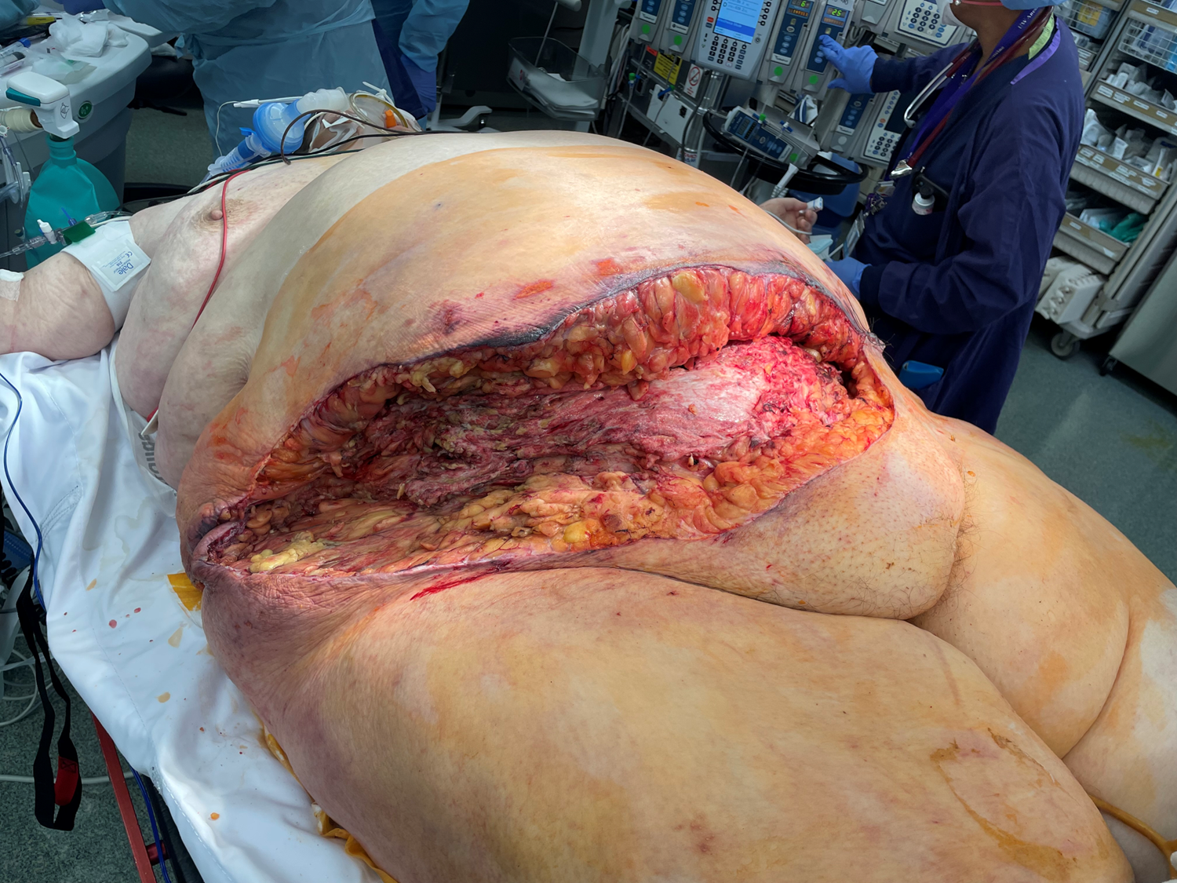
NSTI example

Slide 133
NSTI
Typically requires multiple debridements
Bax rule: qd or qod trips to OR until NO further debridement needed (N+1)

Slide 134
SUMMARY

Slide 135
SUMMARY
Not all bacteria are bad…but most are

Slide 136
SUMMARY
Not all bacteria are bad…but most are
Your immune system is good…most of the time

Slide 137
SUMMARY
Not all bacteria are bad…but most are
Your immune system is good…most of the time
Bax classification has 4 types of soft tissue infection

Slide 138
SUMMARY
Not all bacteria are bad…but most are
Your immune system is good…most of the time
Bax classification has 4 types of soft tissue infection
Look at the patient and site of infection please!

Slide 139
SUMMARY
Not all bacteria are bad…but most are
Your immune system is good…most of the time
Bax classification has 4 types of soft tissue infection
Look at the patient and site of infection please!
Is it a sponge or a water balloon?

Slide 140
SUMMARY
Not all bacteria are bad…but most are
Your immune system is good…most of the time
Bax classification has 4 types of soft tissue infection
Look at the patient and infection please!
Is it a sponge or a water balloon?
Treatment:
Cellulitis and phlegmon -> antibiotics and recheck
Abscess -> Drainage + short course antibiotics
NSTI -> aggressive excisional debridements + antibiotics

Slide 141
Questions??
Thank you

