Slide 1
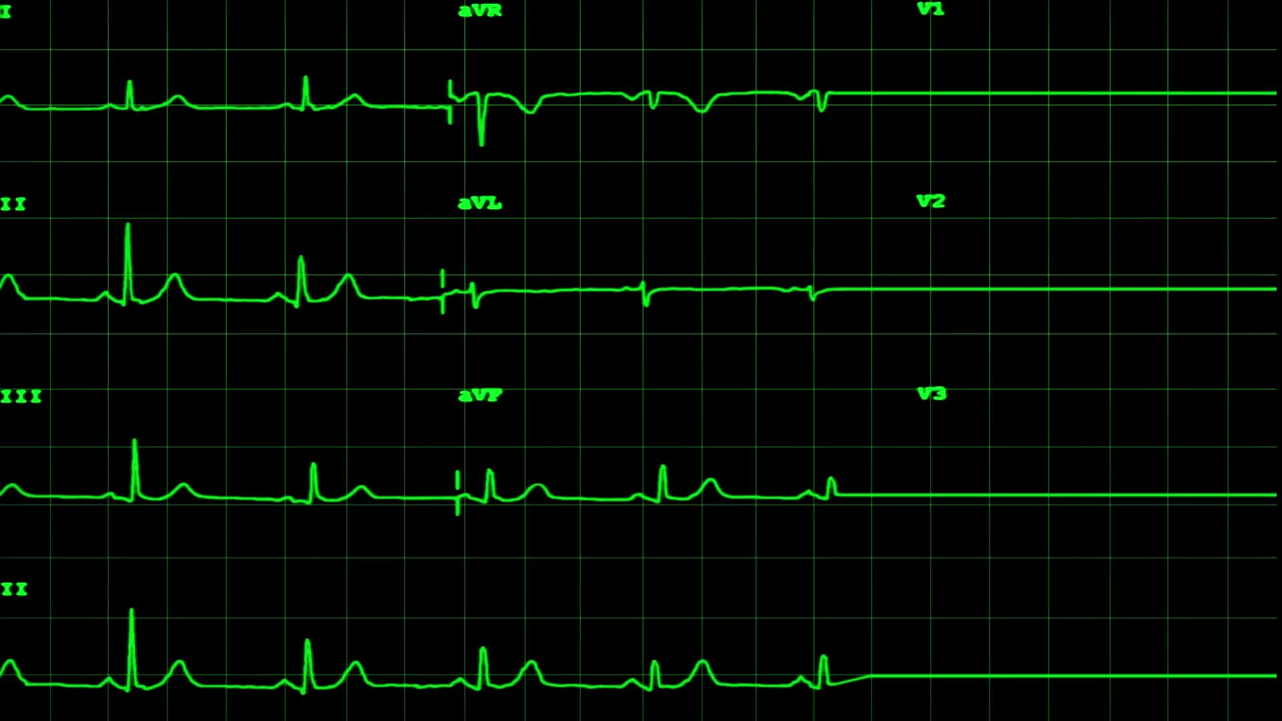
Assessment of Heart Failure Patients with & without Hemodynamic Monitoring
Andrew Coletti MD FACC
Director Cardiac Catheterization Lab & Interventional Cardiology
Wenatchee Valley Medical Group/Confluence Health
Wenatchee, WA

Slide 2

Disclosure- Financial
None

Slide 3

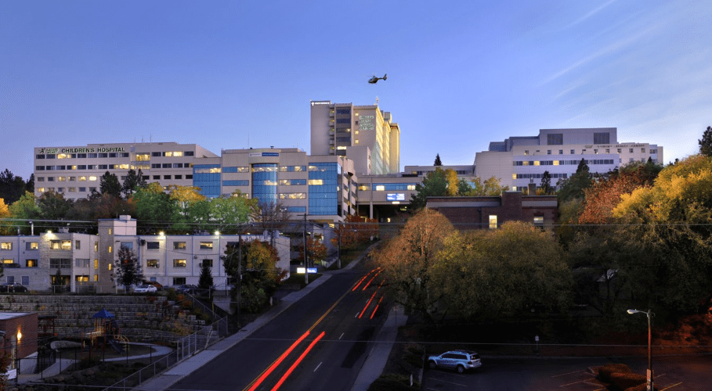
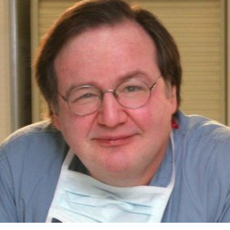

Slide 4
Introduction
Review HF terminology
Assessment tools
WWCD – what would Coletti do ?
Different faces of heart failure
Rational approach to the assessment of the HF patient
Coletti evening rounds @ SHMC

Slide 5


HF mini-boot camp

Slide 6

Systolic (HFrEF) vs Diastolic HF (HFpEF)

Slide 7
Systolic vs Diastolic HF
Systolic HF : LVEF < 50 %
Diastolic HF : normal LVEF 55-70%

Slide 8
What’s failing ?
RV
BiV
LV

Slide 9
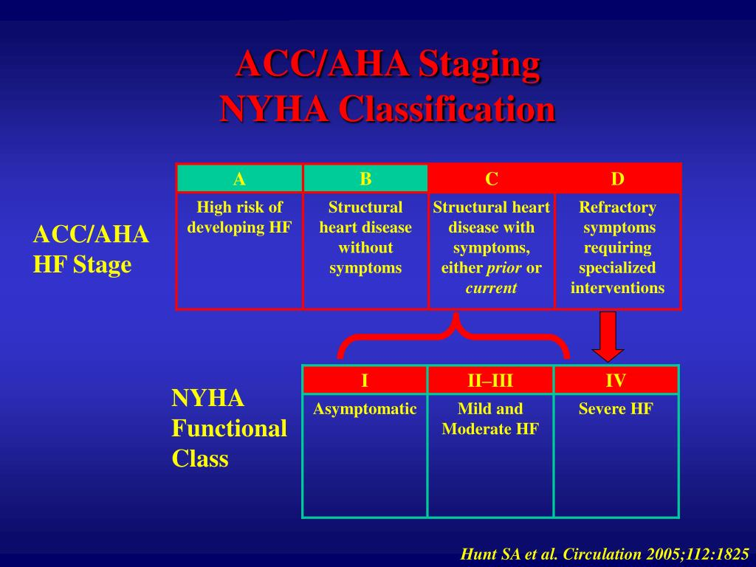
Stages of Heart Failure vs
NYHA
Functional
Class

Slide 10
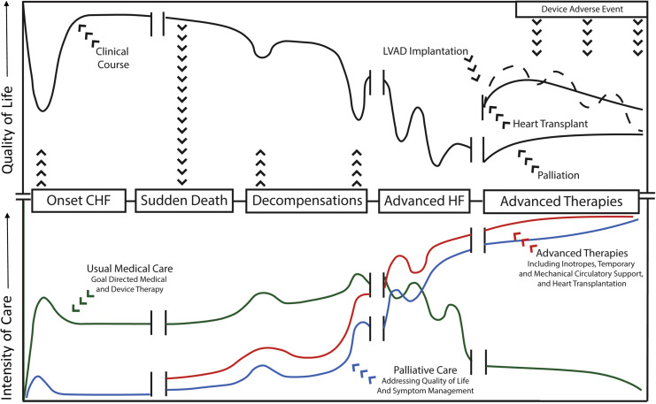

Slide 11

Etiologies of Heart Failure
Ischemic Cardiomyopathy
Familial non-ischemic cardiomyopathy
Valvular Cardiomyopathy
Toxin Induced cardiomyopathy

Slide 12

Assessment of the HF Patient

Slide 13
Assessment
H&P
Labs
ECG
Imaging
Echo / CxR
PA catheter

Slide 14


Slide 15


Slide 16
Coletti’s “morning rounds” SHMC 2016-2024
Assessment of :
--60 yo male remote anterior STEMI / LVEF 15%/AKI/Urosepsis
--29 yo woman s/p LVAD – low flows / progressive dyspnea and hypotension
--17 yo woman LVEF 20%, ST 140’s, “black blood”
--16 yo young man s/p OHT hypotensive, dyspneic and bradycardic

Slide 17
What would Coletti do ?
Who are you ? Tell me your story !
What injured your heart ?
What can you do ? – NYHA functional class
What are your cardiac meds / studies / devices – HF Stage

Slide 18
-60 yo male remote anterior STEMI / LVEF 15%/AKI/Urosepsis – weird guy speaking Korean !
Transfer from HFH for initiation of HD
Remote h/o Anterior STEMI / LAD stent / ICD
LVEF 1 year ago 30% , now LVEF 15%
Starting HD
“Not much to do from a cardiac standpoint – it’s all ID & renal”

Slide 19
Real story …………….
Who are you ? Tell me your story !
What injured your heart ?
What can you do ? – NYHA functional class
What are your cardiac meds / studies / devices – HF Stage

Slide 20
29 yo woman s/p LVAD – low flows / fatigue/anorexia
Who are you ? Tell me your story !
What injured your heart ?
What can you do ? – NYHA functional class
What are your cardiac meds / studies / devices – HF Stage

Slide 21
17 yo woman LVEF 20%, ST 140’s, “black blood”
Who are you ? Tell me your story !
What injured your heart ?
What can you do ? – NYHA functional class
What are your cardiac meds / studies / devices – HF Stage

Slide 22
--16 yo young man s/p OHT hypotensive, dyspneic and bradycardic
Who are you ? Tell me your story !
What injured your heart ?
What can you do ? – NYHA functional class
What are your cardiac meds / studies / devices – HF Stage

Slide 23


Slide 24
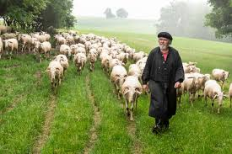

Slide 25


Slide 26


Slide 27

Thank you ! Questions ??

