Slide 1
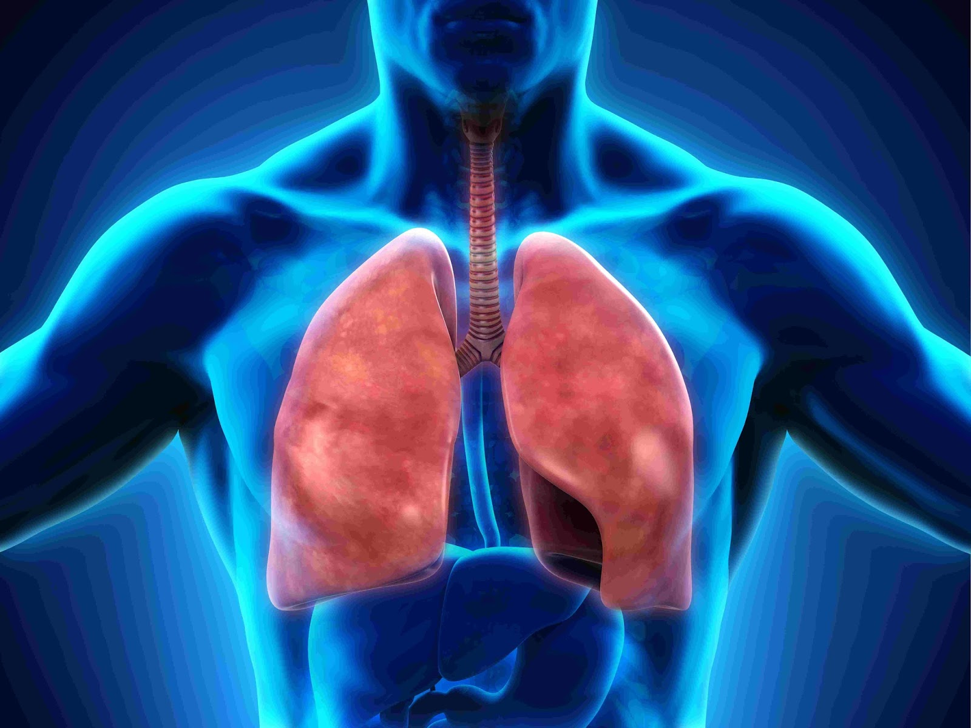
Respiratory Rate (RR)
The Most Undervalued Vital Sign
Shery Wachtel PhD, RN, CNS-CC, CCRN
This Photo by Unknown Author is licensed under CC BY-NC-ND

Slide 2

Join at slido.com
#6624640
This Photo by Unknown Author is licensed under CC BY-NC-ND

Slide 3



Do not edit
How to change the design
How many years have you been a nurse?
The Slido app must be installed on every computer you’re presenting from

Slide 4

Do not edit
How to change the design
What is your primary work setting (unit/department)
The Slido app must be installed on every computer you’re presenting from

Slide 5
Do not edit
How to change the design
How do you typically count patient respirations for non-ventilator patients?
The Slido app must be installed on every computer you’re presenting from

Slide 6
Do not edit
How to change the design
Do you tell the patient you're going to count their respirations prior to starting your count?
The Slido app must be installed on every computer you’re presenting from

Slide 7
Do not edit
How to change the design
Do you ever "guestimate" your patient’s respiratory rate?
The Slido app must be installed on every computer you’re presenting from

Slide 8
Do not edit
How to change the design
When do you assess your patient's respiratory rate?
The Slido app must be installed on every computer you’re presenting from

Slide 9
Why do I ask?
Early evidence supports RR as a strong predictor for detection of early patient deterioration
  Ridley, 2005
  Cretikos et al., 2008
  Cahill et al., 2011
  Parkes, 2011
  Churpek et al., 2013
  Churpek et al., 2016
  Porter et al., 2019
  Rolfe, 2019
  Tollefson & Hillman, 2019
RR more discriminating than other VS
  Barfod et al., 2012
  Churpek et al., 2016
RR is often the first VS affected if change is patient’s cardiac or neurologic status
  Liddle, 2013
  Bloomfield et al., 2017
This Photo by Unknown Author is licensed under CC BY-NC-ND

Slide 10
Why do I ask (cont.)?
RR can detect deterioration several hours before other signs emerge → valuable predictor for ICU admission, cardiac arrest & mortality
  Cuthbertson et al., 2016
  Churpek et al., 2016
First VS to deviate when patient condition worsens
  Bunkenborg et al., 2019
The most important VS for early detection of deterioration
  Kayser et al., 2023
RR is a critical VS to assess overall health status
  AMA. 2023. VS Assessment. Stat Pearls
This Photo by Unknown Author is licensed under CC BY-NC-ND

Slide 11
Why do I ask (cont.)?
RR least likely to be monitored in or automated particularly in medical/surgical wards
  Leuvan & Mitchell, 2008
  Semler et al., 2013
  Elliot & Baird, 2019
  Palmer et al., 2022
RR is missed76%-83% of times that other VS are recorded
  McGain et al., 2008
  Ludikhuize et al., 2012
  Tirkkonen et al., 2013
  Cardona-Morrell et al., 2016
  Difonzo, 2019
RR more likely to be inaccurately recorded…not counting for full 60 seconds
  Rimbi et al., 2019
  Takayama et al., 2019
  Kallioinen et al., 2021
This Photo by Unknown Author is licensed under CC BY-NC-ND

Slide 12
Why do I ask (cont.)?
Reasons listed for not being measured:
  Lack of understanding of importance
  Misconception that O₂ Sat is a sufficient substitute
  Lack of time
  Subjective nature of measuring
  Wide variation for same patient
  Significant discrepancy between RR & EWS
(Hogan, 2006; Chua et al., 2013; Philip et al., 2013; Ansell et al., 2014; Chen et al., 2015; Mok et al., 2015; Smith & Aitkin, 2016; Elliot, 2016; Flenady et al., 2017; Brabrand et al., 2018; Elliot & Baird, 2019)
Multinational issue
  USA, Australia, Norway, Japan, UK, China, Taiwan
This Photo by Unknown Author is licensed under CC BY-NC-ND

Slide 13
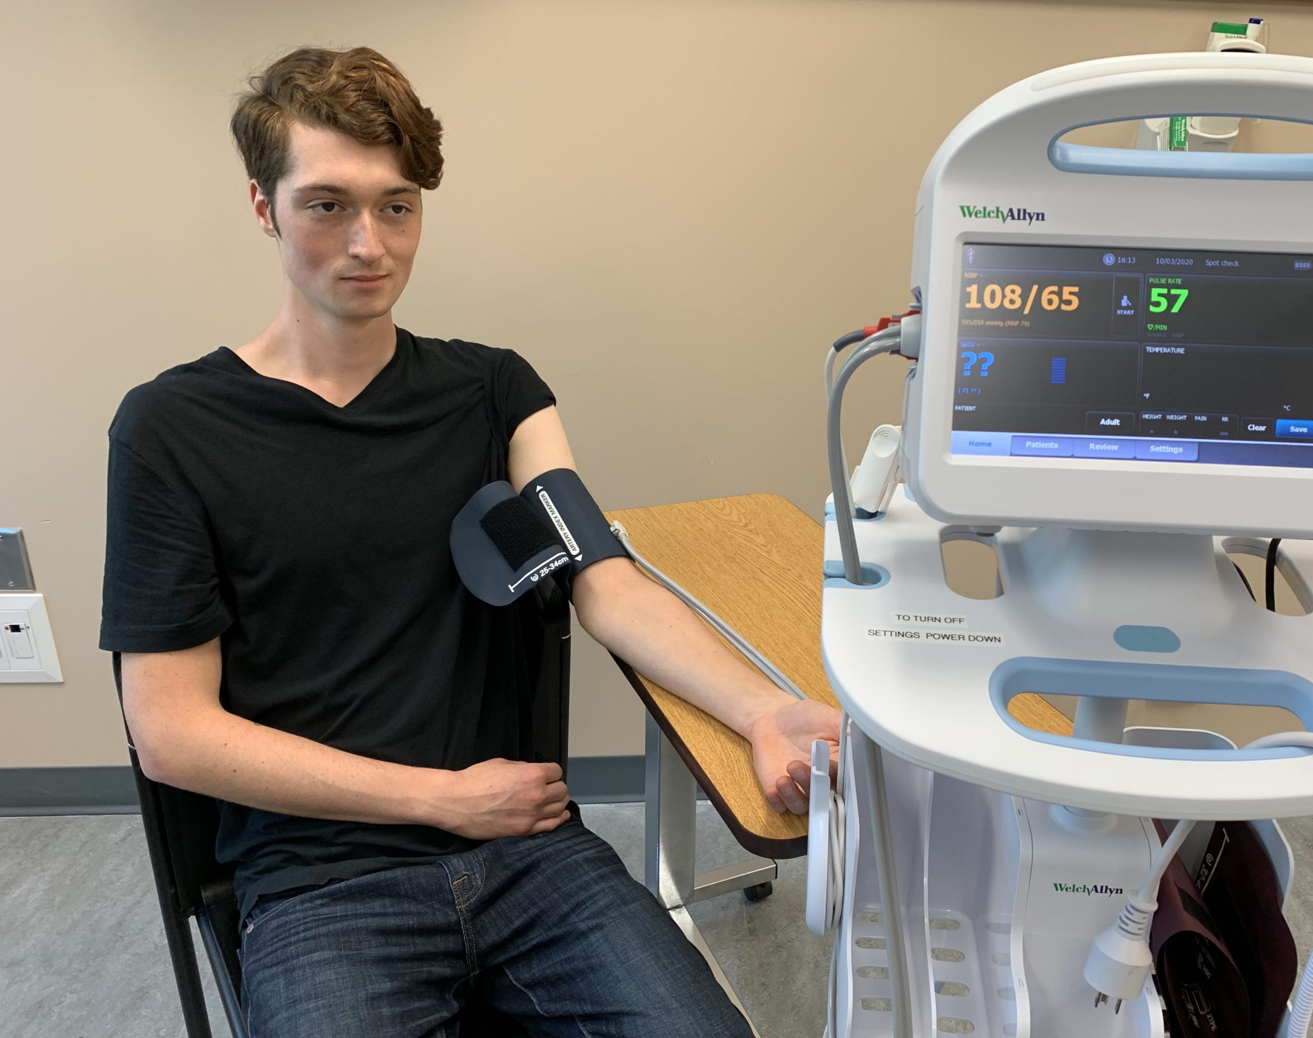
Nursing Fundamentals Textbooks
2022 – Elliot & Williamson
Audit of 29 Fundamentals textbooks to assess descriptions of RR
Consistent for RR normal ranges
Varied on method for measurement
  Assess without patient’s awareness (6)
  Assess after HR check with fingers in place (7)
  Place arm across chest to enhance observation (7)
  Count for 30 seconds multiply by 2 (16)
  Count for full 1 minute (9)
  If RR is irregular, count for full 1 minute (17)
  Start after breath cycle completed & count for full 1 minute (4)
Emphasized clinical importance of RR (16)
This Photo by Unknown Author is licensed under CC BY

Slide 14

CO₂ + H₂0 <-> H₂C0₃ <-> HCO₃- + H+
↑ Respiratory Rate → ↓ CO₂ → ↓ H⁺ → ↑ pH
↓ Respiratory Rate → ↑ CO₂ → ↑ H⁺ → ↓ pH
Hopkins E, Sanvictores T, Sharma S. Physiology, Acid Base Balance. 2022 Sep 12. In: StatPearls [Internet]. Treasure Island (FL): StatPearls Publishing; 2025 Jan–. PMID: 29939584.
Notes:
This buffer system is in equilibrium; that is, all reaction components exist throughout the body and are shifted to the side of the equation appropriate for the environment.
Key Teaching Point:
↑ Respiratory Rate → ↓ CO₂ → ↓ H⁺ → ↑ pH
↓ Respiratory Rate → ↑ CO₂ → ↑ H⁺ → ↓ pH
Every organ system of the human body relies on pH balance; however, the renal system and the pulmonary system are the 2 main modulators. The pulmonary system adjusts pH using carbon dioxide; upon expiration, carbon dioxide is projected into the environment. Due to carbon dioxide forming carbonic acid in the body when combined with water, the amount of carbon dioxide expired can cause pH to increase or decrease. When the respiratory system compensates for metabolic pH disturbances, the effect occurs in minutes to hours.

Slide 15
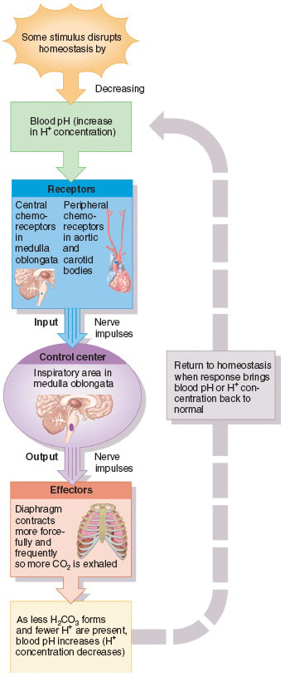
Pulmonary Response to changes in pH
In Response to ↑ CO₂ (Respiratory Acidosis)
Chemoreceptors detect change in seconds
Ventilatory response begins within 10–20 seconds
Peak response typically within 1–2 minutes
This Photo by Unknown Author is licensed under CC BY-SA

Slide 16
Pulmonary Response to changes in pH
In Response to Metabolic Acidosis (↓ pH, normal CO₂ initially)
Example: DKA, lactic acidosis
Peripheral chemoreceptors sense ↓ pH
Hyperventilation begins within 1–2 minutes
Kussmaul breathing pattern may develop quickly
Full compensatory drop in PaCO₂ occurs over minutes
This Photo by Unknown Author is licensed under CC BY-SA

Slide 17
Pulmonary Response to changes in pH
In Response to Metabolic Alkalosis
Hypoventilation occurs
Response is slower and often limited
Begins within minutes but may be blunted by hypoxic drive
This Photo by Unknown Author is licensed under CC BY-SA

Slide 18
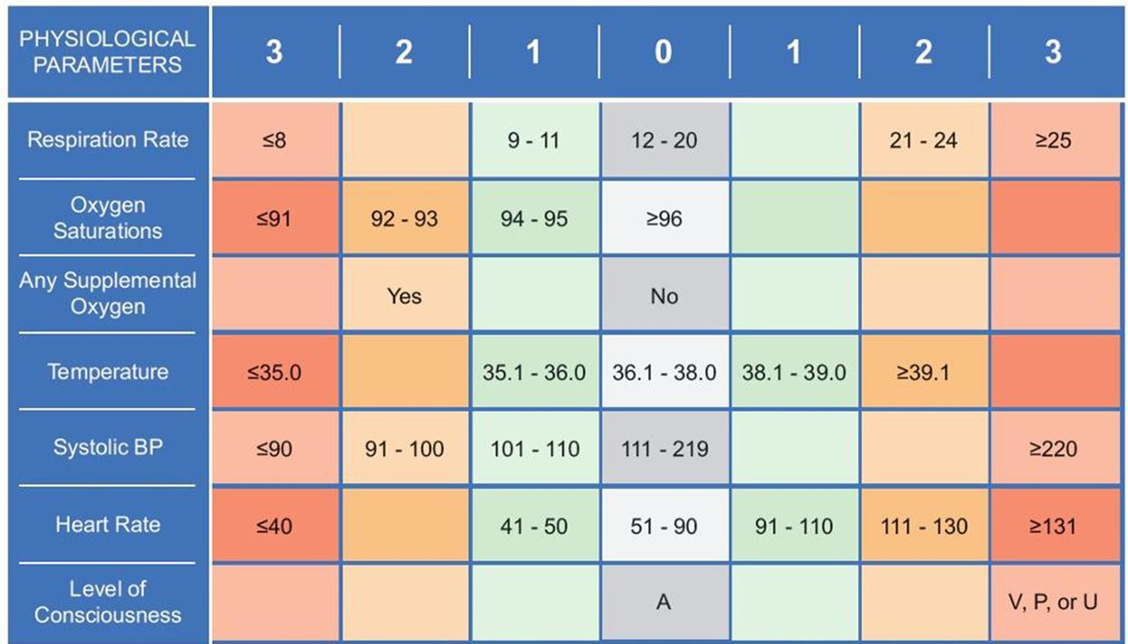
Early Warning Scores
This Photo by Unknown Author is licensed under CC BY-NC

Slide 19

Predictive Aspects of RR
Most EWS developed in US & UK (34).
Most common predictors of mortality:
RR = 88%
HR = 83%
O₂ sat, Temp & SBP = 71%
Age = 38%
Sex = 9%
BMJ 2020;369:m1501
This Photo by Unknown Author is licensed under CC BY-SA

Slide 20
Predictive Aspects of RR
Track & Trigger Systems (2007) – National Institute for Health & Clinical Excellence.
By 2013 > 100 different published systems.
What they told us →
“Patients who suffer adverse events on the wards, such as cardiac arrest and death, often have vital sign abnormalities hours before the event”
Churpek MM, Yuen TC, Edelson DP. Risk stratification of hospitalized patients on the wards. Chest. 2013 Jun;143(6):1758-1765. doi: 10.1378/chest.12-1605.
This Photo by Unknown Author is licensed under CC BY-SA

Slide 21
Predictive Aspects of RR
Less is More…2021
556,848 admissions
19,509 transferred to ICU (3.5%)
5,764 died within 24 hours of observation on the ward (1%)
“Two of the strongest predictors were RR and HR”
Akel MA, Carey KA, Winslow CJ, Churpek MM, Edelson DP. Less is more: Detecting clinical deterioration in the hospital with machine learning using only age, heart rate, and respiratory rate. Resuscitation. 2021 Nov;168:6-10. doi: 10.1016/j.resuscitation.2021.08.024. Epub 2021 Aug 23.
This Photo by Unknown Author is licensed under CC BY-SA

Slide 22
Predictive Aspects of RR
Time-series vital signs (TEWS) using HR, SBP & RR compared to other EWS…2023
16,865 adult admissions, “TEWS detected more deterioration with the same level of specificity as the different algorithms…”
Liu X, Hu P, Yeung W, Zhang Z, Ho V, Liu C, Dumontier C, Thoral PJ, Mao Z, Cao D, Mark RG, Zhang Z, Feng M, Li D, Celi LA. Illness severity assessment of older adults in critical illness using machine learning (ELDER-ICU): an international multicentre study with subgroup bias evaluation. Lancet Digit Health. 2023 Oct;5(10):e657-e667. doi: 10.1016/S2589-7500(23)00128-0. Epub 2023 Aug 18.
This Photo by Unknown Author is licensed under CC BY-SA

Slide 23
Recommendations:
*Count RR for 1 minute
*Count often
*Record accurately
*Support those that question
*TEACH
If respiratory rate changes within seconds to minutes in response to:
Rising CO₂
Falling pH
Increasing metabolic demand
Early sepsis
Shock
Hypoxia
Then RR is not just a vital sign — it is: A real-time reflection of physiologic stress.
Blood pressure may stay normal.
SpO₂ may stay normal.
Heart rate may drift slowly.
But RR moves first.
This Photo by Unknown Author is licensed under CC BY-NC-ND

Slide 24
Questions?
Contact: Shery Wachtel PhD, RN, CNS, CCRN
Eastern Washington University
School of Nursing
swachtel1@ewu.edu
This Photo by Unknown Author is licensed under CC BY-NC-ND

