Slide 1
AACN Inland Northwest Chapter
Spring Symposium
Marcus Torgenson, MD-FACS

Slide 2
Disclosures
None

Slide 3
Field Amputation “Literature”
Earliest review
  5 year survey of the 200 largest metropolitan areas in the United States
  26 Amputations
  Published in 1996
Case reports
News coverage about isolated incidents
Urban field amputation teams
  University of Utah 2017

Slide 4
Kootenai Health
381 bed hospital located in Coeur d’Alene, Idaho
Level II ACS Trauma Center
456 Trauma Activations in 2018
52,000 ER Visits in 2018

Slide 5
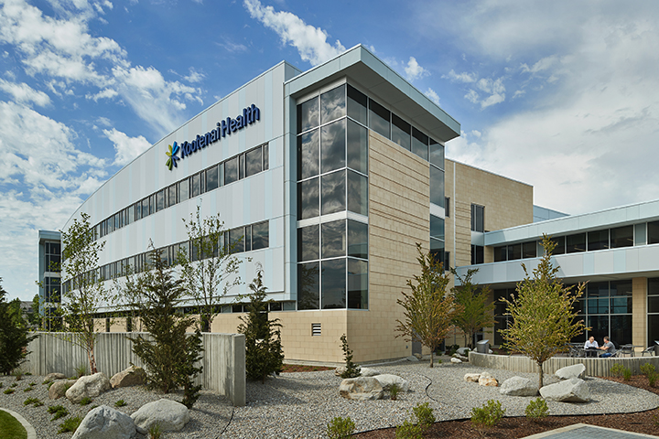

Slide 6
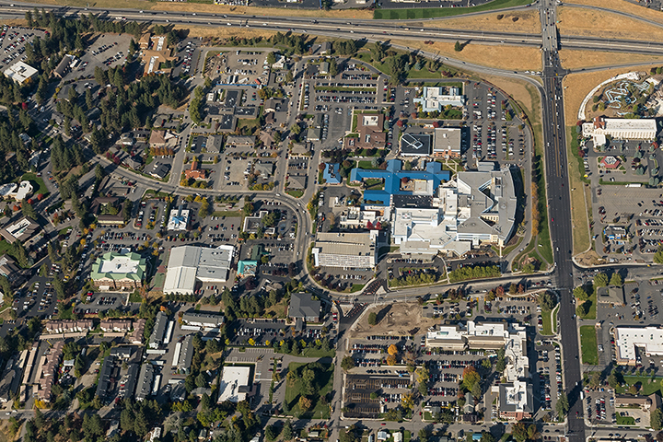
PHOTO OF KH

Slide 7
Timeline- to give perspective
1/14/17- Patient MW. Snowboarder with traumatic axillary artery/vein avulsion and chest crush injury
  Trauma, Vascular, Ortho
1/16/17- Three GSW victims from Bonner County
  Multiple specialties, multiple concurrent surgeries
1/16/17- Patient NM. Stab wound to right groin. Life threatening hemorrhage.
  Surgical exploration
1/19/17- Patient AT

Slide 8
The Initial Call
Phone call from ED around 830
  Details of accident unclear
  Possibly remote logging location
  Requesting a field amputation
    Told I had an hour before they could transport my team to the scene
Began mobilizing an OR
  Anesthesia, OR Nurse Leadership, Partner
  Medications, 2 units O-negative blood
  Cold weather gear, tourniquets
Completed my case and we departed KH 34 minutes after initial call from ED

Slide 9
Transport to the Scene
Kootenai County EMS Chief provided transport
  EMS Suburban Emergency Vehicle: Lights and sirens
Briefed on situation in transport
  On Hwy 90, 22 miles east of Kootenai Health
  Occurred around 530am
  One victim already transported to Shoshone Medical Center
    Ultimately transferred to Kootenai Health under the care of my partner
  One victim, unstable, still pinned in cab of truck by load of logs
    Hwy 90 closed

Slide 10
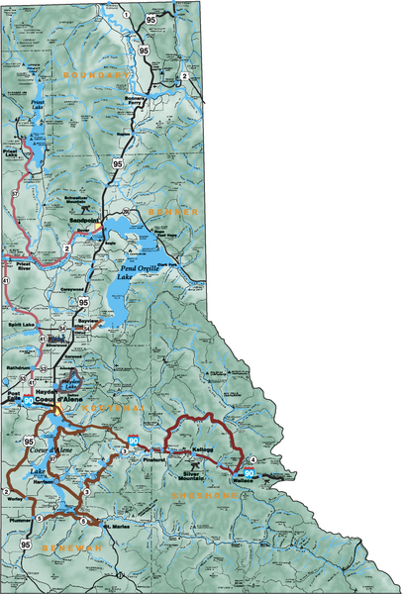

Slide 11
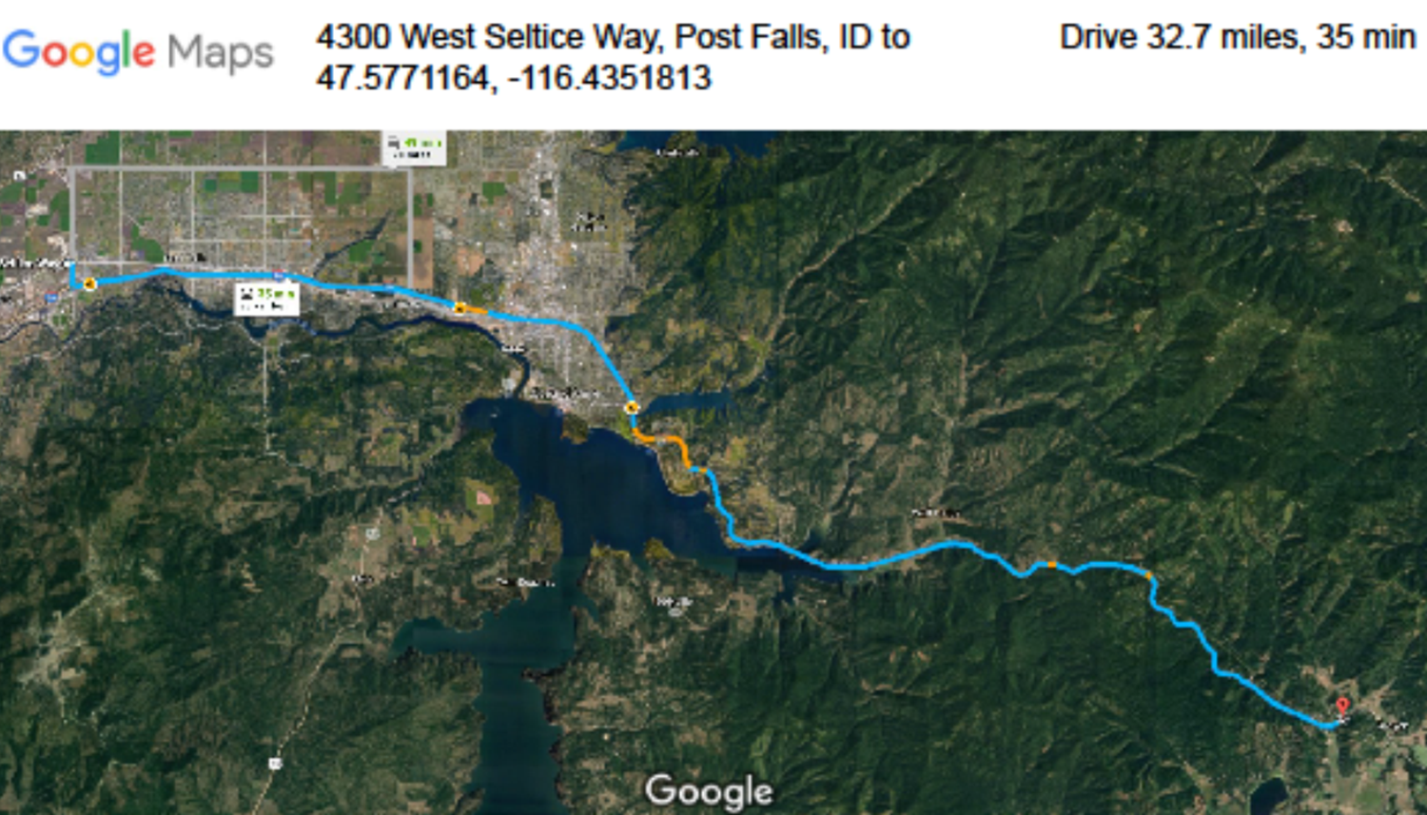

Slide 12
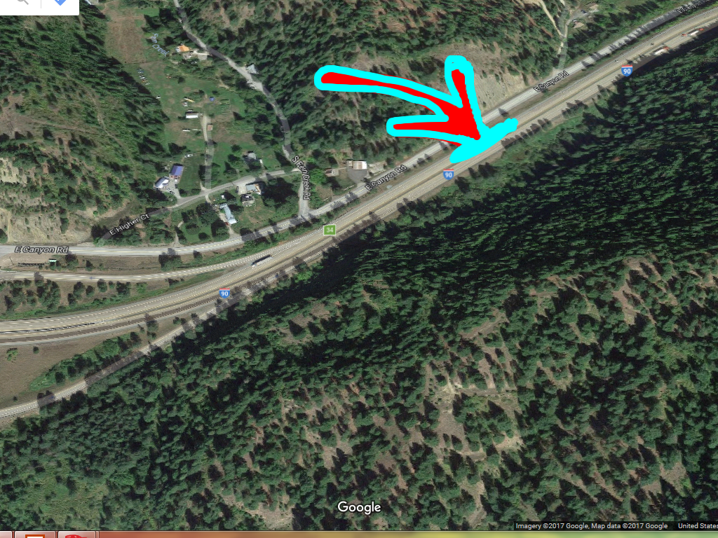

Slide 13
Patient AT
Patient has given consent to share his story
Specifically gave permission to share the photos from surgery and the scene
Patient’s perspective

Slide 14
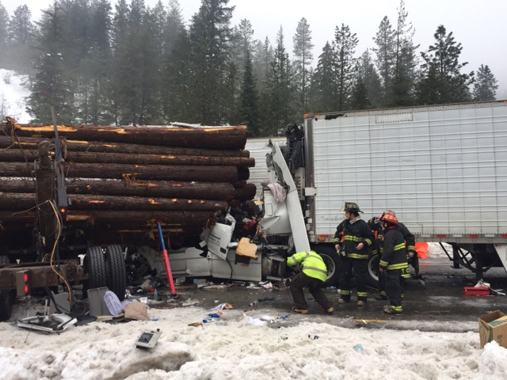
On arrival to scene:
Westbound lane
Steps to driver’s seat
Driver’s seat

Slide 15
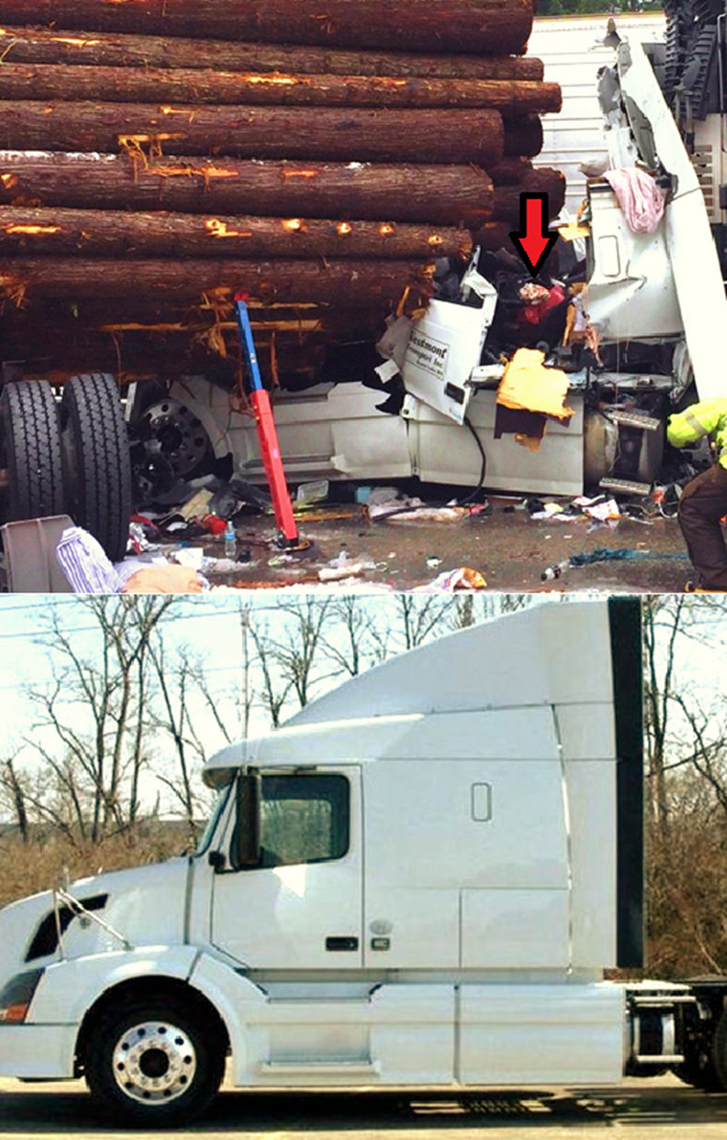

Slide 16
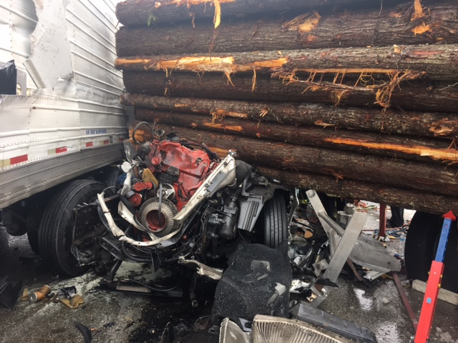

Slide 17
Patient AT

Slide 18
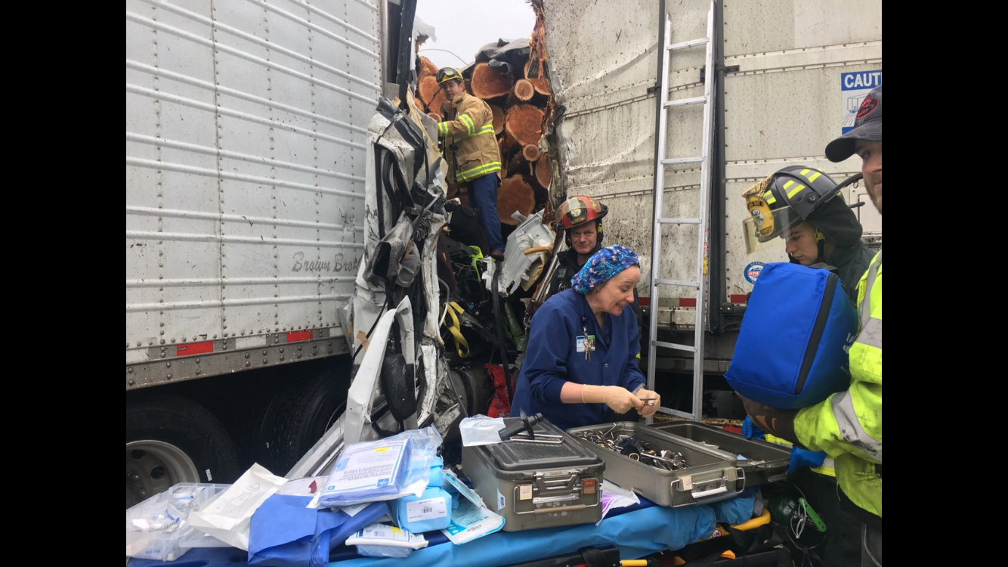

Slide 19
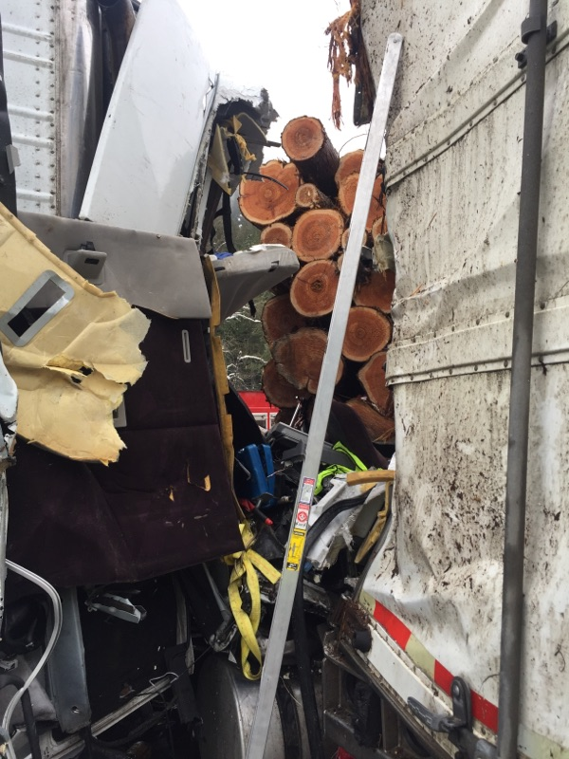

Slide 20
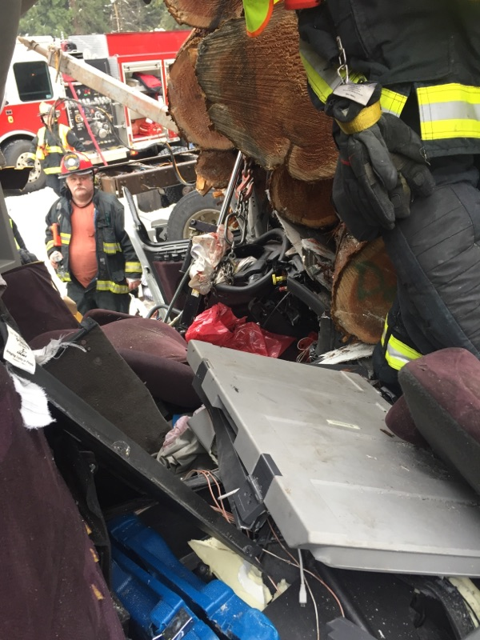

Slide 21
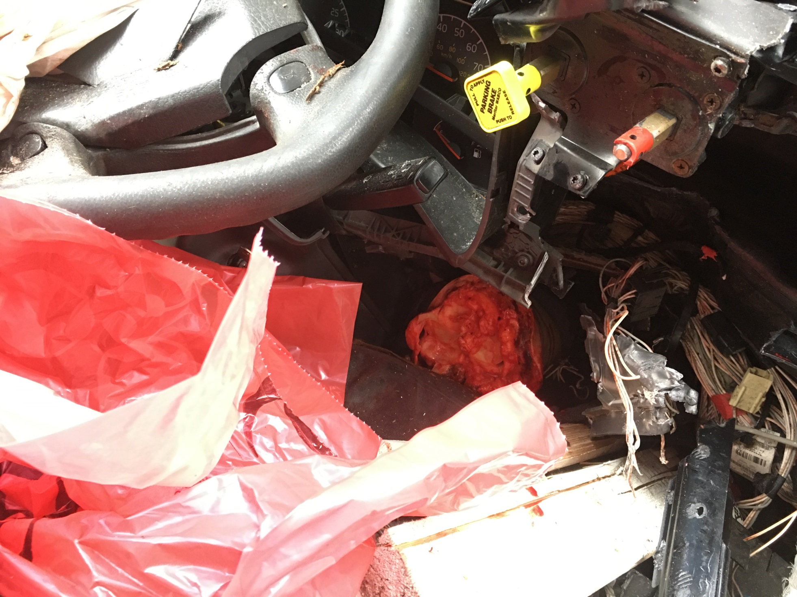

Slide 22
On Scene
Pt was in and out of consciousness
  HR90s, SBP80-90
  Russian speaking
Had an IV, but was not functioning
  Anesthesiologist (in cab with me) placed PIV
Jaw thrust, supplemental O2, ketamine, propofol

Slide 23
On Scene
Completed through the knee amputation
  Dr. Detar from driver’s side and Dr. Wineinger shining flashlights for exposure
  Use of saw/assistance from Dr. Detar
  Took less than 10 minutes

Slide 24
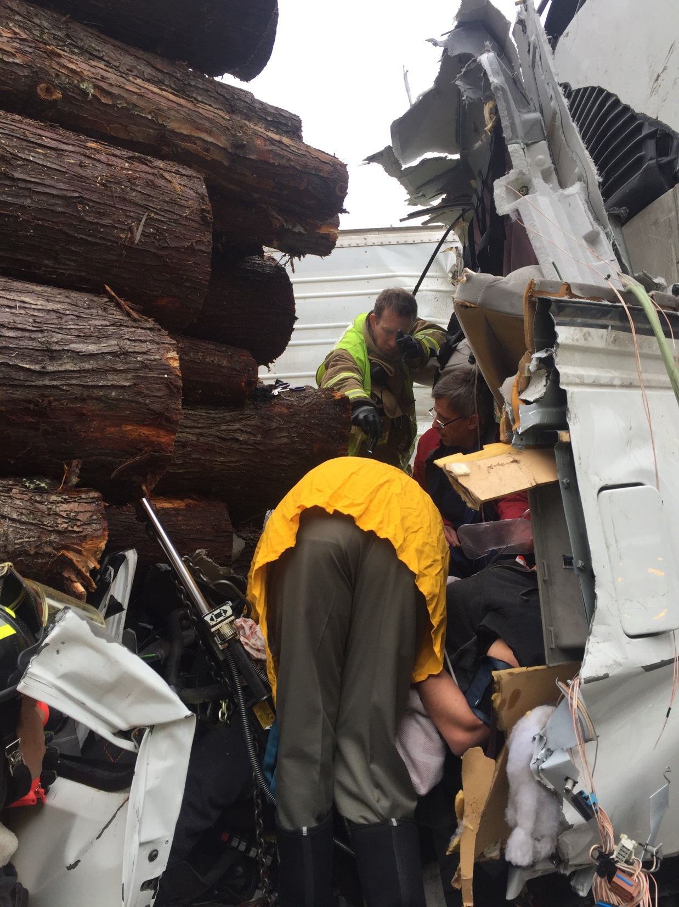
Maurice (KCFR)
Dr. Wineinger
Dr. Torgenson
Dr. Detar
Patient

Slide 25
Transport to Kootenai Health
Transported patient from wreckage to ambulance
  Intubated patient in ambulance
Pressure 75/50, so gave a unit of warmed blood in ambulance
Anesthesia, Paramedic, and I rode with patient from scene to Kootenai Health trauma bay
  Priority 1 Trauma Activation
Partner, OR Nurse, and Kootenai County EMS Chief followed closely behind in the suburban

Slide 26
Timeline
Arrival at scene to departure from scene= 40 minutes
Took ~15minutes intubating/resuscitating in ambulance before departure
Departure from Kootenai Health to arrival back in ambulance bay= 1hr 40minutes

Slide 27
Hospital Course
On arrival in trauma bay at 1130
  Hr 70s, BP 114/76, Temp 33.1
  pH 7.12, Base Deficit 12.4
  PT 17.7, INR 1.5
Other injuries identified prior to going to OR for R AKA revision
  Open left ankle laceration
    Washed out and closed by Ortho
  Right ear avulsion with multiple facial lacerations and nasal fracture
    Repaired/closed/reduced and ear canal stent placed by ENT
  Right sided subpleural emphysema, aspiration pneumonia

Slide 28
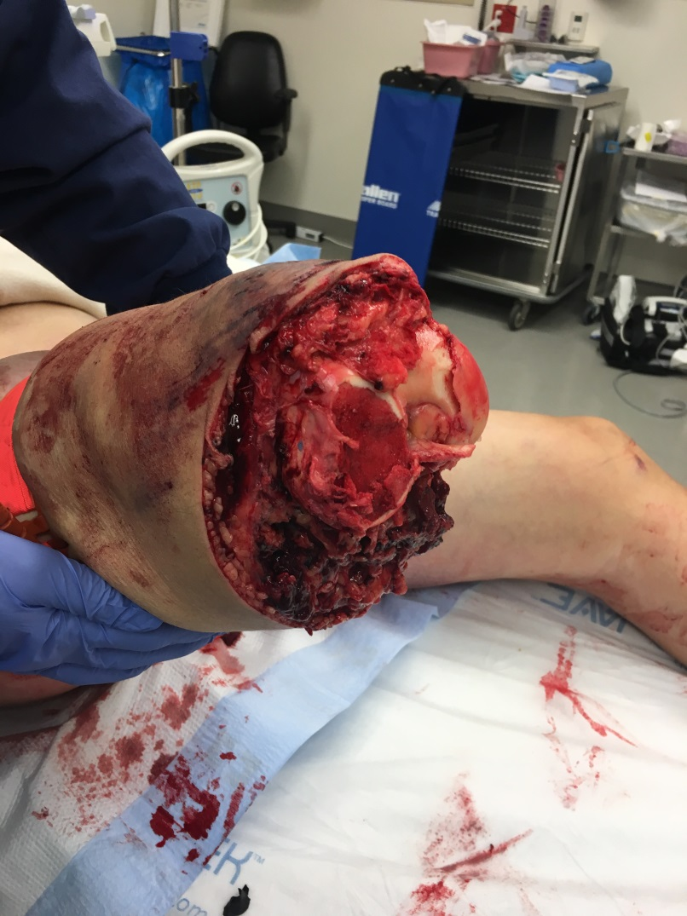
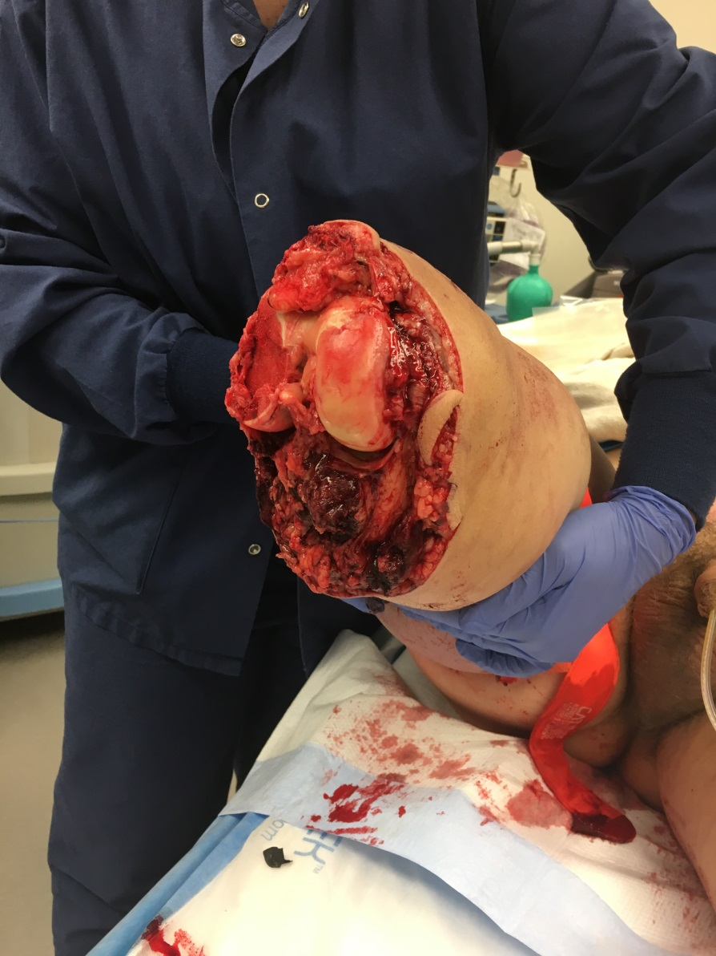
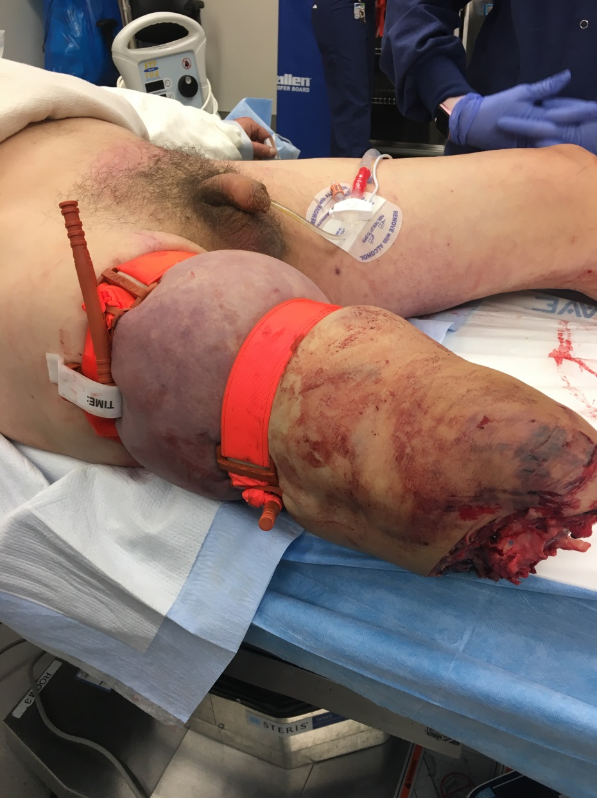
Intraop

Slide 29
Hospital Course
Revised to AKA, left wound open, and placed wound vac day of trauma (1/19)
Extubated 1/20 and transferred to floor
Took back to OR 1/23 for removal of vac and wound closure
Discharged to rehab facility in Moses Lake, WA on 2/4

Slide 30
Hospital Course
Ultimately did imaging of amputated leg
CT and plain XR
Tibia and fibula crush fractures
Old fractures of tibia with hardware

Slide 31
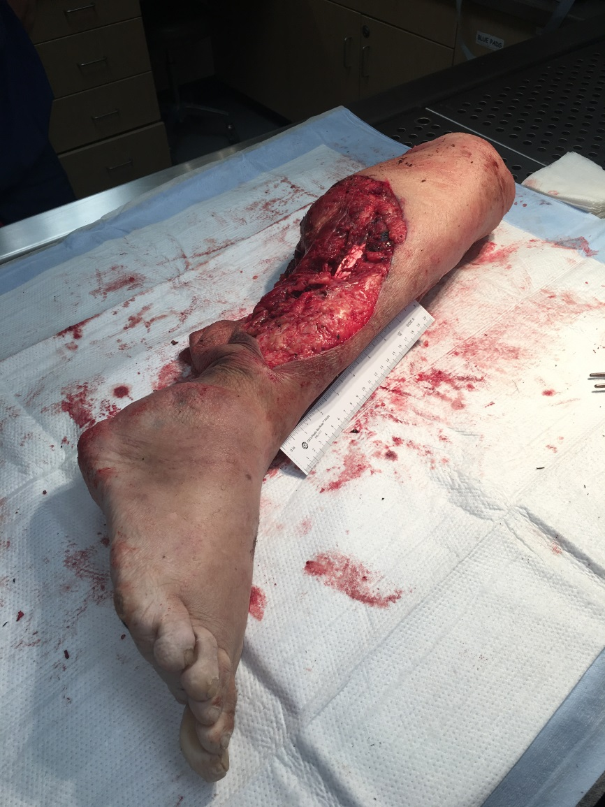
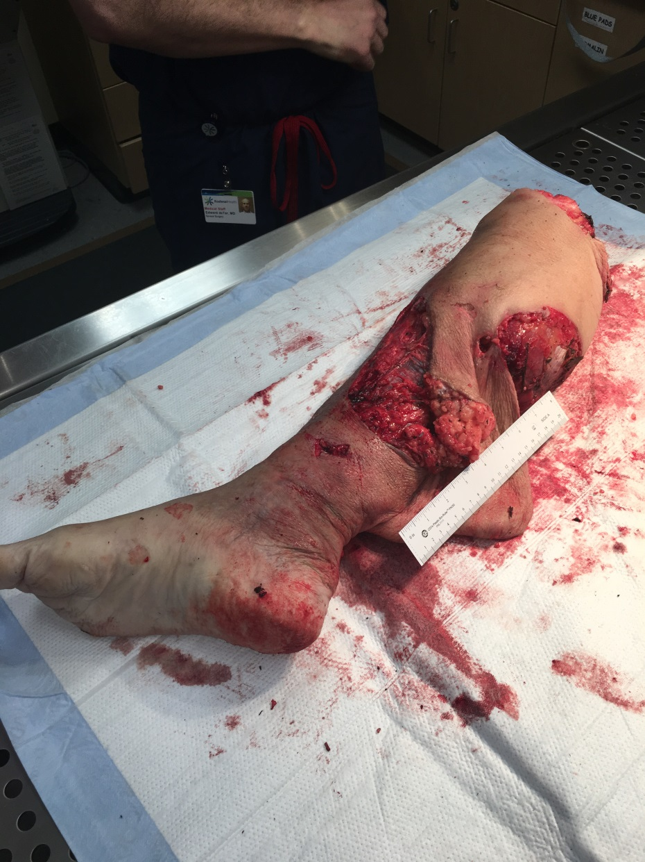
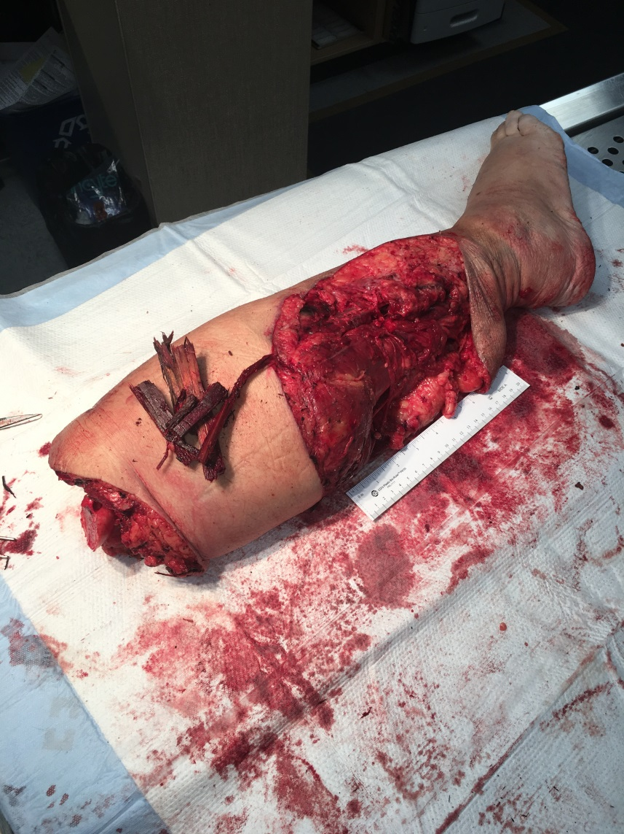
Patient AT

Slide 32
Lessons learned
Could we have avoided amputation?
  Discussion with extrication experts that were on scene
  Took 2 hours just to free left leg
Extrication of amputated leg after we left
Safety debrief and discussion

Slide 33



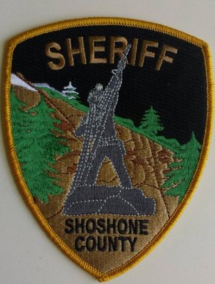





The Agencies/Organizations

Slide 34
Teamwork/Common Purpose
  Kootenai Health
    OR, Blood Bank, Anesthesia, Surgery, ED
    Trauma program
  First Responders
    Made it safe for us to do what they were asking us to do
    New appreciation for what goes on at a scene

Slide 35
Field Amputation
Low frequency, high acuity
Communication/Common Purpose
Teamwork and Collaboration
“Made something extraordinary seem ordinary”

Slide 36
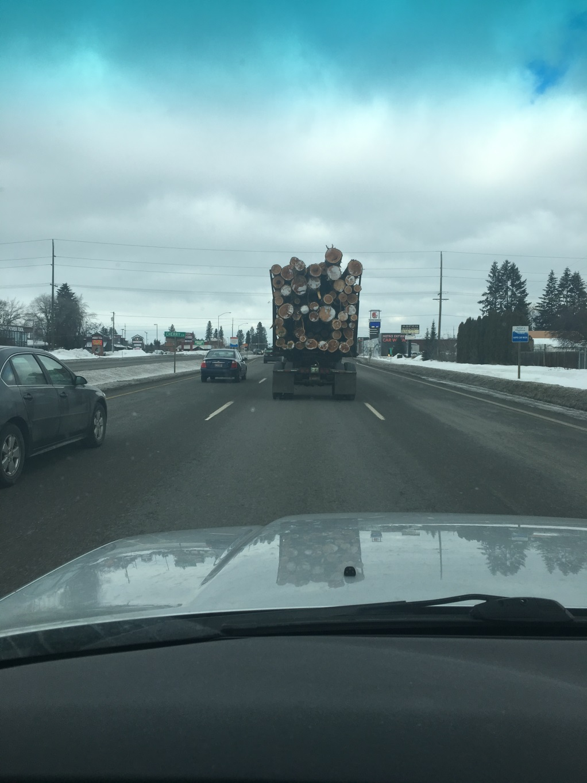
Questions?

