Slide 1
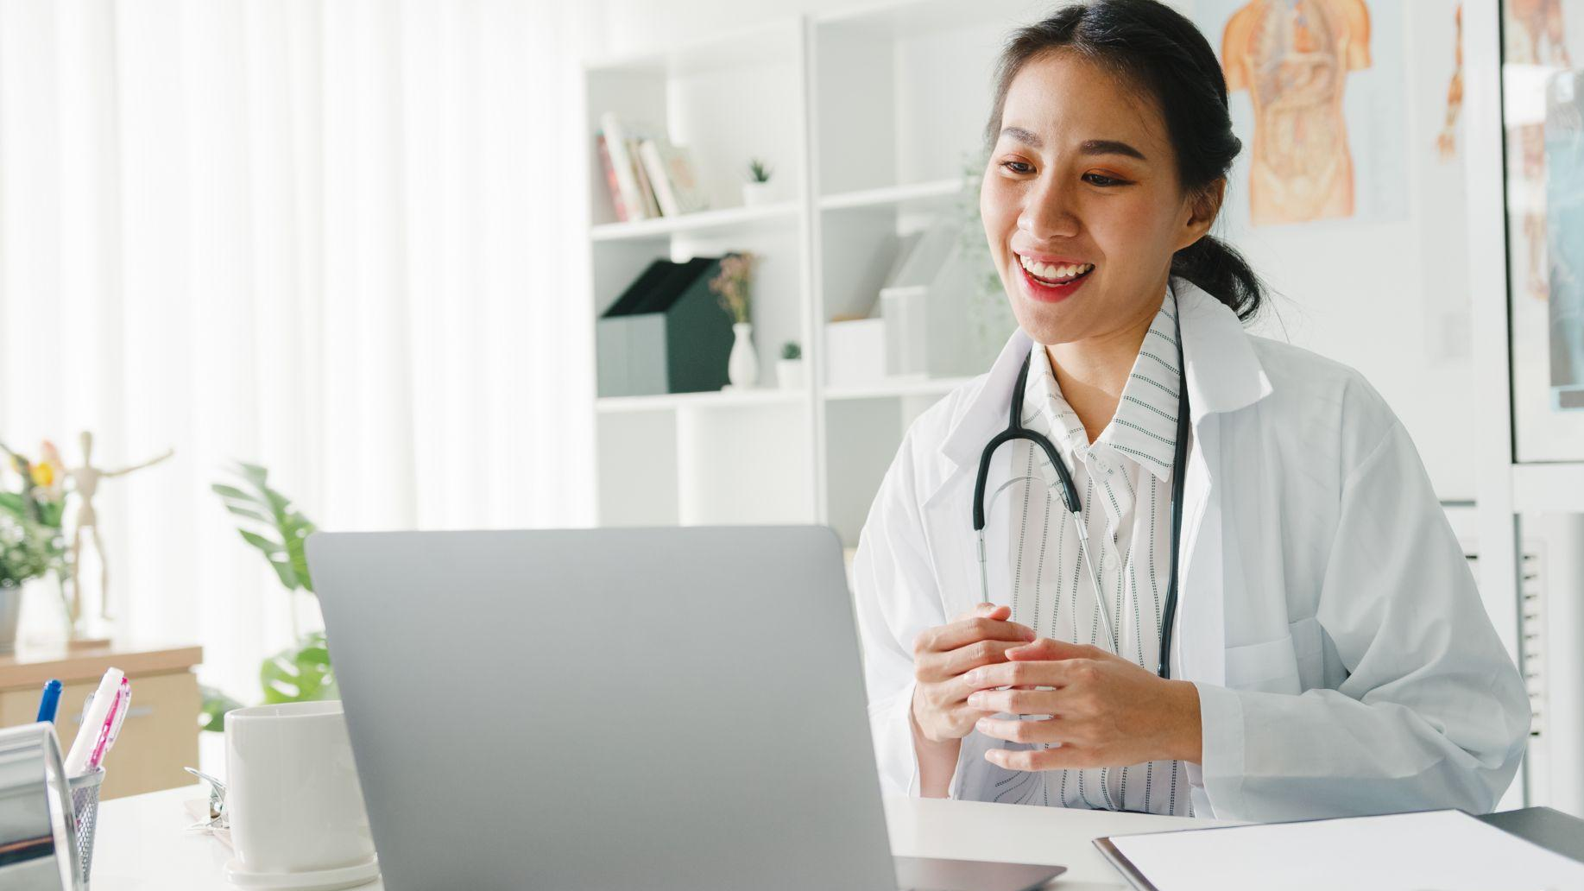

StationMD: Your 24/7 Access to I/DD Specialized Physicians
Helping People with I/DD Thrive in the Community
Jacob Papp, Account Executive

Slide 2


About StationMD’s Specialized Telehealth for People with I/DD
Founded by emergency room doctors
Specially focused on those with I/DD
Winner of the 2022 Leadership Award from The American Association on Intellectual and Developmental Disabilities (AAIDD)
Preferred healthcare partner for major I/DD support and services providers
Notes:
-So a little history on StationMD
-StationMD was founded by emergency room doctors. Through their experience of treating this population they truly saw a gap in healthcare services being provide to individuals with IDD.
-They felt that physicians did not understand these individuals and their unique medical situations. They wanted to create something that was specially focused in providing appropriate care for individuals with IDD.
-They worked closely with universities and other experts in the field to create a curriculum for all of our physicians to go through before treating. So our physicians are specialized in the IDD population and their specific healthcare needs.
-So far StationMD serves over 22 states and has performed over 100,000 telemedicine visits with individuals with IDD.
-I have included some accolades to demonstrate how we are recognized by different organizations as a leader in this niche telehealth service being provided to this population.

Slide 3
Many people with I/DD have no choice but to go to the ER
High-risk/multiple comorbidities
Lack of access
to medical care otherwise
Regulatory requirements
Primary doctor lacks immediate availability

Slide 4
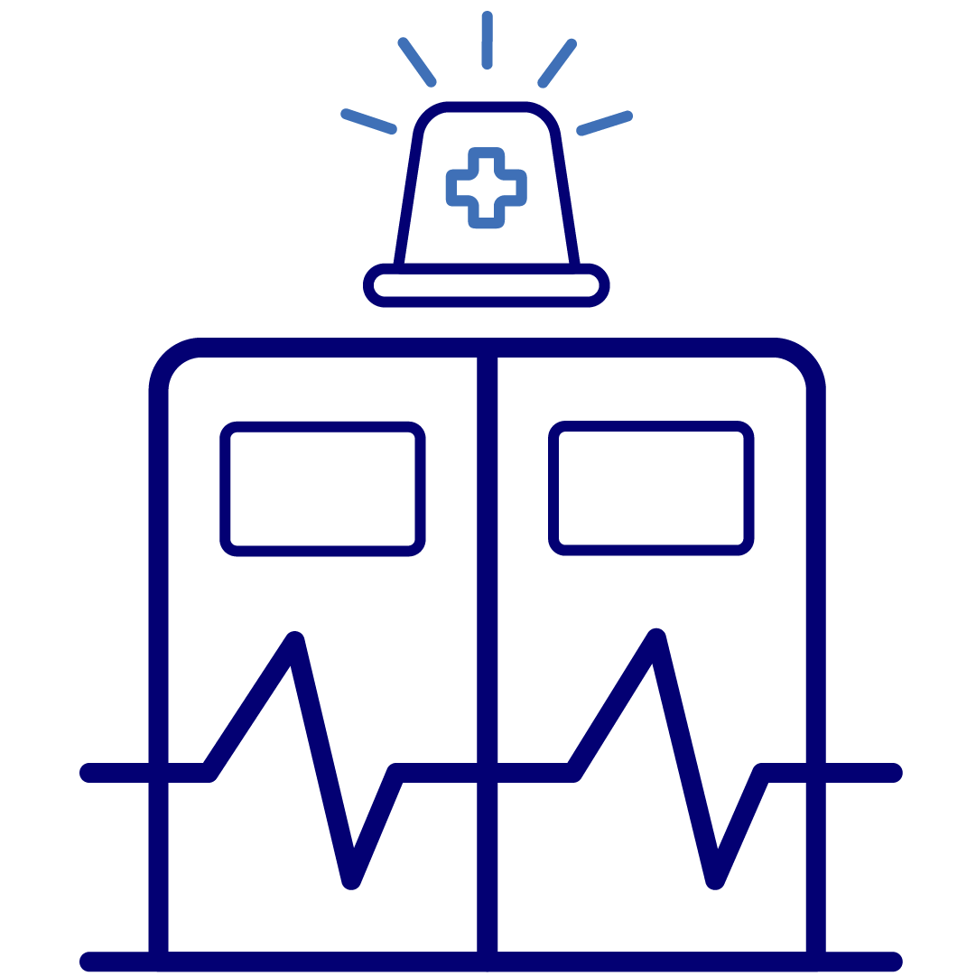
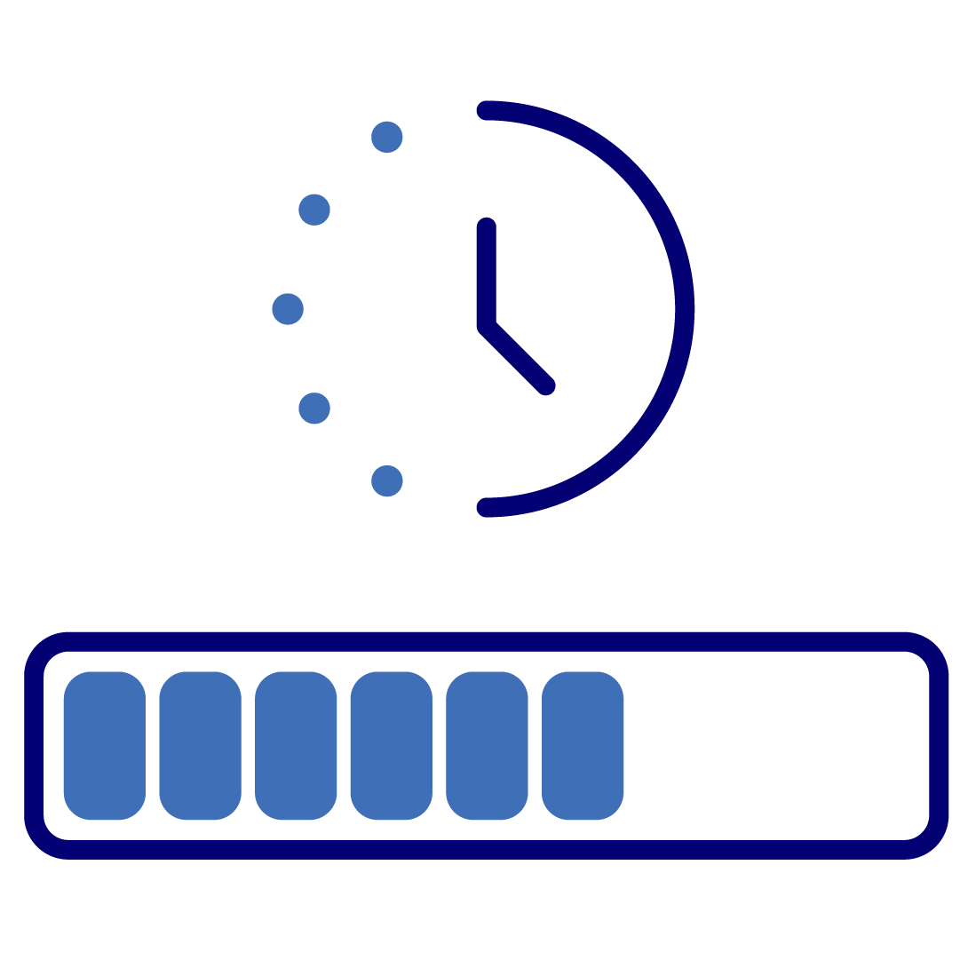
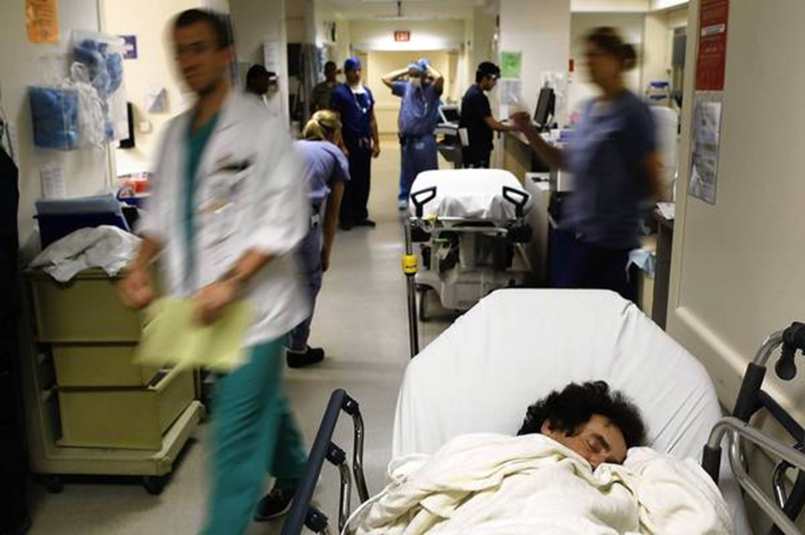
Emergency Room Experience
For Individuals with I/DD
For Staff & Caregivers
Frightening experience
Exposure to infection
Disruption of routine
Missed medication
Trauma of transport
Increased job/home stress
Worsening staff shortages
Time spent in ER
Sleep deprivation
Exposure to infection

Slide 5
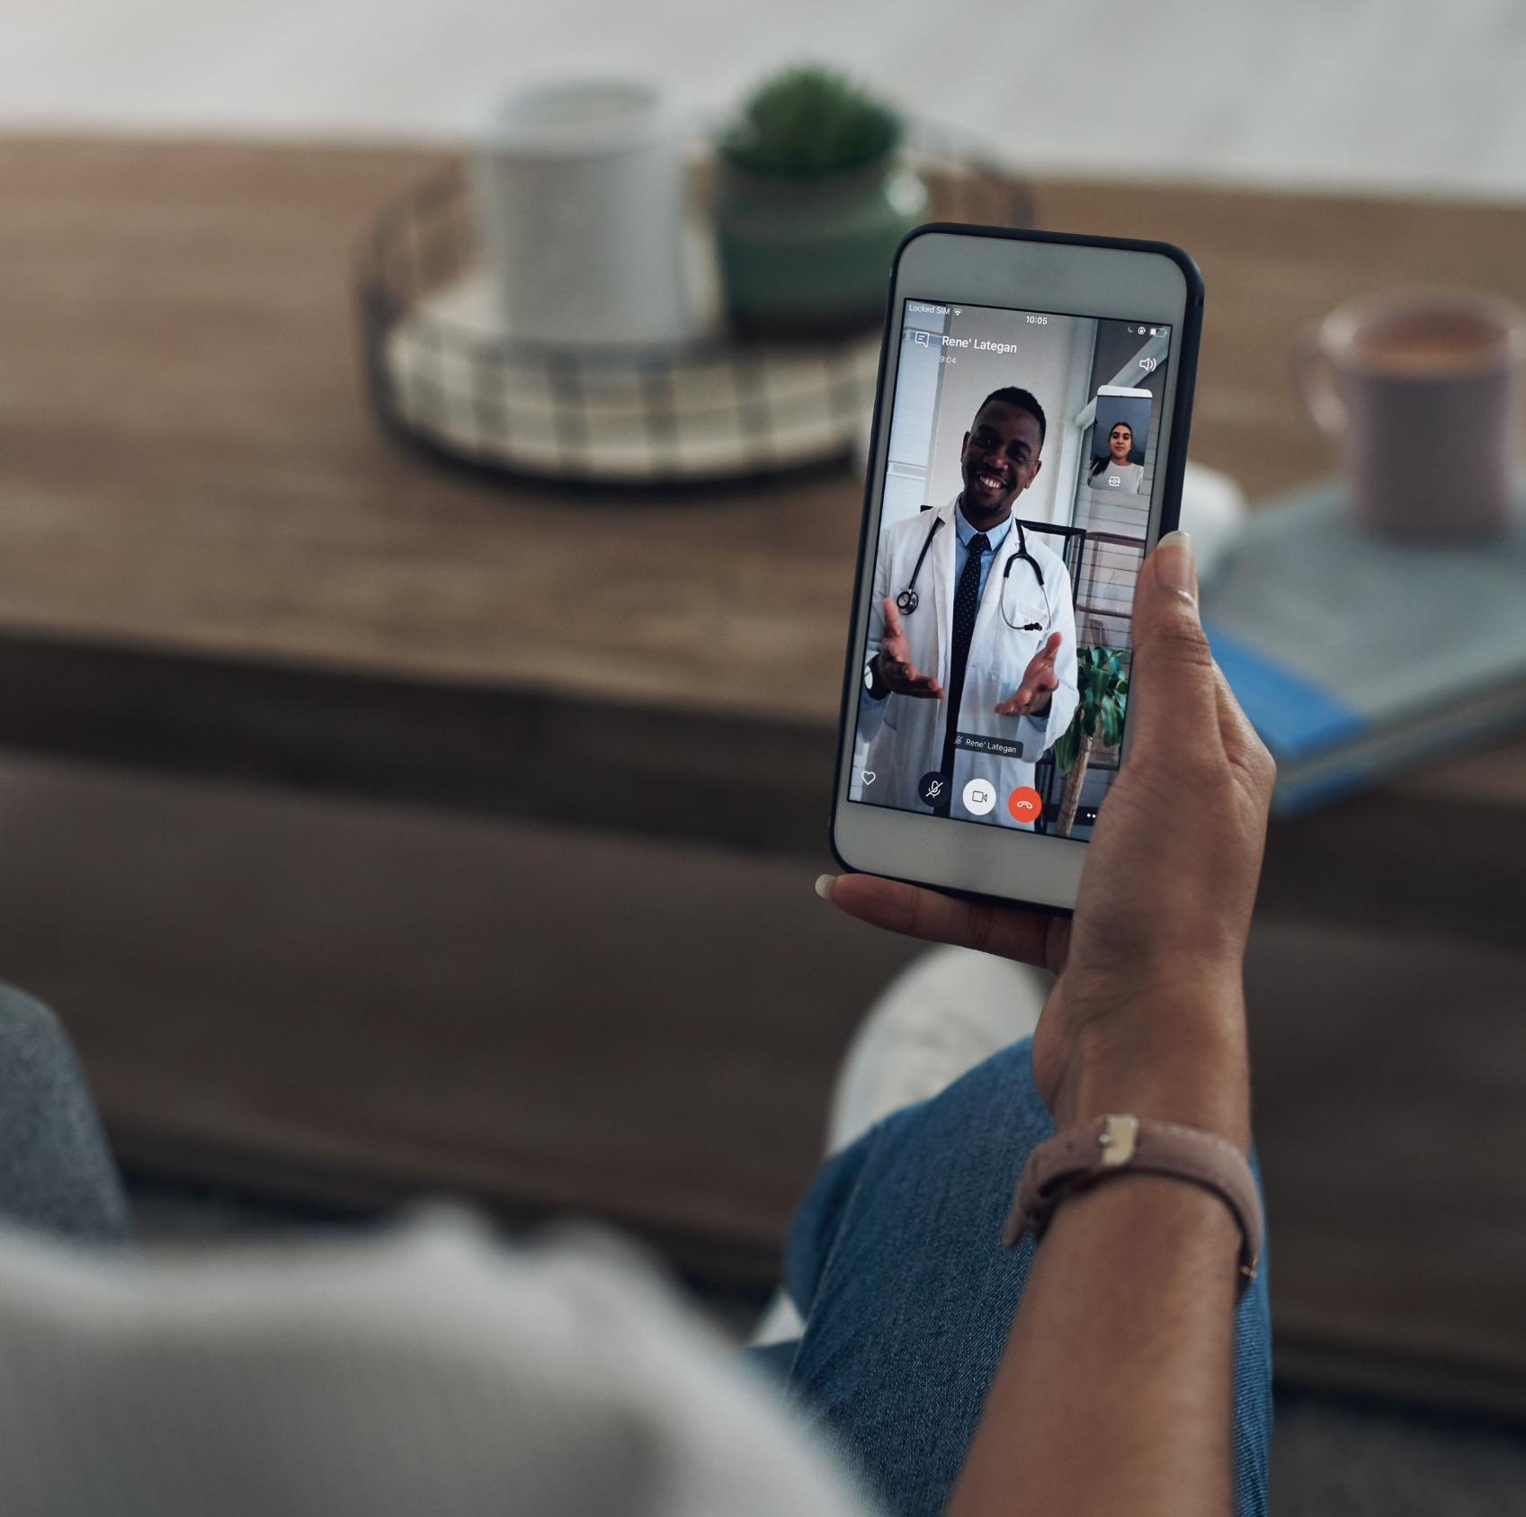
StationMD is a First-Line Medical Resource for Individuals, Families, Providers, and Support Staff
StationMD doctors have extensive training and experience working with individuals with I/DD
Anytime, anywhere
24 hours a day, 7 days a week
Understand the needs of people with high-risk, complex medical needs
Understand challenges of congregate settings, DSPs, nurses & families caring for people with I/DD
Available when primary doctor is not, or when there’s limited access to medical care otherwise
365 days a year
For any medical concern

Slide 6
When to Call StationMD

Slide 7
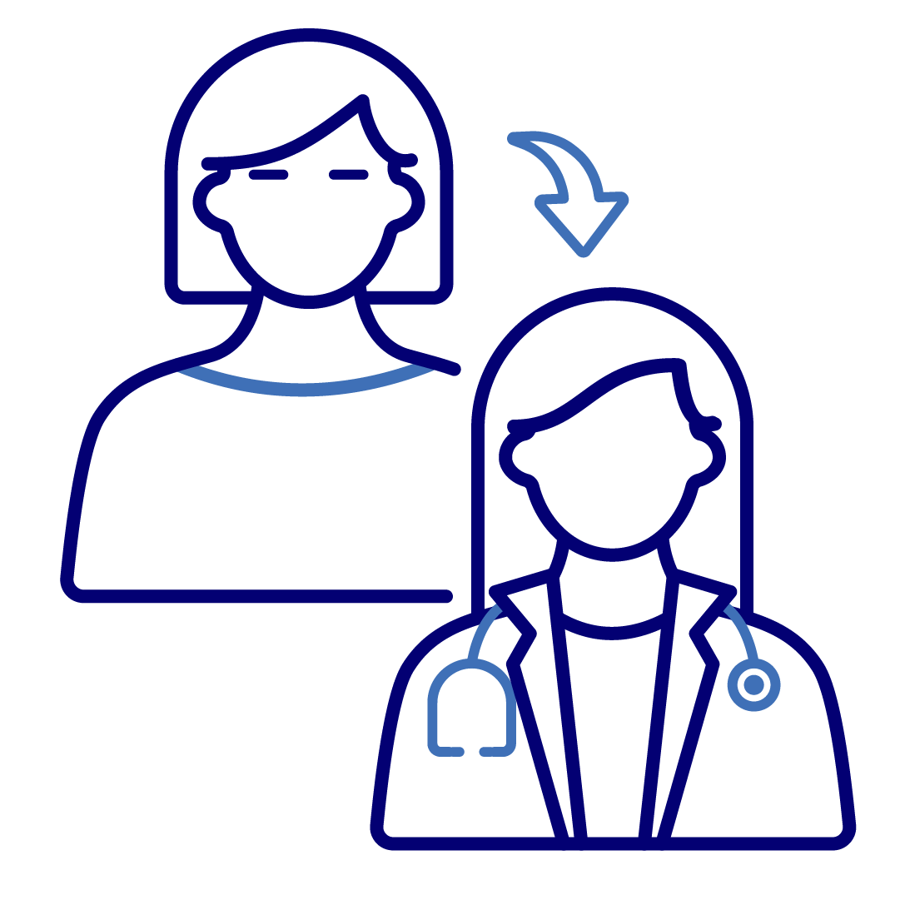
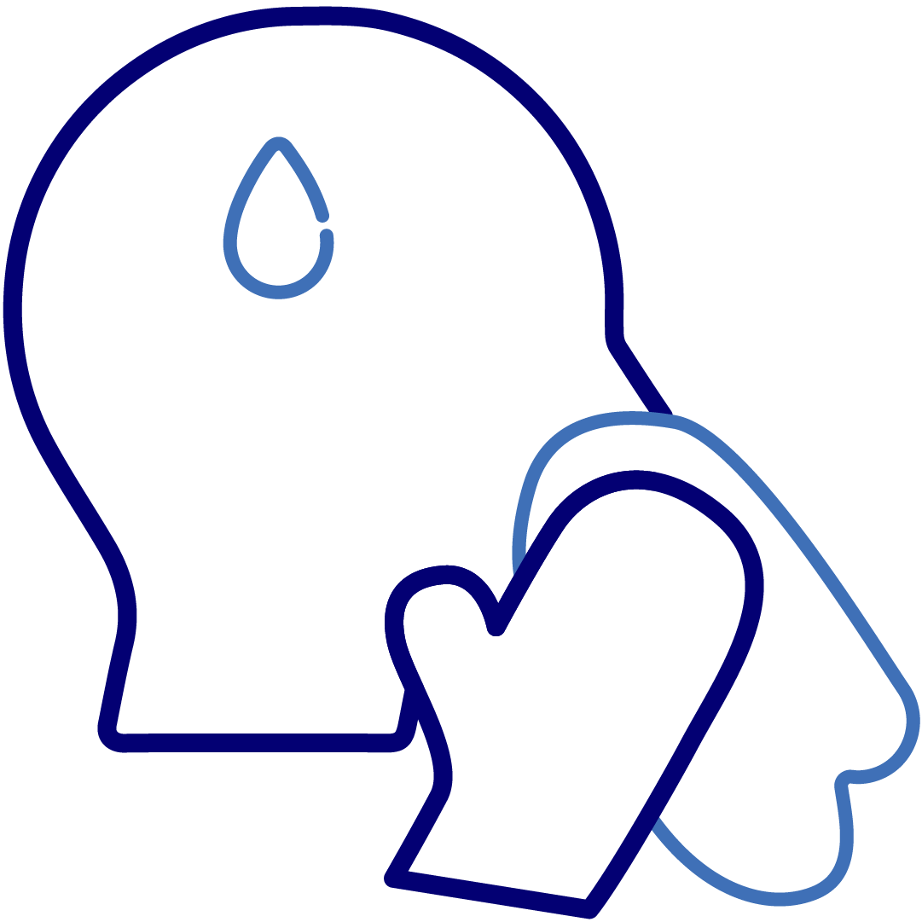

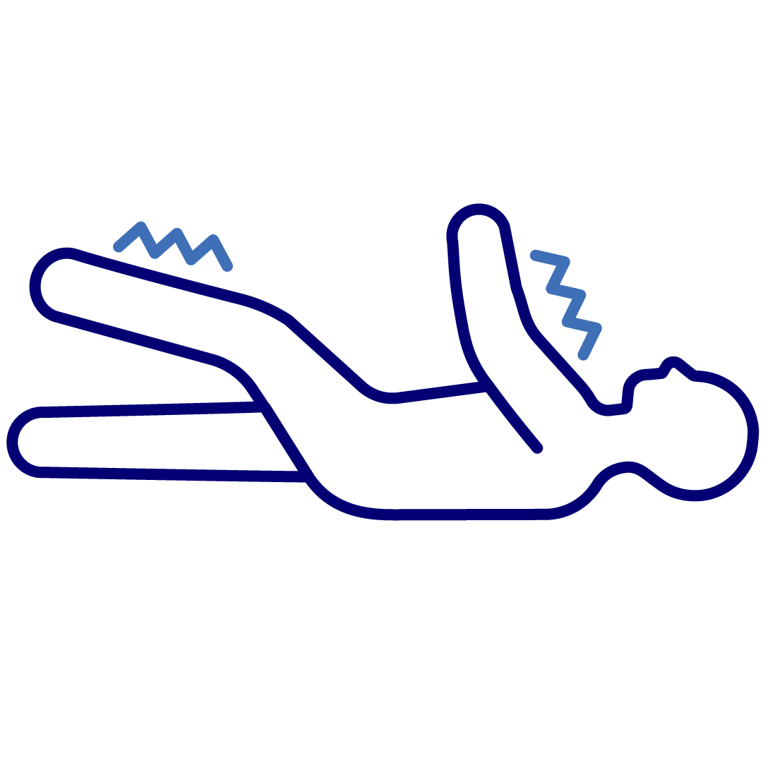
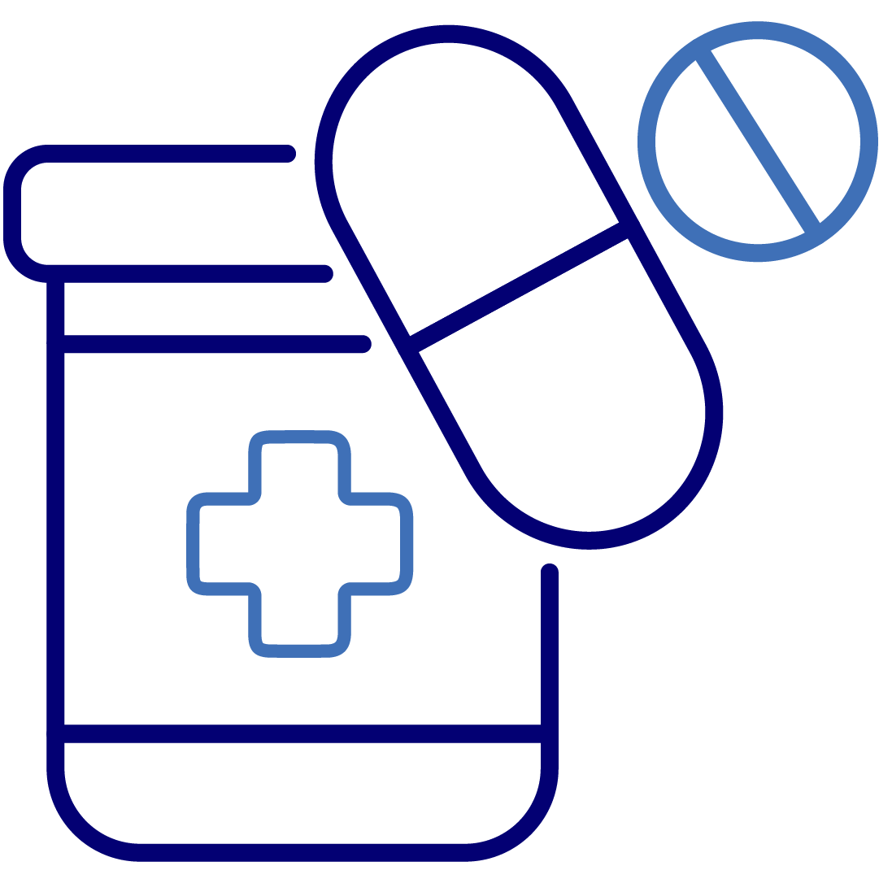
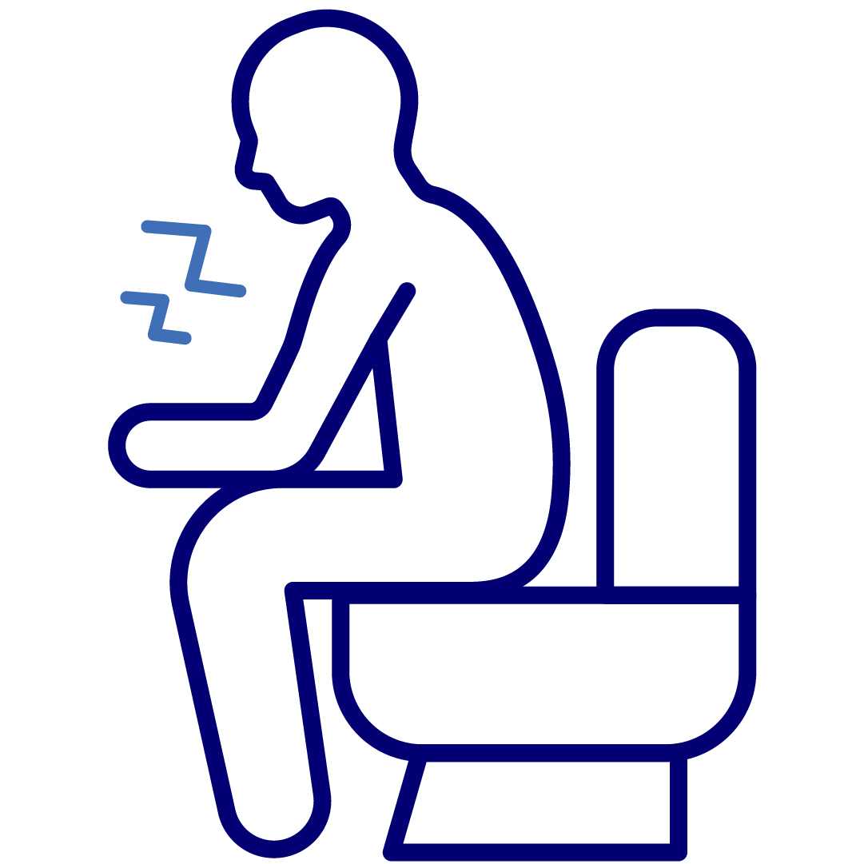


Reasons to Call StationMD
StationMD’s I/DD-specialized telemedicine service can be used for any medical matter that requires a doctor’s attention, including:
To determine if a trip to the ER is necessary
Fever, vomiting, cough, congestion, & seasonal illness
Rashes, cuts, bruises, sores, and minor burns
Seizures, falls, & minor injuries
Prescription refills, general medical guidance
Urinary tract infections, constipation, & diarrhea
Pink eye, allergies, & migraines
Questions for a doctor and other health concerns

Slide 8
If someone is:
Agitated
Anxious
Aggressive
Depressed
Behavioral Health Crisis: StationMD Can Help
StationMD clinicians can:
Help with de-escalation exercises
Guide through a crisis and provide next steps
Implement PRN meds when needed

Slide 9


Why Call StationMD?
“Everyday” questions:
“Potentially Serious” questions:
I gave a medication at the wrong time, what do I do now?
I am about to run out of my seizure medication, can I get a refill?
I have a cough, could this be serious?
My blood pressure is high, what do I do now?
I fell, do I need to go to the ER?
I keep vomiting, is this an emergency?
Should I worry about my fever?
I have an odd pain, is it serious?

Slide 10
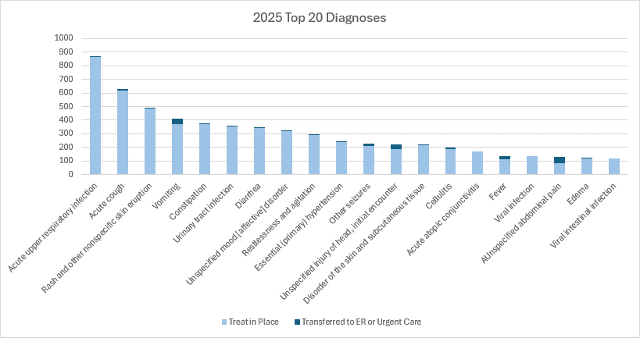
Over 90% of Calls Resulted in Avoided ER Transfers Across Diagnoses

Slide 11

Equipment
Call 1-877-STATMDS (1-877-782-8637)
You can use any smart device
iPhone
Android
iPad
Tablet
Laptop
StationMD Navigator will guide you through the call until you connect with a Clinician

Slide 12
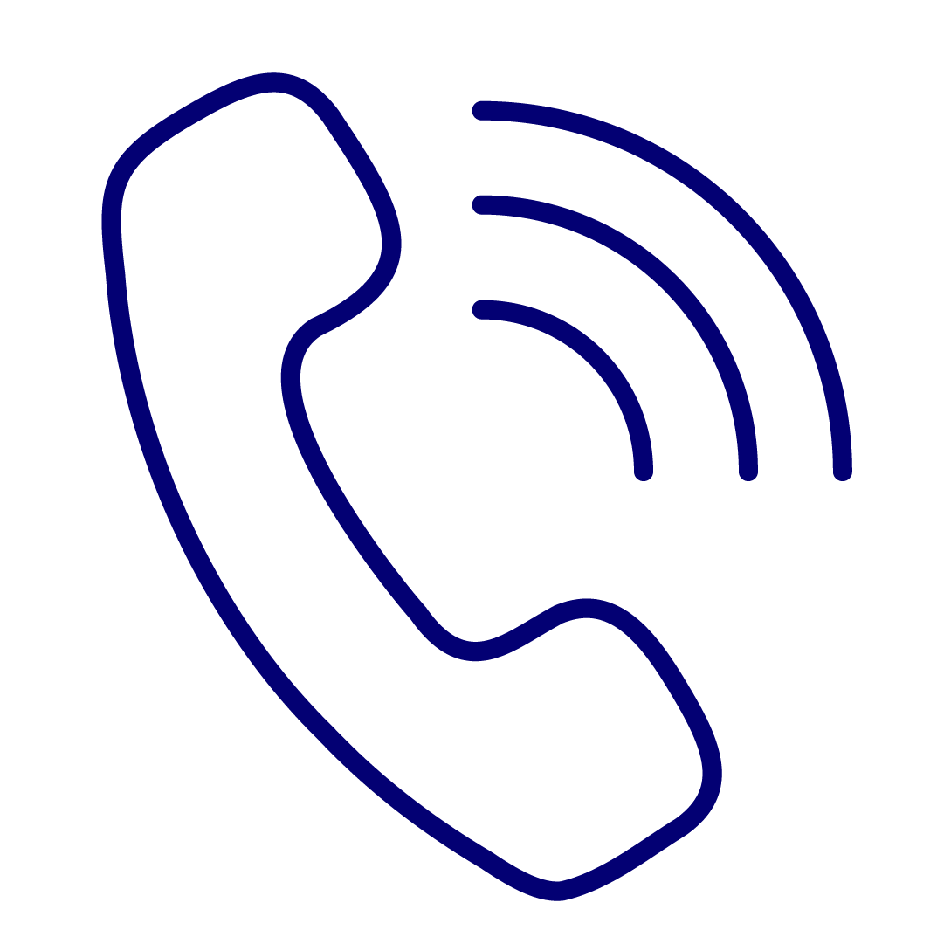
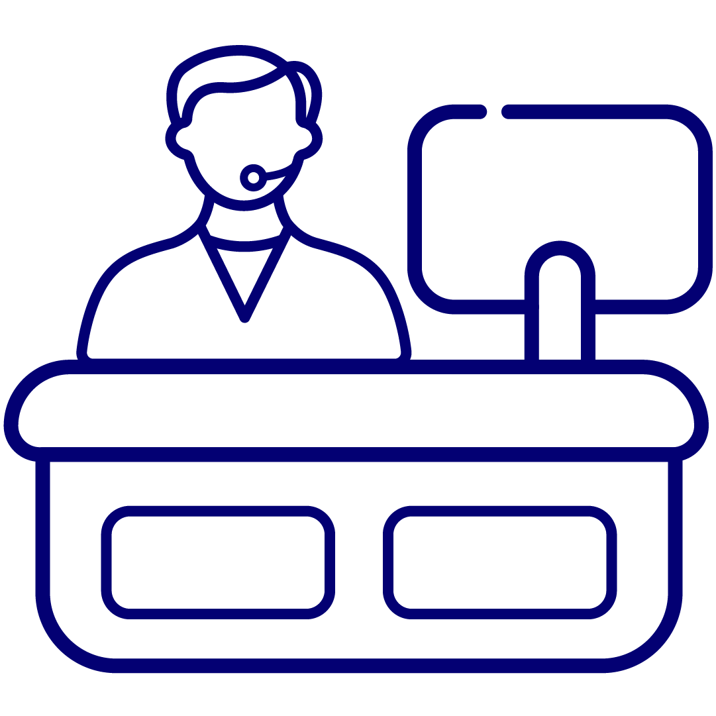

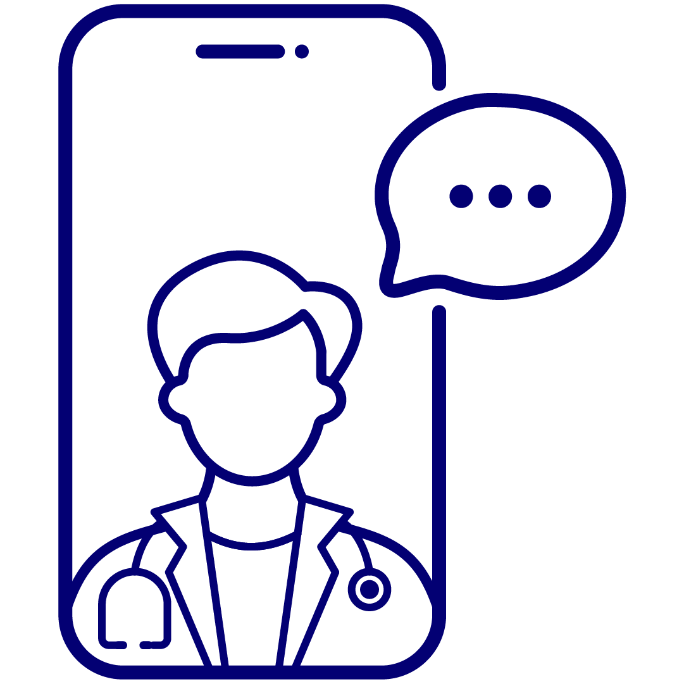

Initiating a StationMD Visit
A StationMD receptionist will collect patient information
A StationMD technical assistant will help you complete patient check-in from your smart device
The StationMD clinician will join you momentarily
Call StationMD at 1-877-STATMDS
StationMD staff walks you through the entire process every time.
No need to stress over technology.
Notes:
Here is the process to connect with the provider. The only thing you need to do is give us a call. Everything else on this slide will be asked to you line by line and we will walk you through the entire process. Once you give us a call, you will reach our answering service and we will ask you the following information: Patient's name and date of birth, patient's location, Callback number, Reason for call, and Vital signs. The vitals are very important because they give our doctors a baseline. The more you can provide to us, the better, and if you can have them handy at time of call, it will expedite the process.
Once all of the information is in our system, someone will give you a call back. We will call you and say “Hi, my name is so-and-so with Station md. I am calling to set up so-and-so with the doctor. Do you have the Station md app downloaded onto a smartphone or tablet?” If yes, we will get to it later; if not, we will tell you how to download the app. We will confirm the fax number we have on file or ask you for one in order to send you the note after the meeting. We will also want you to have a current list of allergies and medications handy. If you use an EHR and we have access, we will check prior to the visit. We will also ask you which pharmacy you would like if anything gets prescribed that day. All prescriptions are prescribed electronically. After we have all the needed information, we will tell you to click on the site of the patient, or we will give you the code to meet with the provider. Once you see the video preview, click “join with video” and then “join with audio”

Slide 13
Documentation Follow Up
Ways to retrieve StationMD Clinician Notes
StationMD Staff
to add to your
Electronic Medical Record
Secure Fax
Visit Notification email with link & log-in to StationConnect
(agency designee’s permission is required to receive log-in)
Notes:
After someone is seen, we have several different ways for staff to gain access to the physician note. If you have an electronic health record and provide us access, we can put the physician note in the EHR. If you provide us with fax numbers for the homes, we can automatically send a secure fax once the note is signed. Your agency can also designate by an overall agency and by individual home who should receive email notifications once someone is seen with a link to the physician note. So, there are a lot of different ways to gain access to the physician note.

Slide 14

Who Benefits from Using StationMD?
People with I/DD
Caregivers & Support Providers
Service Coordinators
Provides immediate access to doctors who understand I/DDs
Reduces time and energy spent addressing health needs
Improves quality of life with better health outcomes sooner & maintained wellness longer
Empowers individuals to thrive in their community and spend more time on activities they enjoy
Provides immediate access to doctors who can give guidance on any health concern
Reduces trips to the ER or urgent care
Offers peace-of-mind and alleviates stress
Prevents caregiver burnout, staff shortages, and turnover
Expands options for people who need more I/DD-specialized healthcare
Reduces critical incident reports and makes case loads more manageable
Offers more choice and person-centered services to people supported

Slide 15

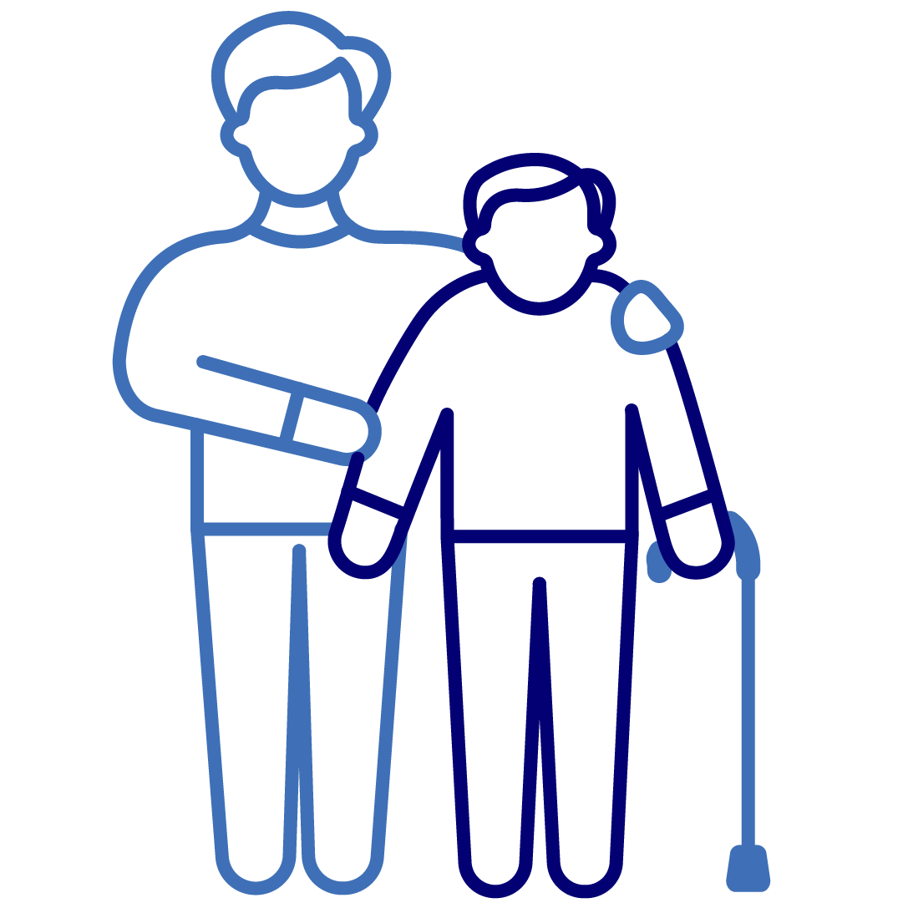
StationMD Users Report Satisfaction
Individuals
DSPs/Caregivers
96% were happy with their StationMD visit
94% would recommend StationMD to a family or friend
84% prefer to use StationMD vs. venturing out to seek medical care
70% feel more job satisfaction with access to StationMD
77% feel they get answers to health questions through StationMD
77% feel access to StationMD improves the lives of their clients

Slide 16

Nursing and StationMD
StationMD’s I/DD-specialized telemedicine service integrates with Nursing services already in place
Nurses have extensive knowledge about the individuals they care for
Nurses can consult with StationMD physicians even without an individual present
StationMD’s medical experts will work alongside the nursing team to decide best course of action
Our aftercall nurses will check in for certain calls to ensure the well being of the individual

Slide 17
How StationMD Enhances Documentation
Benefits to nursing documentation
The StationMD medical note bolsters documentation for nursing by enhancing previous notes from nurse
Nurses can be part of doctor visit (remotely or with individual)
Allows for additional documentation to be added to EMR for rule 116

Slide 18
Webinars
Provide helpful medical information to the field
Provides basic information on StationMDs service and how to obtain it
Educates the field on specific, relevant topics
Health education is important to StationMD
We all have the same goal-helping folks with I/DD live their best, healthiest life

Slide 19

Providing the highest quality of medical care for individuals with IDD, fostering independence, & improving quality of life
Call StationMD for any major or minor healthcare concerns at:
1-877-STATMDS
(1-877-782-8637)
Sign your individual/s up for StationMD anytime
Receive 24/7 access to I/DD healthcare without the stress of the ER
For additional resources on how to use StationMD:
View these training videos: https://stationmd.com/for-clients/ (password: smdeducation)
Jacob Papp
Illinois Account Executive
Jacob.papp@stationmd.com

Slide 20
Questions & Discussion

