Slide 1
ECMO 101
Salman Khan MD
Pulmonary and Critical Care Medicine

Slide 2
ECMO
ExtraCorporeal Membrane Oxygenation
  ExtraCorporeal - outside of the body
  Artificial lung - gas exchange occurs via polypropylene microporous membrane
  ECLS or ExtraCorporeal Life Support is another term frequently used in describing ECMO
  Is NOT a treatment or therapy, it is support, a bridge.
  Modified form of Cardiopulmonary Bypass
  Blood is pulled from the body, passes through centrifugal pump and oxygenator, oxygen is added, and carbon dioxide is removed, blood is then pumped back to the patient via either a vein or artery (or sometimes both).
  ECMO is used when other forms of life support (mechanical ventilator or a circulatory support device) are not maintaining adequate oxygenation and perfusion to meet patient demands.
Notes:
Important to remember that ECMO is NOT a treatment. It is not going to cure the patient or fix the presenting etiology of their disease. It is a mechanism by which we can stabilize the patient in order to allow the heart, lungs or both to rest without the rest of their organs failing. Sometimes it is useful to simply buy time to figure out what is going on with the patient.

Slide 3
Patient Venous Blood
SVO2 = 60%
V-V ECMO OXYGENATION
Oxygenator
SaO2 = 80%
TOTAL OXYGENATION
Right Ventricle
LUNG OXYGENATION
SaO2 = 80%
Patient Lungs
SaO2 = 92%
V-V ECMO: SIMPLIFIED
Left Heart
SaO2 = 92%
Patient Arterial Blood

Slide 4
Who is an ECMO candidate?
Who is an ECMO candidate?
Contraindications
Neonatal through adult
Patients with REVERSIBLE illness
  ARDS
  Cardiac arrest
  Refractory dysrhythmias
  High-risk PCI (pre or post procedure)
  Inability to liberate from CPB
  Cardiogenic shock
  Bridge to VAD/Heart transplant
  Bridge to Lung transplant
  Bridge to a decision
> 65 years of age?
Metastatic cancer with short life expectancy
Irreversible brain injury (anoxia/hemorrhage)
Intubated >10 days
BMI >45?
Severe medical comorbidities
Irreversible MSOF
Uncontrolled coagulopathy?
Notes:
NEITHER OF THESE ARE AN ALL INCLUSIVE LIST AND THERE IS ALWAYS A GRAY AREA!!!
Prior to ARDS patients going on pump all other avenues of mechanical ventilation are exhausted.
Sedation/paralysis
Vent optimization (esophageal balloon or PV tool)
Proning if appropriate etiology
Best outcomes for patients occur when they have single organ failure. So we try to cannulate at first sign of AKI or shock liver, etc.
Cardiac arrest patients can be cannulated during CPR (if it occurs in house and surgeons are available) but most of the time these patients are cannulated when they have refractory cardiogenic shock and are heading toward MSOF. We do our best to ensure neurological status prior to cannulation.
You will see patients placed on ECMO with the contraindications listed here and sometimes it will seem futile. However, it is important to remember that for this patient population without ECMO they have a mortality rate of approximately 90% and we have about a 60% survival to discharge after ECMO. So we are still saving some.

Slide 5
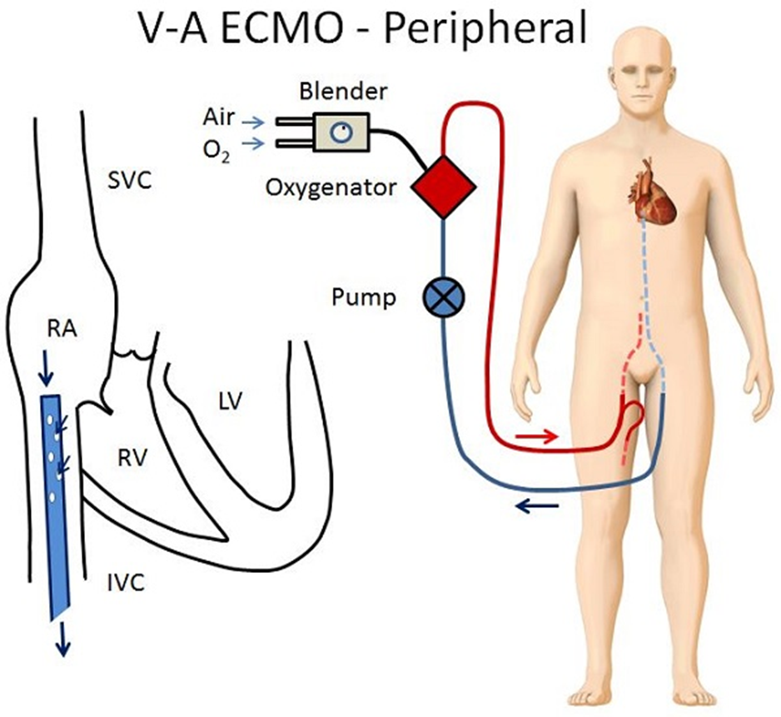
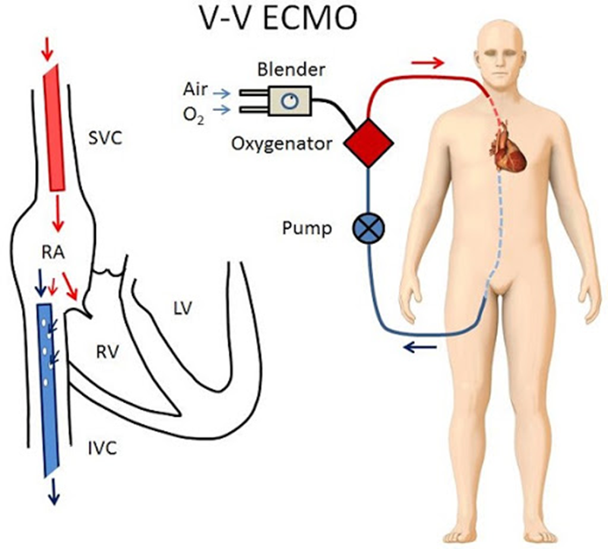
Two Types of ECMO
Cardiac and Pulmonary Support
Pulmonary Support

Slide 7
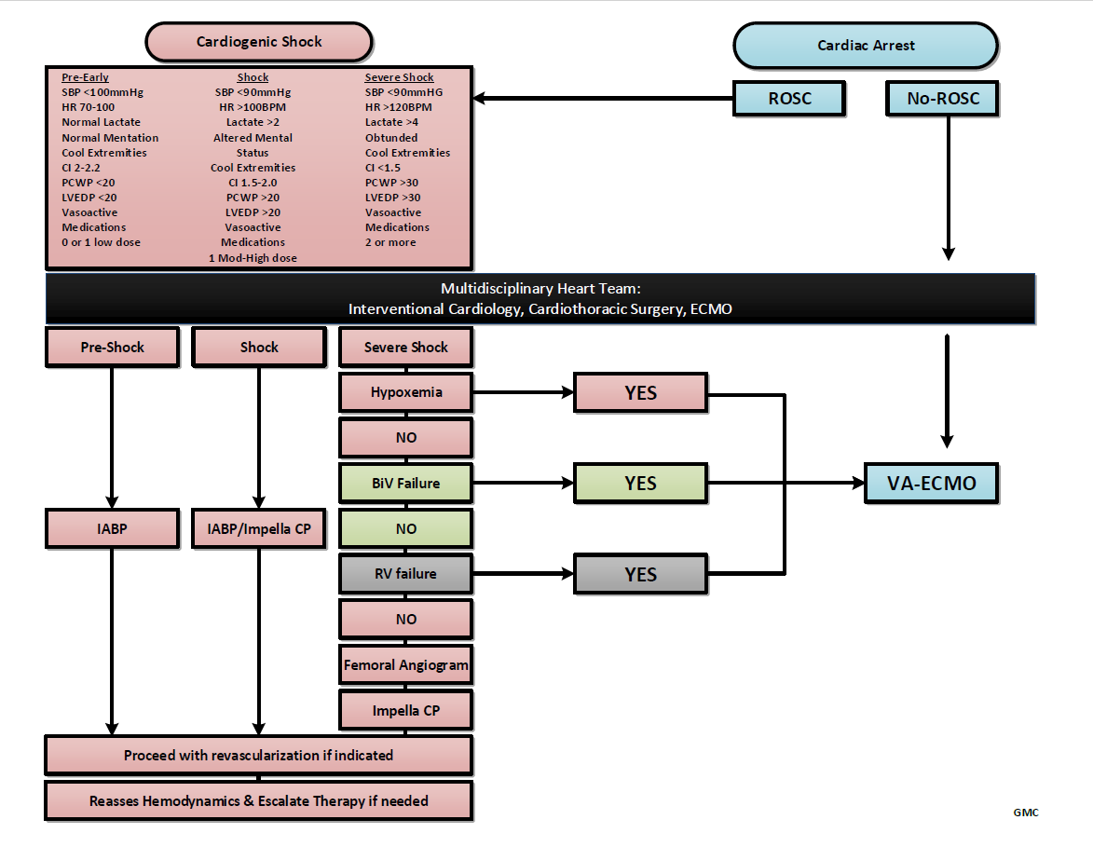

Slide 8
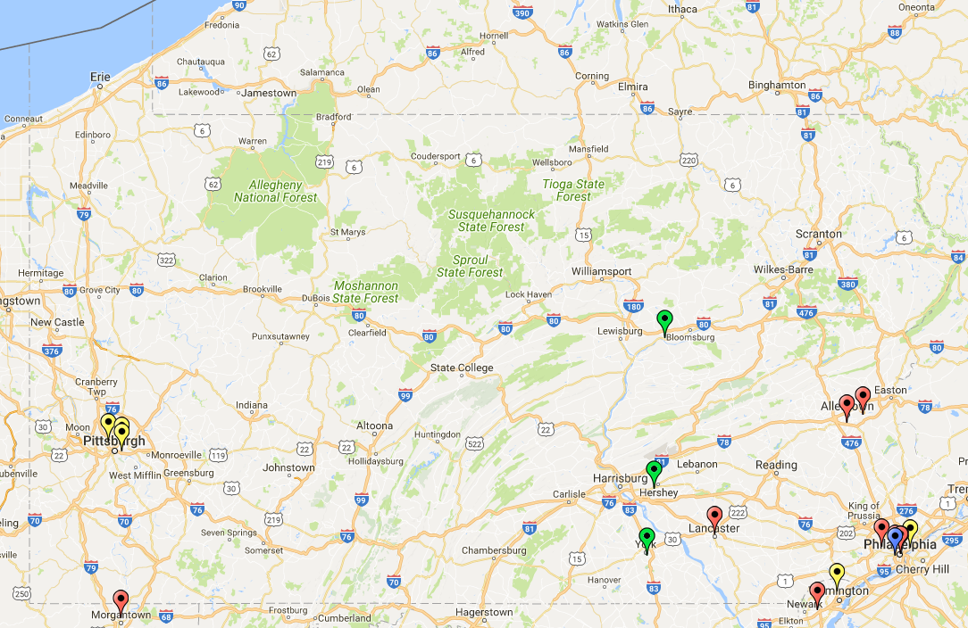
ECMO Programs
GMC

Slide 9
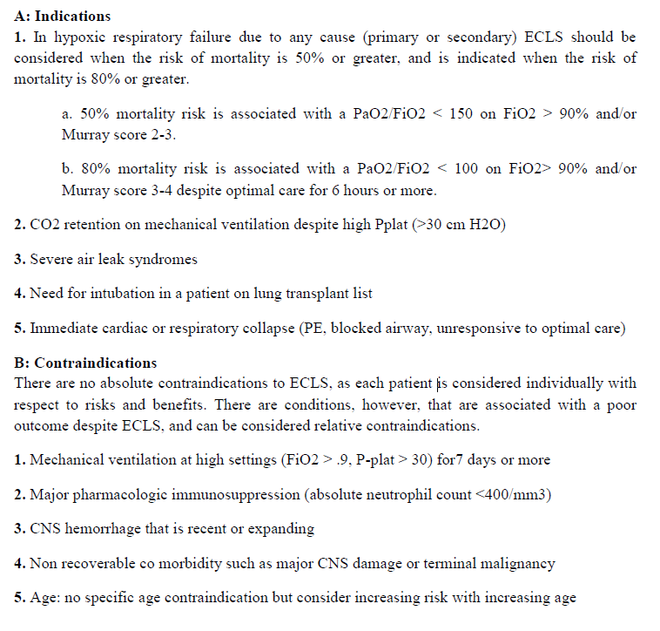
ELSO
Indications and contraindications for VV ECMO
VV ECMO
Inclusion:
Severe hypoxemia (P/F ratio < 100) despite optimized mechanical ventilation
Reversible lung injury
Hypercarbia with respiratory acidosis (pH< 7.15) despite optimized mechanical ventilation
Significant BPF unresponsive to ventilator interventions
Good pre-morbid condition
Exclusion:
Irreversible brain injury
Severely immunocompromised host without chance of recovery
Malignancy with limited life expectancy
Severe medical co-morbidities
Irreversible MSOF or other futile conditions
Cardiac arrest with probable anoxic brain injury
Inability to tolerate anticoagulation
Mechanical ventilation with high Pplat or FiO2 for > 7 days
Advanced age (age > 65 years)
Weight greater than 125kg or BMI greater than 45
Recent or expanding CNS hemorrhage
Active hemorrhage
Inability to receive blood products
Our Shop

Slide 10
Patient selection for V-V ECMO
Goals
  Bridge to Recovery
  Bridge to Transplantation
Contraindications- most are relative
  Irreversible lung injury if not a transplant candidate
  End-stage disease- multi-organ failure/dysfunction, end-stage malignancy, etc
  Older Age- over 65-70
  Immunocompromise
  Prolonged mechanical ventilation (> 7 days)
  Severe Obesity- relative, related to BSA- ability to provide adequate flows
  Inability to anticoagulated
  Refusal to accept blood products

Slide 11
Patient selection for V-V ECMO
Hypoxemic or hypercapnic respiratory failure refractory to appropriate medical care
ARDS
Persistent Air-leak Syndrome
Life-Threatening Asthma Exacerbation
  Primarily for hypercapnic respiratory failure

Slide 12
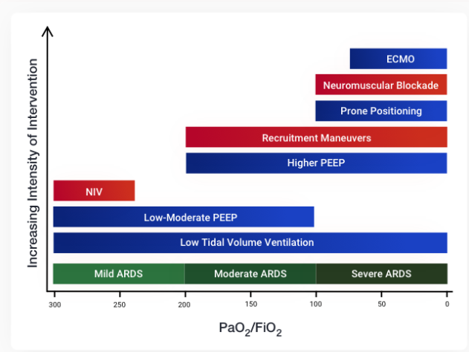

Slide 13
ECMO TEAM Members
ECMO Physicians
CVTS Surgeons
ECMO Coordinator
ECMO Specialist
Perfusion Staff

Slide 14
Support for ECMO Patients and their families
Medical rounds twice a day where family is asked to join
Social Work Support
Palliative Medicine
Spiritual Care
Hotel Accommodations

Slide 15
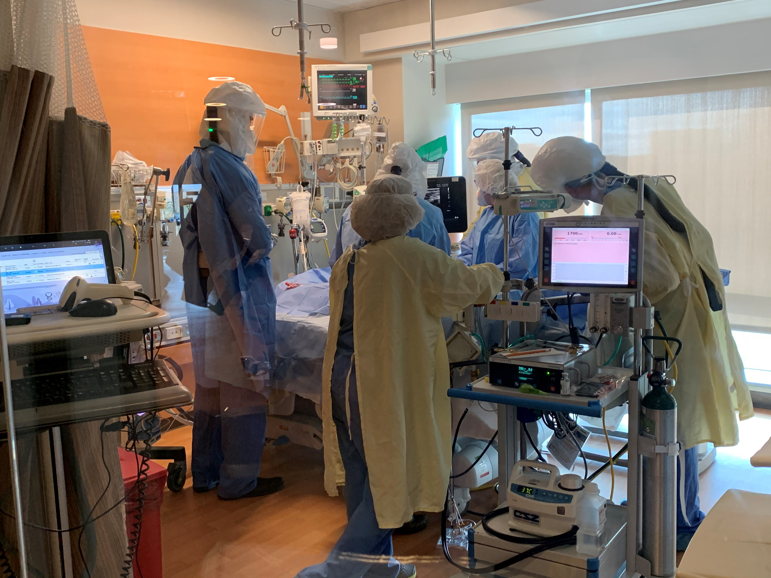
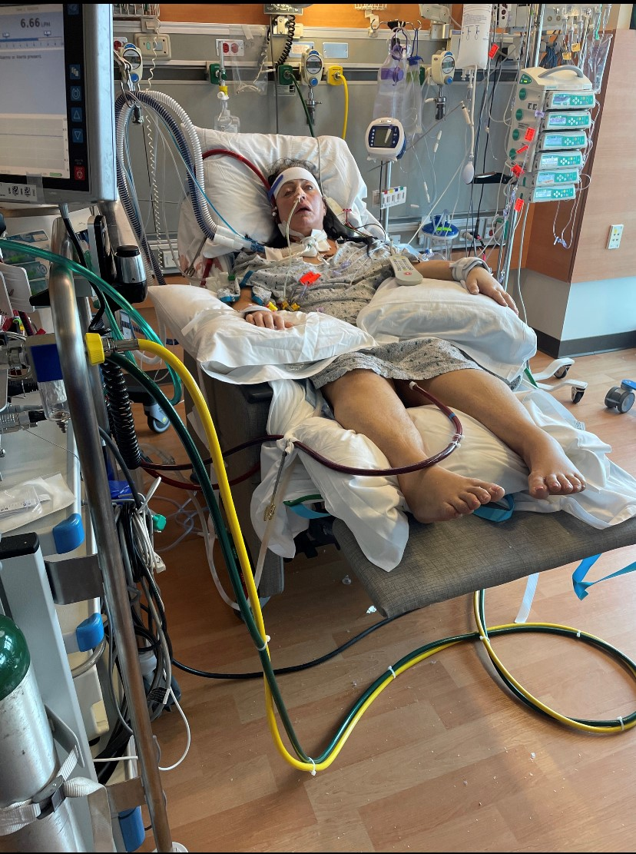
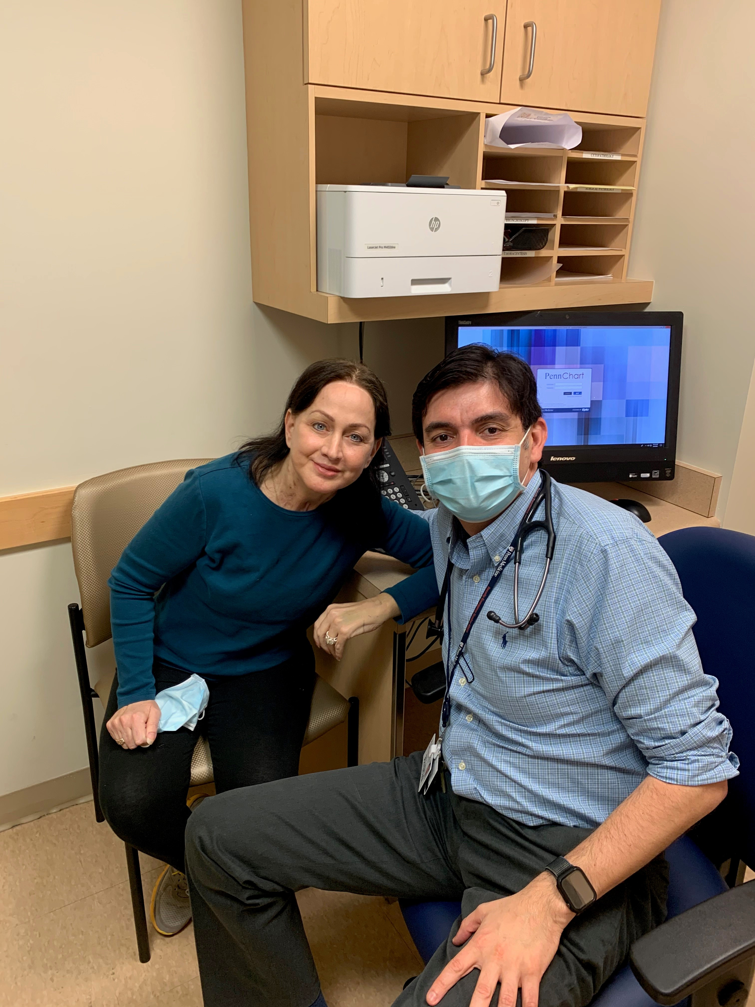
ECMO Full Circle
December 10, 2020
52 yo female with COVID
42 days on ECMO at GMC
19 days on ECMO at UPenn
Double Lung Transplant February 9th
January 21, 2021
May 4, 2021

Slide 16
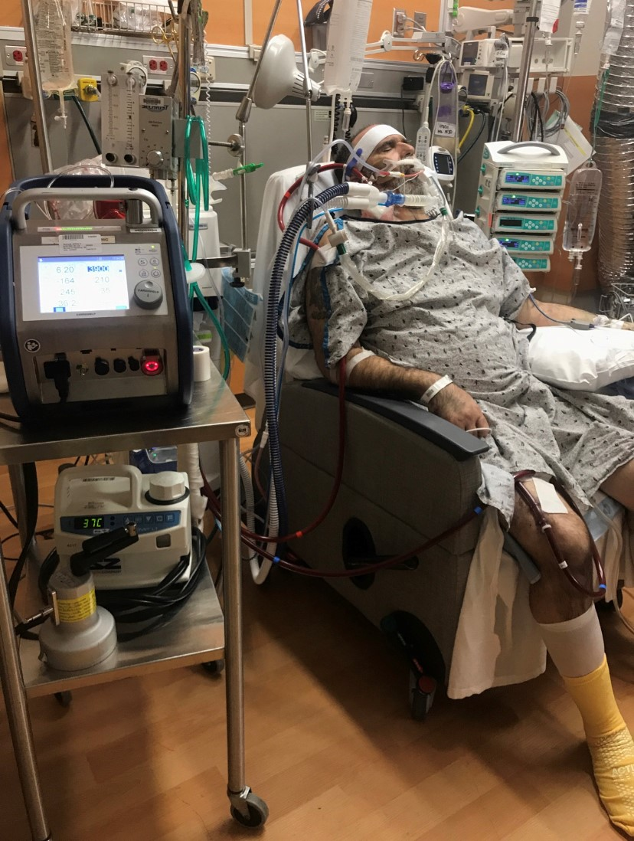
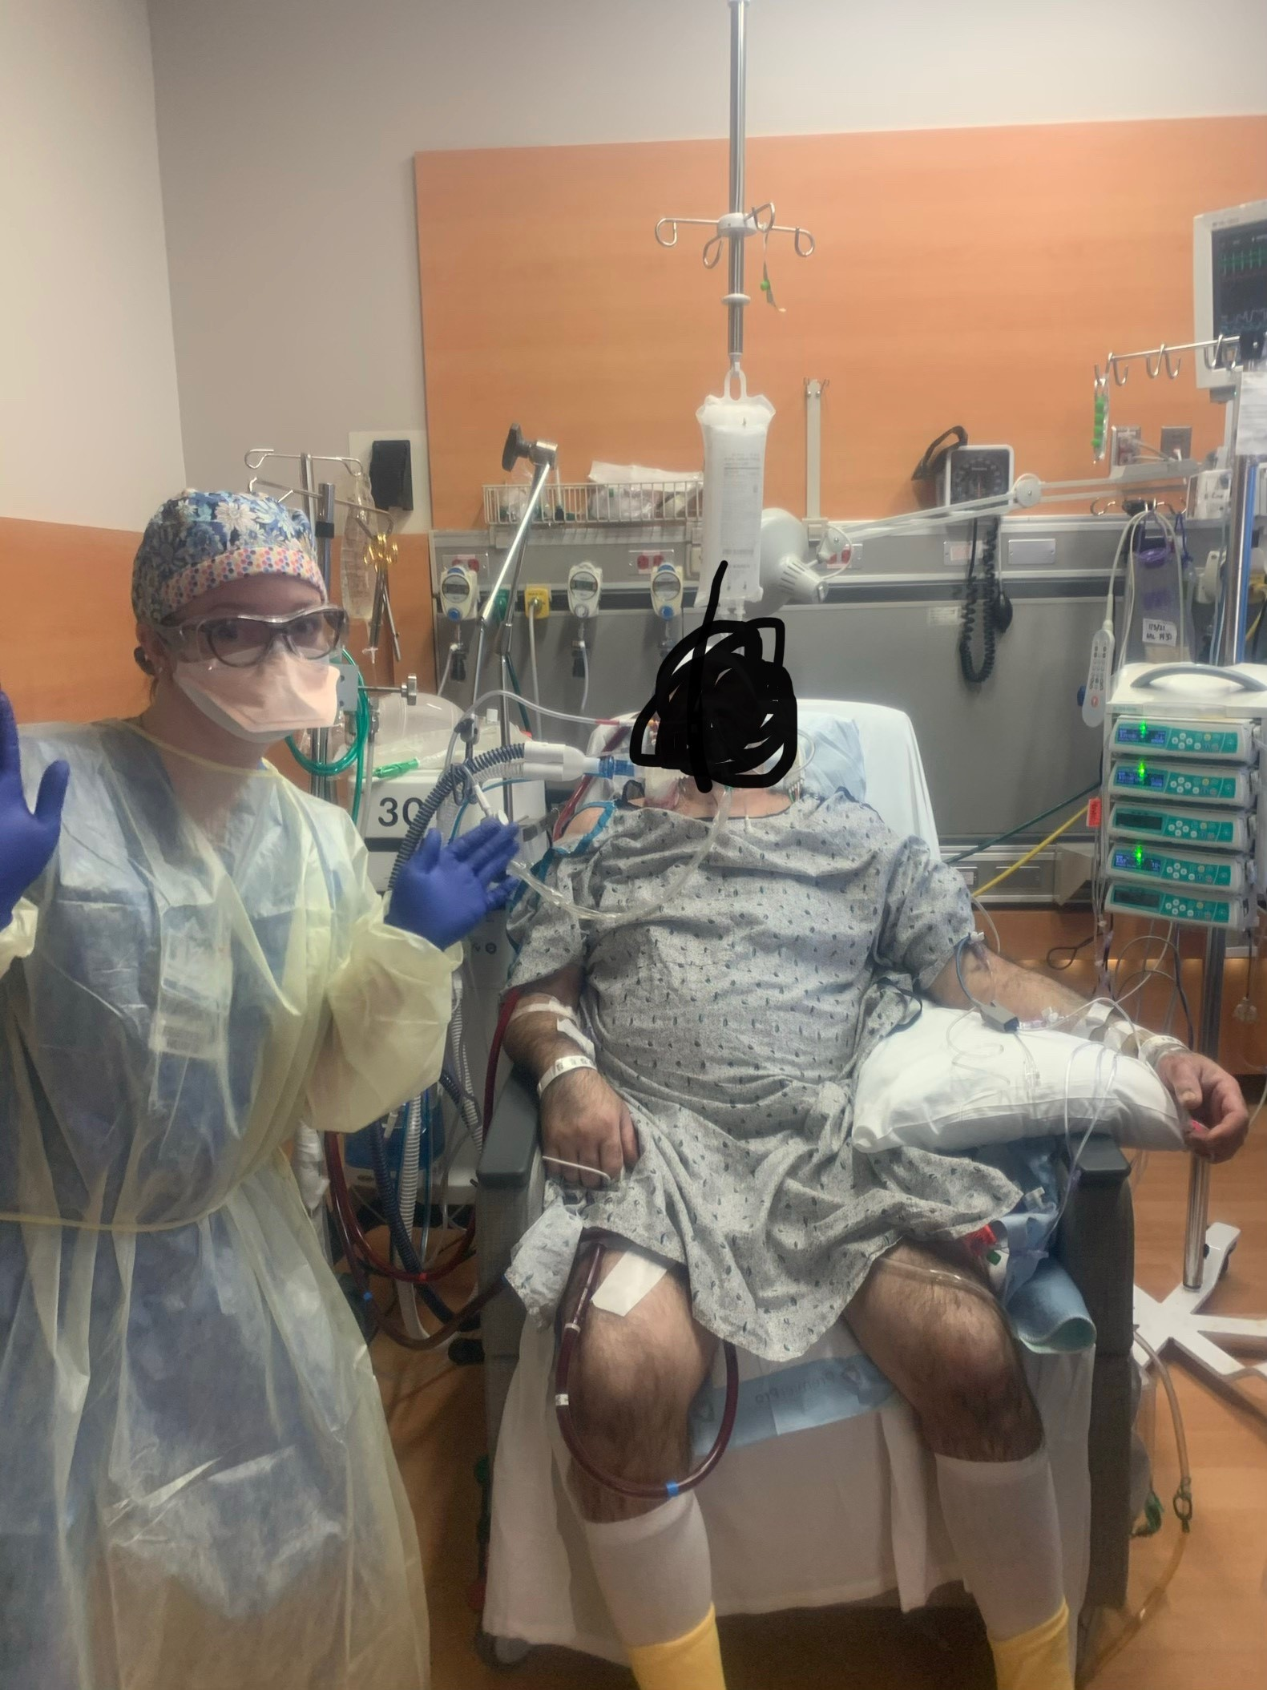
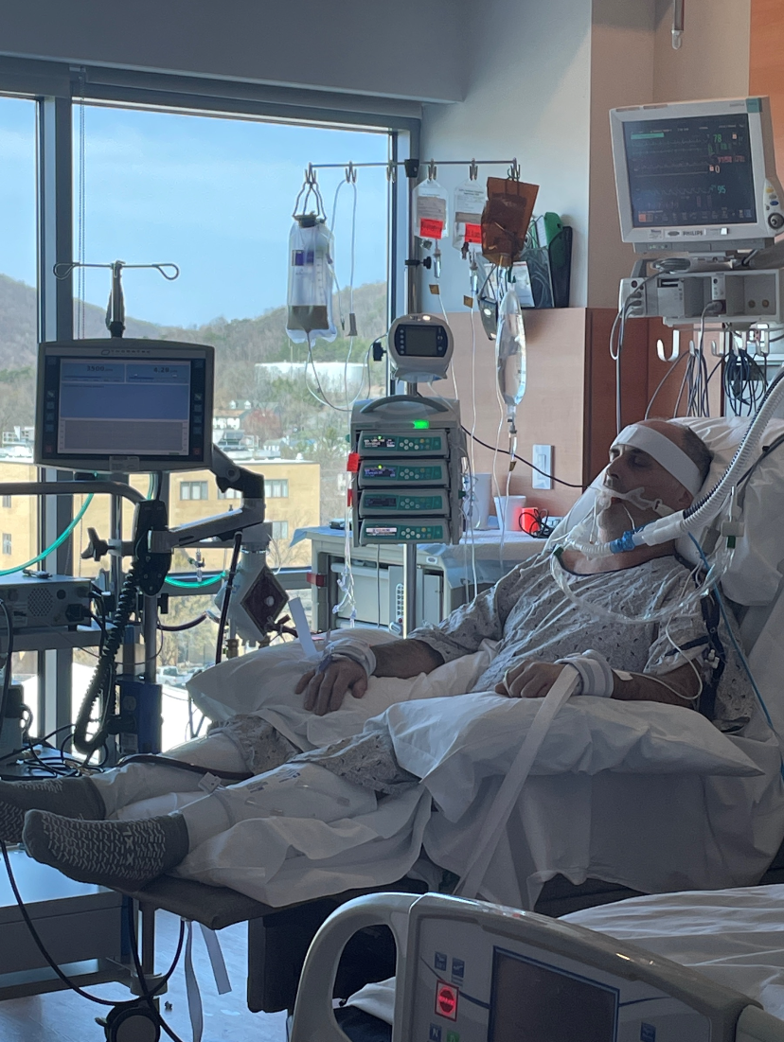
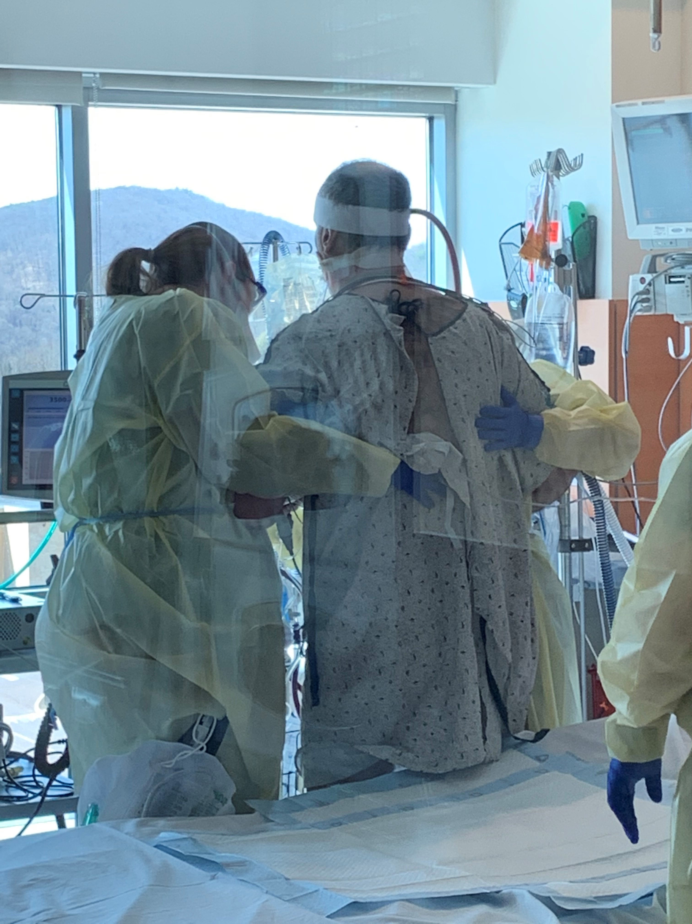
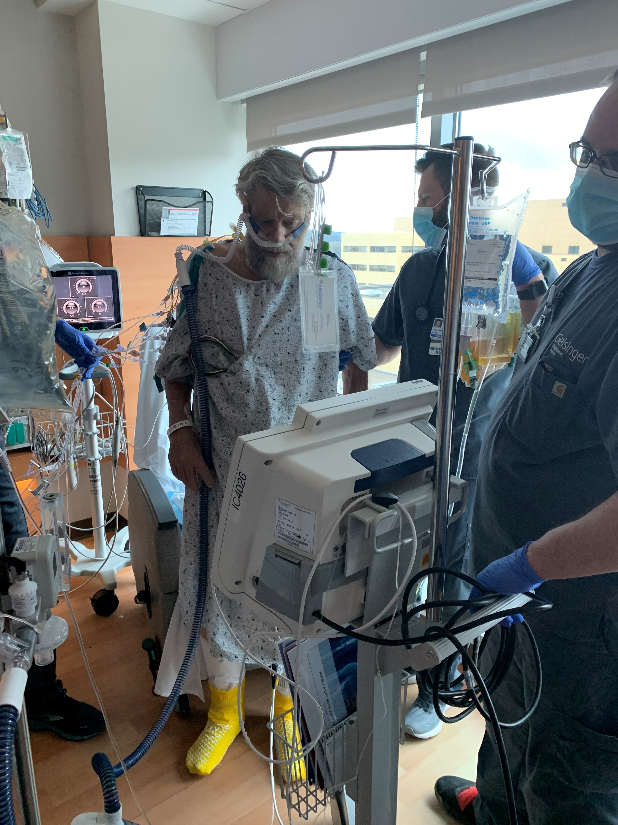
PT On ECMO
PT and OT on ECMO
Patients up out of bed in chair and walking
Improve mobility, decrease time in ICU

Slide 17
ECMO Components

Slide 18
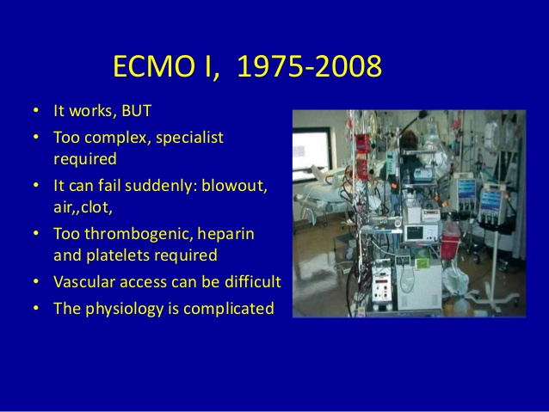
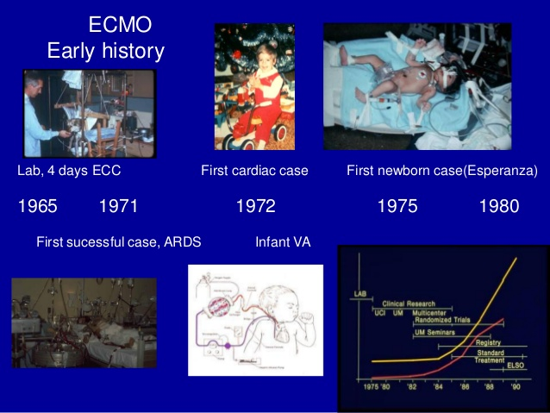
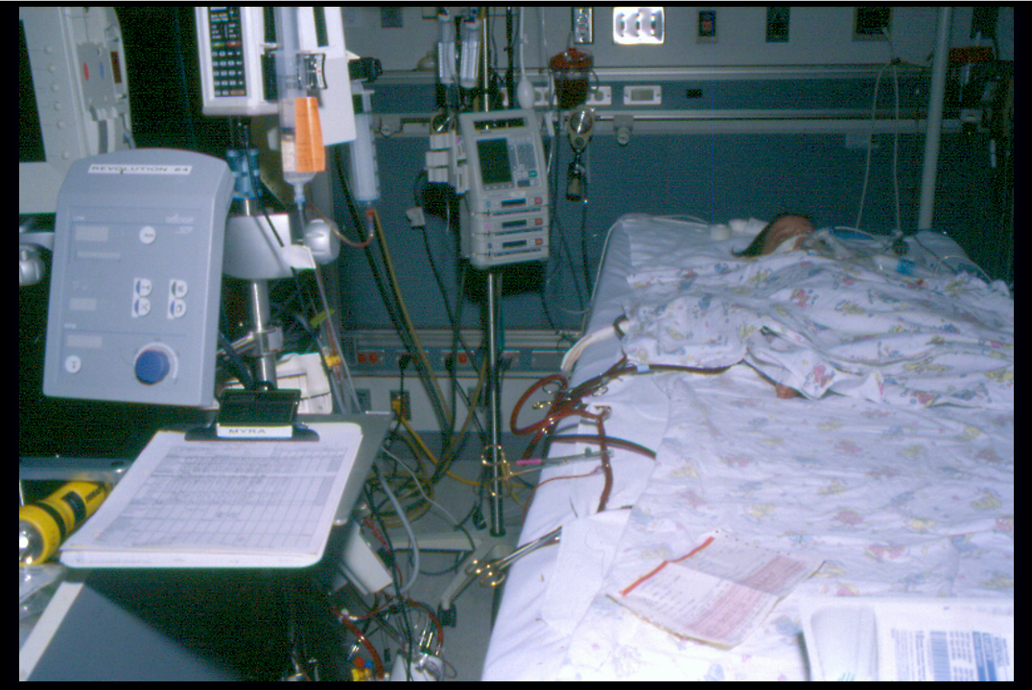
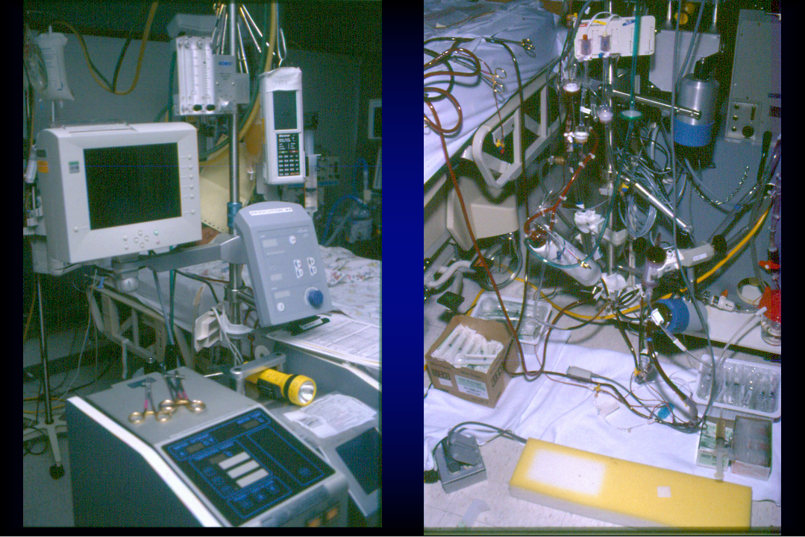
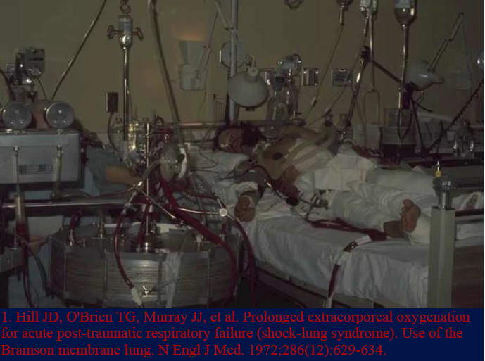
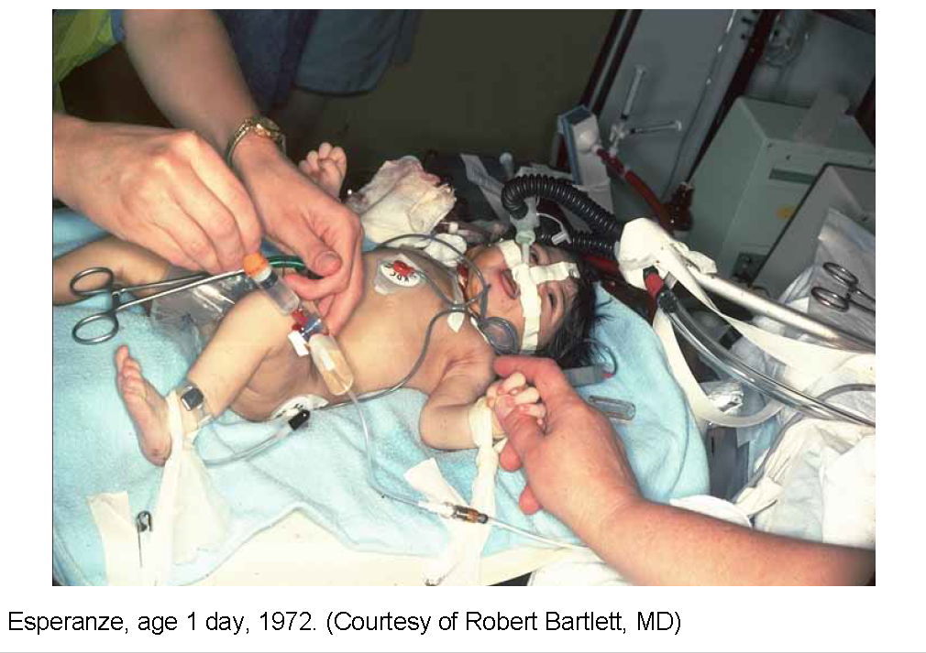
2003-2014 (26 ECMO patients, 12 Years)
Perfusion staff were required to sit ECMO 24/7 (canceled CVTS surgeries, hospital on divert)
Attempts were made to have RRT to sit ECMO, however, with limited patients, limited amount of trained physicians to care for patients, and no core “ECMO Team” it was never consist
Low volume, No Core Team, No Centralization with Geisinger Campuses

Slide 19
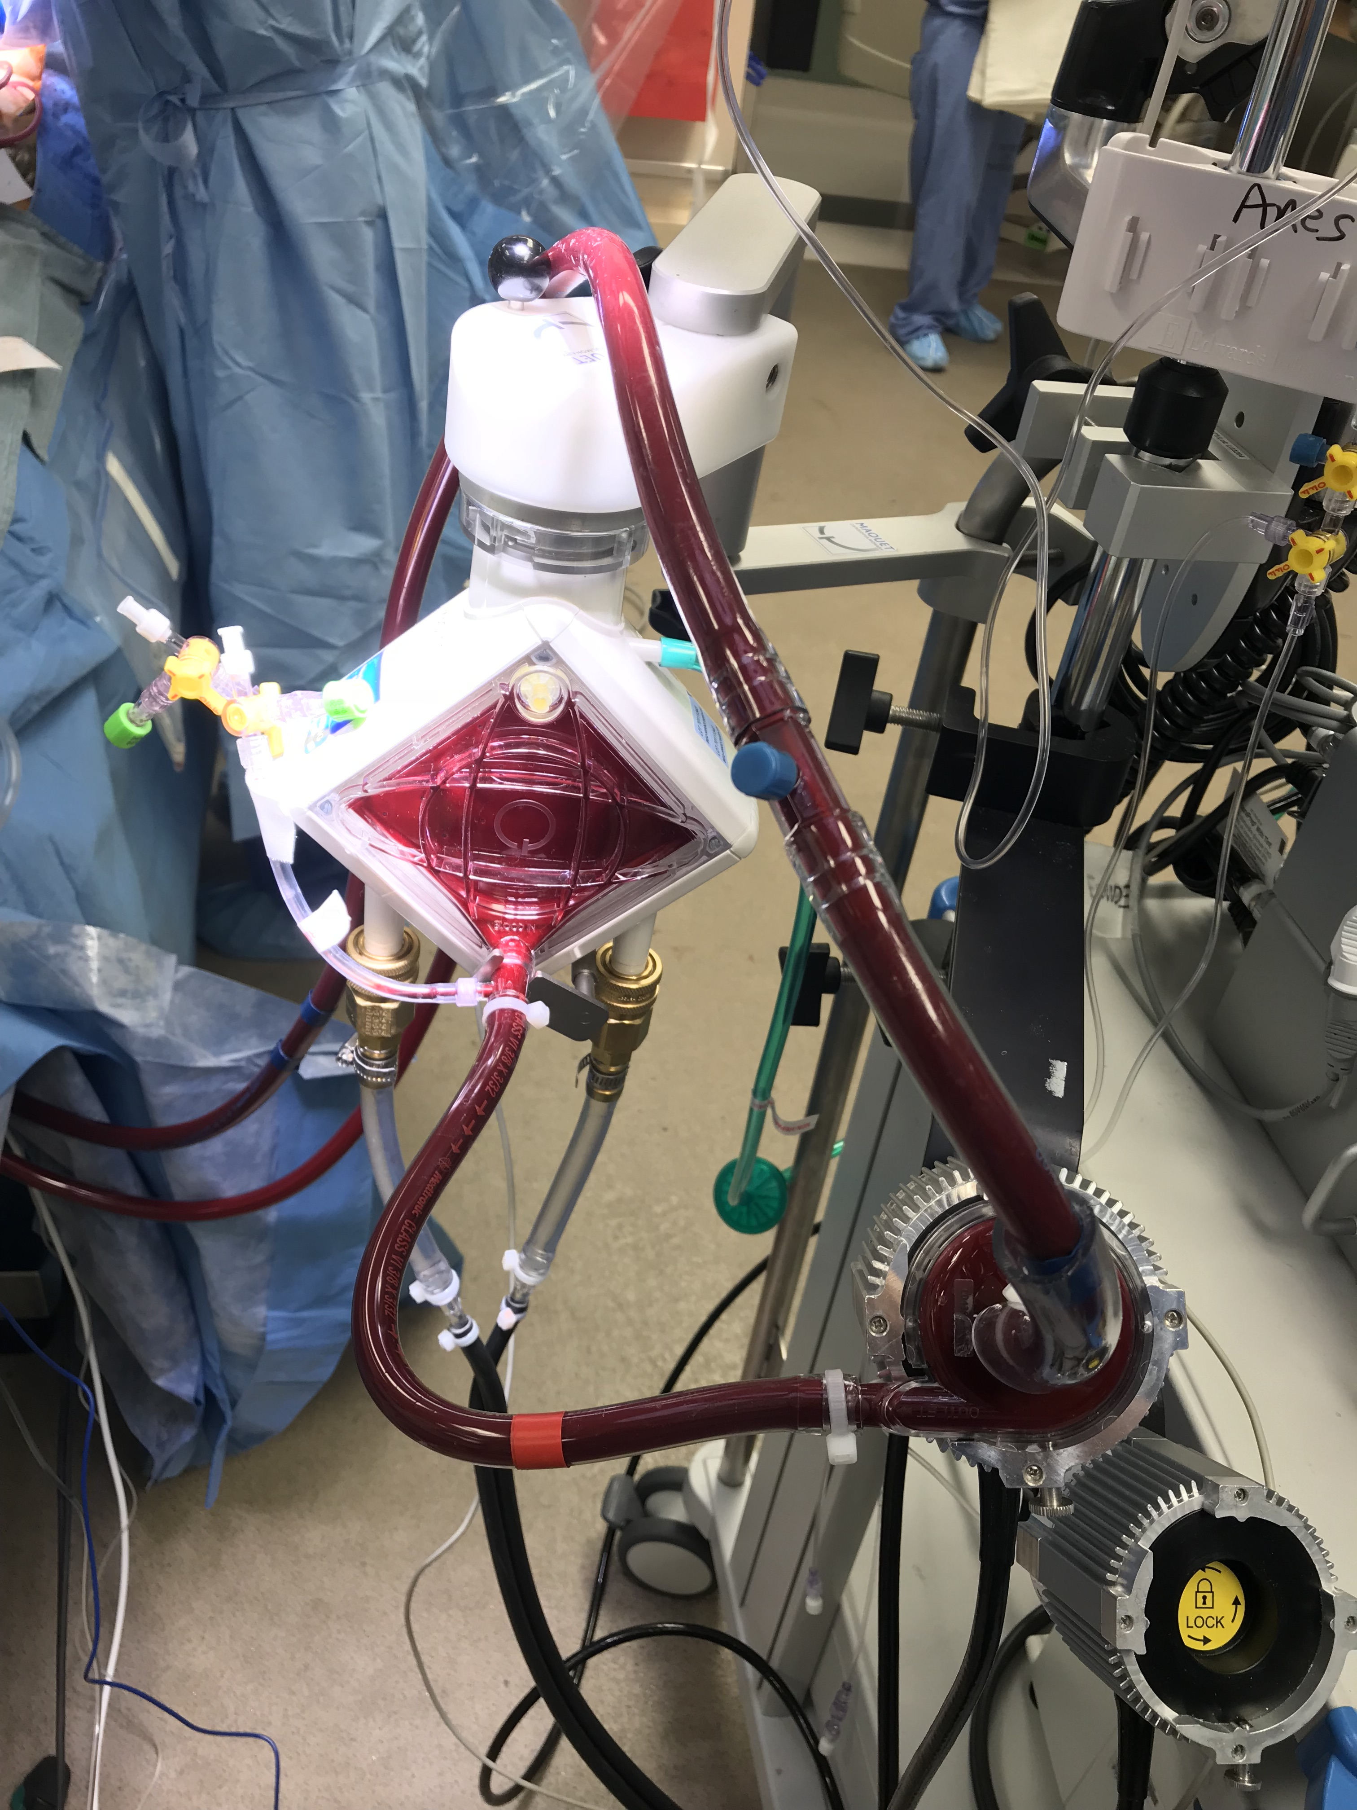
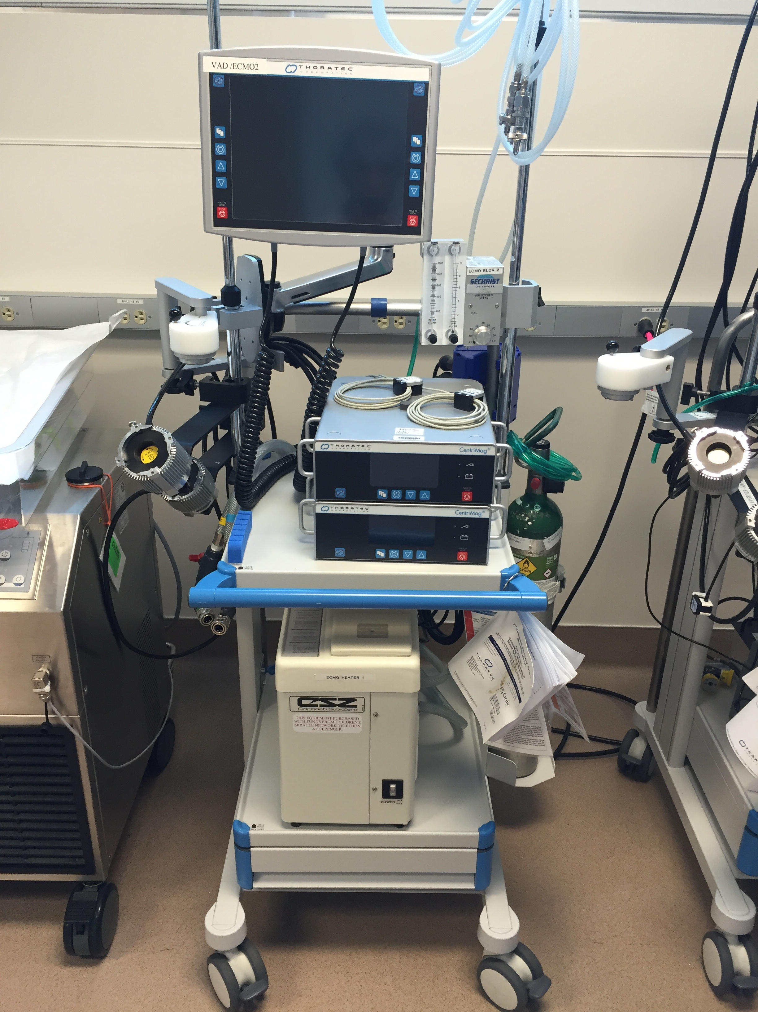
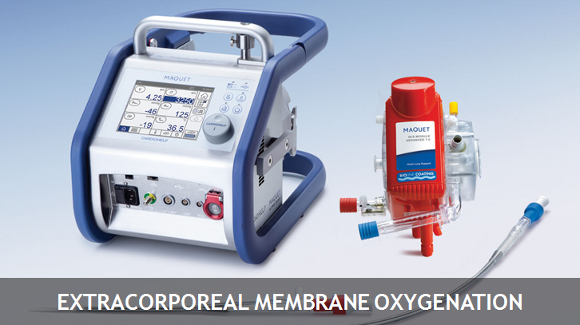
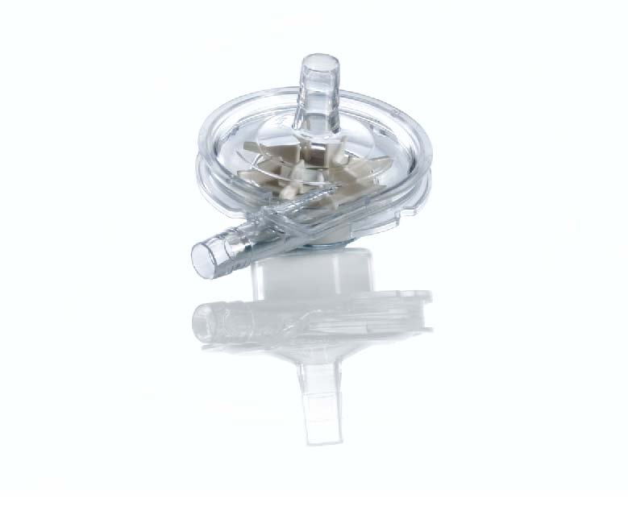
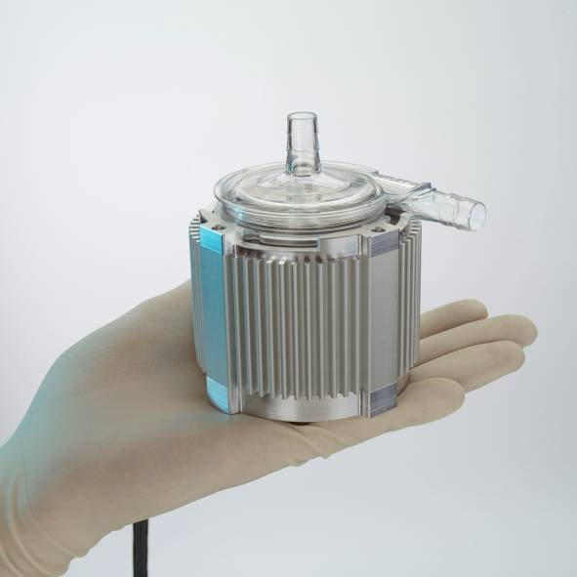
Machines, Pumps

Slide 20
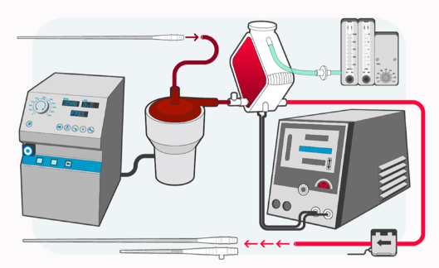
Monitoring
Membrane Lung
Gas Blender
Drainage Cannula
Pump is Centrifugal- therefore preload dependent and afterload sensitive
Pump Console measures RPM, this is not predictive of Flow
Flow Meter – monitors blood flow via ultrasound calculation
Pressure Monitoring
  Drainage Pre- and Post- Membrane Lung
Oxygen Saturation
  Pre- and Post- Membrane
  Patient ABG
Heat Exchanger
Pump Console
Pump
Return Cannula
Flow Meter

Slide 21
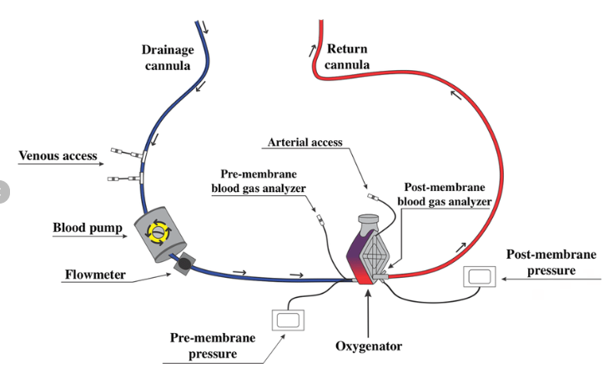
ECMO Circuit
Main Components
  Drainage Cannula
  Pump
    Pump Console
  Membrane Lung
    Heat exchanger
    Gas Blender
  Return Cannula
Chaves et al. Revista Brasileira de Terapia Intensiva. 2019

Slide 22
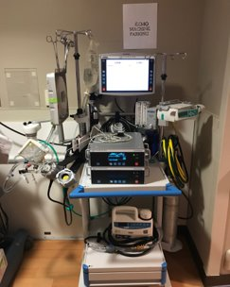
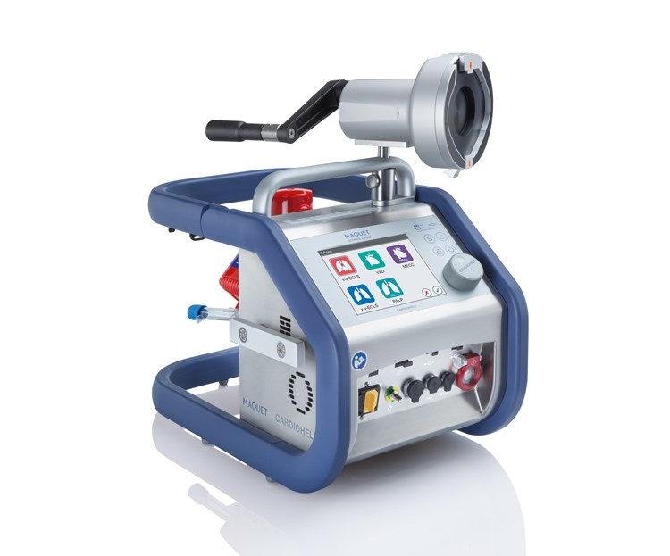
TYPES OF ECMO MACHINES
Centrimag
Cardiohelp

Slide 23
ECMO TERMS
Sweep gas
  Removes C02
  Titrated by LPM
  The higher the sweep gas the more C02 you will remove and the lower the sweep gas the more C02 retained
  If sweep gas is turned off, no oxygen will be delivered to the oxygenator
  Ranges from 0.1 LPM to 10 LPM
Fi02
  Provides oxygenation
  Ranges from 21% to 100%

Slide 24
ECMO TERMS
Sighing
  Momentarily increasing sweep gas to remove excess condensation and allow for better gas exchange across membrane
  Normal to see the condensation drip from bottom of oxygenator
RPM’s
  Rotations per minute to achieve desired flow
Heater/Cooler
  Attached to the oxygenator to allow for blood to be warmed
  Water does not mix with patients' blood, circulates around the membrane

Slide 25
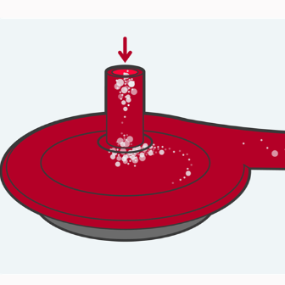
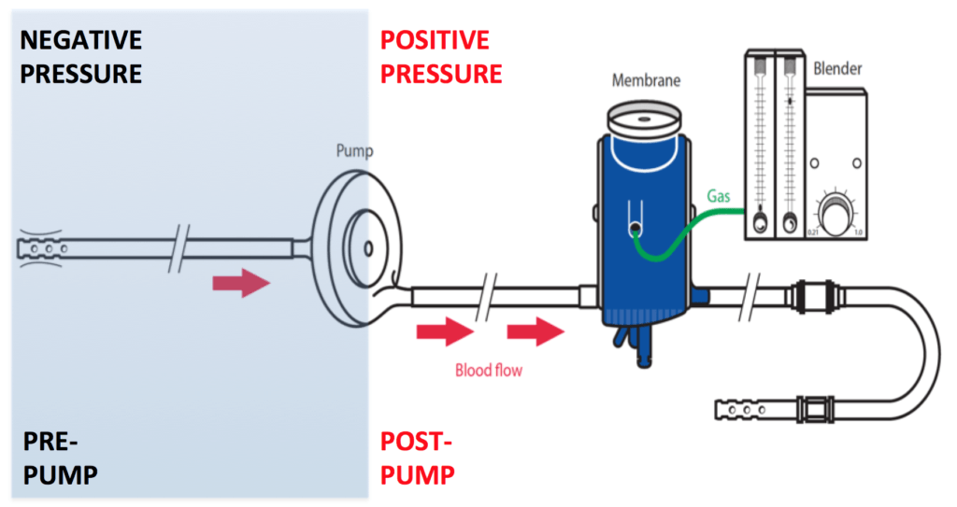
Centrifugal Pump
Can not generate extreme positive pressures
  Safe to clamp return cannula with pump on
They can generate significant negative pressures
  High negative pressures can cause drainage insufficiency (collapse of draining blood vessels- ie “chattering”) and hemolysis or vessel wall damage
  At very high negative pressures
    Cavitation- dissolved air pulled out of blood

Slide 26
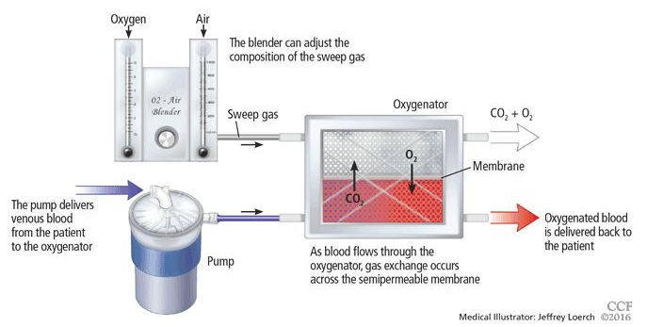
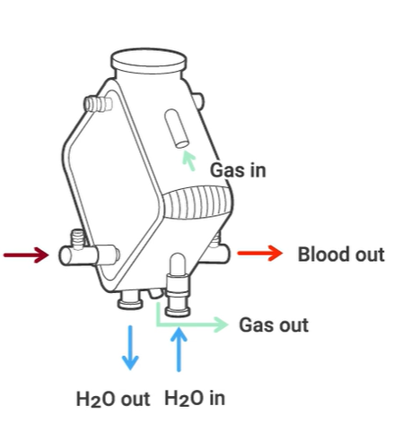
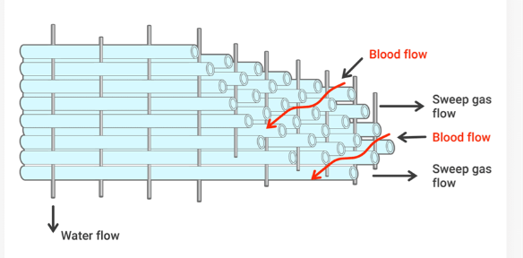

Slide 27
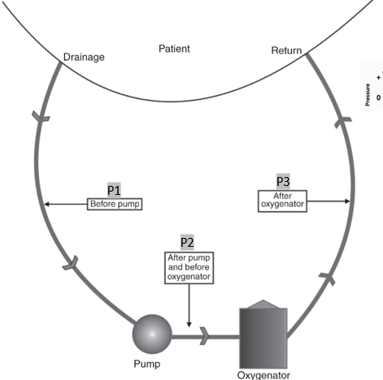
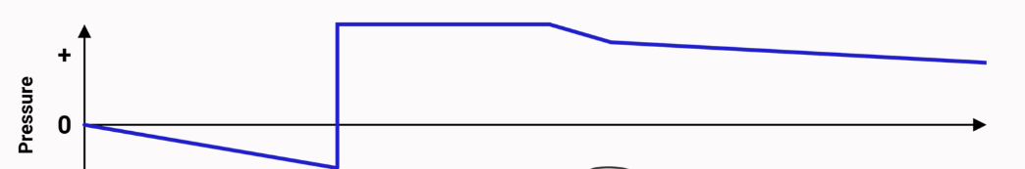
Membrane Lung
Pump
Vuylsteke, A., et al(2017). The ECMO circuit. In ECMO in the Adult Patient (Core Critical Care, pp. 25-57). Cambridge: Cambridge University Press. doi:10.1017/9781139088251.004

Slide 28
ECMO Configurations
V-V (can be dual-lumen)
V-A
VV-V
VV-A
V-VA (or V-AV)
      Hyphen denotes separation of drainage and return cannulas

Slide 29
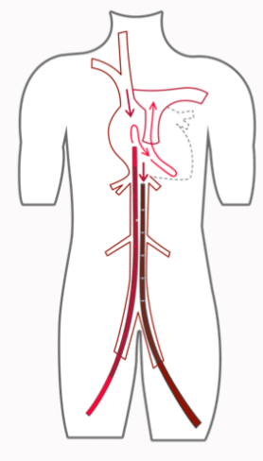
V-V ECMO Configurations
Fem-femoral
  Drainage Cannula in intrahepatic IVC
  Return Cannula in right atrium

Slide 30
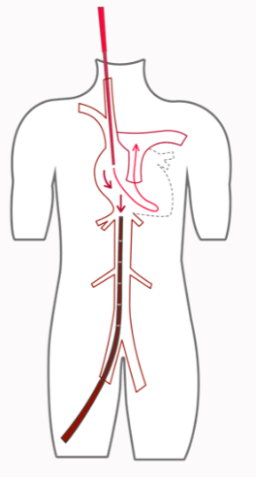
V-V ECMO Configurations
Fem-jugular
  Drainage cannula in intrahepatic IVC
  Return cannula in SVC or Right atrium

Slide 31
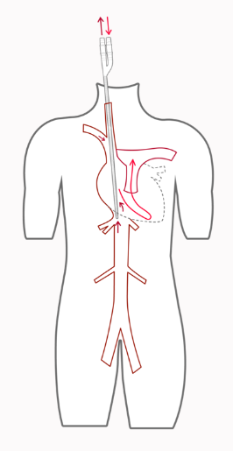
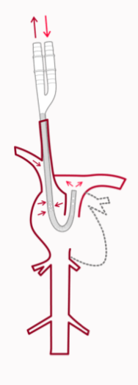
V-V ECMO Configurations
Dual Lumen Jugular
  R IJ
  Drainage from SVC and IVC
  Return in RA with jet directed across Tricuspid valve
  An alternative placement
  Directs return into Pulmonary Artery

Slide 32
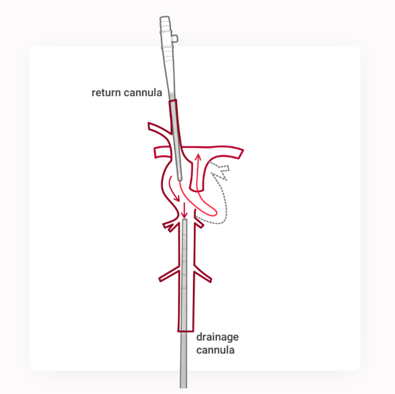
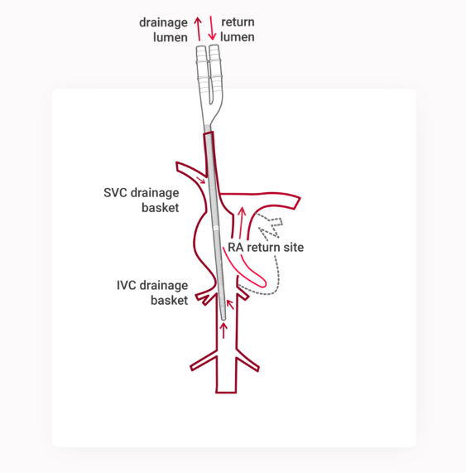

Slide 33
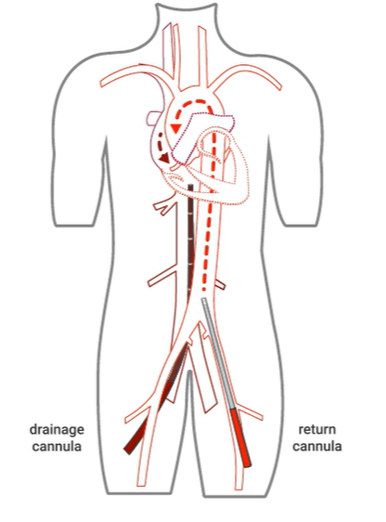
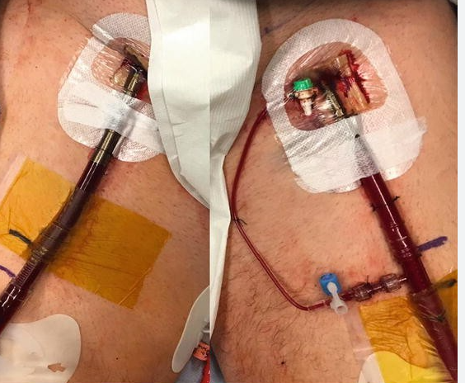
V-A ECMO Configurations
Femoro-femoral- most common
  Drainage catheter at or near Right atrium
  Return cannula in distal aorta or iliac artery
  Can lead to ischemia of ipsilateral leg to return cannula
    This can be addressed with peripheral perfusion cannula

Slide 34
Carbon Dioxide Removal
CO2 production is equal to O2 consumption when RQ=1
  The amount of CO2 exchanged per minute is ~same as O2 exchanged
CO2 is much more soluble and diffusible than O2 in blood
  CO2 clearance will exceed oxygenation in any circumstance
  If CO2 clearance is the primary goal- ECMO flows can be significantly lower
CO2 elimination is a function of the gradient of the inlet PCO2, the sweep gas CO2 (0 mmHg), and the sweep gas flow
  Sweep (new)= Sweep(current) x pCO2/desired PCO2
  **Caution with rapid adjustments in PCO2 (Neurologic complications)

Slide 35
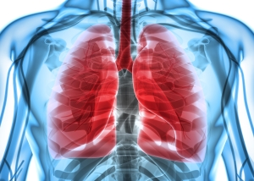
ARDS, PRONING and VV ECMO

Slide 36
CAUSES OF ARDS AND COMPLICATIONS
Primary Causes
  Pneumonia- Aspiration, viral, or bacterial
  Sepsis
  Trauma
  Inhalation injury- Smoke, toxic chemicals
  Mass blood transfusion- TRALI and volume overload
Complications
  Atelectasis- When small air pockets in the lungs collapse
  Failure of other organs secondary to hypoxemia
  Secondary infection- Bacterial pneumonia
  Pulmonary fibrosis

Slide 37
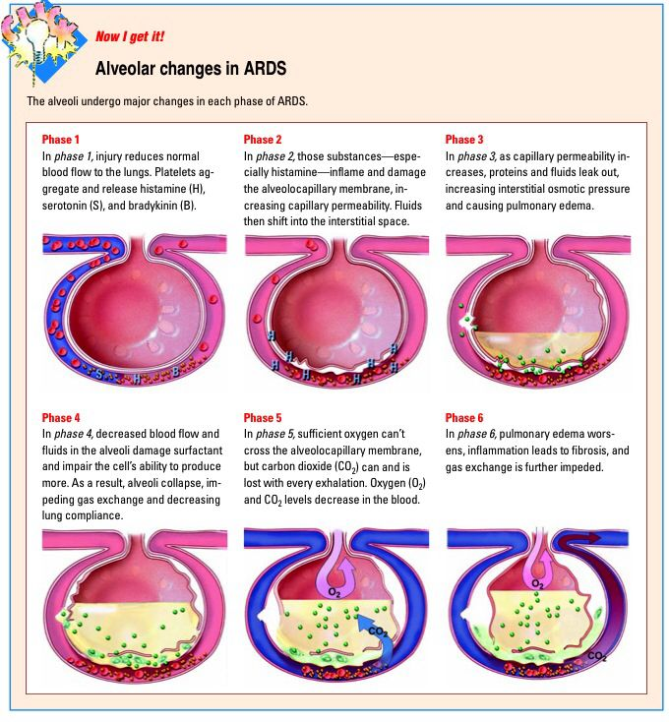
ARDS Pathophysiology

Slide 38
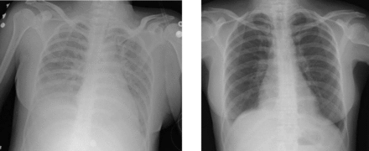
ARDS
HEALTHY LUNG

Slide 39
TREATMENT OF ARDS
Sedation and paralysis
  Allows for better ventilator compliance
Lung protective ventilation
  Low tidal volumes
    6-8ml/kg
  Optimal peep
    PV tool or esophageal balloon
Inhaled Epoprostenol
Treat the cause of ARDS
Proning

Slide 40
VV ECMO
Gives pulmonary support ONLY
Offers NO hemodynamic support
Patients are placed on “rest” settings on vent
  2-4ml/kg
Primary goal of VV ECMO is to allow rest and healing of the lungs

Slide 41
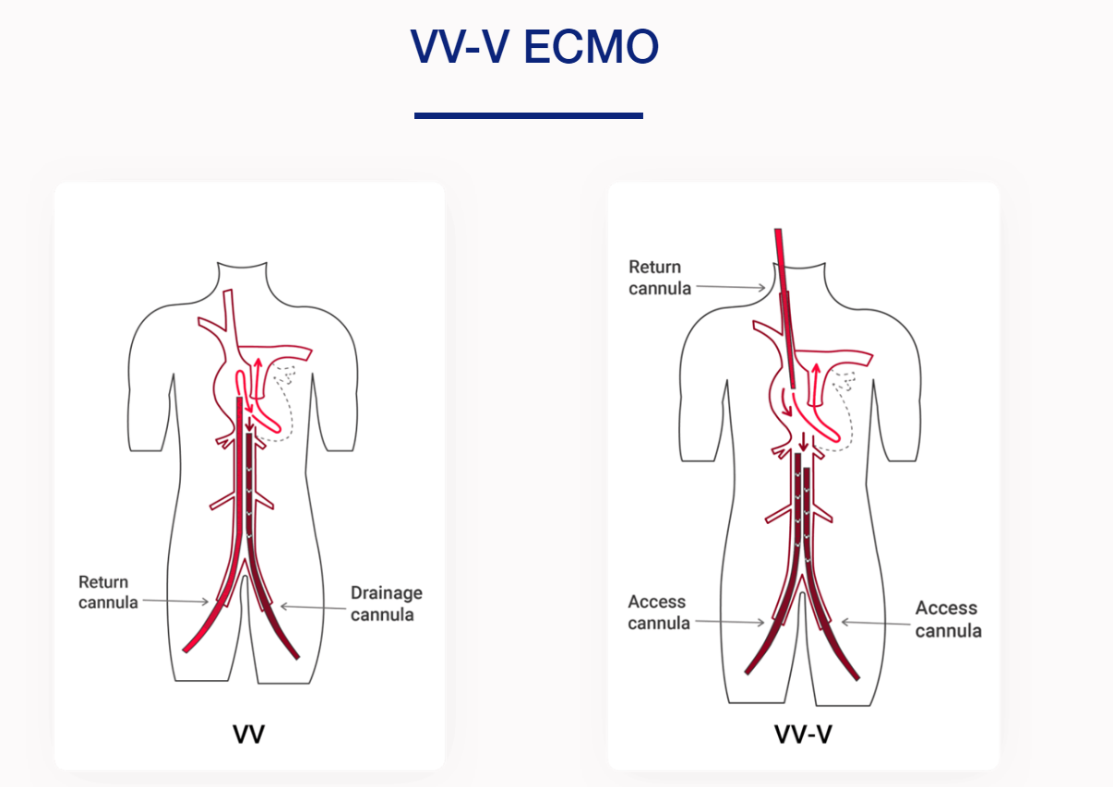
Notes:
23 /25 F 6.5 L PM
Same flow with less drainage pressurs
25 F 4.5 BLPM

Slide 42
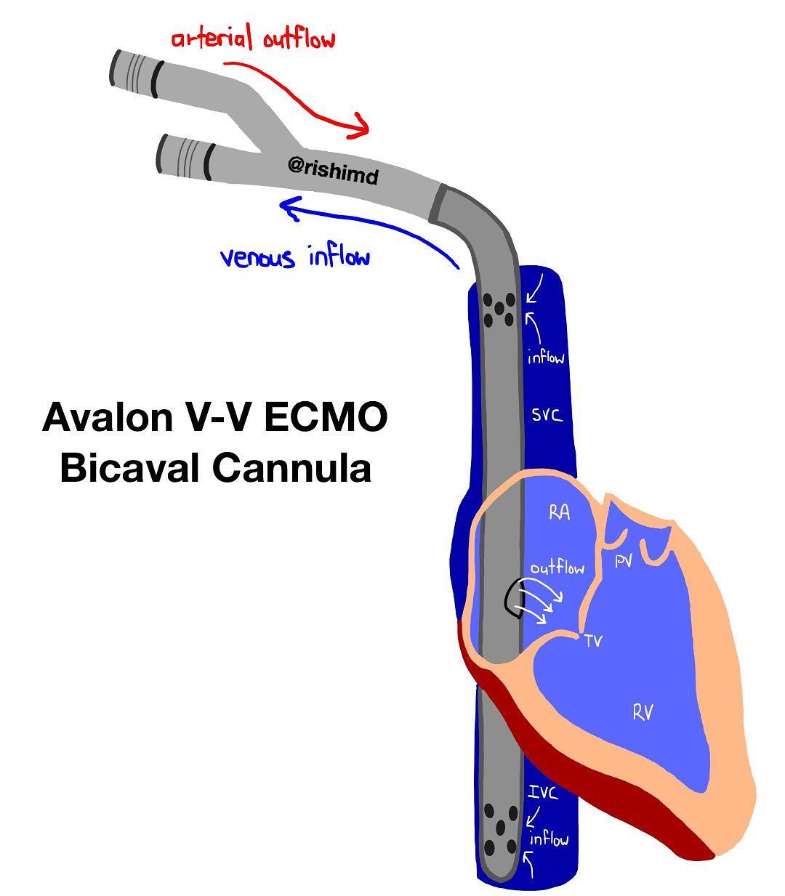
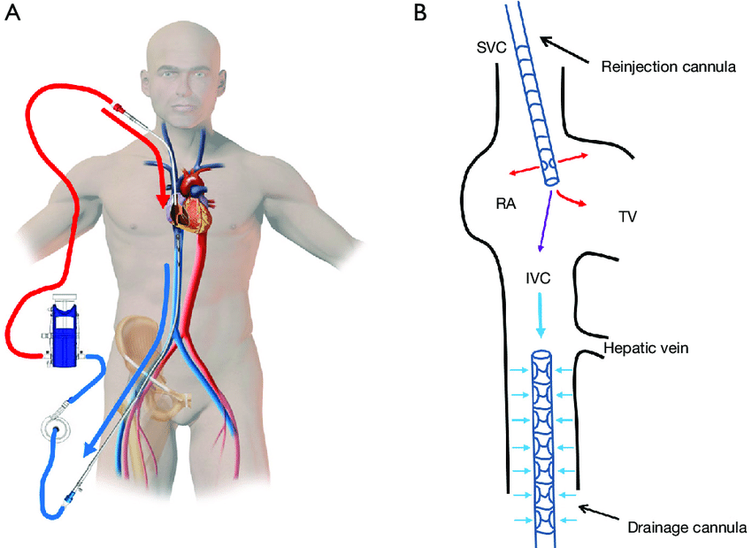
VV ECMO CANNULATION

Slide 43


RECIRCULATION
You should always see a color changed between drainage and return cannula

Slide 44


Slide 45

Notes:
Pump speed and cannula location are modifiable

Slide 46


Slide 47


Slide 48


Slide 49


Slide 50


Slide 51
VV ECMO WEANING
When to wean
  Tidal volume and compliance increases on ventilator without making changes
  Chest x-ray looks better
  Support from ECMO decreases
How to wean
  Patient is placed on optimal ventilator settings
  Gases disconnected from ECMO circuit
    ECMO circuit is just an extension of circulatory system, not adding or taking away

Slide 52
VV ECMO WEANING
Assessment
  Look for signs of respiratory distress, monitor Sp02, HR, and BP
  ABG’s
  Patient will wean for 6-24 hours prior to decannulation
Decannulation
  Done at bedside with help of perfusion or ECMO specialist

Slide 53

BEDSIDE VV ECMO CANNULATION

Slide 54


COVID-19 VV ECMO

Slide 55

EXTUBATE VV ECMO?

Slide 56
VA ECMO
Used in the setting of cardiogenic shock or failure to wean from bypass
Bypasses both heart and lungs so an oxygenator is necessary
Utilized to allow the heart to “rest” and recover
eCPR
Massive PE
Hypothermia

Slide 57
VA ECMO CANNULATION
Central
  Right atrium->Aorta
  Right atrium->Femoral artery
Peripheral
  Femoral vein->Femoral artery
  Femoral vein->Axillary/subclavian vein

Slide 58

CENTRAL CANNULATION

Slide 59

PERIPHERAL CANNULATION

Slide 60
VA ECMO – MIXING CLOUD
Place in the aorta where the blood being ejected from the patient’s left ventricle and the flow from the arterial cannula from the ECMO circuit meet.
Multiple names: mixing cloud, harlequin effect, watershed
Occurs in patients with femoral insertion of VA ECMO as native heart function begins to recover
Worse in patients with simultaneous lung dysfunction
Reason for RUE arterial line and pulse ox
Notes:
Please note that mixing and recirculation are NOT the same thing
Mixing is most easily understood when you know where your cannula’s are placed because then you know the direction the blood is flowing (i.e. antegrade or retrograde)

Slide 61

VA ECMO AND MIXING CLOUD
Notes:
Watch youtube video

Slide 62

VA ECMO AND MIXING CLOUD
Notes:
Also understanding the basic anatomy of the vasculature of the root and head vessels makes this phenomena much easier to understand

Slide 63
VA ECMO CONSIDERATIONS
Frequent monitoring of vital signs, same as other ICU patients
Hourly pulse checks in extremities
Hourly neuro assessment
Patient will have a balloon pump or impella to vent the LV
Arterial line should be on right side to evaluate oxygenation
Patient will usually not have any pulsatility on arterial line
Frequent TEE’s to evaluate cardiac function
NO CPR , the ECMO circuit is the heart and lungs so they are being perfused and oxygenated by way of circuit

Slide 64
VA ECMO - WEANING
Widening pulse pressure generally good sign of cardiac recovery
Assess cardiac function with TEE
  Will decrease ECMO flows gradually to allow the heart to take on more work
  Signs of failure: hypotension, tachycardia, decreased SvO2, increased PAP and RAP, increased respiratory rate, increased rate of vasoactive medications
Can leave patients on prolonged wean 1.5-2 lpm of flow over 24 hrs- patient must be anticoagulated to prevent stroke and circuit thrombosis
Notes:
VV you wean gases for VA you wean flow
Cant send hypoxic hypercarbic blood back into arterial system

Slide 65

ECPR
CPR while cannulating VA ECMO

Slide 66
MEDICATIONS AND ECMO
Meds will sequester in the ECMO circuit, thus patient not getting full dose til circuit is saturated. This can take up to 4 days
Higher doses of medications than normal to illicit a therapeutic effect.
Sedatives and analgesia
  Versed and Dilaudid= preferred medications= sequestered the least (50%)
  Ketamine= works well as adjunct= avoided related to nurse administration restrictions
Albumin is preferable to NSS for volume
Vasopressors and paralytics administered for desired effect
Anticoagulation with Heparin/Bivalirudin
  Lab:
    aPTT, PR/INR, Fibrinogen, TED, ACT
Notes:
Medication sequestration is more of a problem in ECMO patients because of the membrane oxygenator
Propofol has a lipid base that causes a film build up on the oxygenator causing it to fail quicker.
If patient requires TPN it must be mixed without lipids.
Morphine also has low adsorption rate however related to histamine response we usually use dilaudid instead
Ativan also works well in the benzos but is avoided to due it causing lactic acidosis when infused in high doses long term

Slide 67

CRRT AND ECMO

Slide 68




Pre-Hospital ECMO, Paris

Slide 69


Pre-Hospital ECMO

Slide 70

QUESTIONS?

Slide 71
Thank You
Salman Khan MD

