Slide 1
Communication Cognition and Swallowing
Hilary Welty M.S. CCC-SLP
Speech Pathologist

Slide 2
Course Objectives
To be able to identify the difference between disorders of language, speech and cognition.
To understand how patients get diagnosed and receive therapy for these disorders
To gain insight in how to communicate more effectively with both aphasic patients and patients with cognitive deficits.
Understanding both speech and nurses roll in identifying and managing dysphagia

Slide 3
Neurological Diagnosis that can affect Swallowing, Speech, Language and/or Cognitive skills
Strokes
TBI
Other Neuro:
Parkinsons, Huntington's, ALS, Multiple Sclerosis, Myasthenia Gravis, Gillian Barre
Dementia
Brain Tumors
Cardiac Arrest/Anoxia
Spinal Cord Injury

Slide 4
Communication and Cognition
Different lobes of the brain have different functions that can impact speech, language and cognitive skills.
In most people the left side of the brain impacts language production, language comprehension, reading and writing.
The right side of the brain impacts cognitive skills
There are patients where this can be reversed or atypical, usually in patients that are bilingual and/or left-handed

Slide 5
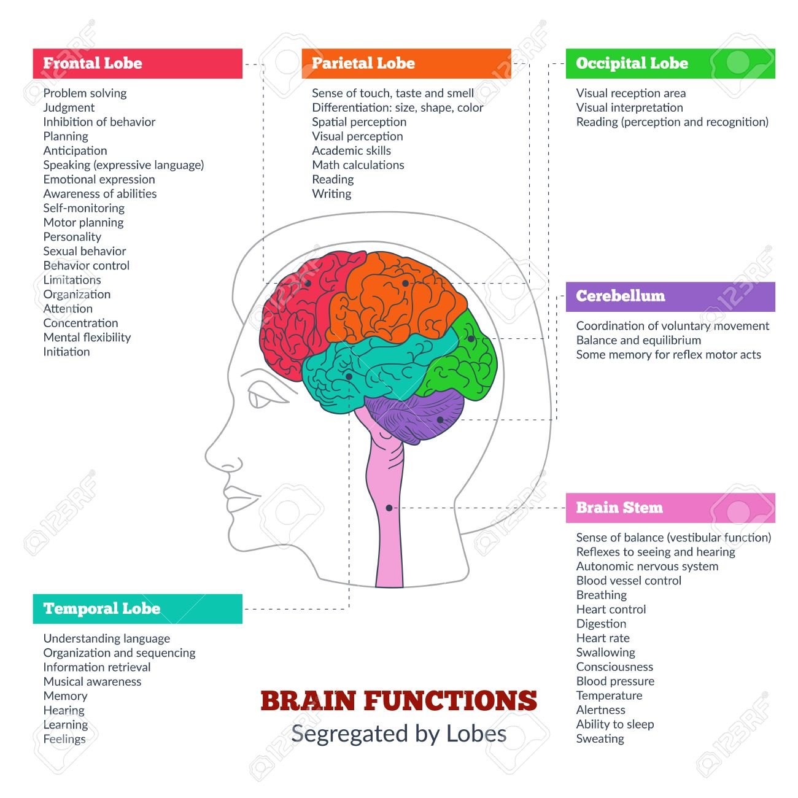
Brain Functions by Lobes

Slide 6
Disorders of communication and cognition?
Disorders of Speech:
Dysarthria and Apraxia
Disorders of Language:
Aphasia, Reading and Writing
Cognitive Deficits

Slide 7
Dysarthria
When the muscles of the face and tongue are impacted, speech can become imprecise and difficult to understand
There are 7 different types of dysarthria that are classified by location of injury and characteristics of production:
Flaccid—associated with disorders of the lower motor neuron system and/or muscle
Spastic—associated with bilateral disorders of the upper motor neuron system
Ataxic—associated with disorders of the cerebellar control circuit
Hypokinetic—associated with disorders of the basal ganglia control circuit
Hyperkinetic—associated with disorders of the basal ganglia control circuit
Unilateral upper motor neuron—associated with unilateral disorders of the upper motor neuron system
Mixed—various combinations of dysarthria types (e.g., spastic-ataxic; flaccid-spastic)
https://www.asha.org/Practice-Portal/Clinical-Topics/Dysarthria-in-Adults/

Slide 8
Apraxia
Apraxia is a neurological disorder characterized by the inability to perform learned (familiar) movements on command, even though the command is understood and there is a willingness to perform the movement. Both the desire and the capacity to move are present but the person simply cannot execute the act.
Apraxia of speech (verbal apraxia) is difficulty initiating and executing voluntary movement patterns necessary to produce speech when there is no paralysis or weakness of speech muscles.
Oral Apraxia involves difficulty voluntarily moving the muscles of the lips, throat, soft palate and tongue for purposes other than speech, such as smiling, whistling or coughing on command. This can also impact voluntary phonation.
Additionally there are multiple types of motor apraxia involving arms, legs and completing normal motoric movements or patterns (e.g. getting dressed, tying shoes)
Apraxia can be difficult to diagnose accurately when it occurs with Aphasia.
https://rarediseases.org/rare-diseases/apraxia/
https://www.strokeassociation.org/en/about-stroke/effects-of-stroke/cognitive-and-communication-effects-of-stroke/aphasia-vs-apraxia

Slide 9
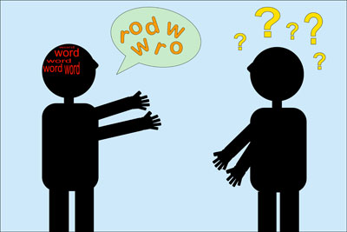
Aphasia
Aphasia is an impairment of language, affecting the production or comprehension of speech and the ability to read or write. Intelligence is often not affected
There are 8 different types of aphasia that are diagnosed by three sets of criteria; fluency, comprehension and the ability to repeat
Anomic
Conduction
Transcortical Sensory
Wernicke’s
Transcortical Motor
Broca’s
Mixed Transcortical
Global
Characteristics of language production can include semantic paraphasias, phonemic paraphasias, neologisms, perseveration

Slide 10
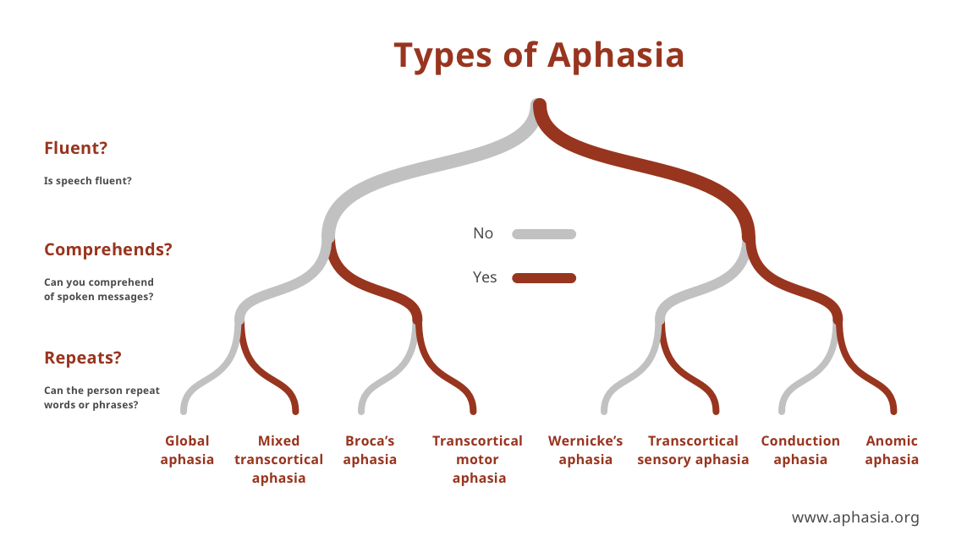
Aphasia
https://www.aphasia.org/wp-content/themes/directorys-child/includes/images/types_of_aphasia.png

Slide 11
Examples of Aphasia
https://youtu.be/3oef68YabD0 -Wernicke’s
https://youtu.be/IP8hkopObvs -Broca’s

Slide 12
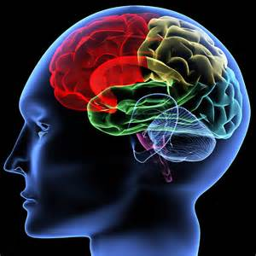
Cognition
The mental process of knowing, including aspects such as perception, awareness, attention, memory, intuition, knowledge.
Components of Cognition:
Awareness
Perception
Attention
Visual Processing
Memory; Short and long-term
Executive Functions;
Plan, execute, initiation, problem solving, reasoning,
Mental flexibility, inhibition, self-monitoring, impulsivity,
Information Processing
All of these work together and impact one other
They rarely work in isolation

Slide 13
High Level Cognitive Disorders
Why do you think high level cognitive deficits can go undiagnosed?
Patient is agitated and pulling at lines, unable to pay attention, not oriented, cannot recall details about their own life. Do they have a deficit?
Pt is alert, oriented, recalls details of what happened to them, knows their family and where they live. Do they have a deficit?
How do we know without an evaluation that they can return to their life without any issues? Return to their jobs without issues?
Patients can easily mask a high-level cognitive disorder without even knowing it themselves. They deny deficits and we may take their word for it in the absence of clear deficits.
We typically do not challenge them to do high level cognitive tasks during their short hospital stay? Can they manage their own medicine? Manage all their own finances? Go back to work as a massage therapist? Go back to work as a lawyer or air traffic controller?

Slide 14
How are communication and cognitive disorders diagnosed?
Frequently communication and cognitive disorders are diagnosed by a Speech Pathologist, sometimes also by a Neurologist or by a Neuropsychologist.
Official therapy is typically provided by the SLP during acute, rehab and/or post rehab setting.
Aphasia and Dysarthria can be easier to recognize by nurses and doctors than Cognitive disorders.
Cognitive disorders can be significantly more difficult to identify and can occasionally go undiagnosed when only mild in nature
SLP’s can use formal or informal assessments

Slide 15
Communicating with Aphasic Patients- Getting the message In
Make sure you have the person’s attention before you start.
Minimize or eliminate background noise (TV, radio, other people).
Keep your own voice at a normal level, unless the person has indicated otherwise.
Keep communication simple, but adult. Simplify your own sentence structure and reduce your rate of speech. Emphasize key words. Repeat yourself and try re-wording information.
Remember that they may understand more than they can communicate. They can also understand tone of voice, body language and facial expressions.
https://www.aphasia.org/aphasia-resources/communication-tips/

Slide 16
Communicating with Aphasic Patients- Getting the message In
Communicate with drawings, gestures, writing and facial expressions in addition to speech. Offer tangible options if possible
Try to involve them in decision-making as much as possible. Keep them informed of events but avoid burdening them with day-to-day details.
https://www.aphasia.org/aphasia-resources/communication-tips/

Slide 17
Communicating with Aphasic Patients- Getting the message Out
Make eye contact
Give them time to speak. Resist the urge to finish sentences or offer words.
Confirm that you are communicating successfully with “yes” and “no” questions.
Use mutually exclusive yes/no questions
Praise all attempts to speak and downplay any errors.
Have pictures and visuals available if possible
Offer two choices
Ask the person to gesture, point, or write (e.g., “Can you show me…?”)
Encourage independence whenever possible

Slide 18
Communicating with Aphasic Patients
Why are communication boards difficult for the aphasic patient?
Aphasia patients can have deficits in reading and writing
Reading skills often mimic receptive language skills and writing often mimics expressive language skills
Most people are right hand dominant and left sided strokes impact the right limb for writing
Patients can have limb apraxia which impacts their ability to point to the correct pictures or follow commands correctly

Slide 19
Communicating with Patients who have Cognitive Disorders
Allow the person extra time to process what you’ve said. Try waiting for up to 90 seconds before repeating yourself.
Provide information in short chunks. If you’re giving directions, break them down into small steps.
If the person has left-neglect provide a challenge by standing to the person’s left. For an important conversation, however, sit on the person’s right side.
Write down key instructions and information, or encourage the person to write it down themselves.
Verify any important information the person gives you with a third party, to be sure it’s reliable. People with memory deficits or insight problems may not be accurate communicators, even if their speech sounds good.
Speak simply. Don’t talk too loudly, though, and don’t talk down to the person
Reduce distractions in the room if needed (e.g. TV, multiple or loud visitors)
https://tactustherapy.com/whatiscogcomm/

Slide 20
Rehab Potential/Prognosis
Acute injury (e.g. CVA or TBI):
Speech Therapy rehab prognosis is heavily dependent on location and severity of injury
Additionally, it can be affected by pt’s motivation, access and amount of therapy, family involvement and possible history/other diagnosis (e.g. previous strokes, dementia)
Degenerative Diseases
Therapy is often aimed at evaluation and education about what can be done to help maintain current level of function and/or compensate for deficits.

Slide 21
Dysphagia
What is Dysphagia?
Dysphagia is a medical condition characterized by difficulty swallowing. It refers to any impairment in the normal process of swallowing, which involves moving food or liquid from the mouth through the throat (pharynx) and into the esophagus and stomach.
Esophageal dysphagia involves impairments in moving bolus through esophagus and into stomach.
In normal swallowing function there are at least 30 pairs of muscles involved
The oral phase of swallowing is voluntary while most of the pharyngeal phase of swallowing is reflexive

Slide 22
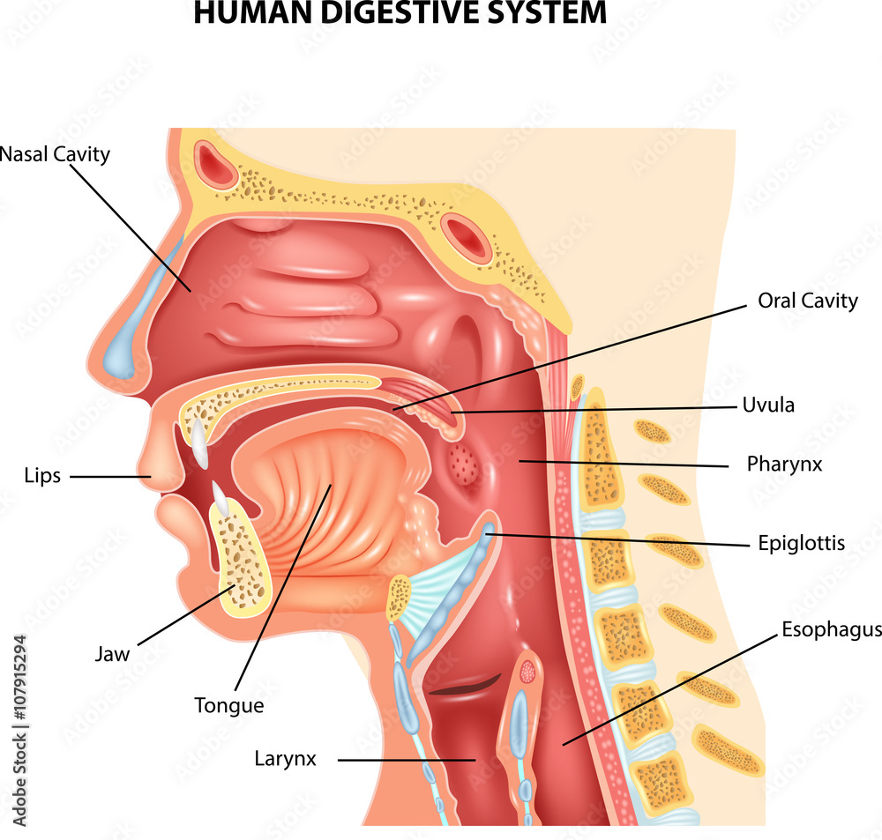
Dysphagia

Slide 23
What causes Dysphagia
Most of the neurological diagnosis mentioned earlier can cause some element of dysphagia along with gross deconditioning and respiratory distress.
Muscles can be directly impacted such as with a stroke, TBI or ALS impacting oral phase, pharyngeal phase or both.
Cognitive deficits such as from stroke, TBI and dementia can impact the voluntary/oral phases of swallowing with bolus awareness, bolus control and pharyngeal phase with swallow trigger timeliness.
Patients can have muscle weakness and cognitive deficits impacting swallow simultaneously.
Dysphagia is not static it can change morning to night (e.g. a patient that sundown's), with medication, with alertness, with breathing ability etc.

Slide 24
Consequences of Dysphagia
Physical consequences:
Aspiration pneumonia/pneumonitis
Lung scarring
Dehydration/Malnutrition
Choking/asphyxiation
Respiratory distress
Weight loss
Psychosocial consequences:
Reduced quality of life
Social Isolation
Emotional Distress
Depression
Anxiety

Slide 25
Consequences of Dysphagia
What is Aspiration?
What is Penetration?

Slide 26
Consequences of Dysphagia
What is Aspiration?
Aspiration is when foreign substance falls below the vocal folds and into the trachea and/or lungs
This can be prandial aspiration of food, liquid or secretions
This can be reflux aspiration of gastric/food coming back up from esophagus
What is Penetration?
Penetration is when foreign substance enters the laryngeal vestibule but remains on the vocal folds or above the vocal folds and does not enter the trachea.
This can also be prandial with food, liquid and secretions or reflux

Slide 27
Evaluation and Treatment
Who evaluates dysphagia and the types of evaluations:
Bedside; informal assessment done by Speech Pathologist usually giving patient a variety of food and liquid consistencies.
Instrumental Assessments:
Modified Barium Swallow Study/Video Fluoroscopic Swallow Study (MBSS/VFSS)
Flexible Endoscopic Evaluation of Swallowing (FEES)
Esophageal Dysphagia is not assessed by SLP but by Radiology/GI depending on the tests ordered
Nursing swallow screening is just a screening not a formal evaluation; it’s an indicator of whether a formal swallowing evaluation should be ordered.
Diet is often recommended based on the bedside evaluation with possible compensatory strategies recommended. The speech therapist will then monitor for tolerance to diet and need for an instrumental evaluation.
Swallowing is the best therapy for swallowing! We want patients swallowing something if it is safe enough, to help them improve.

Slide 28
Evaluation and Treatment
SLP makes Diet and liquid consistency recommendations along with safest/best way to administer medications.
Meds whole with liquid, whole with puree, crushed
We know that feeing a patient liquids tsp by tsp is very time consuming and difficult especially when you have multiple patients and you might want to give them a cup or a straw to help speed up. However, if we recommend by tsp only we strongly feel that the patient is a high risk to take those liquids any other way. Same goes for not recommending straws. (Tsp/5cc’s around the same volume of vallecula)
New liquid consistency is slightly thick (half-nectar); not very utilized yet at most hospitals
Best thickening agent is Gel thickener (Simply Thick) powder cannot go into carbonation and does not hold the correct thickness.
Don’t put ice in thickened water/liquids to make it cold as this will thin the liquid.
Better to place the cup into a pitcher of ice to cool it or use juice from the refrigerator that is already cold.
Confusing consistencies:
Ice chips, ice cream, Jello
Mixed consistencies (e.g. cereal and milk, juicy fruits, soups with solids)

Slide 29
Nursing role in Dysphagia
Nurses and CNA’s are our eyes and ears for how a patient is tolerating their diet. We rely on you to let us know if we should be concerned about something or if a patient might be ready for advancement.
What is the number one cause of aspiration pneumonia and consequently what is the top thing you can do to help prevent aspiration pneumonia?

Slide 30
Nursing role in Dysphagia
Nurses and CNA’s are our eyes and ears for how a patient is tolerating their diet. We rely on you to let us know if we should be concerned about something or if a patient might be ready for advancement.
What is the number one cause of aspiration pneumonia and consequently what is the top thing you can do to help prevent aspiration pneumonia?
Oral bacteria is the number one cause of aspiration pneumonia and oral care is the single most important thing you can do to prevent aspiration pneumonia in our patients
Look for secretion casting in back of throat, especially for mouth breathers and those on O2 masks that are NPO.

Slide 31
Nursing role in Dysphagia
Overall concerns for feeding a patient
Excessive saliva/drooling
Severe fatigue while eating
Difficulty alerting or maintaining alertness
Tachypnea and/or SOB
True or False: There is a moment of Apnea when you swallow?
Concerns during feeding:
Typical s/s of penetration/aspiration would be coughing or throat clearing immediately after eating/drinking.
A gurgle or wet-sounding voice while eating/drinking or right after
Difficulty breathing or complaints of shortness of breath during or after eating/drinking
Silent aspiration; reduced pharyngeal sensation may have no signs or may have wet voice.

Slide 32
Nursing role in Dysphagia
Some difficulties with feeding patients:
Pts can hold bolus in their mouth and sometimes need liquid to help trigger the swallow.
Some patients can trick you that they have swallowed, look at their throat around the Adams apple area and when you see that go up and forward they have swallowed.
Sometimes they open their mouth for more but haven’t swallowed the first bite yet.
Also stroke patients can have food pocketed on impacted side of their mouth. Always good to check for food during and especially at end of meals.
Lots of nurses have been trained in the past about the “chin tuck”. Chin tuck can make swallows worse therefore please don’t tell your patients to do this unless instructed by the SLP. It can only be identified as helpful with a Video Swallow Study after which we will write that on the yellow sheet.

Slide 33
Nursing role in Dysphagia
Aspiration Precautions:
Need for Supervision or 1:1 assistance with PO’s
Sitting upright at 90 degrees or out of bed for meals
Reverse Trendelenburg is great way to help get them upright
Small Bites Sips
Check for pocketing of food
Alternate solids/liquids
Swallow 2-3 times per bite/sip
Remain sitting upright for 20-30 minutes after meal
Avoid Straws
Avoid Serial Swallowing (Gulping liquids and shoveling food)
Avoid talking with food in mouth
Avoid taking more food or liquid when coughing

Slide 34
Picture is worth a thousand words
What is a Video Swallow Study/Modified Barium Swallow Study?
This is a moving xray of the patients swallowing. We watch them chew and swallow multiple consistencies under radiation.
The MBS/VFSE shows us:
How muscles are working, timing of swallow, presence of pharyngeal residue and aspiration or penetration.
Additionally we can attempt swallowing strategies to accurately assess their effectiveness.
https://youtu.be/fqG0QmlaFMs
Normal Swallow versus Abnormal Swallow with aspiration

Slide 35
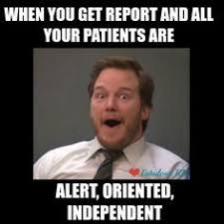
Questions?

Slide 36
References
https://rarediseases.org/rare-diseases/apraxia/
https://www.aphasia.org/wp-content/themes/directorys-child/includes/images/types_of_aphasia.png
https://www.asha.org/Practice-Portal/Clinical-Topics/Dysarthria-in-Adults/
https://www.aphasia.org/aphasia-resources/communication-tips/
https://www.strokeassociation.org/en/about-stroke/effects-of-stroke/cognitive-and-communication-effects-of-stroke/aphasia-vs-apraxia
https://tactustherapy.com/whatiscogcomm/

