Slide 1
Advancements in Stroke Rehabilitation Care
Melissa Kelly, DO, FABPMR

Slide 2
Disclosures
I do not have any disclosures

Slide 3
Learning Objectives
New updated data regarding stroke within the US and the world and the cost of disability
Review of most common stroke rehab treatments and modalities
Updated stroke treatments with dysphagia with regards to new technology interface
Updated FDA approved medical devices to assist with motor recovery after stroke

Slide 4
Stroke Facts
Stroke is a sudden interruption of blood flow to the brain
Outside of non-communicable disorders, stroke remains the second leading cause of death and disability and the third leading cause of death and disability combined
From 1990 to 2021, there was a substantial increase in global stroke burden with 70.0% increase in the incident of strokes, 44.0% deaths from stroke, 86.0% prevalent strokes, and 32% disability-adjusted life-years lost with the bulk of the global stroke burden.
Globally 87.0% of deaths and 89.0% of disability-adjusted life-years resided in lower-income and lower-middle-income countries.

Slide 5
69.0% of all strokes were contributed to metabolic risk factors, environmental risks constituted 37.0%, and behavioral risks constituted 35.0%.
Stroke is highly preventable with 84% of strokes attributed to 23 modifiable risk factors including HTN, air pollution, excess body weight, smoking, physical inactivity
Just in 2021, high outdoor temperature, globally, was responsible for almost 2 million disability-adjusted life-years from stroke, particularly in North and Central Africa, Middle East, and South Asia.
Global Burden of Disease 2021 study revealed the high contribution of particulate matter air pollution to SAH

Slide 6
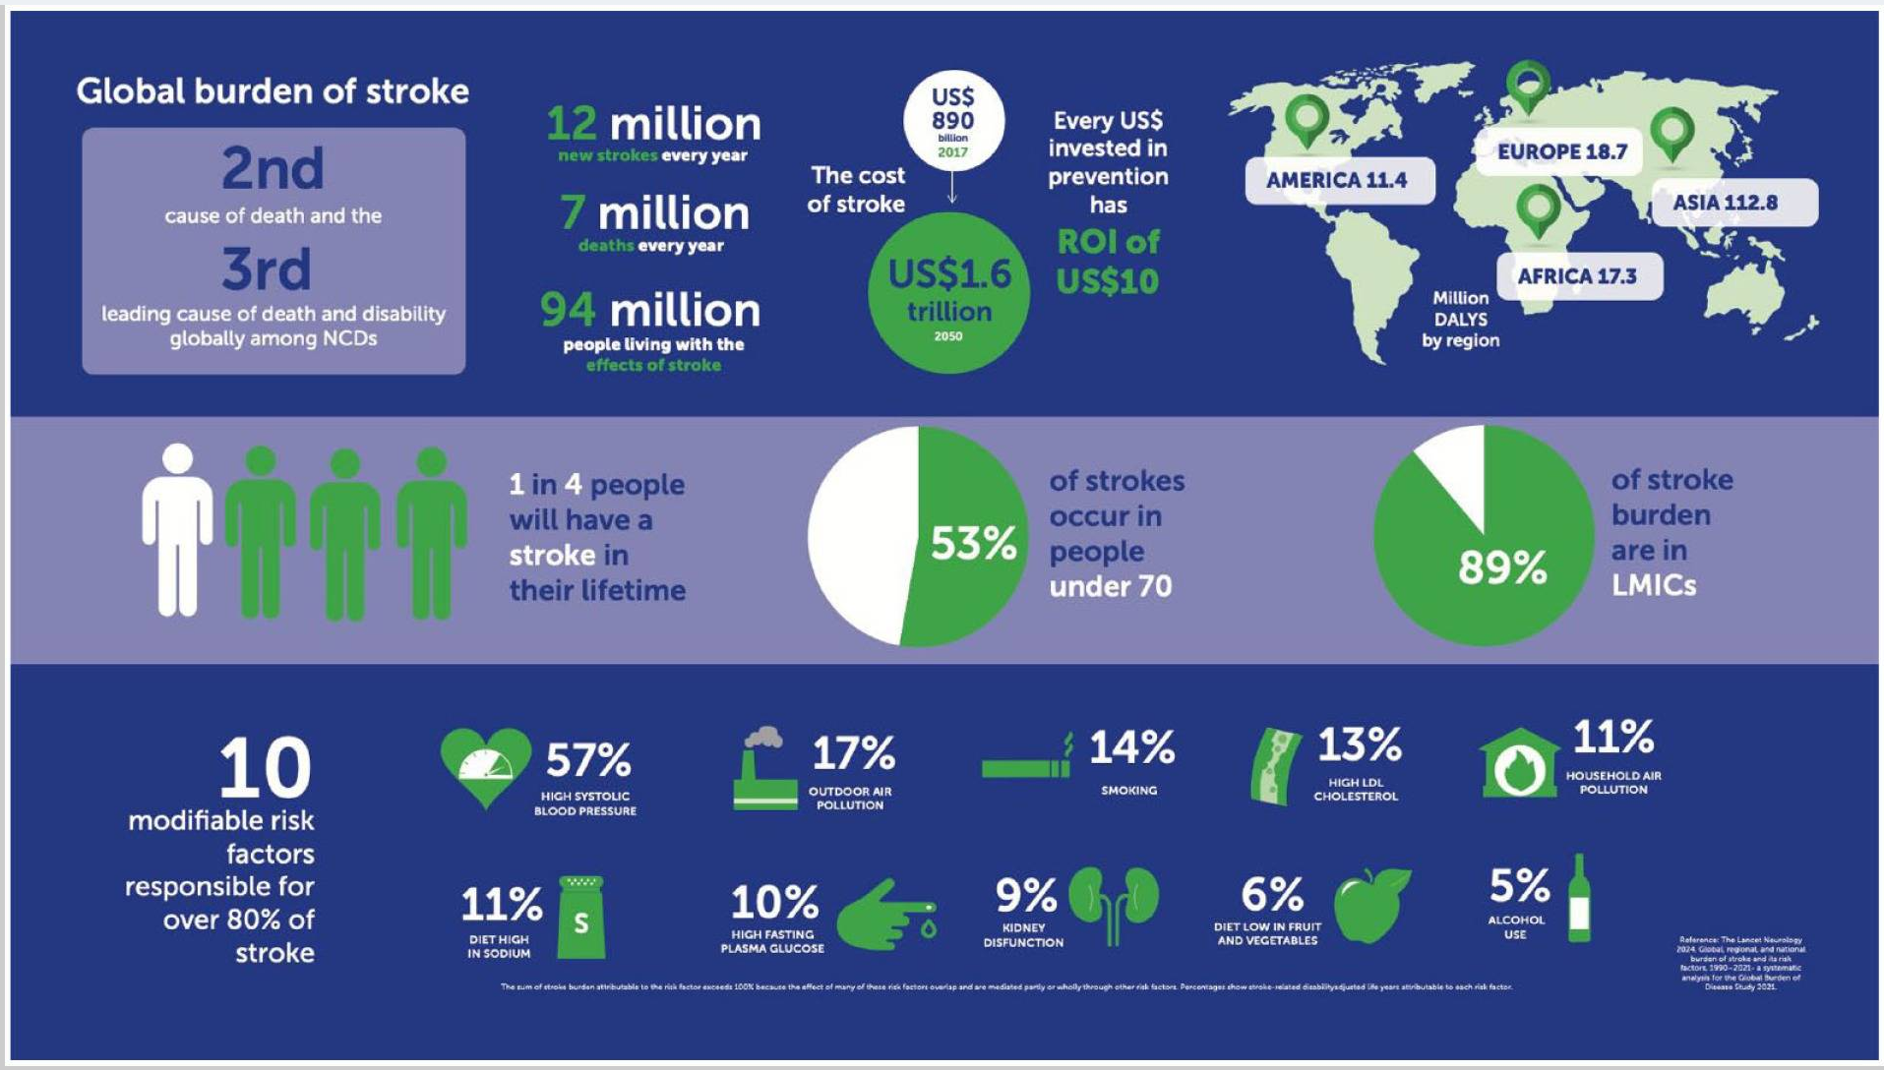

Slide 7
American Stroke Association
More than 795,000 strokes a year in the United States with 610,000 being first time strokes
Study published in Journal of the American Heart Association 2024 observational study of 435,000 American adults found daily use of cannabis ( predominately through smoking) was associated with an increase of 25% risk of heart attack and 42% increased risk of stroke when compared to non-drug use.

Slide 8
Functional Stroke Deficits
Common impairments with stroke include weakness, sensory changes, decreased endurance, aphasia, cognitive linguistic deficits, visuospatial deficits, dysphagia, apraxia, fine motor impairments, visual impairments
20% of stroke patients present with dysphagia and of those patients 50% of them have unimproved dysphagia at discharge home. Given that post stroke dysphagia has serious complications such as aspiration pneumonia, malnutrition and asphyxia, it is known to increase hospital lengths of stay and increase in 34% health care costs and more than doubles in hospital mortality rates.

Slide 9
Traditional Stroke Rehab Treatments
Physical Therapy, Occupational Therapy and Speech Therapy
Electrical stimulation to help muscles and nerves
Constraint –Induced Movement Therapy (CIMT)
Proprioceptive Neuromuscular Facilitation (PNF)
Music Therapy Recreational Therapy
Mirror Therapy
Repetitive Transcranial Magnetic Stimulation

Slide 10
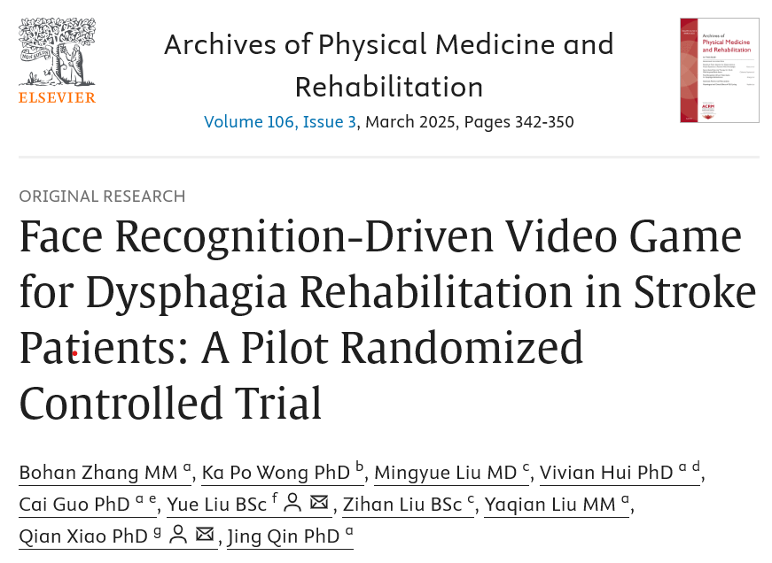
What is new with stroke rehabilitation?

Slide 11
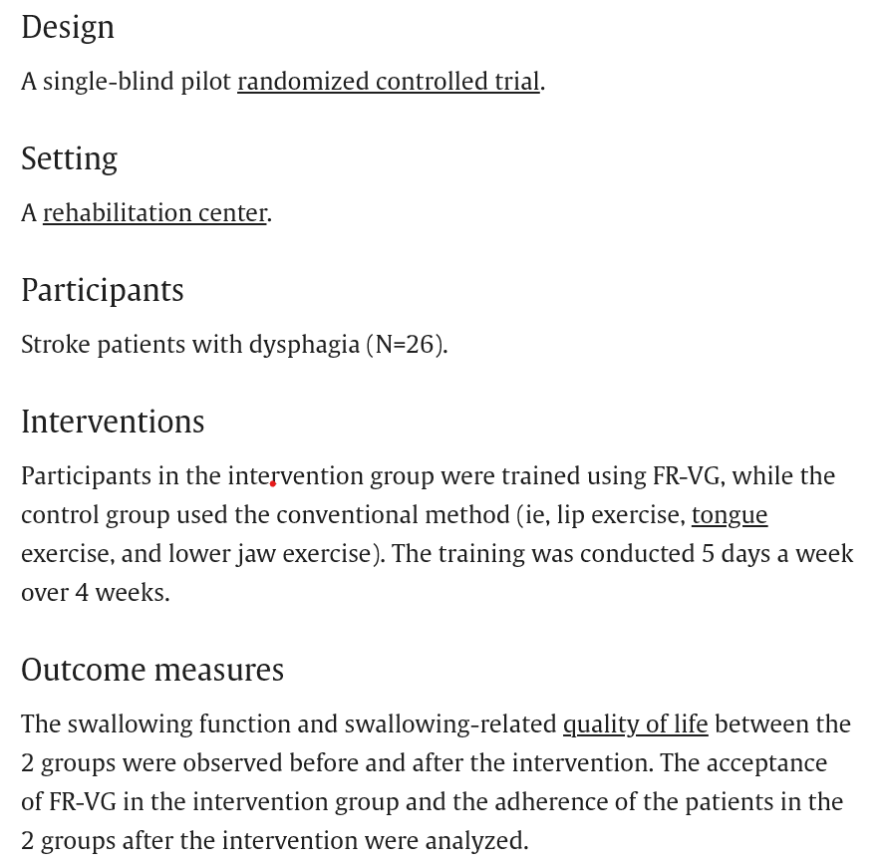

Slide 12
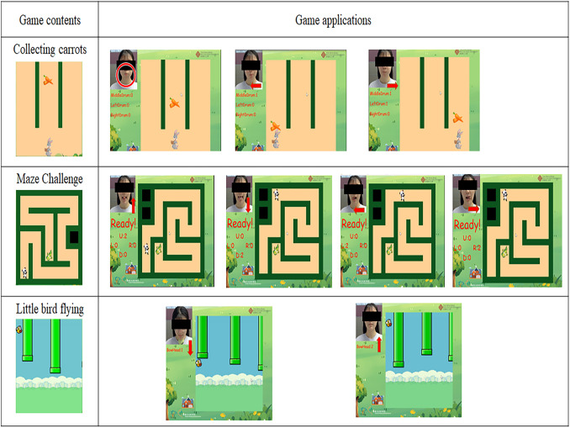

Slide 13
Results demonstrated the FR-VG group had better swallowing function than the control group on the Gugging Swallowing Screen and Functional Oral Intake Scale.
The FR-VG group had a high acceptance of the training and significantly better adherence to following through with the exercises than the control group
This pilot study demonstrates Face Recognition-Driven Video Game training can help improve swallowing function, swallowing related quality of life and exercise adherence with dysphagia.
This new training can be used as adjunctive method to conventional rehabilitation.

Slide 14
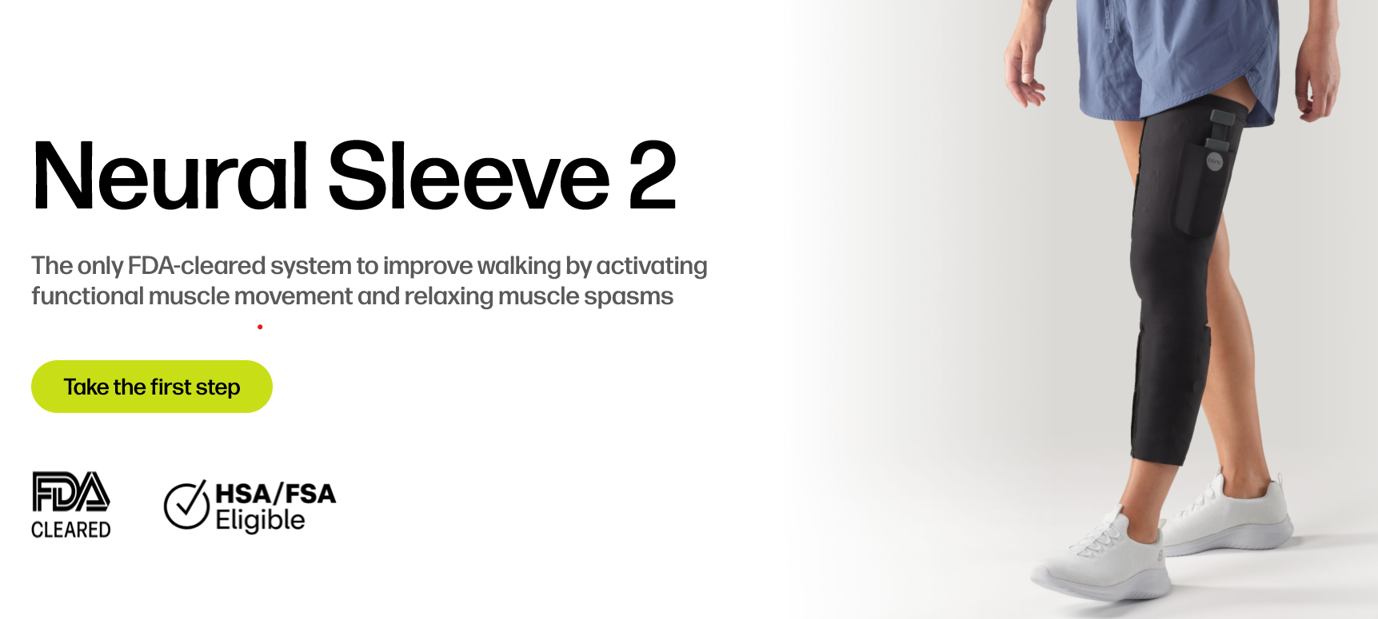
New FDA Approved Medical Devices

Slide 15
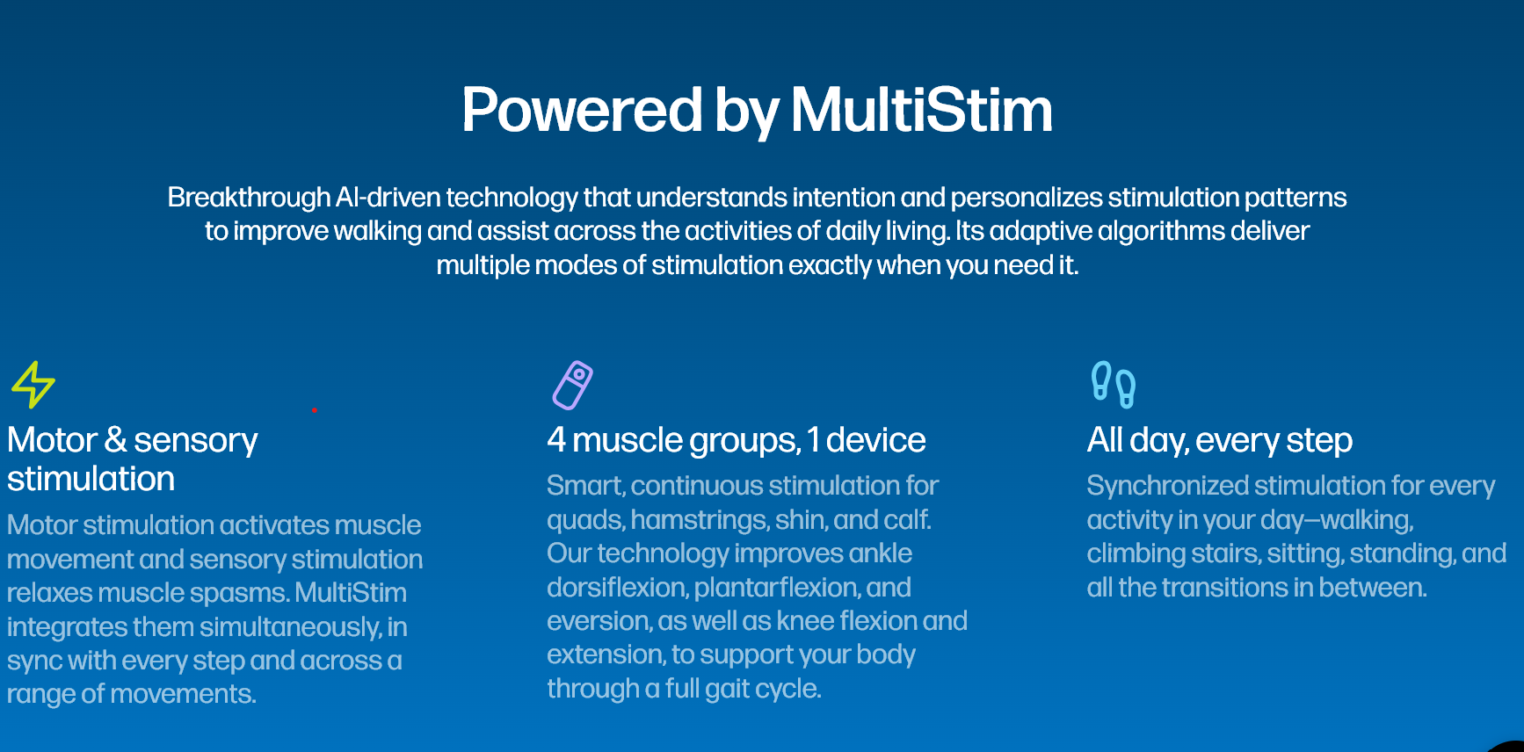

Slide 16
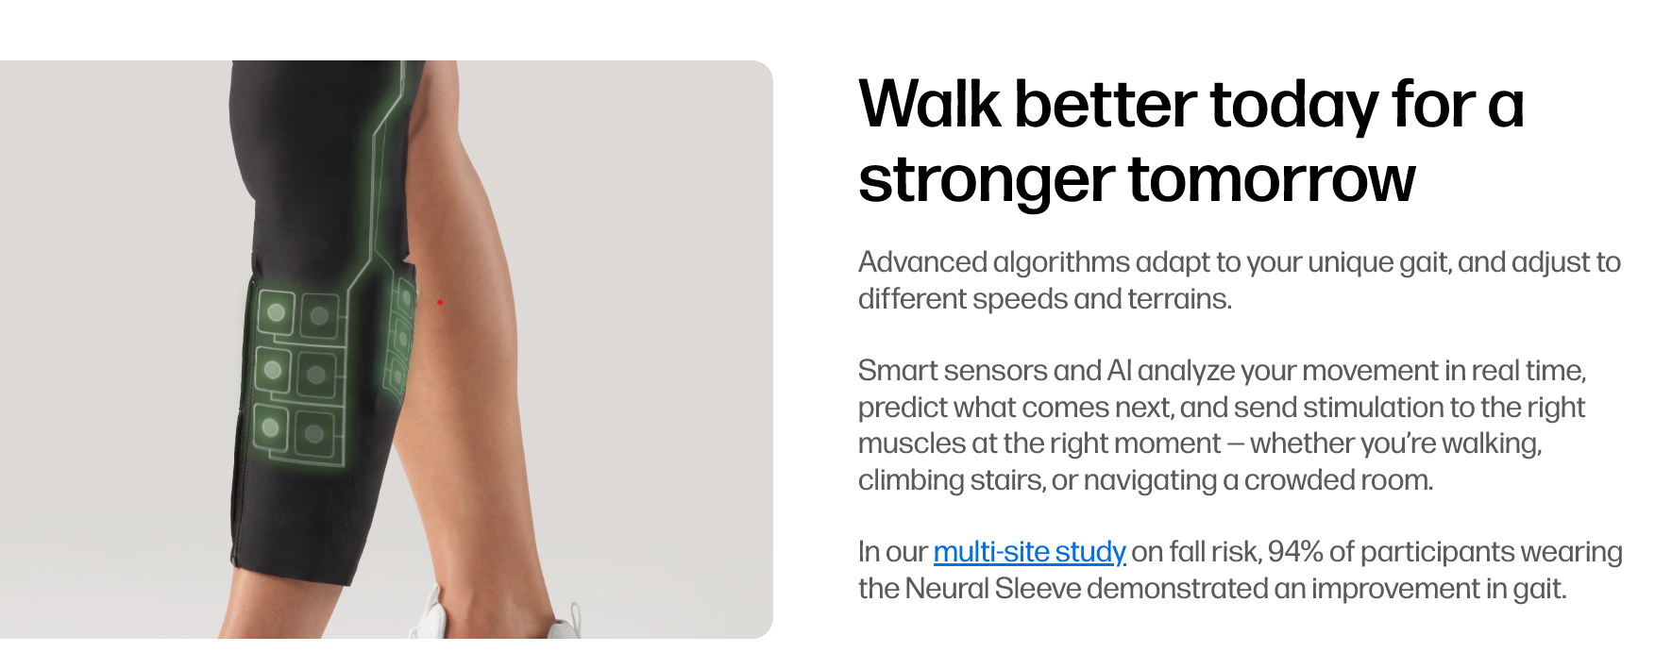

Slide 17
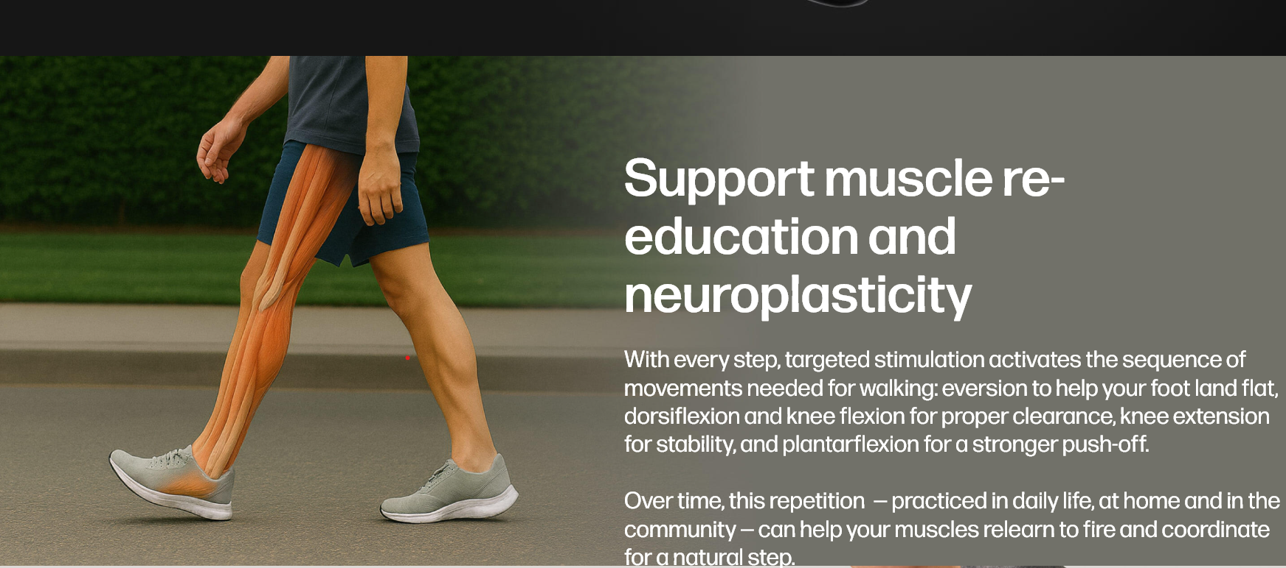

Slide 18
Cionic Sleeve and Spasticity
Relax muscle spasms for greater freedom of movement Spasticity affects 97% of stroke survivors with motor deficits limiting movement and causing pain. Cionic combines continuous sensory stimulation with triggered motor stimulation to simultaneously relax spasms while improving walking. Home trial participants using the Neural Sleeve 2 reported a 30% improvement to spasticity over motor stimulation alone.

Slide 19
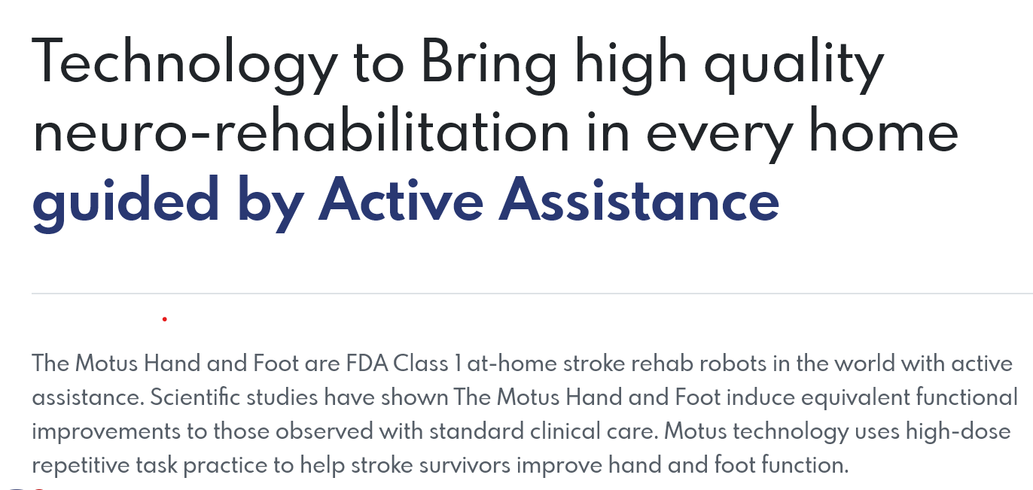
Motus Nova

Slide 20
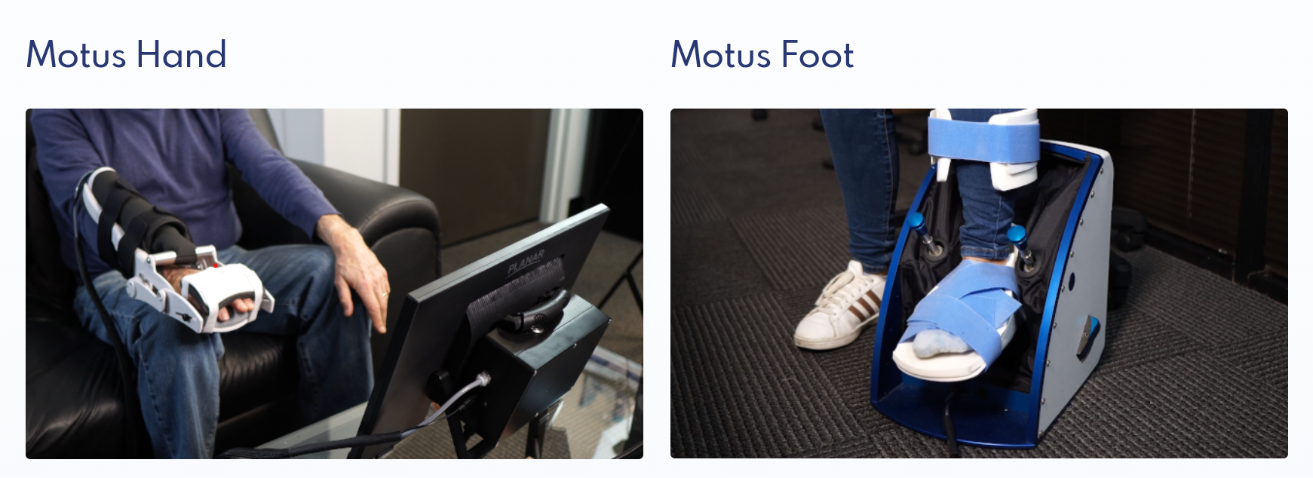

Slide 21
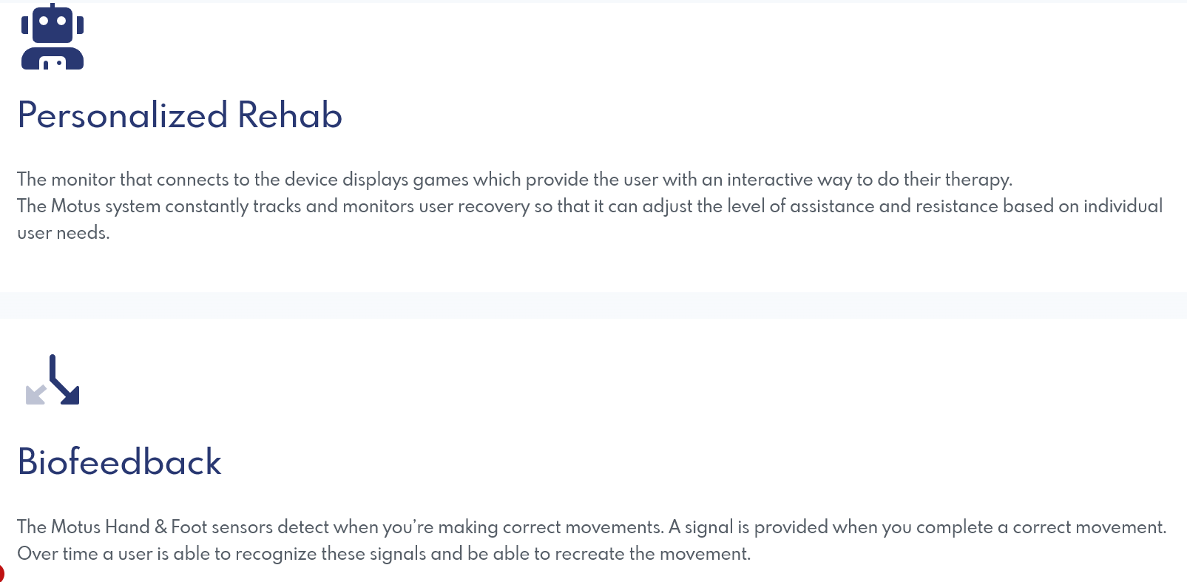

Slide 22
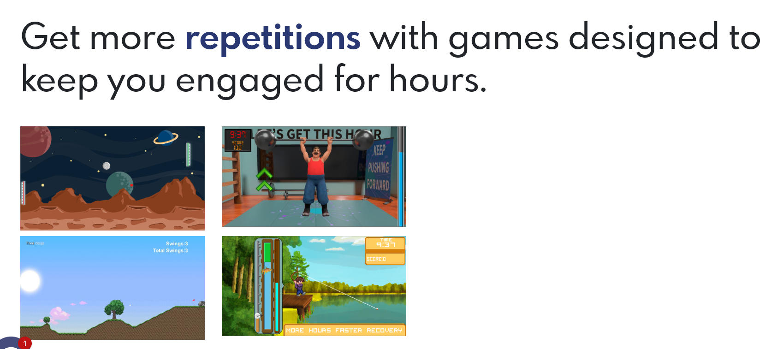

Slide 23
IpsiHand Rehab System
The IpsiHand Rehab System, a stroke rehabilitation device that uses a brain-computer interface (BCI), received FDA market authorization in April 2021. The system uses a headset to read brain signals, which then control a robotic exoskeleton that helps a patient's impaired hand open and close, assisting in the retraining of motor function through a process called Hebbian learning.
How it works: An EEG headset detects brain signals from the uninjured side of the brain. These signals are translated by a tablet computer into movement commands for a robotic exoskeleton worn on the patient's hand and wrist. When the patient thinks about moving their hand, the device physically moves it for them.

Slide 24
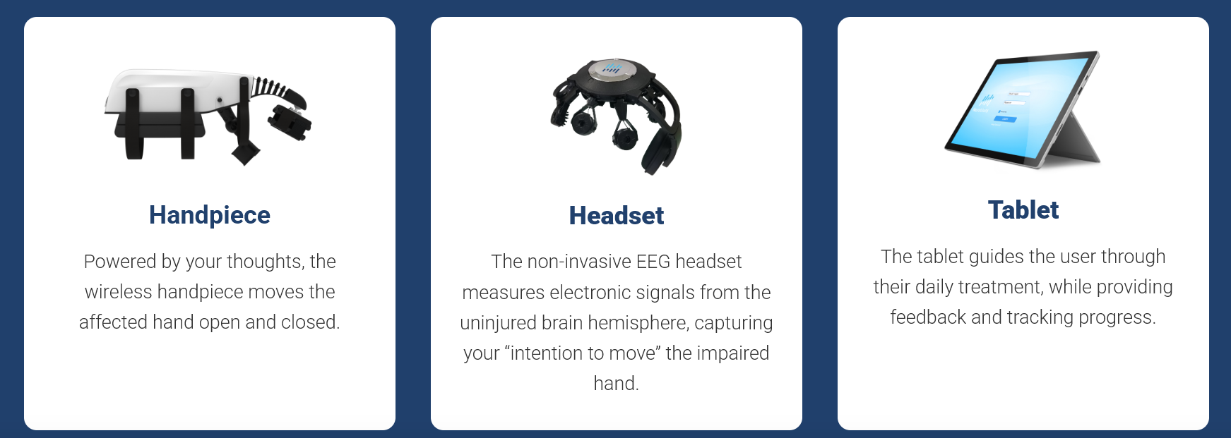

Slide 25
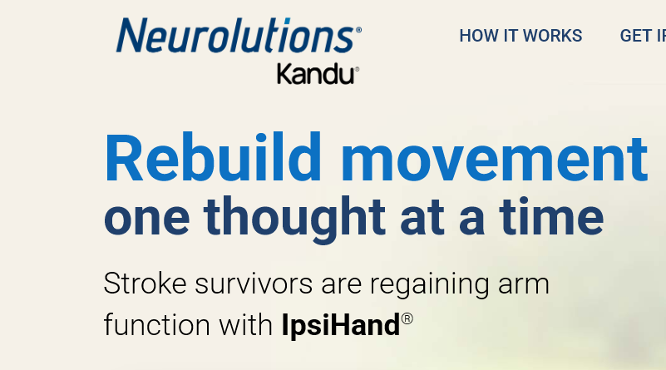
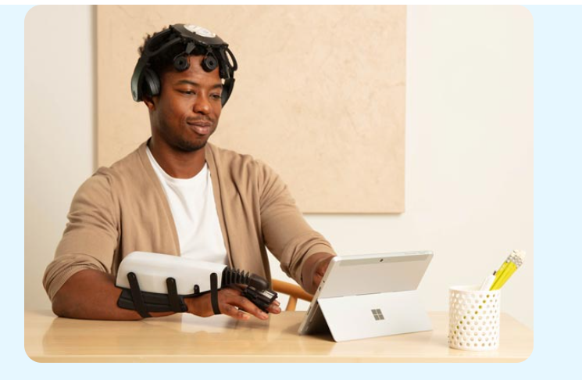

Slide 26
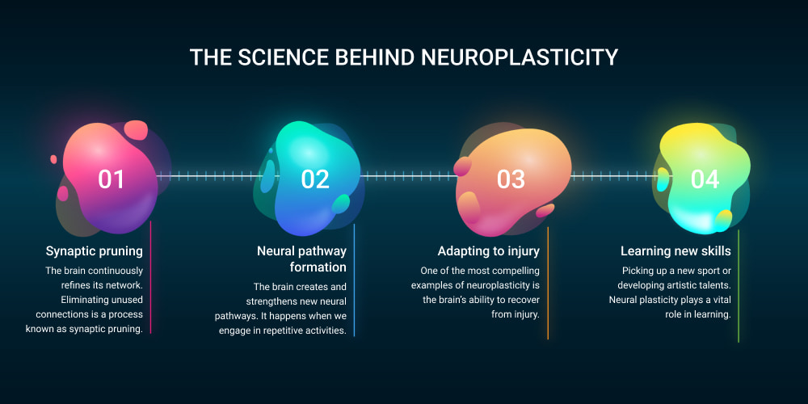
In summary, stroke rehabilitation continues to evolve with therapy modalities which include technology such as AI, robotics and gaming interfaces. All these therapies have the same goal of taking advantage of neuroplasticity, repetition and hoping to increase the daily compliance of these therapies to lead to functional improvements and results in stroke patients.

Slide 27
Thank you!
Questions?
Email: Melissa.c1.Kelly@kp.org

