Slide 1

2025 Board Update
November 2025 Edition

Slide 2
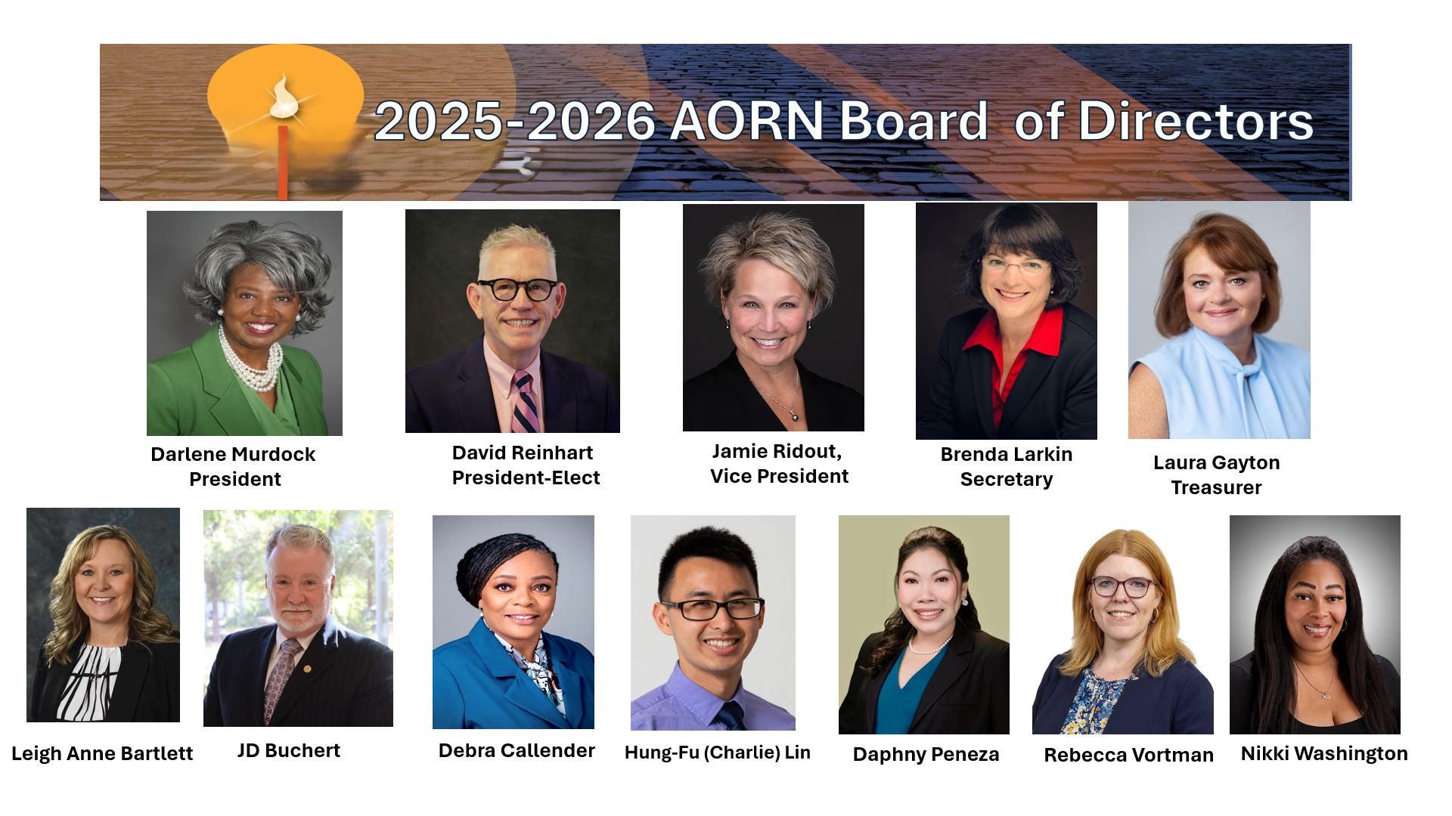

2025-2026 AORN Board of Directors
The 2025-2026 AORN Board of Directors

Slide 3
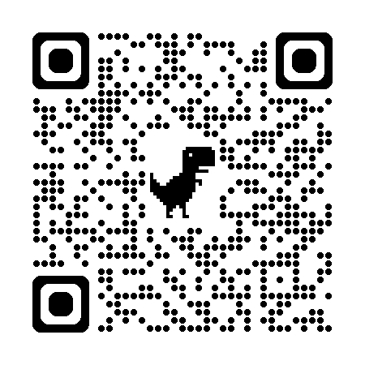

Ju
Registration Now Open!
Attendance Justification Tools
Notes:
Plan on attending our conference. Go to AORN.org/Events for more information.

Slide 4

HAPPY PERIOPERATIVE NURSES WEEK!

Slide 5

CCI Grants are Coming Soon!
AORN Foundation will be partnering with the Competency & Credentialing Institute (CCI) to provide CNOR, CSSM and CNAMB certification grants, and the application will be available on Nov. 1.
These grants can be used for assistance in CNOR, CSSM and CNAMB certification testing. New certification only please.
Visit our website to apply.

Slide 6

Upcoming Dates & Deadlines

Slide 7

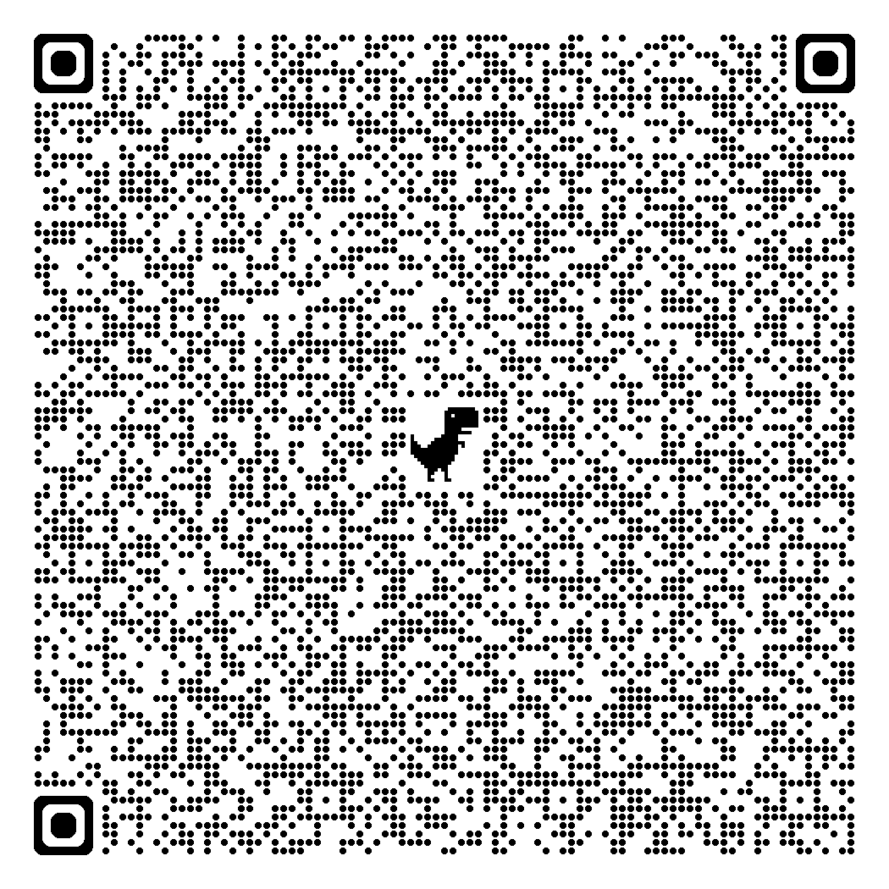
National Legislative Call
The next National Legislative Forum is scheduled on Monday, November 16th at 6:30pm MT.
Missed the October Call: Scan the QR Code:
(You may need to download the file)
The National Legislative Forum (NLF) calls take place on the 3rd Monday of each month at 5:30pm PT, 6:30pm MT, 7:30pm CT, and 8:30pm ET.
If you are interested in joining the calls, click QR Code.

Slide 8
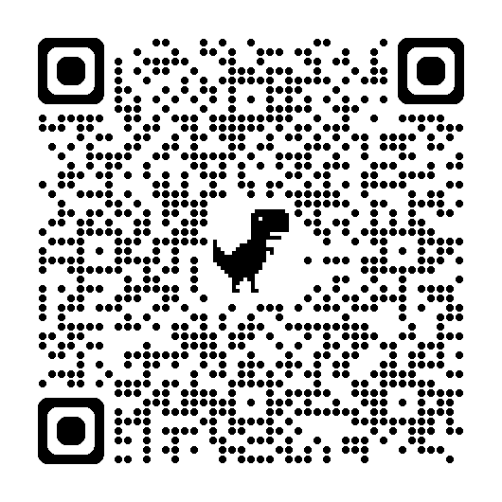
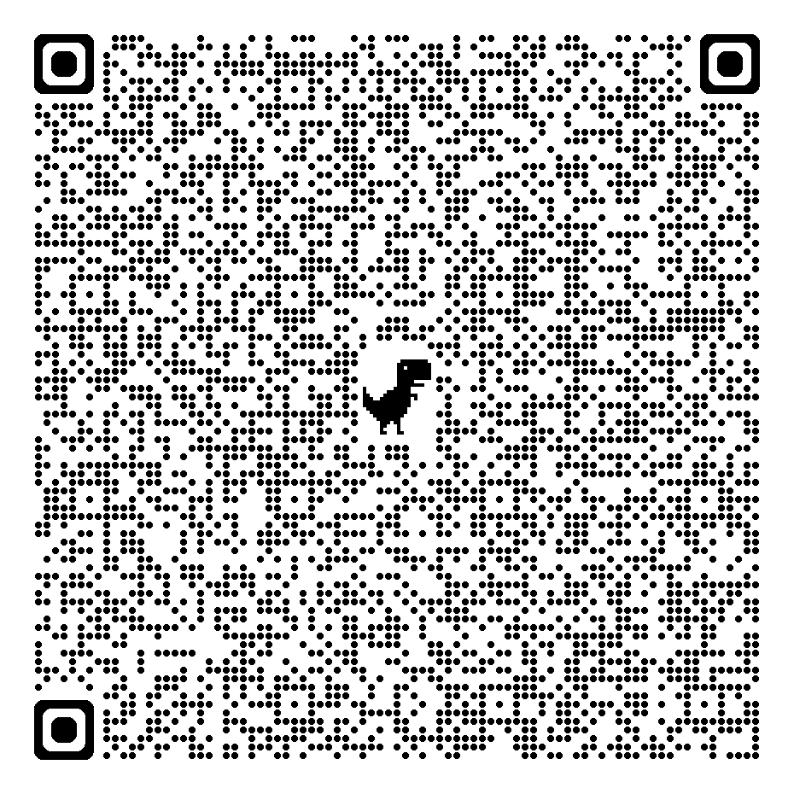
Chapter Leader Townhall 6pm MT, Oct 16th
This is an opportunity for officers to ask questions and find out what other officers are doing successfully.
Open to Chapter Leaders Only
If you missed the October call, scan this QR Code:
To Register for the November call, scan QR Code:

Slide 9
AORN Upcoming Events

Slide 10
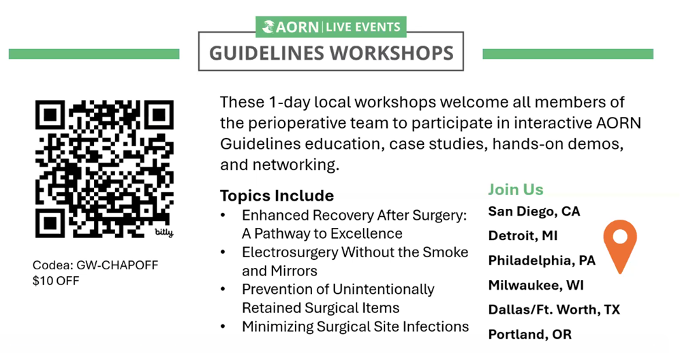

Slide 11
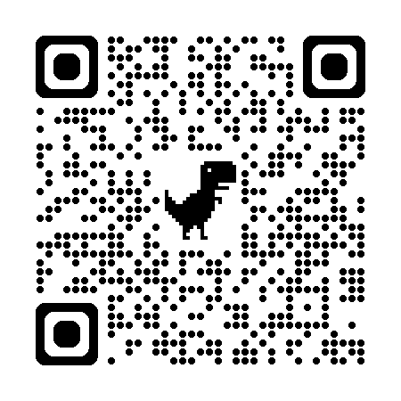

Where Innovation Meets Precision in Total Joint Arthroplasty
Join top orthopedic surgeons and allied health professionals from across the Southeast and beyond at
This one-day intensive orthopedic conference dives into the realities of modern total joint reconstruction — from patient selection and ASC workflows to enabling technologies and complex revision cases.
About the Event
Learn from nationally recognized orthopedic surgeons presenting the latest techniques and best practices in TKA, THA, and revision surgery.
See two live surgeries – primary total knee and anterior total hip – with real-time commentary.
Join interactive panel discussions where leading surgeons walk through complex cases, evidence-based insights and challenges from real world scenarios.
Gain hands-on access to orthopedic surgical innovation in our vendor showcase.
Earn continuing medical education - CME, CBRN, and NCCT accredited

Slide 12
Professional Development

Slide 13
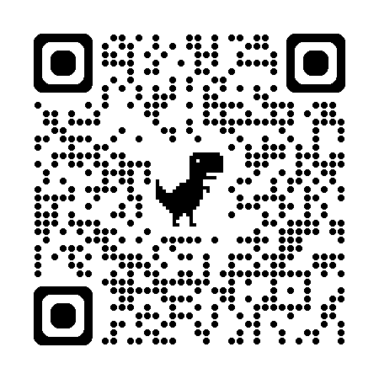
Membership Update
AORN Memberships are tailored to meet the needs of all perioperative nurses. Different memberships include:
New to Profession | Standard Membership
Leader Membership | Organizational Membership (RN and Non-RN)
AORN/APSNA (American Pediatric Surgical Nurses Association) Membership | Retired Membership
Non-RN Memberships
Associate Membership | Student Membership
To discover more details, scan the QR Code. Be sure to invite other perioperative nurses you know to be involved in the only nursing association focused entirely on perioperative nursing in all areas of practice. It’s never to late to join our association and receive the benefits of membership!

Slide 14
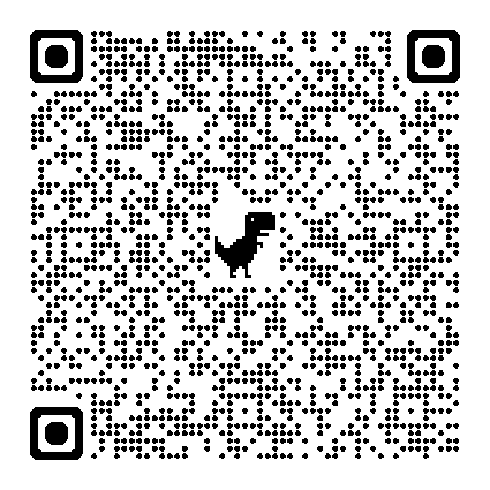
Limited Time Offer: Register by November 15 to Claim
When you register for one of AORN’s ASC infection prevention courses by November 15, 2025, you’ll receive the Infection Preventionist Competency Verification Tool: Fast to download, simple to use, and designed to support safe practice. Get offer details:
Find Ambulatory Surgery Training and Evidence-Based Resources
As ambulatory surgery volumes expand, perioperative teams report challenges with hiring, onboarding, training, and finding networking opportunities to share best practices. AORN has a wide range of resources that support ASC teams in providing safe surgical care and addressing education needs and challenges.

Slide 15
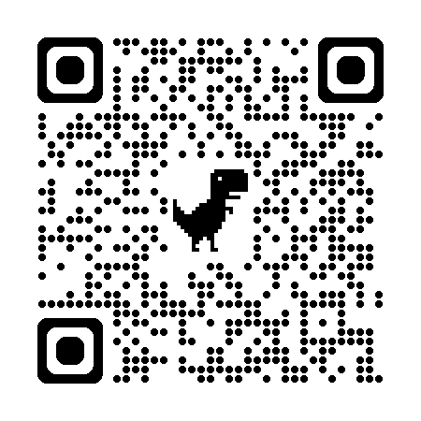

Did you know that Pfiedler, a division of AORN has many online contact hour educational resources available?
There are courses available in several formats including eBooks, eLearning, Live Events and Live Webinars. Many are sponsored by our medical device companies and are therefore free for our members.
Check out their catalog to get the contact hours, education and training you want.
Scan the QR Code above form more information.

Slide 16
Board Representation Activities
President Murdock:
November 6: National Student Nursing Association, Columbus, OH
November 8: Guidelines Implementation Workshop, Dallas, TX
November 14: Chapter Leader Townhall
November 15: AORN West Houston Perioperative Symposium & Vendor Fair
November 16: United Ara Emirates AORN Chapter Symposium, Dubai – Video Welcome
November 20-22: Nursing Organizational Alliance (NOA), Kansas City, MO
David Reinhart:
November 1-2: AORN Southeastern Conference, St. Augustine, Florida
November 8: AORN Chapter 1411 Vendor Fair and ICORN Meeting, Elk Grove Village, IL

Slide 17
Board Representation Activities
Jamie Ridout:
November 1-2: AORN Southeastern Conference, St. Augustine, Florida
November 3-4: Cardinal Surgical Summit
November 5: Rockford Chapter 1403
November 8: Illinois Council of Perioperative Nurses (ICORN)
November 8: Virtual Bingo
November 11: Houston Chapter 4407
November 13: CNESA
November 14: NSSA Journal Club
November 18: Inf. Control SA
November 19: ASCSA Speakers Series
November 20: S. Illinois Chapter 1402

Slide 18

Board Representation Activities
Brenda Larkin:
November 1: AORN Southeastern Conference, St. Augustine, Florida
November 8: Virtual Bingo
November 15: Guidelines Implementation Workshop, Portland, OR
November 18-20: J&J’s Surgical Outcomes Symposium, Raritan, NJ
Leigh Anne Bartlett:
November 1-2: AORN Southeastern Conference, St. Augustine, Florida

Slide 19
Board Representation Activities
JD Buchert:
November 1-2: AORN SE Regional Conference, St. Augustine, FL
November 4: TCORN Leadership Committee
November 6: South Central Society for Healthcare Risk Management & Patient Safety Gathering
November 8 eChapter Winter Symposium-Perioperative Patient Safety & Risk Reduction
November 8: Virtual Bingo
November 17: National Legislative Forum
November 18: AORN of Dallas
November 19: eChapter Education Committee
Debra Callendar:
Nov 1-2: AORN SE Regional Conference, St. Augustine, FL
Nov 15: Guidelines Implementation Workshop, Portland, OR
Charlie Lin:
November 8: Virtual Bingo
Daphny Peneza:
Nov 8: Virtual Bingo
Nov 11: AORN Middle Tennessee
Nov 13: AORN Clinical Nurses Educator Specialty Assembly Fall Education

Slide 20

Board Representation Activities
Rebecca Vortman:
November 7: University of Illinois Chicago, College of Nursing – Power of Nursing Leadership, Chicago, IL
November 8: AORN Chapter 1411 Vendor Fair and ICORN Meeting, Elk Grove Village, IL
November 8: AORN Virtual Bingo with Chapters
November 15: AORN Guidelines Workshop, Portland, OR
November 22: AORN CNOR Virtual Live Review Course, Instructor
NaKeisha Washington:
November 8: Virtual Bingo
November 12: Delta Community College of Nursing
November 15: Guidelines Implementation Workshop, Portland, OR
November 18: Stockton City Hall Meeting – receiving, Perioperative Nurses Week Proclamation

Slide 21

Quote for the Month:

Slide 22

