Slide 1

Memphis AORN 4303
Memphis AORN 4303

Slide 2
September 22, 2025 4303 Memphis AORN Chapter Meeting
Dinner Presentation sponsored by Solventum
Protecting with Prevena presented by Michelle Driskill CWON, APRN
5:30PM-6PM Meet and Greet
6PM-7PM Dinner and Presentation
7PM- Announcements, Survey, and Closing

Slide 3
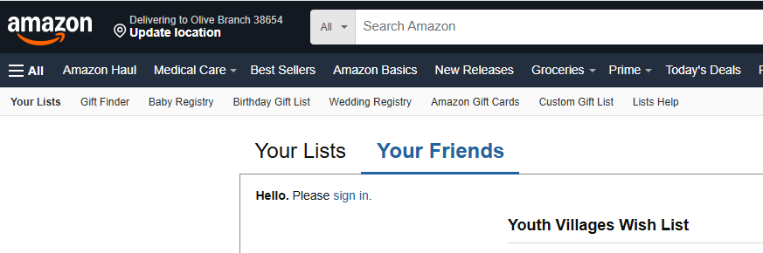
Community Project: Youth Villages Foster Children
https://urldefense.com/v3/__https://www.amazon.com/hz/wishlist/ls/3MPXH2D62RYF8?ref_wl_share.*5Bamazon.com*5D__;JSU!!Oqpa6oA1m1U!jS5smZgWvU-OlnGRm8GtBfLxOB4v6faUIyxFXGttkKWSwehXJZI72vmQOhm34SD131lGIMZmF1-jAfvOpVQWIRB0PDw$
Youth Villages Wish list: Items will be shipped to Girl scouts for packaging back pack/ overnight bags

Slide 4
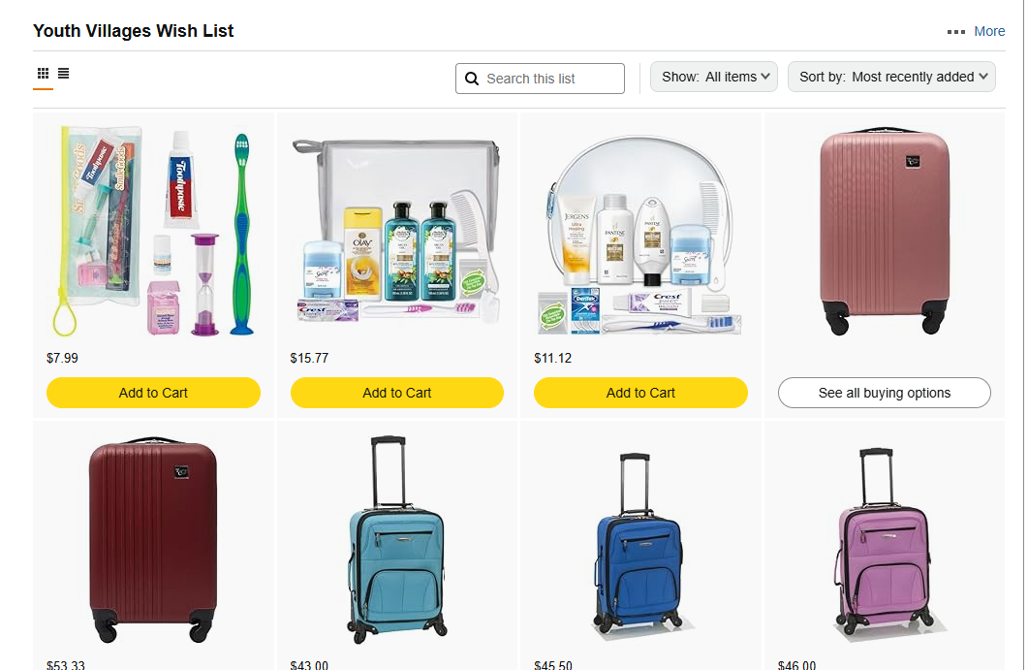
Items needed: Overnight bags, underwear, toiletries, snuggle blankets, hats, gloves, socks

Slide 5


Slide 6
Collect dates and packaging dates
Sept 22, 2025 at AORN meeting
October 20, 2025 At AORN meeting
Contact Karen Elliott for pick up of donated items from home/work
Dec 15 and/or 16, 2025 Meet with Katie and Girl scouts and put items in bags [more information to come]

Slide 7

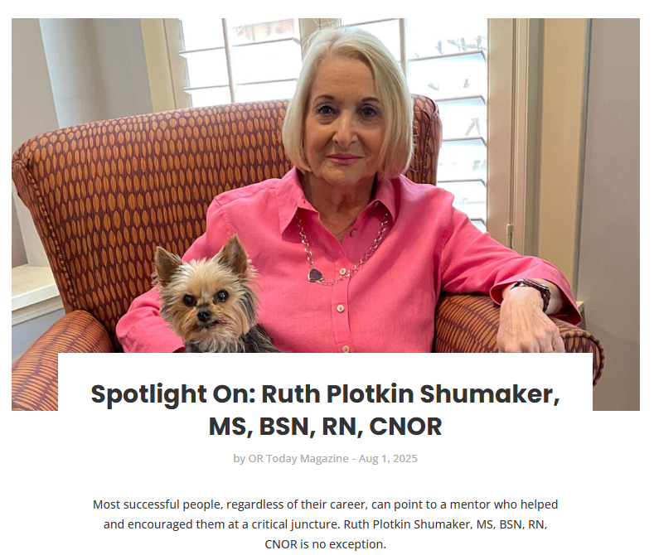
Feature article
August 2025

Slide 8

Chapter Update: Positions
President Elect 2025-2026
Fundraiser Lead (Work with Current Board members)
Membership Challenge (still in progress) 4303 is at Zero increase
TN State Council is being revived. (Members:4303 Karen, Becky, 4302 Daphny,4301 Jennifer)
TN Smoke legislation committee (Karen, Becky, Daphny, Jennifer, Jennifer Pennock [National AORN]

Slide 9
Chapter Meeting Updates and Projects
October 20, 2025
4303 Memphis Dinner meeting and Presentation Todd Dixon Cardinal Health
November 1-2 2025 Southeastern Conference St Augustine
Dec 30, 2025 Chapter Accountability Standards Due
Dec 30, 2025 Small Chapter of the Year application Due
Dec 30, 2025 End of Membership Challenge to RISE
January 26, 2026 Libby Kendrick Restrata
Feb 23, 2026: open
April 11-14, 2026 National AORN Expo
May 18 or June 2, 2025? open

Slide 10

Questions? Comments?

