Slide 1

2025 Board Update
August 2025 Edition

Slide 2
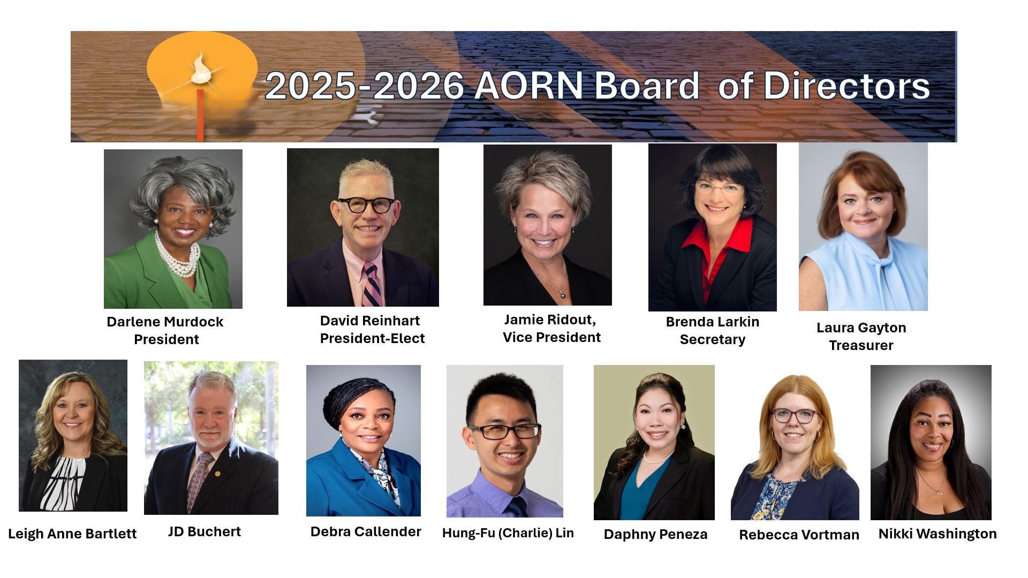

2025-2026 AORN Board of Directors
The 2025-2026 AORN Board of Directors

Slide 3

Notes:
Plan on attending our conference. Go to AORN.org/Events for more information.

Slide 4

Board Representation Activities
President Murdock:
September 5th – Memorial Hermann System Chief Nurse Executive Event
September 18th – Chapter Leader Town Hall
September 19th – Memorial Hermann/Houston Community College SPD Student Graduation
September 20th – Internation Federation of Perioperative Nursing (IFPN) Virtual Board Meeting 2025
September 20th – Federation of Houston Professional Women (FHPW): Women of Excellence celebrating Cheryl Kelley, AORN of Greater Houston Past-President
October 1-3 – Brasilian Association of Nursing in the Operating Room (SOBECC), Sao Paulo, Brasil
David Reinhart:
Oct 4-7 - American College of Surgeons, Chicago

Slide 5

Board Representation Activities
JD Buchert:
September 2nd - Texas Collaboration of Perioperative Registered Nurses- State Council Meeting
September- 12/13 - AORN South Florida Conference
September 16 – AORN of Dallas Chapter Meeting
September 17 - AORN eChapter Education Committee Meeting
September-19-21 – AORN of Los Angeles Conference
September-26/27: AORN Guidelines Workshop- Detroit MI
Brenda Larkin:
September 12/13 – AORN South Florida Conference

Slide 6

Board Representation Activities
Daphny Peneza:
September 20 – AORN of Los Angeles Conference
Rebecca Vortman:
September 12/13 – AORN South Florida Conference
September 20 – AORN Los Angeles Conference
NaKeisha Washington:
October 1 – Becker’s Perioperative Summit

Slide 7

Upcoming Dates & Deadlines

Slide 8

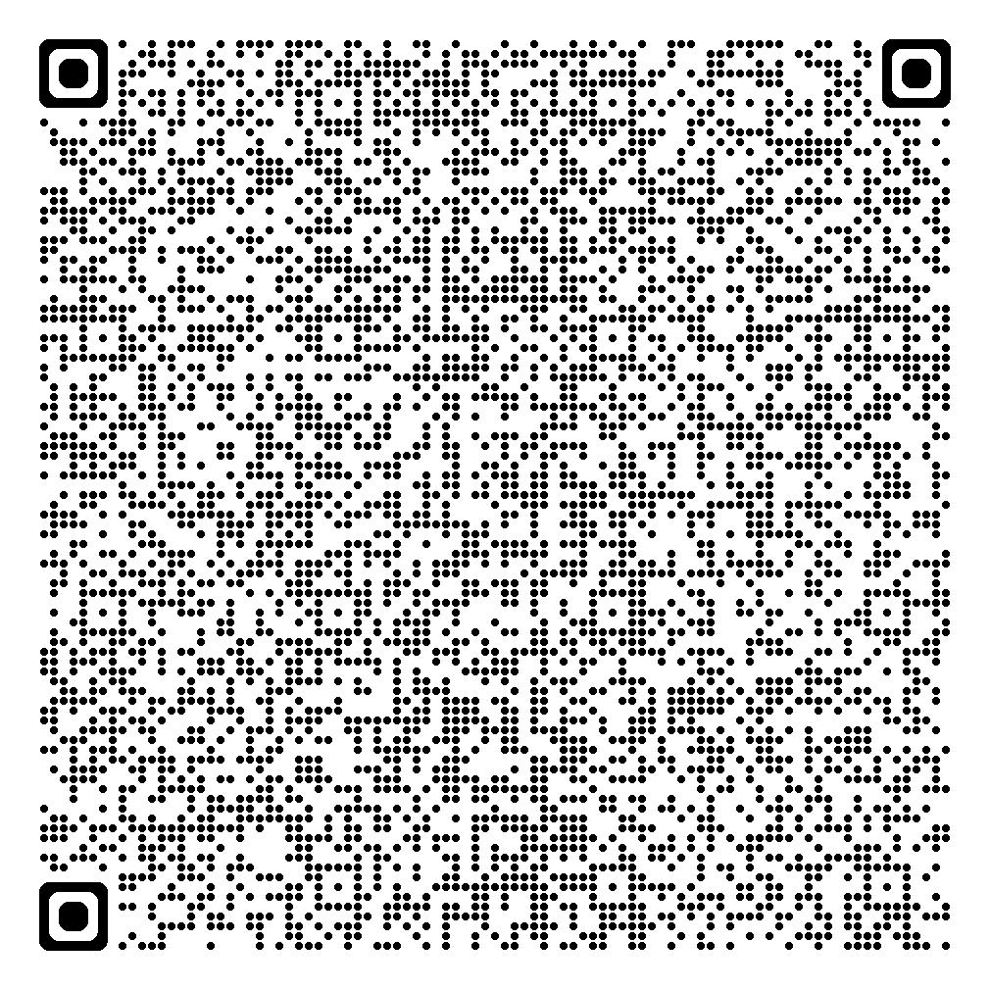
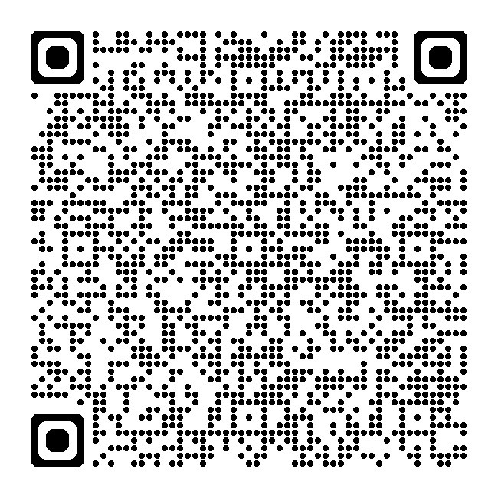
National Legislative Call
The next National Legislative Forum is scheduled on Monday, September 22nd, at 6:30pm MT.
Missed the August Call: click here:
The National Legislative Forum (NLF) calls take place on the 3rd Monday of each month at 5:30pm PT, 6:30pm MT, 7:30pm CT, and 8:30pm ET.
If you are interested in joining the calls, click QR Code.
Notes:
Announcement: Delaware is state #20 to become smoke free as of August 25th! Congratulations to all those who worked hard in securing staff and patient safety from the hazards of surgical smoke!

Slide 9
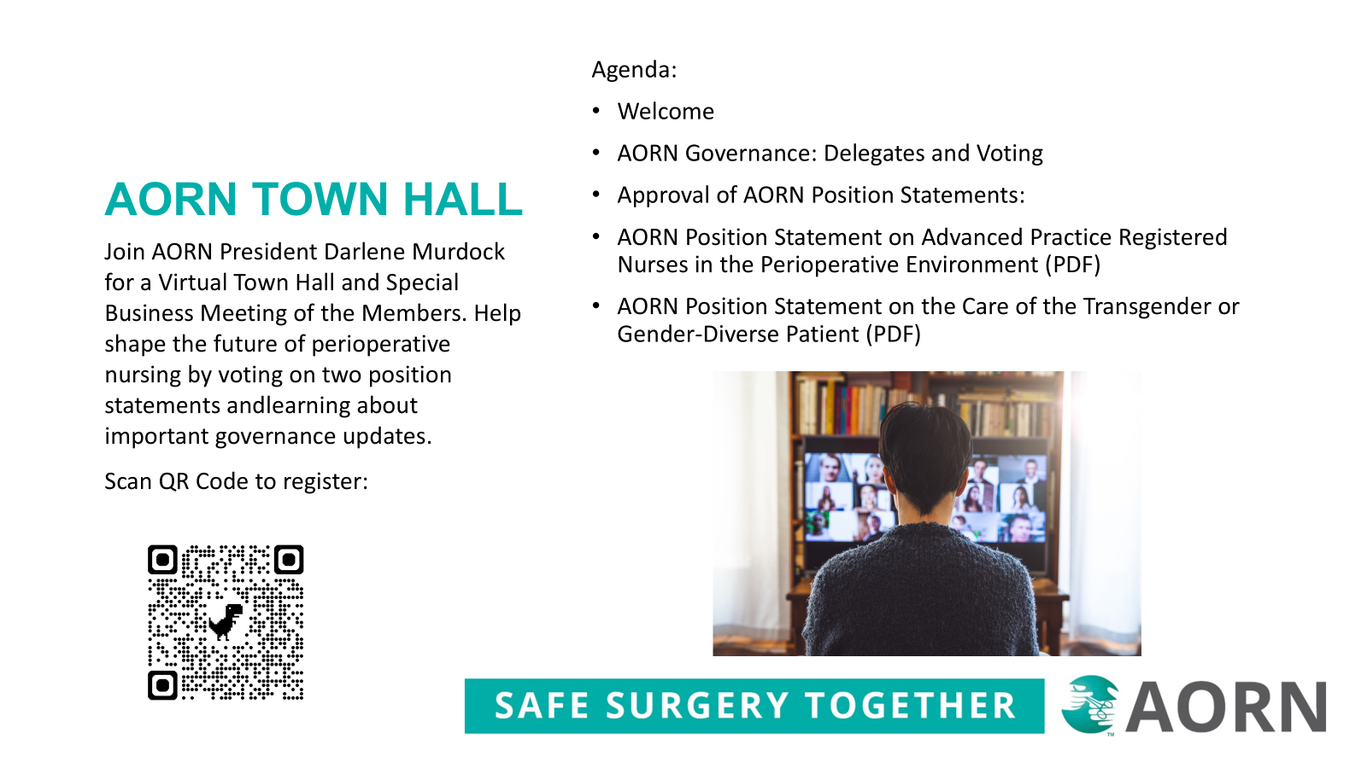

Slide 10
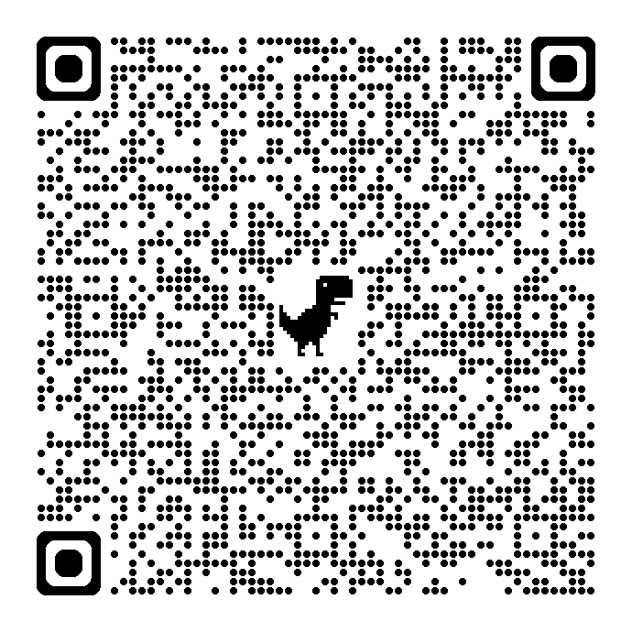

Chapter Leader Townhall 6pm MT, September 18th
This is an opportunity for officers to ask questions and find out what other officers are doing successfully.
Open to Chapter Leaders Only
If you missed the August call, scan this QR Code:
To Register for the September call, scan QR Code:

Slide 11
AORN Guideline for Local Only Anesthesia
Open for Public Comments August 20 – September 20, 2025

Slide 12
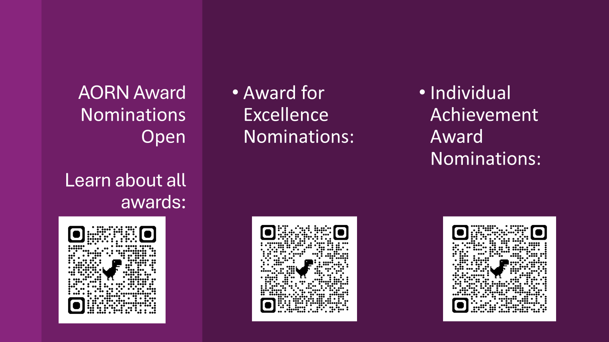

Slide 13
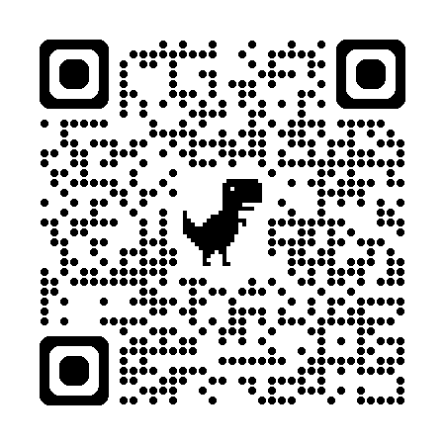
Community
Specialty Assemblies
AORN Specialty Assemblies are member-run, online groups offering members the opportunity to virtually interact with other nurses from across the nation who share an interest in the same specialty. The purposes of specialty assemblies include providing and promoting a dynamic network, serving as a forum for communication, identifying and exploring patient care issues, addressing current trends and issues, and promoting specialized educational programming.
Log in to aorn.org and check out the list of specialty assemblies. Add or change SA Groups in your profile under Professional Info.
AORN has updated its resources to find a Chapter. You can also start the application process to start a new chapter on this webpage.

Slide 14
Membership Update
New Organizational Membership
Leaders Asked. We Listened
Members in leadership roles has indicated a need for additional resources to support their ongoing development. As a result, we have enhanced our Leader Membership to provide expanded networking opportunities
Designed specifically for healthcare facilities aiming to support their teams.
This updated package includes individual memberships for six or more team members, a leader membership, a professional development course of their choice, and a single site subscription to eGuidelines Plus.

Slide 15
AORN Upcoming Events

Slide 16
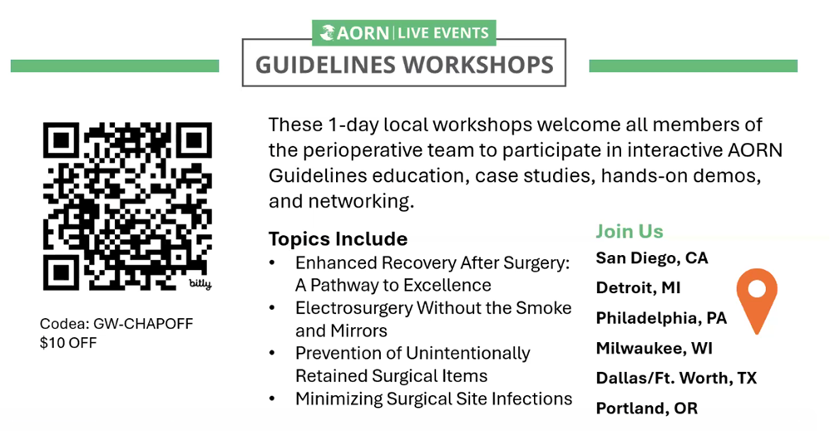

Slide 17
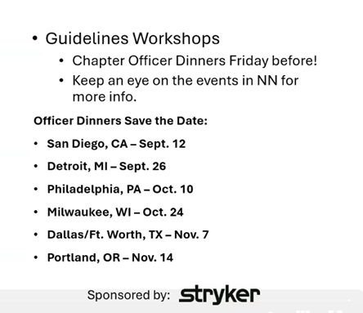

Slide 18
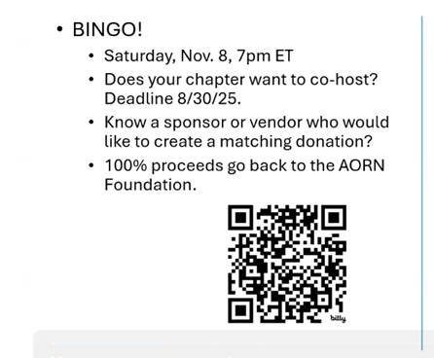

Slide 19
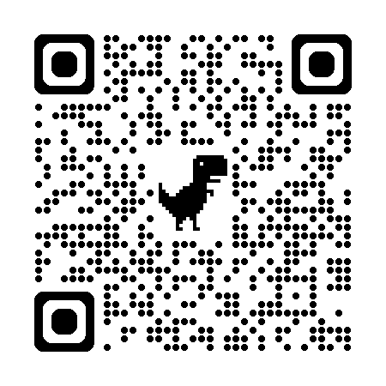
Where Innovation Meets Precision in Total Joint Arthroplasty
Join top orthopedic surgeons and allied health professionals from across the Southeast and beyond at JAM ATL: Joint Arthroplasty Meeting — Atlanta.
This one-day intensive orthopedic conference dives into the realities of modern total joint reconstruction — from patient selection and ASC workflows to enabling technologies and complex revision cases.
About the Event
Learn from nationally recognized orthopedic surgeons presenting the latest techniques and best practices in TKA, THA, and revision surgery.
See two live surgeries – primary total knee and anterior total hip – with real-time commentary.
Join interactive panel discussions where leading surgeons walk through complex cases, evidence-based insights and challenges from real world scenarios.
Gain hands-on access to orthopedic surgical innovation in our vendor showcase.
Earn continuing medical education - CME, CBRN, and NCCT accredited

Slide 20
Professional Development

Slide 21

On-Demand Webinars
Leader Exchange: Bridging Perioperative Care and C-Suite Decision-Making.
October 8, 2025 (Sponsored by Intuitive)
Join a panel of multi-level leaders as they discuss creating a unified environment while making impactful decisions regarding operational and clinical goals. They’ll share how they’ve seen positive impacts on surgical outcomes and strategic initiatives through their partnership.
Leader Exchange: Successful Creation of A Smoke Management Program
October 22, 2025 (Sponsored by CONMED)
This panel will focus on how nurse leaders can create and implement successful smoke management programs in their facilities.

Slide 22
On-Demand Webinars
OR Leadership Essentials: Finance & Operations 2025
October 2025
12.0 CH + Certificate of Mastery
AORN Center for Perioperative Leadership and national productivity expert Pamela Hunt, MSN, RN, NEA-BC, FAAN have teamed up for insightful leadership series to help you fine tune your understanding of financial and operational concepts vital to your success in your role.
For Facilities:
October 22, 2025
(Sponsored by CONMED)
This panel will focus on how nurse leaders can create and implement successful smoke management programs in their facilities.

Slide 23
ASC Academy: Expanding Service Lines
Online Education
3 CH, 3 AEU
Unlock the secrets to expanding service lines. Get the step-by-step process -- from market analysis to implementation, with facility, financial, &amp; staffing considerations -- to navigate growth in the ASC.

Slide 24

Quote for the Month:
“What you leave behind is not what is engraved in stone monuments, but what is woven into the lives of others.”
Pericles

Slide 25

