Slide 1
Nurse, Patient, Advocate
Presented by: Wendy Seiger BSN, RN, CNOR

Slide 2
The Night Shift: Conquering Sleep Apnea with Inspire

Slide 3
Sleep Apnea – A Hidden Patient Problem
Obstructive Sleep Apnea is the most common type of sleep apnea. It occurs when the tongue and other throat muscles relax during sleep, causing your airway to temporarily close.
Central Sleep Apnea occurs when your brain forgets to breathe during sleep.
Complex Sleep Apnea occurs when both obstructive sleep apnea events and central sleep apnea events occur during sleep.

Slide 4
Recognizing Sleep Apnea
Loud Snoring and Breathing Pauses
Cognitive and Physical Symptoms
Daytime Sleepiness and Headaches

Slide 5
My Wake-Up Call
2021
Diagnosed with moderate Sleep Apnea

Slide 6
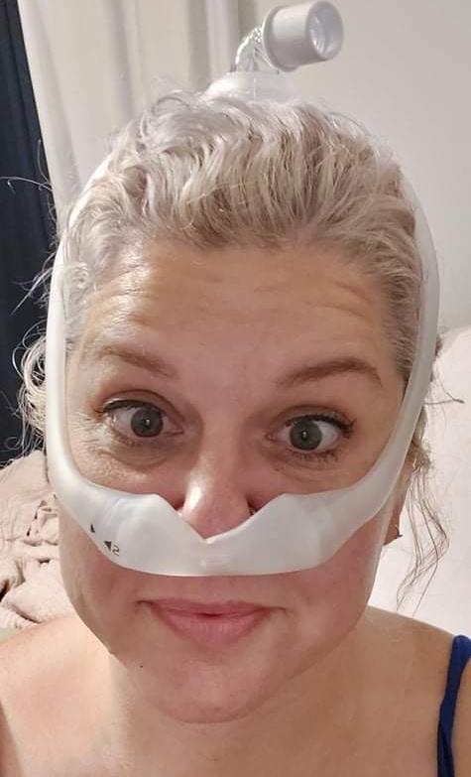

CPAP

Slide 7
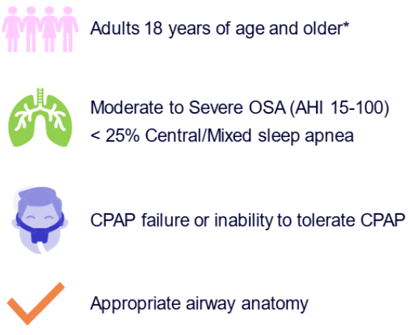
Inspire Therapy– A Game Changer
No Mask
Remote-controlled
Outpatient Surgery
Covered by Most US Insurance
FDA-approved and safe

Slide 8
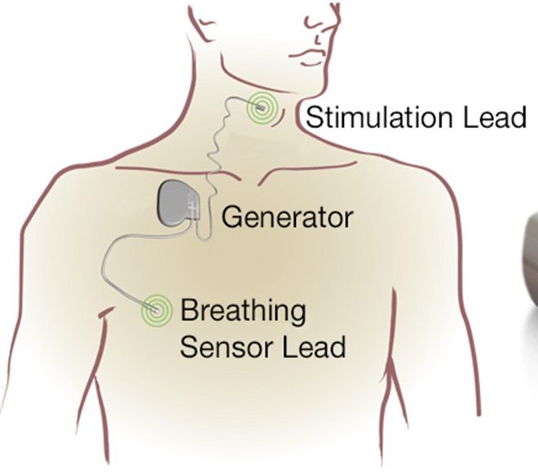
How it WORKS
The Inspire system includes three main components
A small pulse generator is implanted in the upper chest.
A breathing sensor lead is placed near the lungs to monitor your breathing patterns.
A stimulation lead connected to the hypoglossal nerve, which controls tongue movement.

Slide 9
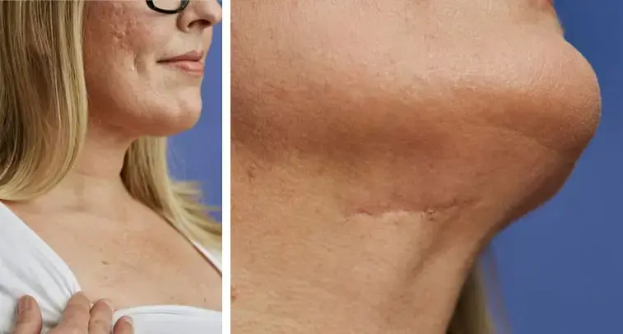
The Procedure
•Outpatient surgery •Two small incisions • One week recovery

Slide 10

What to Expect: First 90 Days
Rest & Heal for 30 days
Activation of Inspire. Review how to use your Inspire remote and discuss your step-up process plan.
Assess Progress after 30 days
Repeat Sleep Study. Review your results and establish a long-term follow-up plan.

Slide 11





My Inspire TIMELINE
Dec 20
Feb 2
Feb 15
Apr 4
May 9
2023
2024
2024
2024
2024
Referral
Sent to ENT physician
Office Visit
With ENT physician
Dr. Nilesh Vasan
Sleep Nasal Endoscopy
Outpatient Surgery
Verification of candidacy
INSPIRE placement
Outpatient Surgery
Activated

Slide 12


My Experience
Apnea episodes dropped from 22.9 per hour to 0.4 per hour.
O2 levels rose from 86% to 93%.
GOOD- BYE Darth Vader mask.
Easier travel experiences.
Boost in self-confidence.
The Sleep Study Follow-Up
Identifying the Optimal Settings
​

Slide 13
Nurse’s FAQ
What are the risks and potential complications?
  Risks include infection, pain at the incision site, device malfunction, and rare nerve injury. Most complications are minor and manageable with standard post-op care.
How long does the Inspire device battery last?
  The battery typically lasts about 10 years. Replacement involves a minor surgical procedure to exchange the pulse generator.
How soon after surgery do patients typically see improvements in sleep quality and oxygen levels?
  Improvements are often seen within the first 30 days after device activation and adjustment.
Can Inspire Therapy help with snoring as well as sleep apnea?
  Yes, Inspire Therapy often reduces snoring in addition to treating sleep apnea.

Slide 14
Nurse’s FAQ
What are the most common patient concerns or misconceptions about Inspire Therapy?
  Patients may worry about surgery, device safety, or effectiveness.
How should nurses educate patients about the Inspire device and it's use? Nurses should explain the therapy, demonstrate the remote control, review post-op care, and encourage follow-up visits for device adjustment.
What signs or symptoms should nurses monitor post-implantation?
  Monitor for infection, pain, swelling, device malfunction, and changes in sleep quality.
What troubleshooting steps should nurses take if a patient reports issues with the device?
  Assess symptoms, check device settings, and refer to the ENT or sleep specialist for further evaluation.

Slide 15
Questions?

Slide 16
References
Inspire Medical Systems. (n.d.). Inspire Therapy for Obstructive Sleep Apnea: Patient and Provider Resources. Retrieved from https://www.inspire.com
U.S. Food and Drug Administration. (n.d.). Inspire Upper Airway Stimulation Therapy for OSA: Approval Summary.
Mayo Clinic. (n.d.). Sleep Apnea: Symptoms and Causes. Retrieved from https://www.mayoclinic.org
American Nurses Association. (n.d.). Nursing Care for Sleep Apnea Patients.
ENT and Sleep Specialist Guidelines for Inspire Therapy candidacy and follow-up

Slide 17
"Regional Nerve Blocks: A Perioperative Nurse’s Guide to Safety, Support, and Success"
Daniel Nash DNAP CRNA

Slide 18
Objectives:
Define regional nerve blocks and their purpose.
Identify common types of regional nerve blocks used perioperatively.
Understand the nurse’s role before, during, and after block placement.
Recognize potential complications and required interventions.

Slide 19
Introduction to Regional Anesthesia
Definition: Targeted delivery of local anesthetic to block specific nerves.
Comparison: Regional blocks vs general anesthesia.
Goals: Pain control, decreased opioid use, improved recovery.

Slide 20
Types of Regional Nerve Blocks
Peripheral Nerve Blocks:
  Brachial Plexus Blocks
    Interscalene (shoulder surgery)
    Supraclavicular (arm/hand)
  Femoral/Adductor canal (knee, leg amputations)AANA August 2020 ERAS for amputations
  Popliteal/sciatic (foot/ankle, leg amputations) AANA August 2020 ERAS for amputations
  PENG/lfcn (hip)
  Fascia Iliaca Compartment Block (FICB)
Truncal Blocks:
  TAP block (abdominal surgery)
  PECS block (breast surgery)
  ESP block (thoracic/lumbar)

Slide 21
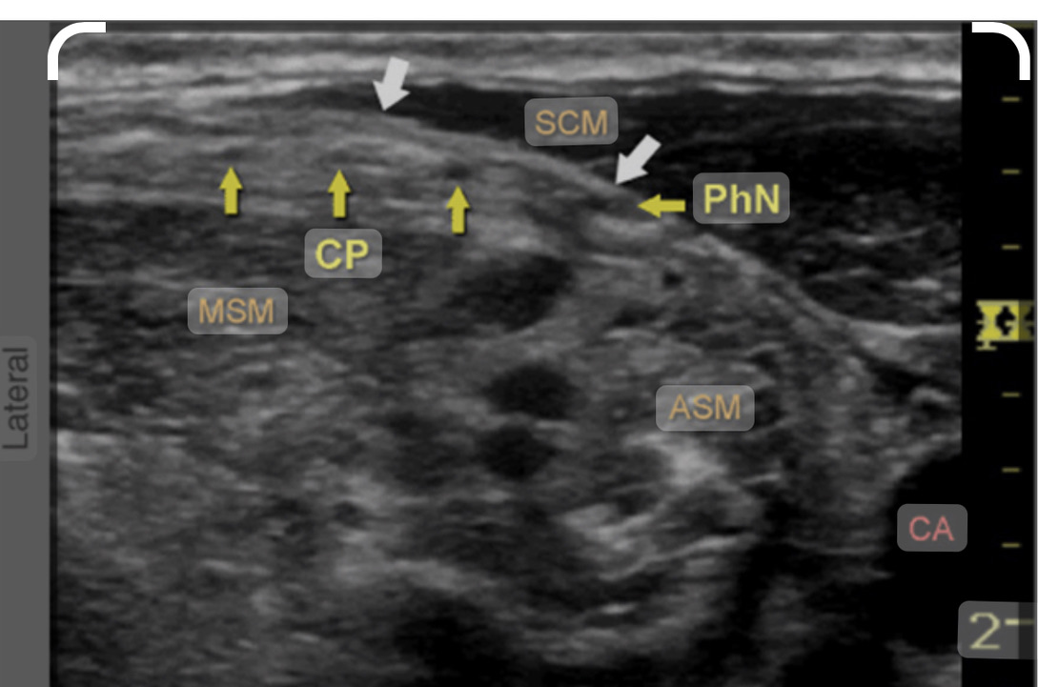

Slide 22
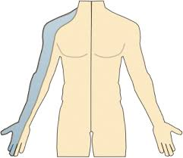
Interscalene nerve distribution

Slide 23
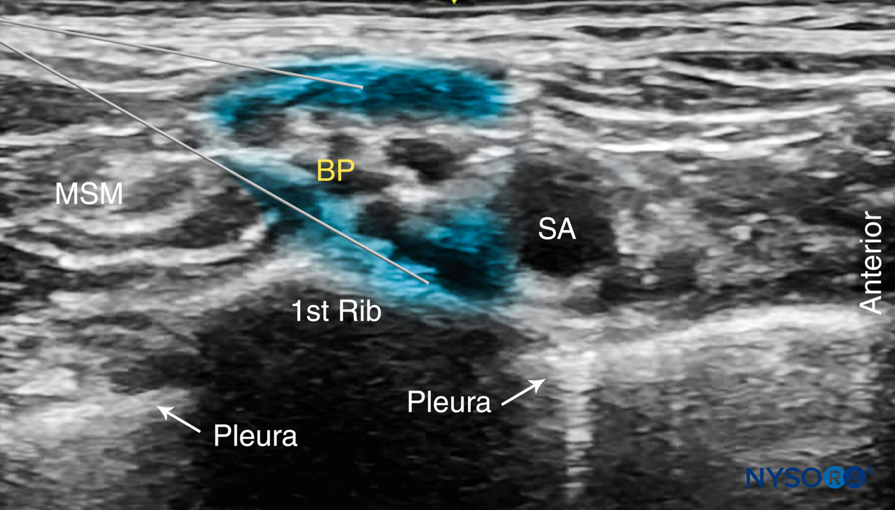
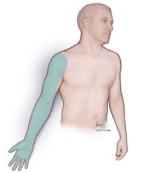
Supraclavicular brachial plexus
(Hand/Wrist)

Slide 24
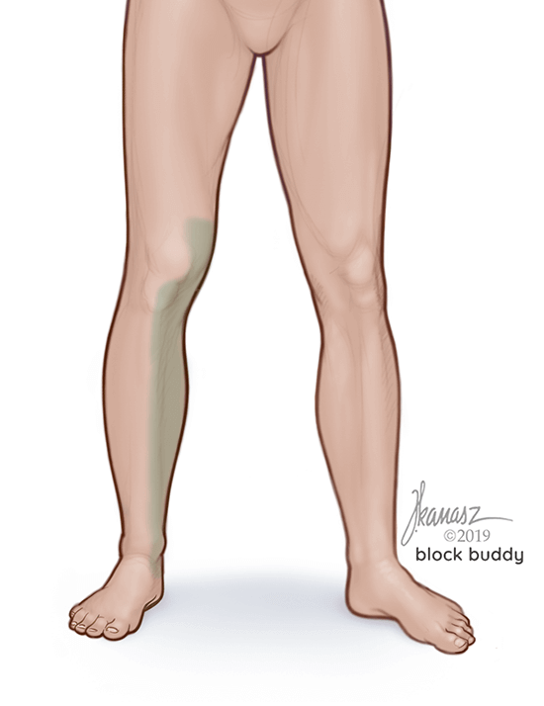
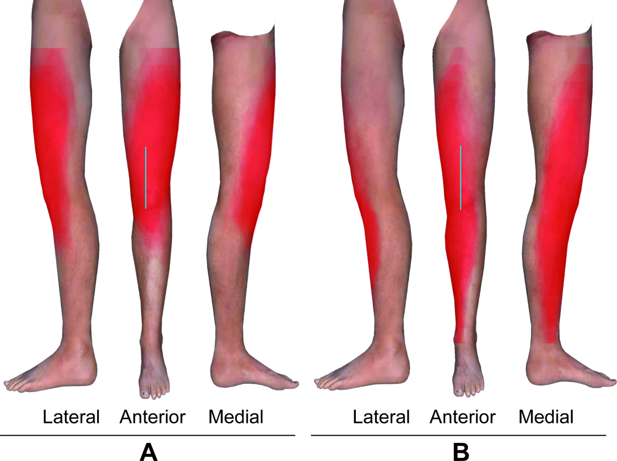
Femoral vs Adductor Canal block
(total knee/ACL)

Slide 25
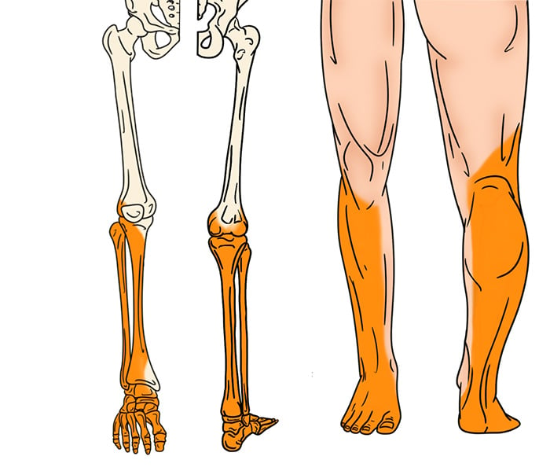
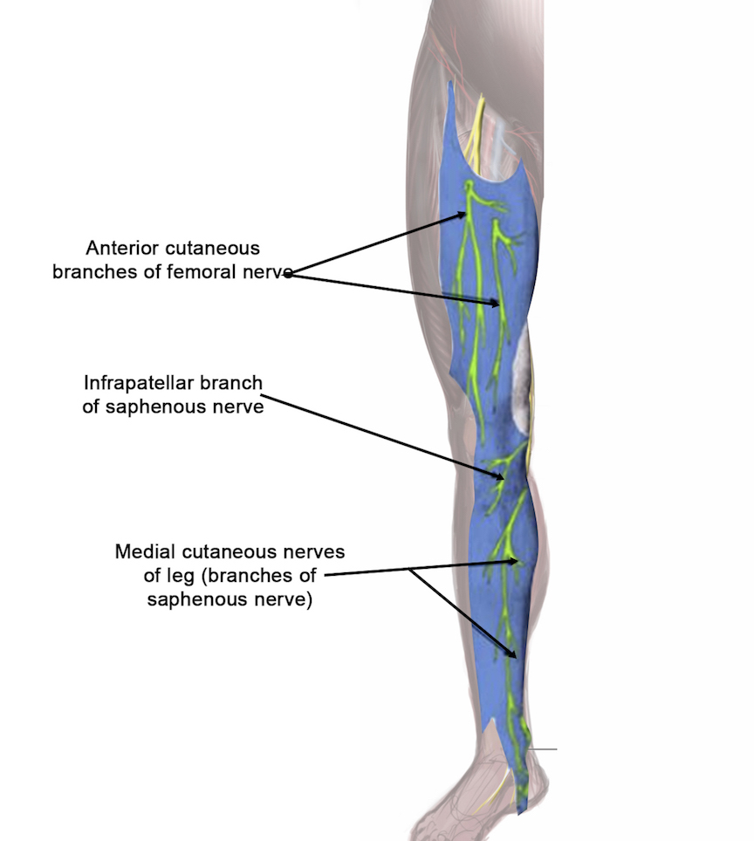
Popliteal Sciatic/Saphenous blocks
(Foot/Ankle)

Slide 26
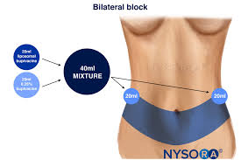
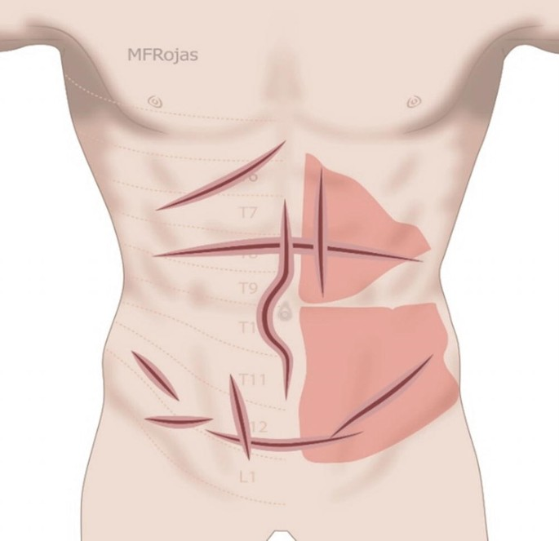
TAP (TRANSABDOMINUS PLANE)LATERAL/SUBCOSTAL

Slide 27
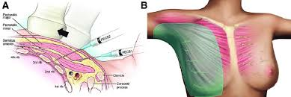
PECS 1&2 BLOCKS

Slide 28
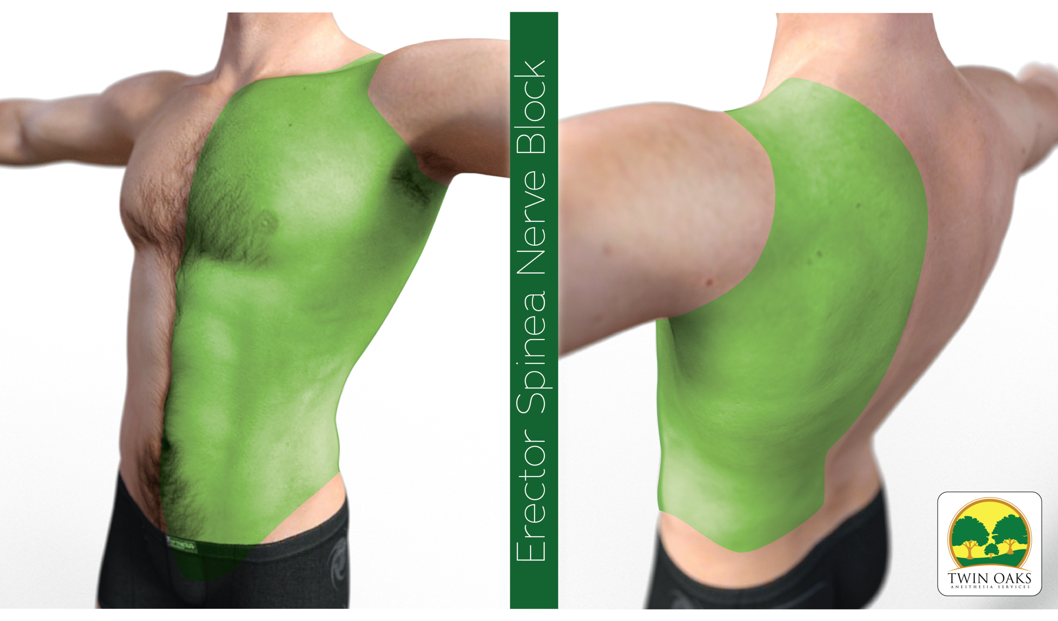
ESP-Erector Spinae block

Slide 29
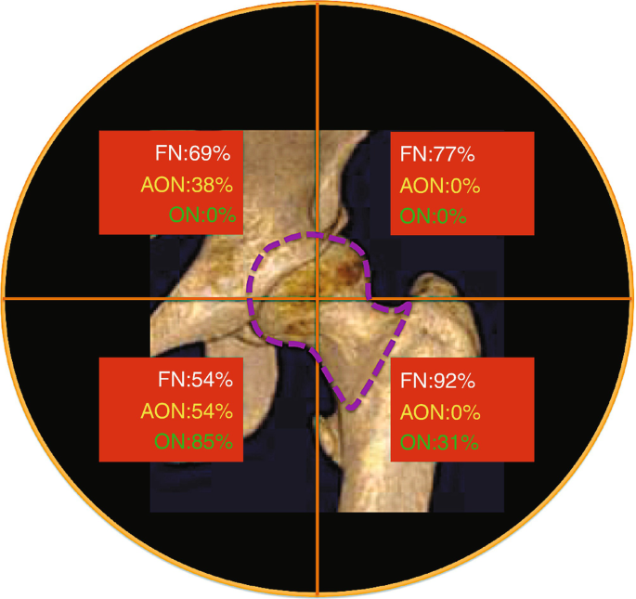
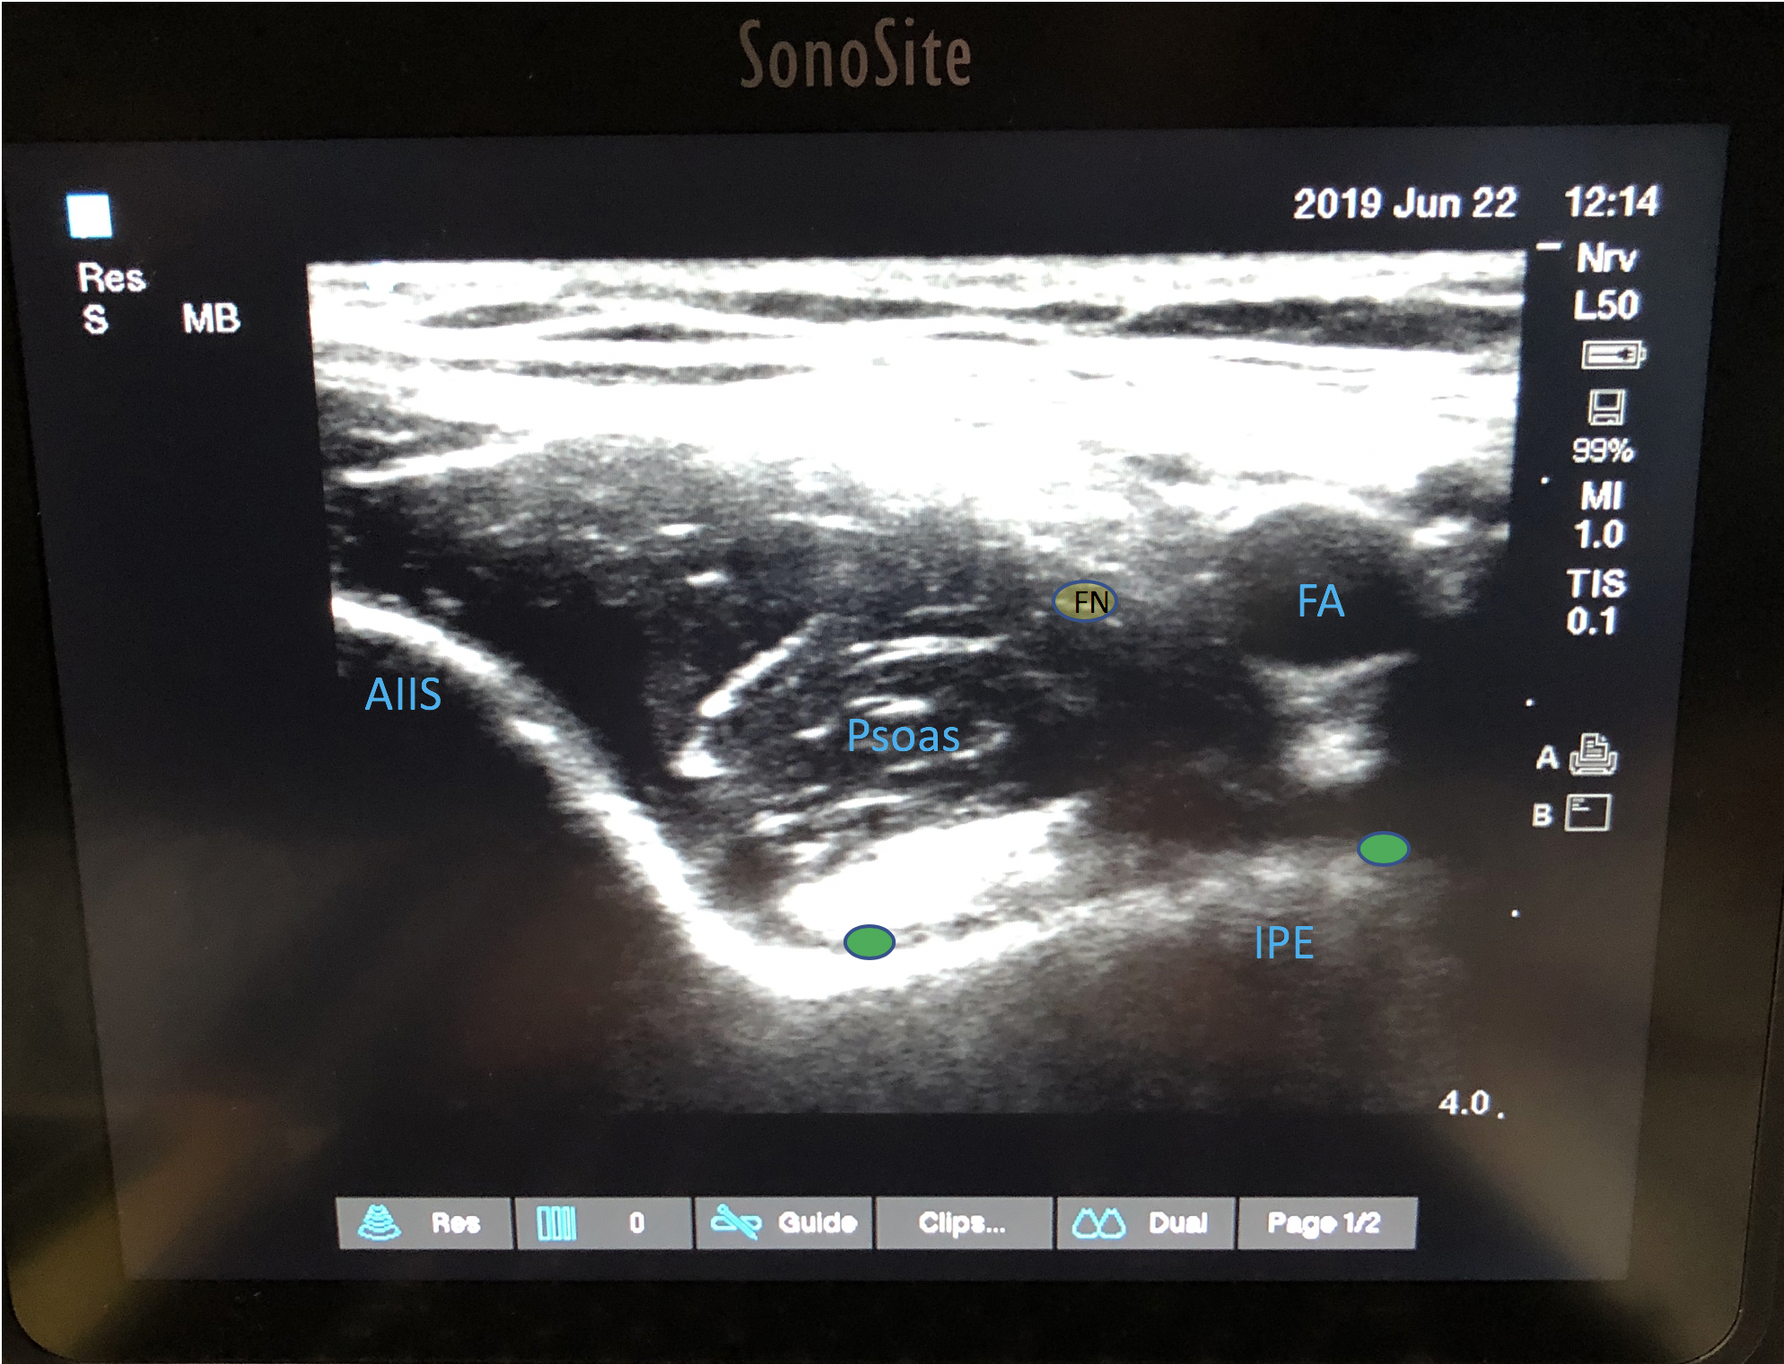
PENG (pericapsular nerve group)

Slide 30
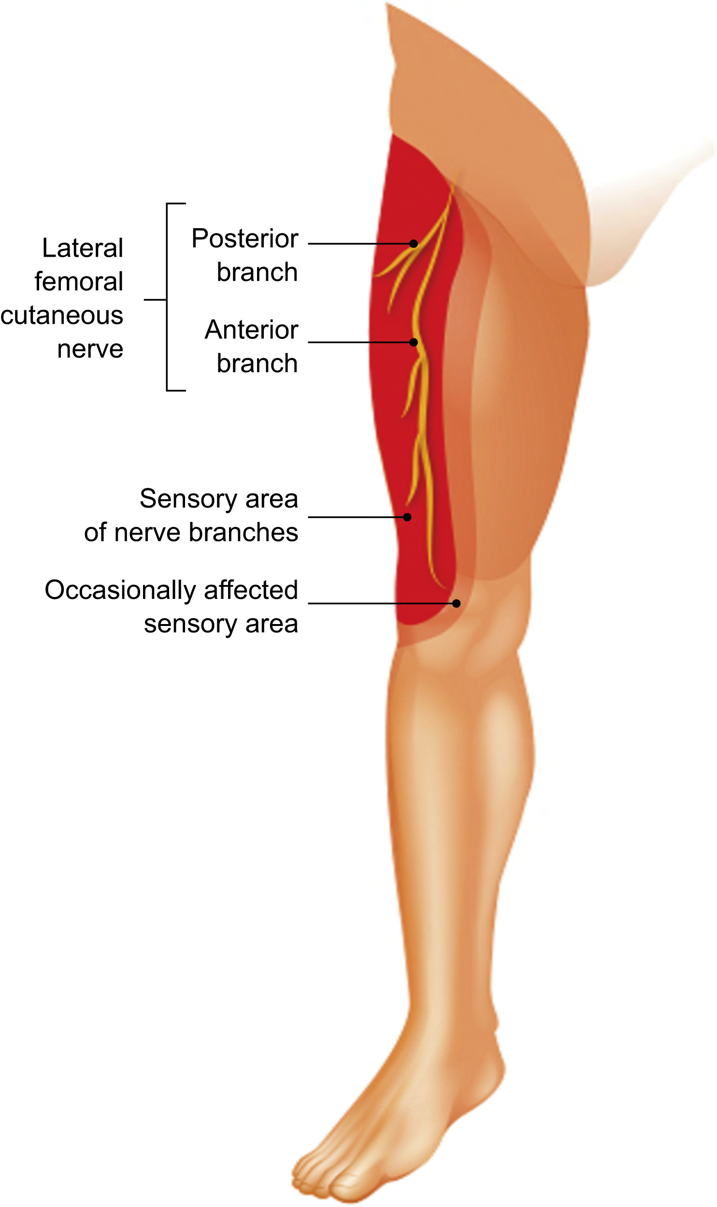
Lateral Femoral cutaneous nerve

Slide 31
Workflow and the Nurse’s Role
Pre-Procedure:
  Consent verification
  Time-out participation
  Monitoring equipment and resuscitation readiness (lipid rescue available)
  IV access, fasting status

Slide 32
Workflow and the Nurse’s Role
During Block Placement:
  Positioning the patient
  Supporting sterile technique (fancy IM injection)
  Assisting with block delivery (aspirating before injecting)
  Monitoring for early signs of complications
  Emotional support and communication

Slide 33
Workflow and the Nurse’s Role
Post-Block:
  Documenting motor/sensory status
  Neurovascular checks
  Protecting insensate limbs
  Monitoring for block regression or return of sensation
  Assessing signs of LAST (usually within 20 minutes of block)

Slide 34
Complications and Red Flags
Common Side Effects:
  Numbness, weakness
    Expected (hopefully in distribution of nerve)
  Phrenic nerve block-ISB
    90% asymptomatic unless pulmonary disease
      Informed consent-information is powerful!
  Delayed ambulation-Muscle weakness
    Femoral nerve-quad weakness
    Adductor Canal and PENG block (designed to avoid quad weakness)
      Less falling, better ambulation-more in control when walking

Slide 35
Complications and Red Flags
Complications to Recognize:
  Local anesthetic systemic toxicity (LAST)
    Symptoms: tinnitus, metallic taste, seizures, cardiac changes
    Nurse’s role: Call for help, stop injection, prepare intralipid (should be in block cart)
    Lipidrescue.org Laminated instruction on block cart
  Nerve injury (prolonged numbness/weakness)
    Follow up and notify anesthesia
  Hematoma, infection

Slide 36
Case Study & Discussion
Typical Total Knee Arthroplasty
Adductor Canal block with accessory nerve blockade-femoral cutaneous and genicular
IPACK block or similar for posterior compartment
SAB (preferred) or General (LMA or ETT)
Inhalational gas or Propofol infusion (ketamine)
Minimal narcotics-PONV, resp depression, urinary retention etc.

Slide 37
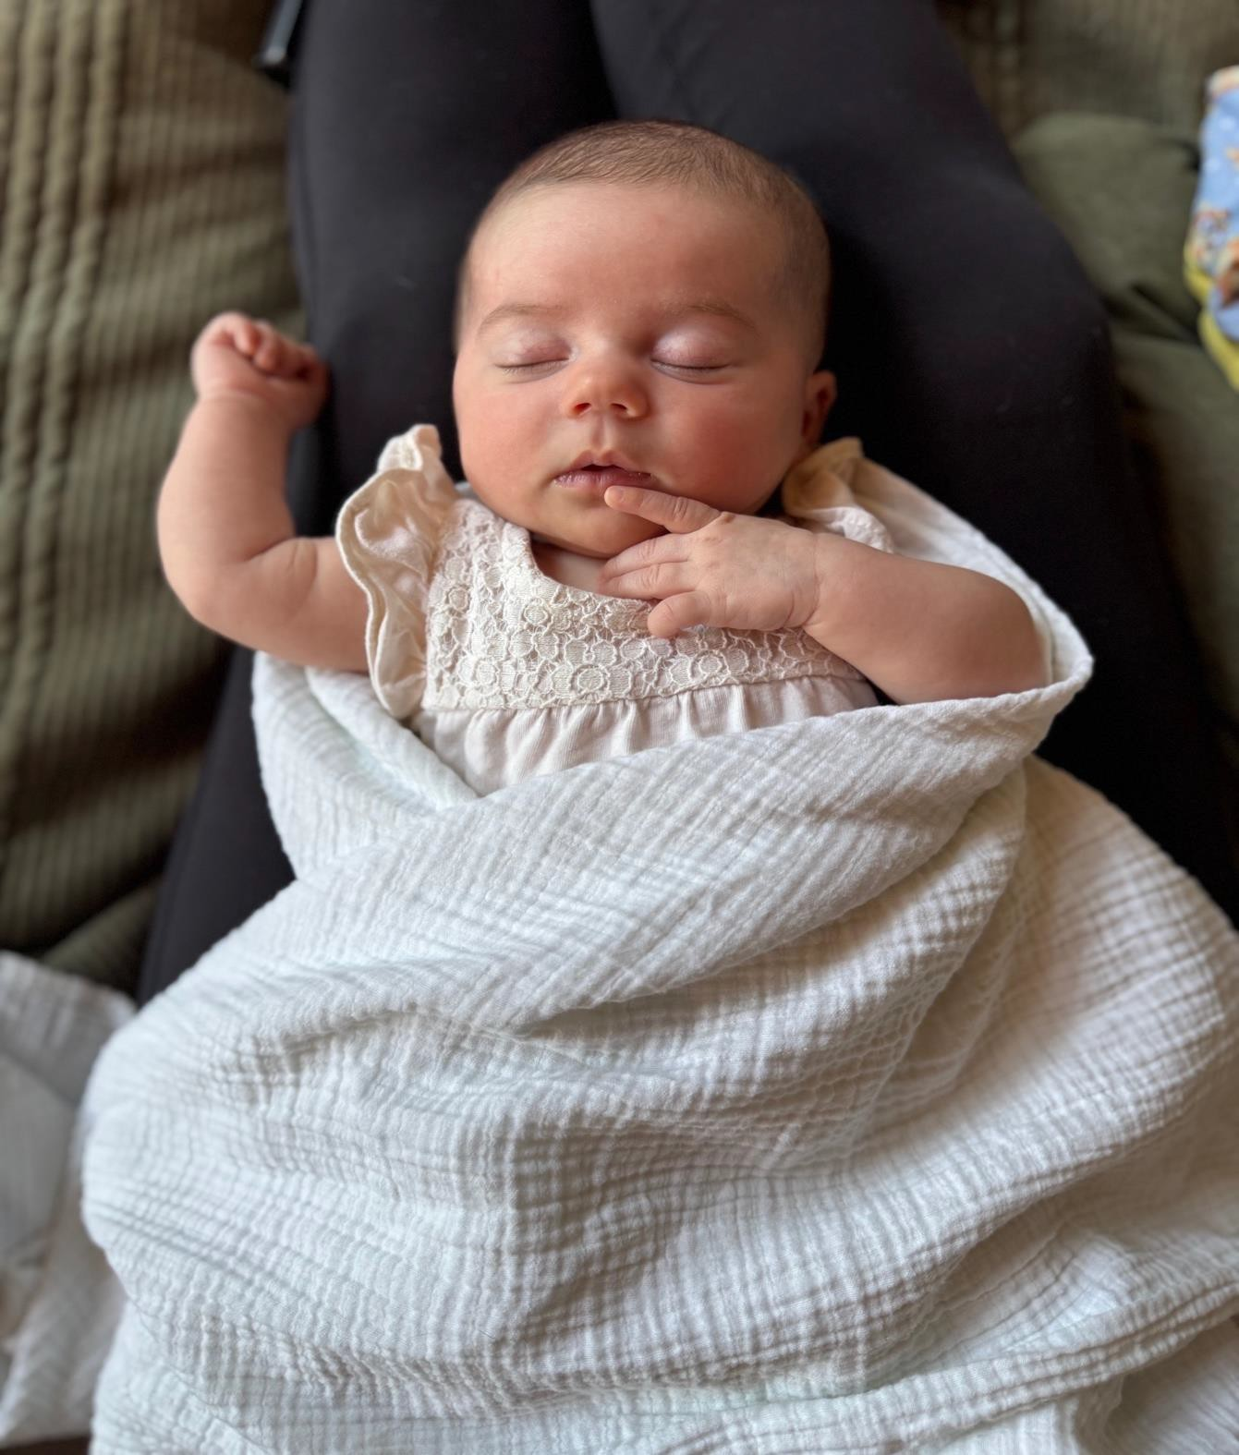
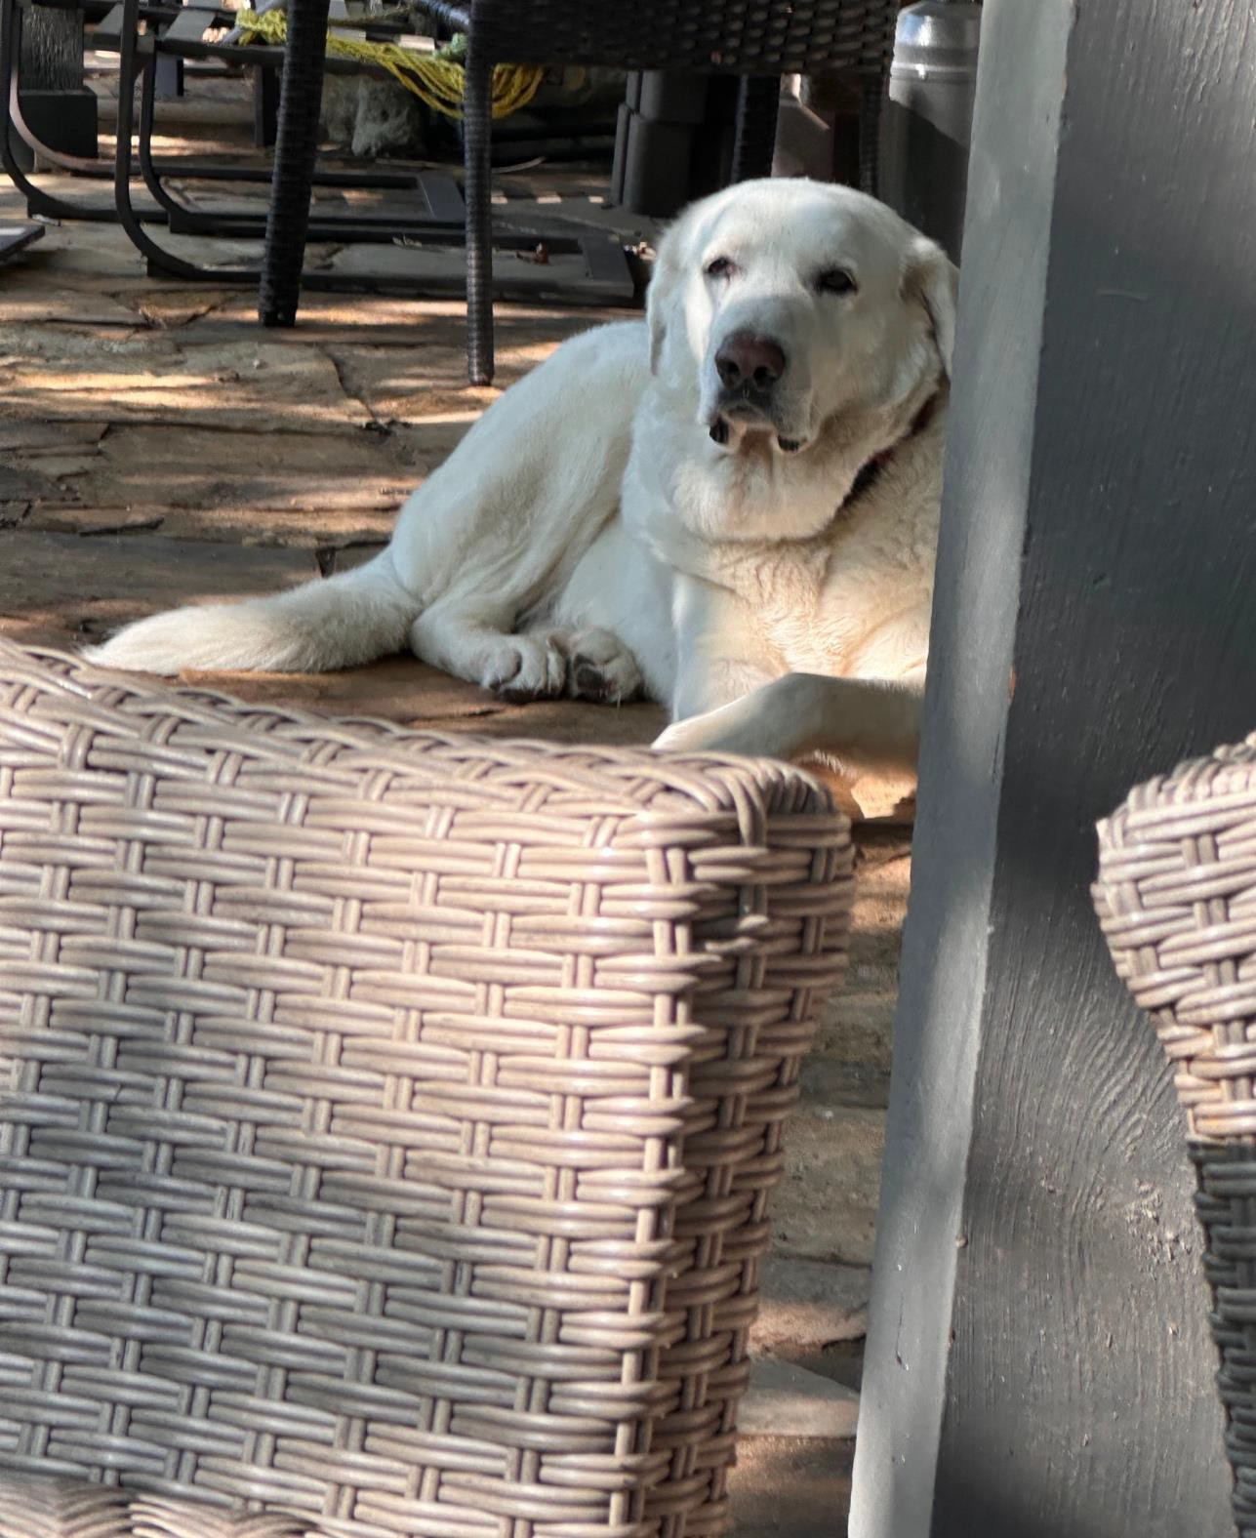
Questions?

Slide 38
ASPAN 101
Everything you wanted to know and more!!

Slide 39
What is ASPAN ?
A nonprofit professional organization with a specific structure
Bylaws, Policies and Procedures
Executive Board of Directors
Representative Assembly
Members from across the country
A National Office staff
ASPAN has a purpose, vision and mission
Notes:
And here we are we have the following….. We are governed by Bylaws and our elected Board members and RA

Slide 40


ASPAN’s Core Purpose
To empower and advance
the unique specialty of
perianesthesia nursing
Compelling Vision:
To be distinguished as the premier organization for perianesthesia nursing.
Notes:
We do have our core purpose, why are we here

Slide 41

ASPAN’s Core Values=
C.A.R.E.S.
ASPAN is here for you and future members, we are approximately 12,555 members strong
Courage
Advocacy
Respect
Excellence
Service
Notes:
41

Slide 42
ASPAN Organization Chart
Notes:
Organizational structure of ASPAN with lines of communications
Some subgroups may change as need arises for the organization and lines of communication and liaisons may change also may remove or dissolve a SWT if no longer needed

Slide 43
Organization
Lines of communication
Responsibilities and liaisons
Basic structure is stable
Subgroups may change to fit the needs of the
organization
Many abbreviations and acronyms
Notes:
Changes are removing Strategic Work Team no longer in need like the Global Outreach SWT or adding the Certification SWT

Slide 44
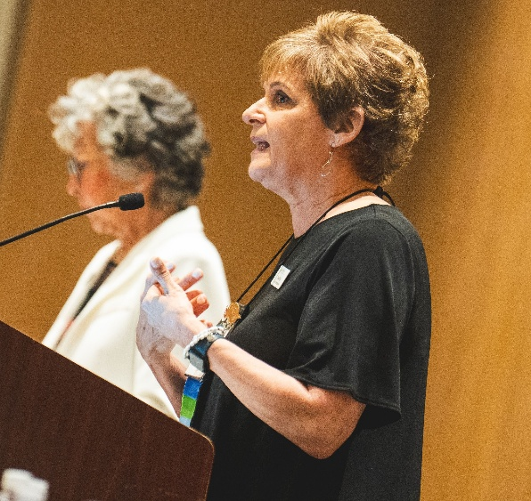
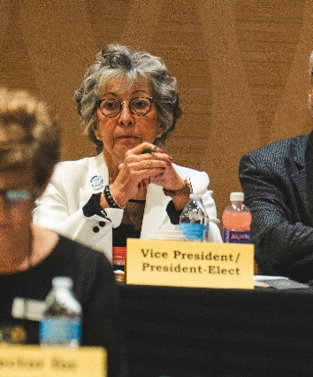
Organization
Representative Assembly, voting body
Executive Board and the Board of Directors
Direct line of communication, liaisons to subgroups
Committees, Strategic Work Team (SWT) and Liaisons to affiliate organizations
Notes:
RA are members chosen to be the representatives at the assembly
Executive and BOD are elected members Pres VP Secretary and Treasurer, 5 Regional Directors, Directors for Clinical Inquiry, Education and Clinical Practice
RA meets annually and if needed at selected times during the year
RA relevant issues are discussed information and state of the organization are presented and the RA is responsible for voting for elected officials

Slide 45

Education Benefits
ALL education is DISCOUNTED for members
Members ASPAN Membership Member Benefits
EDUCATION
All webcasts are free – over 120 hours
All continuing education articles are free
$74 off CPAN and CAPA certification exam fees
Up to $245 off National Conference registration fee
Major savings on additional education including
  Seminars
  On-Demand modules
BSN, MSN and doctoral scholarships
Click here for online education in ASPAN Learn
Notes:
National conference have the opportunity to obtain 88 contact hours NC is an amazing opportunity…, networking is fantastic!
PDI is annual usually mid year one member from each component is funded by ASPAN to attend …,,financial assistance available for components unable to afford sending their representative. Live and hybrid options available.
Live webcast webinars and in person seminars …. registration is online any options …. Toni looking at updating all materials and presentations

Slide 46
Education Benefits
Perianesthesia Certification Review Seminar
Education On Demand Library Modules currently 12 modules
JOPAN Continuing Education Articles = currently 15 FREE
Notes:
PCRS is a group of presentations that can be accessed via U Learn on ASPAN website
ASPAN Select Seminars can be used as a presentation at district and component conferences… example Rhode Island
Currently there are 15 free JoPan articles available for contact hours
ALL EDUCATION AND LEARNING OPPORTUNITIES ARE ON THE ASPAN WEBSITE …….U Learn must log in to access

Slide 47
EDUCATION RESOURCES
ASPAN Perianesthesia Nursing Standards, Practice Recommendations and Interpretive statements
Perianesthesia Nursing Core Curriculum
Certification Review Book
Ambulatory Surgical Nursing
Perianesthesia Nursing Standards, Practice Recommendations and Interpretive Statements
Redi-ref
Competency Based Orientation for Adults
Competency Based Orientation for Pediatrics
Competency Based Orientation for the Pain Management Nurse
Competency Based Orientation for Unlicensed Assistive Personnel

Slide 48


Discounted Publications
Perianesthesia Nursing Standards Practice
Recommendations and Interpretive Statements
CBO for RN in Perianesthesia
CBO for Pediatrics
CBO for Assistive Personnel
Notes:
The Standards are your go to book every unit and PACU should have one …. Reviewed and updated every 2 years a rigorous process by dedicated members on the committee
CBOs available ….. Pain management and pediatrics are the newest to this list

Slide 49


Discounted Publications
Ambulatory Surgical Nursing
Redi- Ref Pocket Guide
CBO for Pain Management
Resources from Elsevier
Notes:
Ambulatory Surgical nursing just published Spring 2024……
Redi Ref pocket sized manual will be available later this fall
Elsevier resources Core Curriculum newest edition slated for 2026 publication Certification review Book in process or revisions
Mosby’s online perianesthesia Nursing Orientation is a product that is purchased by your facility Amy? Akron children’s using this

Slide 50
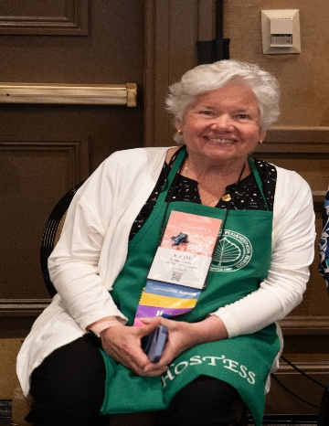
Membership Benefits
  Discounted fee for CPAN & CAPA certifications/recertification
  Free subscriptions to JoPan and Breathline
  Member Deals exclusive travel and entertainment deals
  Access to personal liability insurance
  Networking with colleagues
ADVOCACY
Governmental affairs
Membership and marketing
PeriAnesthesia Nurse Awareness Week (PANAW)
Professional partnerships
COLLABORATION
Clinical Practice Network
Specialty Practice Groups
Committees and Strategic Work Team
Notes:
Self explanatory

Slide 51

Membership Benefits
Personal and professional advancement
Leadership opportunities
Liaison opportunities
Specialty Practice Groups
Committees /SWTs
Notes:
More benefits

Slide 52

Membership Benefits
Member Get a Member
Awards and Recognition
Legacy for Life
PANAW
FASPAN distinction
Notes:
Tiers of membership the member with the highest number of recruits is awarded and recognized at National conference
Awards include: Excellence in Clinical Practice…..Outstanding Achievement….. Above and Beyond Service Award Recruiter of the year
Legacy for Life awarded after $5000 donation to ASPAN ……Assistance and guidelines for PANAW celebration ….how to obtain a proclamation from your governor or mayor. FASPAN is the highest honor in the profession you are a FELLOW and we have s fellow in the room

Slide 53

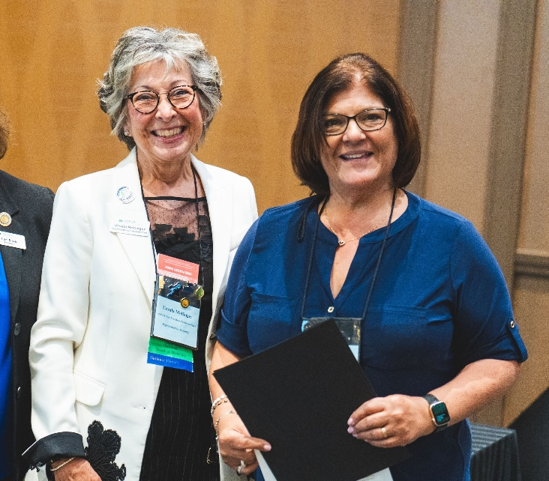
Membership Benefits
ASPAN Membership
Member Benefits
Membership Categories
Legacy for Life
Membership Rates
Member Benefits Flyer
How to Join or Renew Online
Printable Application
Group Membership Program
Join a Specialty Practice Group (SPG)
Find Your Membership Liaison
Awards
Gold Leaf Award
Excellence in Clinical Practice
Award for Outstanding Achievement
Above and Beyond Award
Notes:
Resources include: Leadership Tool box and ASPSAN Insights…. Financial Primer……Publication Primer…. Research Primer see AMY
Advocacy through various means…… collaborating and partnering with other agencies that are collaborative with ASPAN and perianesthesia ….
Meet others with like interests……Group memberships can be purchased by your facilities contact Doug Hanisch in the National office

Slide 54

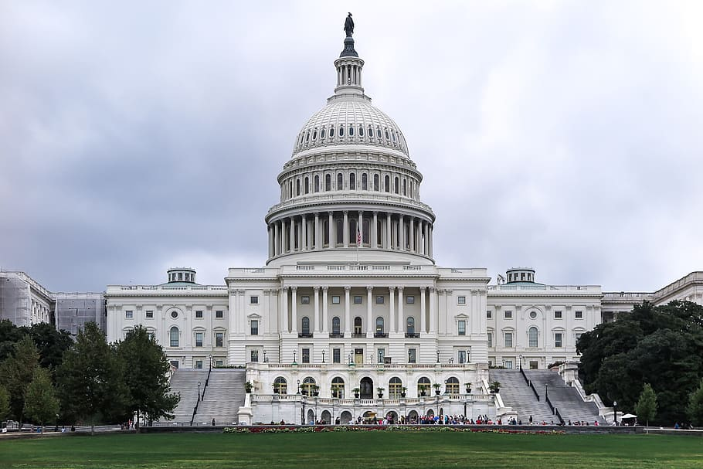
Scholarship Benefits
National Conference
Humanitarian Mission
Certification Advanced Degree
AONL Advocacy Days
Notes:
The following scholarships are available…. Must watch your emails and website for due dates for application … scored on a point system and selected by a committee review
AONL replaced the NIWI scholarship

Slide 55



Specialty Practice Groups (SPG)
Advanced Degree
Management
Pain Management
Pediatric
Perianesthesia Nurse Educator
Pre-op Assessment
Notes:
Members have the opportunity to join smaller group in which they have a special interest, join online at any time
Each SPG has a coordinator and vice coordinator, these provide opportunities for advancements and increase eligibility for leadership opportunities
55

Slide 56

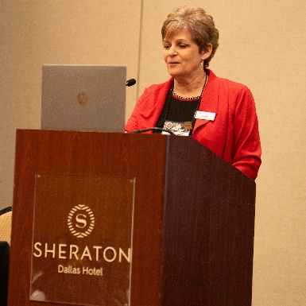

Committees
Clinical Inquiry Committee
Clinical Practice Committee
Education Approver & Provider Committees
Finance Committee
Nominating Committee
Standards Committee
Notes:
See the list each has a chair and co chair join online watch email and website for deadlines …..each committee has a specific function … see website ….for detail, see the ASPAN table display

Slide 57

Strategic Work Teams (SWT)
Enhancing Organizational Capacity
Bylaws/Policy & Procedures
Certification Promotion
Credentials
Advancing/Emerging Leaders
Notes:
SWTs … see the list… each has a charter and specific function, each has coordinator and BOD Liaison contact …..
SWTs can be dissolved when need is met and NEW SWTs can be crated as the need arises….. Newest will be the NEXTGEN SWT that will be charged with bringing the organization to the future and engaging the next generations
57

Slide 58

Strategic Work Teams
Development SWT
Publications SWT
Government Affairs SWT
National Conference SWT
NextGen SWT Strategic Work Team SWT

Slide 59

National Conference

Slide 60
Questions?

Slide 61


Herbal Supplements and the Perianesthesia Experience
Presented by: Ursula Mellinger BSN, RN, CPAN, CAPA
This Photo by Unknown Author is licensed under CC BY-NC

Slide 62
Herbal Supplements
Herbal Supplements and the Dietary Supplement Health and Education Act of 1994 (DSHEA)
  Classified herbs and supplements as foods, not drugs
  Exempted from pre-market safety and efficacy testing
Labeling Restrictions
  Cannot claim to cure, treat, or prevent a specific disease
  Only allowed to make “structure/function” claims (e.g., “supports immunity”)
Quality Concerns
  No federal standardization of quality control
  No guarantee that contents match the label
Regulation
  FDA: post-market role (can only act if harm is proven)
  Europe: Stricter regulation—herbal products often treated as medicinal products
Vitamins & Dietary Supplements
  Fall under the same DSHEA rules in the U.S.
  Wide variability in purity, potency, and manufacturing standards
Notes:
First…. Herbs are a plant-based product…….classified as foods, not medicine or drugs.
All prescription drugs and OTC meds undergo efficacy and safety testing, HERBALS DO NOT
Labeling: supports brain health joint or bone strength.
Quality: no guarantee that what is listed on the bottle is ACTUALLY in the bottle
No guarantee that the dose is appropriate No guarantee the next bottle will have the same composition Same supplement by a different manufacturer can vary in composition
Herbs manufactured outside the US may contain heavy metals, pesticides and other pharmaceuticals
Regulation: only regulation is that FDA can remove the product if it shown to be unsafe, harmful or having adverse effects, but there is no mechanism for
reporting adverse effects.
Germany, France, United Kingdom and Canada have regulatory agencies see on next slide
Vitamins: typically used to correct or supplement a dietary deficiency
FDA does oversee vitamin and supplement industry, does monitor for accuracy in advertising and labeling ……however they do not need to be
by the FDA because they are not intended to treat, diagnose prevent or cure a disease.
Vitamins also have the potential to interact with anesthesia drugs that same way that herbals do

Slide 63
U.S. vs. Europe Regulation of Herbal Supplements
Aspect | 🇺🇸 United States (DSHEA, 1994) | 🇪🇺 Europe (General Regulation)
Classification | Dietary supplements = foods | Herbal products often = medicines
Pre-market Testing | ❌ Not required | ✅ Required for many herbal products
Label Claims | Only structure/function (e.g., “supports immunity”) | Therapeutic claims allowed if approved
Quality Control | No uniform standards | Regulated manufacturing & quality standards
Regulatory Oversight | FDA = reactive (acts only after harm) | EMA/national agencies = proactive (approval before market)
Notes:
EUROPEAN: As I mentioned, Germany, France, United Kingdom and Canada have regulatory agencies,
Rather than food or supplements many classify the herbs as medicine
There is premarket testing for many
Therapeutic claim are allowed only if proven to be positive
There are standards for manufacturing

Slide 64

Healing with Herbs
Therapeutic Uses of Herbs
  Herbal remedies utilize plant-derived substances to support health and “treat” various ailments naturally.
Benefits and Precautions responsible use and professional consultation are essential to avoid adverse effects.
Interactions with Medications
  Herbal remedies may interact with conventional medications. Awareness and guidance are key!
Notes:
Herbal medication uses plant-derived substances for therapeutic purposes.
These remedies are often employed to support health, relieve symptoms, and prevent diseases.
While many herbs offer but not proven benefits, it is important to use them
responsibly and consult healthcare professionals,
as herbal remedies can interact with conventional medications.

Slide 65
Start at the beginning….Preop!
Preop is a phase, not a location, various sites and locations
Goals of preop assessment /interview:
1.Optimize the patient
2.Identify and allow for mitigation of potential risks
3. Verify patient comprehension of pre-op instructions to ensure compliance
Purpose - decrease delays and day of surgery cancelations
Notes:
locations where preop care and assessments are completed, facilities have their own branding
reop clinics sometimes managed by APNs and anesthesia, complete H and P.
preop phone call assessments interviews,
done prior to pt arriving at facility, … focus on assessing the patient and developing a plan of care.
Then, preop admission day of surgery, preop holding. Verify all information with assessment of the patient and reviewing the med reconciliation.
No matter where the assessment or interview is completed
the goal is to 1. optimize the patient for surgery,
2. identify and allow mitigation of potential risks gather information that will ensure a positive outcome and experience for the patient
3. assess patient understanding and need to comply with all pre op instructions.
Purpose is to decrease potential delays and cancellations on day of surgery must identify actual and potential problems.

Slide 66



Plan of care is developed:
Multifaceted …. Not just the disease process!
Cultural sensitivity…herbalists, spiritualists
Focus on med reconciliation and use of:
  Prescribed medications
  Herbals
  Vitamins/Supplements
  OTC
  PRN meds
Notes:
Plan of care takes into account the physical, psychological, educational, socio-economic, and spiritual need of patient family , caretakers and significant other,
Culturally sensitive, some have healers and many cultures have commonly held beliefs and views on health
Hispanics believe health is luck or a gift from God and illness is punishment from God
Asians view health results when the body works in balance manner and achieve CHI illness is caused by excessive deficiency of one element , or loss of CHI cured by herbs, or acupuncture
Native Americans view health as living in harmony with the universe and illness is caused by disharmony or angering the spirits, not takin care of self, they heal thru ceremony and use if the medicine man
Haitian or Caribbean believe health is when someone looks good, depends on faith illness is caused by supernatural forces. Rely on Voodoo or Mambo, the voodoo priestess
More next page
Moslem have Mullah religious healer
Concentration today is on the med reconciliation

Slide 67

Med reconciliation for all:
BE SPECIFIC
Prescription Name
Reason for use
Dose
Frequency – time of day or night
Specific instructions from specialist or surgeon
Herbal
Dietary supplements
Vitamins
OTC meds
PRN meds
Notes:
Many newer prescriptions have multiple uses, may be dose dependent special instructions hold stop and restart coumadin, antiarrhythmics antihypertensive, pain med, antipsychotics, neuro muscular disorder medication.
Med reconciliation must be very specific and
done within a time frame that will allow pt to comply especially for stopping supplements and now of course GLP1 meds
All of the questions on the left also pertain to the items on the right
ASA recommends discontinuation of herbal meds at least 1 to 2 weeks prior to surgery

Slide 68



Geriatrics…Polypharmacy …Failure to disclose
Significant risk factor for geriatric population!
Polypharmacy and other stuff!
Failure to disclose, why?
Notes:
Use of Herbal supplements are most frequently seen in the geriatric population want to stay healthy and “feel young “ and remain active
Cytochrome P-450 enzyme system is responsible for metabolism and clearance of many medications, occurs in the liver including herbals substance, nutrient supplements and anesthesia medications.
When person reaches 80 years there is approximately 40% decrease in liver mass and blood flow (Drain’s) impaired ability to metabolize and synthesize medication and results in slower recovery……
Frail elderly experience a double jeopardy due to diminished ability to absorb, metabolize , distribute and excrete medicines and supplements.
Renal changes in the elderly lead to decreased elimination of substances
POLYPHARMACY and Geriatrics
More co morbidities, chronic diseases and ailments
has been cited as taking 5 or more medications per day (Ambulatory Surgery) researches found that those on 5 or more a day had an 88% increase in adverse drug events compared to those taking fewer.
The more meds, supplements herbal and supplements a person takes the more demand on the liver enzyme systems , results in slower recovery from anesthesia
Also increases the risk of drug-to-drug interactions
Also includes OTC meds that elderly may not mention such as: eye drops inhalers topical ointments cough medicine laxatives OTC analgesic antihistamines supplemental oxygen and alcohol
FAILURE TO DISCLOSE REASONS:
Think they are harmless
Secretive, fear disapproval from family as well as doctors and nurses
Cultural or ethnic beliefs
Do not consider them to be important
Do not think of them as “MEDICINE”
REPEAT AND REPEAT REITERATE THE NEED FOR THIS INFORMATION

Slide 69


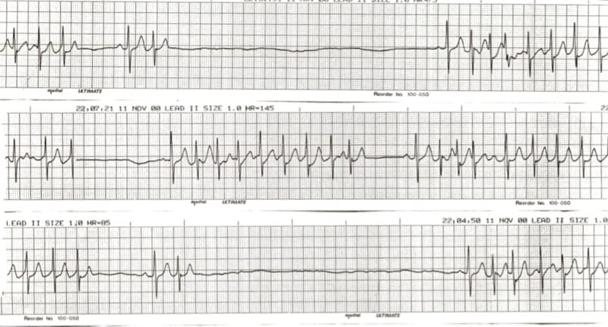
Herbal and Anesthesia Interactions
Herbs Affect Surgical Safety
Coagulation disturbances
Prolongation of sedation, slow recovery
Adverse cardiac effects
This Photo by Unknown Author is licensed under CC BY-SA-NC
This Photo by Unknown Author is licensed under CC BY-NC-ND
Notes:
Certain herbal medications can interact with anesthesia, affecting surgical safety.
Common complications and adverse effects include:
Bleeding,……. Coagulopathies….. Inadequate anesthesia during intra op ……...prolonged anesthesia in recovery …………stroke………..myocardial infarction

Slide 70
Most Common Herbal Supplements
Echinacea = inhibits hepatic enzyme….interfere with anesthesia
Ephedra = tachycardia….increased diuresis….elevated BP….bronchodilation
Kava = inhibits platelets potentiates anesthesia
St John’s Wort = can prolong anesthesia
Valerian = potentiates sedatives
Saw Palmetto = may increase INR if taking coumadin
Notes:
ECHINACEA used for respiratory symptoms inhibit hepatic enzymes interferes with anesthetic agents
EPHEDRA a weight loss stimulant can lead to High BP bronchodilation tachycardia and increased diuresis
KAVA anxiolytic analgesic muscle relaxant had local anesthetic properties inhibits platelet aggregation potentiates anesthesia
St JOHNS WORT antidepressant properties sedative hypnotic interacts with amphetamines should not be taken with other antidepressanrs, can prolong anesthesia
Valerian sedative muscle relaxant potentiates sedatives
Saw Palmetto uses for Benign Prosttic Hypertrophy nocturia may increase pts INR if taking coumadin

Slide 71
The “5 G’s” Supplements
Garlic – increases risk of bleeding (antiplatelet effect)
Ginkgo biloba – increases risk of bleeding (antiplatelet effect)
Ginseng – can cause hypoglycemia and can increase bleeding risk
Ginger – may increase bleeding risk and alter platelet function
Green tea (sometimes Guarana is included instead, depending on the source) – contains caffeine, may cause hypertension, tachycardia, and diuretic effects; also has vitamin K which can affect anticoagulation
Notes:
Garlic used to lower BP and cholesterol risk of post op bleeding stop for at least1 week
Ginko Biloba used for increase in cognitive function memory loss chronic venous insufficiency causes decreased RBC aggregation
Ginseng used for stress reduction increased or enhanced physical performance, improve cardiovascular function questionable anti cancer properties
untoward effects are insomnia, increased irritability and interact with digoxin, coumadin and lithium
Ginger used for antiemetic properties and motion sickness there is increased risk of post op bleeding
Green Tea is used for caffeine effects can lead to hypertension, tachycardia and also has diuretic effects
These supplements can prolong bleeding, alter hemodynamics, and interfere with glucose control or anticoagulation, which is why anesthesia providers recommend discontinuing herbal supplements 1–2 weeks before surgery.

Slide 72

Common Vitamins/Dietary Supplements
Melatonin = May potentiate sedation.
Vitamin E = Anticoagulation effects, augment hypotension from anesthetics.
Fish Oil = Inhibits platelet aggregation
CoQ 10 = May augment hypotension of anesthesia.
Licorice = May increase BP.
Caffeine/high energy drinks = Increase heart rate, temperature, headaches & arrythmias.
Notes:
MELATONIN used for sleep aid
VITAMIN E used for diabetes Alzheimer disease immune system integrity skin disorders menopause
FISH OIL coronary artery disease, hyperlipidemia HTN diabetes and thyroid eye disease.
COQ 10 used to treat cancers heart failure acts an antioxidant

Slide 73
When to Hold Herbs & Supplements
Before Surgery
Herb / Supplement | Reason for Concern | When to Stop Before Surgery
Garlic | ↑ Bleeding risk (antiplatelet effect) | 7 days
Ginkgo biloba | ↑ Bleeding risk | 36 hours – 7 days (often 7)
Ginseng | Hypoglycemia, ↑ Bleeding | 7 days
Ginger | ↑ Bleeding risk (platelet inhibition) | 7 days
Green Tea | Contains caffeine (↑ HR/BP), vitamin K (clotting effect) | 7 days
St. John’s Wort | Alters drug metabolism (CYP450 induction), interactions with anesthesia drugs | 5 days
Kava | Sedation, potentiates anesthetics | 24 hours
Valerian | Sedation, withdrawal risk if abrupt | Gradual taper 1–2 weeks
Echinacea | Immune suppression, liver enzyme effects | At least 24 hours
Notes:
These may be different from hospital to hospital – general idea of when to hold meds and why. Hospital guidelines from anesthesia.

Slide 74

Key Actions for Perianesthesia Nurses
Perform an in-depth preoperative assessment, ensuring accurate medication reconciliation and focused questioning.
Stay informed about anesthesia policies and procedures
Day of surgery: conduct pre-op history review and finalize medication reconciliation.
Notes:
Key Actions: thorough pre op assessment ask the right questions with med reconciliation, don’t assume the patient is telling you everything question question question. Patient safety is paramount having uncomplicated surgical and anesthesia experience.
Evaluate and verify patient understanding of instructions
Need to know your anesthesia department protocols and guidelines

Slide 75
Questions?

Slide 76
References
American Society of Anesthesiologists. (n.d.). Herbal supplements and surgery: What you should know. Made for This Moment. Retrieved August 24, 2025, from https://madeforthismoment.asahq.org/preparing-for-surgery/risks/herbal-supplements/
American Association of Nurse Anesthesiology. (n.d.). Herbal products and anesthesia. Retrieved August 24, 2025, from https://www.aana.com/
Schick L, Windle PE eds. PeriAnesthesia Nursing Core Curriculum Preprocedure, Phase I and Phase II PACU Nursing.4th ed. Elsevier;2021
Forren-Odom J ed. Drain’s Perianesthesia Nursing, A Critical Care Approach. 8th ed. Elsevier; 2024
Clifford T ed. Ambulatory Surgical Nursing, 1st ed. Elsevier; 2025

