Slide 1

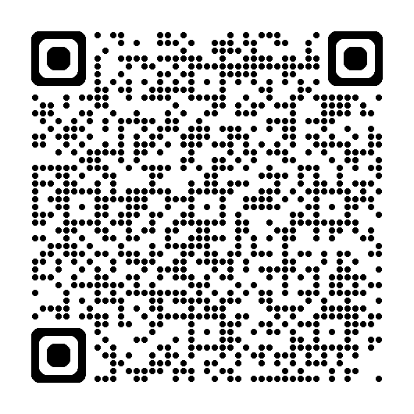
November 14, 2025
5:00 PM – 7:00 PM
Only open to attendees registered for Fall Conference 2025. Space is limited. Must register for this event.
Use QR code for event details.

