Slide 1
LV-AACN Community Outreach
Howie's House
August 1, 2025

Slide 2

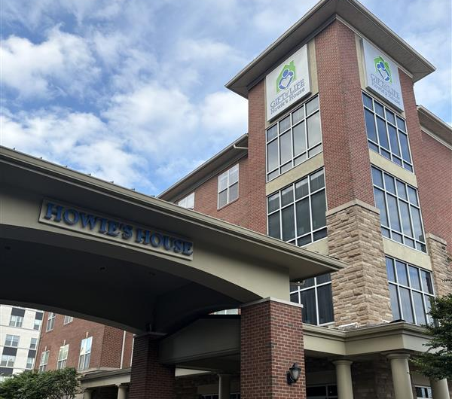
Philadelphia PA
“A home away from home”
providing temporary, affordable lodging, and supportive services to those who travel for transplant-related care

Slide 3

Home Cook Heroes
Home Cook Hero volunteers are essential to helping us ensure all transplant families come back to a home-cooked meal during their stay in Philadelphia.

Slide 4
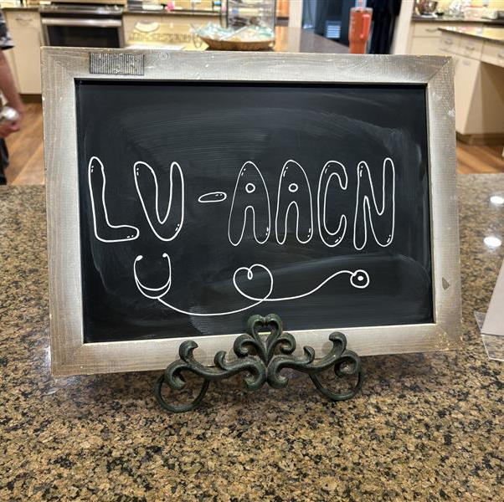
Team Effort
Susan Aquilina-Cook
Kathy Ramson-Cook
Lisa Reph-Delivery and Set Up
Gisele Commins-Delivery and Set Up
Member at Large-financial support

Slide 5
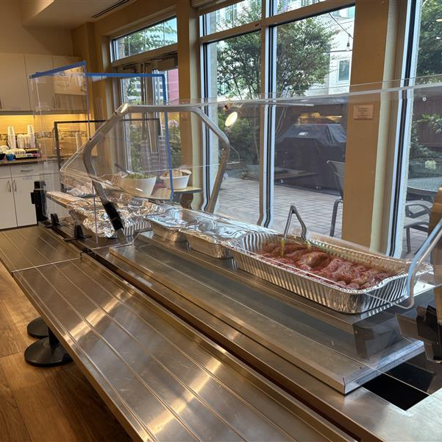
Menu
Garden Salad
Cotton Candy Grapes
Baked Ziti
Italian Sausage
Tuscan Bread
Lemonade
Assorted Cookies

Slide 6
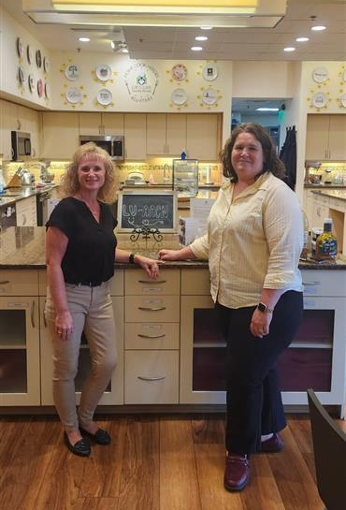
LV-AACN Community Outreach Updates
Hope to plan another Home Cook Heroes Date soon
Looking for more volunteers
Please share additional ideas for service projects

Slide 7
Thank You

