Slide 1
Transition to Practice for New Graduate Nurses: Fostering Professional Development through Reflection, Collaboration, and Mentorship
Cara White, MSN, RN-BC, CNEcl
Sarah Ghozayel MSN, FNP-BC, CEN

Slide 2
Objectives
To examine the key challenges and opportunities encountered by new graduate nurses during the transition to practice.
To discuss the role of reflection in fostering personal and professional growth during the early stages of nursing practice.
To highlight the importance of interdisciplinary collaboration in enhancing patient care and supporting new graduate nurses in their roles.
To explore the benefits of mentorship in providing guidance, support, and professional development for new nurses.

Slide 3

Introduction— The so what factor
New graduate nurses are having a difficult time transitioning to practice
High nurse turnover can lead to increased healthcare costs and adverse patient outcomes (Lyu et al., 2024)
In the acute care setting, clinical decisions are made every 30 seconds!
A literature review was conducted examining works in the last 5 years
The phenomenon is new graduate nurse transition into practice
Why do they leave? What are the factors that hinder a smooth transition into practice?
Notes:
SG INTRO

Slide 4

Importance of Clinical Judgment
Clinical Judgment affects patient safety and client outcomes
46% of tasks performed by entry-level nurses are linked to clinical judgment
50% of novice nurses are involved in patient safety events and critical incidents
​​ATI Nursing Education (2024)

Slide 5

Transition
There is a starting point, there is change and a demand for adaptation
Notes:
Growing pains, awkwardness, discomfort
SG INTRO

Slide 6
Transition
Think about what that means.
Think back to when you were a new grad
https://www.mentimeter.com/app/presentation/alhbkds4vjp2u7m9t2oq7twjenqwfgfv/edit?source=share-modal (This link will expire on 9/14, will need to renew )

Slide 7

Recent evidence and literature suggest an array of factors that hinder the transition to practice.
This presentation aims to discuss those factors and solutions for the future

Slide 8
Factors that lead to burnout
Lack of support
Unclear expectations and responsibilities
Excessive workload
Poor staffing
Limited autonomy
Role conflicts
Reality shock
Depersonalization from patients

Slide 9
Potential Consequences of burnout
Stress
Anxiety
Emotional exhaustion
Poor job satisfaction
High turnover
Medical errors
Diminished quality of patient care
Reduced clinical confidence
Detachment
Low personal efficacy

Slide 10
Strategies to Mitigate Burnout/Stress: Didactic
Curriculum Integration
Develop and deliver clinical orientation workshops
Review typical RN duties, scope of practice, and professional accountability.
Partner with clinical sites
Include preceptors and nurse educators in curriculum planning workshops
Invite transition program leaders to evaluate student readiness and share program gaps.
Host panels with recent grads
Discuss how they addressed challenging workplace behaviors.
Share real-world “day-in-the-life” experiences

Slide 11
Strategies to Mitigate Burnout/Stress: Simulation/Clinical
Reality-Shock Workshops
      Reflect on common emotional struggles
      Self-care and peer support strategies
Structured Emotional Debriefing
    Focused on topics such as stress, culture adjustment, incivility, and ethical dilemmas.
    Use reflective prompts to identify coping methods and normalize the discomfort of transitions.
(Weller-Newton et al, 2022)

Slide 12
How to Mitigate Burnout/Stress: Simulation/Clinical
Schedule group debrief sessions after clinical shifts or simulation
    Students can share their feelings and receive peer/faculty support
    Teaching stress management, mindfulness, and self-reflection
    Introduce resilience workshops
Empowering environments reduce burnout
    Model shared governance in the classroom; invite students to co-create simulation scenarios
    Offer leadership roles to students in clinical and simulation to enhance autonomy
    Teach tools like CUS

Slide 13
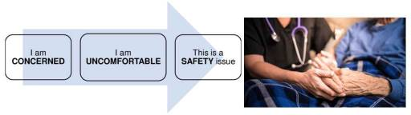

Slide 14
How to Mitigate Burnout/Stress: Hospital/Workplace
Empowering Work Environment:
    Fostering a supportive workplace culture can alleviate stress and enhance job satisfaction. ​
Work-Life Balance:
    Encouraging flexible scheduling and adequate time off helps nurses manage personal and professional responsibilities
Professional Development:
    Providing opportunities for continuous education and career advancement
      Increases job satisfaction and mitigate feelings of stagnation.​
(Dulko et al, 2022)

Slide 15
How to Mitigate Burnout/Stress: Hospital/workplace
Employee Assistance Programs
Implementing programs that offer counseling and mental health support can address personal issues contributing to stress.​
Recognition and Reward Systems
Acknowledging nurses' contributions through recognition and rewards can boost morale and reduce burnout.​
Promoting Resilience
Training in resilience-building techniques equips nurses to handle stress effectively
Notes:
Dulko et al

Slide 16
Lack of Clinical Judgement Factors and Obstacles
Disconnect between academic learning and real-world clinical practice
Heavy workloads
Non-nursing tasks
Limited time for documentation
High acuity cases
Delegation
Interprofessional and patient communication
Prioritization

Slide 17
How to enhance clinical judgement: Didactic/Simulation
Mentoring
Pair students together
Faculty mentorship during student practicum periods.
Set Realistic and Clear Expectations
Clearly define competencies in courses and mirror those expectations
Discuss realistic patient assignments
Review strategies for triage, delegation, and self-care.
Communication
Include multidisciplinary team members
Teach communication tools and prioritize conflict resolution skills
SBAR

Slide 18
How to enhance clinical judgement: Didactic/Simulation
Begin with simple isolated skill stations
    Wound care, med administration, IV tubing
    Track student progress and competence
  Include simulations where students triage, delegate tasks, and prioritize care
  Advance to full-case simulations that include realistic stressors
    Multiple patients with high acuity
    Time-sensitive decisions
    Fluctuating vital signs
    Shift handoffs
    Interprofessional interactions
Notes:
Aldosari et al

Slide 19
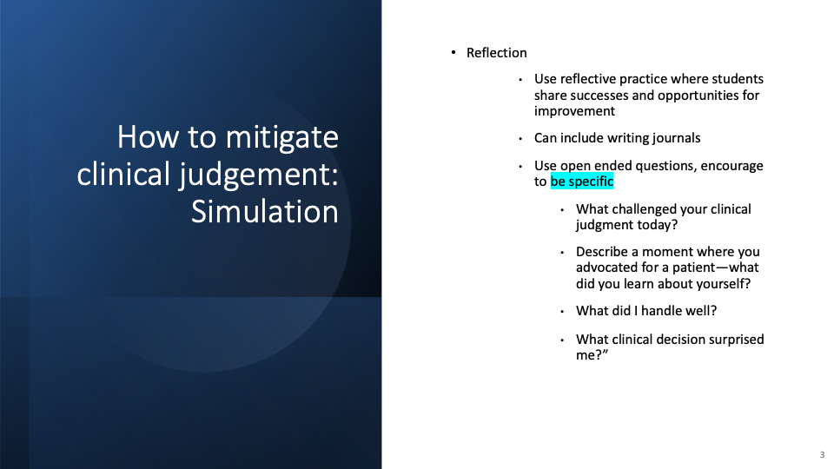
How to mitigate clinical judgement: Simulation
Reflection
  Use reflective practice where students share successes and opportunities for improvement
  Can include writing journals
  Use open ended questions, encourage to be specific
    What challenged your clinical judgment today?
    Describe a moment where you advocated for a patient—what did you learn about yourself?
    What did I handle well?
    What clinical decision surprised me?”
Notes:
Halloran et al

Slide 20
Reflection
Reflective practice serves as a bridge between theory and practice
Reflective practice is now embedded within nursing curricula to help students learn from clinical experiences
Students can identify missteps, rethink situations, and formulate plans for improvement in the future
Involves critically evaluating learning experiences and analyzing actions and decisions
Self-reflection is a fundamental requirement to ensure nurses remain competent, accountable, and "fit to practice"
Self-reflection is not a one-time event but a continuous, evolving cycle of learning, self-assessment, and growth

Slide 21
The Power of Reflection
Promotes personal growth and emotional intelligence
Increases self awareness
Builds resilience
Reduces stress and anxiety
Enhances meta-cognition
Improves critical thinking, clinical judgment, and clinical confidence
Improves patient care

Slide 22
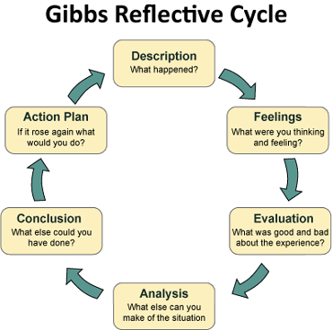

Slide 23
How to enhance clinical judgement: Workplace
Enhance Supportive Practices:
    Fostering a supportive work environment and providing structured orientation programs
  Provide faculty-led workshops for clinical preceptors
      Topics to include: giving constructive feedback and teaching under stress
Address Role Clarity
    Implementing clear role definitions and stress-reduction strategies
Provide Mentorship
    To offer guidance and reduce feelings of isolation among new nurses.​
    Nurse residency programs
Halloran et al, 2023

Slide 24
Lack of Experience
When examined from the lens of new graduate nurses, the academic practice gap is directly leading to the exodus of nurses
Lack of knowledge, information, and tools is a theme among new graduates
Quote:
“I wish we learned more skills. In many clinicals, all we did was shadow and observe. This made me completely unprepared for real nursing.”
New grads were found to be more vulnerable to job burnout, job stress, job difficulty, and job demand than their senior counterparts
New grads don’t have enough professional experience and need to learn many clinical nursing skills in the primary phase of their career.
Discrepancies between academics and practice can be overwhelming.
(Zipf, 2025) (Lyu et al., 2022)

Slide 25
Example
217 intensive care unit nurses were sampled
When people experienced more role ambiguity and role conflict, they felt less compassion satisfaction and more compassion fatigue and death anxiety
Notes:
(Wells, 2021)

Slide 26
Antecedent Factors in Role Ambiguity
Antecedents included
lack of clear role definitions,
lack of education/training, communication problems
supervisory behaviors and support
organizational culture
practice environment conditions, experience
group cohesiveness
preferred work setting
(Cengiz, 2022)
Notes:
(Cengiz, 2021)

Slide 27
Role Ambiguity
To address an issue, the issue must be assessed and understood first
What is it?
A concept analysis of role ambiguity revealed that role ambiguity breaks down to the following:
  lack of information (information deficiency)
  lack of clarity
  unpredictability
(Cengiz, 2021)

Slide 28
Consequences of Role Ambiguity
The consequences of role ambiguity included:
  Increased stress
  Lack of organizational commitment
  Job dissatisfaction
  Burnout
  Increased intent to leave
(Cengiz, 2021)
Notes:
(Cengiz, 2021)

Slide 29
Implications for Practice and Ways to Address
Nurses who reported more coaching from their supervisors experienced less role ambiguity
Coaching involves providing individual and meaningful feedback
Improvements in mentorship as outlined previously
Structured facilitative and person centered care programs that integrate theory, clinical skills and psychological awareness
(Hardiman et al., 2022) (Cengiz, 2021)

Slide 30

Ways to address lack of experience
YOU!

Slide 31
Ways to address lack of experience
More hands on experience in the academic and practice settings
Enhancing the “real life” aspect
Empowerment
Notes:
(Lyu et al. 2021) (Cengiz, 2021)

Slide 32
Mentorship
Fostering a safe space for NGRNs
The Future of Nursing 2020-2030 report, specifically Chapter 7: “Educating Nurses for the Future,” reports that mentoring programs are vital measures and effective approaches for supporting nursing students and novice nurses (Voss, 2022).

Slide 33
Empowerment – Person Centered Culture
A hospital in Ireland uses a person centered practice framework
An ongoing developing program that is revised based on direct feedback of its’ participants
The hospital reports success with the implementation of this model as evidenced by improved recruitment and retention of nurses; vacancies are <3%
Goal of the program is to nurture, guide and foster confidence
New graduate nurses stated that the emphasis needed to be less on academic learning and more on
Teamworking
time management
critical decision making
practical ‘how to’ skills
(Hardiman et al., 2022)
Notes:
(Hardiman et al., 2022)

Slide 34
Empowerment Example
In the work by Hardiman et al. (2022) the newly graduated nurses participated in research, they assisted with data collection and data analysis for research on their colleagues
This strategy served to enhance professional empowerment among the new graduates while simultaneously strengthening their commitment to the institution.

Slide 35
Overall Takeaways and Implications for practice
Curriculum Integration
Simulation
Authenticity
Peer Support
Critical Reflection
Mentorship
Empowerment
How will this impact your practice? — mentimeter
Notes:
Now that we have identified the problems, here are the solutions

Slide 36
Final Thoughts and Mentimeter Link
In this approximately one-hour presentation, new graduate nurses have made 120 clinical decisions
What is one strategy you plan to use in the future?
What was one of your main takeaways?

Slide 37

References

