Slide 1

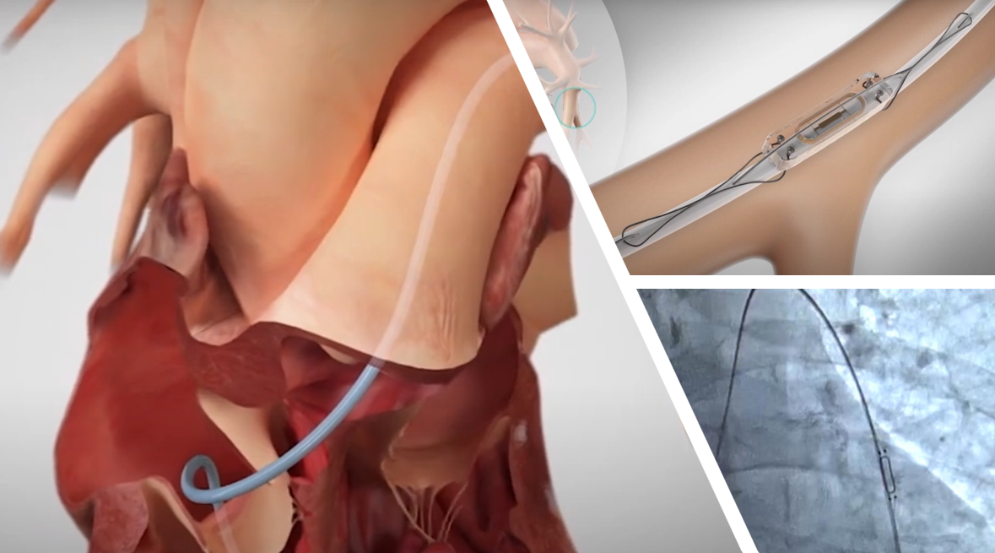
AACN please join us for an Educational Session on Heart Failure
and learn about CardioMems!
Discussion will revolve around the current climate of Congestive Heart Failure, patient access to care, and the benefits of Pulmonary Artery pressure monitoring.
Tuesday Aug 19th
6p
Fin Seafood
3150 William Styron Square
Newport News

