Slide 1
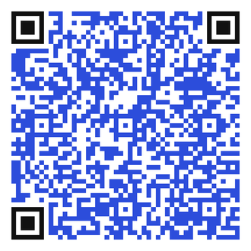


The Menstrual Equity Law
Purpose of The Law
In partnership with DPH, the Diaper Bank of CT is providing free period supplies to eligible schools acess Connecticut.
  Available products include,
    Pads (maxi & thins)
    Tampons
    Liners
If you are interested in this program, please fill out this short application:
Scan this QR code for the application!
Or go to: https://forms.gle/aDwh9mNJuH1uiXpL9
Feel free to reach out!
Jenny Kohl
Project Manager
Jenny@thediaperbank.org

