Slide 1

2025 Board Update
July 2025 Edition

Slide 2


2025-2026 AORN Board of Directors
The 2025-2026 AORN Board of Directors

Slide 3


Slide 4
Strategic Planning
Financial
Operations
Customer

Slide 5
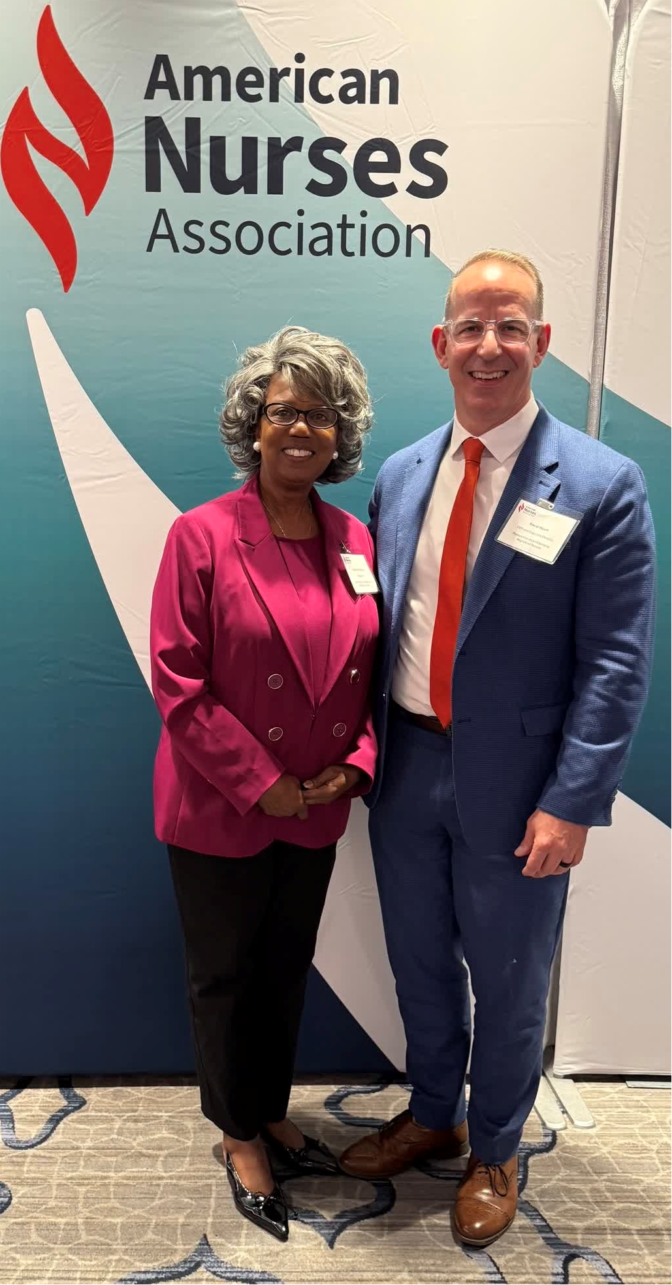

Board Representation Activities
President Murdock:
July 17-18 American College of Surgeons Quality & Safety in San Diego
July 31 Memorial Hermann Periop 101 Graduation, Houston, TX
JD Buchert:
July 16-18 National Association of Hispanic Nurses (NAHN) 50th Annual Conference, Irving, TX

Slide 6
Two New Specialty Assemblies
Healthcare Value Analysis
Perioperative Infection Prevention

Slide 7

Upcoming Dates & Deadlines

Slide 8

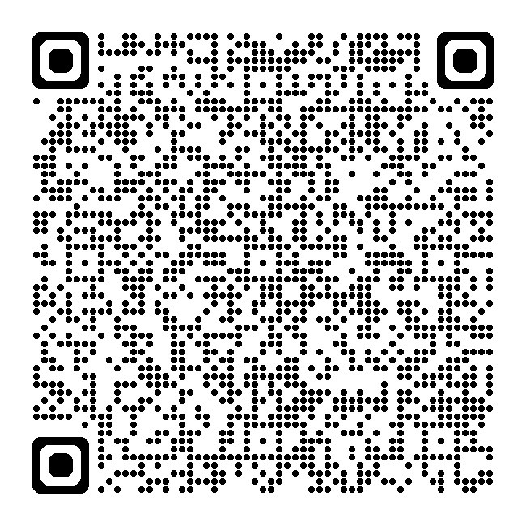
National Legislative Call
The next NLF call is scheduled on Monday, July 21, 2023, at 6:30pm mountain time.
The National Legislative Forum (NLF) calls take place on the 3rd Monday of each month at 5:30pm PT, 6:30pm MT, 7:30pm CT, and 8:30pm ET.
If you are interested in joining the calls, click QR Code.

Slide 9
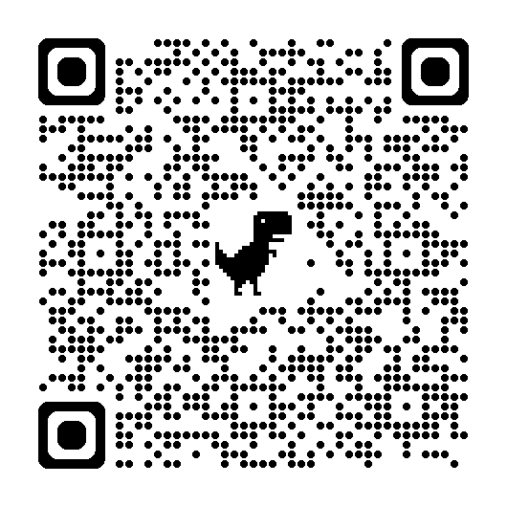
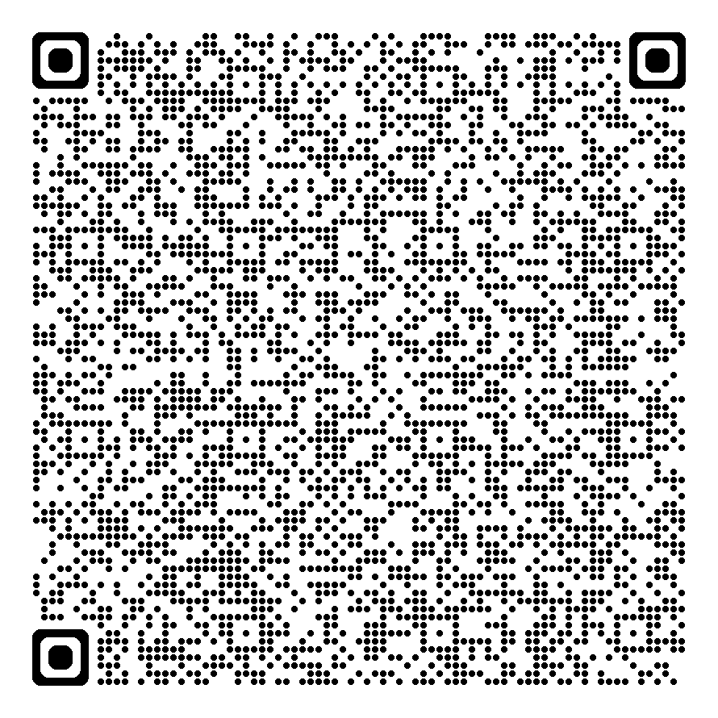
Chapter Leader Townhall
6pm MT, July 13th
This is an opportunity for officers to ask questions and find out what other officers are doing successfully.
If you missed the June call, scan this QR Code:
To Register for the August call, scan QR Code:

Slide 10
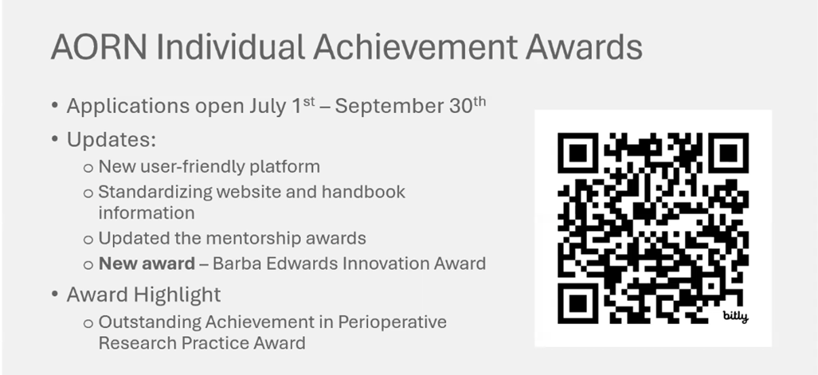

Slide 11
AORN Guideline for the Care & Cleaning of Surgical Instruments
Open for Public Comments through July 13th

Slide 12
AORN Guideline for Electrosurgical Safety
Open for Public Comments July 14th through mid-August

Slide 13
AORN Upcoming Events

Slide 14


Slide 15


Slide 16


Slide 17
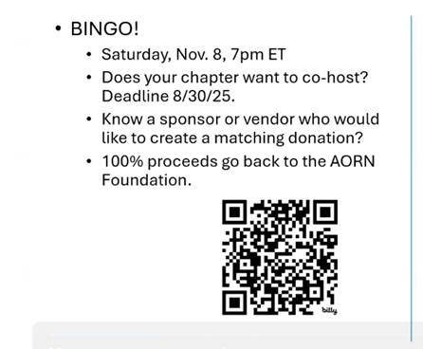

Slide 18
Recorded Webinars
Guideline Update: Sterilization 2025
The Guideline for Sterilization provides guidance for perioperative teams about sterilizing reusable medical devices to be used in perioperative and procedural settings.
Clinical topics: Surgery
Offers 1.0 contact hour
Available until September 10, 2026
Guideline Update: The Implementation of Enhanced Recovery After Surgery 2025
This presentation will review the new guideline for enhanced recovery after surgery.
Clinical topics: Surgery
Offers 1.0 contact hour
Available until October 17, 2026
Surgical Attire: Guideline Update 2025
Guideline for Surgical Attire with guidance for the perioperative RN for wearing surgical attire in semi-restricted and restricted areas, laundering, cleaning items, updates on disinfection criteria.
Clinical topics: Surgery
Offers 1.0 contact hour
Available until January 31, 2026
Access Live Webinars Here

Slide 19
Practice Updates

Slide 20
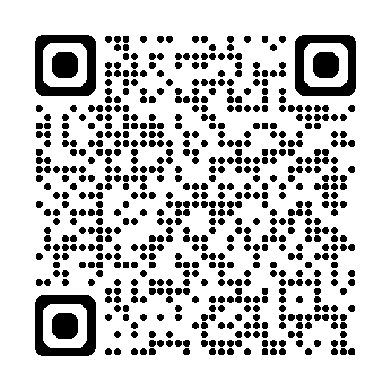
New Tool Kits
Health Equity Tool Kit
Combating Bullying and Incivility
Nurse Legacy
To Access Tool Kits, Scan the QR Code:

Slide 21

Have a Wonderful Summer!
We appreciate everything you do for our profession and for AORN. Please take of yourself mentally physically, emotionally, and spiritually! We care about you!

