Slide 1
Emergency Preparedness
Employee Health Services
April 2025
Notes:
Check out aspr.hhs.gov and snp

Slide 2
Barb Yendra, Practice Manager Employee Health Services City of Asheville Marathon Health Urine Drug Screen Trainer Emergency Coordinator Vaccine Coordinator MA, LPN, RN Peer Support
Employee Health Services is dedicated to the City of Asheville employees, spouses and dependents over the age of 16
Manage all Workplace Injuries
Opened in March of 2022

Slide 3
Agenda
Emergency Action Planning
Group Discussion
Events after Hurricane Helene
Decision to Reopen Health Center
Group Discussion

Slide 4
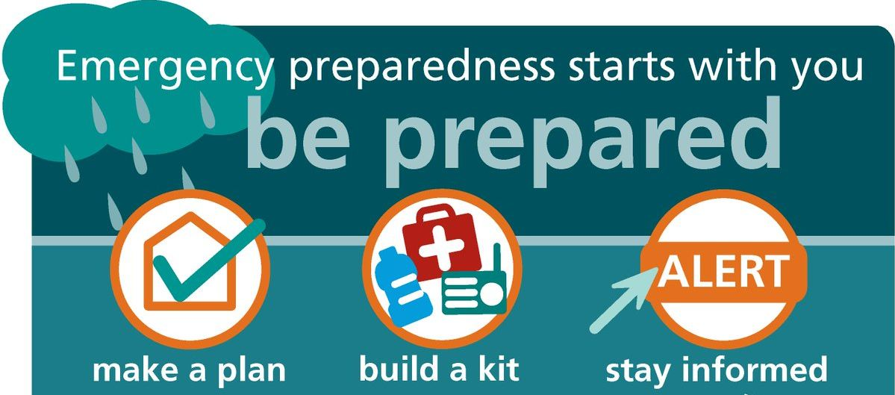
Emergency Action Plan
Flip Binder for Emergency Action Plan - Quarterly Training Sessions
Contacts and Resources – Making sure we have correct information for all contacts
For this discussion we will be talking about ACTIVE HURRICANE EMERGENCY and ACTIVE FLOOD EMERGENCY
Notes:
We have a flip binder for Emergency Action Plan. We are required to complete Quarterly Training Sessions. Prior to Hurricane Helene I had all teammates take a photo of the Contacts and Resources in our Emergency Action Plan.

Slide 5
Health Center Impact Assessment
Potential disruptions to patient care.
Facility vulnerability points.
Vaccine Storage and power outage.
Communication protocols during emergencies.
Photograph or video record each room in the office.
Where to go during a flooding event.
Personal Emergency Preparedness
Family Evacuation and/or Communication Plans
Home Safety Planning
Pet Emergency Arrangements.
Photograph or video record each room at home and surrounding outdoor area.
Prepare a To Go Bag
Notes:
When talking to the team we discussed potential disruptions to patient care. Facility vulnerability points. I changed batteries in the vaccine monitoring device to make sure they were new. We talked about how we planned to communicate with each other during the hurricane. However, we hadn’t planned on losing all cellular activity. To be honest at the time of the hurricane I wasn’t talking to the team about personal emergency preparedness. Now we do. I just reviewed what to do in case of a wildfire not only at the health center but also at their homes. Are they prepared to leave if necessary.

Slide 6
Emergency Kit Components
Every Teammate should maintain both workplace and home emergency kits.
First Aid Supplies
3-day supply of non-perishable food and water
Battery-powered or hand-crank radio
Written family communication plan
Extra batteries
Flashlights
Emergency whistle
One-week supply of essential medications
Important documents in waterproof container
Portable Phone Charger preferably solar powered
Notes:
Every office should have an emergency kit. Everyone should also have an emergency kit at home personalized to your needs and your family

Slide 7
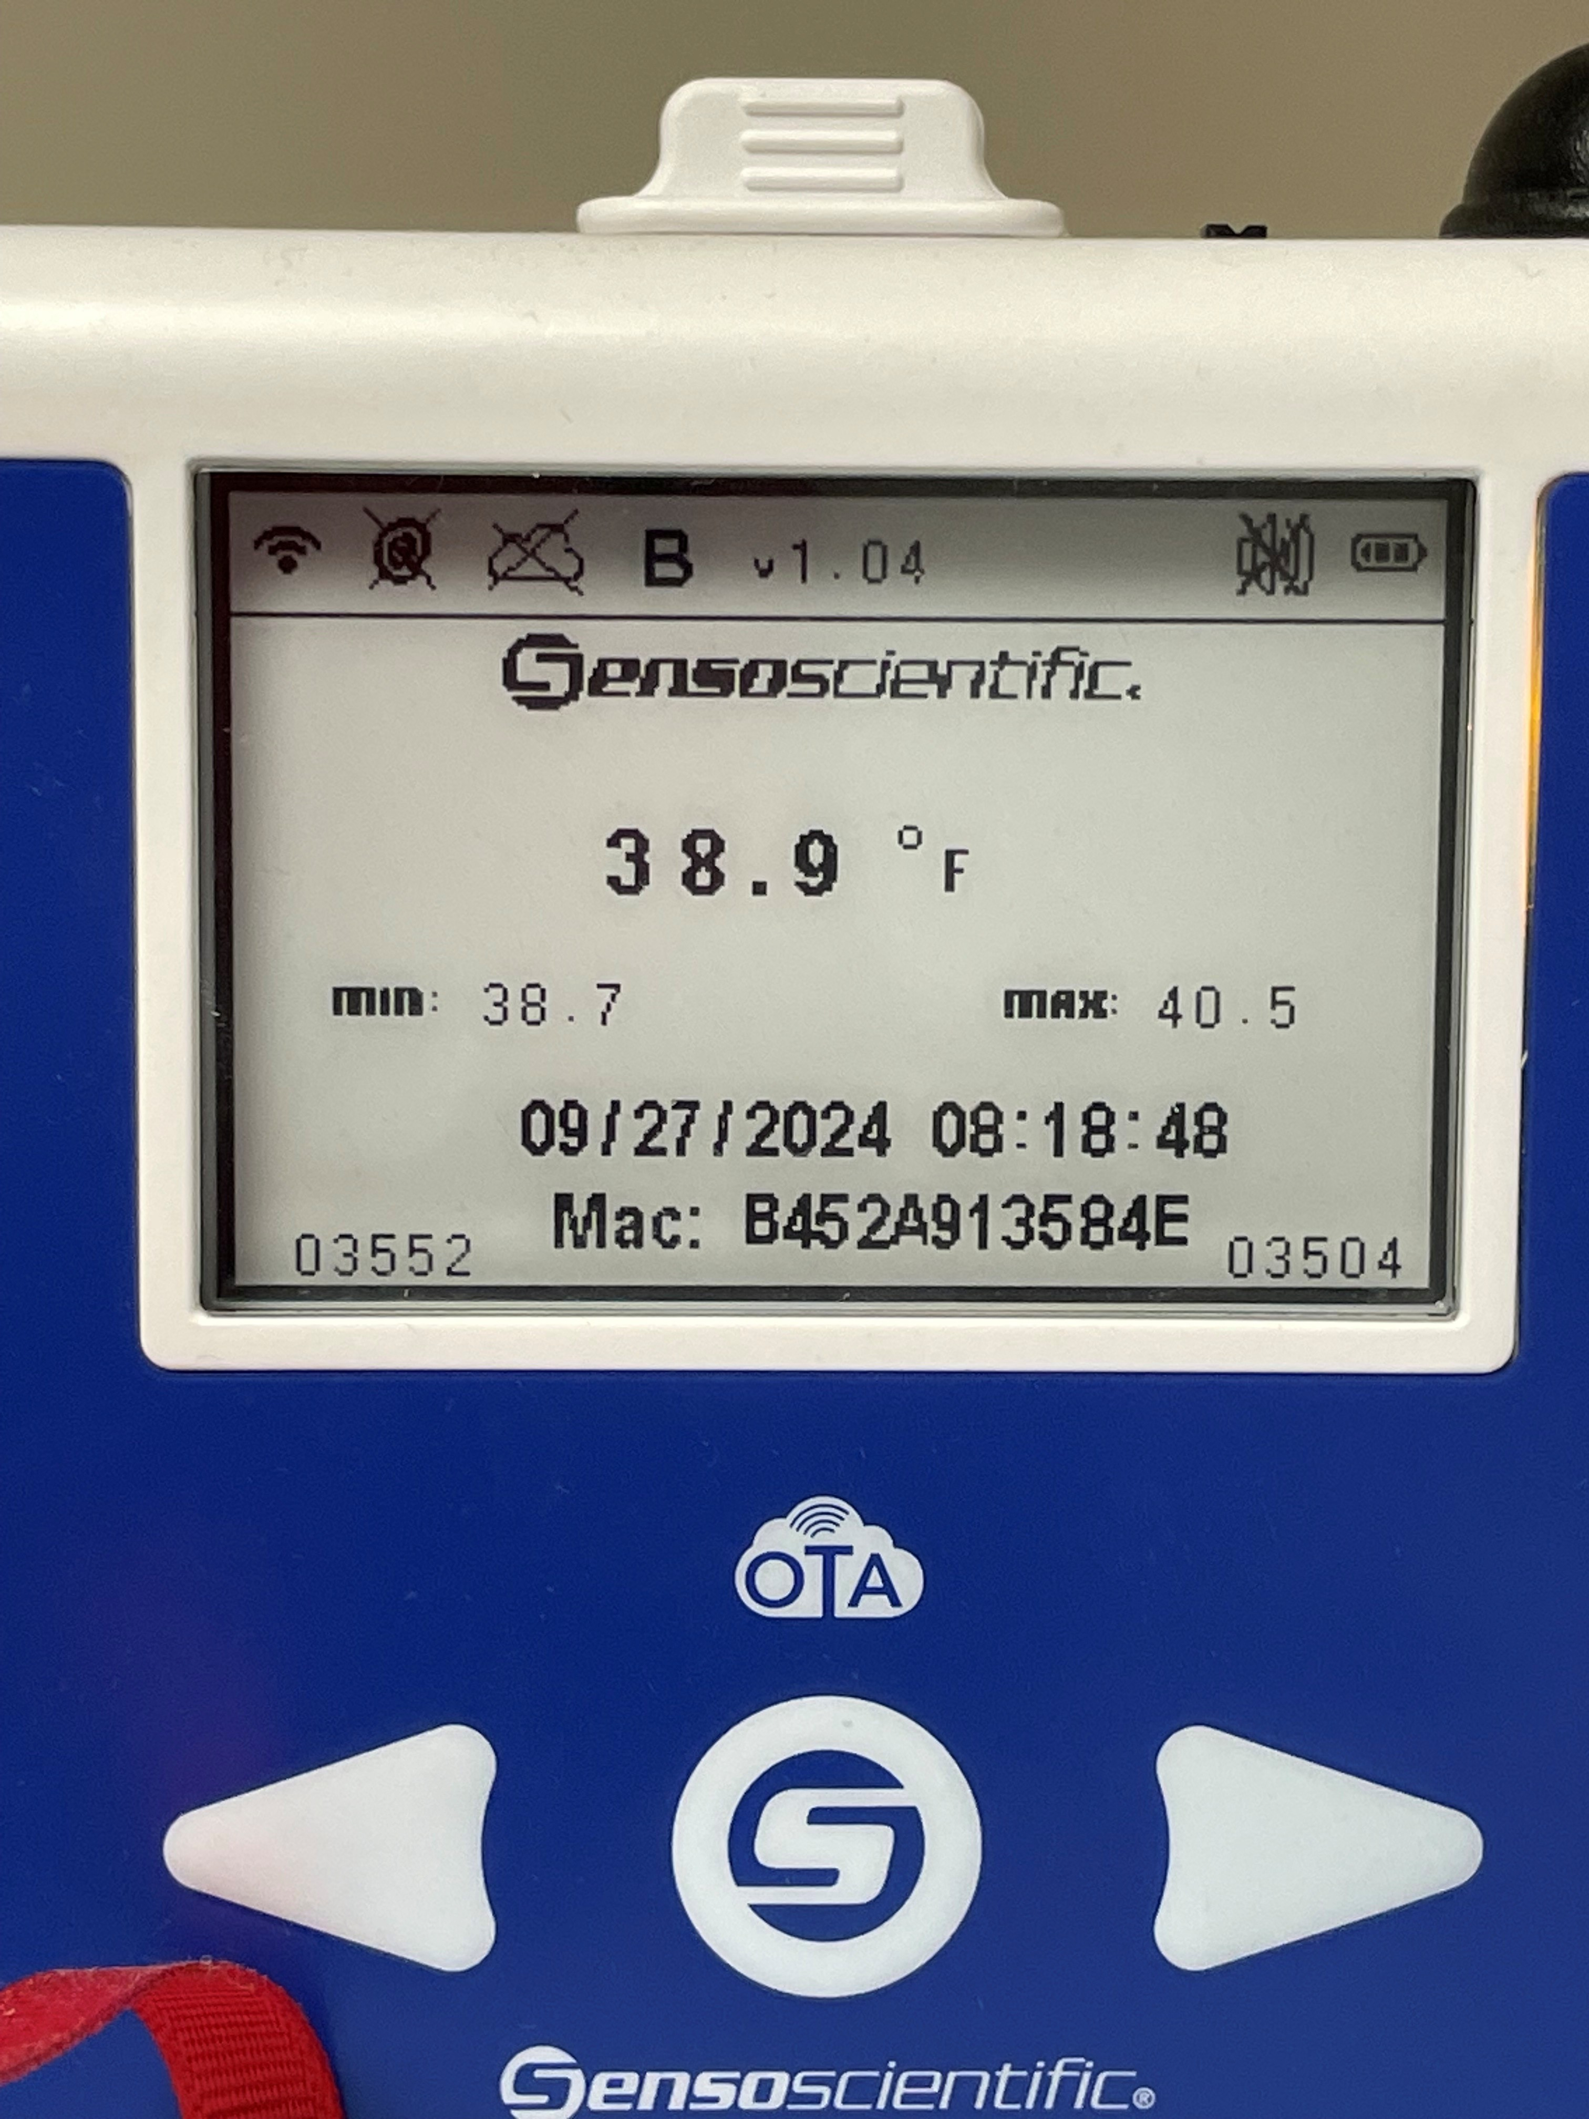
Preparing for a Hurricane and Flood
Who is the Health Center’s Emergency Coordinator?
Ensure client has procedures to notify Health Center in the event of an Emergency.
Establish phone or calling tree. (do you have secondary phone numbers?)
Review your Health Center’s vaccine storage procedures.
All teammates are asked to take photos of “CONTACTS and RESOURCES” with their phone, prior to the event.
In the future, I will take a video of the clinic and vaccine storage monitoring prior to leaving the building, if at all possible.
Talk about where to go during a flood for safety. What about your risks at home?

Slide 8
Pre-Closure Preparedness Actions
Personal/Home Preparation
Fill their cars with gas.
Purchase non-perishable food supplies.
Obtain additional water for drinking and flushing (fill bathtub for flushing)
Charge all electronic devices including external power sources.
Facility Preparation
Verify vaccine refrigerator functionality.
Replace batteries in external refrigerator monitoring system.
Post closure notices on facility doors
Take laptop home to work remotely.
Record health center closure information on the phone voice messages.
Notes:
These are the items that we did talk about prior to Hurricane Helene on that Wednesday in the health center.

Slide 9
Facility Closure Decision
Due to severe flood warnings in the Hendersonville area, the Health Center was closed Thursday and Friday as a preventive safety measure for staff.
Operational Continuity Measures
Staff maintained health center operations on Thursday with remote patient visits.
Friday Operations
Full closure was implemented
All patients were rescheduled
Workplace injuries were redirected to Urgent Care facilities or Emergency Room Services.
Communication Protocol
Signs were placed on the door of the office informing patients of closures.
Voice messaging on the phone reported closure of the health center.
City of Asheville sent out health center closure on their intranet.

Slide 10
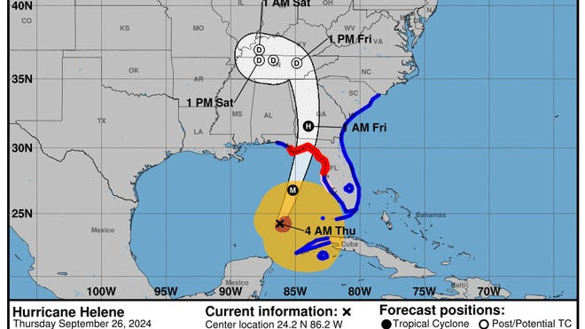
City of Asheville
Thursday the City of Asheville set up a command center before the storm hit.
Heads of departments were at the safe location throughout the course of the storm.
Immediately after the storm City of Asheville first responders were conducting rescue operations.
City of Asheville and Buncombe County worked together as a team prior to Hurricane Helene and in the aftermath of it.

Slide 11
Group Discussion
What did you do prior to the hurricane that you are glad that you did?
What do you wish you should have done prior to the hurricane?
Next, we will discuss Hurricane Helene impact.

Slide 12
Hurricane Helene Friday, September 27th
Power went out at 2:00 a.m. Friday, September 27th, 2024
1:00 pm on Friday, I left my area to go to the health center to check on the vaccines and power at the clinic. DO NOT DO THIS!
Since all communication had stopped, I had no way of knowing anything regarding the storm.
I drove I26 into Asheville, and I could see the French Broad causing severe flooding.
Clinic had power! Vaccines were safe. I took photos of vaccine monitoring device.
I tried to call staff and found out we had no cell service.
Phones and internet were out at the office.
I drove to the hospital parking lot and could get a cell phone signal.
I tried to call of the staff – no answer. I did get a call to my daughter in Nebraska. She became the disaster director for our family. Brooke had been trying to contact my daughter in Brevard, but no answer. Brooke was extremely worried about all of us since she was seeing photos of damage..
We drove back to my place the same way we came to the office.

Slide 13
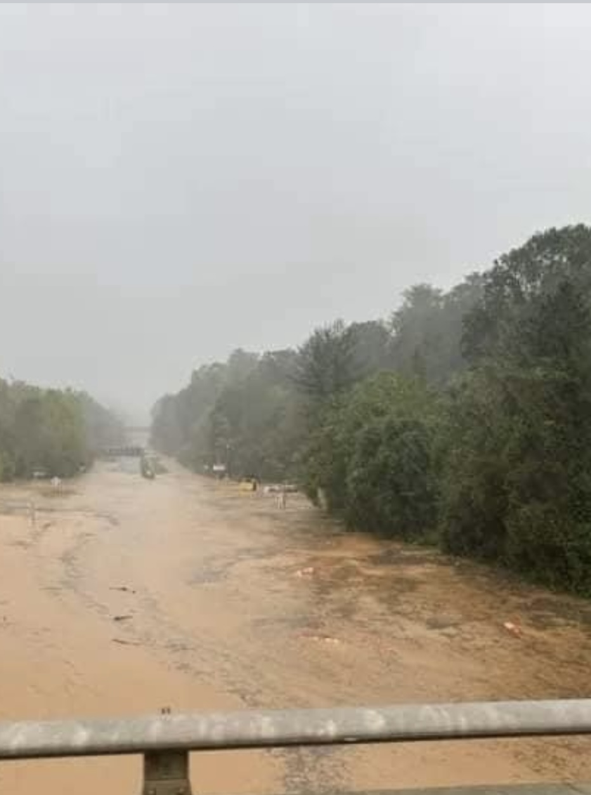
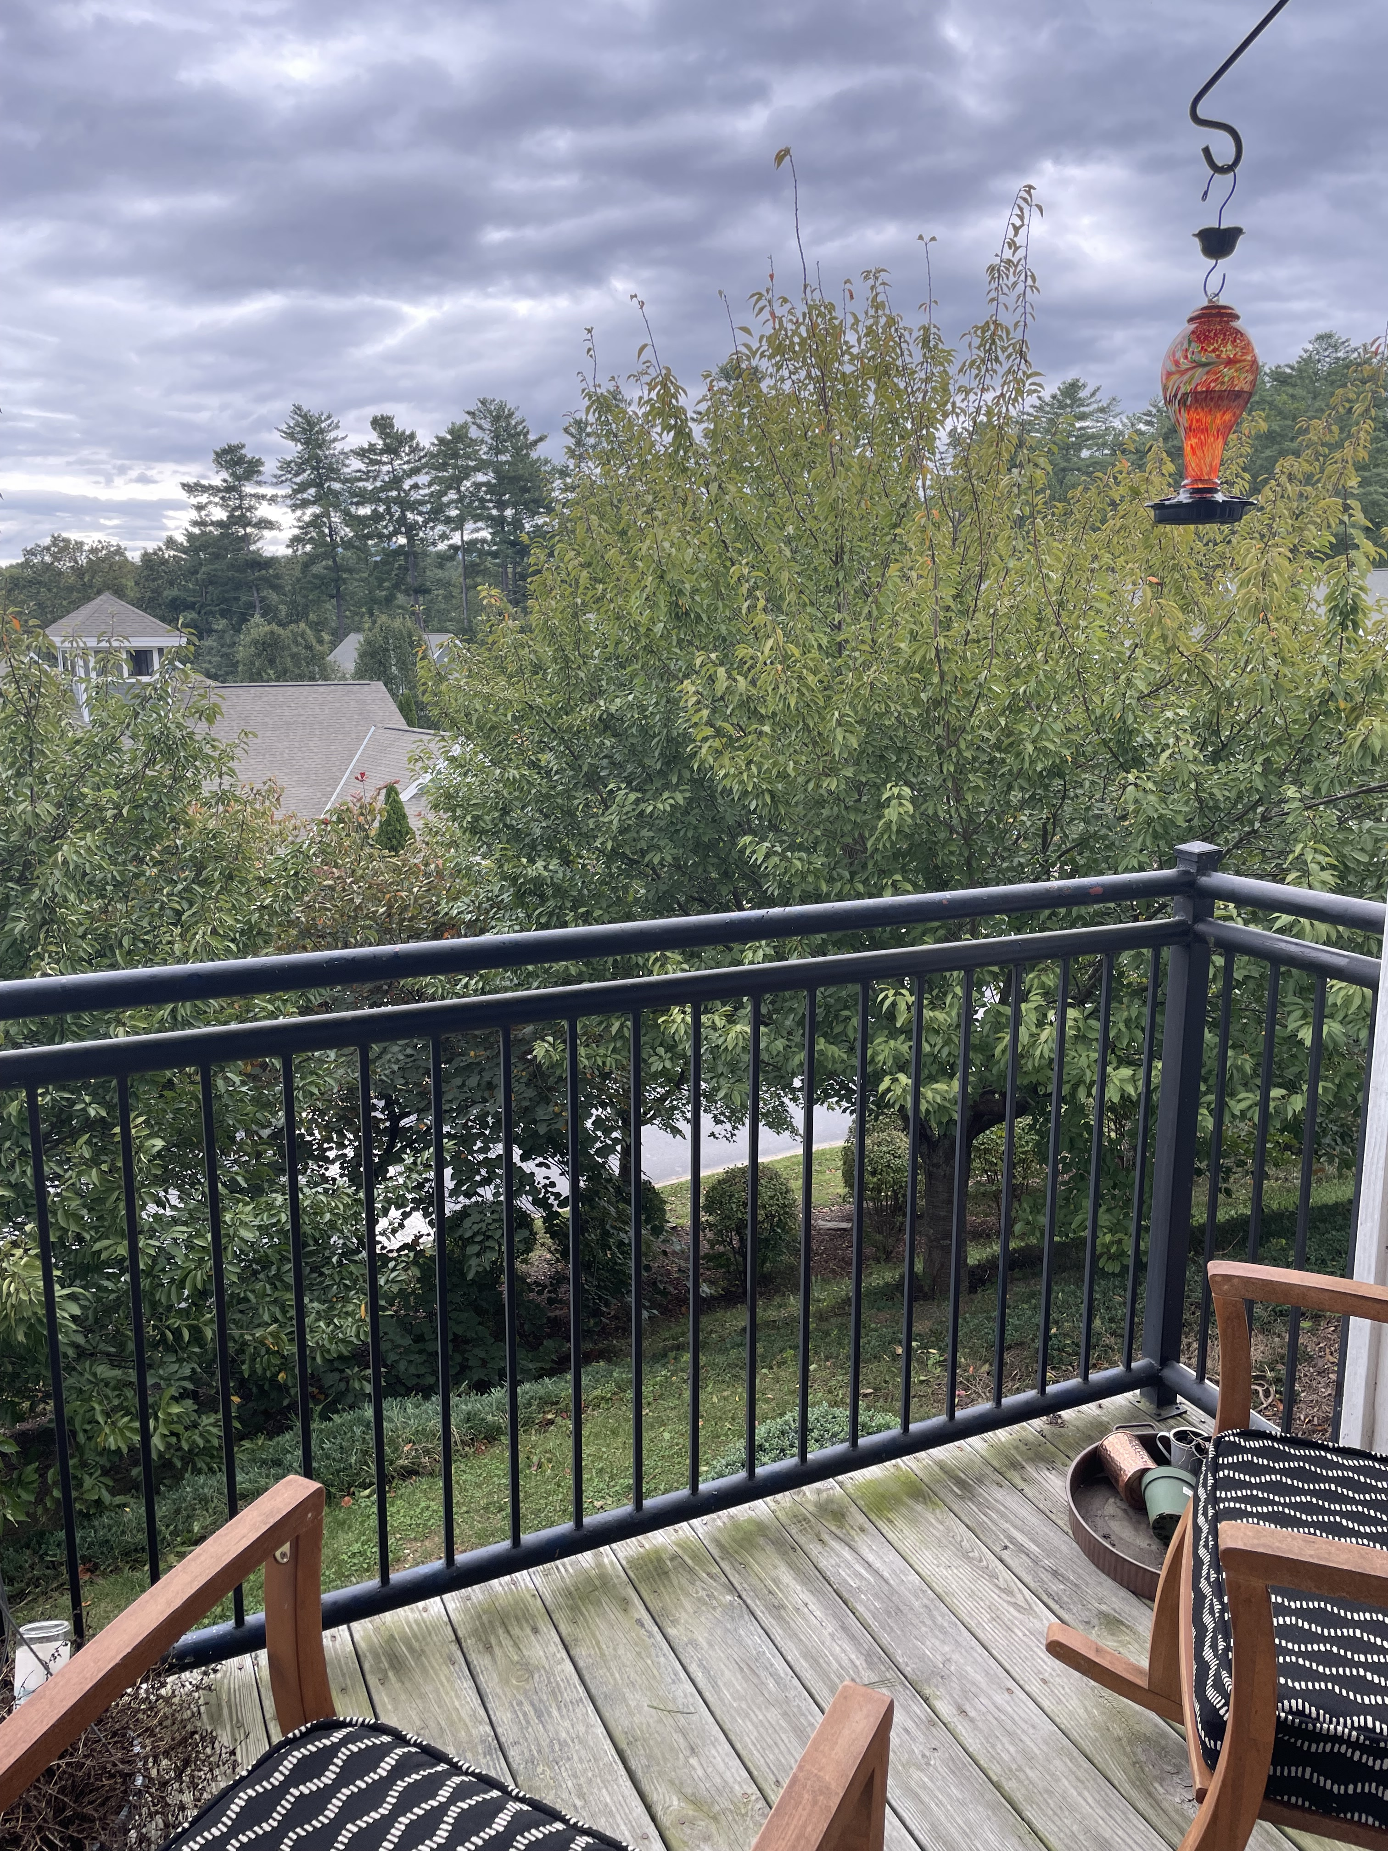
Friday, September 27th
My view Friday afternoon verses the reality of the surrounding area.

Slide 14
Hurricane Helene-Saturday, September 30th
Very thankful that I filled the bathtub with water to use for flushing the toilet.
I had 8 cases of water at the health center for Urine Drug Screens. I took two of those to my place. I did give some water to staff at Hopscotch. They drove in to check their office right up above our clinic. I also had several cases of snacks, and I gave some of that to them.
I was able to use the toaster over to cook some food from my refrigerator at home.
After recharging devices, we tried to drive to Brevard. We got south of the airport. Water from the French Broad was over the road. The line for gas was about 1 mile long.
We stopped at Fair grounds and got cell signal.
At this point I had no communication with City of Asheville HR department or any of my Marathon Health leaders due to the communication services being impacted by the storm.

Slide 15
Hurricane Helene- Saturday continued
I texted with team members. I did get a response from several. They were safe.
I called Brooke my disaster manager. She was prior military and was managing our family great from afar. It had been 24 hours since she had contact with us. She was thrilled to hear my voice. My son was with her. So that alerted me to how worried and stressed she was about the situation. Brooke hadn’t heard anything from Brevard family. She wanted addresses for Britts (Brevard Family), my health center and my apartment.
She told us that Asheville was an island. All access had been cut off. This is first that I heard the term “Hurricane Helene Disaster of Biblical Proportion.” Those words hit extremely hard. I am from Nebraska and Colorado. Tornados, blizzards, wildfires were common Emergency events. Tornados were reported to look like a war zone after they went through.
Brooke informed us of reports of looting and to be very careful.
She also let me know that there was a curfew in the city.
Truly at this point I had no idea of the magnitude of this event.

Slide 16
Hurricane Helene-Sunday, September 29th
Sunday, we drove to the office to cook, recharge devices, and get more water.
At this point we started taking a 5-gallon bucket to the swimming pool where I live. We would fill it up to replenish the bathtub water for flushing.
Sunday evening Starlink was connected in Woodfin. This gave me the ability to text from home.
Brooke still had no contact with family in Brevard.
I received a text from Natalie Guynn. She is a friend who I have worked with. Her brother lives in Asheville, and she was checking in on us.
She was able to give me navigation routes to drive to Brevard Monday morning.

Slide 17
Hurricane Helene-Monday, September 30th
Monday morning, I was able to get a phone call out to Brooke. She told me she had communication with Britt in Brevard. They were safe, had power and water. They were so worried about us in Asheville.
I let Brooke know that we were going to attempt to drive to Brevard, and the route that we would be taking.
We left before curfew had lifted. I had seen the back up of traffic on 126 on Sunday. We knew if we wanted to get out and still have gas to get there we needed to leave early.
Monday morning at 8:30 am we arrived safely to be greeted with open arms by the family in Brevard. Best HUGS I have had in YEARS….
We learned that the fiber optic cable had been severed. Which resulted in everyone losing communication ability.
My son-in-law is a professor at Brevard college. They were driving students north of Brevard to get a cell signal so students could call family.

Slide 18
Hurricane Helene-Monday, September 30th Communication with City of Asheville and Marathon Health
I drove north of Brevard about 5 miles to get cell signal to make phone calls.
I called and spoke with the acting HR Director for the City of Asheville. I let her know that the team was safe, the building was intact.
The City of Asheville was making sure all city employees were safe. Some homes were lost. Some city buildings were gone.
My next call was to my managers and teammates.

Slide 19
Health Center Services Redirected
Marathon Health redirected all clinical services immediately. We have Care Anywhere team that provides virtual and phone visits for our clients that opt into that service. We have MD’s that are licensed in 50 states.
I was able to talk to the lead for the Care Anywhere team and let them know important information about our client “City of Asheville.” They navigated services to find pharmacies where medications could be filled.
They created a clinical schedule for virtual or phone visit to be started on Tuesday.
This gave our onsite team a chance to regroup and deal with personal issues before having to return to work.

Slide 20
Hurricane Helene-Tuesday, October 1st Internet is up and going in Brevard
I could now log into my work computer to help navigate patients to Care Anywhere.
I held meetings with Senior Leadership at Marathon Health to discuss what our needs were.
I advocated for teammates to make sure they were paid. During the event all staff was paid normally throughout the course of this event. Marathon Health wanted to make sure that the teammates were able to focus on being safe and helping others in need.
I had meetings with City of Asheville HR department to discuss next steps and possible reopening.
Five days after Hurricane Helene, I saw the first news clips and photos. I couldn’t stop looking at the devastation. The stories had such a huge impact. I was now seeing what the world was seeing.
One image that had a lot of impact of the water department. All the roads were gone, water treatment had been heavily damaged. I knew this was going to take a long time to fix.

Slide 21
Hurricane Helene – Thursday, October 3rd We determined that the team wanted to get back to work as soon as possible. The City of Asheville wanted us to be able to take care of first responders. Barriers to reopening the health center. 1. No running water – City of Asheville delivered bottled water 2. No flushing toilets – City of Asheville delivered two port-a-potties 3. Curfew in place – When we returned to work it was reduced hours. 4. No internet or phone service – I worked with Starlink. However, service came on several hours prior to Starlink setting us up. 5. No ability to wash hands – I went to Ace Hardware and bought large Igloo drink containers. My daughter had 4 containers with dispensing device. We used those for patient exam rooms.

Slide 22
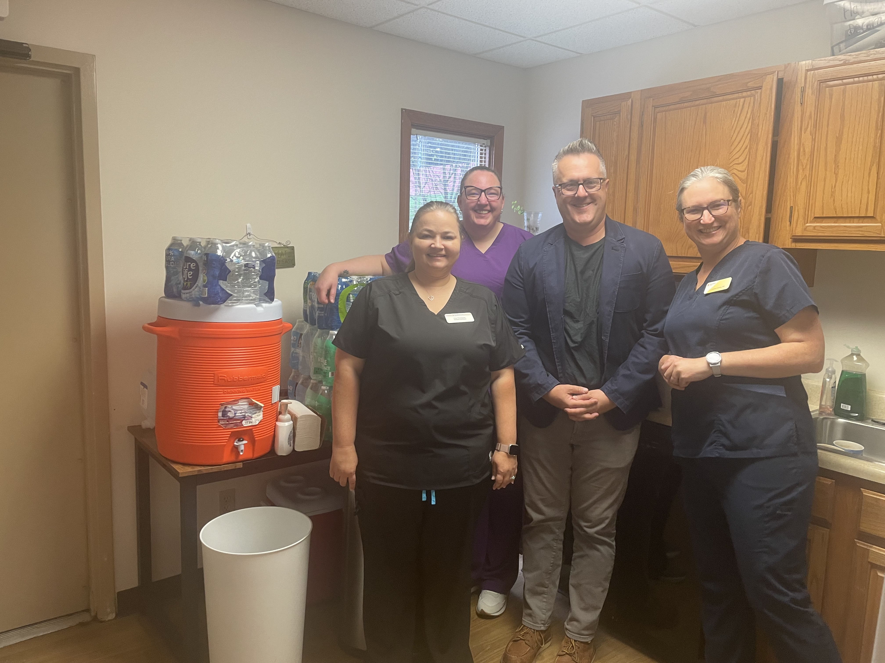
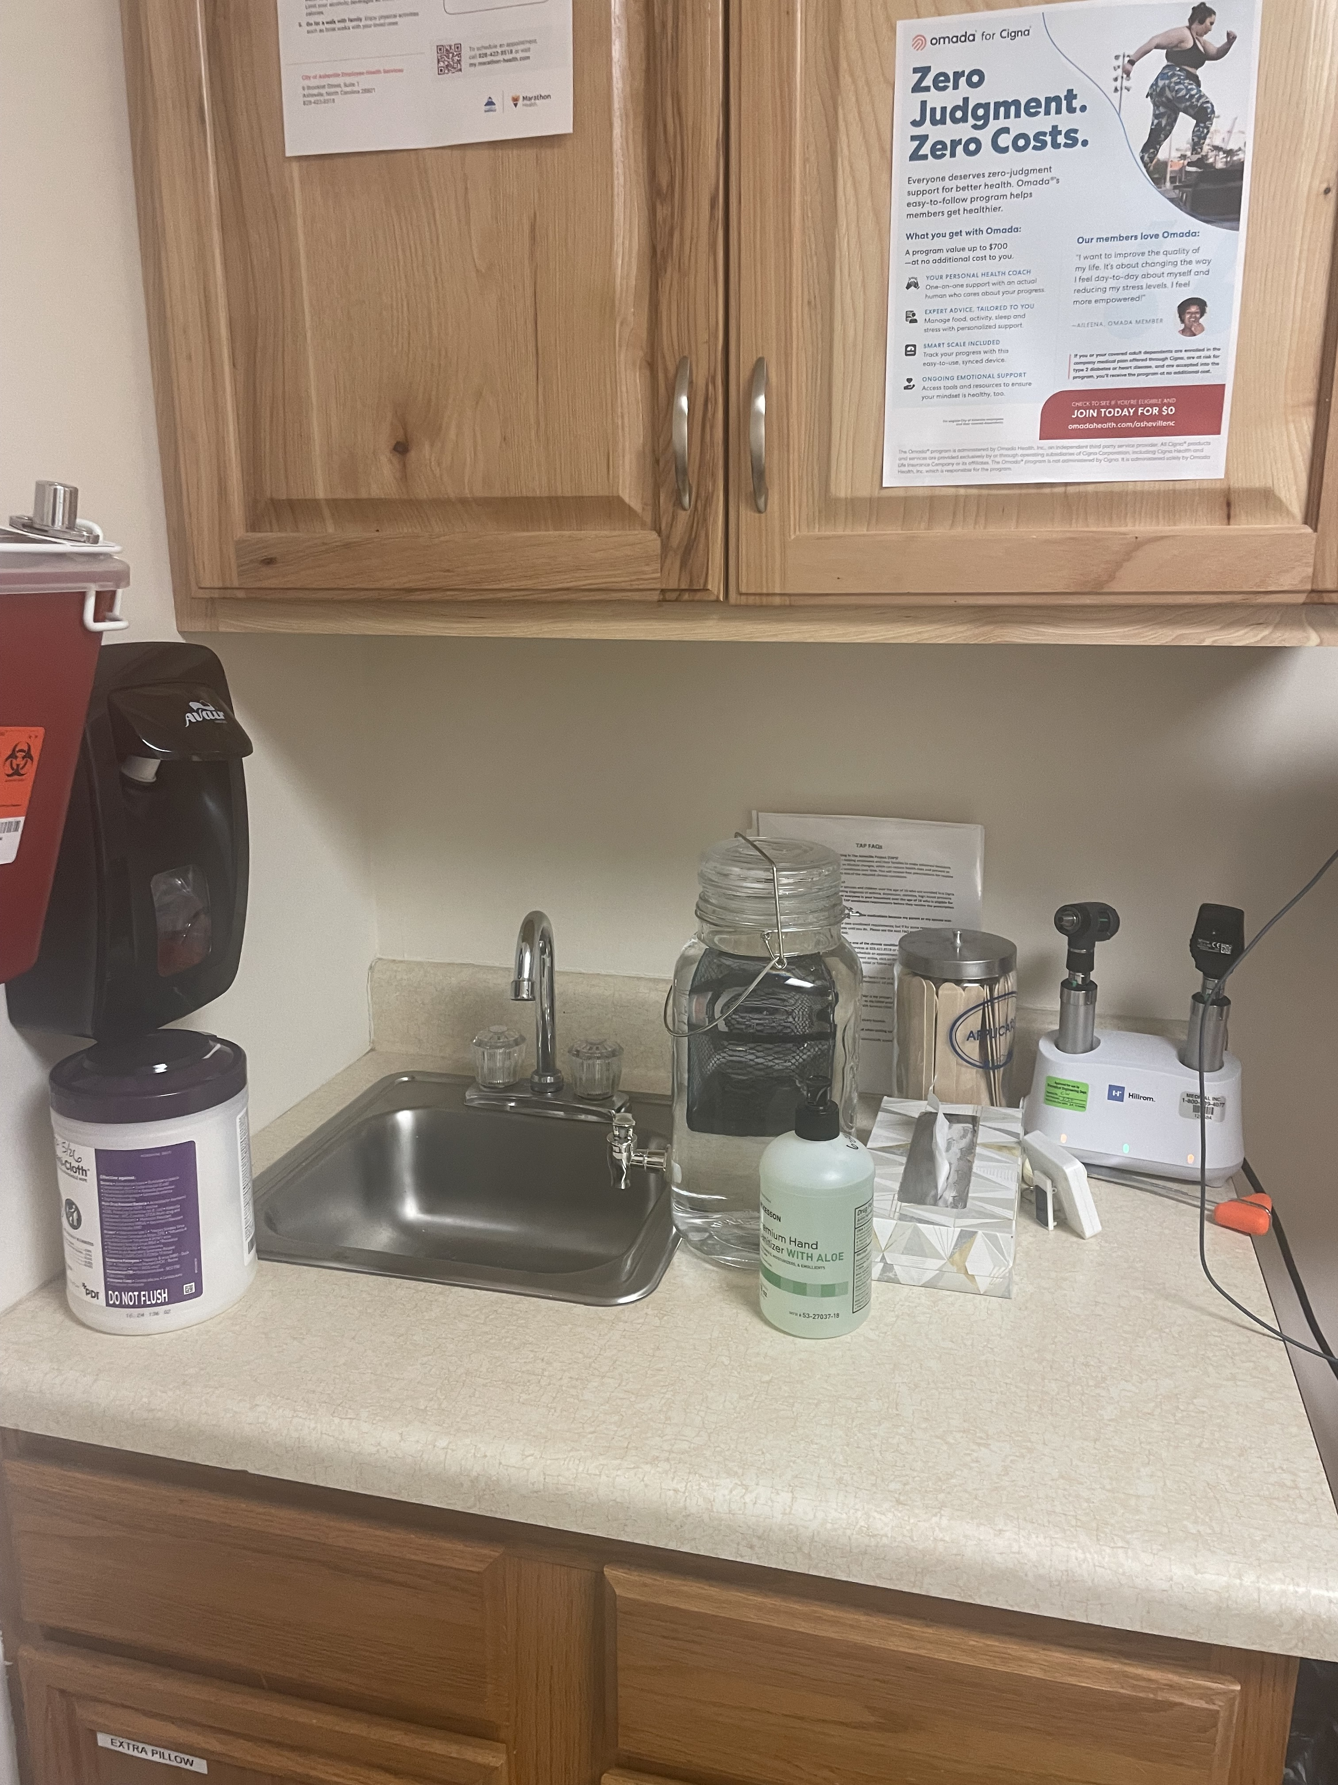
Main Hand Washing Station and Patient Room

Slide 23
Reopening the Health Center Marathon Health in a nationwide health care company. We have over 700 health centers across the US. This was the first time that we would be opening a health center without running water or working toilets in the health center. A lot of work was being done behind the scene with Marathon Health. Their concern was for the safety of all of our staff and patients. I drove into Asheville on Friday and set up hand washing stations. On Monday, October 7th we reopened Employee Health Services from 9:00 am – 3:00 pm One of my VP’s for the region lives in Charlotte. He came into the health center that Monday with supplies from some of the Charlotte offices. Internet and phone service started Monday morning we did not have to use Starlink. I connected with the safety manager for the City of Asheville. We ordered an extra 60 Tdap vaccines. These were delivered by the end of the week. Those first several weeks were all about listening. Employees just needed a safe place to be heard.

Slide 24
Services that were available The Buncombe County Health Department was sending out emails with lists of pharmacies that were open. Richard Hill FNP volunteered to go to Fire Stations to give care. Care Anywhere continued for the next two weeks (total of three weeks that they were utilized). City of Asheville added BetterHelp for mental health issues due to the hurricane.

Slide 25
Vaccine Information If power would have been disrupted, I would have called the manufacturers for the vaccines we had in inventory. I would have told them how long power was out, what the high and low temperatures were. They would have told me if they supported us to use them or if we had to discard them.

Slide 26
Time to Debrief as a Team
My provider had a tree on two of her vehicles.
One of my MA’s had police deliver food and water to her.
My other MA’s daughter was rescued Sunday by a swift water rescue team.
Marathon Health paid all the staff normal pay during and after the hurricane even as we worked reduced schedules. It was extremely important to me that they were taken care of financially.
Mental Health Counselors for team. We needed to make sure we were all in a good head space, so we could be there for city employees.

Slide 27
Future needs for Emergency Events
Phone that has satellite capability.
Portable Crank Radio
Make sure every device is fully charges.
Solar powered battery pack that can charge multiple devices.
Travel to safety prior to major storm events.

Slide 28
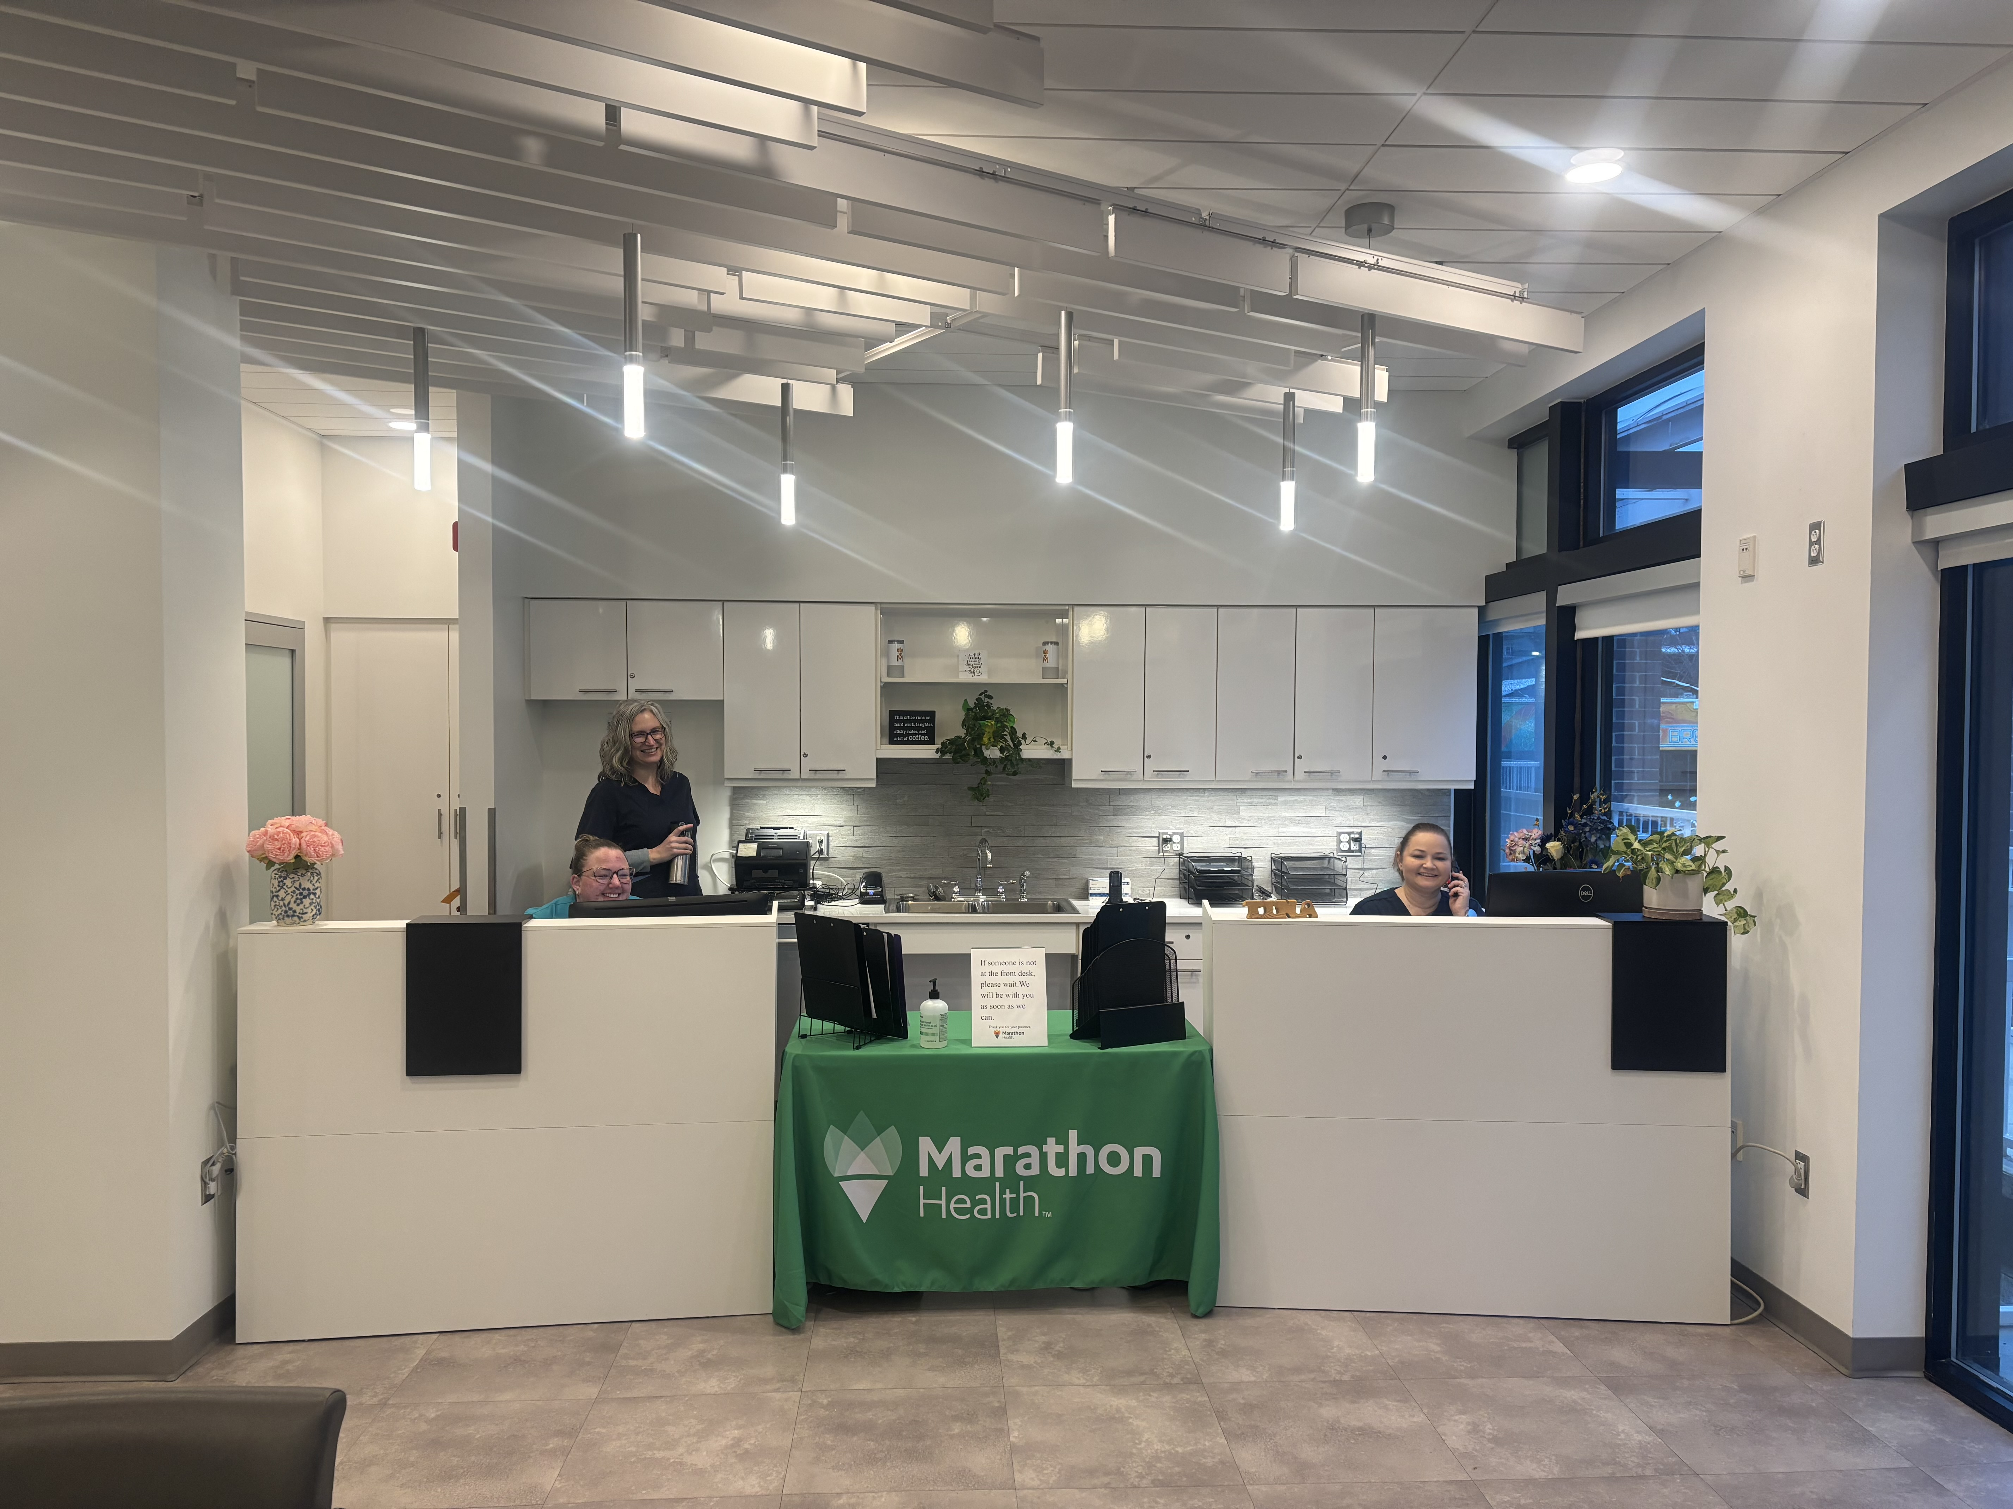
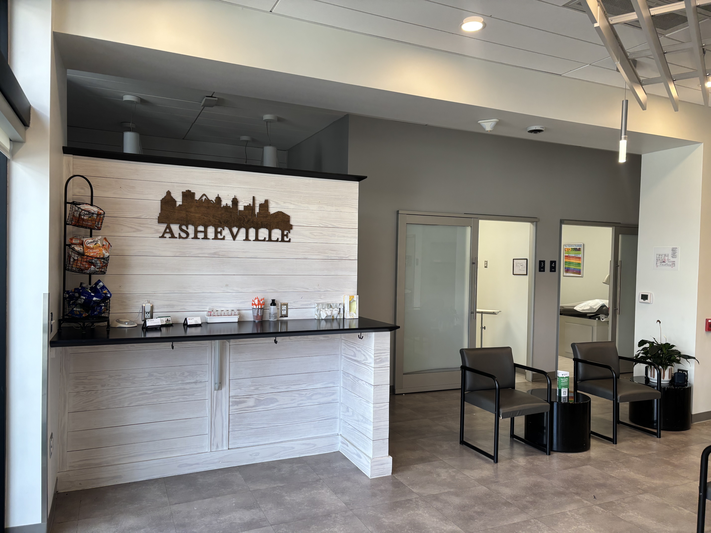
New Location for Employee Health Services

Slide 29
Group Discussion
What worked well for your teams during and right after the hurricane?
What would you have done differently?

Slide 30
Employee Health Service
City of Asheville
marathon.health

