Slide 1
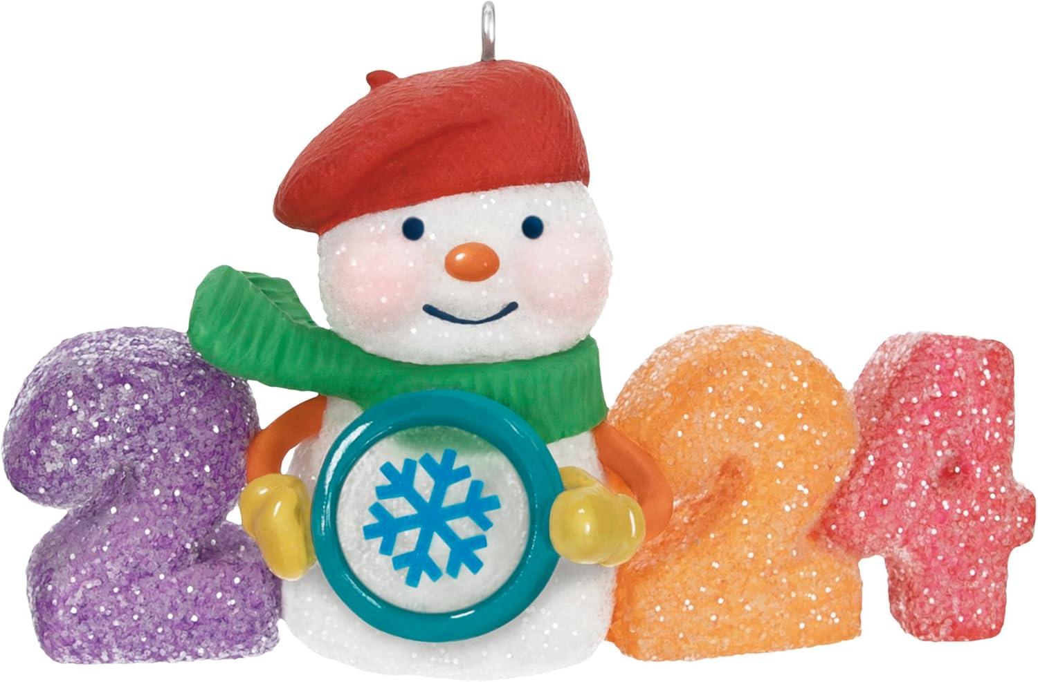
Reminder: CIC-AACN Annual Ornament and Gift Basket Auction Monday December 9!!
When: Dec 9, 2024
Registration begins at 5:30 pm
Dinner begins at 6:00 pm
Ruth Chris Steakhouse at Ironworks
2727 E. 86th Street
Indianapolis, In. 46240
Donate an ornament or basket to be auctioned off or just shop!!
All proceeds will go to Riley Child Life this year!!
We have a couple seats left if interested go to Nursing Network to register for this event

