Slide 1

National Hispanic Heritage Month Celebration
Latinas In Nursing
Dr. Tina Loarte-Rodriguez, RN, CIC, CPPS, CPHRM

Slide 2
NHHM: Latinas In Nursing
Objectives:
Summarize the significance of NHHM
Examine the impact of Hispanics / Latinos|e|x in the US
Value the mission of Latinas In Nursing

Slide 3
NHHM
Each year, Americans observe National Hispanic Heritage Month from September 15 to October 15, by celebrating the histories, cultures and contributions of American citizens whose ancestors came from Spain, Mexico, the Caribbean and Central and South America.
The observation started in 1968 as Hispanic Heritage Week under President Lyndon Johnson and was expanded by President Ronald Reagan in 1988 to cover a 30-day period starting on September 15 and ending on October 15. It was enacted into law on August 17, 1988, on the approval of Public Law 100-402.
The day of September 15 is significant because it is the anniversary of independence for Latin American countries Costa Rica, El Salvador, Guatemala, Honduras and Nicaragua. In addition, Mexico and Chile celebrate their independence days on September 16 and September18, respectively. Día de la Raza, which is October 12, falls within this 30 day period.

Slide 4
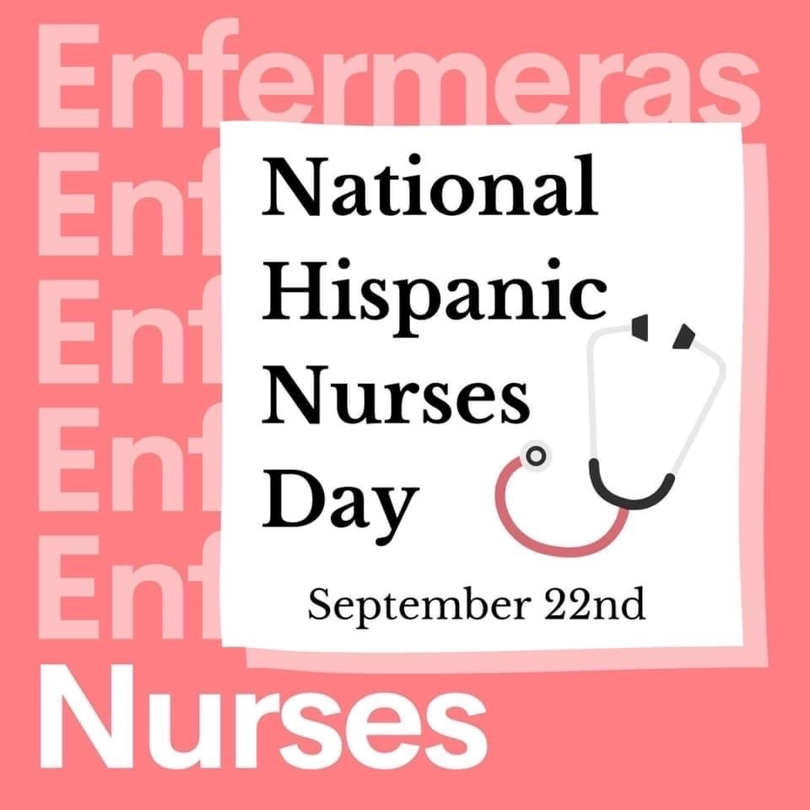
Expressing support for the designation of September 22, 2020, as “National Hispanic Nurses Day”.
Whereas the World Health Organization declared 2020 as the year of the Nurse and Midwife, and coincidentally, 2020 is experiencing unprecedented times highlighting the intelligence, agility, grit, and tenacity of nurses in all sectors across the Nation;
Whereas a special group of nurses in the Nation are the Hispanic nurses;
Whereas Hispanic nurses provide culturally and ethnically competent care and are educated to be sensitive to regional and community customs of persons needing care;
Whereas Hispanic nurses are well-positioned to provide leadership to eliminate health care disparities that exist in the Nation;
Whereas, since 1975, the National Association of Hispanic Nurses (NAHN) has represented Hispanic nurses (RNs/LPNs) in the United States and is the only nursing organization for Hispanic nurses whose mission is to advance the health in Hispanic communities and to lead, promote, and advocate for educational, professional, and leadership opportunities for Hispanic nurses;
Whereas, since September is the month that has been set aside to honor the contributions of Hispanics, it is only fitting that Hispanic nurses be recognized and honored during this time for their outstanding contributions to their community and country;
Whereas the designation of an observation day will help to raise awareness of the accomplishments of Hispanic nurses and pave the way for the important work that they must continue to carry out;
Whereas, each February, NAHN convenes nearly 100 nursing leaders from academia, research, education, and practice in Washington, DC, for a Day on Capitol Hill promoting legislation that improves the health of Hispanic communities;
Whereas Hispanic nurses are strong allies to Congress as they help inform, educate, and work closely with legislators to improve the education, retention, recruitment, and practice of all nurses and, more importantly, the health and safety of the patients they care for; and
Whereas Hispanic nurses add needed diversity to the profession, and these nurses have engaged in numerous ways to support community and needs of an overlooked, under resourced, and underserved population being severely impacted by COVID–19: Now, therefore, be it
Resolved, That the House of Representatives—
(1) supports the goals and ideals, and the designation, of National Hispanic Nurses Day, as proposed by the National Association of Hispanic Nurses;
(2) recognizes the significant contributions of Hispanic nurses to the health care system of the
United States; and
(3) encourages the people of the United States to observe National Hispanic Nurses Day with
appropriate recognition, ceremonies, activities, and programs to demonstrate the importance
of Hispanic nurses to the everyday lives of patients and communities they serve.
Text - H.Res.1141 - 116th Congress (2019-2020): Expressing support for the designation of September 22, 2020, as "National Hispanic Nurses Day". | Congress.gov | Library of Congress

Slide 5
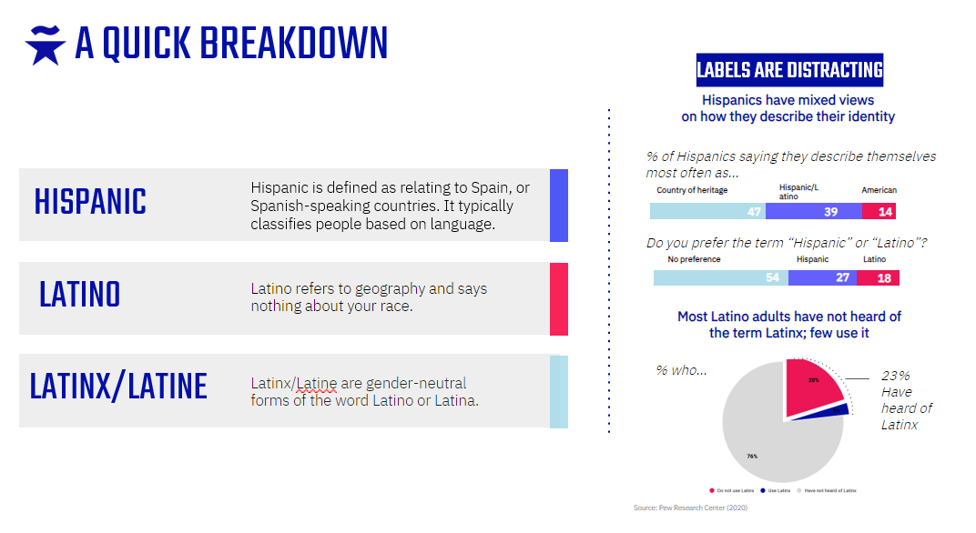

Slide 6


Slide 7
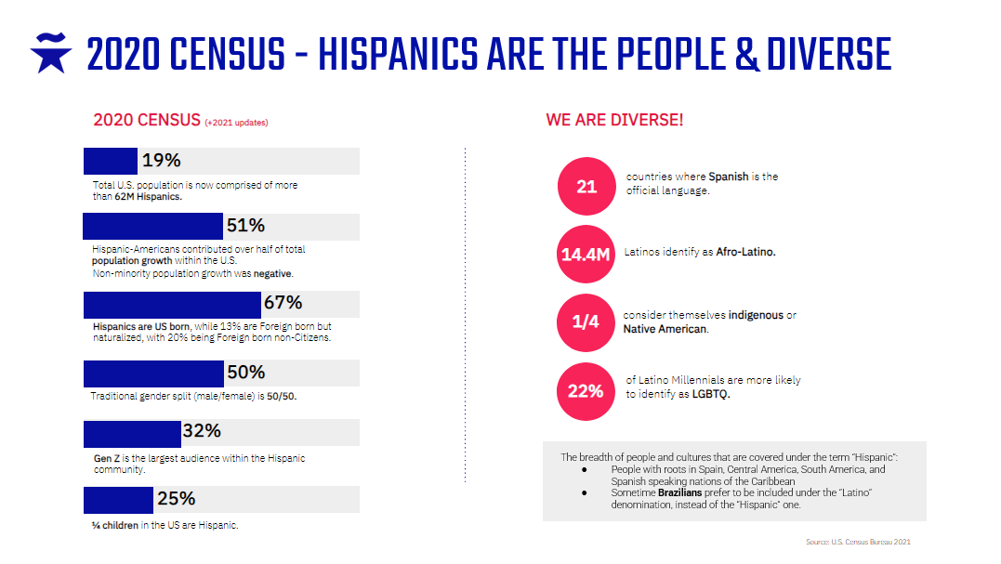

Slide 8
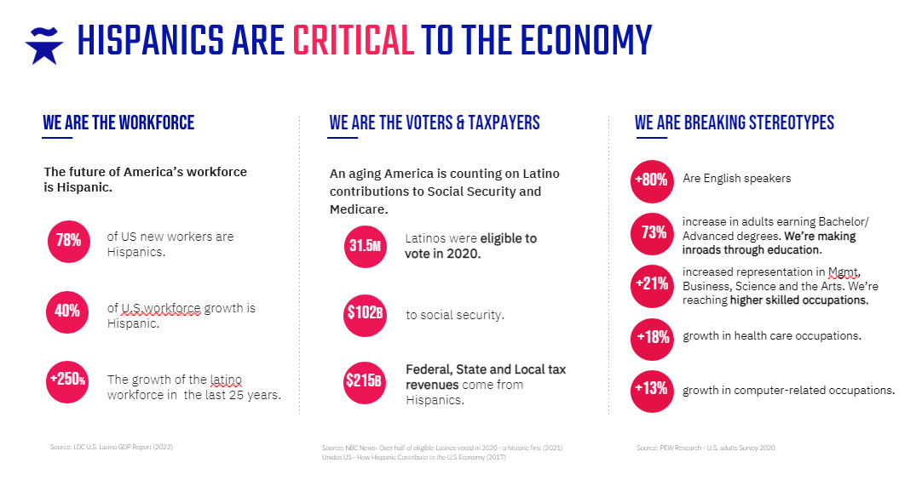

Slide 9
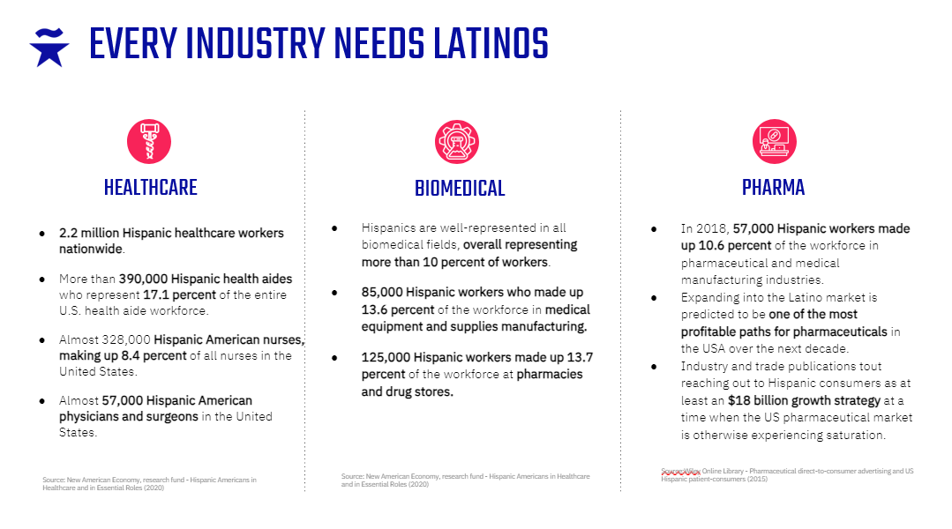

Slide 10
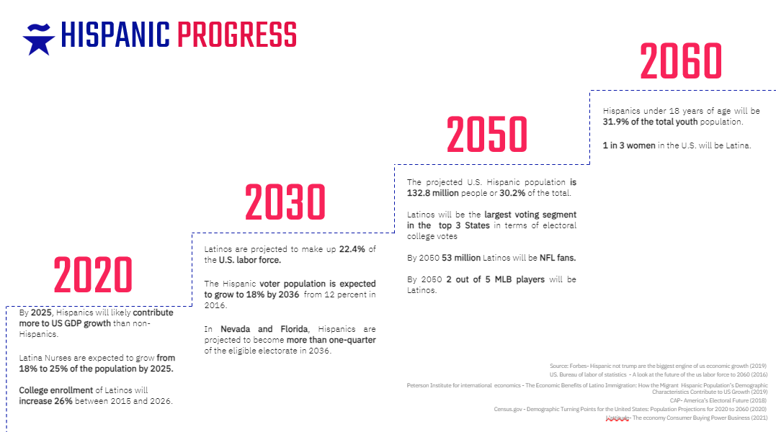

Slide 11
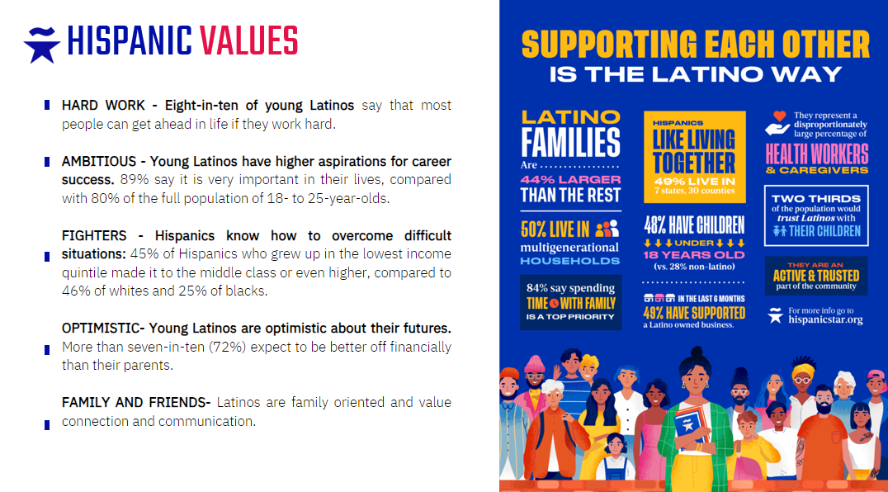

Slide 12
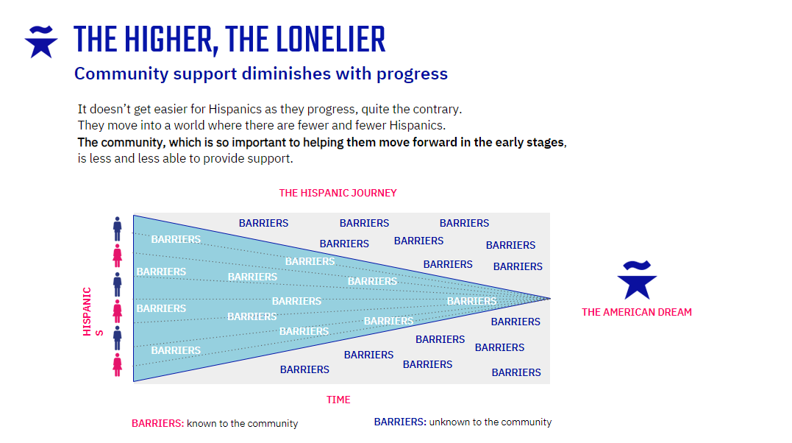

Slide 13
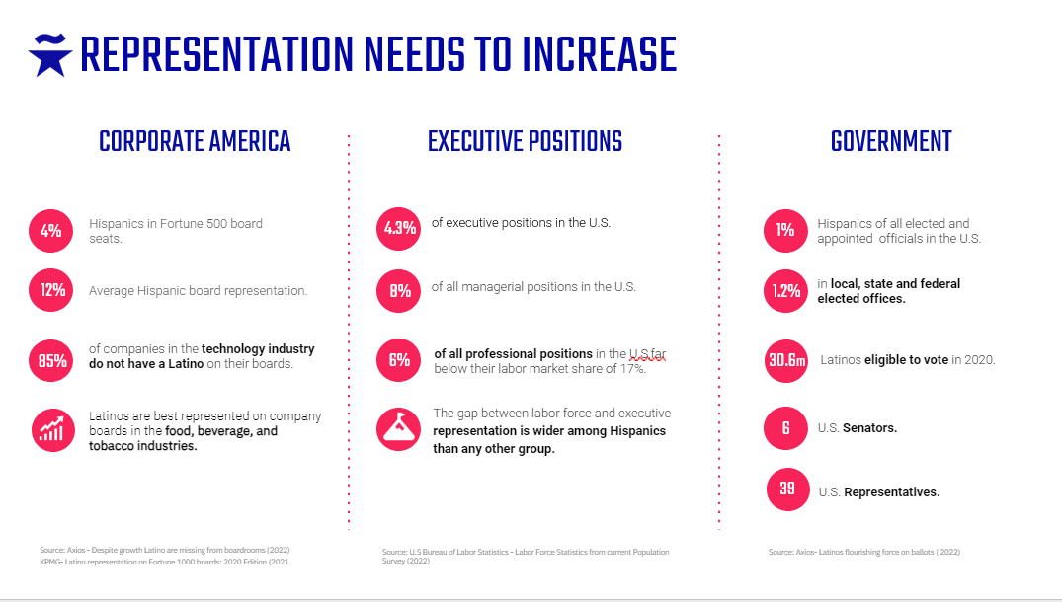


Slide 14


Slide 15
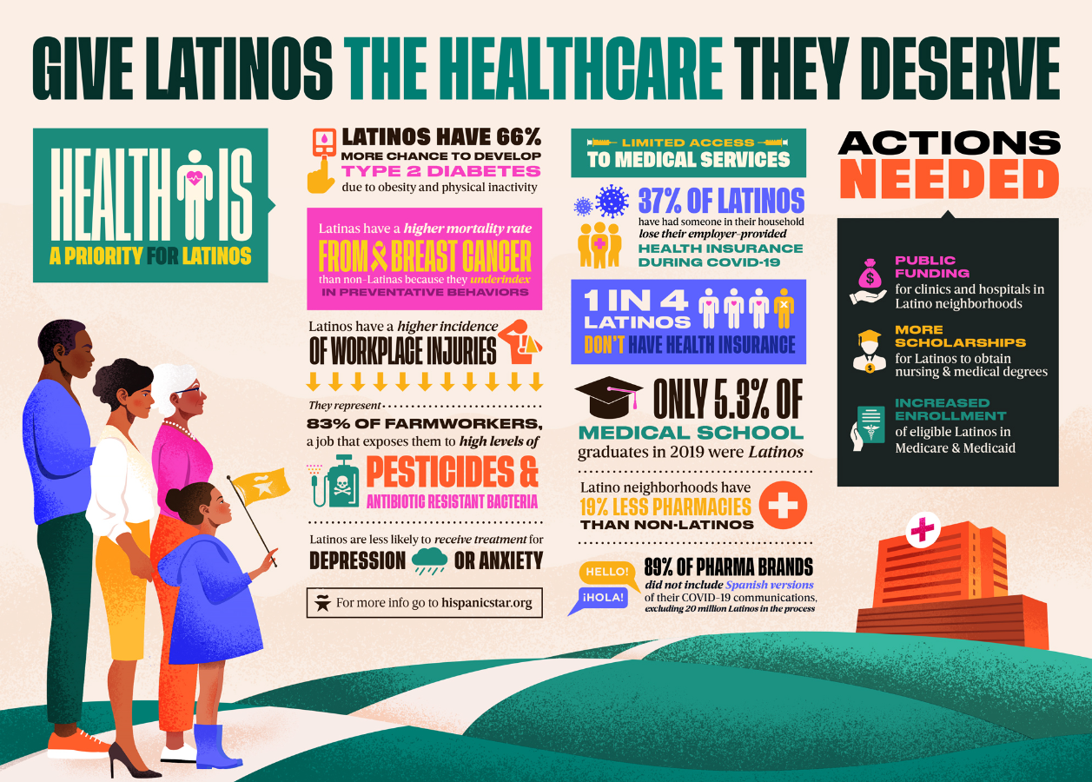

Slide 16


Slide 17
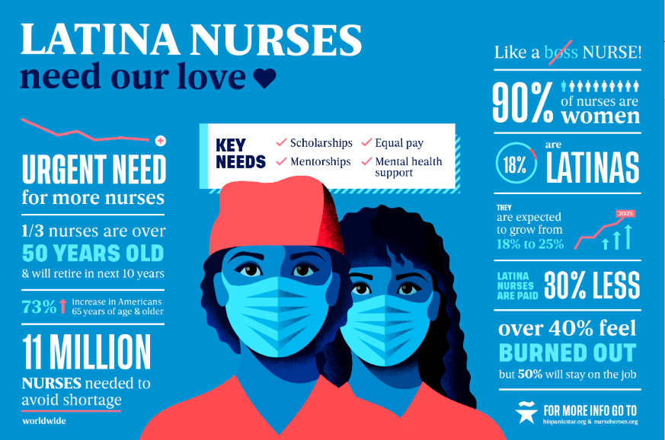

Slide 18
