Slide 1


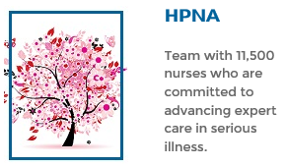
Join Us
Midwest Chapter
Hospice and Palliative Nursing Association
Education Program
Date: September 28, 2023
Location: virtual webinar, Zoom
6:00-6:30: Business Meeting, Virtual Networking
6:30-7:30 Program: Buprenorphine: Good for many things, but not wordle…
Speaker: Ben Skoch, DO, MBA. Palliative Care Physician, The University of Kansas Health System
Description
Purpose of this program is to provide the healthcare provider with EBP strategies to describe and understand the role and use of Buprenorphine for pain management in hospice and palliative care populations. Target audience: RNs, APRNs, Chaplains, and SW in acute care and community settings.
Disclosures
There have been no conflicts of interest identified during the planning of this offering. To receive contact hours, participants must attend the entire program and complete the online evaluation.
Register
* 1 hr CE for RN/ APRN (Pharm hour)
*Free for Midwest HPNA chapter members
*$10 for non-members
*Fee waived if you join chapter at the meeting
*Support HPNA and join the chapter go to:
https://midwesthpna.nursingnetwork.com/
The University of Kansas Health System is accredited as a provider of nursing continuing professional development by the American Nurses Credentialing Center’s Commission on Accreditation.

