Slide 1

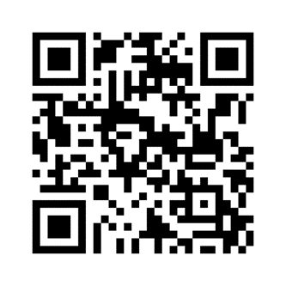
Chapter Board and Open Meeting
August 2nd 4:30 PM at Cohen’s Retreat
Take advantage of Happy Hour at Cohen’s. Learn more about upcoming chapter activities and share your ideas and thoughts. We will be in an area just past the bar.

