Slide 1
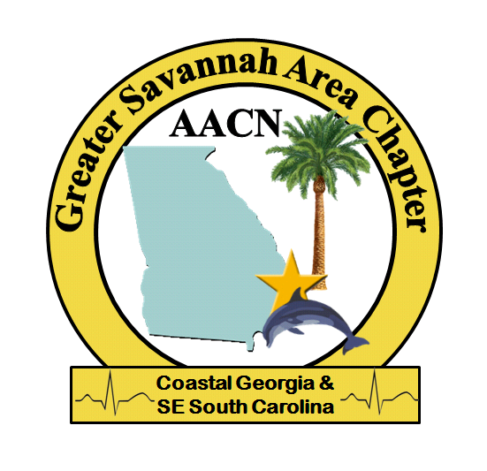
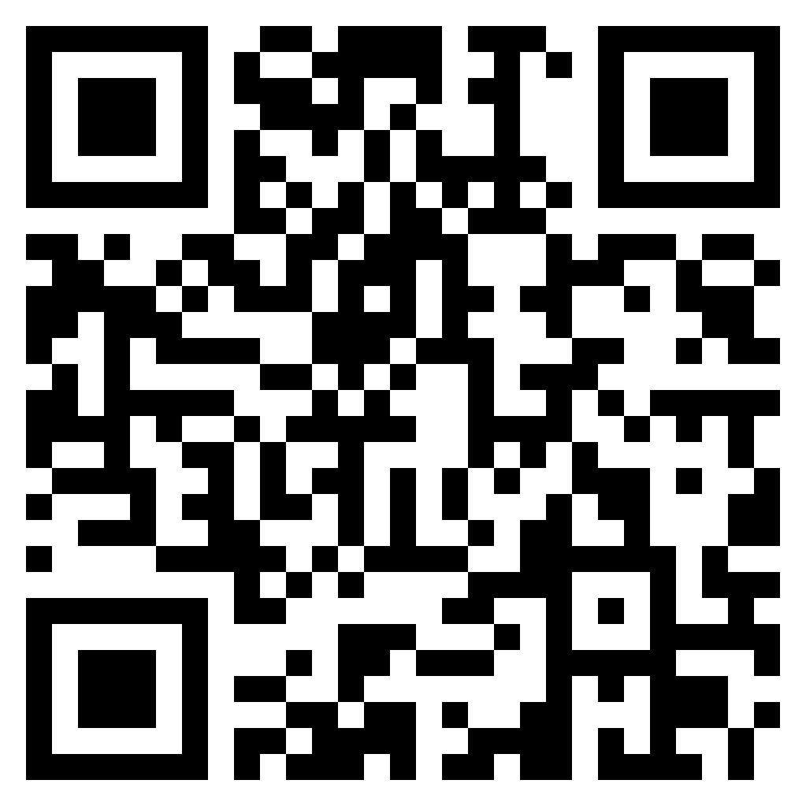
Continuous Kidney Replacement Therapy: Prescription and Clinical Management
Educational Program and Dinner sponsored by Nyxstage and Greater Savannah Area Chapter
August 2nd at 6:30 PM Cohen’s Retreat
Registration deadline July 14th
GSACAACN.nursingnetowork.com

