Slide 1

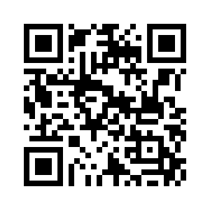
GSAC Happy Hour and Monthly Meeting
1st Thursday of each month
5PM at Cohen’s Retreat
Do not need to be a member to attend.
For details visit the GSAC website

