Slide 1
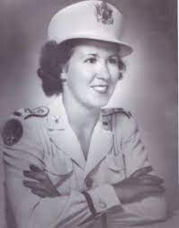
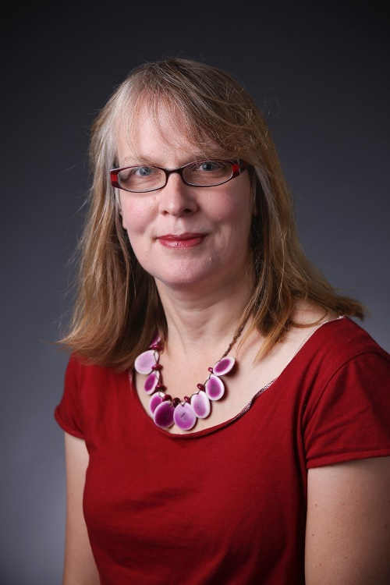
Medicine of Care: Oral History of Nurse Practitioners in the Rochester Region, 1980-2000
Join us on May 24, 2023 as Dr. Morag Martin, will hold a discussion on the Oral History of the Nurse Practitioner
With the help of nursing and history students at SUNY Brockport, Morag Martin collected 30 interviews of Nurse Practitioners who received their certification from 1980-2000. The nearby University of Rochester was one of the first nursing schools to offer an NP certification, under the leadership of Loretta Ford starting in 1972. Many of the subjects interviewed attended the University of Rochester for their MSNs and DNP after receiving their RNs at local colleges. The goal of the project is to trace the educational, professional, and personal journeys of those who chose to become NPs when the profession was still fairly new. This talk contextualizes the lived experiences of NPs in the Rochester region in the larger history of the profession and of healthcare more generally
Dr. Morag Martin is professor and chair of the History Department at SUNY Brockport. She received her PhD in 1999 from University of California, Irvine. Her book, Selling Beauty: Cosmetics, Commerce and French Society 1750-1830, came out in 2009 with Johns Hopkins University Press. She has since published on the history of midwifery in France and in the media. She co-edited Sacred Inception: Reclaiming the Spirituality of Birth in the Modern World (2018). Her most recent article, “Wimples and Bassinets: Midwifery as Religious Calling in Call the Midwife,” appeared in The Nurse in Popular Media (McFarland Books, 2021). Her current work focuses on oral histories of Nurse Practitioners in New York State
Pictured: Top Right: Loretta Ford, NP Pioneer; Bottom Right: Dr. Morag Martin
Program Medicine of Care: Oral History of
Nurse Practitioners in the Rochester
Region, 1980-2000
When May 24, 2023 6:00PM
Where RRH Archives 1441 East Ave
Registration 922-1847 or archives@rochesterregional.org
by May 21
Tickets A suggested donation of $10/person may be made at the door. Light dinner and refreshments will be served. Free
off-street parking available. Building is
accessible.
Your Pic?

Slide 2
RRH Archives
1441 East Avenue
Rochester, NY 14610

