Slide 1

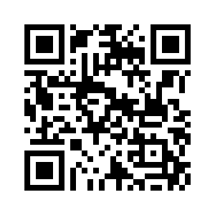
GSAC Open Meeting
“Get Excited About Nursing”
Tuesday, December 6, @ 3:30 PM
GSU – Waters College of Health Professions, Savannah
Discover the benefits of belonging to a community of exceptional nurses
Discuss how the chapter can support local acute and critical care nurses
Discuss upcoming GSAC events and chapter goals for 2023
Determine ways the chapter can facilitate transition of new graduate nurses into the profession
For details visit the GSAC website
Or email Kimberly Burke @ kfenton@georgiasouthern.edu

