Slide 1


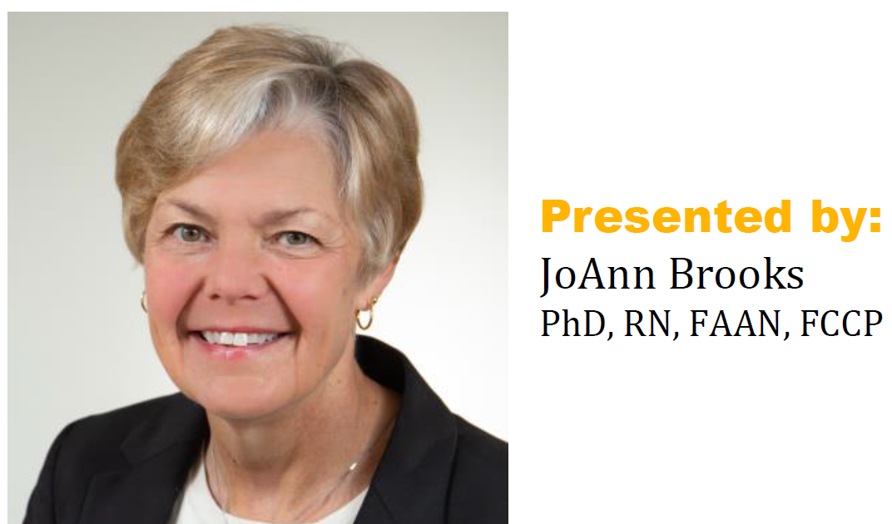

AACN-GFAC Presents:
Non-Ventilator Hospital Acquired Pneumonia
Attention, Intervention, & Prevention
Free Offering – dinner provided
Wednesday, September 28th, 5:30 p.m.
^{Ristorante Renato}
^{422 William St.}
^{Fredericksburg, VA}
^{GFAC-AACN Business meeting}
^{to follow}
Sponsored by Paige White from
RSVP by 9/23 via
gfacaacn.nursingnetwork.com

