Slide 1
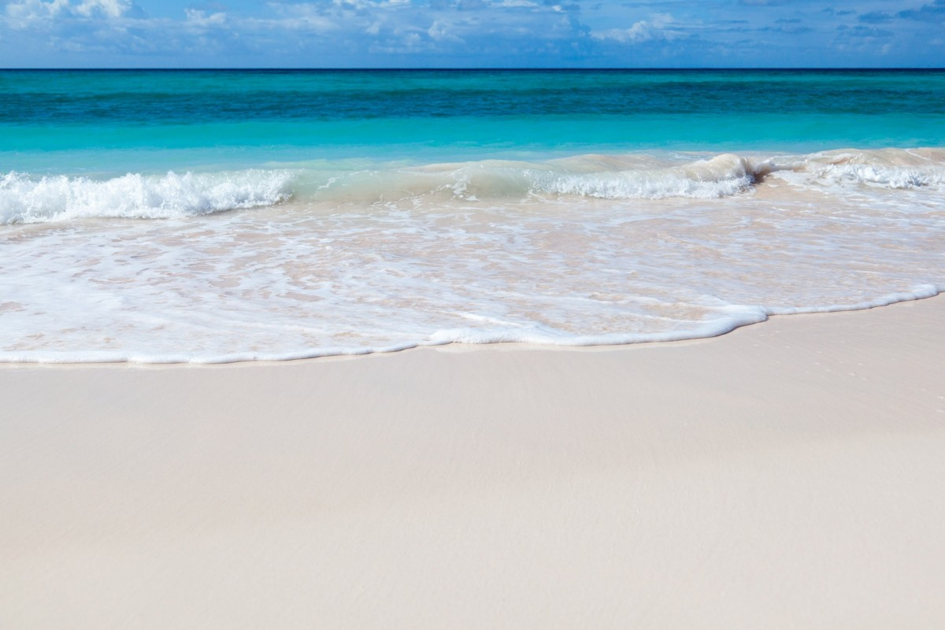
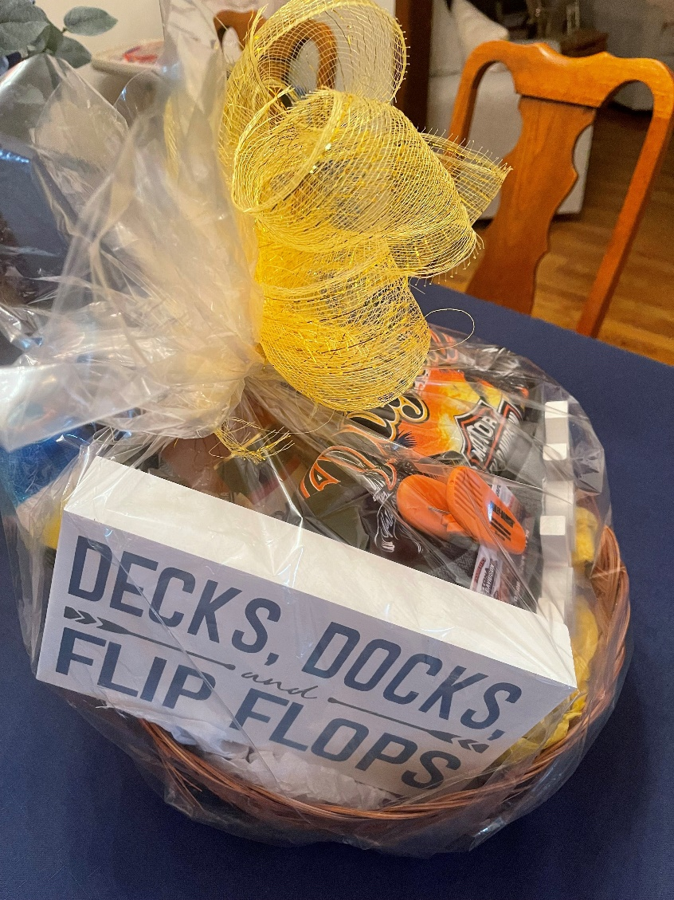
AACN Volusia Flagler Chapter “Daytona Beach is Special!”
Basket Items:
Beach Towel, “Relax” wood sign, Decks, Docks,& Flip Flops sign, 2 beach themed stone drink coasters, “Sea spray” Sachet, “Ocean Waves” candle, 750 ml Daikiri beverage, Harley Davidson brand Thermal Lunch bag, clip, $25 gift card, Insulated drink cup and XL T-Shirt

