Slide 1
COVID-19 and More! Presentation
Arkansas School Nurse Association
June 8, 2022
Joel Tumlison, MD Diplomate ABFM
Medical Director, Immunizations & Outbreak Response, ADH

Slide 2
Thank
YOU!

Slide 3
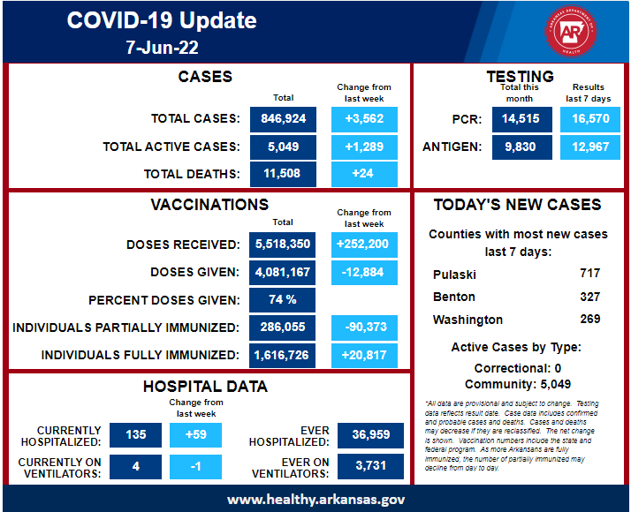
COVID-19 Vaccine
Townhall for Educators
Joel Tumlison, MD Diplomate ABFM
Medical Director for Child & Adolescent Health, ADH
Physician Specialist in Outbreak Response, ADH
Notes:
7-day average new cases: 508

Slide 4
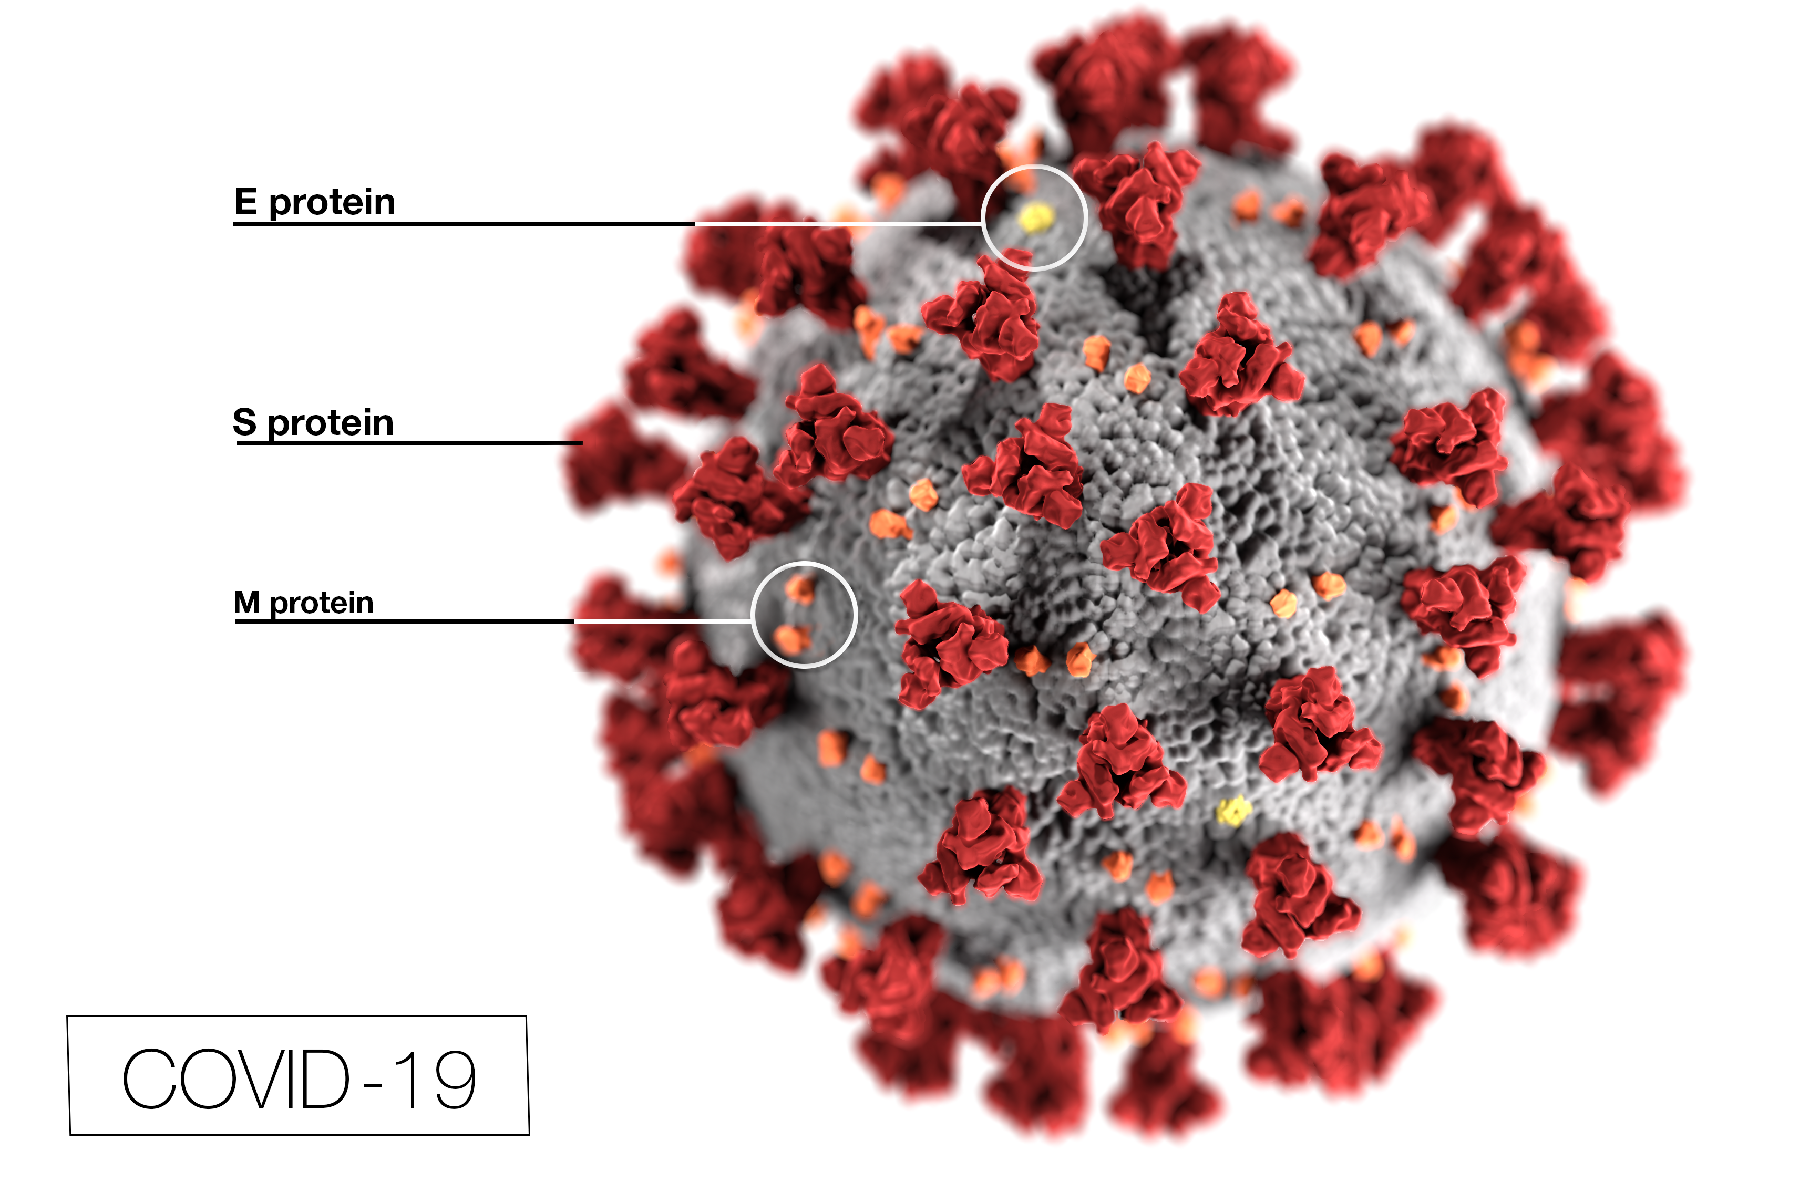
SARS-CoV-2 Structure
Centers for Disease Control and Prevention
Notes:
Spike (S) protein binds to ACE2 Receptor --- key to infecting cells

Slide 5
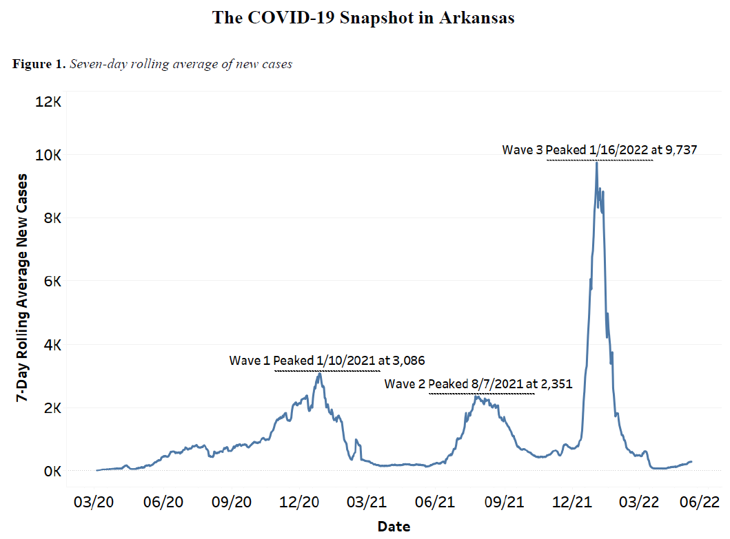
Notes:
UAMS COPH

Slide 6
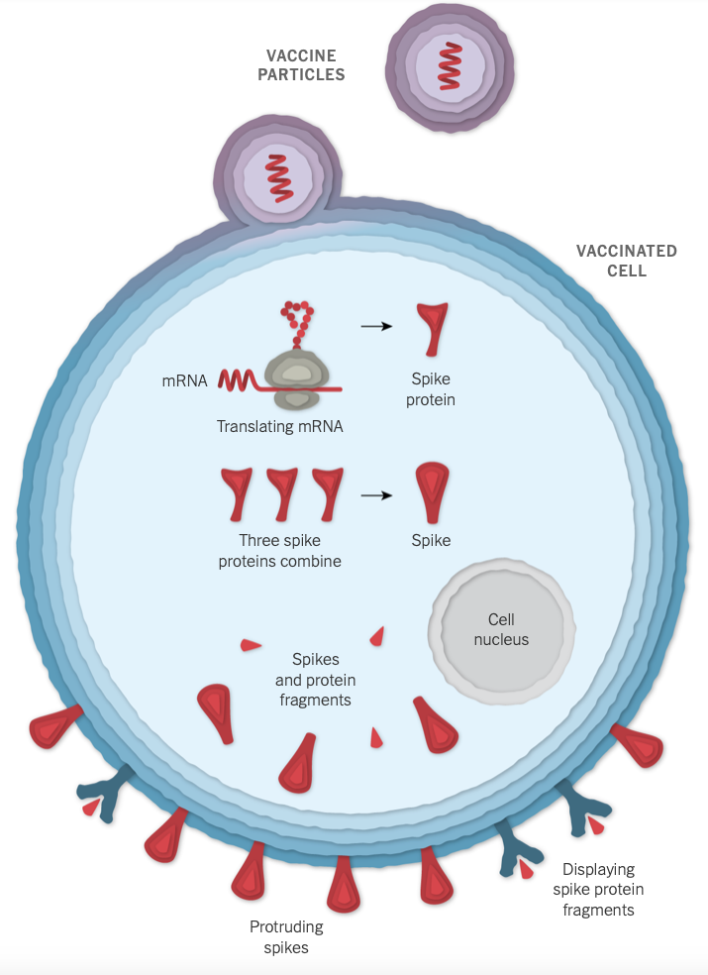
How mRNA
Vaccines Work
New York Times
Notes:
change

Slide 7
COVID-19 Vaccines in U.S.
Initial Series
Pfizer-BioNTech Initial Series
  Age 5-11yo --- 2 dose, interval “at least 3 weeks”, Orange cap
  Age 12+ --- 2 dose, interval 3-8 weeks, Gray or Purple cap
  Coming soon! 6 mos-4yo --- 3 dose series
    FDA/VERBPAC meet June14/15, ACIP after that
Moderna Initial Series
  Age 18+ --- 2 dose, interval “at least 4-8 weeks”, Red cap
  Coming soon! 6 mos-5yo --- 2 dose series
  Maybe coming soon? 6- 17 yo, but you’ll just have to wait and see

Slide 8
COVID-19 Vaccines in U.S.
Booster doses
5-11 yo:
  Pfizer Booster Dose #1 at least 5 months after Dose #2 (of initial series)
12-17yo:
  Pfizer Booster Dose #1 at least 5 months after Dose #2 (of initial)
  Immunocompromoised: Booster Dose #2 at least 4 months after booster dose #1
18+ yo:
  Pfizer or Moderna Booster Dose #1: Everyone
    at least 5 months after Dose #2 (of initial series)
  Age 50+ or Immunocompromised:
    Pfizer or Moderna Booster Dose #2 at least 4 months after booster dose #1 (dose #3)

Slide 9
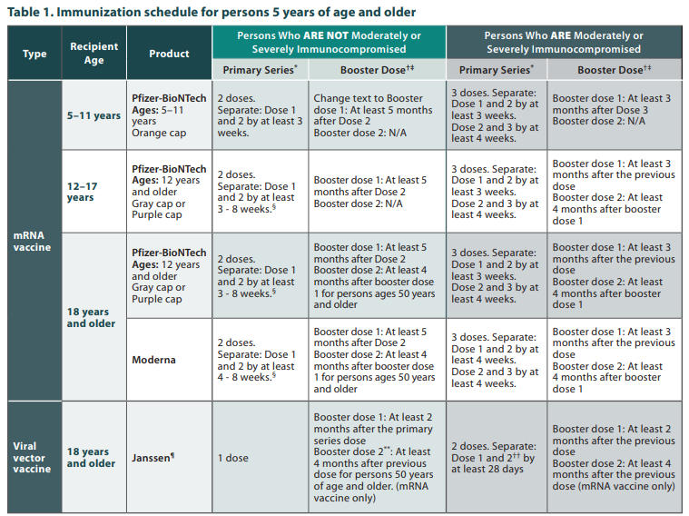
Notes:
https://www.cdc.gov/vaccines/covid-19/downloads/COVID-19-immunization-schedule-ages-5yrs-older.pdf

Slide 10
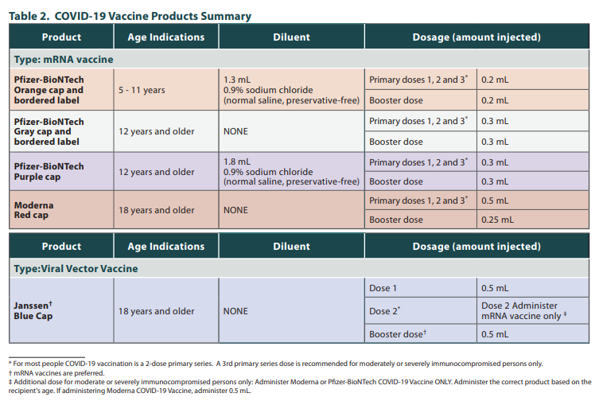
Notes:
https://www.cdc.gov/vaccines/covid-19/downloads/COVID-19-immunization-schedule-ages-5yrs-older.pdf

Slide 11
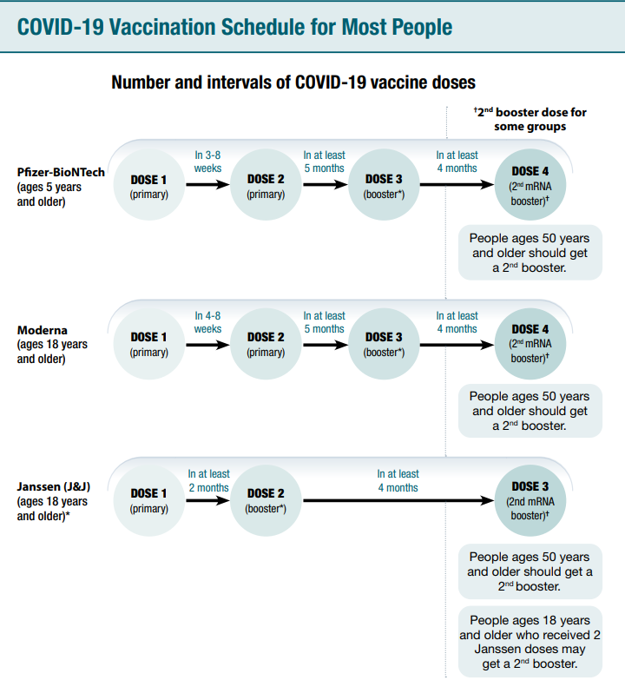

Slide 12
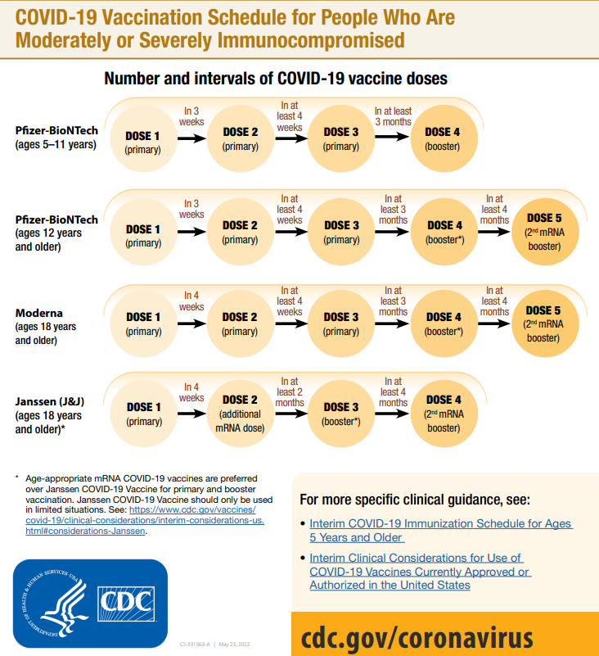
Notes:
At a glance

Slide 13
Vaccine Rates in Arkansas
Total Population: 54.8% Fully vaccinated (66.7% nat’l avg)
40.3% First Booster dose (46.9% nat’l avg) of those fully vaccinated
Population 5+: 58.5% Fully vaccinated (70.9% nat’l avg)
Population 12+: 62.8% Fully vaccinated (75.2% nat’l avg)
41.5% First booster dose (48.7% nat’l avg) of those fully vaccinated
Population 65+: 81.2% Fully vaccinated (91.2% nat’l avg)
65.5% First booster dose (69.7% nat’l avg) of those fully vaccinated
25.3% Second booster dose (30% nat’l avg)

Slide 14
Of Variants, Subvariants, and Sub-sub Variants
“OG” SARS-CoV-2, Alpha, Delta
  Came and went ---- will they return?
Omicron
  B.1.1.529, then BA.1.1
  BA.2 – now BA.2 subvariants are predominant
    Currently BA.2.12.1 is most predominant – 53.1% our region, 62% USA
    30% more transmissible than B.1.1.529
  BA.4/BA.5
    Growing – just about 8% of most recent samples our region, 5% USA
    But Nowcast predicts now just over 20% of our region samples
    Based on very small number of samples

Slide 15
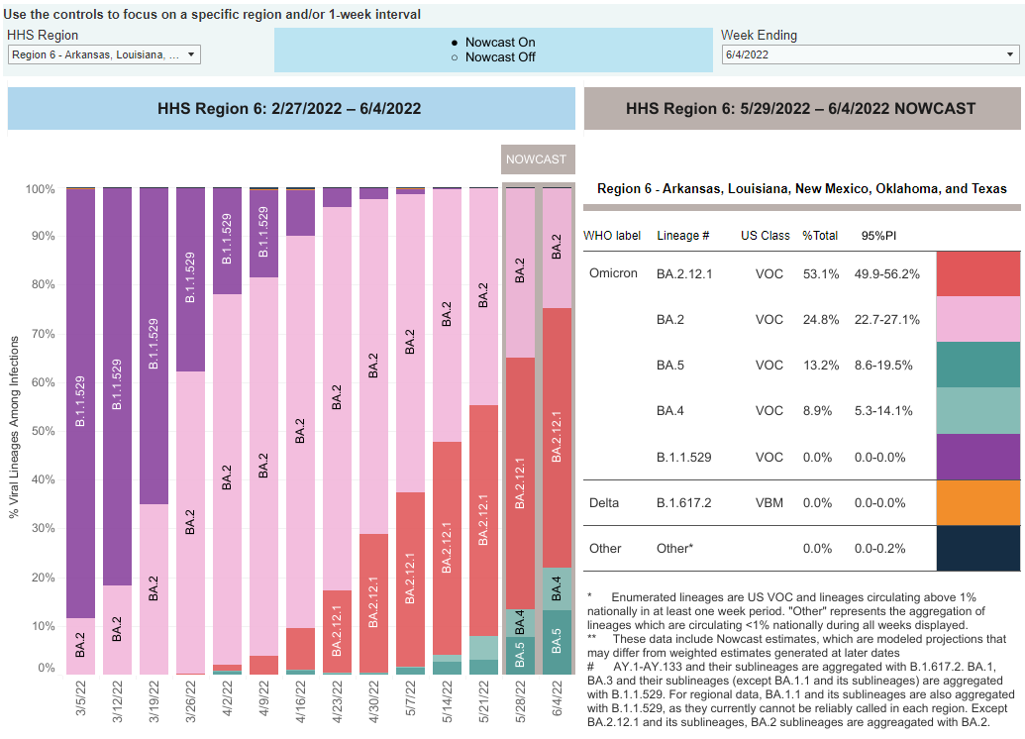
Notes:
https://covid.cdc.gov/covid-data-tracker/#variant-proportions

Slide 16
Post-COVID Conditions – “Long-COVID”
Multiple Onset Patterns:
  Persistent symptoms and conditions that begin at the time of acute COVID-19 illness
  New-onset late sequelae following asymptomatic disease or a period of acute symptom relief or remission
  Evolution of symptoms and conditions that include some persistent symptoms (e.g., shortness of breath) with the addition of new symptoms or conditions over time (e.g., cognitive difficulties)

Slide 17
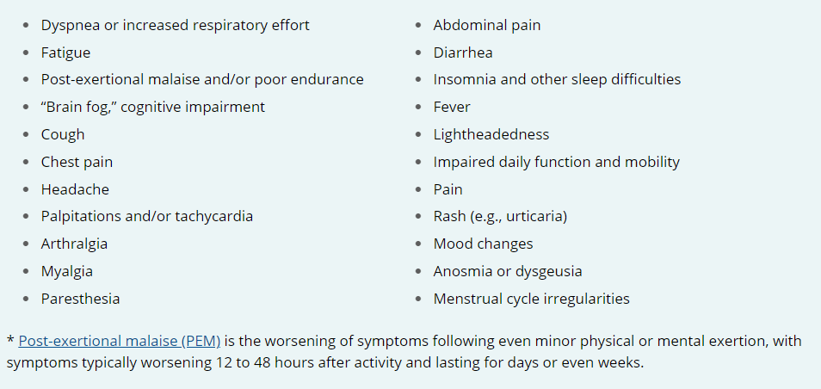
Symptoms commonly reported among people with post-COVID conditions

Slide 18
School Year 2022-23
CDC Updated K-12/ECE Operational Guidance May 27, 2022
  https://www.cdc.gov/coronavirus/2019-ncov/community/schools-childcare/k-12-childcare-guidance.html
  Basically, breaks prevention measures into 2 groups
    “Strategies for Everyday Operations”
      Up-to-date vaccination, Stay home when sick, ventilation, hand hygiene, cleaning
    “COVID-19 Community Levels and Associated Prevention Strategies”
      Things that will vary in how you implement with level, or if you implement
      Masks, testing, cohorting, etc.
Notes:
How often Delta causes severe disease in young people is unclear, but some early indications that can MORE often cause severe disease.

Slide 19
School Year 2022-23
Quarantine of Close contacts
  Will still be decision of school district whether/not to do this
  “Exempt from quarantine”
    Up to date with COVID-19 vaccinations
    Recent infection within 90 days of this exposure
    Both parties masked
Masks -- Do based on COVID-19 Community Levels
  When low(green) – medium(yellow) = no universal mask rec for indoor, public places
  When high (orange) = recommend universal masking indoor, public places

Slide 20
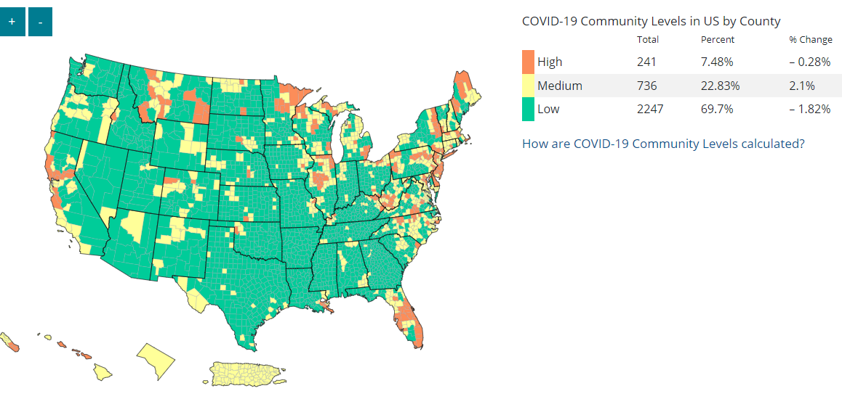
COVID-19 Community Levels
Notes:
https://covid.cdc.gov/covid-data-tracker/#county-view?list_select_state=all_states&list_select_county=all_counties&data-type=CommunityLevels&null=CommunityLevels

Slide 21
COVID-19 Testing in K-12 SY 2022-23
Pooled Screening PCR Testing still available
  ThermoFisher Scientific/Color
  Weekly/biweekly
POC Antigen testing/rapid antigen
  “Clinical boxes” – what many of you got last year
  Only have to report + tests
OTC/At-home Antigen testing
  Like POC testing, but in single/double packs
  Send home w/ sick kid for other siblings/family; Exposed kids; use in nurse office
  They should report to you so that you know, but no requirement to report to ADH

Slide 22
Other diseases still exist? Diarrhea
Salmonella
  Recent outbreak: 7 confirmed cases genotype linked from a common source
  20% people with Salmonella dx are hospitalized
STEC (Shiga-toxin E.Coli)
  Daycare with multiple confirmed cases, several others who had been sick
  HUS – Hemolytic Uremic Syndrome
Norovirus – you don’t wanna ride this wave
  CCF with over 20 ill, 7+ and counting norovirus +
Campylobacter, other E. Coli, many, many more.
Wash hands, clean restrooms, wear PPE when cleaning up emesis/stool

Slide 23
Other diseases still exist? Varicella
Was it a “clinical diagnosis”?
  Epidemiologic link to similar/confirmed case makes more certain
Was a sample taken from one of vesicles?
  This really helps ADH
EXCLUSIONS! AHHHHH!
  Who had prior immunity at time of exposure?
      Prior complete vaccination – 2 doses
      Prior Medical provider confirmed disease
      Titers
  We exclude non-immune w/ close contact (class/bus) exposed during infectious period for 21 days (long incubation) from last exposure
    If immunization can be made up to date by 1 dose, then give within 5 days of exposure and allow immediate return
Varicella – 61-100% secondary attack rates in susceptible household contacts
Case stays out until all lesions are crusted over and dry.

Slide 24
Monkeypox
No confirmed or probable cases in AR at present
35 cases in USA as of 6/7/22
  Majority have been in MSM but can occur in anyone touching someone with the rash
Physical contact/skin-to-skin contact most common way to spread
  Literature says can spread via large respiratory droplet if person is at most infectious time of illness, but this also requires prolonged close contact with someone
  B/c of this unlikely to spread widely or cause a pandemic
  But could it become endemic?
Vaccines for Pre and Post Exposure prophylaxis
  Jynneos and ACAM 2000

Slide 25
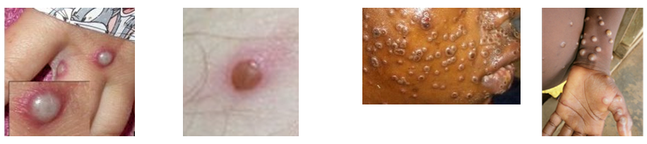
Monkeypox Symptoms
Possible (but not all have) prodrome of fever, HA, myalgia, fatigue
Rash: macular →popular →vesicles →pustular
  Vesicles and pustules tend to umbilicate
  In recent outbreaks, lesions often initially found on genitals/perianal area as this for many was likely site of initial contact, but then spread to other parts of body

Slide 26
Citations
https://www.cdc.gov/coronavirus/2019-ncov/community/schools-childcare/k-12-childcare-guidance.html
https://covid.cdc.gov/covid-data-tracker/#county-view?list_select_state=all_states&list_select_county=all_counties&data-type=CommunityLevels&null=CommunityLevels
https://www.cdc.gov/poxvirus/monkeypox/pdf/MonkeyPox-sexually-active-InfoSheet-508.pdf
https://www.cdc.gov/poxvirus/monkeypox/index.html

Slide 27
Citations, cont.
UAMS COPH COVID-19 Forecasts in Arkansas; May 24, 2022; Ben Amick, Jaimi Allen, Clare Brown, Mark Williams
https://www.healthy.arkansas.gov/programs-services/topics/novel-coronavirus
https://covid.cdc.gov/covid-data-tracker/#datatracker-home
https://www.cdc.gov/vaccines/covid-19/downloads/summary-interim-clinical-considerations.pdf
https://www.cdc.gov/vaccines/covid-19/downloads/COVID-19-immunization-schedule-ages-5yrs-older.pdf
https://www.cdc.gov/vaccines/covid-19/downloads/COVID-19-vacc-schedule-at-a-glance-508.pdf
https://www.cdc.gov/vaccines/covid-19/clinical-considerations/covid-19-vaccines-us.html
https://covid.cdc.gov/covid-data-tracker/#variant-proportions

