Slide 1

ISEP
Your Eyes and Ears for All Things Medicaid
Innovative Solutions for Educational Partnerships https://isepartnerships.com/

Slide 2
Learning Outcomes
The learner will be able to self-report an increase in the latest updates for Medicaid requirements for school districts.
The learner will be able to self-report tips and strategies to avoid lost billing time when preparing/monitoring PA approvals.
The learner will be able to self-report advantages and benefits to utilizing electronic documentation for personal care services provided to students.

Slide 3
The ISEP Team
Laurie McDowell – Director
Medicaid Consultant; Medicaid Biller: V & H
Kathleen Courtney – Medicaid Consultant, PCPRO, Web-page
Medicaid Biller: Personal Care
Carmen Smith – Medicaid Consultant
Medicaid Biller: PT/OT, Speech
Melissa Dugan – Medicaid Biller: Therapy

Slide 4
Provide Billing and Technical Assistance
Vision and Hearing
PT/OT/Speech
Personal Care
SBMH
Audiology

Slide 5
Vision and Hearing
2006 - 2007 – Mandated V & H Screenings
2010 – 2011 – Process started for Medicaid Billing for V & H
Billable V & H Screenings
Students: Pre-K, K, 1, 2, 4, 6, 8, and Transfer Students
Must have RN Employed, Trained in Vision screening
RN and LPN MUST be trained by CHNS for Screenings
Screenings Completed as per AR State Board of Nurse Practice Guide
  ARK.CODE ANN. §§ 6-18-1501et seq. and 25-15-201 et seq.
Documentation entered into eSchool

Slide 6
Permission to Bill
Permission to Bill – REQUIRED
Parents/students must be advised of FERPA Rights
Notification – Discretion of District
    Special Letter, PTA Bulletin Inclusion, Student Handbook, Etc.
    Records Kept Minimum 5 Years
ASBA PERMISSION TO BILL EXAMPLE :
"In compliance with the Family Education Rights and Privacy Act (FERPA) (20U.S.C. & 1232g; 34 CFR Part 99), I give permission for my child’s personally identifiable information/student education records to be disclosed to Third Party Billing Vendor for the purpose of billing Medicaid and/or private insurance related to health screenings if applicable.
**If object, the parent/guardian should submit in writing to the district within 10 school days upon receipt of this notice.”

Slide 7

Medicaid V & H Reimbursement
Only ONE Reimbursement/Payment per calendar year.
- Sept. 1, 2022 screening Not Eligible until Sept 2, 2023
Vision: 14.08 Per Screen
Hearing: 12.02 Per Screen
Medicaid Portal
V & H Provider Numbers end in 61
V & H Provider # has to be registered
Each Provider # has Username and Password
RA (Remittance Report) Available in MMIS Portal
- ONLY students with active Medicaid # will pay.
- Parents may get random Medicaid Bill from Medicaid.

Slide 8

Personal Care . . .

Slide 9


Slide 10
Personal Care . . . . . Updates . . . . Tips . . . . . Do’s . . . . Don’ts . . .
Arkansas Provider Relations
ar.pr@eqhs.com
Rebecca Mason
Provider Outreach and Education Specialist

Slide 11
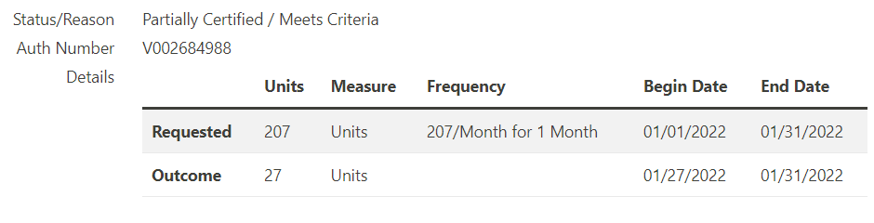
The service plan must be signed and dated by an RN prior to providing services.
PA Signed by Nurse on 01/27/2022

Slide 12
Align your PA dates to match with student assessment dates.
You do NOT have to align PA dates with school year.
*Approved PA from eQHealth does NOT always mean the student is active/eligible in Medicaid Portal.
As Per AFMC, Eligibility should be checked EVERY DAY student receives services.

Slide 13
Initial Prior Authorizations
- NEW students receiving PC
- Never have been previously assessed by Optum
Renewal Prior Authorizations
- Continue to require PC services
- Need Optum Assessment scheduled

Slide 14
Renewing a PA- Up to 90 days prior to (or 60 days minimum) the existing assessment expiration date.
Optum assessment is valid for 365 days (1 year).
Optum has 60 days to contact parents – once referral date is entered.
Parents, Guardians, School Nurses CAN call Optum to schedule an assessment.
844-809-9538

Slide 15
Make an eQHealth Folder in your e-mail.
Customer Support
  Help Ticket73635 has been created
  Help Ticket 73635 has been resolved - 72Hrs
It can take up to 9 business days to approve a PA – WITH a current assessment in place.
– 9 days AFTER assessment has been completed.
* Keep an eye on older submitted PAs.

Slide 16
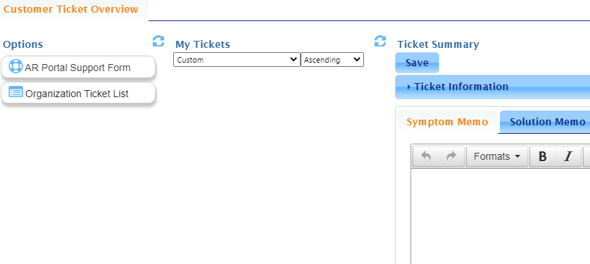
ALWAYS Submit a Help Ticket.

Slide 17
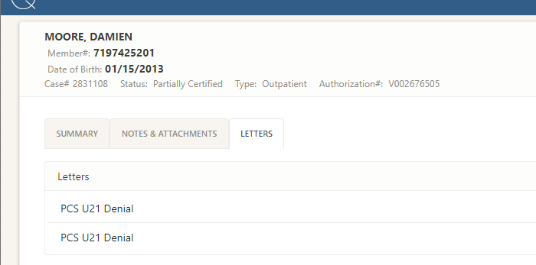
When Checking PAs

Slide 18
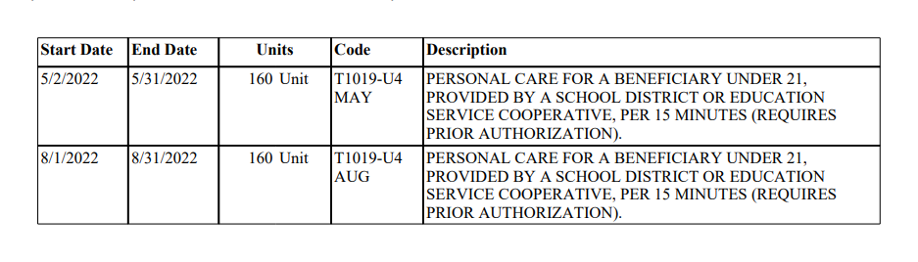
Authorized PA

Slide 19
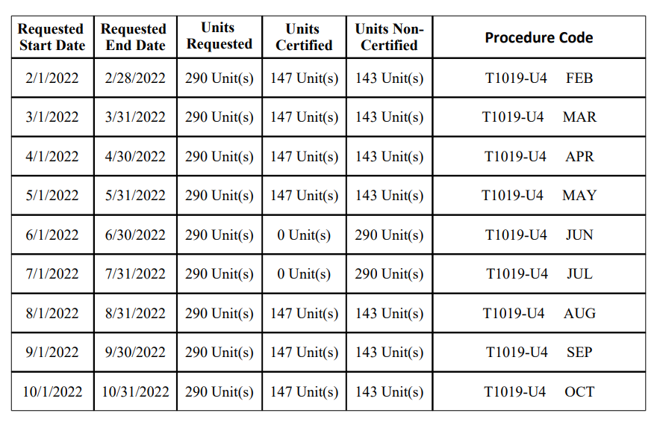
PCS U21 Denial

Slide 20
Task and Hour Tool
- “Rubric” Reviewers USE to determine/approve Units – Use It!!
- ISEP Website – PC https://isepartnerships.com/index.php/services/personal-care

Slide 21
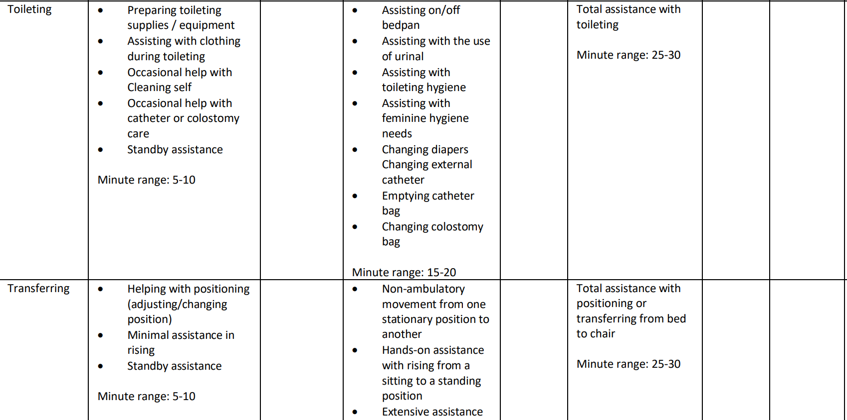
Task and Hour Tool Example

Slide 22
eQHealth reviewers also must consider information provided from Optum Assessment results.
Mobility
PCS regulations are specific regarding mobility.
- It does not include supervision or hand holding due to flight risk or getting lost.

Slide 23
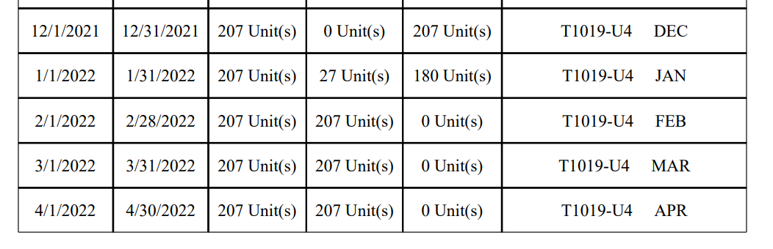
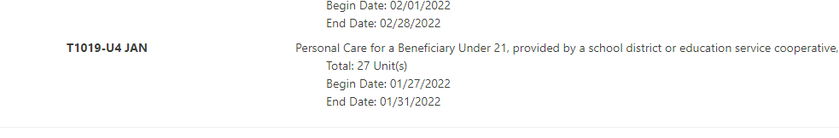
PCS U21 Denial Letter
eQHealth Provider Portal

Slide 24
*Check your Math!
Total Minutes required for student for ONE day.
100 Min/day = 6.6 Units/day
(15 Min = 1 Unit)
6.6 Units x 22 Days = 145 units/month
(1 Unit = $5.12)

Slide 25
PAs are not approved for June and July
PAs are school based.
Schools are not in session in June and July.
You can request a Reconsideration – Help Ticket.
Provide documentation supporting the need for services during summer school.

Slide 26
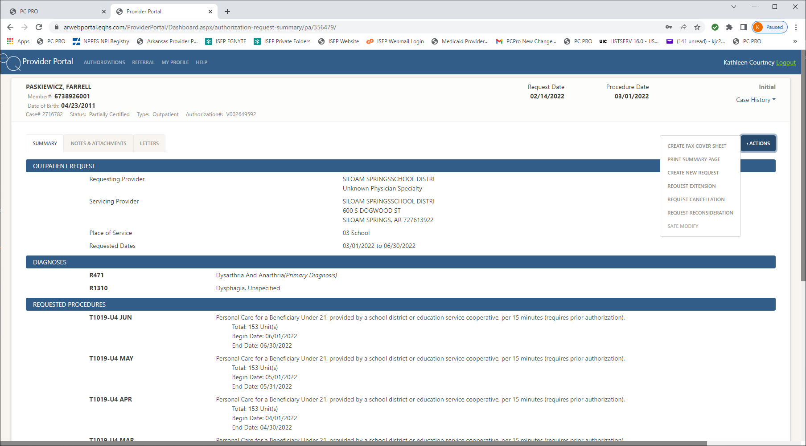

Slide 27
When Optum cancels a PA request or completes an assessment, the information typically gets to eQHealth in 2-3 business days.
Optum is backlogged with scheduling assessments. Suggestion: Do not wait for Optum to contact parent.

Slide 28
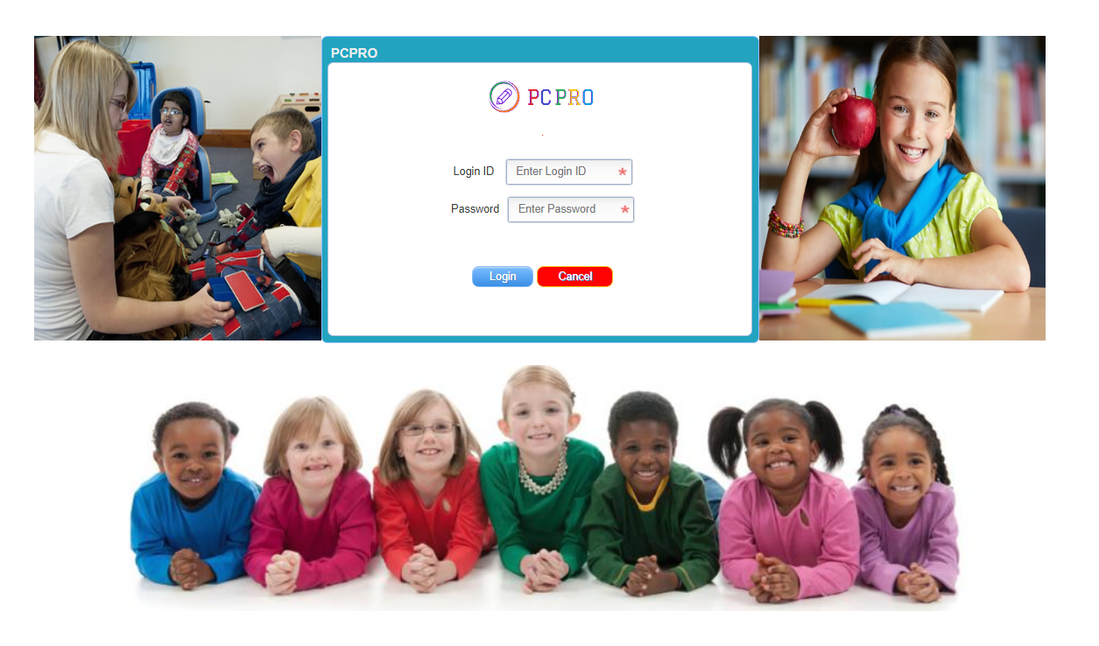
https://isepdoc.com/app/login.aspx

Slide 29
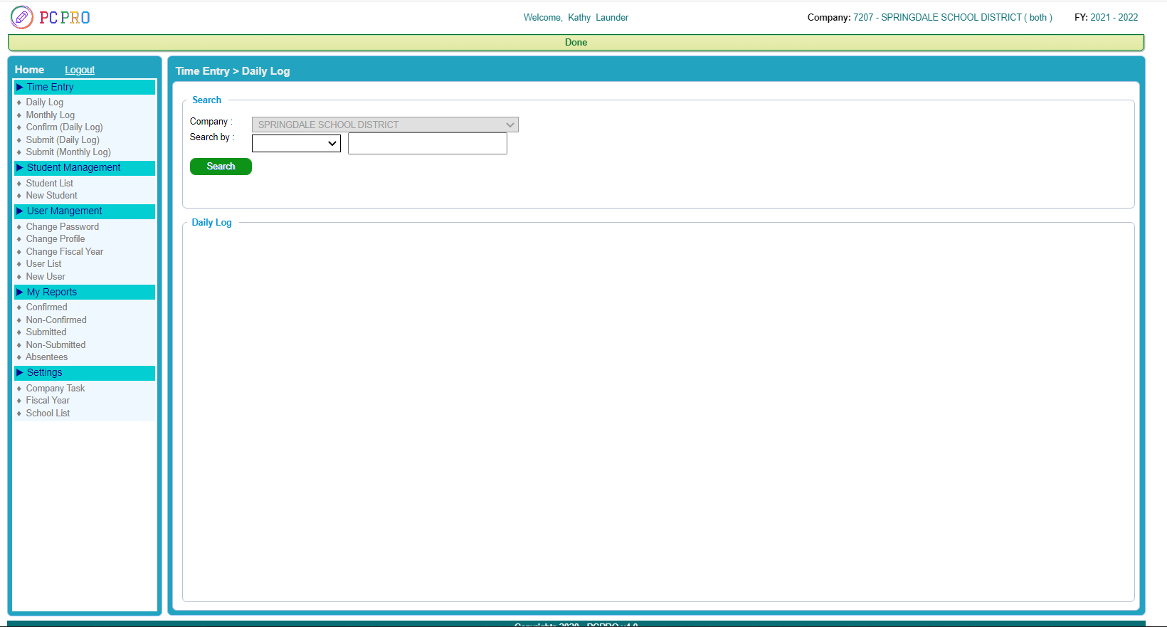
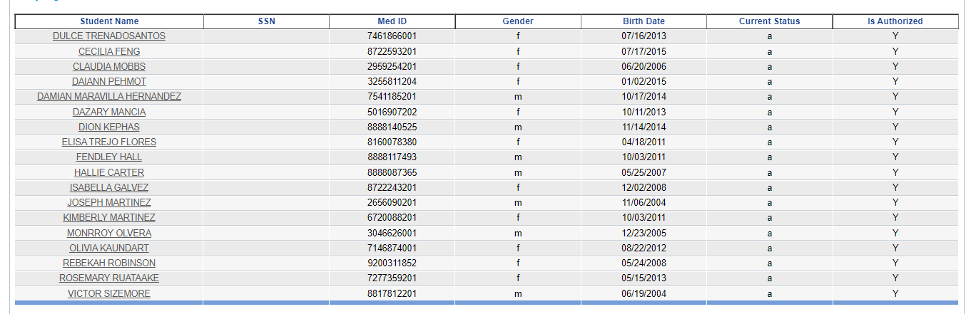

Slide 30
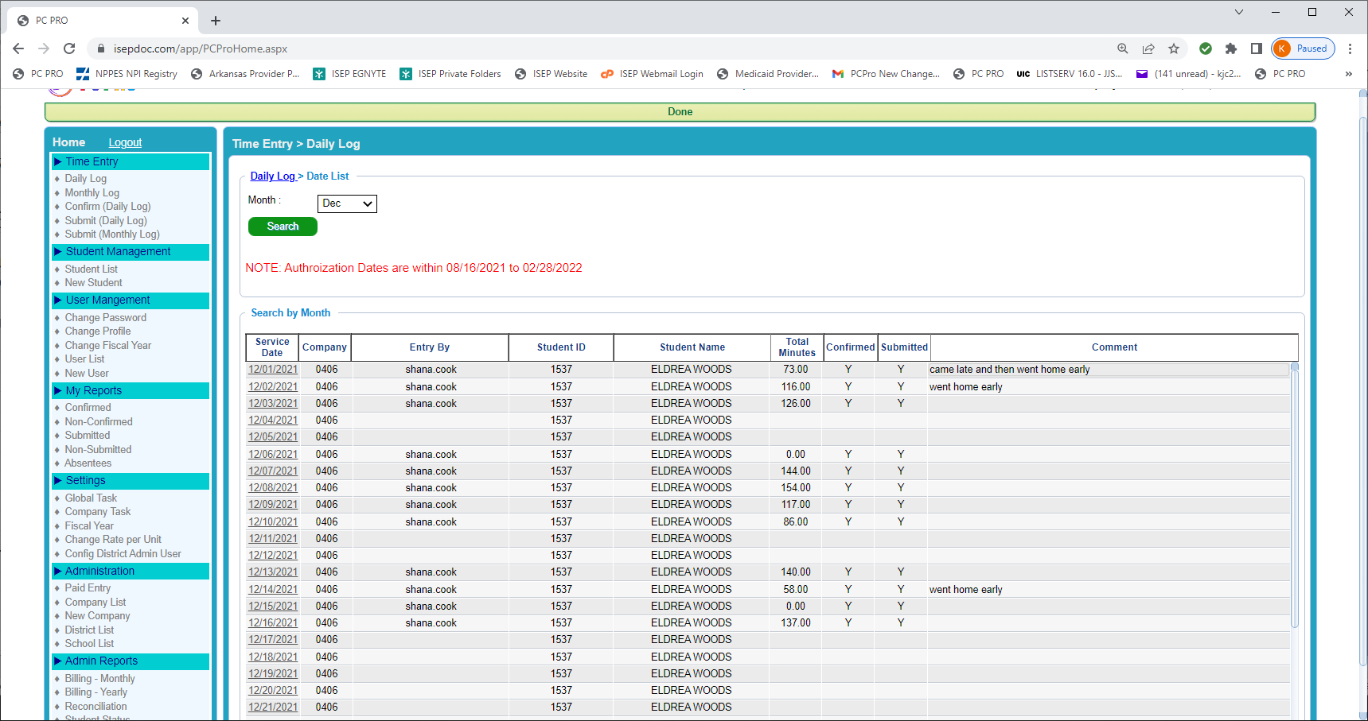

Slide 31
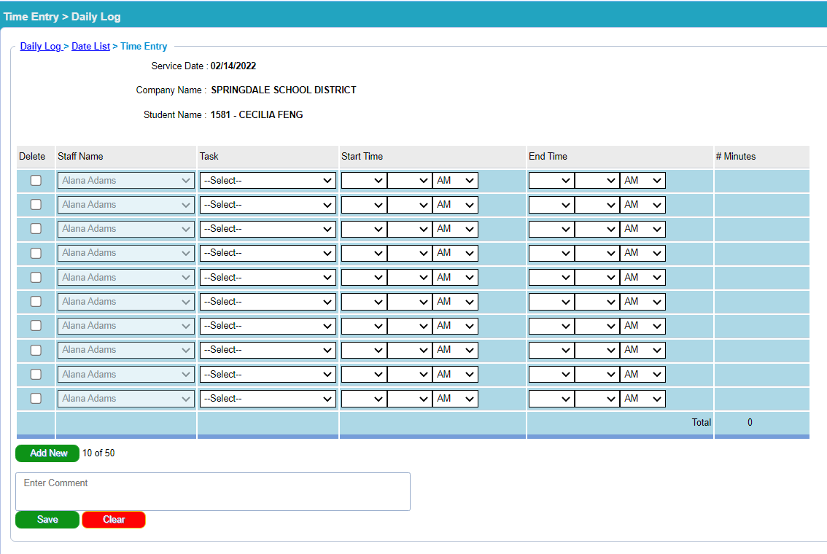

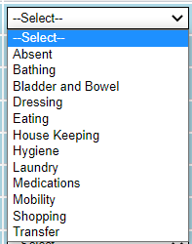

Slide 32
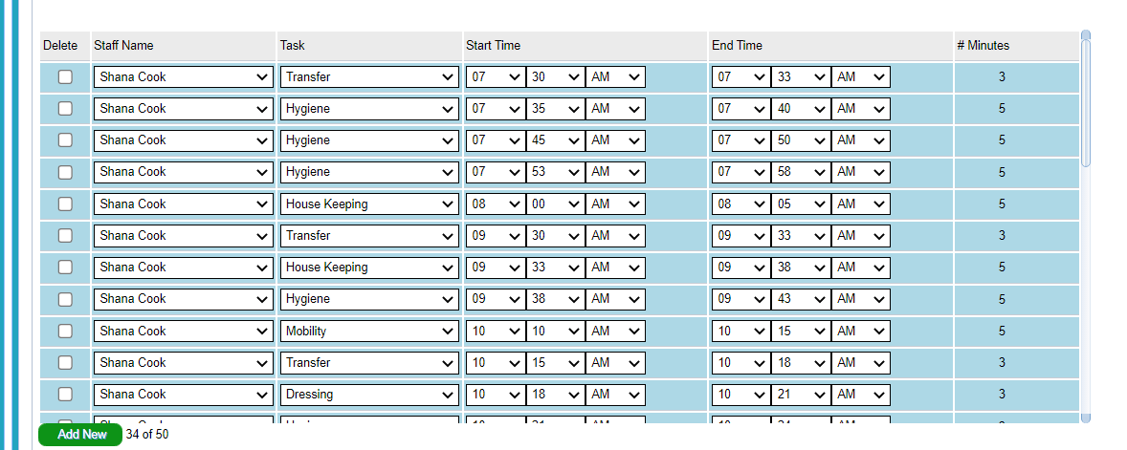
Interested??

Slide 33
Come See ME!!
Erin | Berry |  | Kim | Lipe
Gina | Cornish |  | Dana | Marshall
Shelly | Dominguez |  | Heather | Moore
Amanda | Fairchild |  | Stacey | Rushing
Melinda | Gardner |  | Amy | Schultz
Chelsea | Grubbs |  | Amber | Smith
Haley | Haney |  | Julie | Tate
Karin | Henzel |  | Marti Jo | Whitehead
Mandy | Hickman |  | Marcia | Widel
Nickolle | Karnes |  | Monica | Whittschen
Nickie | Kent |  | Meghan | Wolfinbarger
Angela | Kitchen

Slide 34
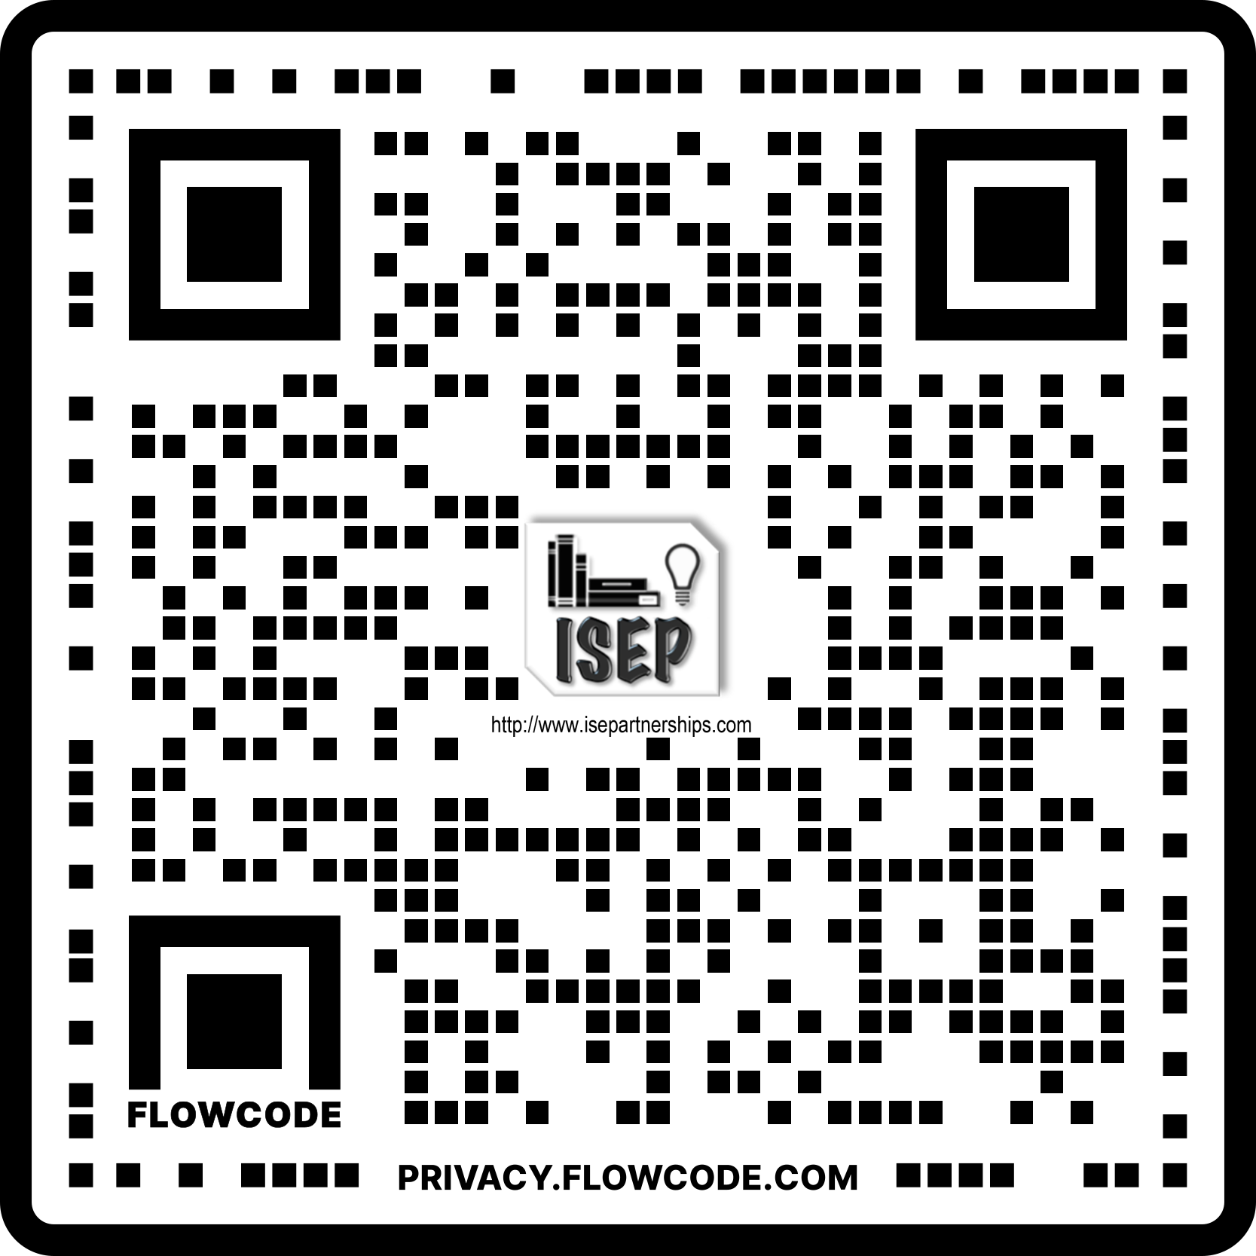

Questions??
https://isepartnerships.com
Thank You!!

