Slide 1
Staffing Shortages… Does Anyone Have A Solution?
Holton Community Hospital

Slide 2

Let’s Be Honest - How Many of Us Feel Like This?

Slide 3

But Wait… We Are All Here
So are we crazy or is there hope?

Slide 4
COVID-19 State of Existence
Recruitment
Retention
Sign-on bonuses
Nursing student recruitment
  Event at The Pennant
  Donuts and presentations to local nursing schools
Creative marketing – bonuses for staff to share positions on Facebook and to create videos for recruitment
The ugly truth – we recruited agency staff!
Bonuses for extra shifts ($600/shift)
Internal contracts with PRN staff
SPARK funds for one-time bonuses
Retention bonuses
We needed the agency staff to decrease the burden on our staff
Food trucks, snacks, drinks

Slide 5
Moving Forward
Sustainable efforts for recruitment and retention

Slide 6
Lessons from the Pandemic
For 2 years every organization has had to demonstrate incredible:
  Agility
  Flexibility
  Efficiency
  Determination
  Resilience
Can we continue to be just as agile in meeting staff needs?

Slide 7
Two Studies on Work-Life Balance
Work-life balance behaviors cluster in work settings and relate to burnout and safety culture
Leadership Strategies to Improve Employee Well-Being
2019: Pre-pandemic
Workers in first 6 months had better work-life balance
Barriers to work-life balance are deeply rooted in healthcare
Organizations create the culture, if leaders do not support and demonstrate work-life balance individuals in the organization will have poor work-life balance
2021: Focused on the entertainment industry!
Three key recommendations:
  Leadership development programs
  Create a culture that emphasizes employee well-being
  Provide employees the resources needed to manage demands

Slide 8
It is Time for New Ideas and New Strategies – Which Requires Leaders Who Can Listen and Adapt!
Recruitment
Retention
The single most important thing we can do is create a culture that promotes work-life balance for new and existing employees (easier said than done).
Reconnect with our purpose and our passion
Organizational chart – tear it down and start over!
Work-life balance
Training and opportunity
Most of all – every one of us has to walk the walk and talk the talk. So take time for you and your well-being (so dang hard though!)

Slide 9
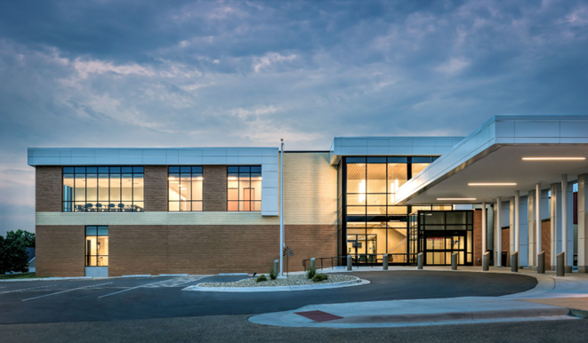
Thank You!

