Slide 1
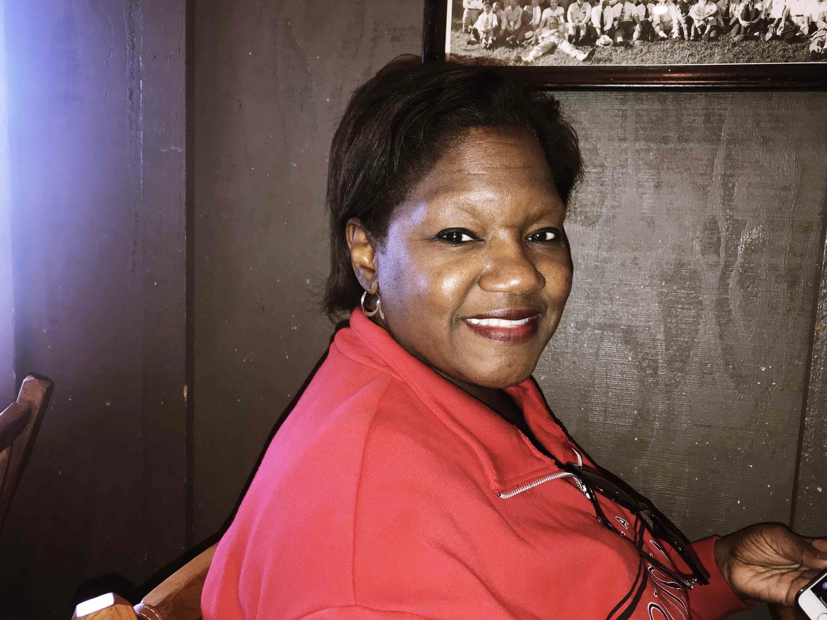
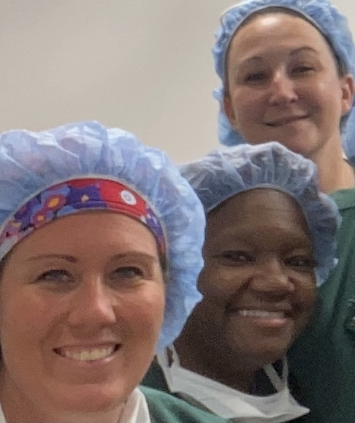
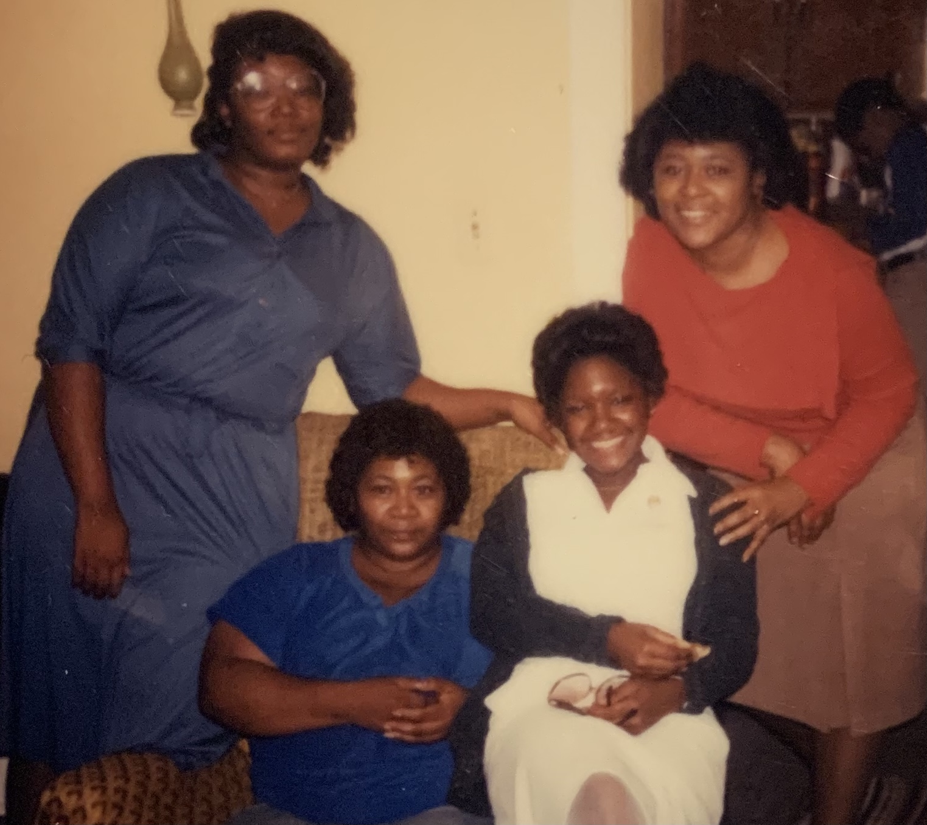
Bio
Paula S. Jones – BSN RN
I was born in Massillon, Ohio (Stark County). I am a 1975 graduate of Washington High School in Massillon, Ohio. I am a single mother and my daughter’s name is Bailey.
Education
Registered Nurse having received my bachelor’s degree of Science in Nursing (BSN), Associate Degree in Nursing (ADN), and Diploma of Practical Nursing (PN).
Work
30+ years in healthcare with strong emphasis in perioperative and operating room services. I have traveled and worked in various capacities in the mainstream operating room as a circulating nurse and scrub nurse as well as in management for orthopedic surgery and neurosurgery services.
After Hurricane Katrina forced our departure from our home in New Orleans, Louisiana we moved to Georgia where I ventured into a faster-paced ambulatory surgery arena. Eventually, I brought my family to Winston Salem as a travel nurse to Baptist Health accepting a position in Surgical Information Systems. Initially assisting in implementing the first-generation medical record for the department of anesthesia, I was eventually chosen as the only clinical nurse to remain in the department to continue to learn the EPIC system, implementing the system as the first hospital to go-live in the Winston Salem market at Baptist Health. I was a super user at Novant Health for surgical services in the implementation of EPIC/Dimensions where I am currently working in ambulatory surgery.
Personal
I am a member of Chi Chi Chapter of Chi Eta Phi Nursing Sorority Incorporation and a member of the Association of PeriOperative RegisteredNurses (AORN). I treasure spending time with my daughter, family and friends, playing piano, gardening, light exercise and participating in various community and church services.
Why
For as long as I can remember, I always wanted to be a nurse or a teacher. God has blessed me the opportunity to do both everyday on a personal and professional degree on various levels.

