Slide 1
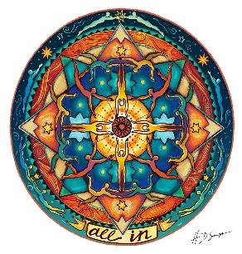

GRA-FL AACN
March Zoom Educational Session:
Dysrhythmias, Nursing and Technology in the Electrophysiology Lab
Presented by:
Trish Koops, RN, BSN, CCRN, BC-RN
Susan Stell, RN, MSRN, CCRN-CME, PCCN, BC-RN
Rochester Regional Health Cardiac Cath Lab
When:
March 18, 2021
6:00pm-7:30pm
This activity has been submitted to the American Association of Critical-Care Nurse for approval to award contact hours. The American Association of Critical-Care Nurses is accredited as an approver of nursing continuing professional development by the American Nurses Credentialing Center’s Commission on Accreditation.
Nurses House is local and offers assistance with housing expenses and medical expenses to RNs who are seriously ill, injured, disabled or facing other dire circumstance. Nurses House has partnered with the American Nurses Foundation to help nurses nationwide affected by COVID-19.

