Slide 1
An Infectious Disease Overview of COVID-19
Inland Empire Chapter of the American Association of Critical-Care Nurses
Bruce Weng, DO
October 10, 2020
Infectious Disease
Riverside University Health System

Slide 2
Case Examples
A 43 year old male PMHx of obesity (BMI 33) presented to your office for the complaint of 3 days history of oral sores. He denies ever having a history of any cold sores. He is happily married and denies any other partners. On exam, vitals are stable and you note an apthous-like ulcer on the lower inner lip and left buccal mucosa. You chalk it up to typical cold sores and recommend conservative therapy.
He calls your office 2 days later and updates that he has now lost his sense of taste and smell. 2 days after that he starts to develop fevers of 102-103F with a new nonproductive cough.
7 days later he called complaining of acute worsening SOB to the point where he can barely catch his breathing just walking around. You ask him to go to the ED where he is found to have O2 sat of 82% on room air.

Slide 3
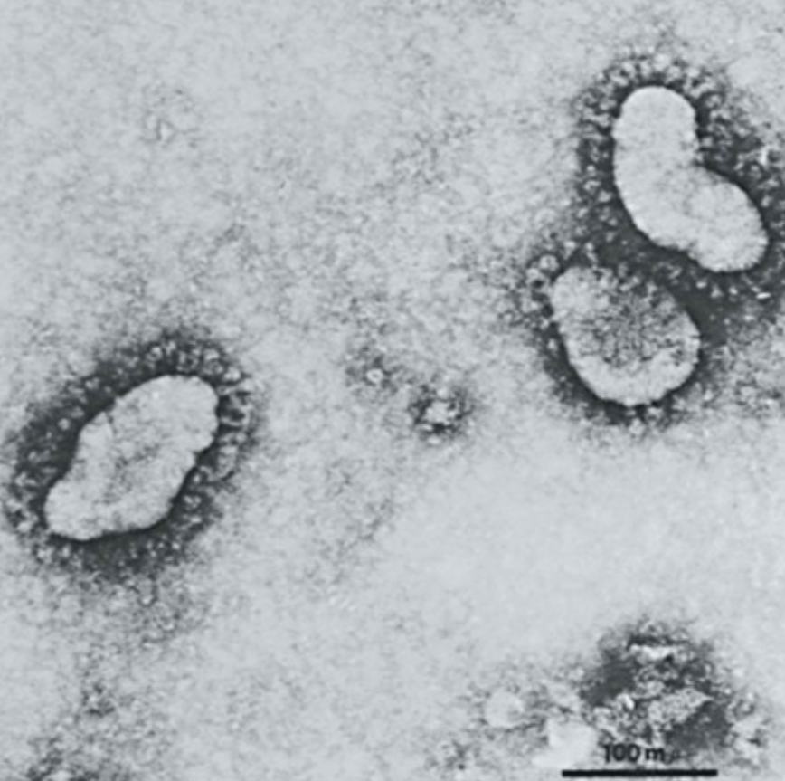
Coronavirus
Common human coronaviruses (HCoVs)
  229E (alpha coronavirus)
  NL63 (alpha coronavirus)
  OC43 (beta coronavirus)
  HKU1 (beta coronavirus)
SARS
MERS
SARS-CoV-2
Bennett, John E., Raphael Dolin, and Martin J. Blaser. Principles and practice of infectious diseases. Vol. 1. Elsevier Health Sciences, 2014.

Slide 4
Coronavirus - HCoVs
Common human coronaviruses (HCoVs) are RNA virusus
Usually one of the causes for “common cold” ~ 15%
  URI and LRI
  Also gastrointestinal disease: diarrhea
Self-limited disease
  Your “common cold”
No treatment
Bennett, John E., Raphael Dolin, and Martin J. Blaser. Principles and practice of infectious diseases. Vol. 1. Elsevier Health Sciences, 2014.

Slide 5
Coronavirus - SARS-CoV-2 – At the Beginning
Novel viral PNA in Wuhan, China → New Coronavirus strain (identified 1/9/20)
The first reported case was December 12, 2019 in Wuhan, China
When was the outbreak first made public?
  December 31, 2019. (Chinese health authorities reported 27 patients with 7 in critical condition, according to the Wuhan Municipal Health Commission on its Weibo social media account (12/31/19 Reuters)
Take care to get a travel history over the next few remaining months especially if patients present with PNA (oh my, how times have changed…)
Presentation as bilateral infiltrates on radiography
We all know what has happened since then across the globe and especially now in the United States….
RUHS – Grand Rounds 2.19.20

Slide 6
Populations at Risk
Everyone!
https://www.cdc.gov/coronavirus/2019-ncov/index.html

Slide 7
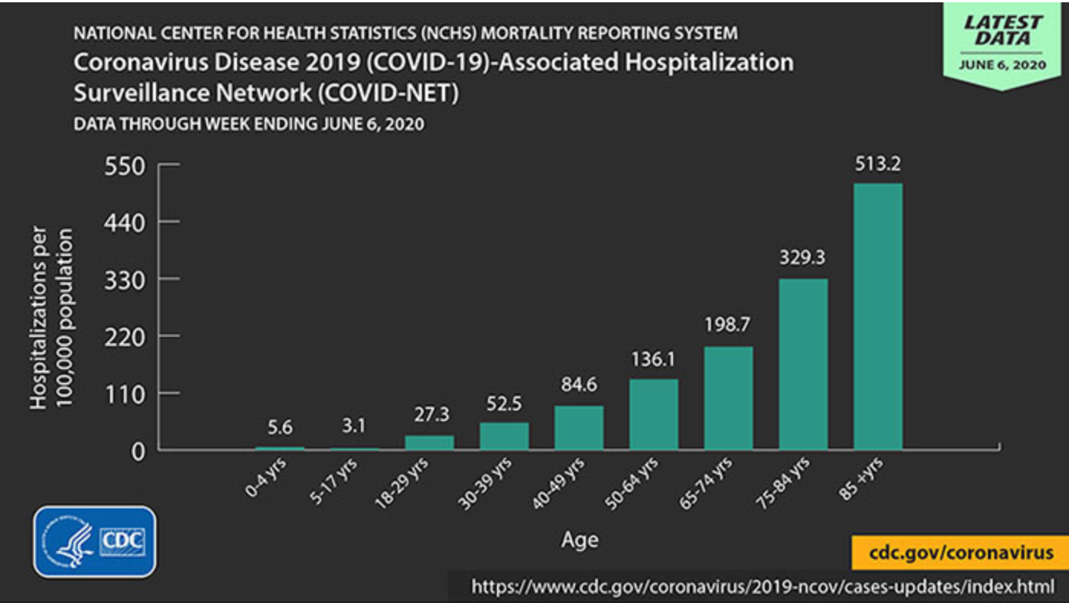
Populations at Risk - Age
https://www.cdc.gov/coronavirus/2019-ncov/index.html

Slide 8
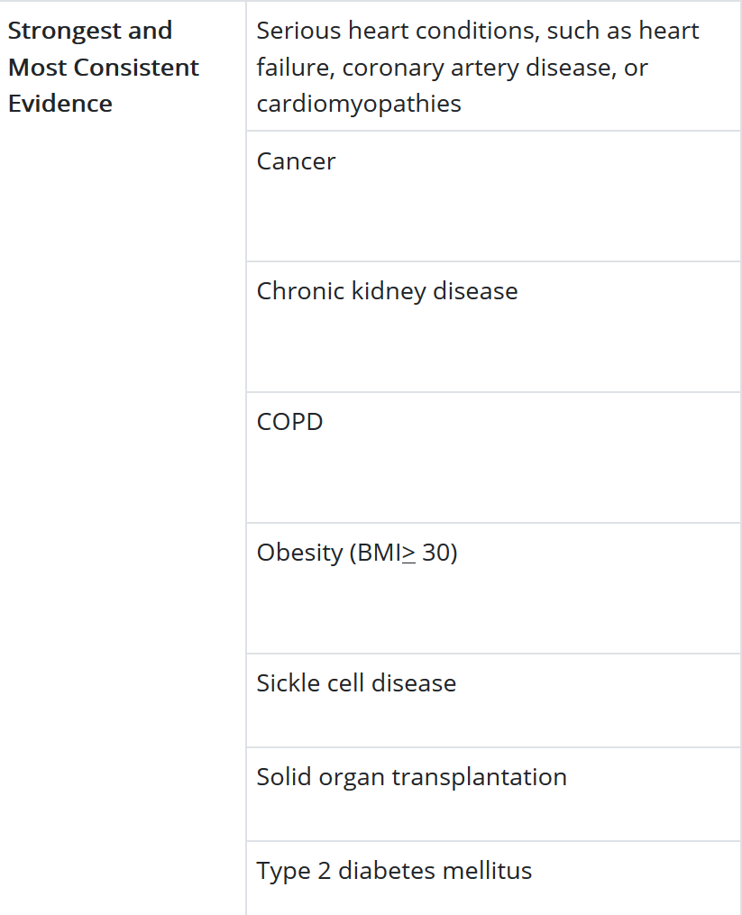
Populations at Risk - Comorbdities
https://www.cdc.gov/coronavirus/2019-ncov/index.html

Slide 9
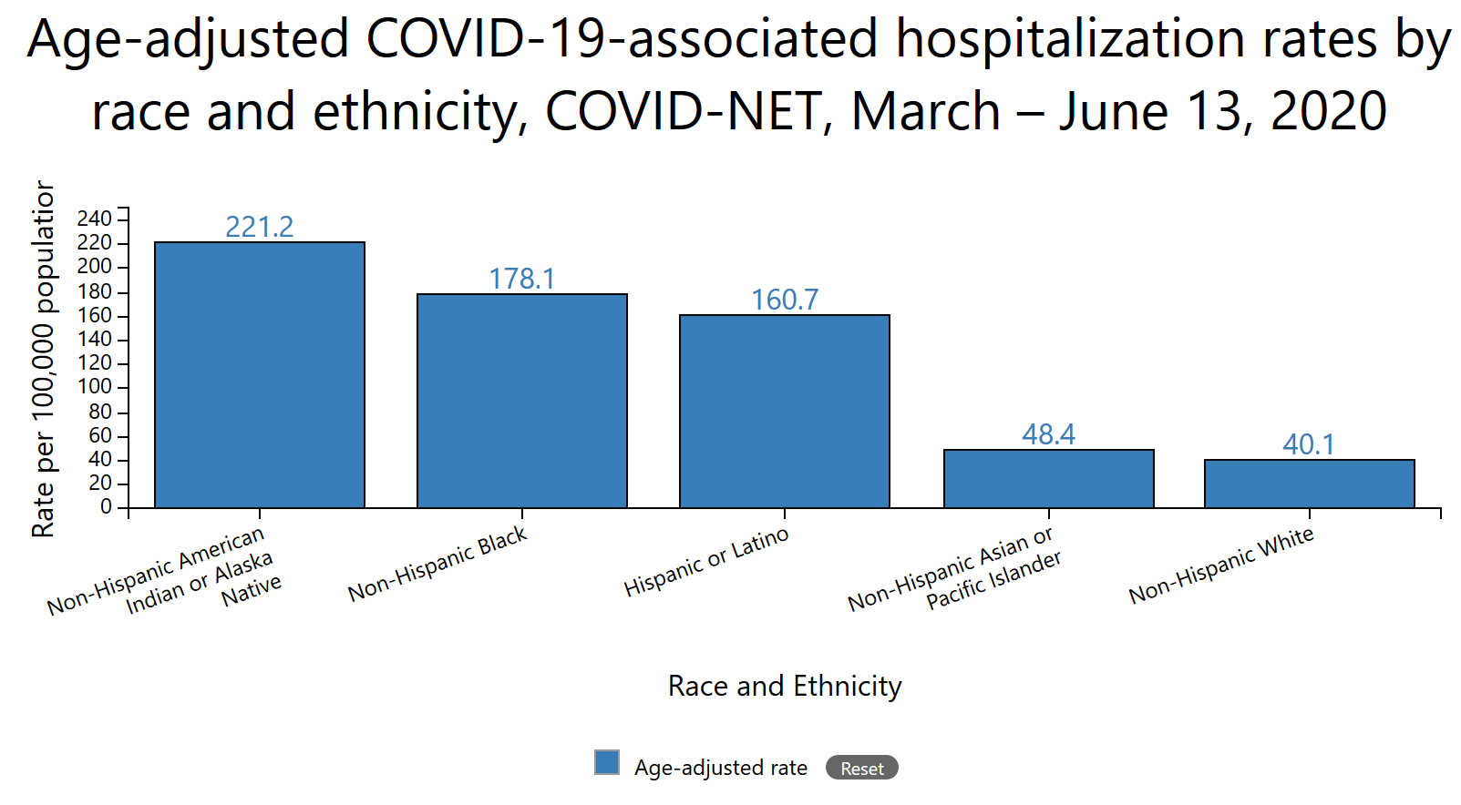
Populations at Risk – Race and Ethnicity
https://www.cdc.gov/coronavirus/2019-ncov/index.html

Slide 10
Clinical Presentations – Most common
Fever or chills
Cough
Shortness of breath or difficulty breathing
Fatigue
Myalgias/body ache
Headache
Loss of taste or smell
Sore throat
Nausea, vomiting and/or diarrhea
Congestion or runny nose
https://www.cdc.gov/coronavirus/2019-ncov/index.html

Slide 11
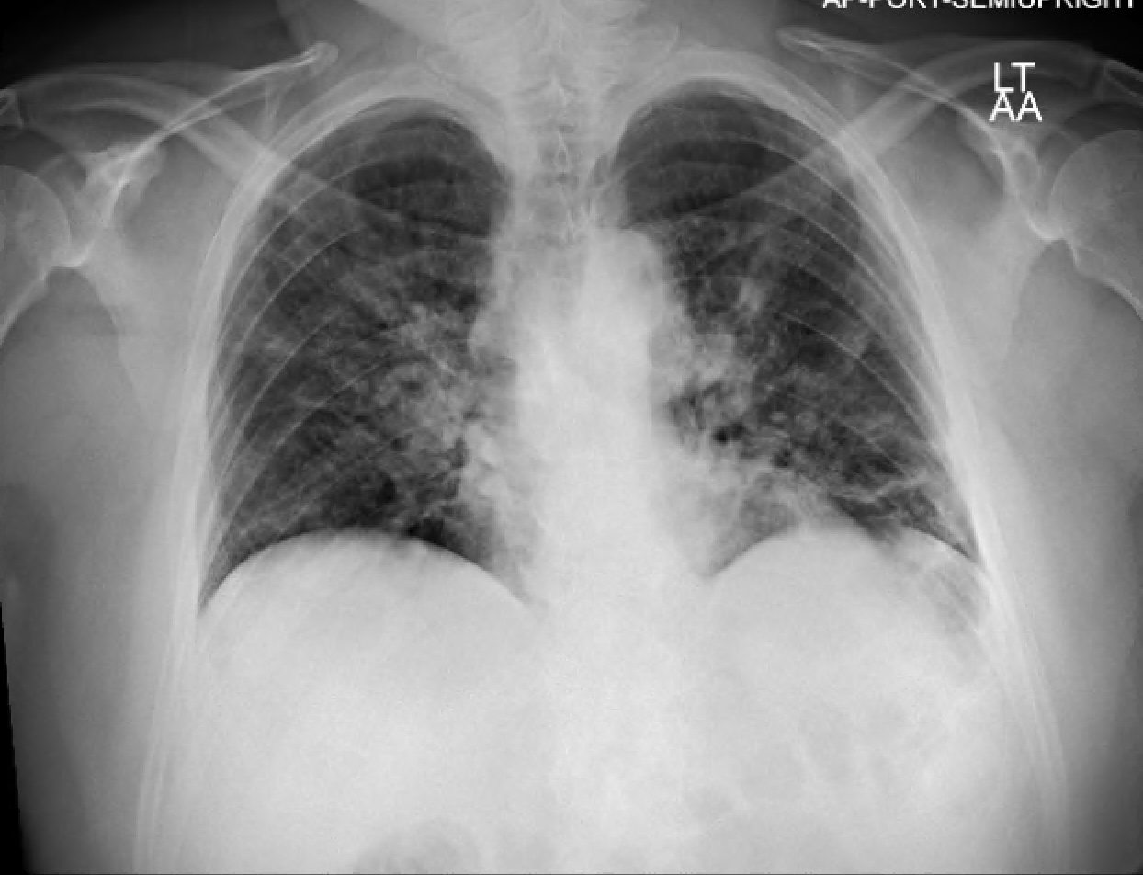
Radiography
CXR

Slide 12
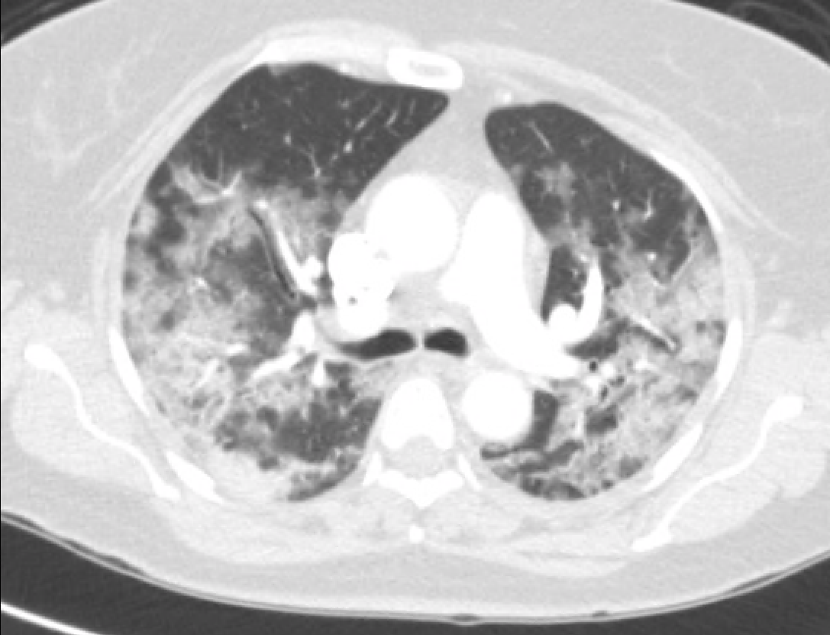
Radiography
CTPA
Notes:
Multilobar PNA: diffuse bilateral consolidations, GGO less visible and noted peripheral lesions

Slide 13
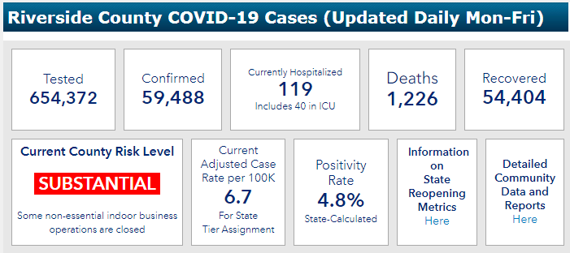
Riverside County COVID-19 Cases (Oct 2, 2020)
https://www.rivcoph.org/coronavirus; accessed October 2, 2020
Notes:
-Difficult to determine “during” ongoing pandemic
-Mortality rate still unclear: number tested total, designation of what is “deemed COVID-19 related death”
-Case fatality rate/ratio: might provide better estimate as this is death/total cases over a specific time frame (deaths/deaths+recover)

Slide 14
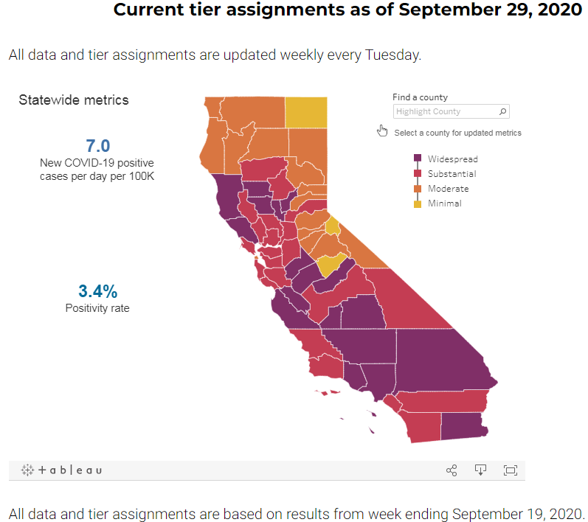
California COVID-19 Status – Week 9/29/20
https://covid19.ca.gov/safer-economy/#reopening-data; accessed October 2, 2020
Notes:
-Positive rate: 7 day average of positive tests/total tests
-Counties must remain in a tier for at least 3 weeks before moving forward. Data is reviewed weekly and tiers are updated on Tuesdays. To move forward, a county must meet the next tier’s criteria for two consecutive weeks. If a county’s metrics worsen for two consecutive weeks, it will be assigned a more restrictive tier.

Slide 15
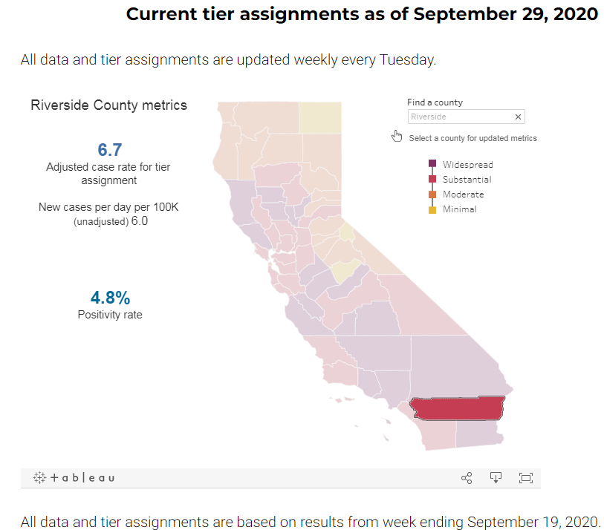
Riverside County COVID-19 – Week 9/29/20
https://covid19.ca.gov/safer-economy/#reopening-data; accessed October 2, 2020
Notes:
Positive rate: 7 day average of positive tests/total tests

Slide 16
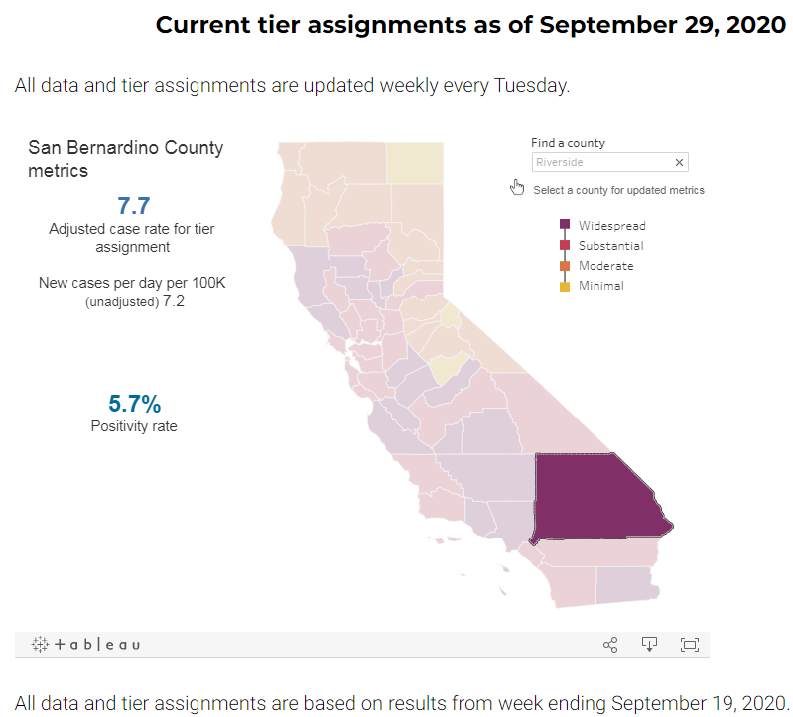
San Bernardino County COVID-19 – Week 9/29/20
https://covid19.ca.gov/safer-economy/#reopening-data; accessed October 2, 2020
Notes:
Positive rate: 7 day average of positive tests/total tests

Slide 17
Prevention - General
Wear a mask in public
  Over your nose AND mouth
Clean hands regularly
  Alcohol-based, soap/water
Maintain social distancing
Keep at least six feet apart in public
Limit gathering/mixing of people you do not live with

Slide 18
Prevention – Healthcare Setting
Contact
Droplet
Airborne
  Aerosolizing situations

Slide 19
Immunity
Herd Immunity
Development of antibodies
Reinfection
Vaccines
Notes:
-WHO estimated you would need 60-70% of the population to have immunity (France had estimated for their population it was 67%)
-This is assuming you remain immune
-Why not let everyone just become infected → collateral damage to our healthcare system would be devastating! (look at Italy and even NYC)
-We can’t rely on this at this time so hence the vaccine…

Slide 20
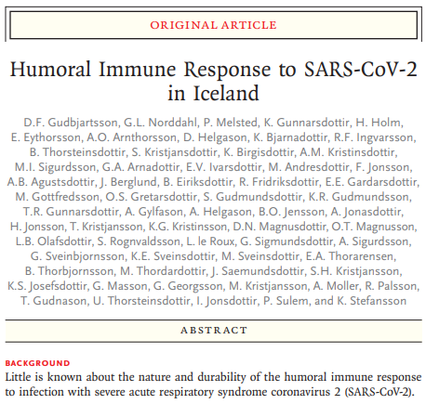
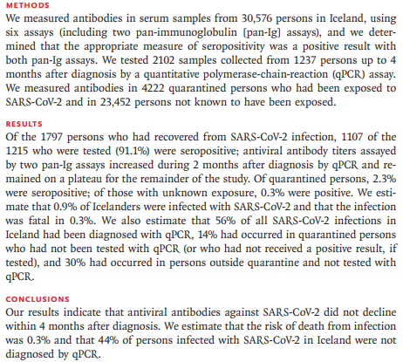
Antibody Response After Infection
Gudbjartsson, Daniel F., et al. "Humoral immune response to SARS-CoV-2 in Iceland." New England Journal of Medicine (2020).
Notes:
-Ab persisted to 4 months at least
-about 0.9% of the population of Iceland had been infected by SARS-CoV-2 by early July 2020
-fatality risk was 0.3% overall
-4.4% in those over 70 years of age
-VERY homogeneous population so can be difficult to apply to other areas of the world given essentially a single ethnic community
-at least it does provide some evidence on the overall case-fatality rate as well as reassurance regarding the durability of the immunoglobulin response

Slide 21
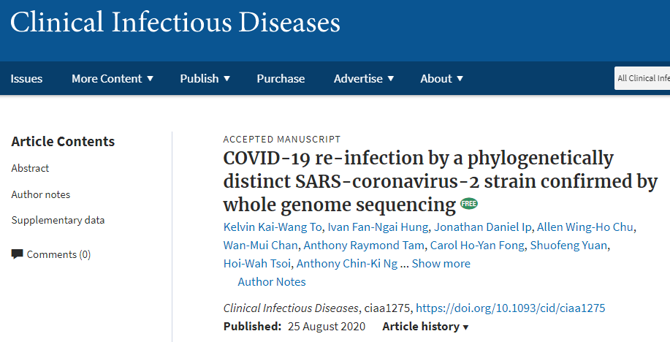
Re-infection
To, Kelvin Kai-Wang, et al. "COVID-19 re-infection by a phylogenetically distinct SARS-coronavirus-2 strain confirmed by whole genome sequencing." Clinical Infectious Diseases (2020).

Slide 22
Re-infection
First documented case was a Hong Kong man who had been traveling to Spain and returned through the UK
  ~ 4.5 months after initial infection
  March 25 and Aug 15
First case in US was a 25 year old Nevada man
  March 25 symptom onset, tested positive April 18, resolved April 27
    Repeat negative tests May 9 and 26
  May 28 new symptoms, June 5: Symptoms worsened, and now with hypoxia; admitted to the hospital and found to have new infiltrates on chest x-ray. PCR positive for SARS-CoV-2.
  Different genetic strains on sequencing
To, Kelvin Kai-Wang, et al. "COVID-19 re-infection by a phylogenetically distinct SARS-coronavirus-2 strain confirmed by whole genome sequencing." Clinical Infectious Diseases (2020).

Slide 23
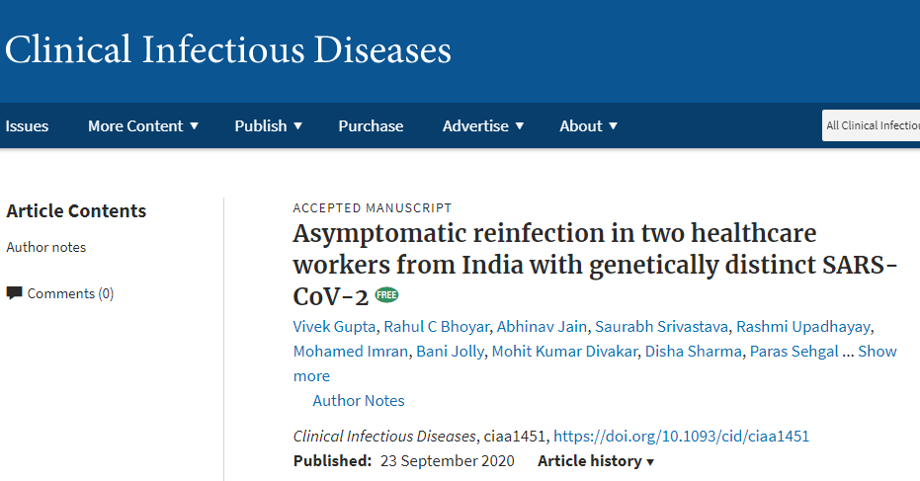
Re-infection
Gupta, Vivek, et al. "Asymptomatic reinfection in two healthcare workers from India with genetically distinct SARS-CoV-2." (2020).

Slide 24
Re-infection – Questions
How frequently does reinfection occur?
Are they more mild or severe?
Is transmission still the same?
How does this affect testing policies?
How would this affect vaccines?
Notes:
-We know this occurs now, but likely infrequent (at least currently) or else we would be seeing this everywhere
-So far of the reinfection cases reported, most are mild to asymptomatic presentations: this would make sense if you really think about how our immune system works, re-exposure to similar viruses often prompt a more brisk immune response: This is how our immune system is suppose to work!
-Assume no changes in the transability in a re-infection
-will need to see…currently not recommending retesting within a 90 day period per CDC and studies that have come out. Cases are going to be looked at individually
-Unclear still, may need seasonal vaccine potentially…will need to see what happens…

Slide 25
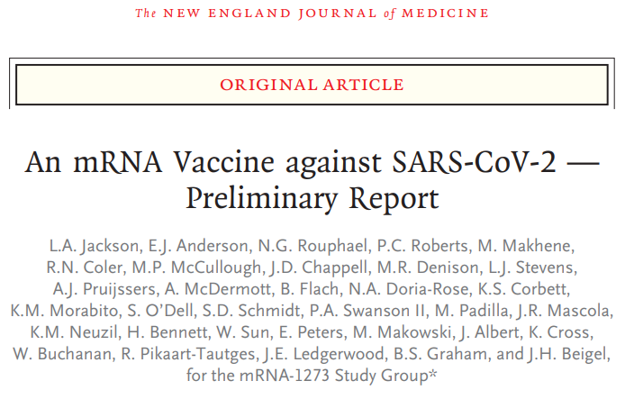
Jackson, Lisa A., et al. "An mRNA vaccine against SARS-CoV-2—preliminary report." New England Journal of Medicine (2020).
Notes:
-essentially designed mRNA that would promote production of spike protein to elicit an antibody response
-adenovirus vector to generate spike protein for antibody response
-inactivated virus

Slide 26
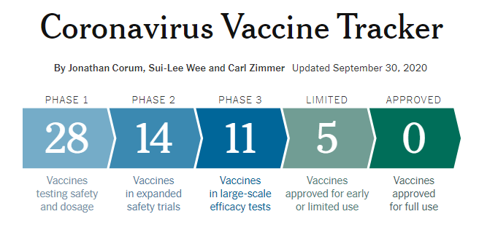
Vaccines
https://www.nytimes.com/interactive/2020/science/coronavirus-vaccine-tracker.html; accessed October 2, 2020

Slide 27
Infectivity and De-isolation: Severity
Mild:
  Individuals who have any of the various signs and symptoms of COVID-19 (e.g., fever, cough, sore throat, malaise, headache, muscle pain) without shortness of breath, dyspnea, or abnormal chest imaging.
Moderate:
  Individuals who have evidence of lower respiratory disease by clinical assessment or imaging, and a saturation of oxygen (SpO2) ≥94% on room air at sea level.
Severe:
  Individuals who have respiratory frequency >30 breaths per minute, SpO2 <94% on room air at sea level (or, for patients with chronic hypoxemia, a decrease from baseline of >3%), ratio of arterial partial pressure of oxygen to fraction of inspired oxygen (PaO2/FiO2) <300 mmHg,, or lung infiltrates >50%.
Critical:
  Individuals who have respiratory failure, septic shock, and/or multiple organ dysfunction.
https://www.cdc.gov/coronavirus/2019-ncov/hcp/disposition-hospitalized-patients.html; Accessed October 2, 2020 / RUHS De-isolation Policy

Slide 28
Infectivity and De-isolation: Severity
For patients with MILD to MODERATE illness:
  For most patients with COVID-19 illness, airborne/contact isolation can be discontinued 10 days AFTER symptom onset.
  In addition, the patient must have resolution of fever for at least 24 hours, without the use of fever-reducing medications, AND improvement of other symptoms.
  For patients who tested positive, but were asymptomatic and not severely immunocompromised, airborne/contact isolation can be discontinued 10 days after the date of their first positive PCR test.
https://www.cdc.gov/coronavirus/2019-ncov/hcp/disposition-hospitalized-patients.html; Accessed October 2, 2020 / RUHS De-isolation Policy

Slide 29
Infectivity and De-isolation: Severity
For patients with SEVERE to CRITICAL illness:
  In this group of patients, airborne/contact isolation can be discontinued at least 10 days and up to 20 days AFTER symptom onset.
  In addition, the patient must have resolution of fever for at least 24 hours, without the use of fever-reducing medications, AND improvement of other symptoms.
  For patients who tested positive, but were asymptomatic and severely immunocompromised, airborne/contact isolation can be discontinued at least 10 days and up to 20 days after the date of their first positive PCR test.
https://www.cdc.gov/coronavirus/2019-ncov/hcp/disposition-hospitalized-patients.html; Accessed October 2, 2020 / RUHS De-isolation Policy

Slide 30
Therapies and Treatments…?
Clear effective therapeutic management of Covid-19 is limited and can be confusing
  Azithromycin
  Hydroxychloroquine
  Lopinavir/ritonavir
  Interleukin (1, 6) antagonists: Tocilizumab or sarilumab / anakinra
  Remdesivir
  Convalescent plasma
  Steroids
  Vitamin C / Zinc
  Thymosin alpha-1is the newest thing in the news…

Slide 31
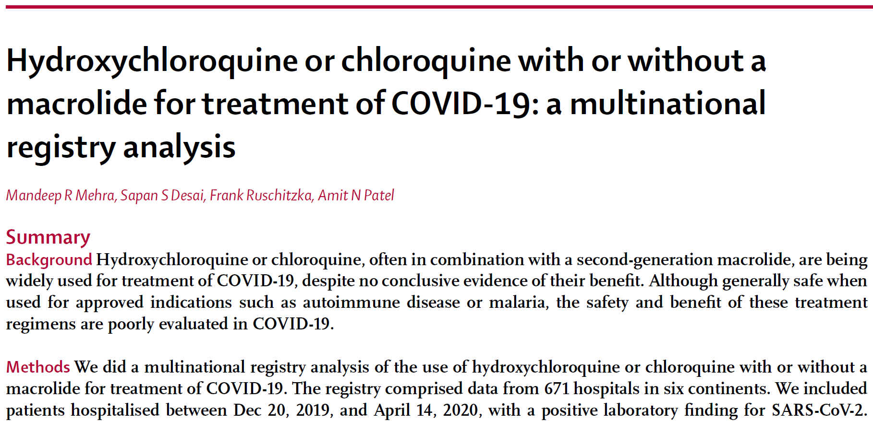
Mehra, Mandeep R., et al. "Hydroxychloroquine or chloroquine with or without a macrolide for treatment of COVID-19: a multinational registry analysis." The Lancet (2020).

Slide 32
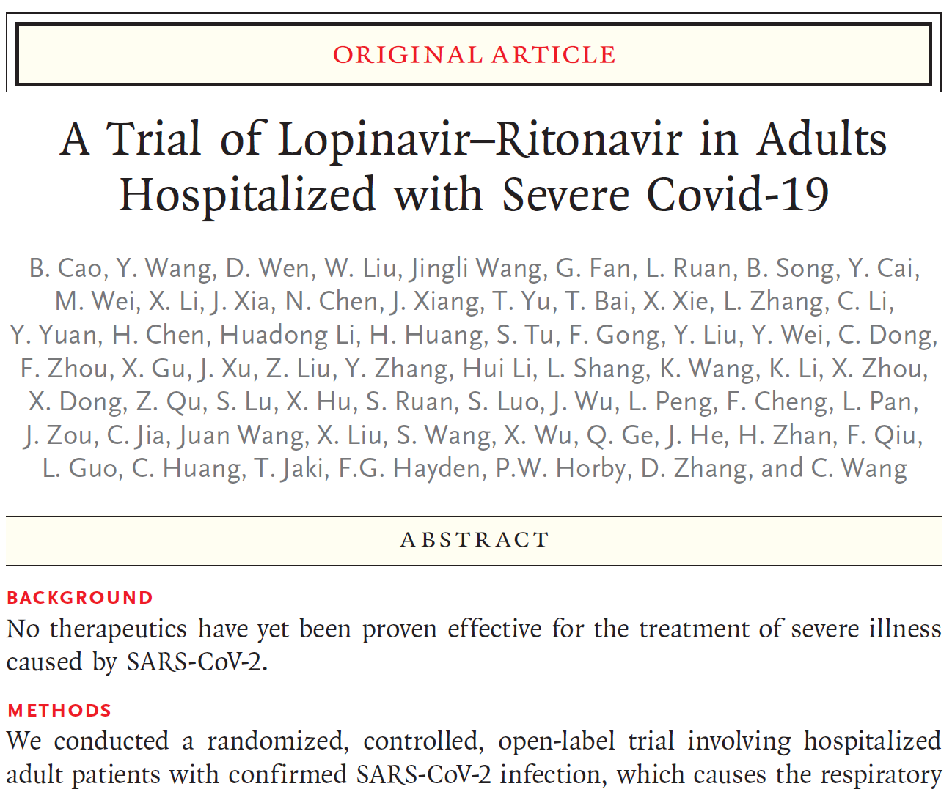
Cao, Bin, et al. "A trial of lopinavir–ritonavir in adults hospitalized with severe Covid-19." New England Journal of Medicine (2020).

Slide 33
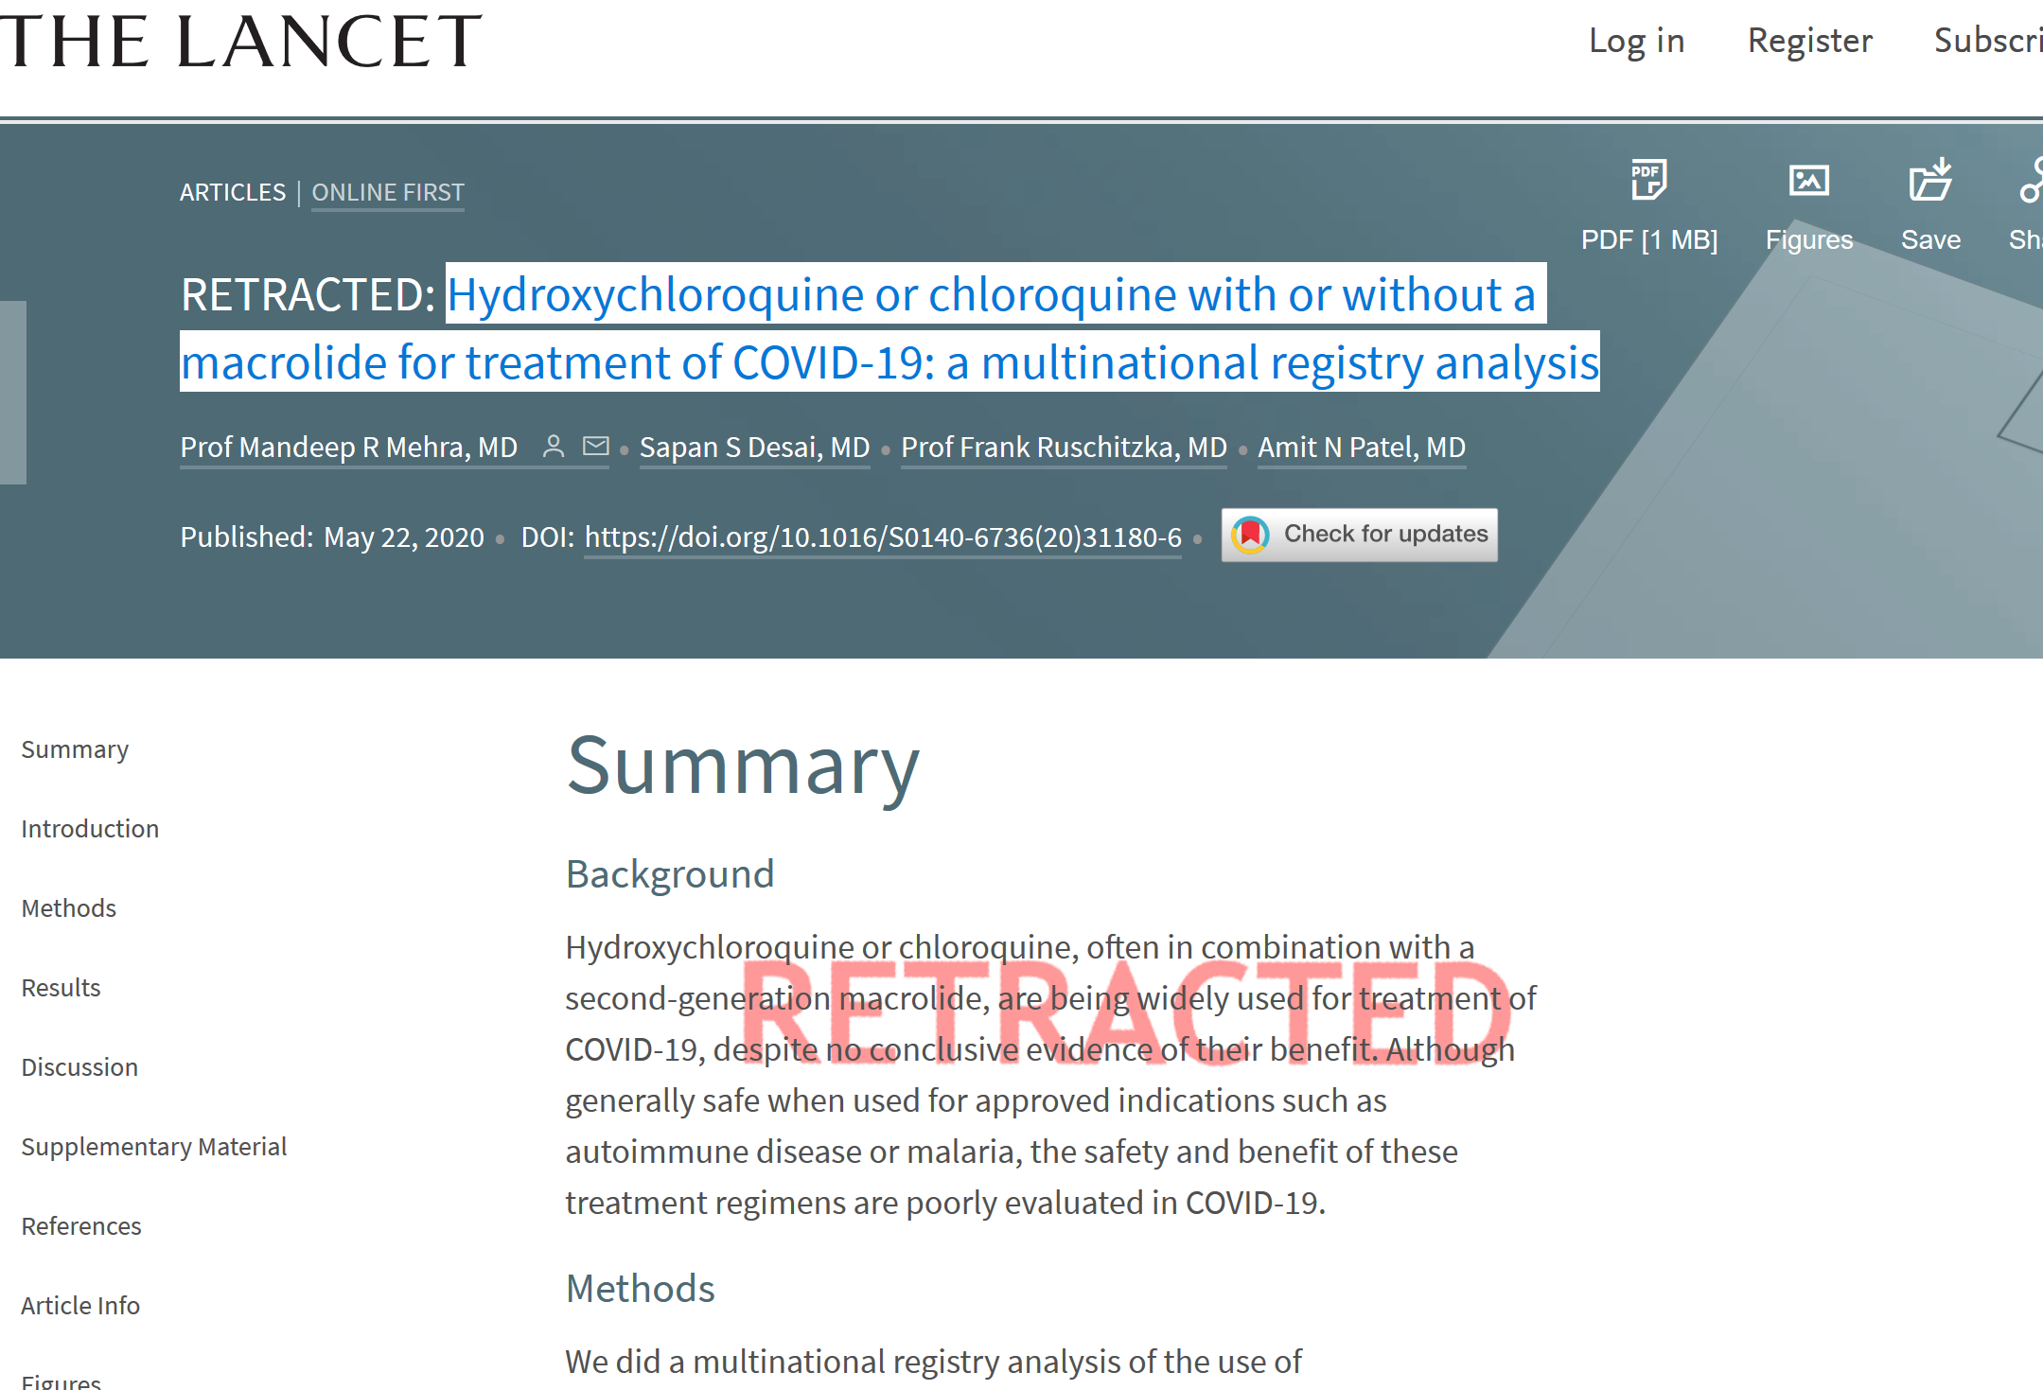
Mehra, Mandeep R., et al. "Hydroxychloroquine or chloroquine with or without a macrolide for treatment of COVID-19: a multinational registry analysis." The Lancet (2020).

Slide 34
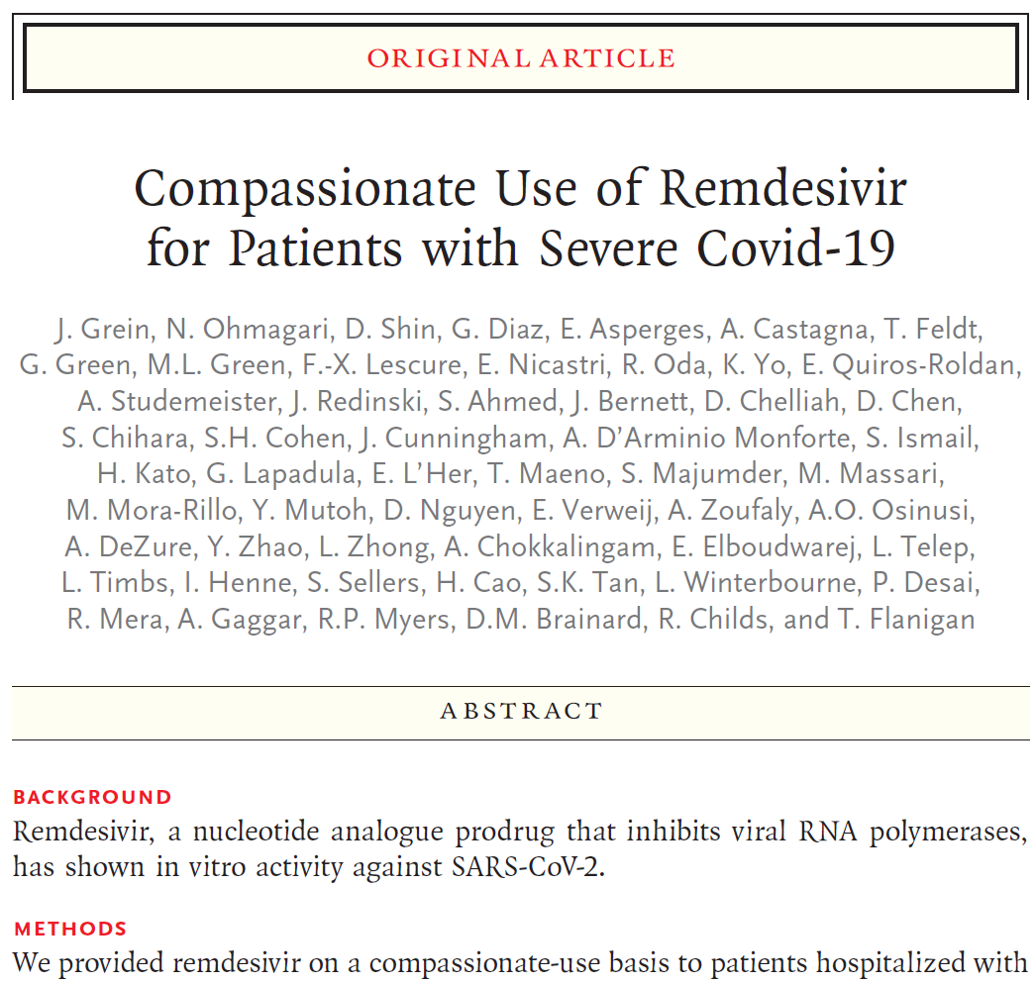
Grein, Jonathan, et al. "Compassionate use of remdesivir for patients with severe Covid-19." New England Journal of Medicine 382.24 (2020): 2327-2336.

Slide 35
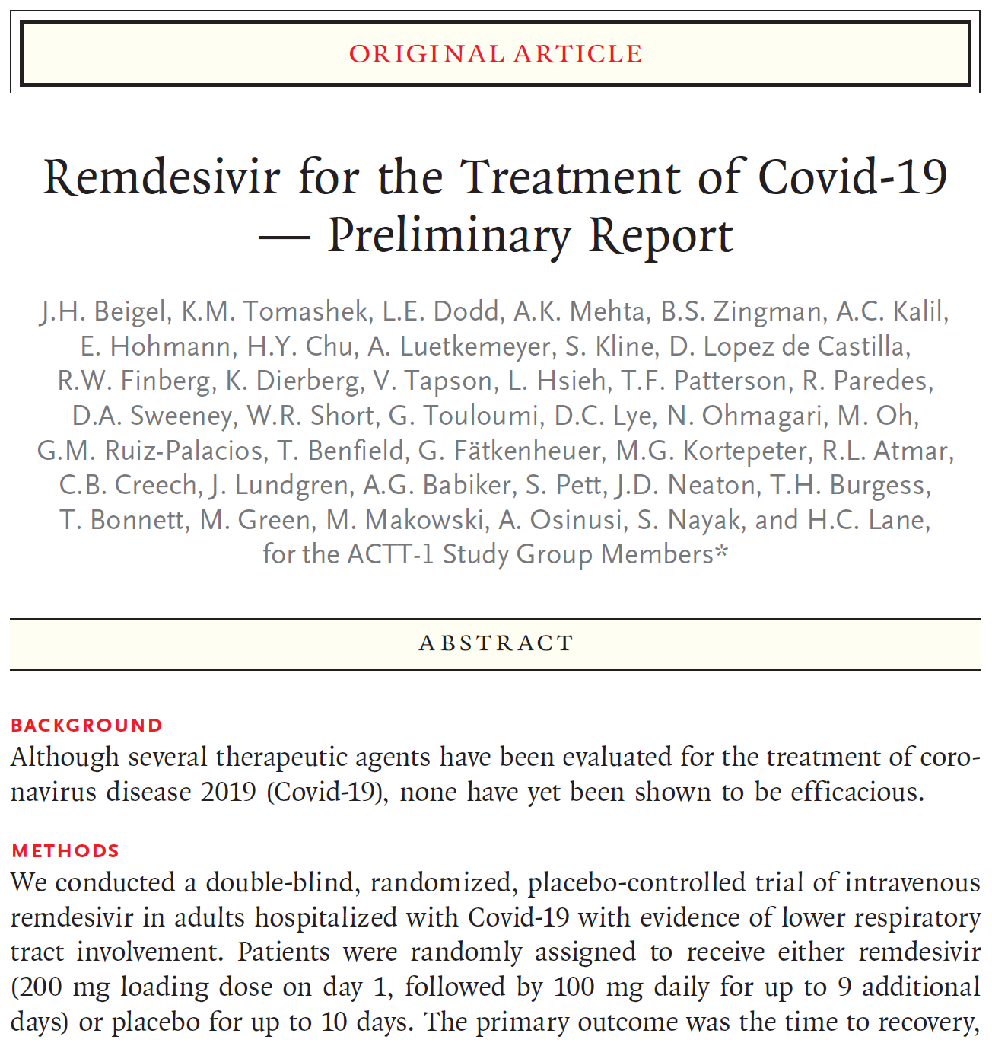
Beigel, John H., et al. "Remdesivir for the treatment of Covid-19—preliminary report." New England Journal of Medicine (2020).

Slide 36
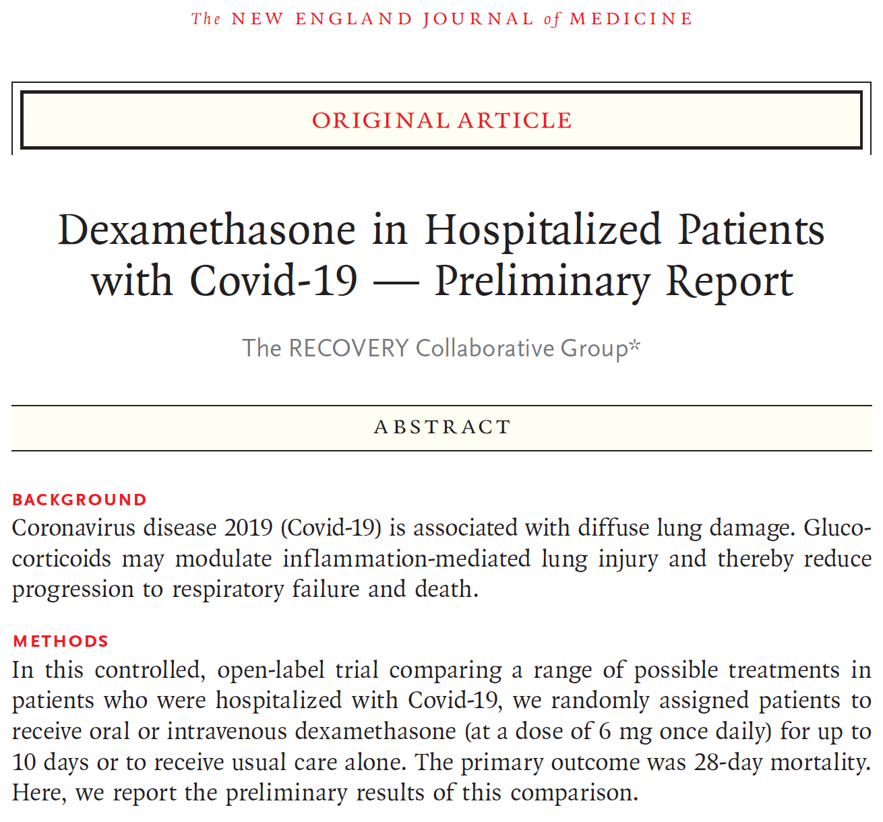
RECOVERY Collaborative Group. "Dexamethasone in Hospitalized Patients with Covid-19—Preliminary Report." New England Journal of Medicine (2020).

Slide 37
Challenges in Developing Protocols
Health Care Worker Exposure and Infection
Scarce Resource Allocation
Testing Protocols
Therapeutics
De-isolation Protocols

Slide 38
Influenza and COVID-19
Previous data back in Dec 2019 – Early 2020 noted low co-infection rate with influenza and COVID-19
Southern Hemisphere noted significant decrease with influenza rates
Early models predict another spike in late Oct / early Nov for COVID

Slide 39
Questions?
? ? ?

Slide 40
References
Bennett, John E., Raphael Dolin, and Martin J. Blaser. Principles and practice of infectious diseases. Vol. 1. Elsevier Health Sciences, 2014.
Cao, Bin, et al. "A trial of lopinavir–ritonavir in adults hospitalized with severe Covid-19." New England Journal of Medicine (2020).
Mehra, Mandeep R., et al. "Hydroxychloroquine or chloroquine with or without a macrolide for treatment of COVID-19: a multinational registry analysis." The Lancet (2020).
Grein, Jonathan, et al. "Compassionate use of remdesivir for patients with severe Covid-19." New England Journal of Medicine 382.24 (2020): 2327-2336.
Beigel, John H., et al. "Remdesivir for the treatment of Covid-19—preliminary report." New England Journal of Medicine (2020).
RECOVERY Collaborative Group. "Dexamethasone in Hospitalized Patients with Covid-19—Preliminary Report." New England Journal of Medicine (2020).
Gudbjartsson, Daniel F., et al. "Humoral immune response to SARS-CoV-2 in Iceland." New England Journal of Medicine (2020).
To, Kelvin Kai-Wang, et al. "COVID-19 re-infection by a phylogenetically distinct SARS-coronavirus-2 strain confirmed by whole genome sequencing." Clinical Infectious Diseases (2020).
Gupta, Vivek, et al. "Asymptomatic reinfection in two healthcare workers from India with genetically distinct SARS-CoV-2." (2020).
Jackson, Lisa A., et al. "An mRNA vaccine against SARS-CoV-2—preliminary report." New England Journal of Medicine (2020).
https://www.cdc.gov/coronavirus/2019-ncov/index.html; accessed October 2, 2020
https://www.rivcoph.org/coronavirus; accessed October 2, 2020
https://www.nytimes.com/interactive/2020/science/coronavirus-vaccine-tracker.html; accessed October 2, 2020
https://www.cdc.gov/coronavirus/2019-ncov/hcp/disposition-hospitalized-patients.html; Accessed October 2, 2020

