Slide 1

Obesity:
Why Size Matters
Notes:
Obesity: Why Size Matters!

Slide 2
Objectives
Discuss the prevalence of obesity in the United States
Discuss physiological considerations associated with obesity
Review management of the adult obese patient in the PACU

Slide 3
Definition
Obese – 100 pounds over ideal body weight
Obese – Defined by using Body Mass Index (BMI) which is ratio of height to weight
  Normal BMI 20-24
  Overweight BMI 25-29
  Obese BMI 30+
  Morbidly Obese BMI 35+ and experiencing obesity-related health conditions, such as high blood pressure or diabetes
  Morbidly Obese BMI 40+

Slide 4
Prevalence of Obesity in USA 2015-2016
Prevalence of obesity is 39.8% in adults, 18.5%
Higher in women (38.3%) than men (34.3%)
Higher in middle aged 40-59 (42.8%) and older >60 (41%) than younger 20-29 (35.7%)
CDC Overweight & Obesity https://www.cdc.gov/obesity/data/adult.html

Slide 5
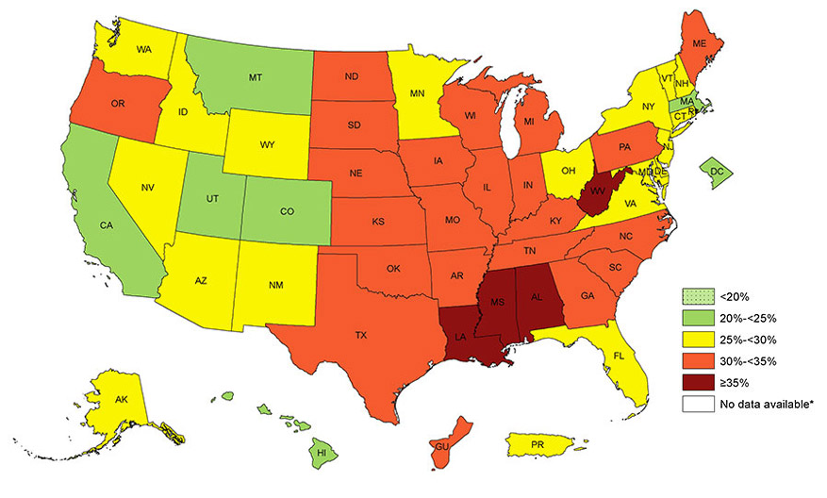
Regional Differences of Obesity - 2016
https://www.cdc.gov/obesity/data/prevalence-maps.html

Slide 6
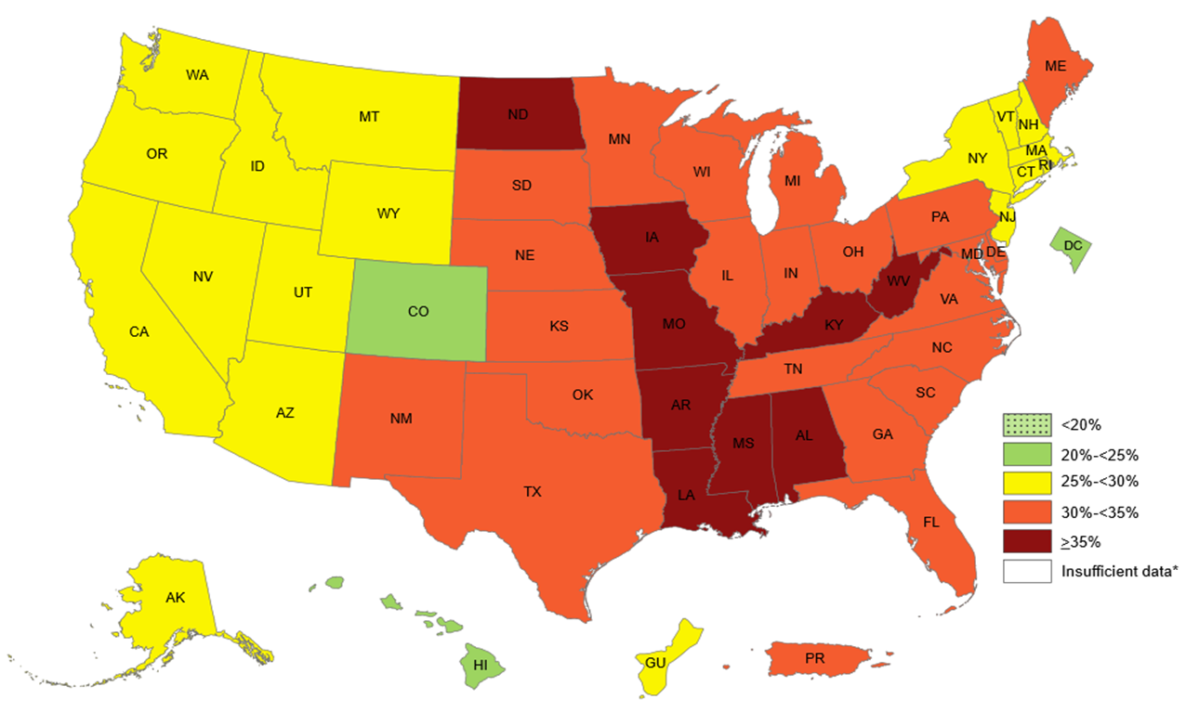
Regional Differences of Obesity - 2018
https://www.cdc.gov/obesity/data/prevalencemaps.html
Notes:
Just 2 years later, here are the rates for 2018. there are 5 additional states in the dark red. Only DC, Hawaii, and Colorado are green. No change in Mississippi or NH!

Slide 7




Physiologic Considerations

Slide 8
Pulmonary
Present with exertional dyspnea & orthopnea
Layers of fat reduce the bellow action of the thoracic cage
Overall lung-thorax compliance is decreased → increased elastic resistance

Slide 9
Pulmonary
Primary respiratory defect
  Decreased expiratory reserve volume
  Functional residual capacity less
Resulting mismatch of ventilation to perfusion produces systemic arterial hypoxemia

Slide 10
Pulmonary
Obstructive Sleep Apnea (OSA)
  50% of obese patients have OSA
  Undiagnosed OSA is common despite awareness of increase abdominal girth as significant risk factor
  Diagnosis when 3 factors present
    Breathing cessation > 10 sec during sleep
    Apneic episodes occur > 5 times/hour
    Apneic episodes have a concurrent 4% decrease in oxygen saturation

Slide 11
Pulmonary
Asthma
  Prevalent comorbidity for obese patients
  Due to decreased lung volumes sensitizing the airway and leading to reactive airways
  Contributing to asthma
    OSA
    Respiratory stasis
    Gastroesophageal reflux disease (GERD)

Slide 12
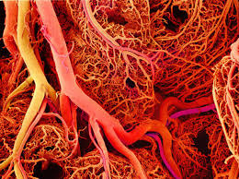
Cardiovascular
30 lbs of fat = 25 miles of blood vessels
Increased body mass results in:
  Increased oxygen consumption
  Increased CO2 production
  Increased cardiac OP
  Increased blood volume

Slide 13
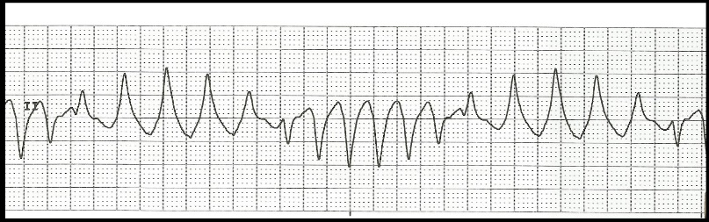
Cardiovascular
Predisposed to EKG changes
  Q-T interval prolonged
  QRS voltage reduced
  Ventricular arrhythmias increased
    Result of myocardial hypertrophy hypoxemia, CAD, fatty infiltration of conducting and pacing systems

Slide 14
Cardiovascular
Comorbidities
  Hypertension
  Dyslipidemia
  Coronary artery disease
  Atherosclerosis
  Angina
  Sudden cardiac death
  Congestive heart failure

Slide 15
Integumentary
Presence of multiple skin folds
  Potential impaired hygiene
    Difficulty seeing or reaching areas
  Retained moisture
    Excoriations or rashes
      Infections—yeast, fungi
    Problem areas
      Groin, perineum, axilla, beneath the breasts, under large skin folds

Slide 16
Endocrine
Obesity primary risk factor
90% of type 2 diabetics are obese
36% individuals with impaired glucose tolerance will progress to type 2 diabetes within 10 years
Diabetes risk factor for
Atherosclerosis
Vascular disease
Obesity

Slide 17
Musculoskeletal
Peripheral osteoarthritis
Knees, hips, ankles and feet
Back and disk disease
Chronic lower back is most common

Slide 18
Psychological
Multiple contributing factors associated with obesity
  -Environmental
  -Genetics
  -Food intake: high processed, high caloric
  -Lack of exercise
  -Depression: low self-esteem

Slide 19
Other Disorders
Abnormal liver function tests
Gallstones
Hiatal hernia
Gastro-esophageal reflux
Stress incontinence
Varicose veins
Increase risk of DVT, pulmonary emboli
Degenerative joint disease

Slide 20
Pre-Admission Care
Should be seen for optimization
Ask about co-morbidities
Alert OR of BMI
Pre-order appropriate size bed

Slide 21
Preoperative Care
Use appropriate size equipment for vital signs
Verify specialty bed is available

Slide 22
Surgical Treatments
Roux-en-Y Gastric Bypass
Duodenal Switch
Endogastric sleeve gastroplasty
Adjustable Gastric Band
Sleeve Gastrectomy
Gastric Balloon

Slide 23
PACU Management
Preparation
  Correct size equipment
Review H & P for co-morbidities
Awareness of potential complications due to large size
Appropriate size equipment
  Hospital gowns
  BP cuff (transfer with patient)
  Transport cart

Slide 24
Pulmonary
Apply supplemental oxygen as ordered per protocol
Continuous O2 saturation monitoring
Capnography monitoring
Keep HOB > 30 degrees due to physical attributes
Encourage C&DB
History of OSA: use CPAP in PACU
Incentive spirometer

Slide 25
Cardiovascular
Obtain VS
Assess circulation
Assess frequently for chest pain, angina
Use compression boots/compressive stockings as ordered
Notes:
-

Slide 26

Gastrointestinal
Assess for post-operative
nausea/vomiting
  Treat as needed
History of reflux
  keep HOB elevated
Assess and document any
dressings

Slide 27
Integumentary
Do complete and full skin assessment
Ensure arms not resting on side rails
Place patient in size appropriate bed as available
Provide privacy

Slide 28
Endocrine
Obtain post operative blood glucose reading
Treat glucose as ordered

Slide 29
Psychosocial
-Assess for anxiety and emotional well-being
-Reassure patient as appropriate
-Initiate visitation of family or significant other per protocol
-Awareness of prejudges toward obese patients

Slide 30
Pain Management Considerations
Sedatives, opioids & anesthetics alter airway tone
Alteration of Drug Metabolism
Risk of resedation from redistribution of anesthetics & analgesics
Multimodal approach

Slide 31
Pain Management Recommendations
Multimodal
  Nonpharmacological and pharmacological
Medications
  Regional, NSAIDS, Opioids
O2 sat monitor
  Continuous
“Go low and go slow”

Slide 32
Certification
Certified Bariatric Nurse - CBN
Sponsored by American Society for Metabolic and Bariatric Surgery (ASMBS) organization

Slide 33
References
CDC (2018). Overweight & Obesity https://www.cdc.gov/obesity/data/adult.html. Accessed on September 28, 2019
CDC (2018). Obesity prevalence maps
https://www.cdc.gov/obesity/data/adult.html. Accessed on September 28, 2018

Slide 34
Bibliography
American Nurses Credential Center. Certification. http://www.nursecredentialing.org/Magnet/Magnet-CertificationForms, Accessed April 17,2017.
Clifford T. (2018). Care of the patient undergoing bariatric surgery. In: Odom-Forren J, ed. Drain’s Perianesthesia Nursing A Critical Approach 7th ed. St. Louis, MO: Elsevier, p. 656-663.
Cooney MF. Managing post-operative pain in the severely obese patient: Treatment & monitoring challenges. http://www.aspmn.org/Documents/2014%20Conference%20Documents/Friday/CooneyObesityR.pdf Accessed April 8, 2017.
Elrazek A, Elbanna A, Bilasy S. (2014) Medical management of patients after bariatric surgery: Principles and guidelines. World J Gastrointest Surg. 2014;6(11):220-228.

Slide 35
Bibliography
Gamboa J. S. B., Nunez, D. G. (2016). Pain management in weight loss surgery: Aiming for multimodal approach. Advances in Obesity, Weight Management & Control. 5(2), 125-130.
Noble K. (2016). Bariatrics. In: Schick L, Windle P, eds. Perianesthesia Nursing Core Curriculum 3rd ed. St. Louis, MO: Elsevier, p.1147-1177.
Watson S, Aguas M, Colegrove P, Foisy N, Jondahl B, Anastas Z. (2016). Level of agreement between forearm and upper arm blood pressure measurements in patients with large arm circumference. Journal of Perianesthesia Nursing, 32(1), p.15–21.

Slide 36
Questions?
ADOOLEY@ASPAN.ORG
Thank you!

